Slide 1
Book2
File created on: 3/2/2020 11:33:13 AM

Slide 2
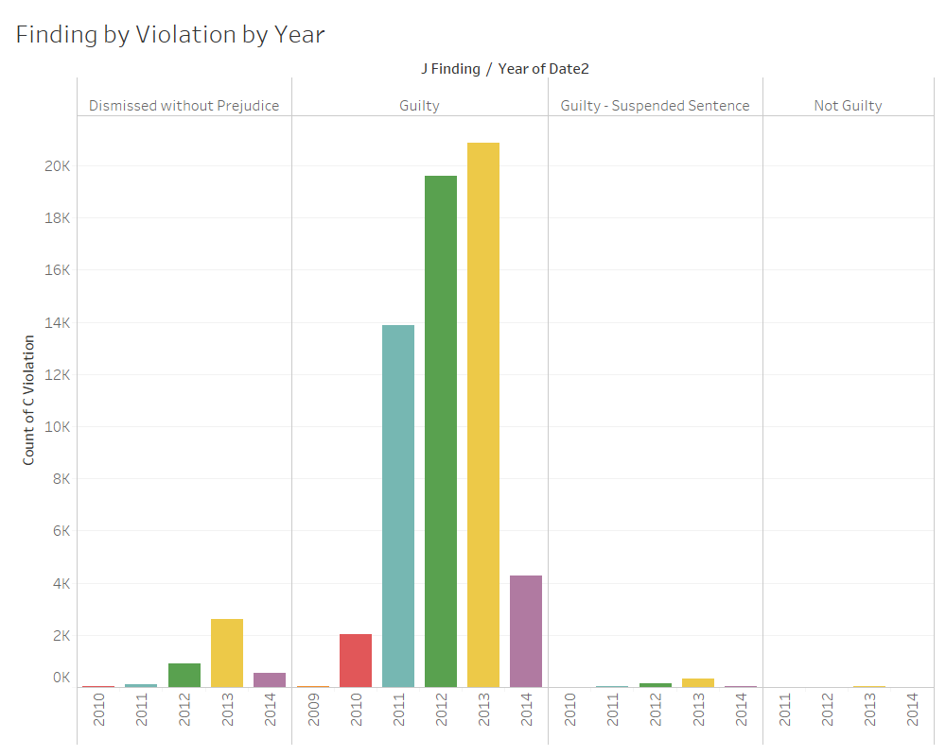

Slide 3
