Slide 1
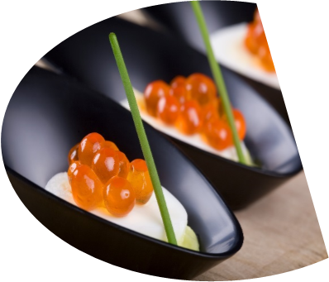
DETERMINING CATEGORIES
ON YELP
CMSC 12300
Lucy Chen | Daniel Cheng

Slide 2
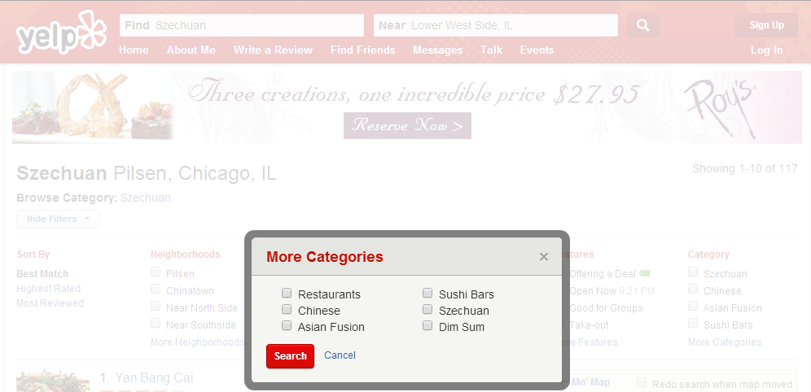
What categories should we have?

Slide 3
Not too broad, not too specific...
Chinese cuisine
  Cantonese
  Szechuan
  Anhui
  Shangdong
  Fujian
  Jiangsu
  Hunan
  Zhejiang
  Xinjiang
  Mongolian
  Tibetan
--->
There are a lot of very different styles that appeal to very different people here...
Chinese cuisine
  That's it.
Probably none of these restaurants in most places that Yelp covers. Not a useful category.
<---

Slide 4
Why is this interesting?
Generally, there may be situations where it's not ideal to manually handle subcategories.
  Eg: Recommending politics blogs. What to track? Stance on big government? Stance on feminism? Stance on gun laws? Stance on first/third abortions with/without rape/incest?
With a sufficiently large dataset, can we automatically compute these subcategories? Working on this specific case may shed insights into how to deal with similar cases. [← Look specifically at Yelp data to figure out how to automatically compute these categories?]

Slide 5
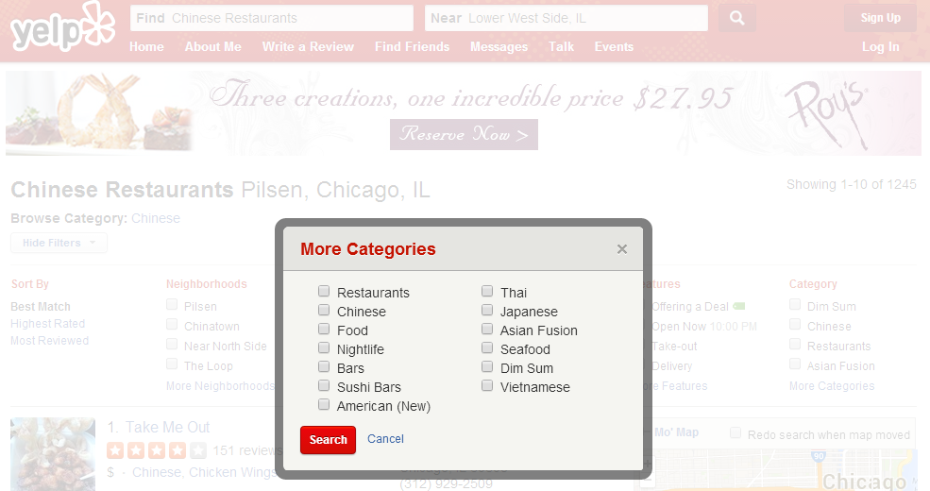
Other Yelp Problems
Like, look at these “related” categories (for “Chinese restaurants”), it doesn't even list Szechuan (though it lists stuff like “Nightlife” and “American (New)” wtf), WHY? Can we do better?

Slide 6
Approach

Slide 7
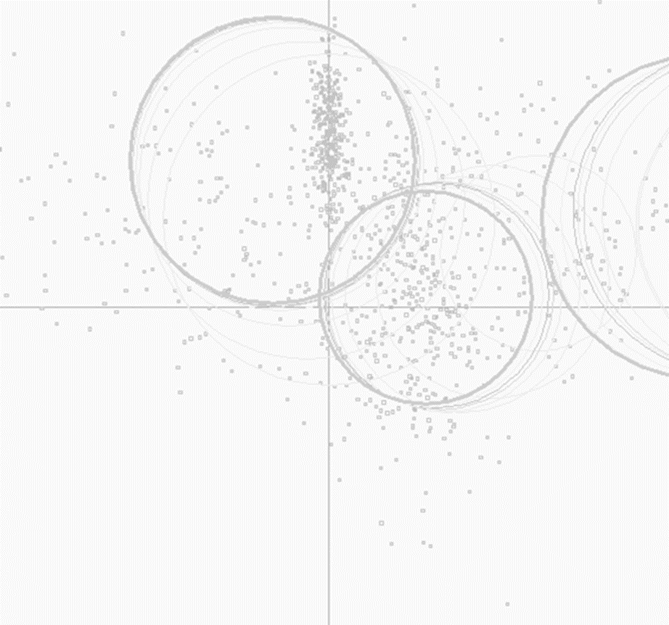
Clustering Yelp Data
Notes:
Dataset provided by Yelp on Phoenix metropolitan area—information on businesses (attributes like ambience, attire, wifi availability etc), check-in data, tips, social graph of reviewers, and the text of the reviews. 15K businesses, 300K reviews
What dimensions would we cluster on? How would we determine similarity among businesses?

Slide 8
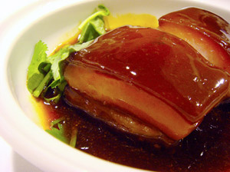
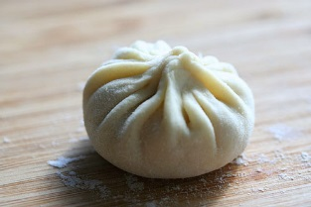
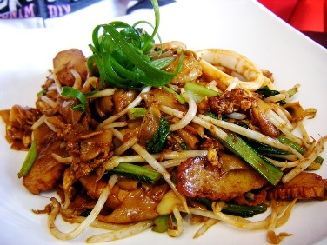
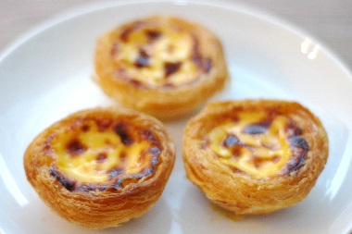
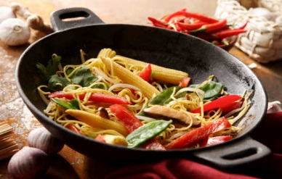
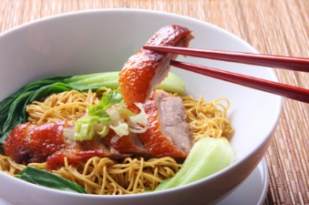
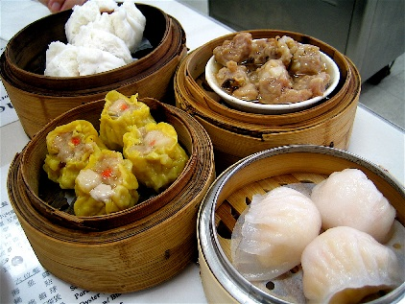
WHAT DEFINES A RESTAURANT CLUSTER?
Notes:
Serve similar types of food

Slide 9
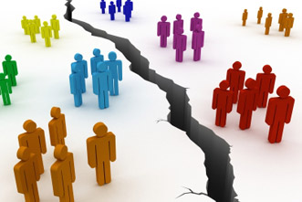
WHAT DEFINES A RESTAURANT CLUSTER?
Notes:
A similar group of people frequents the same set of restaurants—
Measure this analyzing the distribution of reviewers

Slide 10
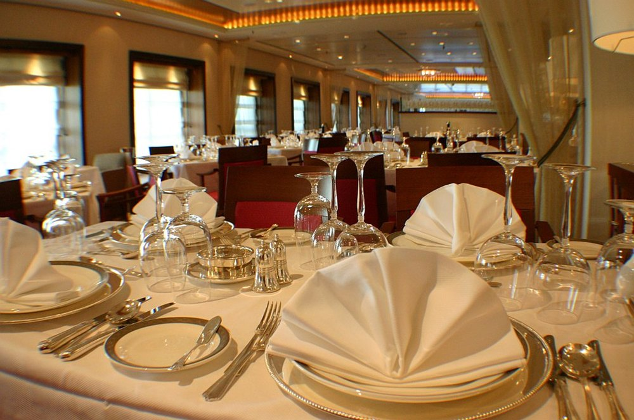
WHAT DEFINES A RESTAURANT CLUSTER?
Notes:
Restaurant self-descriptions: “classy and upscale ambience” versus

Slide 11
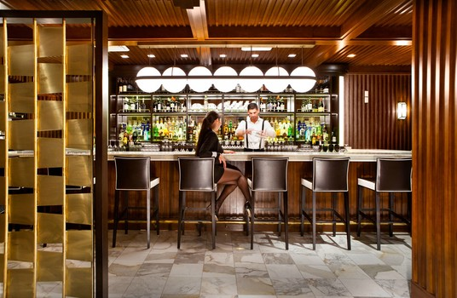
WHAT DEFINES A RESTAURANT CLUSTER?
Notes:
A “casual and trendy” bar—another potential source for distinguishing categories

Slide 12
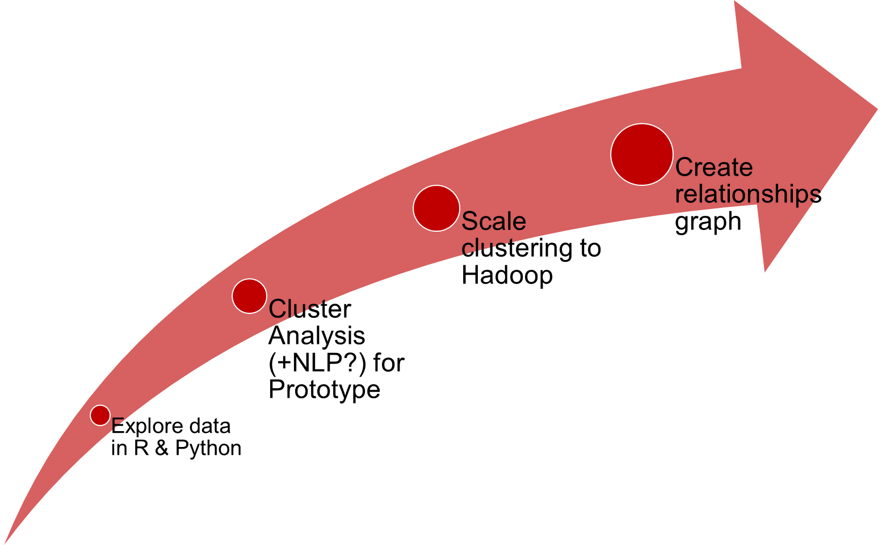
Notes:
Timeline!
Clustering in R & Python—figure out how to cluster categorical and continuous
NLP using NLTK or Stanford Parser
Summarize Final Product: [some paraphrase of] We aim to develop a program that can analyze the linguistic relationships between restaurants, discover new groupings of restaurants, and present these relationships in an easy-to-read graph.
Groupings should also show us new restaurant categories that teach us something new about how people pick restaurants based on similarities in food options, other patrons, and restaurant self-image.

Slide 13
Any Questions/Suggestions?
?

