Slide 1



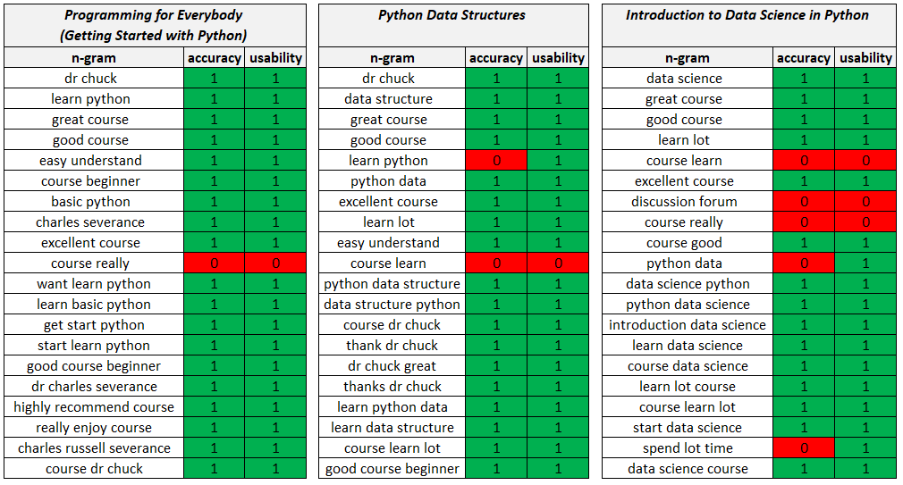






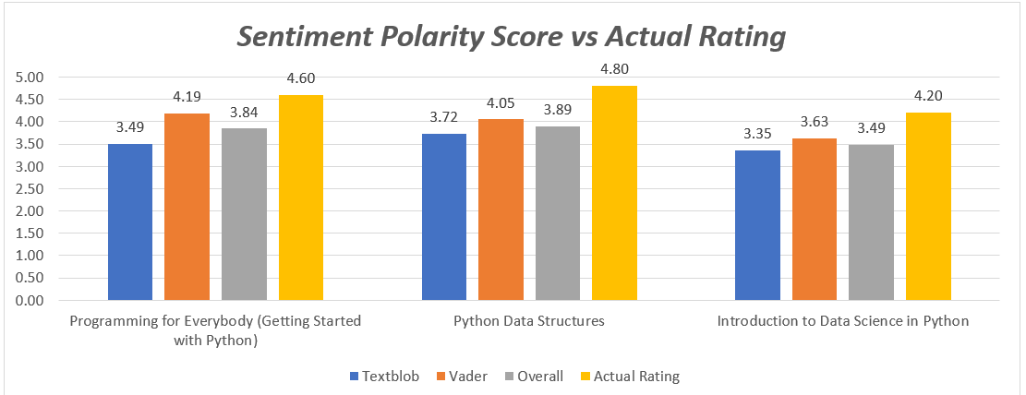
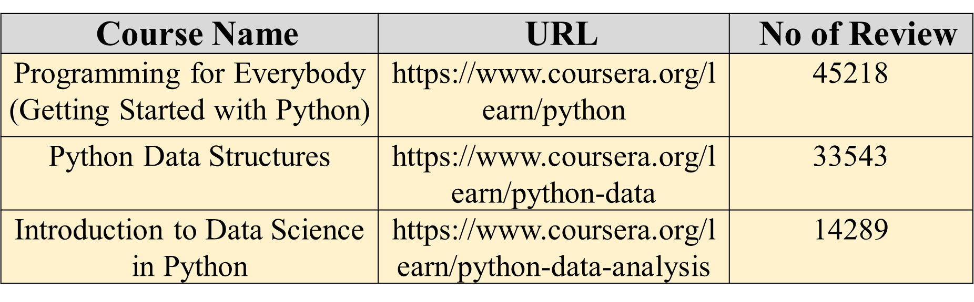
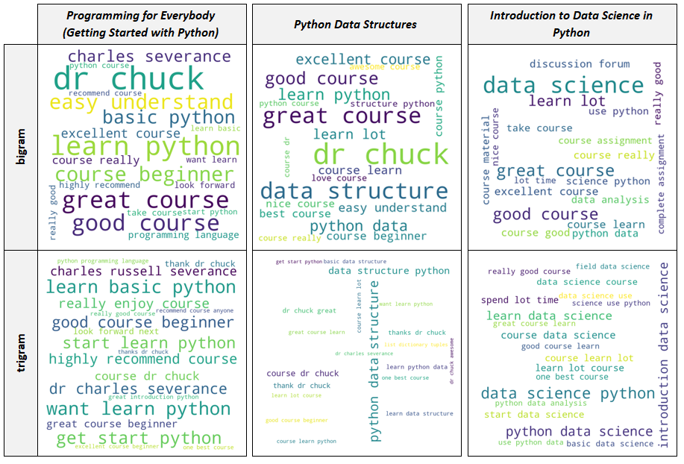
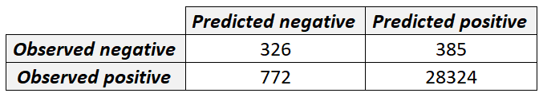
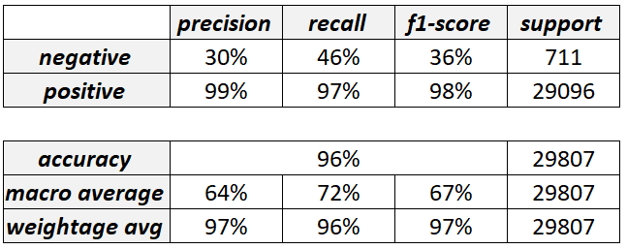
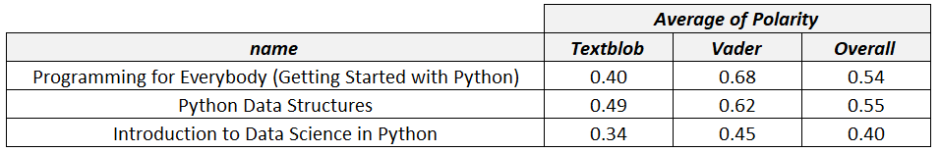
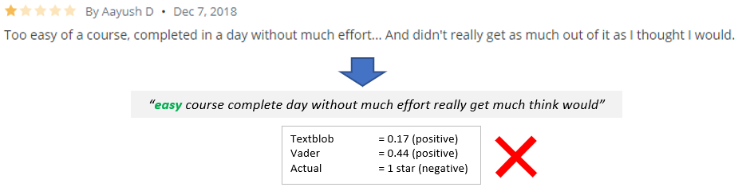
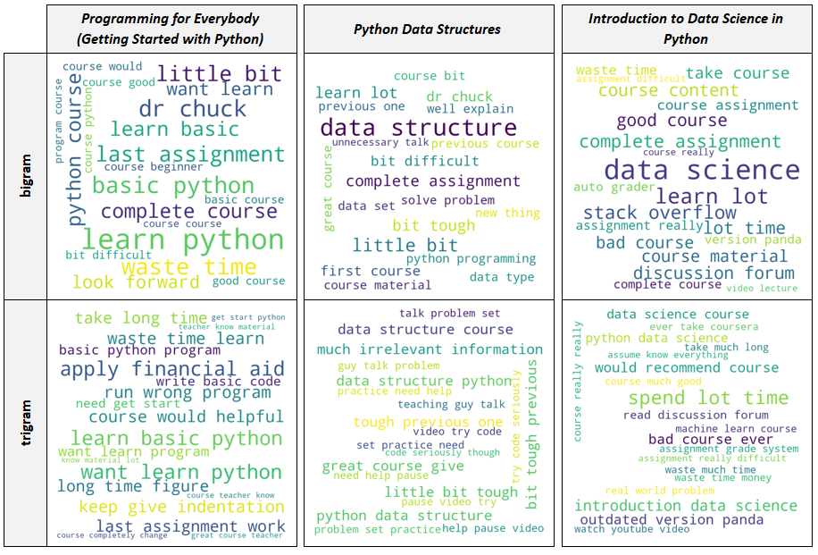
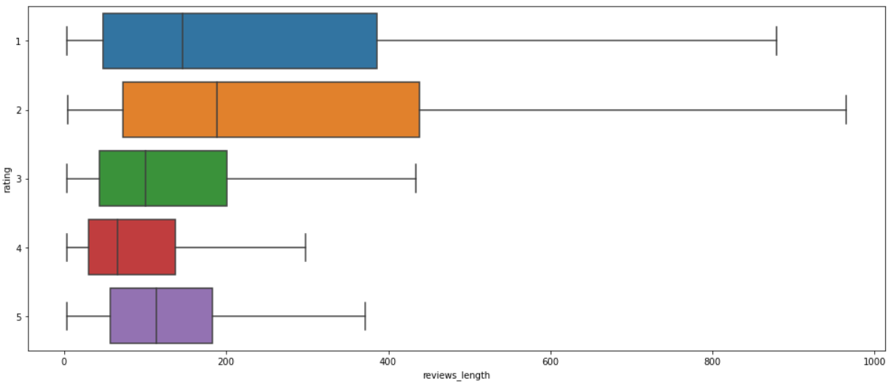
Text Analytics of Course Reviews on Coursera Platform
Chan Huan Yang, Ramindhran Raja Mohan
School of Computer Science, University Science of Malaysia, Penang, Malaysia
Introduction
We are now entering a new era - the revolution of online learning. From working professionals to recent high school graduates, many of them have found the reasons to take all or some of their courses online in platform such as Coursera, Udemy, and Edx
Problem Statement
Ratings and reviews are always the major consideration factor by online course seekers before they joining the course. However, it can be time-consuming to read all the information especially the course reviews.
Research Question
The research questions for this work were: How text analytics techniques such as n-gram analysis, word cloud, and sentiment analysis can be applied to improve the online course searching process? What insights can be obtained by using text analytics techniques such as n-gram analysis, word cloud, and sentiment analysis?
Purpose of The Study
Our objective is to propose a text analytics pipeline that includes text cleaning, text lemmatization, sentiment analysis, text mining, and visualization that can help course seekers to gain a quick insight into the courses as well as enables them to make a quick comparison between multiple courses
Research Method
Data Collection
The data used in this work is from Kaggle.
Data Preprocessing
Data preprocessing steps include: removed the duplicate reviews removed the reviews with string’s length less than three selected the English labeled reviews only using package “langid”
Exploratory Data Analysis
Text Preprocessing
Text Mining
Sentiment Analysis
Discussion and Finding
Conclusion
The n-gram analysis and word cloud are sufficient enough to provide an accurate and informative glance into the course. However, it falls short on sentiment analysis especially in detecting the negative reviews.
Data Collection
There is too much time spent on stuff that isn't programming. It's maddening.
there is too much time spent on stuff that isn't programming. it's maddening.
there is too much time spent on stuff that is not programming. it has maddening.
there is too much time spent on stuff that is not programming it has maddening
there be too much time spend on stuff that be not program it have madden
much time spend stuff program madden
Evaluation of accuracy and usability of n-gram
Data Preprocessing
Lowercasing
Exploratory Data Analysis
Expanding Contractions
Text Preprocessing
NLTK
Punctuation Removal
Text Mining
Lemmatization
Vader
Stopword Removal
Sentiment Analysis
Evaluation of sentiment polarity score
Word cloud of overall reviews
Confusion matrix and classification report
Example review from the dataset
Word cloud of negative reviews
Reviews length of each rating

