Slide 1
LAB TASK: SELF INTRODUCTION
NAME:LOW MENG HOCK
STUDENT ID:CST1909541
DATE:27/9/19

Slide 2
WHO AM I
LOW MENG HOCK
19 years old
Malaysian
Computer Science and Technology

Slide 3
MY FAMILY MEMBERS
My family has 8 family members which is my grandfather(Low Chin Chua),father(Low Puay Seng),mother(Kuar Soo Huan),three elder brothers(Low Meng Siong,Low Meng Soon,Low Meng Lai),2th elder brother wife(Goh Gui Fen) and I.

Slide 4
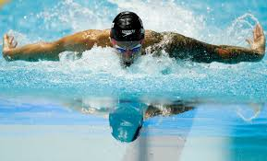
My hobby is swimming

Slide 5
END

