Slide 1
Input as 10 2d-matrics

Slide 2
Input as 25 2d-matrics

Slide 3
Input as 250 2d-matrics

Slide 4
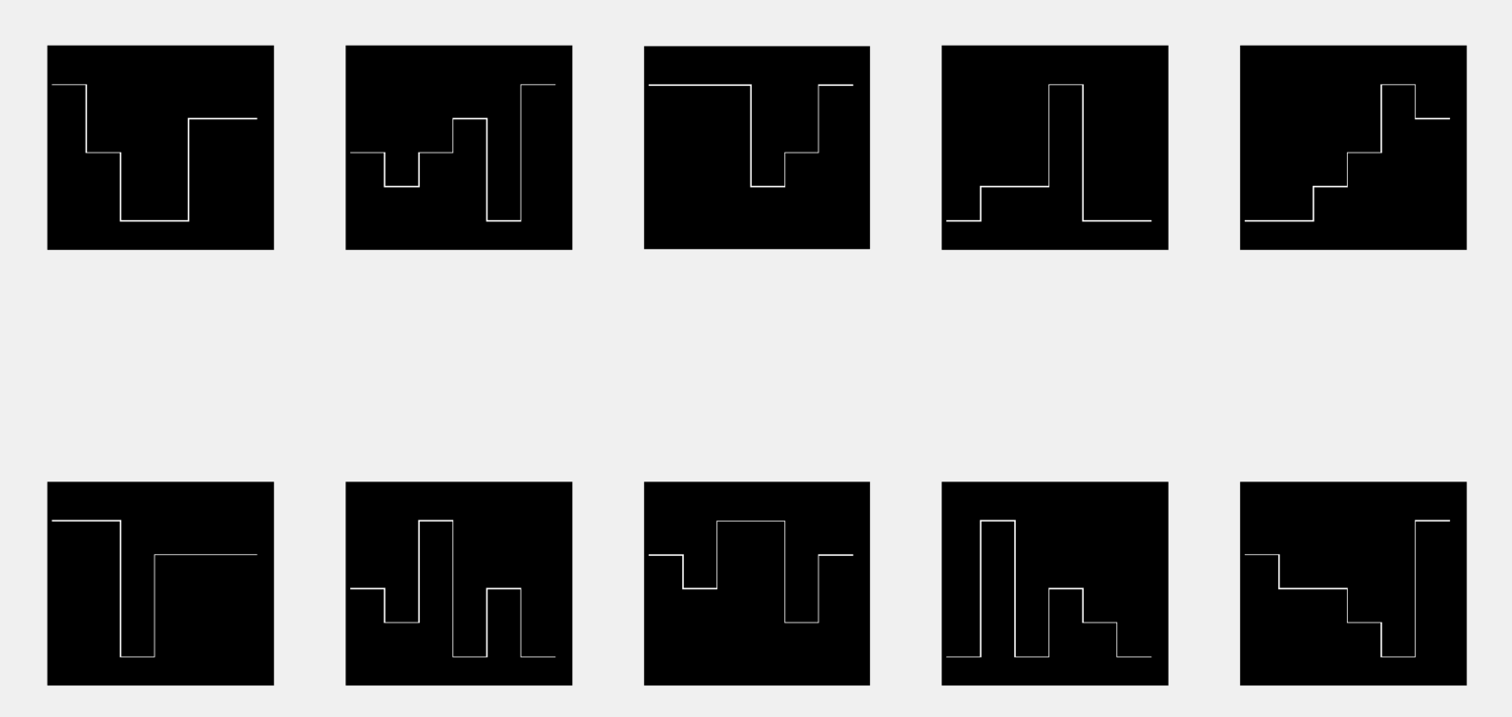
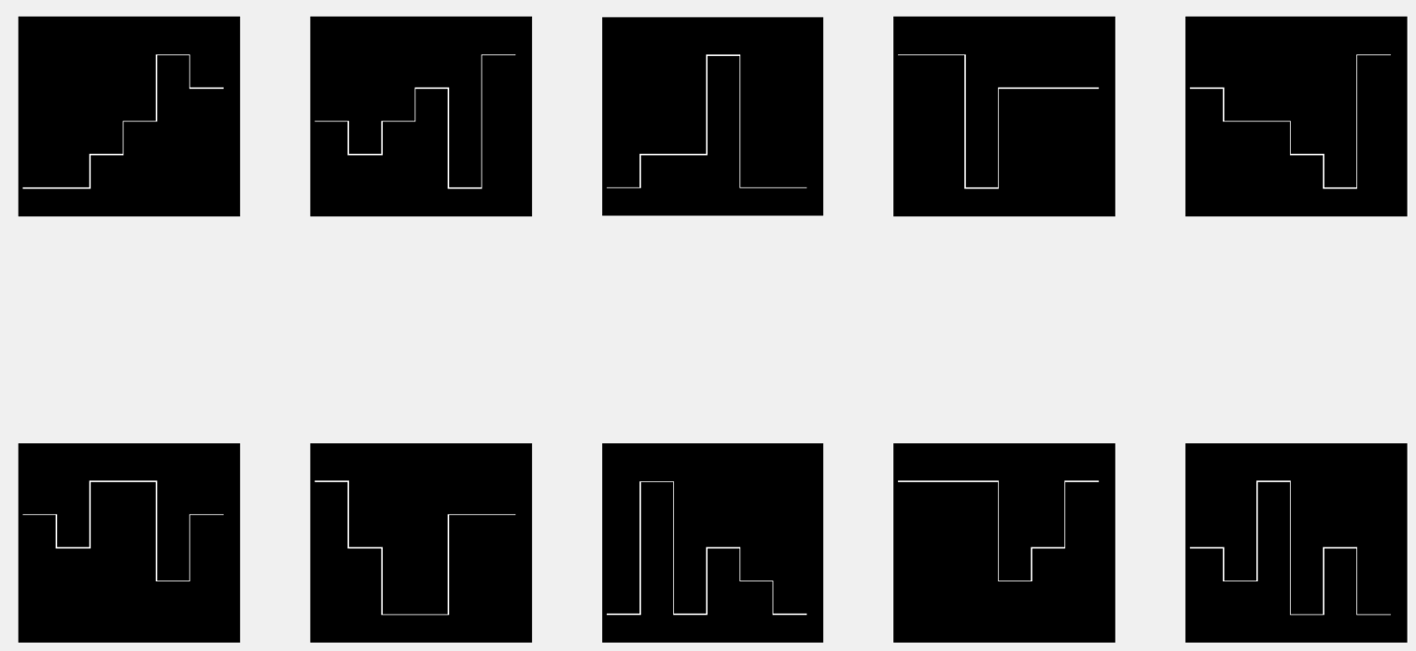
Randomly generated 2D hypnogram images
Central moment 1
Central moment 1_sorted
Aligned hypnograms using sorted central moment 1

Slide 5
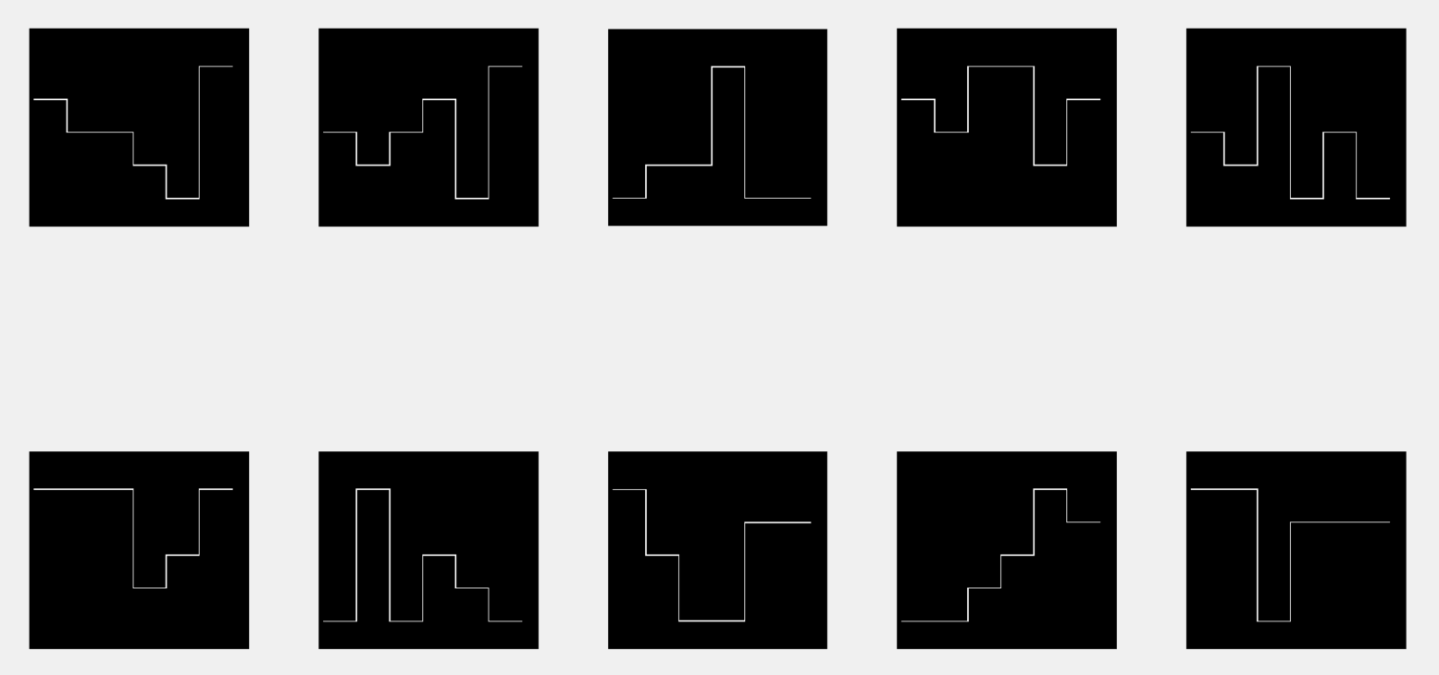
Randomly generated 2D hypnogram images
Central moment 4
Central moment 4_sorted
Aligned hypnograms using sorted central moment 4

