Slide 1
kernel_size_experiment_1
Resnet size: 18 layers
kernel size: (2,2), (2,10), (2,15), ..., (2,45)

Slide 2
OSA
Insomnia
COMISA
 | test_acc
(2,2) | 0.599119
(2, 10) | 0.599119
(2, 15) | 0.599119
(2, 20) | 0.599119
(2, 25) | 0.599119
(2, 30) | 0.599119
(2, 35) | 0.599119
(2, 40) | 0.599119
(2, 45) | 0.599119
 | test_acc
(2,2) | 0.635036
(2, 10) | 0.671533
(2, 15) | 0.671533
(2, 20) | 0.671533
(2, 25) | 0.671533
(2, 30) | 0.671533
(2, 35) | 0.671533
(2, 40) | 0.671533
(2, 45) | 0.671533

Slide 3
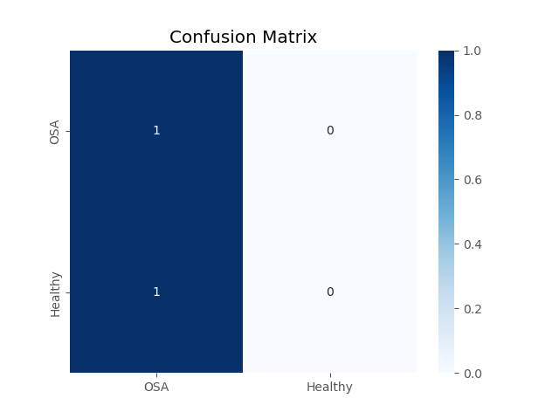
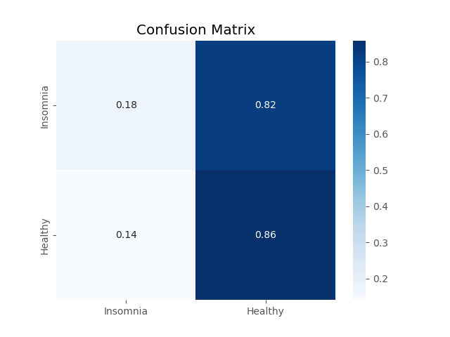
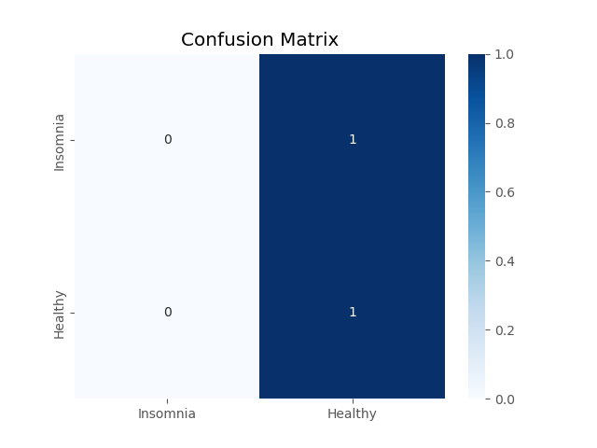
(2,2)
(2,2)
(2,2)
(2,10)
(2,10)
(2,10)

Slide 4
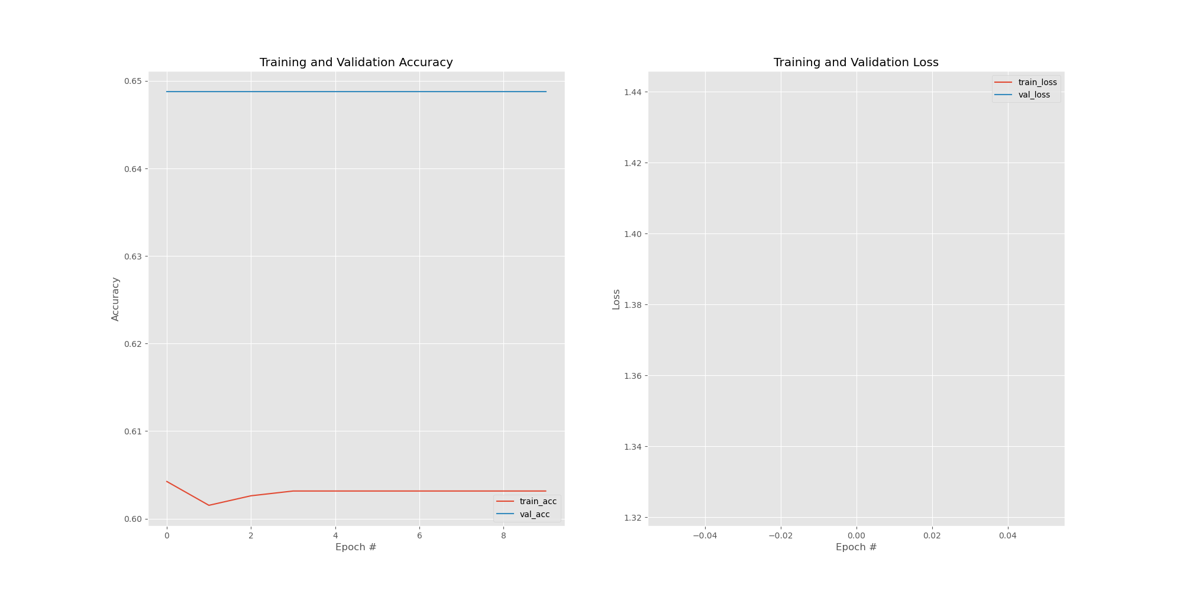
OSA, kernel_size=(2,2)

Slide 5
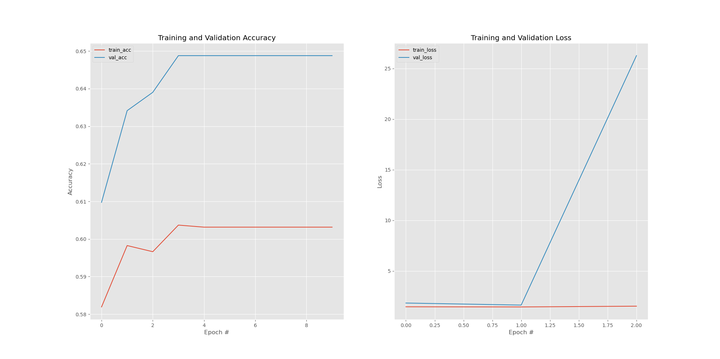
OSA, kernel_size=(2,10)

Slide 6
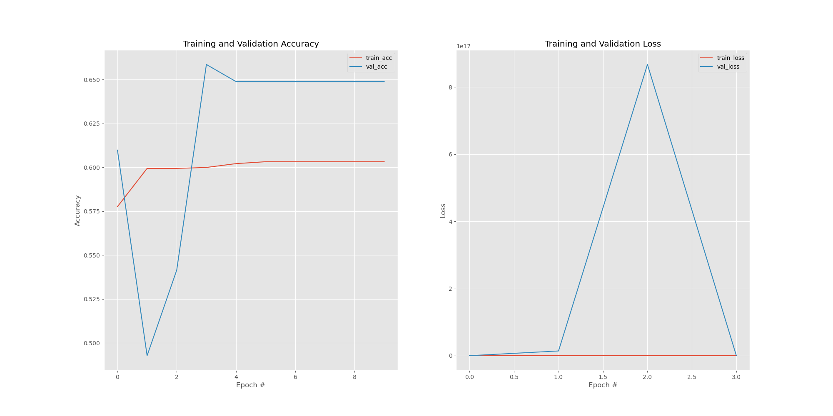
OSA, kernel_size=(2,15)

Slide 7
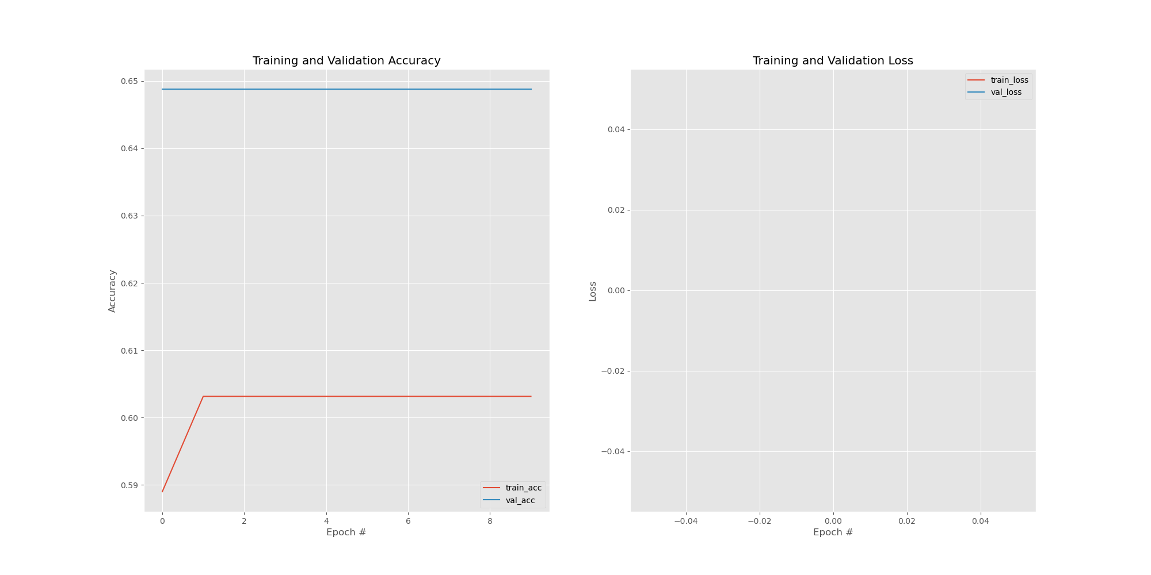
OSA, kernel_size=(2,45)

Slide 8
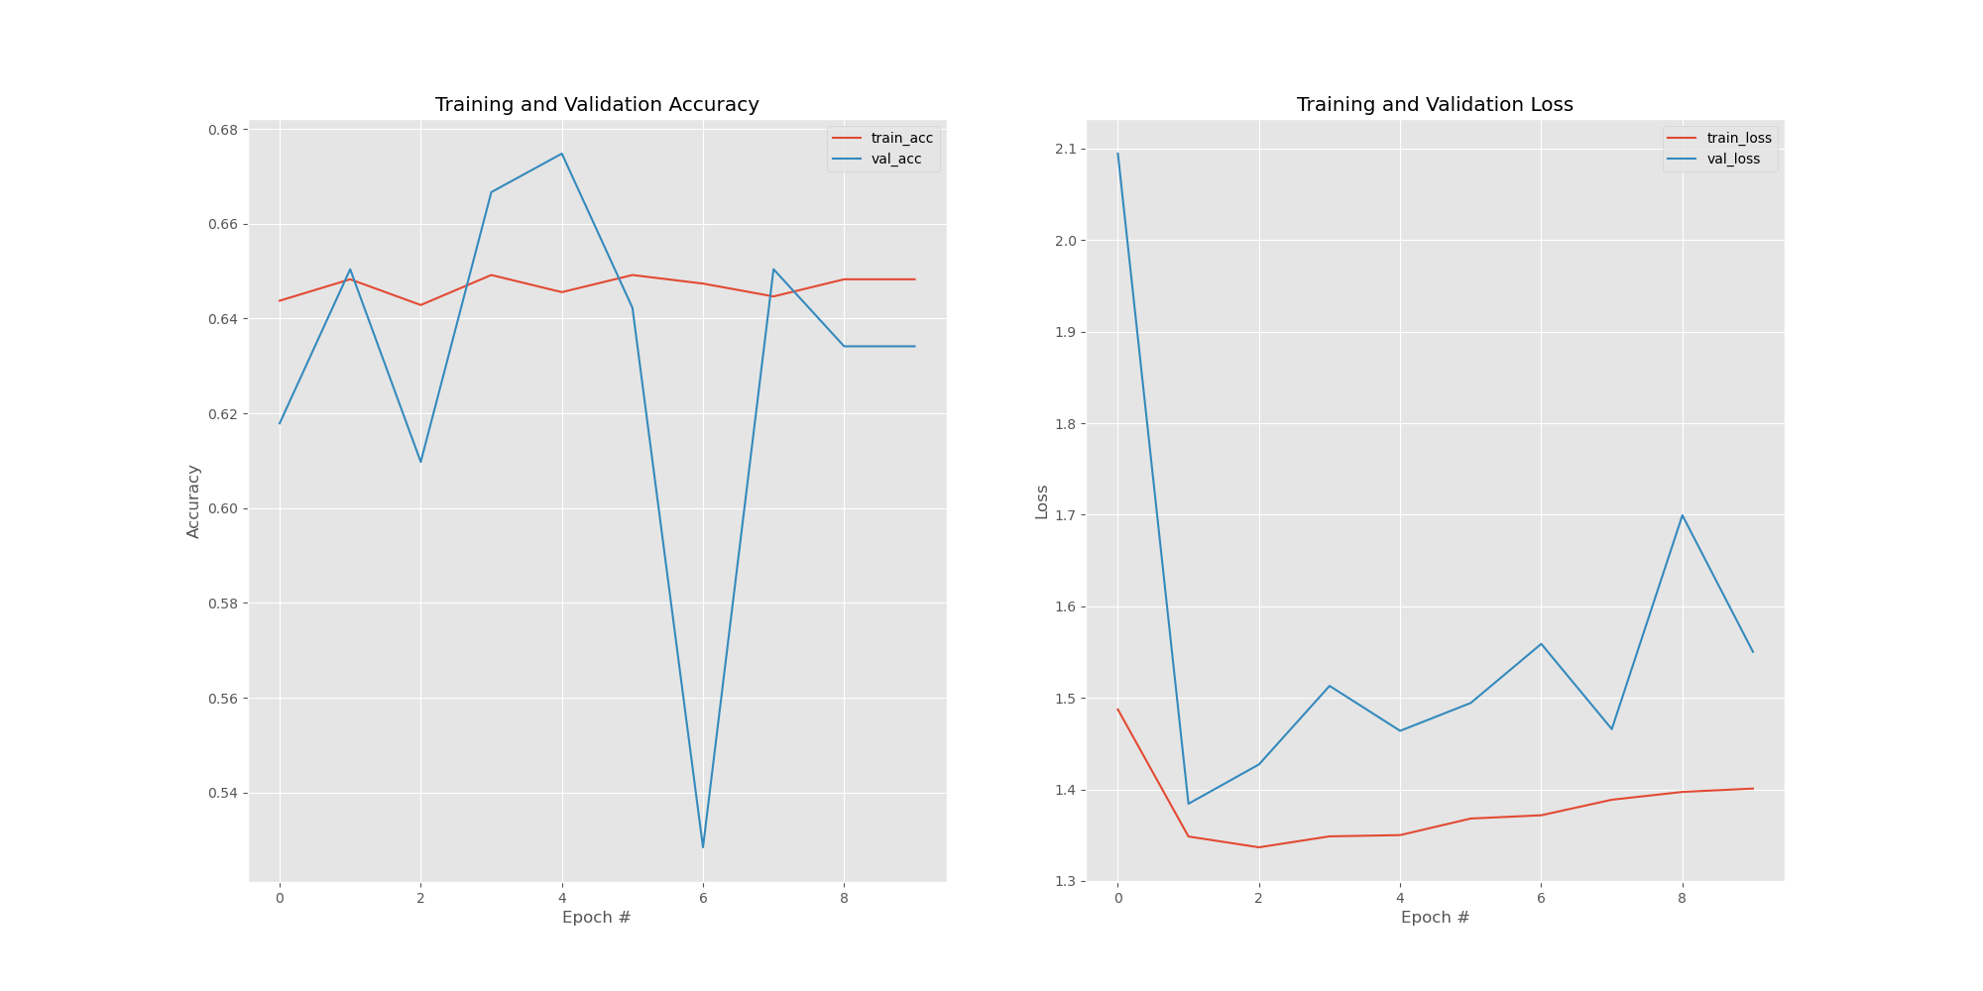
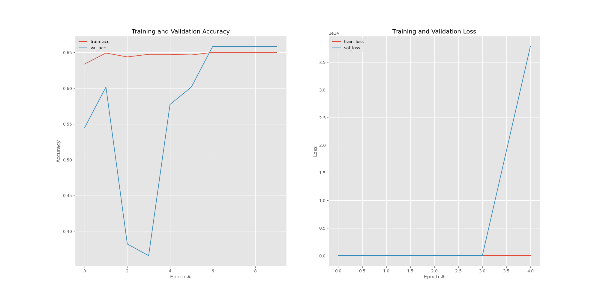
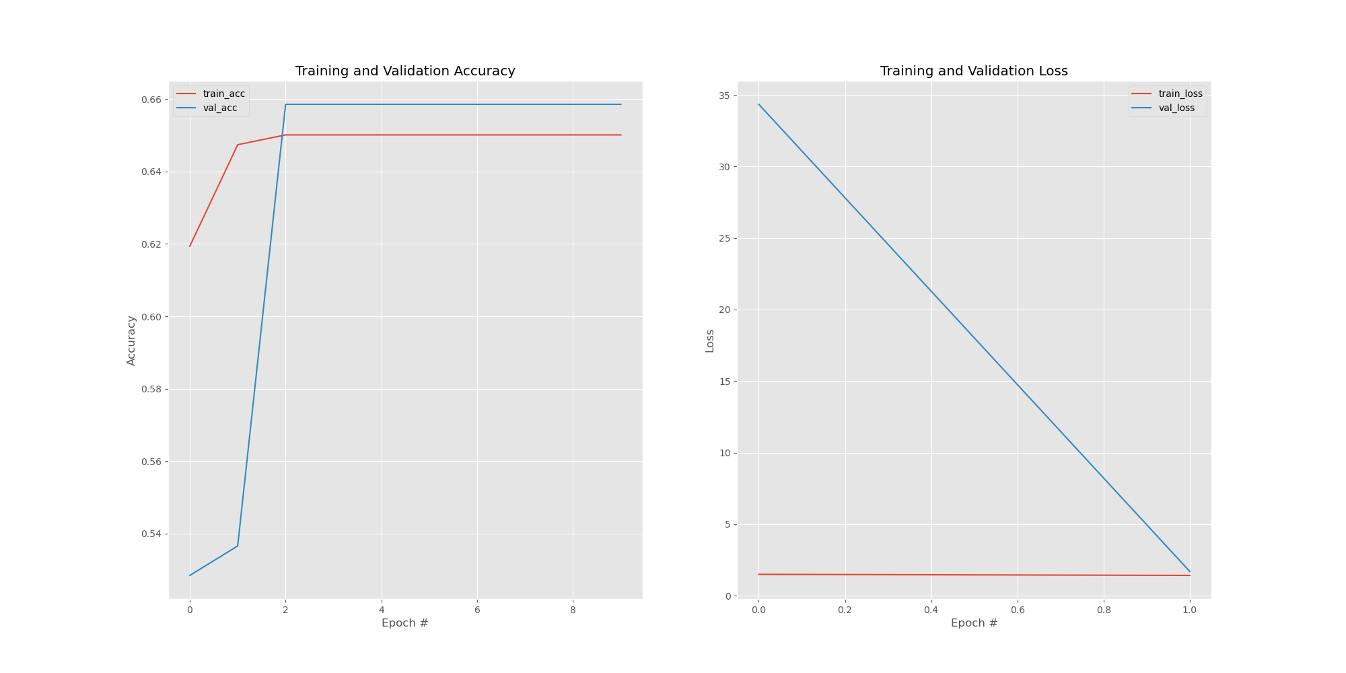
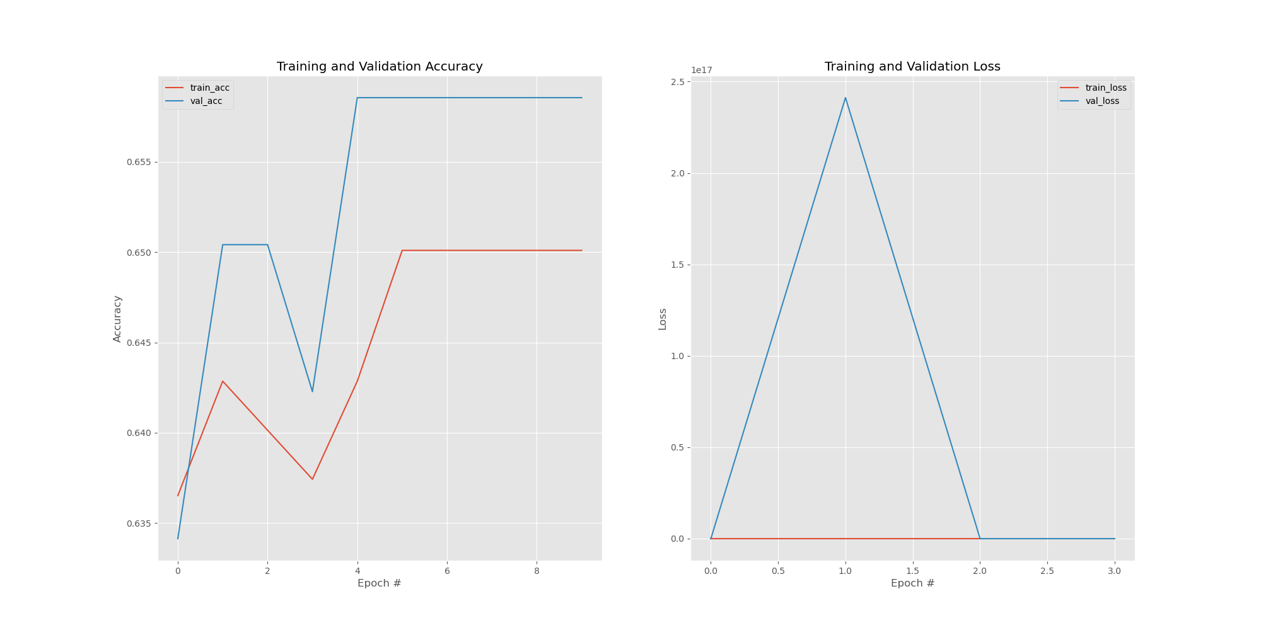
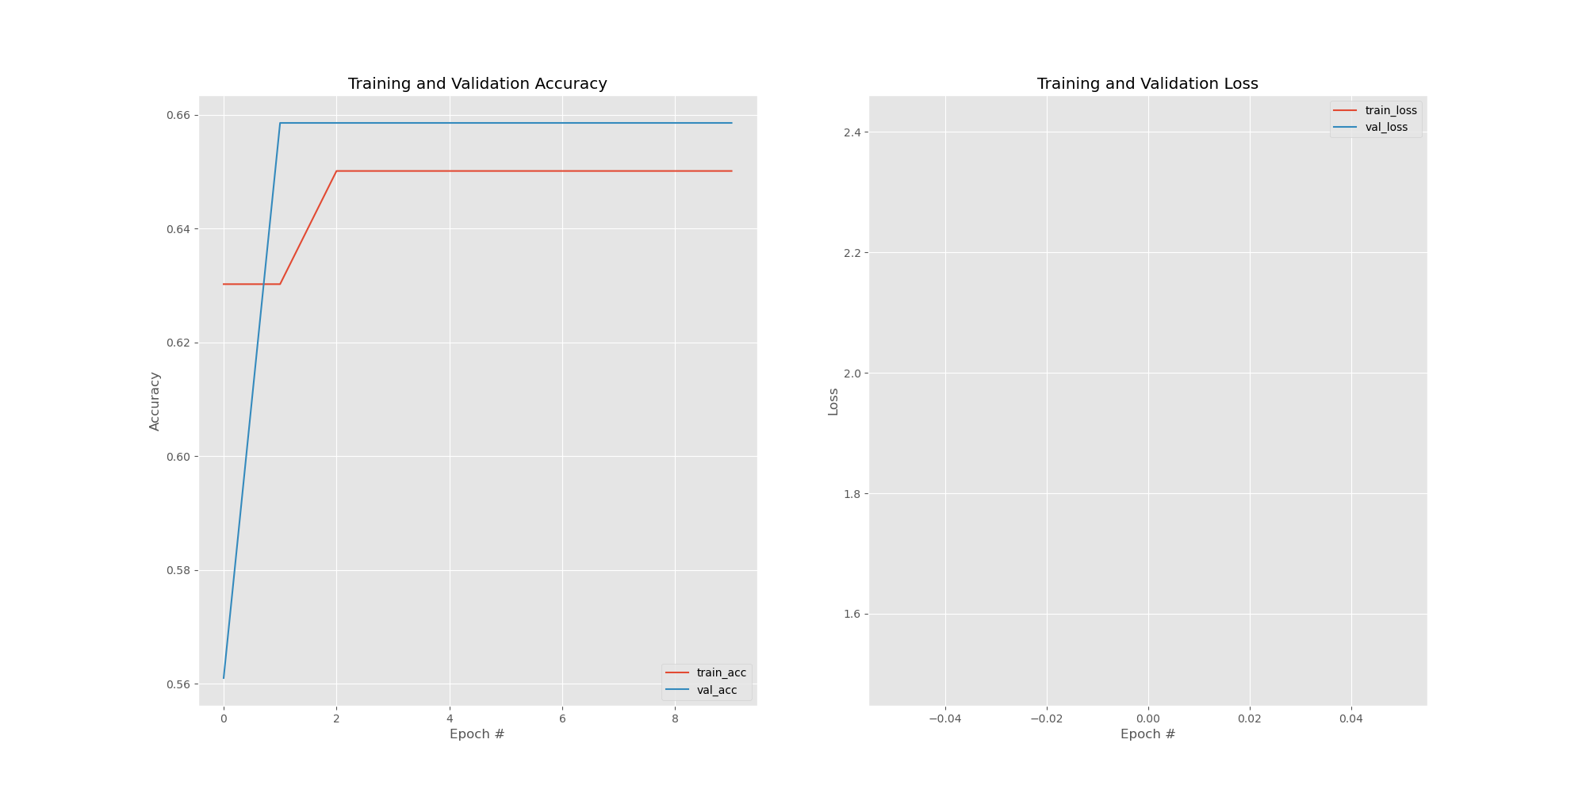
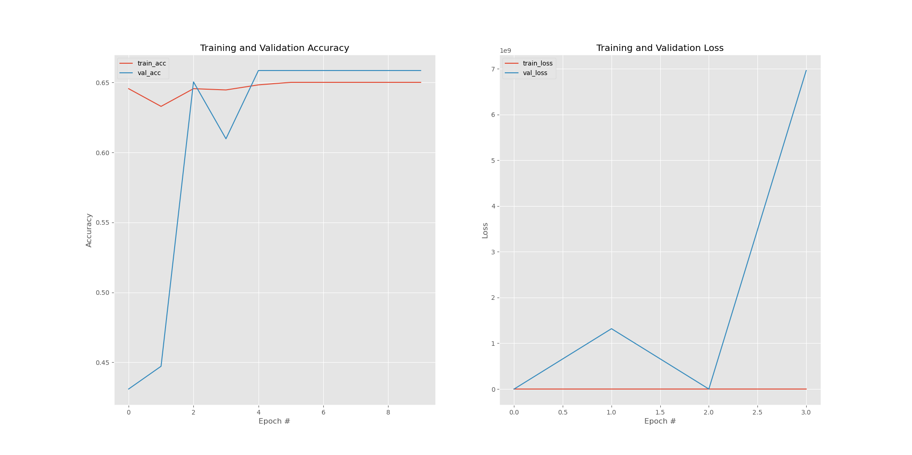
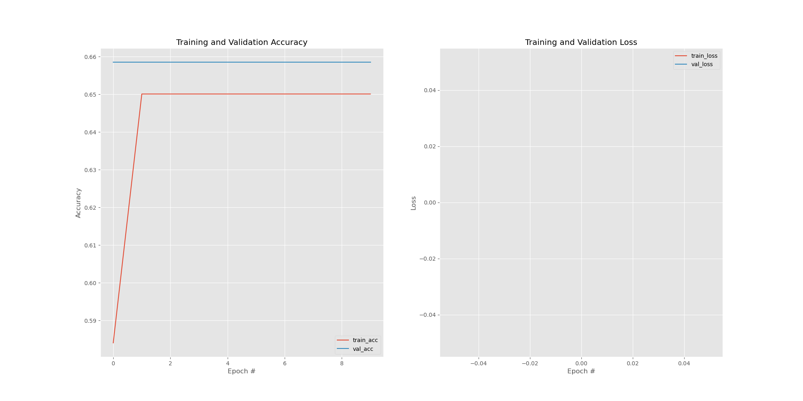
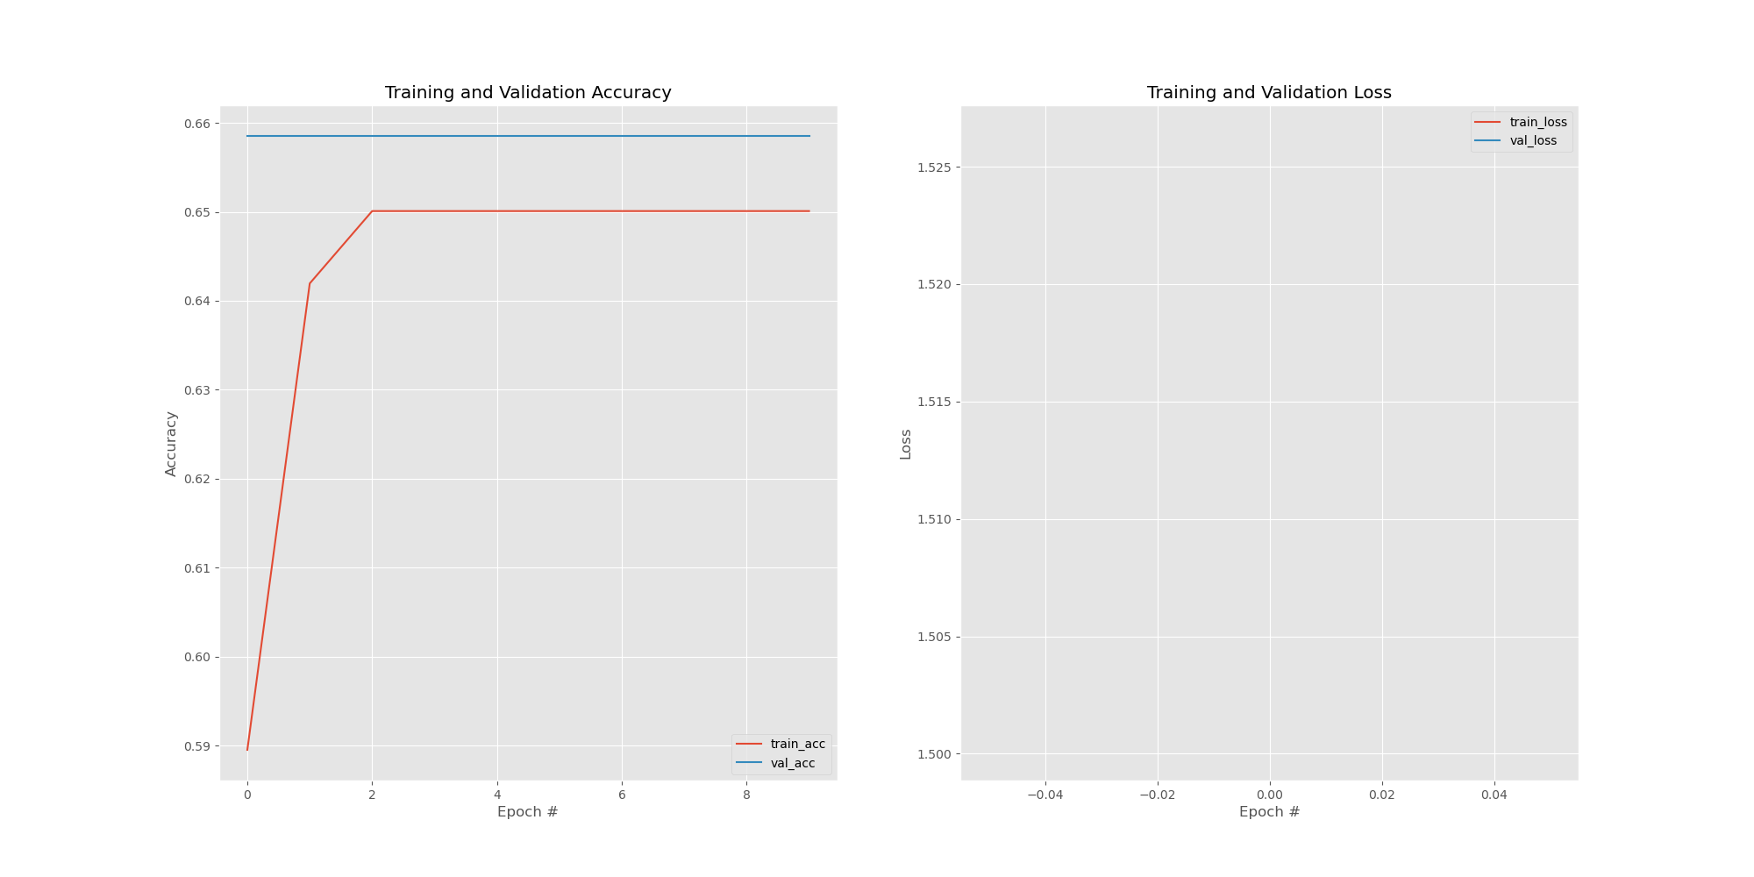
Insomnia
67%
(2,2)
(2,10)
(2,15)
(2,20)
67%
(2,2)
(2,10)
(2,15)
(2,20)

Slide 9
Insomnia, kernel_size=(2,2)

Slide 10
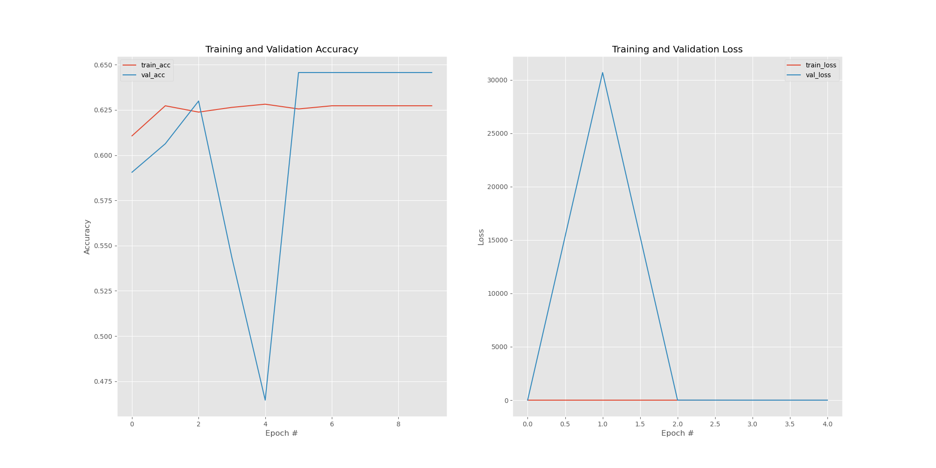
Insomnia, kernel_size=(2,10)

Slide 11
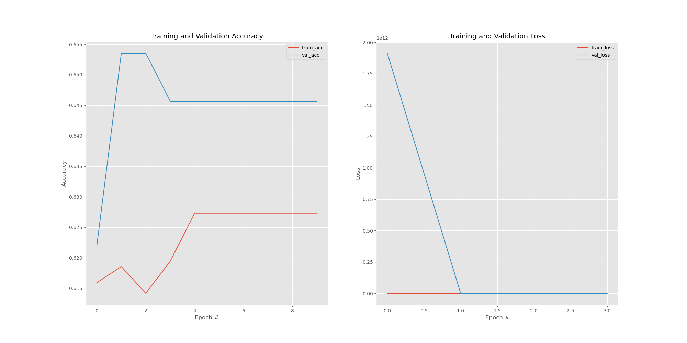
Insomnia, kernel_size=(2,15)

Slide 12
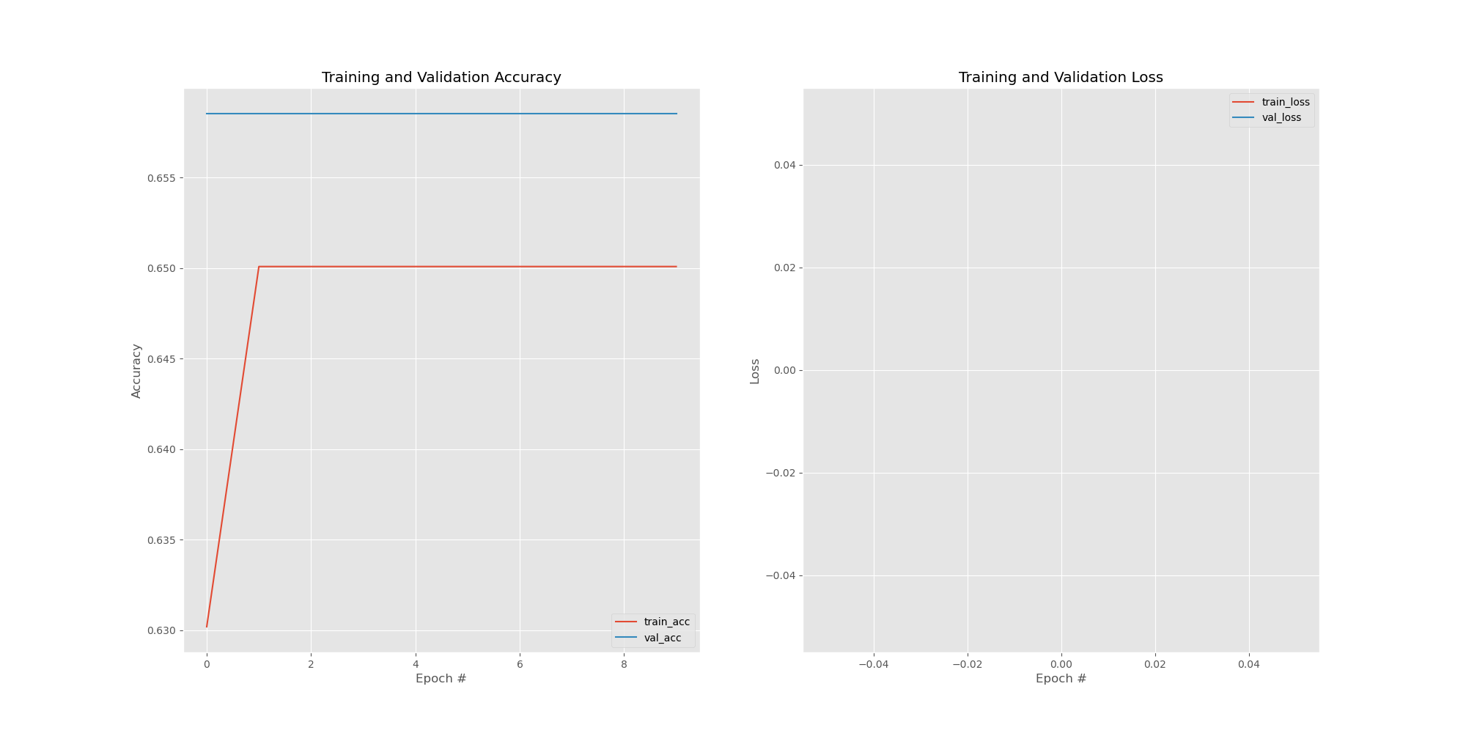
Insomnia, kernel_size=(2,45)

Slide 13
COMISA, kernel_size=(2,2)

Slide 14
COMISA, kernel_size=(2,10)

Slide 15
COMISA, kernel_size=(2,15)

Slide 16
COMISA, kernel_size=(2,45)

