Slide 1
Jitk: A Trustworthy In-Kernel Interpreter Infrastructure
Operating Systems Design and Implementation (OSDI '14)
Xi Wang, David Lazar, Nickolai Zeldovich,
Adam Chlipala, Zachary Tatlock
MIT CSAIL and University of Washington

Slide 2
Introduction
Many operating systems allow user-space applications to customize and extend the kernel by downloading user-specified code into the kernel.
One well-known example is the BSD Packet Filter (BPF) architecture.
For portability and safety, the kernel defines a simple language, and uses an interpreter to execute code written in that language.
The security of these systems critically relies on both the interpreter and user-supplied code.
Unfortunately, it is challenging to ensure that both the in-kernel interpreter and the supplied user-specified code are bug-free.
This paper presents Jitk, a new in-kernel interpreter infrastructure that addresses these challenges through formal verification.
Notes:
许多操作系统允许用户空间应用程序通过下载用户指定代码到内核来自定义和扩展内核空间。一个著名的例子就是BSD包过滤架构（BPF），用户可以通过加载一个过滤器到内核来筛选想要的包。出于可移植性和安全性的考虑，内核通常定义一个简单的受限语言并使用一个解释器来执行该语言编写的代码（如BPF），而不是直接下载和执行机器代码。这样，系统的安全性很大程度上依赖于内核解释器和用户代码的。解释器运行在内核拥有完整权限，一旦出错会给整个系统带来巨大威胁。然而现有技术很难保证解释器和代码的正确性。因此，作者提出了Jitk，能保证用户代码翻译为本机码过程中的正确性和安全性，并进行了形式化验证。同时，作者还提出了一种新型高级规范语言SCPL，来减少用户代码出错的几率。

Slide 3
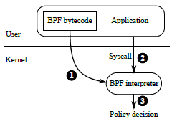
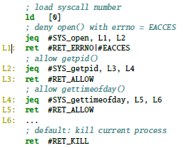
Example—BPF
Figure 1: The architecture of the Seccomp system in Linux.
Figure 2: The system call filter used in OpenSSH, in the BSD Packet Filter (BPF) language
Notes:
BPF的一个典型应用是Linux内核的Seccomp系统，通过BPF指定进程的系统调用策略，如图1。应用程序提交字节码形式的BPF过滤器到内核，内核中的BPF解释器对之后每个系统调用进行过滤，决定是否允许此系统调用。如果解释器出现bug，内核可能无法阻止非法系统调用。

Slide 4
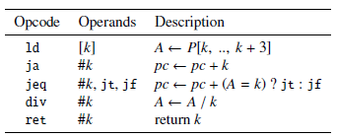
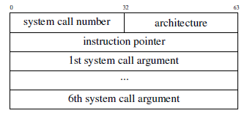
Example—BPF
a 32-bit accumulator A
a 32-bit index register X
a scratch memory M for temporary storage
an input packet P (the data blob for inspection),
an implicit program counter pc
Figure 3:Examples of BPF instructions
Figure 4: Input to system call filters
Notes:
BPF过滤器就是BPF指令序列，指令长度固定为64字节。可以读取输入数据包P，在寄存器A和X以及暂存M之间传输数据，执行算术运算，终止同时返回一个32位整型值。良好定义的BPF过滤器必须以ret指令结束，只能向前跳转，不能执行非法操作。当解释器无法拒绝非法BPF过滤器时将会出现bug

Slide 5
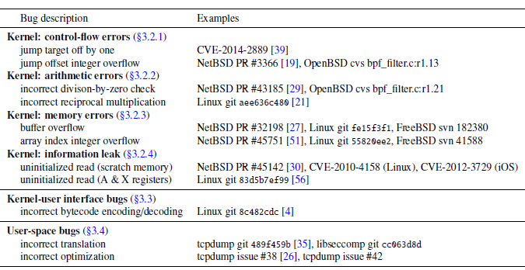
Case study
Figure 5: Representative bugs in BPF interpreters

Slide 6
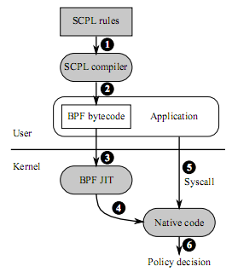
Architecture of Jitk/BPF
Compared to the current Seccomp, Jitk/BPF have three improvements:
System Call Policy Language (SCPL)
JIT interpreter with a shared backend
Formal verification
Notes:
本文Jitk的应用环境是 Linux中使用了Jitk/BPF JIT的Seccomp子系统，与传统的Seccomp相比，有三个重要区别。

Slide 7
Goals——Correctness
Theorem1 (End-to-end correctness). For any system call policy p written in SCPL, if Jitk accepts it, the overall system enforces the semantics of p.
Lemma 2 (SCPL-to-BPF semantic preservation). Given a system call policy p written in SCPL, if the SCPL compiler translates it into a BPF filter f , f preserves the semantics of p:
∀p : SCPLc(p) = OK f =⇒ p ≈ f
Lemma 3 (User-kernel representation equivalence). If a BPF filter f is encoded into bytes in user space and the bytes are decoded back to a BPF filter in kernel space, f is preserved.
∀ f : encode( f ) = OK b =⇒ decode(b) = OK f
Lemma 4 (BPF-to-native semantic preservation). Given a BPF filter f , if the JIT accepts it and generates native code n, n preserves the semantics of f .
∀ f : jit( f ) = OK n =⇒ f ≈ n
Notes:
对于在内核中执行用户指定策略，Jitk提出了两个总体目标：一是正确性，二是安全性。
正确性是指用户空间编写的SCPL规则应该能在内核中正确执行

Slide 8
Goals——Safety
The safety concern is that an arbitrary user-space application should not be able to misuse Jitk to monopolize CPU time or to corrupt the kernel’s memory.
Particularly, both native code generated by the BPF JIT and the JIT itself must be safe for in-kernel execution.
Theorem 5 (Termination). Given any BPF filter f , if the JIT accepts it and generates native code n, then n terminates.
∀ f : jit( f ) = OK n =⇒ terminate(n)
Theorem 6 (Bounded stack usage). Given any BPF filter f , if the JIT accepts it and generates native code n, n uses at most S bytes of stack.
∀ f : jit( f ) = OK n =⇒any run of n uses at most S bytes of stack space
The safety of the BPF JIT itself is guaranteed by Coq.
Notes:
安全性目标即应用程序不能滥用Jitk来独占CPU时间或者污染内核内存。特别地，内核中无论是BPF JIT生成本机码还是JIT本身都要安全地执行。定理1确保了从SCPL规则到本机码的正确性，但不能保证本机码不会出现无限循环或堆栈溢出。定理5保证了本机码必定在有限步骤停止，即CPU时间有界限（没有无限循环）并且没有使执行卡主的未定义行为（内存越界访问和除零）；

Slide 9
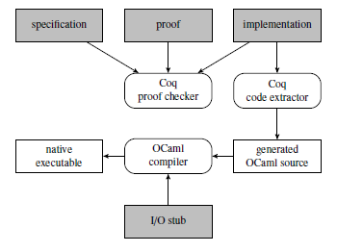
Development flow
Figure 6: Development flow of Jitk using the Coq proof assistant
Notes:
为了构建值得信赖的内核解释器，开发人员需要证明其实现满足正确性和安全性目标。开发流程如图所示。
JIT以及SCPL编译器都用Coq编写，每个组件的Coq源代码包括三个主要部分：规范、实现、证明

Slide 10
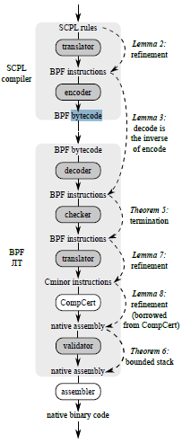
Design
BPF JIT
A correct BPF JIT implementation should satisfy BPF-to-native semantic preservation (Lemma 4), termination (Theorem 5), and bounded stack usage (Theorem 6).
The translator and semantic preservation
Lemma 7 (BPF-to-Cminor semantic preservation).
Lemma 8 (Cminor-to-native semantic preservation).
The checker and termination
The validator and bounded stack usage

Slide 11
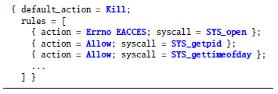
Design
SCPL（ System Call Policy Language）
Figure 7: OpenSSH’s system call filter from Figure 2, expressed in
the higher-level System Call Policy Language (SCPL).

Slide 12
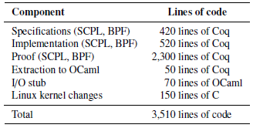
Implementation
Figure 8: Lines of code for the Jitk/BPF prototype
Notes:
BPF JIT是用Coq编写的，并将Coq代码提取为Ocaml代码，然后与I/O stub和Ocaml运行环境一起链接成一个可执行文件。Jitk支持生成x86、ARM、PowerPC机器码，因为CompCert提供了这些相应后端，并不支持CompCert中没有的架构。

Slide 13
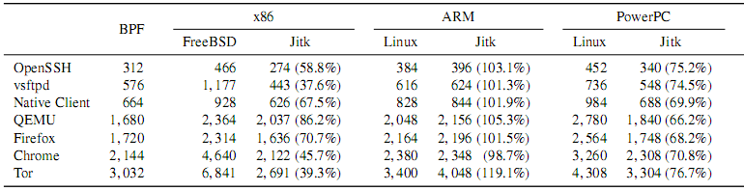
Evaluation
Code quality
Figure 9: Comparison of sizes of native code generated by
the BPF JIT of Jitk, the Linux kernel and the FreeBSD kernel

Slide 14
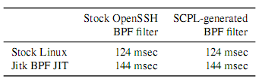
Evaluation
Performance
Figure 10: Time taken to login and disconnect from an OpenSSH server in different configurations;
using SCPL gives the same performance as hand-written BPF filters
Notes:
Jitk的BPF JIT有大约20秒的额外延迟，这是由于调用一个设置OCaml运行环境和汇编器的新进程所用开销。
Jitk的BPF JIT较于传统解释器的一个优势是，一旦BPF过滤器被翻译为本机码，执行后续的系统调用花费较低.

Slide 15
Conclusion
Overall, the contributions of this paper are as follows:
The Jitk infrastructure and approach for building verified in-kernel JIT interpreters.
A case study of real-world vulnerabilities found in BPF interpreters in several operating systems.
A formalization of correctness and safety goals for executing user-specified policies in the kernel.
The Jitk/BPF and Jitk/INET-DIAG verified JITs along with the formal specifications of both languages.
The SCPL high-level language for specifying system call policy rules, along with a proof of correctness for an SCPL-to-BPF compiler.
An evaluation of how well Jitk’s formal verification prevents the vulnerabilities that have been discovered in bytecode interpreters in real-world kernels.

Slide 16
Thanks!

