Slide 1
Non-scalable locks are dangerous
In Proceedings of the Linux Symposium (OLS 2012)
Silas Boyd-Wickizer, M. Frans Kaashoek, Robert Morris, and Nickolai Zeldovich

Slide 2
Outline
Introduction
Are non-scalable locks a problem?
Model
Which scalable lock?
Using MCS locks in Linux
Conclusion

Slide 3
Introduction
It is well known that non-scalable locks, such as simple spin locks, have poor performance when highly contended.
It is also the case that many systems collapses suddenly due to non-scalable locks, while the offending critical sections are often tiny.
This paper argues that non-scalable locks are dangerous.
One piece of the argument is that non-scalable locks can seriously degrade overall performance, which is likely occur in real systems.
Another piece of the argument is that the onset of performance collapse can be sudden as cores are added.
A third element of the argument is that critical sections which appear to the eye to be very short, perhaps only a few instructions, can nevertheless trigger performance collapses.
The paper presents a predictive model of non-scalable lock performance that explains these phenomenon.
Naturally, one should use scalable locks, particularly in operating system kernels where the workloads and levels of contention are hard to control.

Slide 4
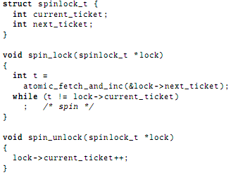
Are non-scalable locks a problem?
How non-scalable locks work
The lock has two fields:
current_ticket
next_ticket
Figure 1: Pseudocode for ticket locks in Linux.
Notes:
作者以Linux内核使用的ticket锁为例说明了非扩展性锁的工作原理以及会引发的问题。2.6.25版本之后的Linux内核都默认使用ticket锁，它有两个字段：当前占用锁的票号(current_ticket)和下一个未使用的票号(next_ticket)，需要获取锁的核使用原子指令对next_ticket增一来获得票号，然后该核保持自旋转直到其票号与current_ticket相等则成功获取锁，释放时核对current_ticket增一使锁交给下一个等待的核。等待锁的核都有锁变量缓存，一旦解锁这些核都将读取缓存，多数架构中这些读取是串行化的，因此读取操作所需时间与核数呈正比。锁等待队列中的下一个核会在这个过程中获得其锁变量缓存的副本，因此每次切换锁的花费也与核数呈正比，则自旋锁每次释放的成本可以设为O(N)。

Slide 5
Are non-scalable locks a problem?
Benchmarks
FOPS creates a single file and starts one process on each core. Each thread repeatedly opens and closes the file.
MEMPOP creates one process per core. Each process repeatedly mmaps 64 kB of memory with the MAP_POPULATE flag, then munmaps the memory. MAP_ POPULATE instructs the kernel to allocate pages and populate the process page table immediately, instead of doing so on demand when the process accesses the page.
PFIND searches for a file by executing several instances of the GNU find utility. PFIND takes a directory and filename as input, evenly divides the directories in the first level of input directory into per-core inputs, and executes one instance of find per core, passing in the input directories.
EXIM is a mail server. A single master process listens for incoming SMTP connections via TCP and forks a new process for each connection, which accepts the incoming message. We use the version of EXIM from MOSBENCH.
Notes:
作者在一个采用Linux内核2.6.39版本的48核机器上从4个基准方面测试了自旋锁。FOPS：每个核建立一个文件并启动一个进程，每个线程反复打开和关闭该文件。MEMPOP：每个核创建一个反复定位64KB内存的进程，该进程用MAP_POPULATE标志指示内核分配页并立即填入进程页表。PFIND：通过执行GNU查找功能的实例来搜索一个文件。有一个路径和文件名作为输入，将最高级路径划分为不同路径作为每个核的输入并在每个核中执行一个查找实例。EXIM：一个邮件服务器。单主控进程通过TCP监听到来SMTP连接并为其创建一个新进程来接收消息。

Slide 6
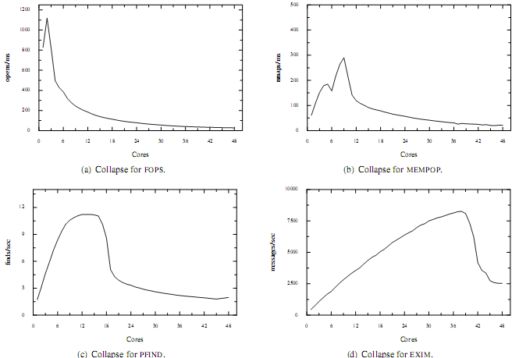
Are non-scalable locks a problem?
Results
Figure 2: Sudden performance collapse with ticket locks.
Notes:
一种常见的想法是随着核数量增加总吞吐量呈正比增长，然后由于临界区的存在总吞吐量趋于平稳，但是测试结果表明一定时间内吞吐量随着核增多而上升，之后并不会趋于平稳而是在增多几个核后急速下降，往往在 N 核时拥有良好性能而增加1或2个核后性能会急剧下降。FOPS：2核时性能最高而48核时总吞吐量只有1核的3%，这是由于文件系统名称/索引缓存中的per-entry锁引起的。MEMPOP性能在9核时最高之后快速下降然后逐渐变缓，48核时吞吐量只有1核时的35%，原因是非扩展性锁保护了从物理页映射到虚拟内存区域的数据结构。

Slide 7
Are non-scalable locks a problem?
Questions
The four graphs have common features which raise some questions:
• Why does collapse start as early as it does?
• Why does performance ultimately fall so far?
• Why does performance collapse so rapidly?

Slide 8

Model
Hardware cache coherence
The directory
Each core has a cache directory. The hardware assigns evenly sized regions of DRAM to each directory. Each directory maintains an entry for each cache line in its local DRAM:
[ tag | state | core ID ]
The possible states are:
1. invalid (I) – the cache line is not cached;
2. shared (S) – the cache line is held in one or more
caches and matches DRAM;
3. modified (M) – the cache line is held in one cache
and does not match DRAM.
Figure 3: Directory transitions for loads and stores.
Notes:
首先概述了硬件缓存一致性协议。每个核都包含一个缓存目录，硬件为每个目录均匀分配DRAM中一个区域，目录对它本地DRAM的每个缓存行有一个入口。状态可能为无效、共享、或修改的

Slide 9

Model
Hardware cache coherence
Network messages
When a core begins accessing an uncached cache line, it will send a load or store request to the cache line’s home directory. Depending on the type of request and the state of the cache line in the home directory, the home directory may need to send probe messages to all directories that hold the cache line.
Figure 4: Probe messages for loads and stores.
Notes:
一个核访问一个未缓存的缓存行时，它会发送读取或写入请求到缓存行的目录。依据请求类型和缓存行的状态，目录会发送一些消息给其它所有占有该缓存行的目录。

Slide 10

Model
Performance model for ticket locks
Figure 5: Markov model for a ticket spin lock for n cores.
State i represents i cores holding or waiting for the lock. ai is the arrival rate of new cores when there are already I cores contending for the lock. si is the service rate when i+1 cores are contending.
the arrival rate: ak = (n−k)/a
a-the average time between consecutive lock acquisitions on a single core
the service rate: sk=1/( s+ck/2)
s- the time spent in the serial section
c- the time taken by the home directory to respond to a cache line request
Notes:
在此协议的基础上构建了一个用于理解排队自旋锁的性能的模型，该模型能近乎准确的预测之前测试中的崩溃。构建模型需要考虑两种情况，一是没有争用时可以快速获得锁，二是在很多核争用锁时拥有权的转换所花费的时间会显著增加，此外，锁行为变化的确切点取决于锁的使用模式和临界区的长度等参数. 。 为了能精确表示ticket锁的行为，作者提出了一个基于马尔科夫链的排队理论。

Slide 11

Model
Performance model for ticket locks
P0, . . . ,Pn- the steady-state probabilities of the lock being in states 0 through n respectively.
Steady state means that the transition rates balance: Pk · ak = Pk+1 · sk.
the average number of waiting (idle) core:
the speedup achieved in the presence of this lock and serial section can be computed as n−w, since on average that many cores are doing useful work, while w cores are spinning.

Slide 12
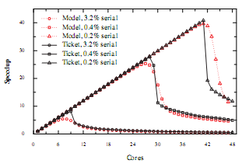
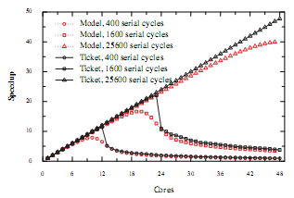
Model
Validating the model
Figure 6: Predicted and actual performance of ticket spin locks with a 400-cycle serial section, for a microbenchmark where the serial section accounts for a range of fractions of the overall execution time on one core.
Figure 7: Predicted and actual performance for a microbenchmark where the critical section accounts for 2% of the execution time on one core, but with varying execution time for each invocation of the serial section.
Notes:
作者通过比较单核上微基准测试得到的实际速度与模型的预测速度，来验证所提出的模型，分别测试了两种情况，一是固定临界区的执行周期而总体执行周期递增，二是临界区占总执行时间的比不变但临界区花费时间递增。测试结果中模型基本与实际速度匹配，表明该模型能准确地捕捉导致 ticket锁性能崩溃的相关因素。但预测速度与测量速度存在一定的差异，即相比实际观测到的崩溃预测结果中崩溃略微平缓，原因是崩溃点附近 ticket锁的性能很不稳定，而模型预测的是平均稳态行为。

Slide 13
Model
Implications of model results
The behavior predicted by the model has several important implications:
First, the rapid collapse of ticket locks is an inherent property of their design, rather than a performance problem with the experimental hardware.
Second, the collapse of the ticket lock only occurs for short serial sections.
Third, the collapse of the ticket lock prevents the application from reaching the maximum performance predicted by Amdahl’s law (for short serial sections).

Slide 14
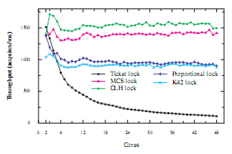
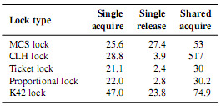
Which scalable lock?
Scalable locks
MCS lock 、K42 lock 、CLH lock、HCLH lock
Figure 9: Performance of acquiring and releasing an MCS lock, a CLH lock, and a ticket lock.
Single acquire and release are measurements for one core. Shared acquire is the time for a core to acquire a lock recently released by another core.
Figure 8: Throughput for cores acquiring and releasing a shared lock.
Notes:
可扩展的锁为每个获取生成一个固定量的缓存丢失从而避免非扩展性锁中存在的崩溃。这些可扩展性锁都维护一个等待队列，其中每个等待的核都自旋于自身的队列条目，不同之处在于每个锁维护队列方式不同
以及锁定和解锁API的不同

Slide 15
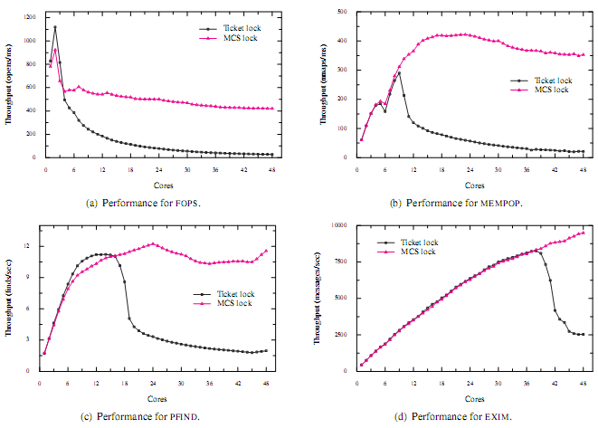
Using MCS locks in Linux
Figure 10: Performance of benchmarks using ticket locks and MCS locks.
Notes:
图 4：不同锁的性能比较 锁后，作者从四个基准方面进行了测试，结果如图 5 所示，用 MCS锁替代ticket 锁使性能提高了 3.5 倍甚至特定情况下 16 倍之多。这说明使用可扩展性锁不需要太多代价，且能避免非扩展性锁带来的性能崩溃。

Slide 16
Conclusion
The main contribution of this paper is amplifying the conclusion from previous work that non-scalable locks have risks: not only do they have poor performance, but they can cause collapse of overall system performance.
First, this paper demonstrated that the poor performance of non-scalable locks can cause performance collapse for real workloads, even if the spin lock is protecting a very short critical section in the kernel.
Second, the paper proposed a single comprehensive model for the behavior of non-scalable spin locks that fully captures all regimes of operation, unlike previous models.
Third, the author confirmed on modern x86-based multicore processors that MCS locks can improve maximum scalability without decreasing performance, and conclude that the scaling and performance benefits of the different types of scalable locks is small.

Slide 17
Thanks!

