Slide 1
Security bugs in embedded interpreters
4th Asia-Pacific Workshop on Systems (APSYS 2013)
Haogang Chen, Cody Cutler, Taesoo Kim, Yandong Mao,
Xi Wang, Nickolai Zeldovich, M. Frans Kaashoek

Slide 2
Outline
Introduction
Embedded interpreters
Vulnerabilities in interpreters
Security guidelines

Slide 3
Introduction
Many systems offer customization by allowing third parties to download executable extensions.
For flexibility and portability reasons, these systems often define an instruction set, in the form of bytecode, and implement an embedded interpreter to run downloaded bytecode.
For performance reasons, they may translate bytecode into machine code before execution, using a just-in-time(JIT) compiler
One example is the BPF.
Notes:
现在很多系统都提供了用户定制功能。出于灵活性和可移植性的考虑，系统通常定义一个字节码形式的指令集并在内核实现一个嵌入式解释器来执行加载的字节码；出于性能考虑，在内核中使用一个JIT解释器将字节码翻译为机器代码后执行。

Slide 4
Introduction
Embedded interpreters raise interesting security concerns.
First, many real-world systems do not adopt sandboxing techniques, thus a compromise of the interpreter is likely to lead to a compromise of the host system as well.
Second, embedded interpreters often validate untrusted bytecode using ad-hoc rules, which is error-prone.
Third, the bytecode usually accepts input data in which case both the bytecode and its input data maybe untrusted, thereby exposing the host system to a wider range of attack vectors.
This paper investigates the security implication of deploying embedded interpreters in systems
Notes:
然而嵌入式解释器可能会对系统安全造成危害，主要原因有三点：
一是许多系统不使用沙盒技术，如进程隔离或软件故障隔离，因此解释器的漏洞可能导致系统被攻击；
二是嵌入式解释器经常会确认不可信的字节码，容易造成错误；
三是字节码通常会接收输入数据，字节码和输入数据都可能是不可信的，使攻击者可以利用的空间更大

Slide 5
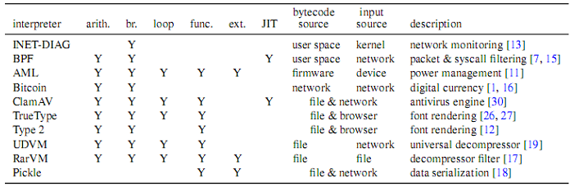
Embedded interpreters
Figure 1：Summary of embedded interpreters and their features
Notes:
Arith：算术操作；br：条件分支和只向前的跳转；func：用户定义函数；ext：外部函数调用；JIT：是否已经有JIT实现

Slide 6

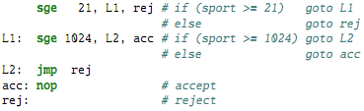
Embedded interpreters
Linux Socket Monitoring Interface (INET-DIAG)
The ss command monitors sockets with source port in range [21,1024), and generates the following bytecode and submits it to the kernel.
Supports comparisons and forward jumps, but not backward jumps.

Slide 7
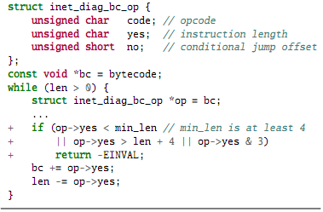
Vulnerabilities in interpreters
Resource exhaustion
Figure 2： The vulnerability was missing validation of INET-DIAG instructions in the Linux kernel, which results in infinite loop if op->yes is zero.
Notes:
若节码支持跳转，可能出现向后跳转导致无限循环。类似地，调用子程序也可能引起使栈溢出的无限递归。
避免无限循环或递归的一种常见方法是限制执行的指令数和嵌套函数调用的层数。但是很多设置了相应计数器的复杂解释器仍然存在这种错误。

Slide 8

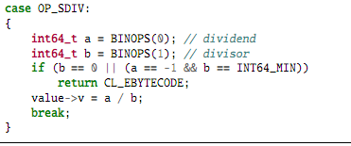
Vulnerabilities in interpreters
Arithmetic errors
Figure 3：Incorrect division-by-zero check in BPF interpreter. The code uses the wrong mask 0x18, and thus fails to reject BPF code that performs division by zero, which may lead to a kernel crash
Figure 4： Incorrect handling of the signed division op-code in ClamAV’s interpreter. The correct check to avoid signed division overflow should swap a and b (i.e.,a == INT64_MIN && b == -1)

Slide 9
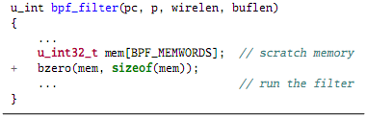
Vulnerabilities in interpreters
Information leak
Figure 5： OpenBSD BPF filters loading from uninitialized scratch memory (mem array) could leak sensitive information from the kernel stack. The patch initializes it with bzero.
Notes:
嵌入式解释器可能无意识的将其输入或执行环境暴露给字节码，从而使攻击者可以提取信息和观察执行结果。这种情况通常发生于提供了寄存器、暂存或者栈用于执行字节码的解释器。若这些存储区域未能被解释器正确初始化，那么攻击者就可以获得里面存储的有关系统或其他用户的敏感信息

Slide 10
Vulnerabilities in interpreters
Arbitrary code execution
Enabling external calls breaks the isolation between the interpreter and the host system, and can lead to arbitrary code execution in the host system if not carefully designed.
Unless both the bytecode and the input come from trusted sources, the embedded interpreter should have a clear plan for isolating the execution of the bytecode.
Notes:
外部调用会破坏解释器和主系统之间的隔离，可能导致系统中执行攻击性代码。若不能保证字节码及其输入都是可信的，解释器应该确保字节码与系统隔离，以防止攻击代码对系统的危害。

Slide 11

Vulnerabilities in interpreters
Memory corruption
Figure 6： Incorrect bounds check, which a large k can bypass
since it overflows k + sizeof(int32_t) to a smaller value. A correct
check is k > buflen || sizeof(int32_t) > buflen – k.
Notes:
由于许多嵌入式内存器的编写语言并不安全，可能存在程序错误导致内存污染。例如忽略了字符串操作的边界检查而造成的栈的不当处理。

Slide 12
Vulnerabilities in interpreters
JIT spraying
JITted bytecode introduces a new attack vector called JIT spraying, in which attackers encode shell code as constants in benign-looking bytecode.
These constants can be strung together to form code gadgets that facilitate return-oriented programming.
For example, when specially constructed BPF bytecode is compiled and loaded into the kernel, attackers can trigger another memory corruption vulnerability, and jump into the middle of the JIT-compiled code, where the attacker-controlled constants are interpreted as native machine instructions.
Notes:
由 JIT 生成的代码会引起一种新的攻击方式——JIT 喷射，即攻击者将shell 代码编码为常量写在外表良好的字节码中，这些常量会造成 ROP攻击。例如当特殊构建的BPF字节码编译加载到内核时，攻击者可以触发内存污染并跳转到被JIT 编译的代码中，其中存在已经编译为机器指令的攻击者可以控制的常量。JIT 喷射的产生原因有两个：一是 JIT 编译的字节码通常驻留在可以同时写入和执行的页中，导致现有的保护技术失效；二是JIT 工具更可能编译来源不可信的字节码。

Slide 13
Security guidelines
Process isolation
Limiting resource consumption
Limiting feature sets
Limiting calls to host
Notes:
(1)进程隔离有一定局限性，由于IPC花费增多使性能下降，不适用于注重性能的应用；二是不能避免语义错误；三是很难应用于OS内核中（2）解释器应确保字节码的执行不会耗尽系统资源，尤其对提供跳转和子程序的解释器，应该监控并限制运行时间和内存使用以避免无限循环（3）字节码的表现能力越强，相应的解释器的实现就
会包含越多的不变量，于是给攻击载体提供了空间，应注重灵活和安全的平衡（4）字节码程序与外部联系或处理主机发来的输入时，解释器应该定义在它们之间定义一个明确的接口，例如BPF的输入是一个包而输出时一个表明该包是否被过滤的位。

Slide 14
Conclusion
A case study of how systems use embedded interpreters in practice
Analyzed security bugs found in embedded interpreters and classified their effects
Summarized state-of-the-art defense techniques and provided security guidelines
Notes:
研究了各种系统中对嵌入式解释器的实际应用；分析了嵌入式解释器存在的各种错误以及他们对系统的影响；
在对嵌入式解释器及其错误研究的基础上，总结了目前最先进的防御技术并提出了保证的安全性的方针。解释器开发人员可以通过借鉴此文的研究结果，了解各种可能出现的错误，并结合作者提出的安全性建议构建解释器安全策略，从而设计更安全的新型解释器。

Slide 15
Thanks!

