Slide 1
Spanner: Google’s
Globally-Distributed Database
James C. Corbett, Jeffrey Dean, Michael Epstein, Andrew Fikes, Christopher Frost, JJ Furman, Sanjay Ghemawat, Andrey Gubarev, Christopher Heiser, Peter Hochschild, Wilson Hsieh, Sebastian Kanthak, Eugene Kogan, Hongyi Li, Alexander Lloyd, Sergey Melnik, David Mwaura, David Nagle, Sean Quinlan, Rajesh Rao, Lindsay Rolig, Yasushi Saito, Michal Szymaniak, Christopher Taylor, Ruth Wang, Dale Woodford
Google, Inc.
Figures taken from paper and Alex Lloyd’s presentation at Berlinbuzzwords-2012

Slide 2
Agenda
Outline and Key Features
System Architecture
Software Stack
Data Model
TrueTime
Evaluation
Case Study

Slide 3
Outline
Next step from Bigtable in RDBMS path with strong time semantics
Key Features:
  Temporal Multi-version database
  Externally consistent global write-transactions with synchronous replication.
  Transactions across Datacenters.
  Lock-free read-only transactions.
  Schematized, semi-relational (tabular) data model.
  SQL-like query interface.

Slide 4
Key Features cont.
  Auto-sharding, auto-rebalancing, automatic failure response.
  Exposes control of data replication and placement to user/application.
  Enables transaction serialization via global timestamps
  Acknowledges clock uncertainty and guarantees a bound on it
  Uses novel TrueTime API to accomplish concurrency control
  Uses GPS devices and Atomic clocks to get accurate time

Slide 5
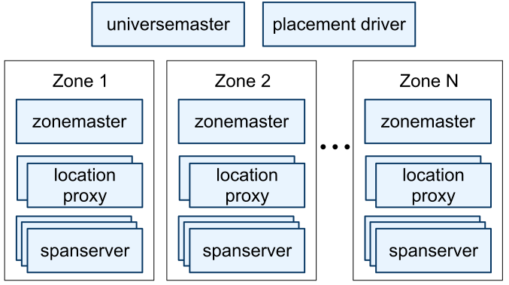
System Architecture

Slide 6
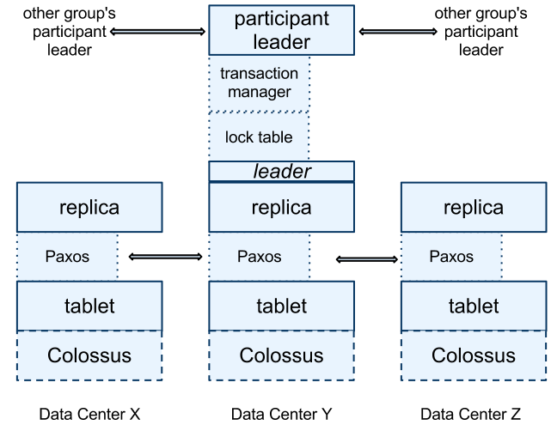
Software Stack

Slide 7
Software Stack cont.
(key:string, timestamp:int64) → string
Back End: Colossus (successor to GFS)
Paxos State Machine on top of each tablet stores meta data and logs of the tablet.
Leader among replicas in a Paxos group is chosen and all write requests for replicas in that group initiate at leader.
Transaction Leader
  Is Paxos Leader if transaction involves one Paxos group

Slide 8
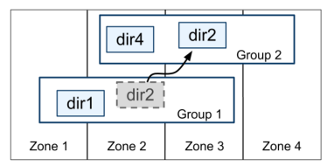
Software Stack cont.
Directory – analogous to bucket in BigTable
  Smallest unit of data placement
  Smallest unit to define replication properties
Directory might in turn be sharded into Fragments if it grows too large.

Slide 9
Datamodel
One or more databases supported in Spanner Universe
Database can contain unlimited schematized tables
Not purely relational
  Requires rows to have names
  Names are nothing but a set(can be singleton) of primary keys
  In a way, it’s a key value store with primary keys mapped to non-key columns as values

Slide 10
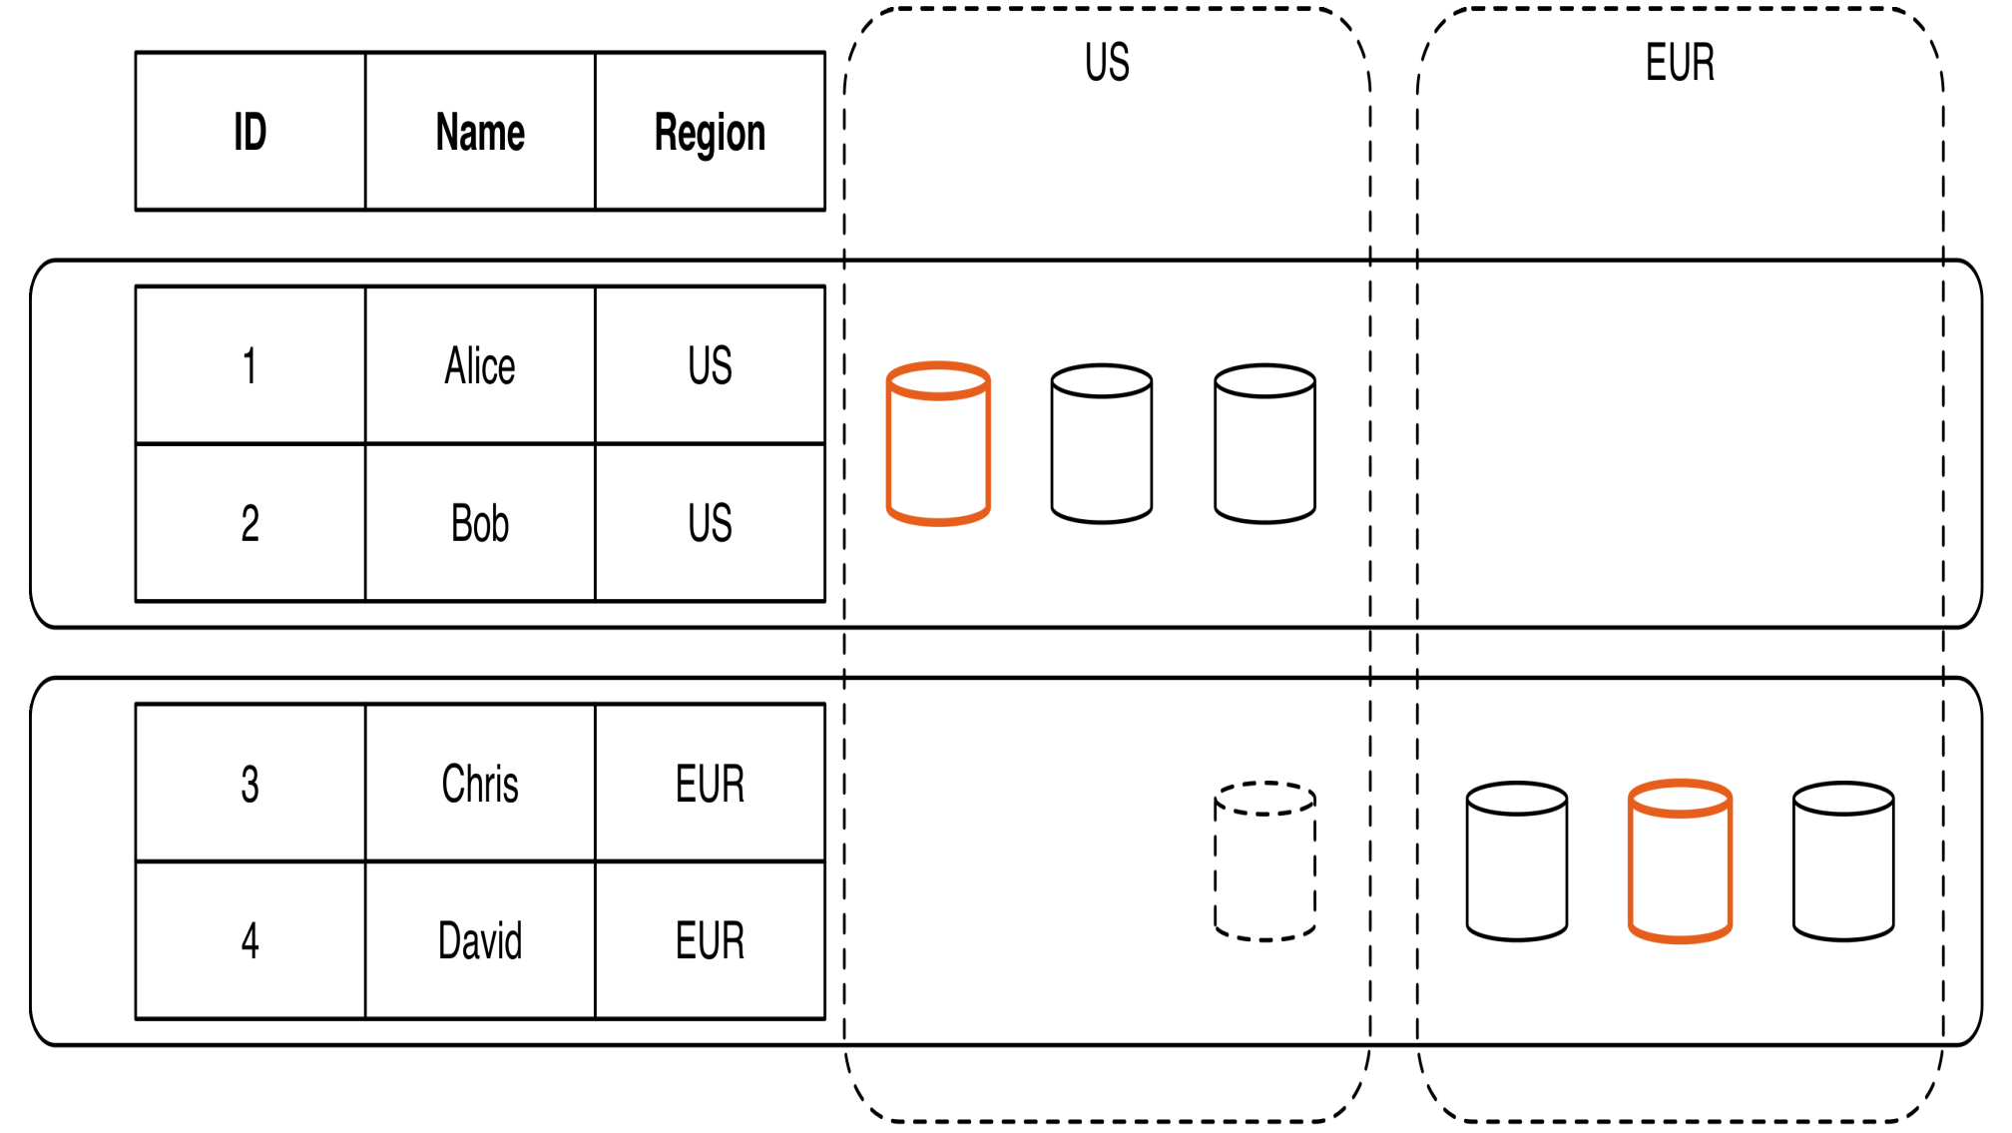
Datamodel

Slide 11
TrueTime
Novel API behind Spanner’s core innovation
Leverages hardware features like GPS and Atomic Clocks
Implemented via TrueTime API.
  Key method being now() which not only returns current system time but also another value (ε) which tells the maximum uncertainty in the time returned
Set of time master server per datacenters and time slave daemon per machines.
Majority of time masters are GPS fitted and few others are atomic clock fitted (Armageddon masters).
Daemon polls variety of masters and reaches a consensus about correct timestamp.

Slide 12
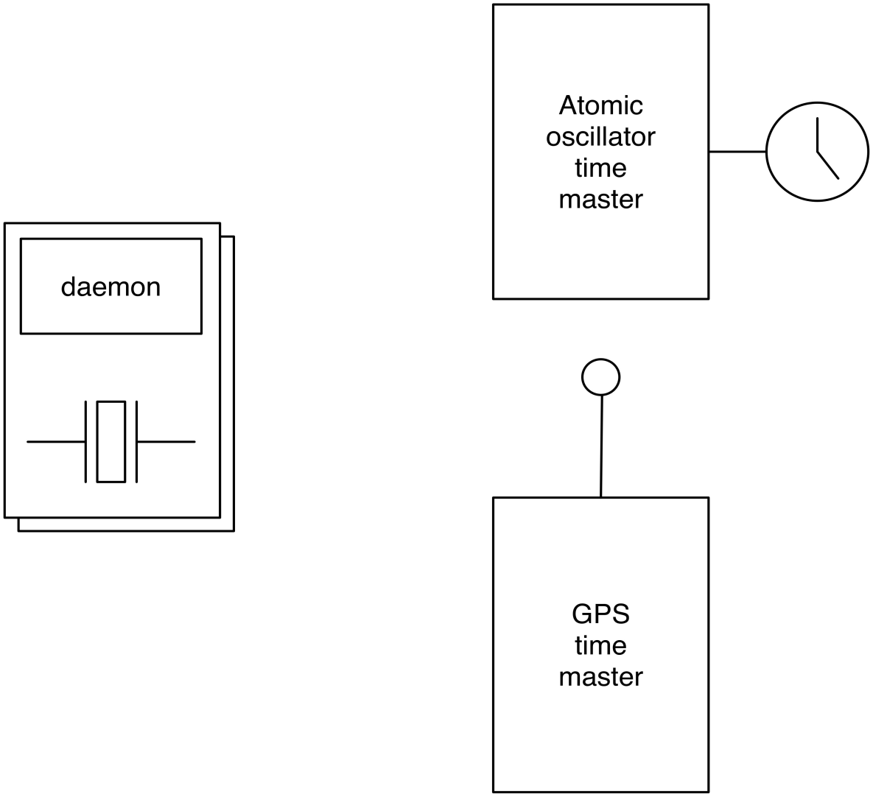
TrueTime

Slide 13
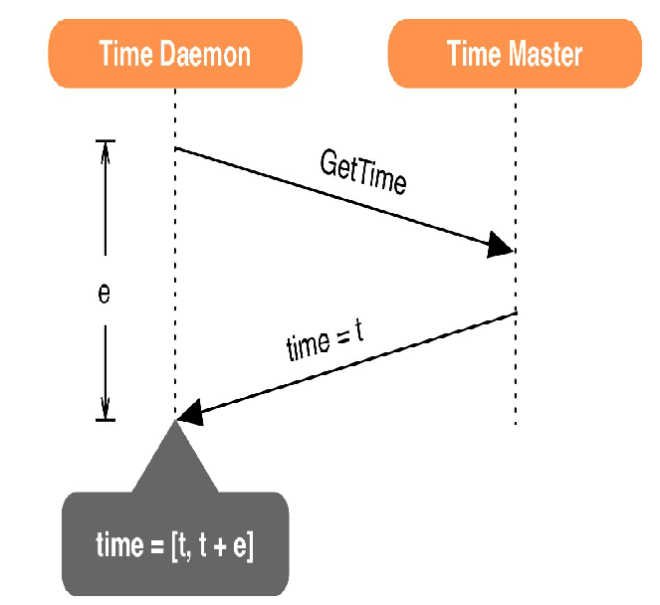
TrueTime

Slide 14
TrueTime Cont.
TrueTime uses both GPS and Atomic clocks since they are different failure rates and scenarios.
Two other boolean methods in API are
  After(t) – returns TRUE if t is definitely passed
  Before(t) – returns TRUE if t is definitely not arrived
TrueTime uses these methods in concurrency control and t serialize transactions.

Slide 15
TrueTime Cont.
After() is used for Paxos Leader Leases
  Uses after(S_{max}) to check if S_{max} is passed so that Paxos Leader can abdicate its slaves.
Paxos Leaders can not assign timestamps(S_{i}) greater than S_{max} for transactions(T_{i}) and clients can not see the data commited by transaction T_{i} till after(S_{i}) is true.
  After(t) – returns TRUE if t is definitely passed
  Before(t) – returns TRUE if t is definitely not arrived
Replicas maintain a timestamp t_{safe} which is the maximum timestamp at which that replica is up to date.

Slide 16
TrueTime Transactions
Read-Write – requires lock.
Read-Only – lock free.
  Requires declaration before start of transaction.
  Reads information that is up to date
Snapshot Read – Read information from past by specifying a timestamp or bound
  Use specifies specific timestamp from past or timestamp bound so that data till that point will be read.

Slide 17
Evaluation
Evaluated for replication, transactions and availability.
Results on epsilon of TrueTime
Benchmarked on Spanner System with
  50 Paxos groups
  250 Directories
  Clients(applicatons) and Zones are at a network distance of 1ms

Slide 18
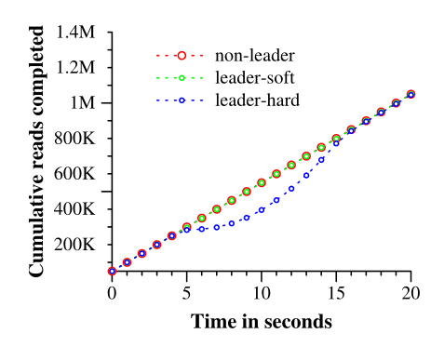
Evaluation - Availability

Slide 19
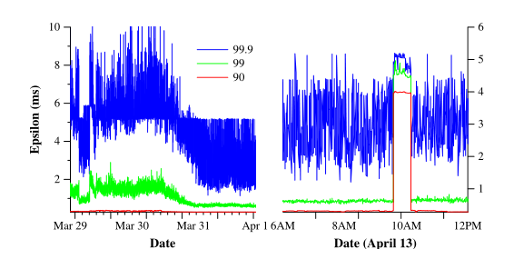
Evaluation - Epsilon

Slide 20
Case Study
Spanner is currently in production used by Google’s advertising backend F1.
F1 previously used MySQL since it requires strong transactional semantics which NoSQL database solution impractical.
Spanner provides synchronous replication and automatic failover for F1.

Slide 21
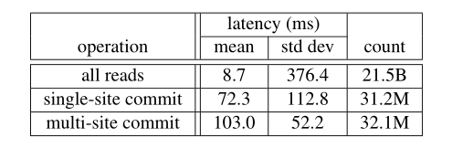
Case Study cont.
Enabled F1 to specify data placement via directories of spanner based on their needs.
F1 operation latencies measured over 24 hours

Slide 22
Thank You

