Slide 1
SUNDR:
Secure Untrusted Data Repository
Jinyuan Li N.Y.U.
Maxwell Krohn M.I.T.
David Mazières N.Y.U.
Dennis Shasha N.Y.U.
OSDI 2004

Slide 2



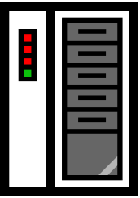
Motivation
File system integrity is critical
  sourceforge.net: 90,000+ projects, including kernel projects
Notes:
Say: sourceforget.net is a CVS like server. Clients collaborate with each to update and check file in the file server.
Sourceforge.net hosts many projects.

Slide 3
Goal
Prevent undetected tampering with your files!

Slide 4
Current approaches
Trust system administrator to do a good job
  Keep up with latest security patches
  Restrict accesses as much as possible
  …
Notes:
e.g. you might access files on NFS server. Just think about, if you want your files without tampering, you must trust your admin securing the server at all the time. For example (sub-bullet1, sub-butlet2) (Coz any intrusion would result in tampering, and users do not even get the change to detect it)

Slide 5

Not always reliable
Notes:
Transition: Unfortunately, because you can not always trust your system to be *secure*. Our main design constraint is not to trust servers in the first place.

Slide 6
SUNDR’s approach
SUNDR is a network f/s designed for running on untrusted, or even compromised server
Place trust in users authorized to modify particular files, not in server or admins maintaining server
SUNDR properties:
  Unauthorized operations will be immediately detected
  If server drops operations, can be caught eventually
Notes:
The system we designed is called SUNDR. SUNDR is a network file system…………….
XXX
High level: making server act as dummy data repository simplifies proof/arguments for its security property.
=======================
SUNDR properties

Slide 7
Talk Outline
Motivation
Design
  A strawman file system
  SUNDR design
Implementation
Evaluation
Notes:
Okay to get rid of outline

Slide 8
Ideal File system semantics
File system calls can be mapped to fetch/modify operations
  Fetch – client downloads new data
  Modify – client makes new change visible to others
“Fetch-modify” consistency: A fetch reflects exactly the modifications that happen before it
Impossible without online trusted parties
  Goal: Get as close to possible to “fetch-modify” consistency without online trusted parties
Notes:
Simple attacks by servers to return user bogus data is easy to fix by users signing their operations, however, there is no way for server to hide user’s operations to show users might
Somewhere to mention what kind of attack server can carry out?
Some operations in UNIX changes files, but do not use
Open/close, therefore close-to-open consistency is not sufficent.

Slide 9



Strawman File System
A: echo “A was here” >> /share/aaa
A
Modify f1
sig1
B
Fetch f4
sig2
A
Modify f2
sig3
userA
File server
sig1
A
Modify f1
sig1
B
Fetch f4
sig2
A
Modify f2
sig3
sig2
sig3
A
Modify f1
sig1
B
Fetch f4
sig2
userB
B: cat /share/aaa
A
Modify f1
sig1
B
Fetch f4
sig2
A
Modify f2
sig3
B
Fetch f2
sig4
Notes:
FETCH FETCH FETCH
Assumes all operations happen one at a time
Server keeps a log as well as Each user keeps a complete log of all fetch/modify operations by all users
To perform an operation, a user retrieves the server log first, do some checking and append the new operations and
Signing the entire log
Checking ensures that its local log is always a prefix of the newly fetched server log

Slide 10
An ordering relation
A’s latest log:
A
Modify f1
sig1
B
Fetch f4
sig2
A
Modify f2
sig3
LogA
We define ≤ relation:
LogA ≤ LogB iff LogA
is prefix of LogB
B’s latest log:
A
Modify f1
sig1
B
Fetch f4
sig2
A
Modify f2
sig3
B
Fetch f2
sig4
LogB

Slide 11
Detecting attacks by the server
A: echo “A was here” >> /share/aaa
A
Modify f1
sig1
B
Fetch f4
sig2
A
Modify f2
sig3
A
File server
A
Modify f1
sig1
B
Fetch f4
sig2
A
Modify f2
sig3
A
Modify f1
sig1
B
Fetch f4
sig2
B
B: cat /share/aaa
(stale result!)
A
Modify f1
sig1
B
Fetch f4
sig2
B
Fetch f2
sig3
Notes:
It is a per user log approach.

Slide 12
Detecting attacks by the server
A’s latest log:
A
Modify f1
sig1
B
Fetch f4
sig2
A
Modify f2
sig3a
LogA
sig1
sig2
A’s log and B’s log can
no longer be ordered:
LogA ≤ LogB, LogB ≤ LogA
sig3a
B’s latest log:
A
Modify f1
sig1
B
Fetch f4
sig2
B
Fetch f2
sig3b
LogB

Slide 13
Properties of Strawman FS
High overhead, no concurrency
A bad server can’t make up operations users didn’t perform
A bad server can conceal users’ operations from each other, however, it will be detected if users check with each other.
  Call this property “fork consistency”
Notes:
Strawman is impractical, expensive and no support for concurrent operations
Coz there is no way to let each user to “forget” its previous operations in log No support for concurrent operations

Slide 14
Fork Consistency: A tale of two worlds
A’s view
File Server
B’s view
…
…
Notes:
RE

Slide 15
Implications of fork consistency
Closest possible consistency to “fetch-modify” without online trusted parties
Can be leveraged with online trusted parties to detect violations of “fetch-modify” consistency
  users periodically gossip to check violations
  or deploy a trusted online “timestamp” box

Slide 16
Talk Outline
Motivation
Design
  Strawman FS
  SUNDR approach
Implementation
Evaluation

Slide 17
SUNDR architecture
SUNDR server-side
userA
SUNDR
client
Untrusted
Network
block server
userB
consistency server
SUNDR
client
block server stores blocks retrievable by content-hash
consistency server orders all events
Notes:
Strawman is very simple, but impractical:
Here we are going to present the design of SUNDR, which achieve the same good properties of strawman without its unrealistic assumptions and its overhead.

Slide 18
SUNDR data structures (I)
Strawman FS problem:
  High bandwidth and storage consumption
  Need to reconstruct the whole file system
Each file is writable by one user or group
Partition inodes by allowed writer
  Hash each partition down to a 20-byte digest
Notes:
Basically, why do we care out this complication, MOTIVATE SUNDR’s design. Related back the strawman FS. Write it down.

Slide 19
Hash tree (1): File handle
Each file is hashed into a 20-byte value using a hash tree
Blocks are stored and indexed by their content-hash on the block server
data1
i-node
Metadata
data2
20-byte File Handle
H(data1)
data3
H(data2)
iblk1
H(iblk1)
H(data3)
data4
H(data4)
Notes:
Ellude the existance of block server. Emphasize on each user has its own EXCLUSIVE fs map.
Add legend: arrow means SHA1-hash

Slide 20
Hash tree (2): FS digest
Hash all files writable by each user/group to a 20-byte digest
From this digest, client can retrieve and verify any block of any file (SFSRO, CFS, Pond …)
i-table
i-node 2
i-num
2
20-byte
20-byte digest
3
20-byte
4
20-byte
i-node 3
i-node 4
Notes:
Ellude the existance of block server. Emphasize on each user has its own EXCLUSIVE fs map.

Slide 21
SUNDR FS
Lookup “/”
2
20-byte
Lookup “/share”
digest
3
20-byte
Superuser:
4
20-byte
SUNDR State
2
20-byte
Fetch “/share/aaa”
digest
3
20-byte
UserA:
4
20-byte
digest
How to fetch “/share/aaa”?
UserB:
…
2
/:
Dir entry: (share, Superuser, 3)
digest
3
GroupG:
4
/share:
Dir entry: (aaa, UserA, 4)

Slide 22
SUNDR data structure (II)
Want server to order users’ fetch/modify operations
Goal: Expose server’s failure to order operations properly
Sign version vector along with digest
Version vectors will expose ordering failures

Slide 23
Version structure
A
A - 1
B - 1
G - 1
B
A - 1
B - 2
G - 2
VST_{A}
≤
VST_{B}
Digest A
Digest B
Signature A
Signature B
Each user has its own version structure (VST)
Consistency server keeps latest VSTs of all users
Clients fetch all other users’ VSTs from server before each operation and cache them
We order VST_{A} ≤ VST_{B} iff all the version numbers in VSTA are less than or equal in VSTB
Notes:
Therefore in order to make comparison, we don’t need to ship the whole log to save bandwidth

Slide 24
Updating VST: An example
Consistency
Server
A
A-0
B-0
A
DigA
B
A-0
B-1
DigB
A
A-1
B-1
A: echo “A was here”
>> /share/aaa
DigA
A
A-1
B-1
B
B
A-0
B-1
DigA
DigB
A
A-1
B-1
DigA
VSTA ≤ VSTB
B
A-1
B-2
B: cat /share/aaa
DigB
B
A-1
B-2
DigB
Notes:
All red blocks signed by A
All blue blocks signed by B

Slide 25
Detecting attacks
A
Consistency Server
A
A-0
B-0
DigA
B
A-0
B-1
DigA
A
A-1
B-1
A: echo “A was here”
>> /share/aaa
B
DigA
A
A-1
B-1
B
A-0
B-1
DigA
DigB
A
A-0
B-0
≤
DigA
A’s latest VST and B’s can
no longer be ordered:
VSTA ≤ VSTB, VSTB ≤ VSTA
B
A-0
B-2
B: cat /share/aaa (stale!)
DigB
B
A-0
B-2
DigB

Slide 26
Supporting concurrent operations
Two clients may issue operations concurrently
How does second client know what vector to sign?
  If operations don’t conflict, can just include first user’s forthcoming version number in VST
  But how do you know if concurrent operations conflict?
Solution: Pre-declare operations in signed updates
  Server returns latest VSTs and all pending updates, thereby ordering them before current operation
  User computes new VST including pending updates
  User signs and commits new VST
Notes:
Why this is a problem in SUNDR? In SUNDR, both fetch and modify operations will cause a user to increment its own version number. However if both users increment their numbers concurrently. The resulting VST can no longer ordered, even if the server didn’t do anything wrong, so we need to solve this problem. The second are operations that do cause conflicts

Slide 27
Concurrent update of VSTs
A
Consistency Server
A
A-0
B-0
B
DigA
update: A-1
B
A-0
B-1
DigB
update: B-2
B
A-0
B-1
A-1
DigB
A
A-1
B-1
A: echo “A was here”
>>/share/aaa
DigA
A
A-0
B-0
A-1
A
A-1
B-1
DigA
A-1
B-2
DigA
A-1
B: cat /share/bbb
B
A-1
B-2
VSTA ≤ VSTB
DigB
B
A-1
B-2
A-1
B-2
DigB
A-1
B-2
Notes:
H

Slide 28
Talk Outline
Motivation
Design
  Straw-man FS
  SUNDR approach
Implementation
Evaluation
Notes:
At this stage, you might wonder SUNDR is quite expensive, coz for each opeation, there is a lot of cryptographic signing and verifying of data structre, and for each data block,

Slide 29
SUNDR Implementation
Client Machine Domain
SUNDR server-side setup
SUNDR
client daemon
FS operations
User
block server
Kernel
VFS
xfs.ko redirector
consistency server

Slide 30
Block server implementation
bstore
Index System
Stripe 1
Stripe 2
Stripe 3
SCSI
Permanent Log
Temporary Log
EIDE
(cf. Venti)

Slide 31
Evaluation
Running on FreeBSD 4.9
  PentiumIV 3G, 3G RAM, LAN
Two configurations:
  SUNDR : write updates to disk synchronously
  SUNDR/NVRAM : simulates effects of NVRAM
Block server benchmark
  STORE: 18.4MB/s (peak), 11.9MB/s (sustained)
  FETCH: 1.2MB/s (random), 25.5MB/s (sequential)
Esign cryptographic overhead
  Sign: 155us
  Verify: 100us
Notes:
One might not expect perf to be very bad. Expection low!

Slide 32
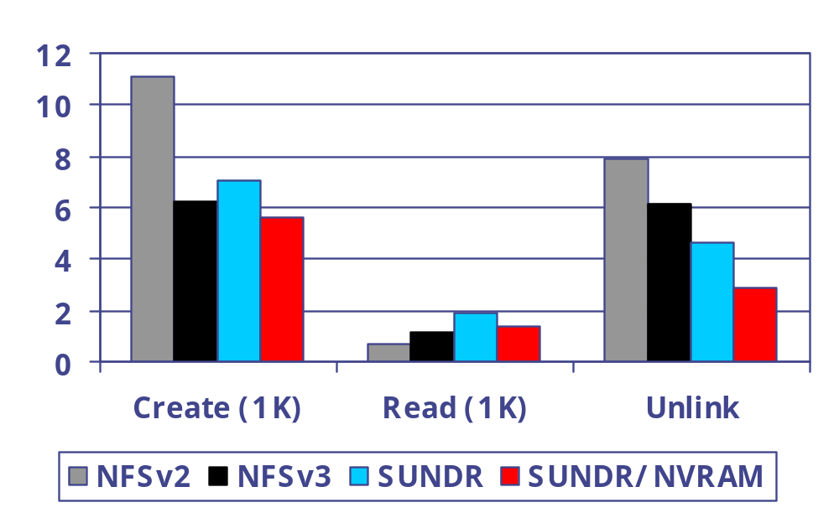
LFS small file benchmark
Seconds

Slide 33
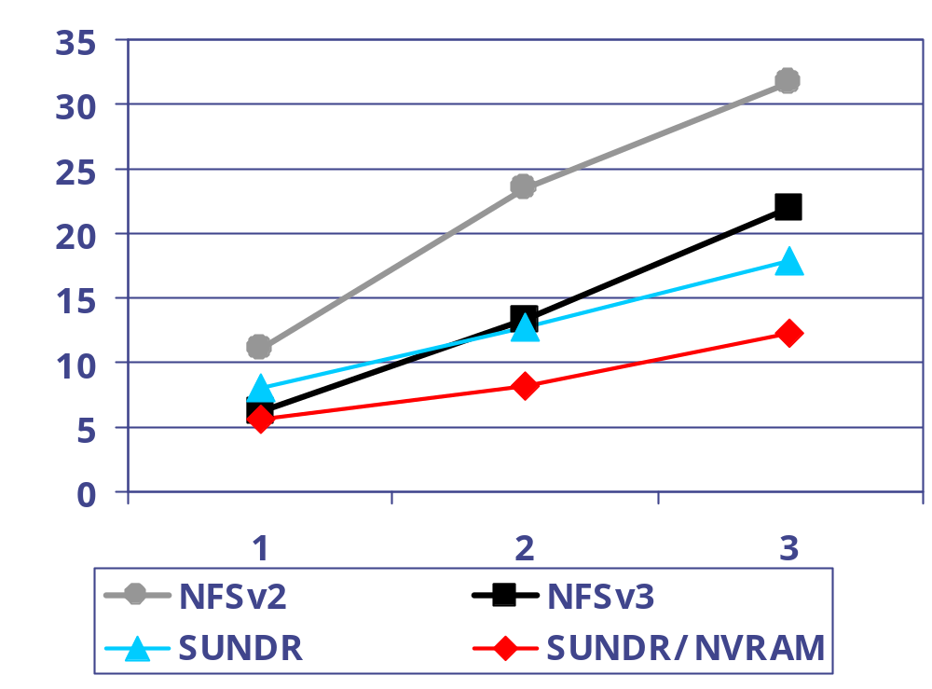
LFS multiple clients CREATE
Seconds
Number of users

Slide 34
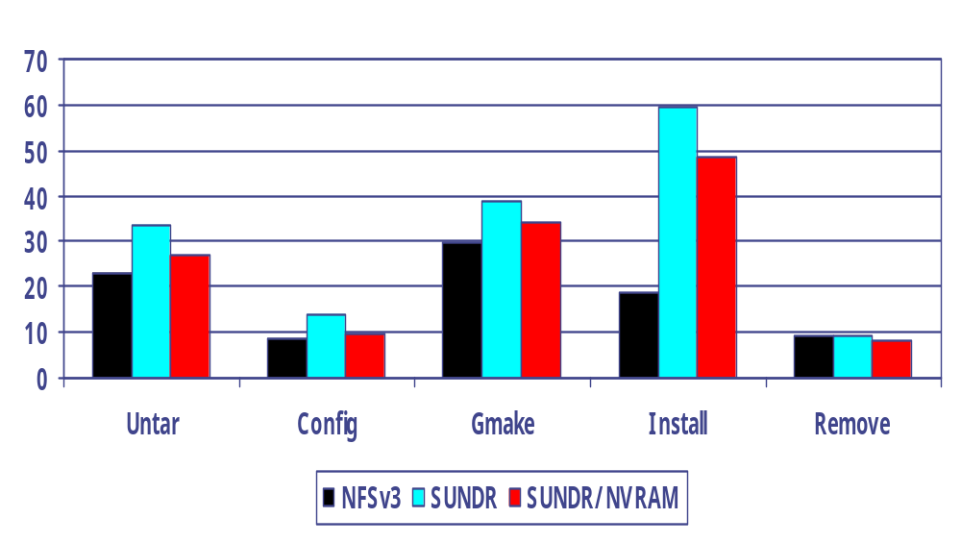
Emacs installation performance
Seconds

Slide 35
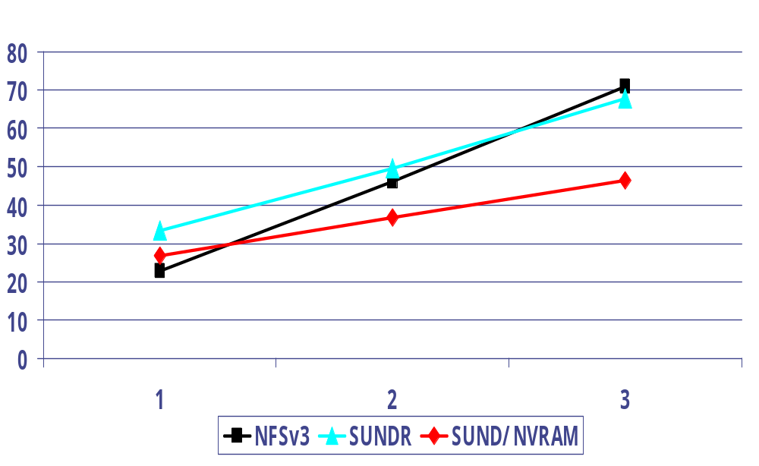
Emacs multiple clients untar
Seconds
Number of users

Slide 36
Conclusion
SUNDR provides file system integrity with untrusted servers
  Users detect unauthorized operations immediately
  Users can detect consistency violations eventually
Yes, SUNDR is a practical file system
  performance is close to NFS

Slide 37
A working example (3)
Server
/share
A-1
B-1
A
A – 2
(fa, A, 2)
A-1
B-1
B
B – 2
(fb, B, 5)
A – 2
(fa, A, 2)
A-2
B-1
A – 2
(fa, A, 2)
B – 2
(fb, B, 5)
A-2
B-1
/share/fa
A-2
B-2
A-2
B-2
/share/fa
/share/fb

