Slide 1

Autonomous Driving Safety Analyst
Technical RAG assistant for ISO 26262, ISO 21448 (SOTIF), ISO 8800, NCAP/IIHS, Hazard and Risk Analysis (HARA), AI safety evidence, scenario analysis, item safety cases, and video-grounded evidence review.
OpenAI premium path
Local Qwen baseline
LoRA fine-tuning experiment
Standards + video RAG
Whisper STT + optional TTS
Evaluation
Harn Zhin Chong

Slide 2
HOOK + OVERVIEW
02
Why this is more than a chatbot
Problem
Solution
Portfolio value
• Creating and reviewing safety-case work products across multiple standards is time-consuming, repetitive, and easy to make inconsistent across functions.
Autonomous-driving safety work spans multiple standards and evidence sources.
Overlapped safety standards (core behavior safety standards):
ISO 26262,
ISO 21448 (SOTIF) ,
ISO 8800
• A Streamlit safety analyst grounded in project evidence.
• RAG over standards, examples, HARA profiles, dataset notes, and video transcripts.
• Three model paths: OpenAI (GPT-4o), local Qwen, and Qwen LoRA experiment.
• RAG architecture and prompt conditioning.
• Local/private model integration.
• Fine-tuning workflow in Colab.
• Evaluation with rubric, plots, saved answers, and hallucination checks.

Slide 3
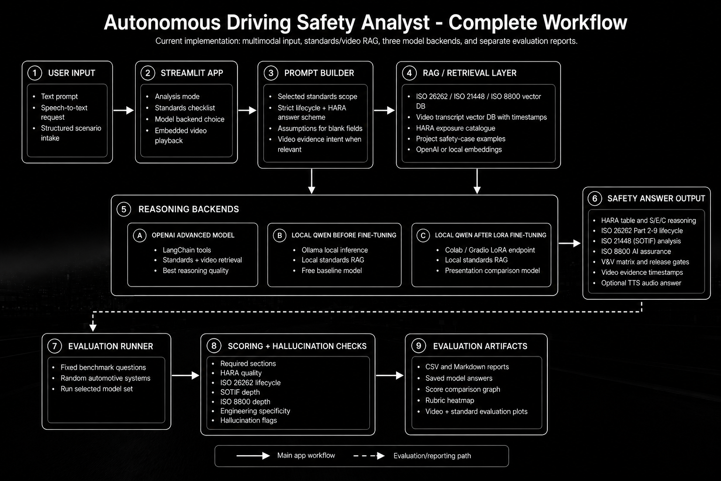
TECHNICAL SUMMARY
03
End-to-end project workflow

Slide 4
DATASET
04
Sources, preprocessing, chunking, and vector storage
Source | Processing | Storage / Use
ISO Standards (ISO 26262. ISO 21448 (SOTIF) and ISO 8800) + Synthetic evaluation schemes | Markdown/PDF parsing, chunking, metadata tagging | Chroma standards DB for ISO 26262, ISO 21448, ISO 8800
Safety-case examples (Synthetic safety-case examples) | Curated worked examples for AEB, lane keeping, LiDAR perception | Retrieved as project-specific evidence
HARA + dataset profiles (nuScene dataset from Kaggle) | Structured risk/evidence snippets | Used for S/E/C rationale and ISO 8800 data risks
YouTube video transcripts (84 videos) | Transcript ingestion with timestamps | Video DB for evidence snippets and playback timestamps
python ingest_all.py # builds standards DB and video transcript DB Chroma metadata: source, standard, section, video_id, timestamp
• Paid path can combine standards + video evidence.
• Local path can use local standards embeddings to reduce embedding cost.
• Each answer states assumptions and evidence limits.

Slide 5
Q&A AGENT
05
Prompt builder and answer contract
Prompt conditioning
LOCAL_STRICT_ANSWER_SCHEME = """ 1. Opening Map 2. Item Definition 3. Functional Decomposition 4. HARA Screening ... 12. Final Safety Argument """
• Scopes the answer to selected standards.
• Injects a strict lifecycle and HARA answer scheme.
• Handles blank structured fields by stating assumptions.
• Adds video-evidence intent when the question asks for evidence or failure analysis.
Why this matters
• Safety answers must be complete, not conversational summaries.
• The schema makes model comparison possible.
• The evaluator can check required sections and standards coverage.

Slide 6
TOOLS
06
RAG, audio, video, local model serving, and evaluation
Tool / component | Purpose
Chroma vector DB | Stores standards chunks, examples, HARA evidence, and video transcript chunks
OpenAI tools agent | Premium reasoning path with tool calls and review pass
Ollama | Runs local Qwen baseline before fine-tuning
Google Colab + Gradio | Serves the Qwen LoRA adapter endpoint
Whisper STT | Speech request input through uploaded/recorded audio
OpenAI TTS | Optional audio answer output
Evaluation scripts | Generate reports, saved answers, score plots, and rubric heatmaps

Slide 7
REASONING BACKENDS
07
Why the app supports three model paths
Backend | Strength | Trade-off | Best use
OpenAI | Best reasoning, tools, video + standards retrieval | Paid API cost | Final/premium analysis
Local Qwen base | Free/private path, strong with RAG + answer schema | Slower; no hosted API by default | Cost-sensitive use
Qwen LoRA | Shows fine-tuning workflow and adapter learning | Colab endpoint/Out of Memory (OOM) risk; small SFT data | Portfolio experiment
Key lesson
if model_key == "openai": run_agent_tools() if model_key == "local_base": run_ollama_rag() if model_key == "local_lora": call_gradio_lora()
• Fine-tuning is not automatically better than RAG.
• Local Qwen base performs strongly when prompt + retrieval + guardrails are disciplined.

Slide 8
LOCAL MODEL + FINE-TUNING
08
What was built and what the experiment showed
Training and serving path
Current conclusion
• Generated synthetic Safety Functional Triggering (SFT) examples from project safety-case patterns.
• Trained a Qwen LoRA adapter in Google Colab.
• Served adapter through Gradio and connected it through LOCAL_LORA_API_URL.
• Added invalid-output detection for numeric/debug-style degeneration.
• The LoRA path proves the fine-tuning workflow, but current evaluation shows it is not production-quality.
• The local Qwen base remains the stronger free/local answer path.
• Future work should use larger curated data and stable GPU hosting before claiming improvement.

Slide 9
SAFETY ANSWER OUTPUT
09
What a good answer must contain
Section | Expected content
Opening map / item definition | System boundary, ODD, interfaces, assumptions
Functional decomposition + HARA | Function-level hazards, S/E/C rationale, ASIL/QM outcome
ISO 26262 lifecycle | Safety goals, FSC/TSC, Parts 2-9 evidence
ISO 21448 (SOTIF) | Performance limits, triggering conditions, Operational Design Domain (ODD) gaps, residual risk
ISO 8800 assurance | Data gaps, robustness, uncertainty, OOD, release gates
V&V and final argument | Test matrix, production controls, worst case, safety argument

Slide 10
EVALUATION
10
Transparent scoring for standards answers
Rubric category | Max
Required sections | 20
HARA quality | 20
ISO 26262 lifecycle | 20
SOTIF depth | 15
ISO 8800 depth | 15
Engineering specificity | 10
Hallucination control | 10
How it runs
• Runs fixed benchmark questions from evaluation/test_questions.jsonl.
• Adds random automotive systems when requested.
• Saves every generated answer for manual inspection.
• Scores with deterministic 110-point rubric normalized to percent.
• Flags unsupported clause-like claims and missing evidence limits.
.venv/bin/python evaluation/evaluate_models.py \ --models openai local_base local_lora \ --limit 2 --random-cases 2 --seed 42

Slide 11
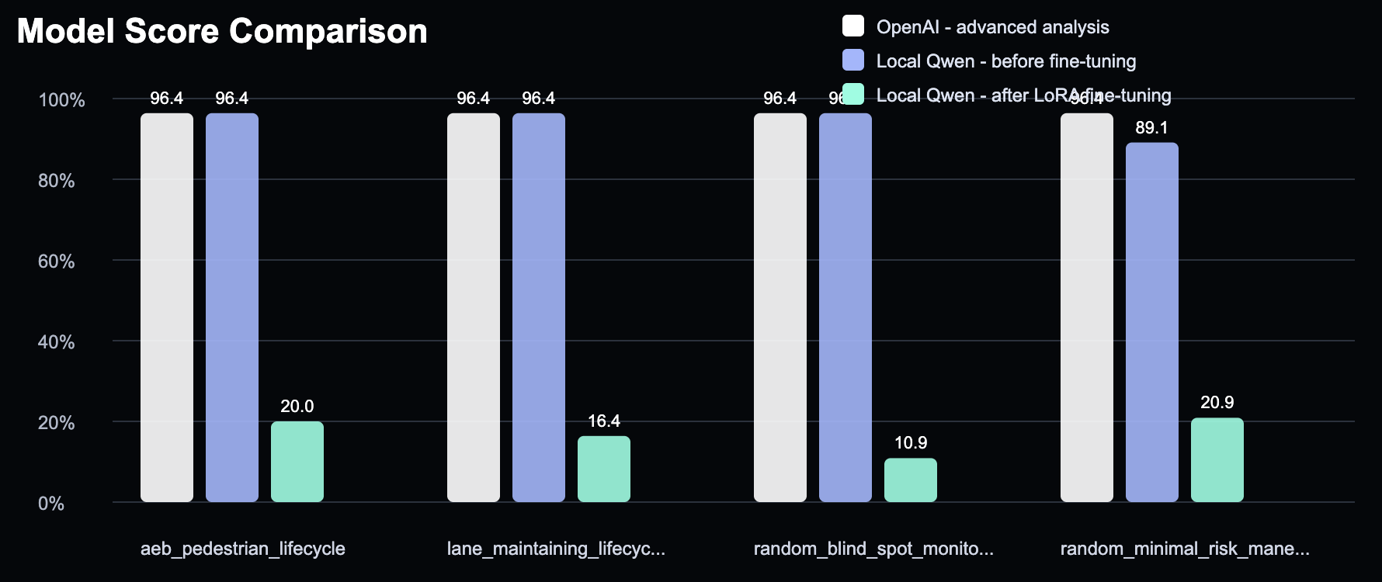
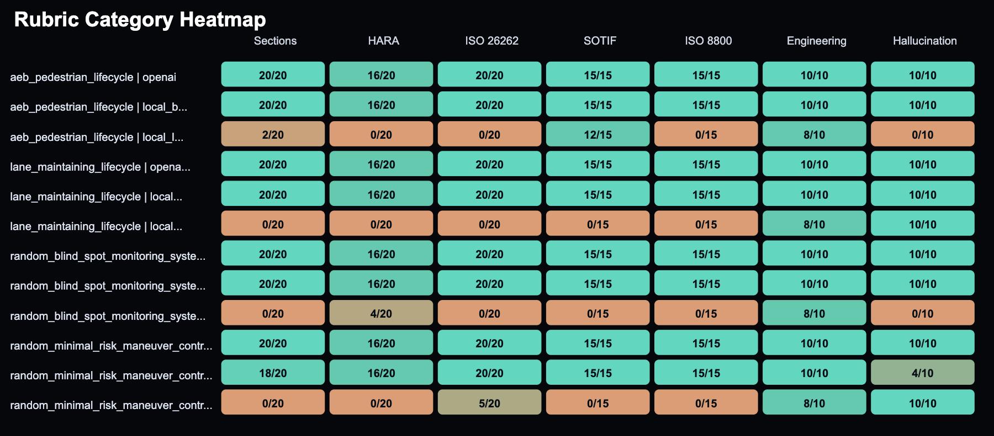
MODEL EVALUATION RESULTS
11
Latest standards-only benchmark
Average evaluation result for each model
Interpretation
OpenAI
96.4%
• OpenAI and local Qwen base both score strongly on the strict answer schema.
• LoRA results are kept honest: current endpoint/answer quality is not strong enough for final use.
• This is useful evidence that RAG + prompt discipline can outperform a small fine-tune.
Local Qwen base
94.6%
Qwen LoRA
17.1%
Artifacts: model_eval_20260528_094923.csv / .md, saved answers, score plot, rubric heatmap.

Slide 12
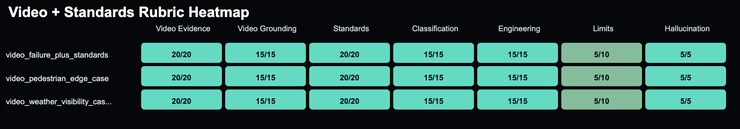
PAID FEATURE EVALUATION
12
Video evidence + standards reasoning
Why it matters
Failure + standards
95.0%
• This is the premium selling point: standards + real video transcript evidence.
• Answers include video timestamps, safety interpretation, engineering actions, and evidence limitations.
• Latest sample score: 95.0% average across three cases.
Pedestrian edge case
95.0%
Weather visibility
95.0%
.venv/bin/python evaluation/evaluate_video_standard.py
Outputs: video_standard_eval_20260528_110341.csv/.md, saved answers, video-standard score graph, heatmap.

Slide 13
13
Model Comparison Summary
Path
How it reasons
Strength
Current limitation
OpenAI
LangChain tool-calling agent over standards + video tools
Best quality, dynamic retrieval, paid feature path
Uses paid API and external service
Local Qwen Base
Pre-retrieved local standards context + strict prompt
Free/private path, strong with RAG guardrails
No direct tool loop, slower local generation
Qwen LoRA
Colab-served adapter + local RAG prompt context
Proves fine-tuning workflow
Only 30 synthetic examples; endpoint/GPU instability
Takeaway
• The strongest product story is OpenAI for premium standards+video evidence, local Qwen base for free/private standards reasoning, and LoRA as a future fine-tuning improvement path.

Slide 14
CONCLUSION + LIVE DEMO
14
Closing argument and demo script
Final message
• This is a standards-aware safety analysis workflow, not a generic chatbot.
• It demonstrates RAG, tool use, local model integration, LoRA experimentation, audio input/output, video evidence, and quantitative evaluation.
• The strongest engineering lesson: structured retrieval and evaluation matter as much as model choice.

Slide 15
ARCHITECTURE ANNEX
Architecture Annex

Slide 16
ARCHITECTURE ANNEX
End-to-End Architecture: User Request to Output
Live app path
1 User Request
• text prompt
• speech input
• scenario form
2 Streamlit App
• mode selector
• standards selector
• model selector
3 Prompt Builder
• scope standards
• strict answer scheme
• assumptions
4 RAG Context
• standards DB
• video transcript DB
• examples/profiles
5 Reasoning Backend
• OpenAI tools
• local Qwen
• LoRA endpoint
6 Structured Output
• safety case
• tables
• evidence
Evaluation is a separate reproducibility path, not part of every live answer
7 Evaluation Runner
• fixed benchmark cases
• random systems
• selected model list
8 Rubric + Checks
• required sections
• HARA quality
• ISO/SOTIF/ISO 8800 depth
• hallucination flags
9 Artifacts
• CSV report
• Markdown report
• saved answers
• graphs
Annex 1

Slide 17
ARCHITECTURE ANNEX
Shared Front-End + Prompt Conditioning
1 Input Channels
• typed request
• speech-to-text request
• structured scenario form
2 Streamlit State
• chat history
• selected standards
• backend selection
• voice output toggle
3 Scoped Prompt
• adds ISO scope
• preserves original question
• allows unknown fields
4 Answer Contract
• opening map
• functional decomposition
• HARA S/E/C
• lifecycle + V&V
• final safety argument
Why this matters
• prevents short chatbot summaries
• makes missing assumptions explicit
• creates a common answer shape for all models
Backend-neutral design
• OpenAI, Qwen base, and LoRA receive the same task intent
• model differences become easier to evaluate
Output hooks
• optional TTS
• video evidence cards
• timestamp playback
Annex 2

Slide 18
ARCHITECTURE ANNEX
1st Model:
OpenAI Path: LangChain Tool-Calling Agent
Annex 4

Slide 19
ARCHITECTURE ANNEX
OpenAI Path: LangChain Tool-Calling Agent
A Streamlit get_agent()
• cached with st.cache_resource
B ChatOpenAI
• temperature 0.1
• premium reasoning
C ChatPromptTemplate
• SYSTEM_PROMPT
• chat_history
• human input
• agent_scratchpad
D AgentExecutor
• max 6 iterations
• parsing recovery
E Final Answer
• structured safety output
• reviewed for lifecycle/HARA
11 LangChain Tools
• video evidence search
• failure-case video search
• ISO standards search
• specific standard search
• dataset profiles
• project safety examples
Standards Guidance Tools
• SOTIF guidance
• ISO 8800 guidance
• ISO 26262 guidance
• safety lifecycle guidance
• HARA guidance
Retrieval Engine
• MultiQueryRetriever expands query
• Chroma standards DB
• Chroma video DB
• dedupe + formatted evidence
Second-pass quality review
• checks HARA coverage
• checks ISO 26262 Parts 2-9
• rewrites only missing coverage
Annex 5

Slide 20
ARCHITECTURE ANNEX
2nd Model:
Local Qwen Base Path: Pre-Retrieval RAG
Annex 6

Slide 21
ARCHITECTURE ANNEX
Local Qwen Base Path: Pre-Retrieval RAG
1 User Question
• same scoped prompt
2 Local Retrieval Planner
• selects standards queries
• no tool-calling loop
3 Local Context Pack
• ISO evidence
• SOTIF / ISO 8800 guidance
• project examples
4 Ollama Qwen
• local inference
• free/private path
5 Completeness Guard
• same-model revision if sections missing
Why not direct LangChain tools?
• local model tool calls can be malformed
• pre-retrieval is more stable for demos
• keeps context deterministic
What it still uses
• local standards Chroma DB
• local embeddings for free model
• same answer schema as OpenAI
Result
• strong baseline performance
• private/local option
• no video DB in local answer path
Annex 7

Slide 22
ARCHITECTURE ANNEX
3rd Model:
Fine-Tuned LoRA Path: Experiment and Serving Flow
Annex 8

Slide 23
ARCHITECTURE ANNEX
Fine-Tuned LoRA Path: Experiment and Serving Flow
1 Synthetic SFT Data
• 30 teacher-generated examples
• from seed prompts + retrieved evidence
2 Colab Training
• Qwen LoRA adapter
• GPU training
3 Adapter Folder
• qwen_safety_lora
• saved to Drive/local
4 Gradio Endpoint
• temporary public URL
• LOCAL_LORA_API_URL
5 Streamlit Call
• gradio_client
• returns answer
Runtime safeguards
• invalid numeric/debug output detection
• large output token setting
• error message if endpoint unreachable
Experiment result
• pipeline works
• small synthetic data is not enough
• not production-quality yet
Presentation position
• show as fine-tuning experiment
• local Qwen base remains stronger free path
• future work: curated data + stable GPU
Annex 9

Slide 24
ARCHITECTURE ANNEX
Evaluation Architecture
Annex 10

Slide 25
ARCHITECTURE ANNEX
Evaluation Architecture: Standards + Video Evidence
1 Standards Evaluation
• evaluate_models.py
• OpenAI + local base + LoRA
• fixed + random systems
3 Answer Generation
• same app model functions
• saved Markdown answer per case
4 Rubric Scoring
• required sections
• HARA / lifecycle depth
• video evidence use
• hallucination control
5 Reports + Graphs
• CSV
• Markdown summary
• score bar charts
• rubric heatmaps
2 Video + Standards Evaluation
• evaluate_video_standard.py
• OpenAI paid path
• video transcript + ISO reasoning
Evaluation principle
• The evaluation path is separate from the live chat path so model quality can be compared with saved answers, reproducible prompts, and visible scoring criteria.
Annex 11

