Slide 1
Comparison of Text Feature Representations and Classification Models for Fake News Detection
Mohamed Omari & Harn Zhin Chong (Group 4)
Ironhack Bootcamp - AI Engineering
24.04.2026

Slide 2
Objective
Build a model to classify news as Real vs Fake.
Compare different text preprocessing, feature representations, and models.
Hypothesis
Advanced representations (e.g., Word2Vec, BERT embeddings) will outperform classical methods like BoW or TF-IDF.

Slide 3
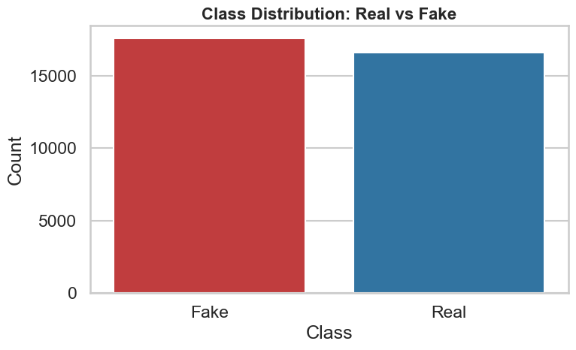
Data Overview
Number of headlines: 34152

Slide 4
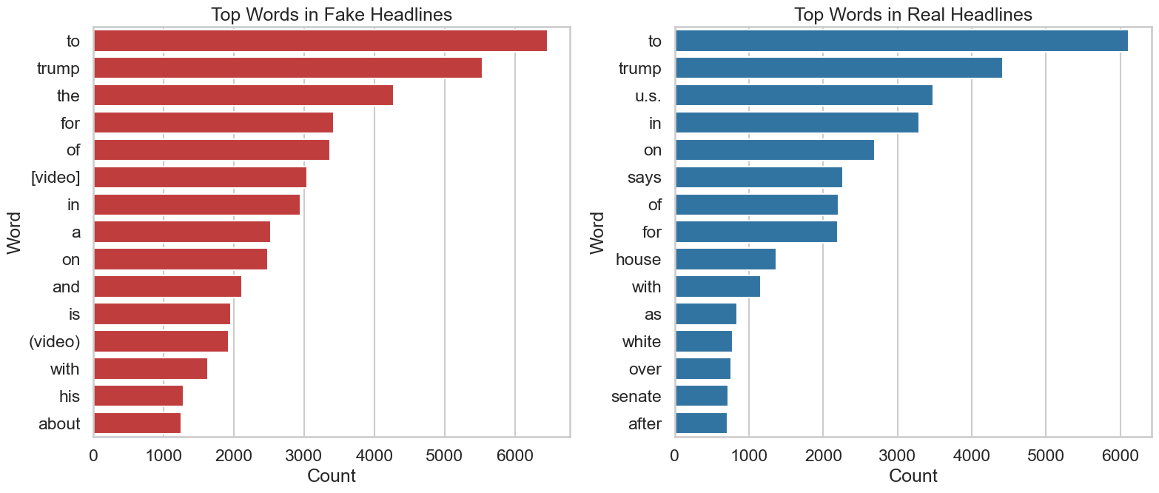
Data Overview
Fake and real headlines share many common top words (e.g. “to”, “Trump”).
The word “video” is mostly mentioned in the fake headlines.

Slide 5
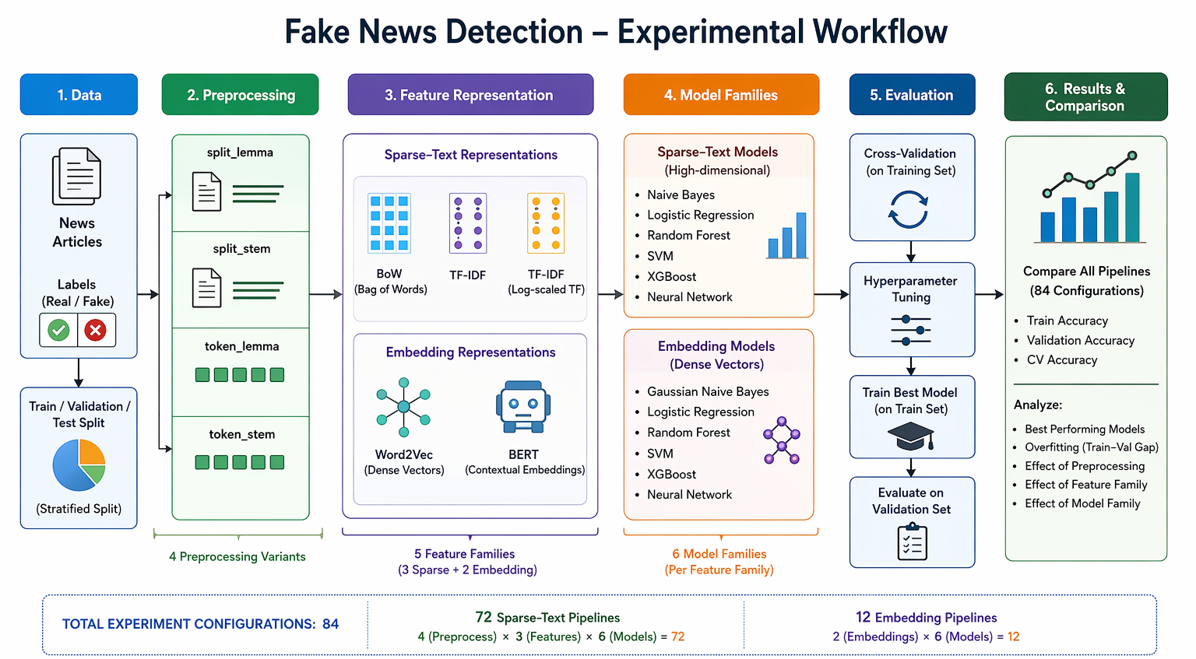

Slide 6
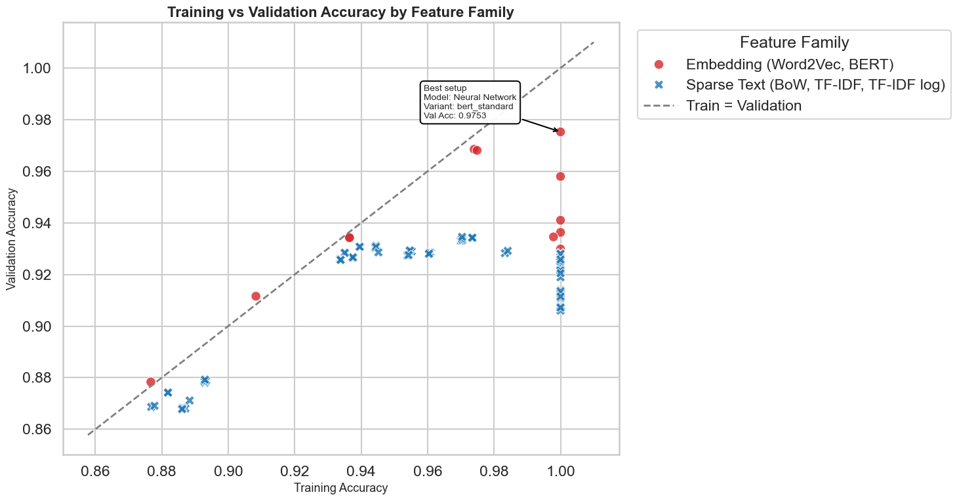
Training vs Validation by Feature Family
Embedding-based methods, especially BERT, achieved the highest validation accuracy and included the best overall setup.
Sparse-text methods were more tightly clustered, showing stable but generally lower performance than embeddings.

Slide 7
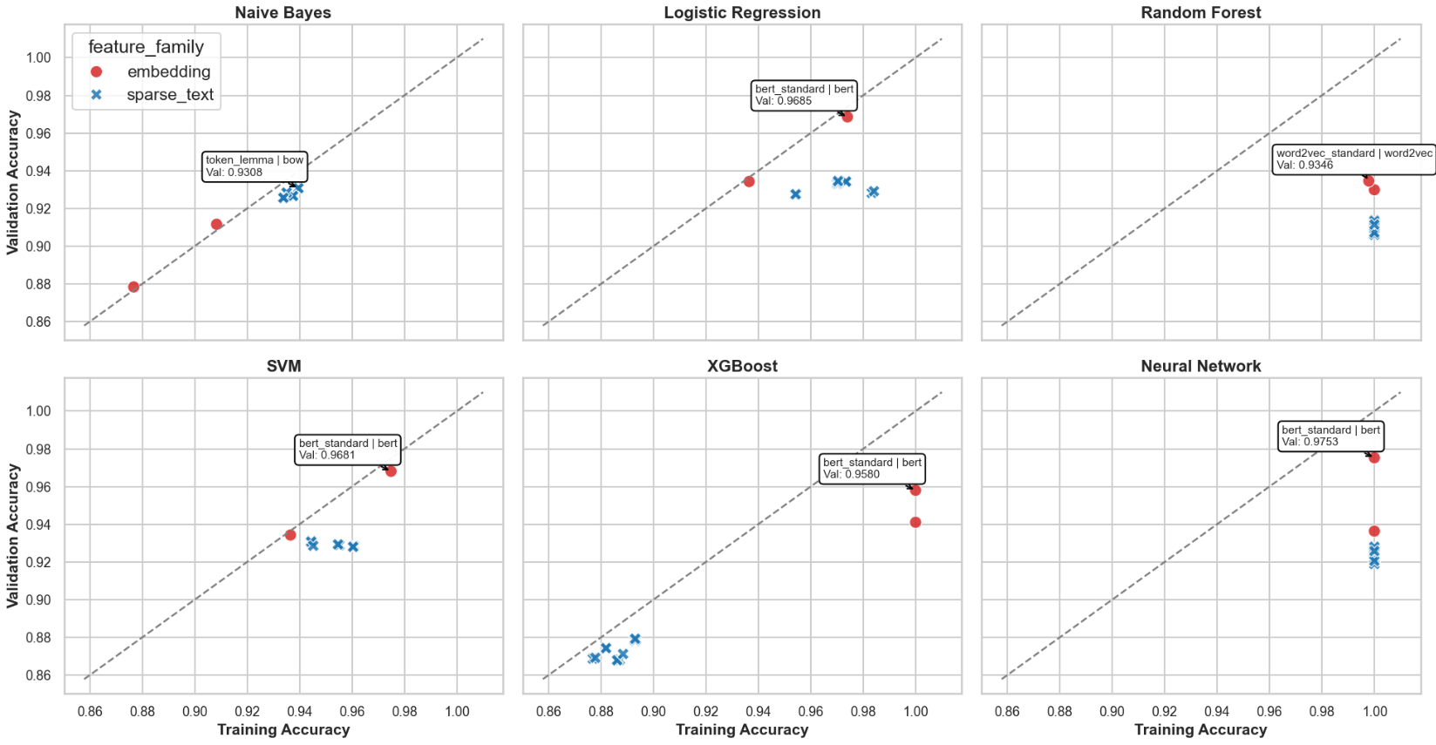
Training vs Validation: Feature and Model Families
Embeddings helped Neural Network and XGBoost the most.
Logistic Regression, SVM and Random Forest remained strong across both feature families.
Naive Bayes benefited less.

Slide 8
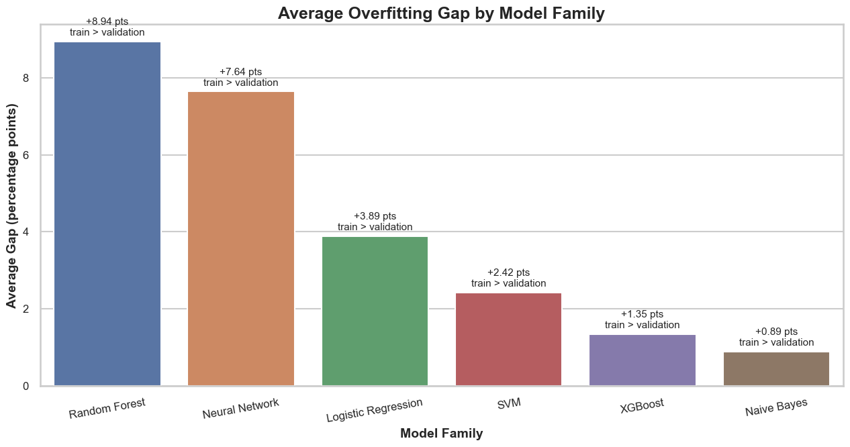

Slide 9
Recap:
Feature representation mattered more than preprocessing.
Sparse-text tweaks had little impact.
Embedding-based methods, especially “BERT”, can outperform classical sparse-text approaches when paired with suitable models such as Neural Networks.
Classical sparse-text pipelines, especially “TF-IDF + Logistic Regression”, remain strong and interpretable baselines.
Complex models tend to overfit more, while simpler models generalize better.
Challenges:
84 Pipelines meant long runtime.
Used Pipeline and RandomizedSearchCV.
Final choice:
It depends on accuracy vs interpretability:
Maximum performance → BERT + Neural Network
Simplicity & efficiency → TF-IDF + Logistic Regression

Slide 10
Thank you for the attention

Slide 11
