Slide 1
Sales prediction
G2
Harn
João
Pavithra

Slide 2
Executive summary
The goal of this project was to predict store sales using machine learning techniques.
We performed data cleaning, feature engineering and tested multiple regression models.
The best performing model was Gradient boosting with an R square of 94.72%.
We expect a similar performance on the real dataset, around 90%.
 | Group 2:
R2 validation | 92.72%
R2 Prediction | 90%
R2 score | 92.72%
R2 difference | 2%

Slide 3
Data & preprocessing
The dataset contains daily store information including customers, promotions, holidays and sales. We performed several processing steps:
Removed irrevelant columns. (unnamed)
Converted date into multiple features (year, month, day, day of week)
Handled categorical variables using one-hot encoding
Ensured all features were numerical.

Slide 4
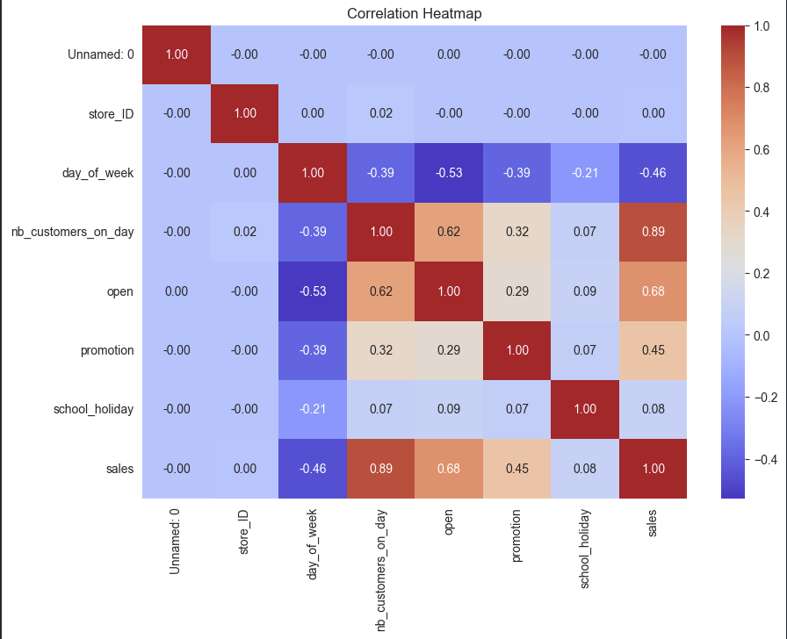
Feature engineering
We creature aditional features from the date variable:
Year, month and day
Day of the week
Weekend indicator
These features helped capture
seasonality and patterns in sales.

Slide 5
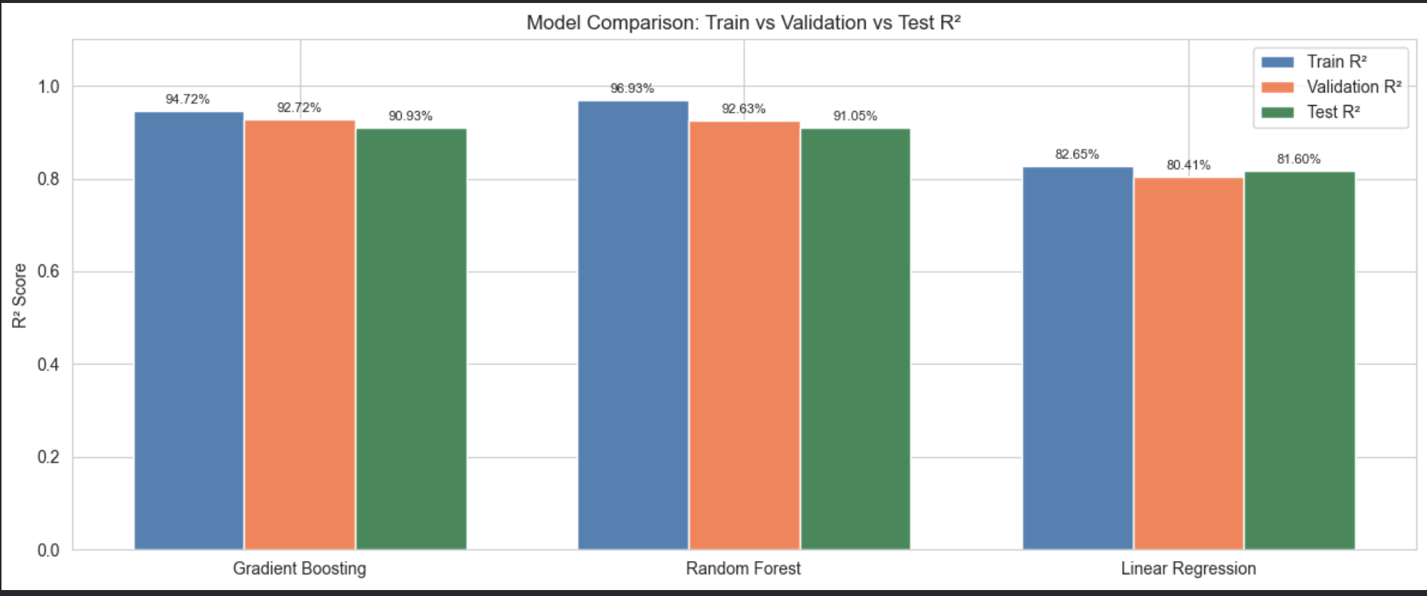
Models tested
We testesd several models:
Linear regression(baseline)
Random forest
Decision tree

Slide 6
Results
The best model achieved an R square score of 92% on the validation set.
Random forest outperformed Linear regression.
Based on this, we selected it as our final model.

Slide 7
Takeaways
Key takeaways
Feature engineering had a strong impact on performance
Tree based models perform better than linear models
Data preprocessing was critical
Challenges
Handling categorical variables
Ensuring consistent preprocessing for real data

