Slide 1
Monitoring
Availability Events
Hardware and Component Events
Electrical & Energy Events
Billing & Payment Events
Diagnostic & Maintenance Events
Communication Events
Security & Access Events
User Interaction Events
Station Offline / Online
Connector Available / Occupied / Reserved
Scheduled Maintenance Window
Reboot or Power Cycle
Contactor Failure
Cable Disconnected / Cable Fault
Cooling System Fault
Fan Failure / Overheating
Overcurrent / Undervoltage
Door Opened / Tamper Detection
Start/Stop Charging Session
Energy Delivered (kWh)
Overvoltage / Undervoltage
Power Factor Alert
Grid Disconnection (V2G mode)
OCPP Heartbeat Missed
Network Loss (Wi-Fi/4G/Ethernet)
Server Disconnection / Reconnect
Message Retries / Failures
Roaming Service Downtime (OCPI/OICP)
Session Payment Completed / Failed
Invalid Tariff Applied
Pricing Mismatch Detected
Overstay Fee Triggered
Subscription Validation Failure
Self-Test Passed/Failed
Firmware Update Start/End
Internal Diagnostic Triggered
Temperature Threshold Breached
Component Wear Indicator
Plug Inserted / Removed
Touchscreen/Keypad Use
Mobile App Check-In
Help Request Button Pressed
User Session Timeout
Unauthorized Access Attempt
RFID Scan Success/Failure
PIN or App-Based Login
Firmware Tampering Detected

Slide 2
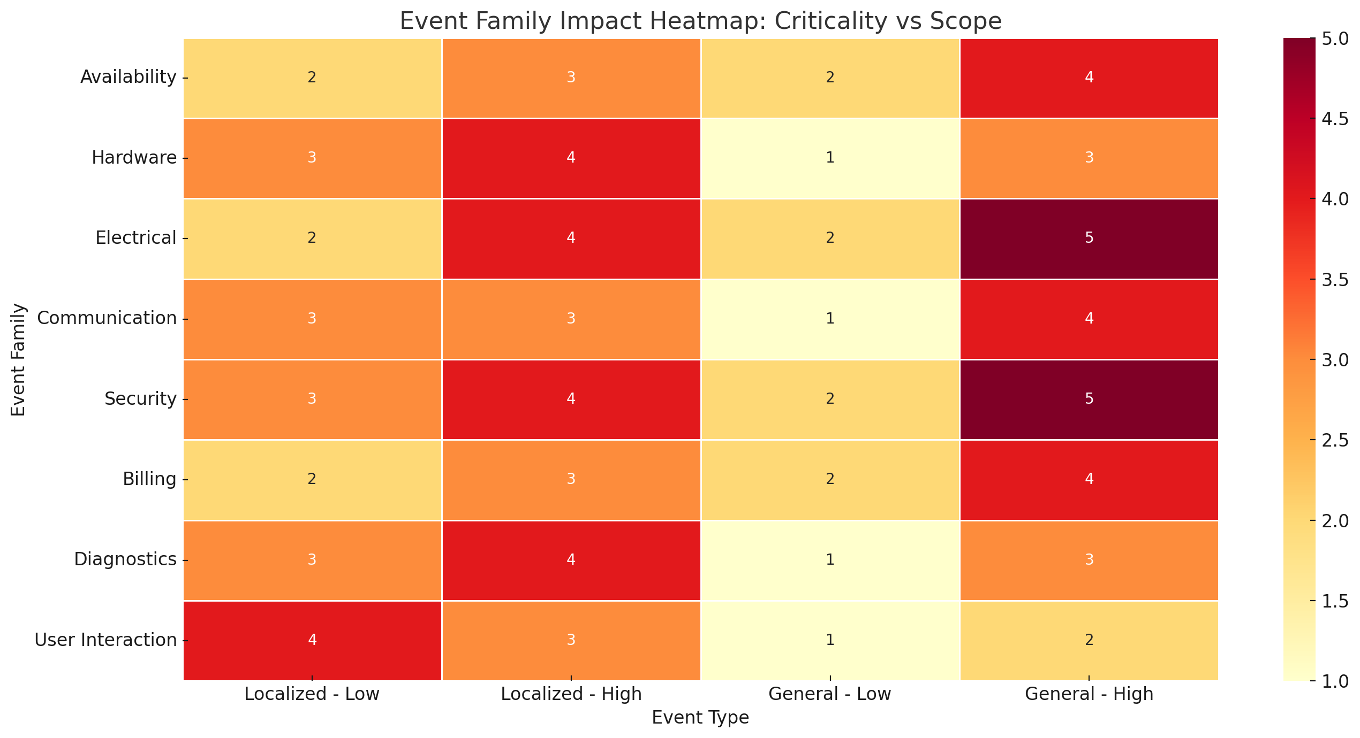

Slide 3
1. Availability Events
Event Example | Mode of Occurrence
Station Offline / Online | reactive – status polling / heartbeat
Connector Available / Occupied / Reserved | reactive – real-time charger logic
Scheduled Maintenance Window | proactive – set by backend operator
Reboot or Power Cycle | proactive (commanded) or reactive (watchdog/fault reset)

Slide 4
2. Hardware and Component Events
Event Example | Mode of Occurrence
Contactor Failure | reactive– relay diagnostics
Cable Disconnected / Fault | reactive – detection via plug sensors
Cooling System Fault | reactive – temperature monitoring sensors
Fan Failure / Overheating | proactive – system thermal management
Overcurrent / Undervoltage | proactive – real-time protection circuit
Door Opened / Tamper Detection | reactive – triggered by physical tamper sensor

Slide 5
3. Electrical & Energy Events
Event Example | Mode of Occurrence
Start/Stop Charging Session | reactive-manual (user plug-in) and Automatic (CPMS logic)
Energy Delivered (kWh) | proactive – continuous metering
Overvoltage / Undervoltage | proactive – live voltage monitoring
Power Factor Alert | proactive – power quality analyzer logic
Grid Disconnection (V2G mode) | reactive – triggered by grid or EMS event

Slide 6
4. Communication Events
Event Example | Mode of Occurrence
OCPP Heartbeat Missed | reactive – backend timeout logic
Network Loss (Wi-Fi/4G/Ethernet) | reactive – system connection health
Server Disconnection / Reconnect | reactive – protocol handling
Message Retries / Failures | reactive – OCPP engine retry logic
Roaming Service Downtime (OCPI/OICP) | proactive – roaming backend status

Slide 7
5. Security & Access Events
Event Example | Mode of Occurrence
Unauthorized Access Attempt | reactive – failed login attempt
RFID Scan Success / Failure | reactive-manual (user swipe) + automatic validation
PIN or App-Based Login | reactive-manual (user input) + automatic backend auth
Door Opened (Physical Security) | reactive – sensor-triggered
Firmware Tampering Detected | reactive – checksum or security watchdog

Slide 8
6. Billing & Payment Events
Event Example | Mode of Occurrence
Session Payment Completed / Failed | reactive – triggered at session end
Pricing Mismatch Detected | reactive – CPMS validation or reconciliation
Overstay Fee Triggered | reactive – idle timer policy
Subscription Validation Failure | reactive – user entitlement check

Slide 9
7. Diagnostic & Maintenance Events
Event Example | Mode of Occurrence
Self-Test Passed / Failed | reactive – triggered by schedule or boot
Firmware Update Start / End | reactive (operator-triggered) or proactive scheduled auto-update
Internal Diagnostic Triggered | reactive
Temperature Threshold Breached | proactive – real-time thermal sensor
Component Wear Indicator | proactive – based on usage cycles or operating hours

Slide 10
8. User Interaction Events
Event Example | Mode of Occurrence
Plug Inserted / Removed | reactive – user action triggers sensor
Start/Stop from App or Interface | reactive – user via UI or mobile app
Timeout or Inactivity | reactive – internal session timeout logic
Screen Input, Button Press | reactive – user physical interaction

Slide 11
