Slide 1
NERS551 Nuclear Reactor Dynamics Numerical Solution of the Exact Point Kinetics Equations 3-8-2022
Prof T. Downar

Slide 2
Outline
Review Exact P.K. Equations (EPKE)
Derivation (See Backup Slides)
Comparison w/ “Conventional” P.K.
Numerical Solution of P.K. Equations
Theta method for temporal discretization
Exponential transformation
Precursor time integration
Solution of EPK
Linear feedback model
Solution of EPK with feedback
Application to NEACRP PWR Rod Ejection

Slide 3
Compare Exact and Conventional Point Kinetics
Exact Point Kinetics
Conventional Point Kinetics
EPK Parameters
CPK Parameters
Initial are used for entire transient,
The reactivity are often evaluated with core average parameters and reactivity coefficients which were evaluated near steady state condition.
It is hard to obtained accurate reactivity for CPK.

Slide 4
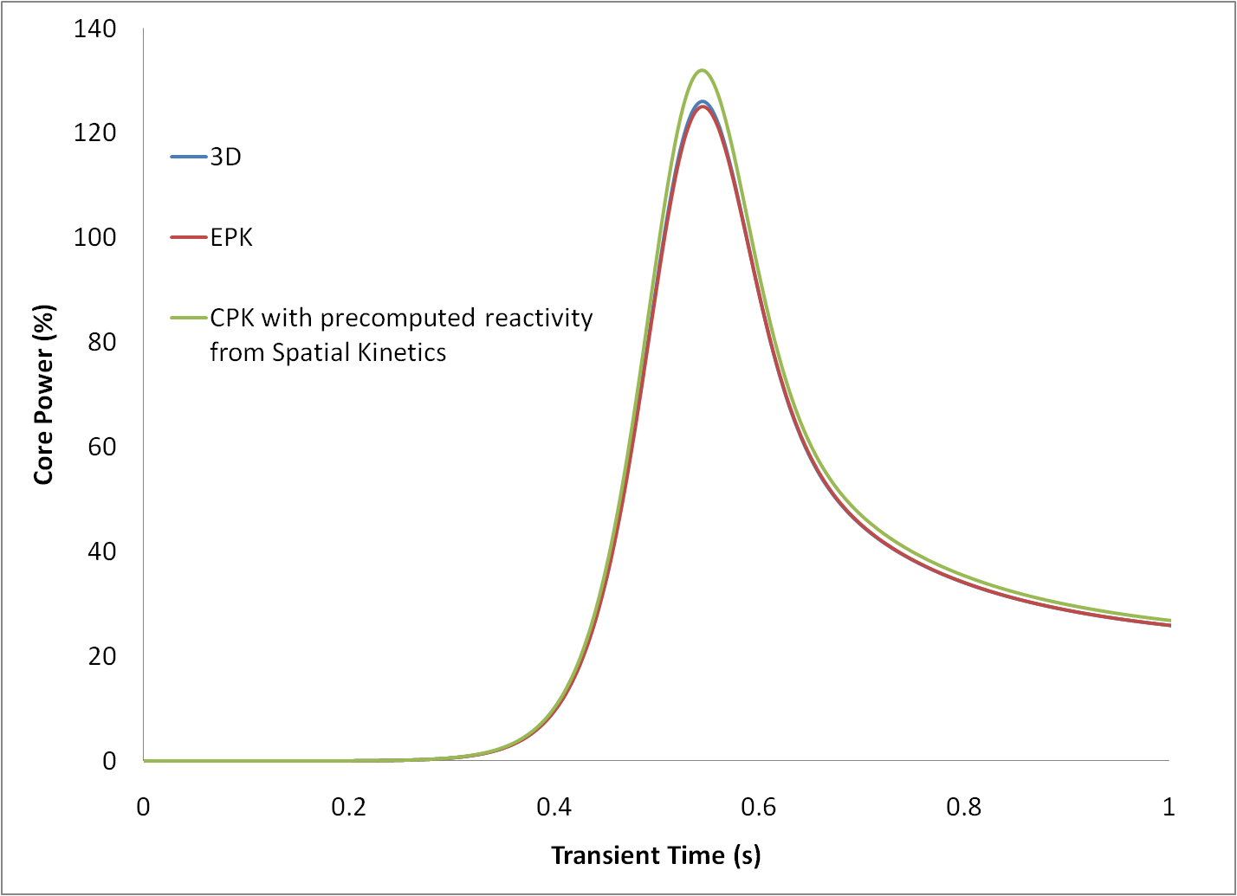
EPK and CPK for Rod Eject Benchmark(A1)

Slide 5
Benefits from Exact Point Kinetics
As EPK parameters rely on solutions of spatial kinetics, in order to obtain EPK solution, the spatial kinetics solution is always needed. So, what are the Benefits from EPK?
Help user to analyze the mechanism of transient results from spatial kinetics,
Identify the error sources of conventional point kinetics,
Accelerate the spatial kinetics solution without impacting the accuracy (e.g. improved quasi-static method).

Slide 6
Outline
Review Exact P.K. Equations
Derivation
Comparison w/ “Conventional” P.K.
Numerical Solution of Exact P.K. Equations
Theta method for temporal discretization
Exponential transformation
Precursor time integration
Solution of EPK
Linear feedback model
Solution of EPK with feedback
Application to NEACRP Rod Eject

Slide 7
Temporal Discretization Method for Point Kinetics
Theta method is used for flux level equation. Explicit, implicit and Crank-Nicolson methods can be realized with 0, 1 and ½ as theta values.
Exponential transformation is used to reduce the stiffness of point kinetic equations.
The precursors will be analytically integrated over time step with linear approximation of flux level during the time step.

Slide 8
Theta method (Review?)
System of ordinary differential Equations
Theta method
Test problem
Explicit method:
Implicit method:
Crank-Nicolson:
Explicit and implicit methods are first order in time, Crank-Nicolson is second order in time which is more accurate for small time step size, i.e.

Slide 9
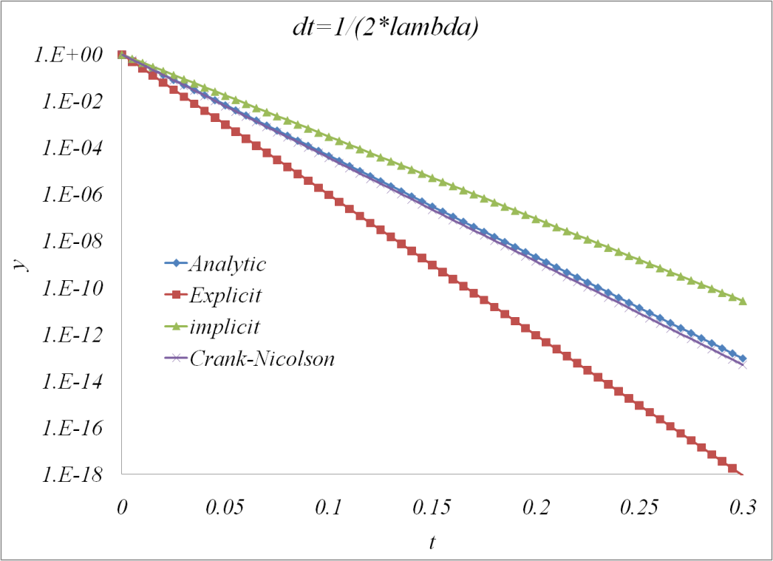
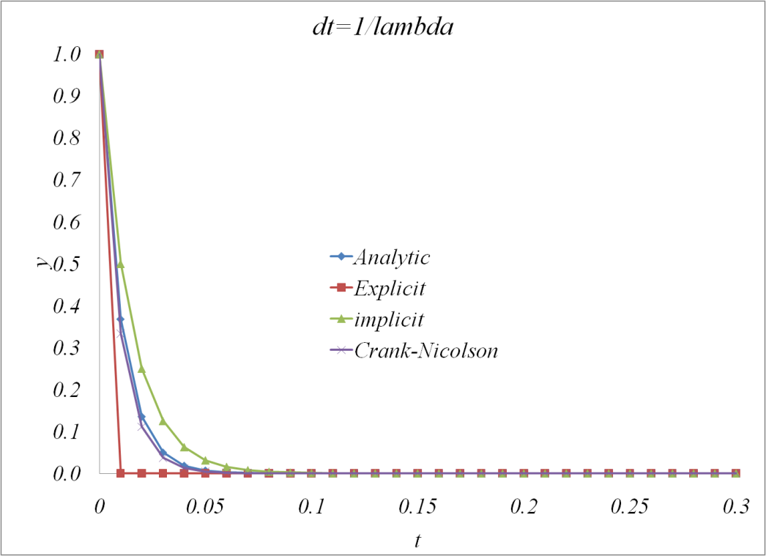
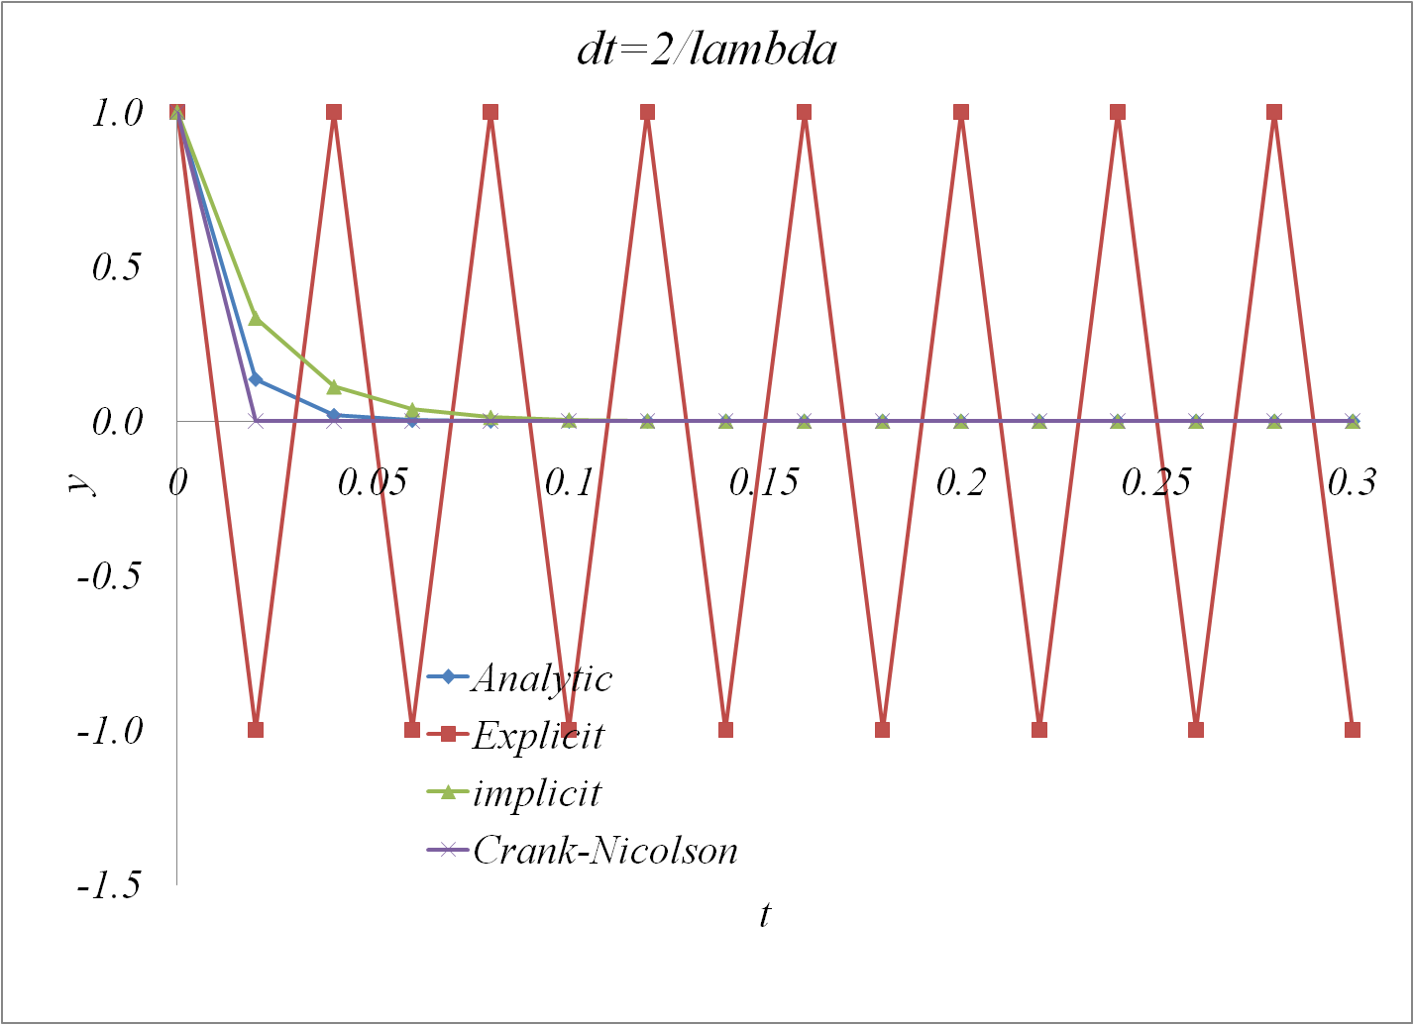
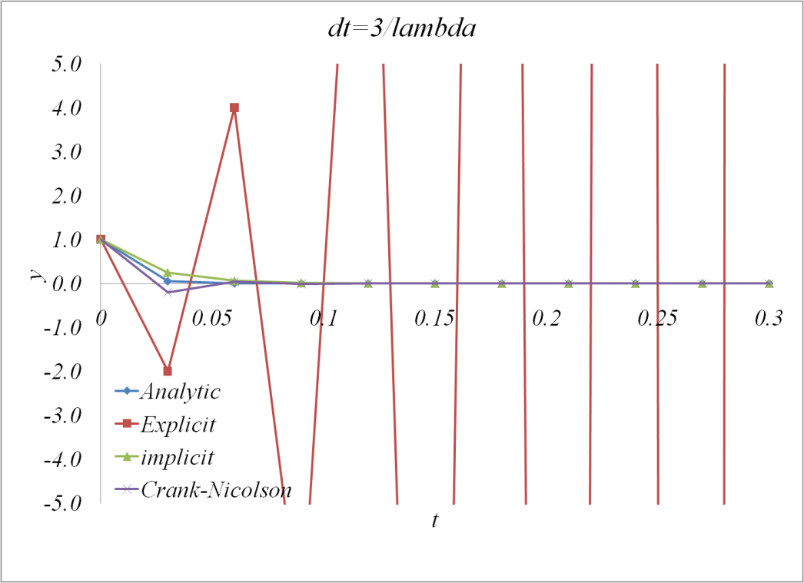
Theta method solution for test problem

Slide 10
Stability of Theta Method
Implicit method is unconditionally stable, Crank-Nicolson is unconditionally neural stable, explicit method is conditionally stable.
For the test problem, explicit method is stable when
is called the stiffness of test problem.
For system of linear ordinary differential equations
the stiffness is where is eigenvalues of A
The max eigenvalues of PKE:
Λ=1E-4
Λ=1E-5
Λ=4E-7

Slide 11
Theta method applied to EPKE
Theta method for flux amplitude equation
Where θ is user input parameter.
If θ=0, the finite differencing is explicit,
If θ=1, the finite differencing is implicit,
If θ=0.5, the finite differencing is called Crank-Nicolson scheme, which has high accuracy ( 2nd order)
If same method is apply to precursor equations (6), then we get K+1 equations for K+1 unknowns.
As the precursors depend only on power, and are independent from each other, we can get solution without introducing finite different error to precursor equations.
11

Slide 12
Exponential Transformation
Test problem:
Analytic Solution:
Stiffness:
Exponential Transformation:
Stiffness after Exponential Transformation
If estimated alpha is close to negative of lambda, then the stiffness is “softened”.

Slide 13
Exponential Transformation for PKE
Exact Point Kinetic Equations
Initial Condition
Exponential Transformation

Slide 14
Analytic Integration of Precursors
Theta method is used for flux level equation. Explicit, implicit and Crank-Nicolson methods can be realized with 0, 1 and ½ as theta values.
Exponential transformation is used to reduce the stiffness of point kinetic equations.
The precursors will be analytically integrated over time step with linear approximation of flux level during the time step.
Exact Point Kinetics

Slide 15

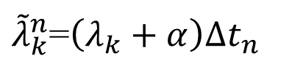
Analytic Integration of Transformed Linear Precursor
Assume $\frac{Λ_{0}}{Λ\left(\tilde{t}\right)}β_{k}^{eff}\left(\tilde{t}\right)p\left(\tilde{t}\right)e^{−α\tilde{t}}$ to be linear during step
$$G\left(\tilde{t}\right)≡\frac{Λ_{0}}{Λ\left(\tilde{t}\right)}β_{k}^{eff}\left(\tilde{t}\right)p\left(\tilde{t}\right)e^{−α\tilde{t}}≈G^{n}w+G^{n−1}(1−w)$$
(8)
$w$=$\tilde{t}/∆t_{n}$
Integrate eq. (6) over step
$$ζ_{k}^{n}=e^{−λ_{k}∆t_{n}}ζ_{k}^{n−1}+e^{α∆t_{n}}Δt_{n}\left\{G^{n}κ_{1}\left({\tilde{λ}}_{k}^{n}\right)+G^{n−1}\left[κ_{0}\left({\tilde{λ}}_{k}^{n}\right)−κ_{1}\left({\tilde{λ}}_{k}^{n}\right)\right]\right\}$$
(9)
${\tilde{λ}}_{k}^{n}$=$\left(λ_{k}+α\right)∆t_{n}$

Slide 16


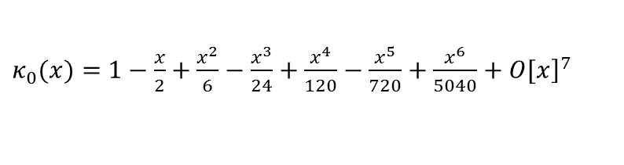






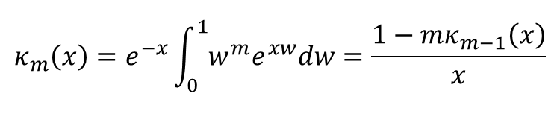
Exponential Integration
$$κ_{m}\left(x\right)=e^{−x}\int_{0}^{1}{w^{m}e^{xw}dw}=\frac{1−mκ_{m−1}\left(x\right)}{x}$$
$$(10)$$
$$|x|<0.06$$
$$κ_{0}\left(x\right)=(1−e^{−x})/x$$
$κ_{0}(x)=$ $1−\frac{x}{2}+\frac{x^{2}}{6}−\frac{x^{3}}{24}+\frac{x^{4}}{120}−\frac{x^{5}}{720}+\frac{x^{6}}{5040}+{\left.O[x\right]}^{7}$
$$(11)$$
$$κ_{1}\left(x\right)=\left[1−κ_{0}\left(x\right)\right]/x$$
$$κ_{1}\left(x\right)=\frac{1}{2}−\frac{x}{6}+\frac{x^{2}}{24}−\frac{x^{3}}{120}+\frac{x^{4}}{720}−\frac{x^{5}}{5040}+\frac{x^{6}}{40320}+{\left.O[x\right]}^{7}$$
$$(12)$$
$$κ_{0}\left(x\right)− κ_{1}\left(x\right)=\frac{1}{2}−\frac{x}{3}+\frac{x^{2}}{8}−\frac{x^{3}}{30}+\frac{x^{4}}{144}−\frac{x^{5}}{840}+\frac{x^{6}}{5760}+{\left.O[x\right]}^{7}$$
$$(13)$$
16

Slide 17
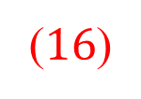

Integrated Precursor Transformed Linear Equation
Integrated precursor
$$Ω_{k}^{n}=\frac{Λ^{0}}{Λ^{n}}β_{k}^{eff,n}{Δt_{n}κ}_{1}\left({\tilde{λ}}_{k}^{n}\right)$$
(15)
$${\hat{ζ}}_{k}^{n−1}=e^{−λ_{k}∆t_{n}}ζ_{k}^{n−1}{+e}^{α∆t_{n}}Δt_{n}G^{n−1}\left[κ_{0}\left({\tilde{λ}}_{k}^{n}\right)−κ_{1}\left({\tilde{λ}}_{k}^{n}\right)\right]$$
($16$)
Delay Neutron terms
$\sum_{k}{λ_{k}}ζ_{k}^{n}=p^{n}\sum_{k}{λ_{k}}Ω_{k}^{n}+\sum_{k}{λ_{k}}{\hat{ζ}}_{k}^{n−1}=τ^{n}p^{n}+{\hat{S}}_{d}^{n}$ (17)
(18)

Slide 18
Solution of EPKE
Theta method for flux level equation
Flux Level Solution
Fission Power
18

Slide 19
Exponential transformation parameter
First take parameter,
Evaluate the power.
The transformed solution is closer to linear than original solution, and the transformation parameter is accepted, if
Otherwise re-evaluate solution without transformation, i.e.
19

Slide 20
Outline
Review Exact P.K. Equations
Derivation (See Backup Slides)
Comparison w/ “Conventional” P.K.
Numerical Solution of P.K. Equations
Theta method for temporal discretization
Exponential transformation
Precursor time integration
Solution of EPK
Linear feedback model
Solution of EPK with feedback
Application to NEACRP PWR Rod Ejection

Slide 21
Linear Feed Back Model
Reactivity feed back
$ρ\left(t\right)=ρ_{im}\left(t\right)+γ_{d}\int_{0}^{t}{\left(H\left(t^{′}\right)−P_{0}\right)\exp\left(λ_{H}\left(t^{′}−t\right)\right)dt^{′}} (25$)
imposed reactivity
feed back constant
conduction time constant
Doppler feedback
Feed back Reactivity
$ρ_{d}\left(t\right)=ρ\left(t\right)−ρ_{im}\left(t\right)=γ_{d}\int_{0}^{t}{\left(H\left(t^{′}\right)−P_{0}\right)\exp\left(λ_{H}\left(t^{′}−t\right)\right)dt^{′}} (27$)

Slide 22
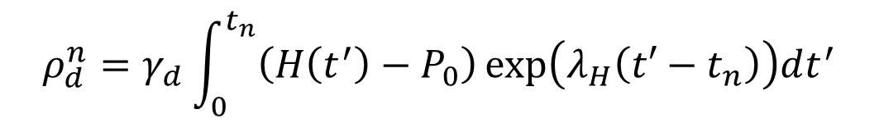


Feedback Reactivity at Next Step
Feed back Reactivity at new step
$$ρ_{d}^{n}=γ_{d}\int_{0}^{t_{n}}{\left(H\left(t^{′}\right)−P_{0}\right)\exp\left(λ_{H}\left(t′−t_{n}\right)\right)dt^{′}}$$
$${\hat{λ}}_{H}^{n}=λ_{H}Δt_{n}$$
$ρ_{d}^{n}=e^{−{\hat{λ}}_{H}^{n}}ρ_{d}^{n−1}−P_{0}γ_{d}Δt_{n}κ_{0}({\hat{λ}}_{H}^{n})+γ_{d}e^{−{\hat{λ}}_{H}}\int_{0}^{Δt_{n}}{H\left(\tilde{t}\right)\exp\left(λ_{H}\tilde{t}\right)d\tilde{t}} (28$)
Linear approximation
$${\tilde{λ}}_{H}^{n}={(λ}_{H}+α)Δt_{n}$$
$$Q\left(\tilde{t}\right)=f_{fp}\left(\tilde{t}\right)p(\tilde{t})e^{−α\tilde{t}}=Q^{n}w+Q^{n−1}\left(1−w\right)$$
(29)
$\int_{0}^{Δt_{n}}{Q\left(\tilde{t}\right)\exp\left(λ_{H}+α\right)\tilde{t}d\tilde{t}}=e^{{\tilde{λ}}_{H}^{n}}Δt_{n}\left\{Q^{n}κ_{1}({\tilde{λ}}_{H}^{n})+Q^{n−1}\left[κ_{0}\left({\tilde{λ}}_{H}^{n}\right)−κ_{1}({\tilde{λ}}_{H}^{n})\right]\right\}$ (30)
$$ρ_{d}^{n}=e^{−{\hat{λ}}_{H}^{n}}ρ_{d}^{n−1}−ηP_{0}γ_{d}Δt_{n}κ_{0}\left({\hat{λ}}_{H}^{n}\right)+e^{αΔt_{n}}γ_{d}Δt_{n}\left\{Q^{n}κ_{1}({\tilde{λ}}_{H}^{n})+Q^{n−1}\left[κ_{0}\left({\tilde{λ}}_{H}^{n}\right)−κ_{1}({\tilde{λ}}_{H}^{n})\right]\right\}$$

Slide 23
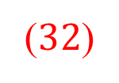
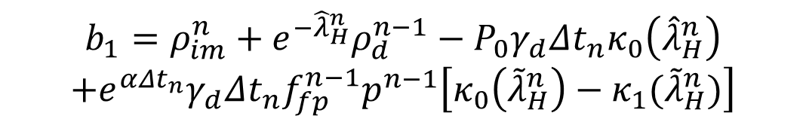


Linear Expression of Next Step Reactivity
$$a_{1}=f_{fp}^{n}γ_{d}Δt_{n}κ_{1}({\tilde{λ}}_{H}^{n})$$
($32$)
$$b_{1}=ρ_{im}^{n}+e^{−{\hat{λ}}_{H}^{n}}ρ_{d}^{n−1}−P_{0}γ_{d}Δt_{n}κ_{0}\left({\hat{λ}}_{H}^{n}\right)$$
$$+e^{αΔt_{n}}γ_{d}Δt_{n}f_{fp}^{n−1}p^{n−1}\left[κ_{0}\left({\tilde{λ}}_{H}^{n}\right)−κ_{1}({\tilde{λ}}_{H}^{n})\right]$$
$$(33)$$

Slide 24
Solution with Feedback
Substitute (31) into (20)
Rearrange eq. (34)
Flux Level Solution
No feedback or explicit:
24

Slide 25
P.K. Solution Scheme
Only formula with red numbers need to be coded, the sequence of these formula in your program should be as follows:
Prepare and with eq. (15),(16)
the exponential integration functions (10)~(13) are called
Prepare with eq. (18),(19)
Prepare a1,b1 with eq. (32) and (33)
Determine transformation parameter with eq. (23)
Prepare a,b,c with eq. (36), (37), and(38)
Evaluate flux level with eq. (39) or (40)
Check if exponential transformation is acceptable with eq. (24), if not, redo step 5 and 6 with
Evaluate power level, precursors and reactivity with eq. (22), (14) and (31)
25

Slide 26
E.P.K.E. Solution Scheme

Slide 27
Outline
Review Exact P.K. Equations
Derivation
Comparison w/ “Conventional” P.K.
Numerical Solution of P.K. Equations
Theta method for temporal discretization
Exponential transformation
Precursor time integration
Solution of EPK
Linear feedback model
Solution of EPK with feedback
Application to NEACRP Rod Eject

Slide 28
Kinetics options implemented in PARCS
Transient card in CNTL block
transient (tran) (kinopt)
Kinopt, integer, kinetic option, default 0
0: 3d spatial kinetics
1: point kinetics with adjoint weighted cross section change as reactivity exclude control rod reactivity component,
2: point kinetics with adjoint weighted cross section change as reactivity,
3: Conventional point kinetics with power weighted core average parameter feedback,
4: point kinetics with adjoint fission weighted core average parameter feedback,
5: point kinetics without feedback (user input reactivity),
6: no kinetics,(user input power levels)
Impose reactivity are acceptable for option 1 to 5
28

Slide 29
Impose Reactivity for point kinetics
IMPOSERHO cardsin TRAN block
imposerho t1 r1 t2 r2 ...
ti: real, time point for impose reactivity
ri: real, impose reactivity ( or power level if kinopt=6)
Example:
imposerho 0.000000E+00 0.000000E+00
imposerho 1.000000E-03 2.532442E-04
imposerho 2.000000E-03 5.697343E-04
imposerho 3.000000E-03 9.885548E-04
29

Slide 30
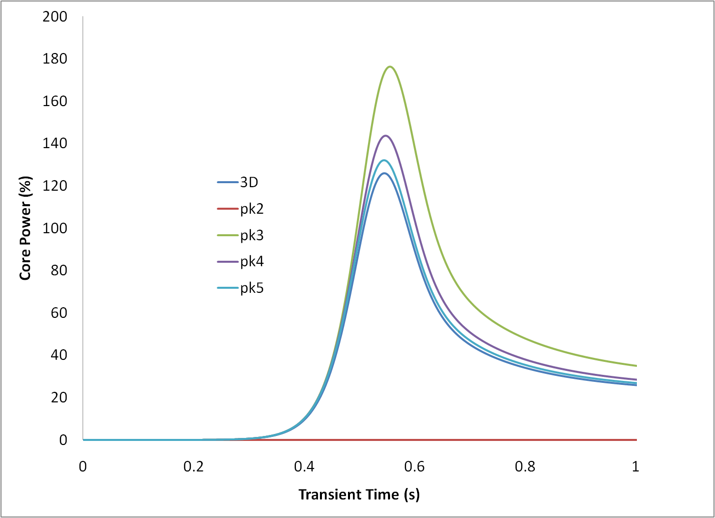
Point kinetic solutions for NEACRP-A1

Slide 31
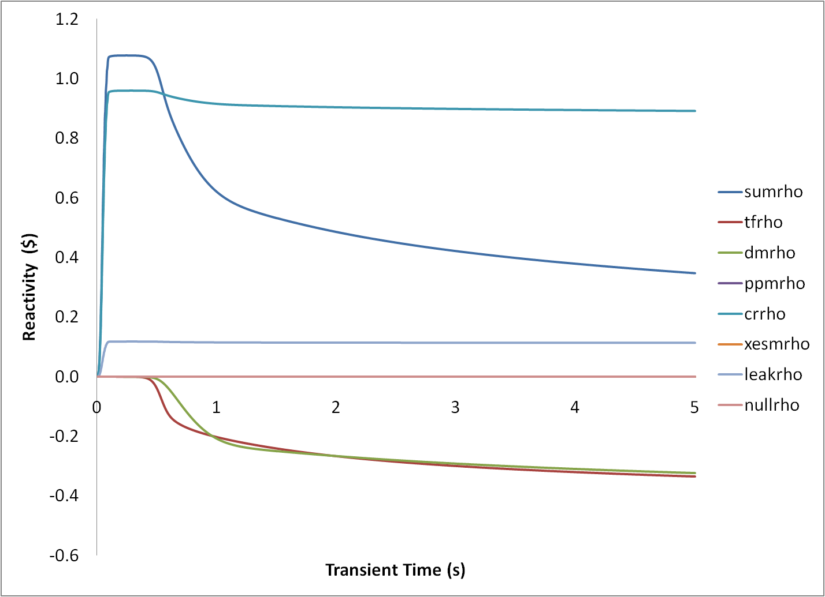
Reactivity Components from spatial kinetics

Slide 32
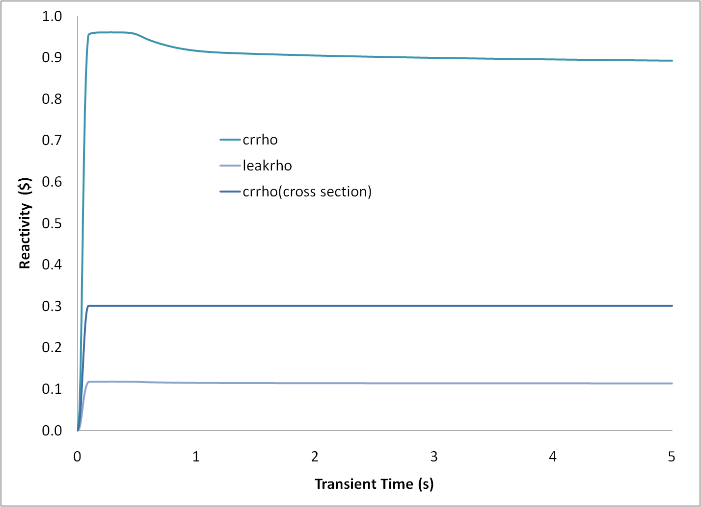
Control Rod Reactivity from Cross Section with initial flux shape

Slide 33
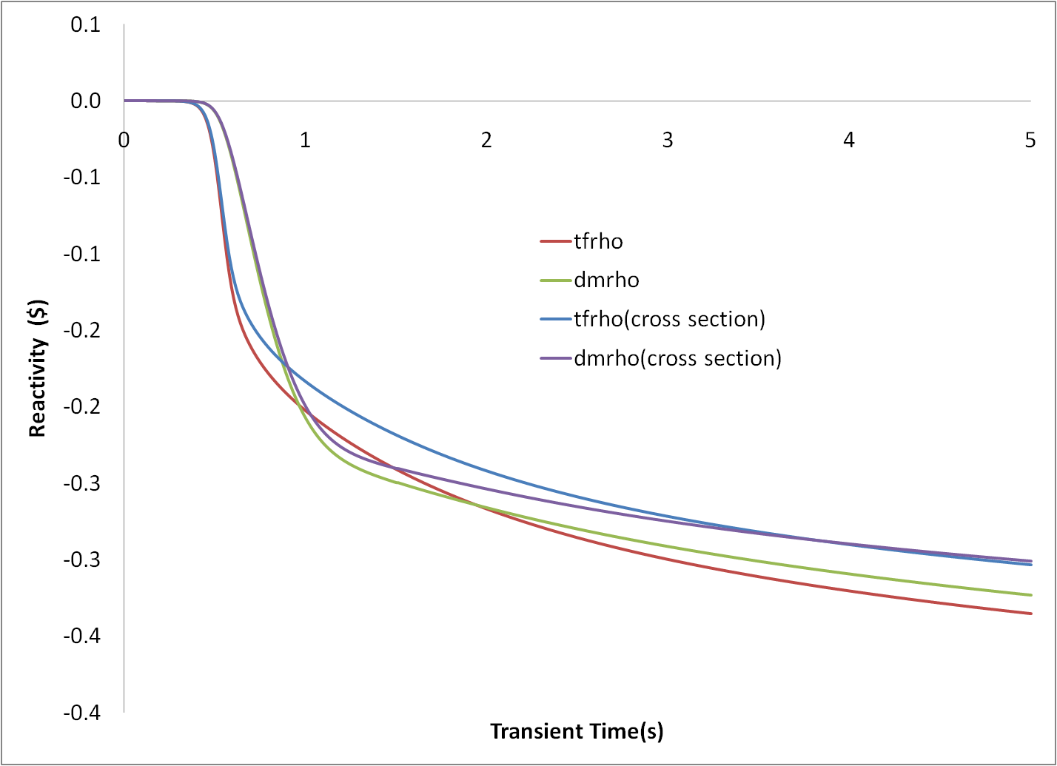
Feed back Reactivity from Cross with initial flux shape

Slide 34
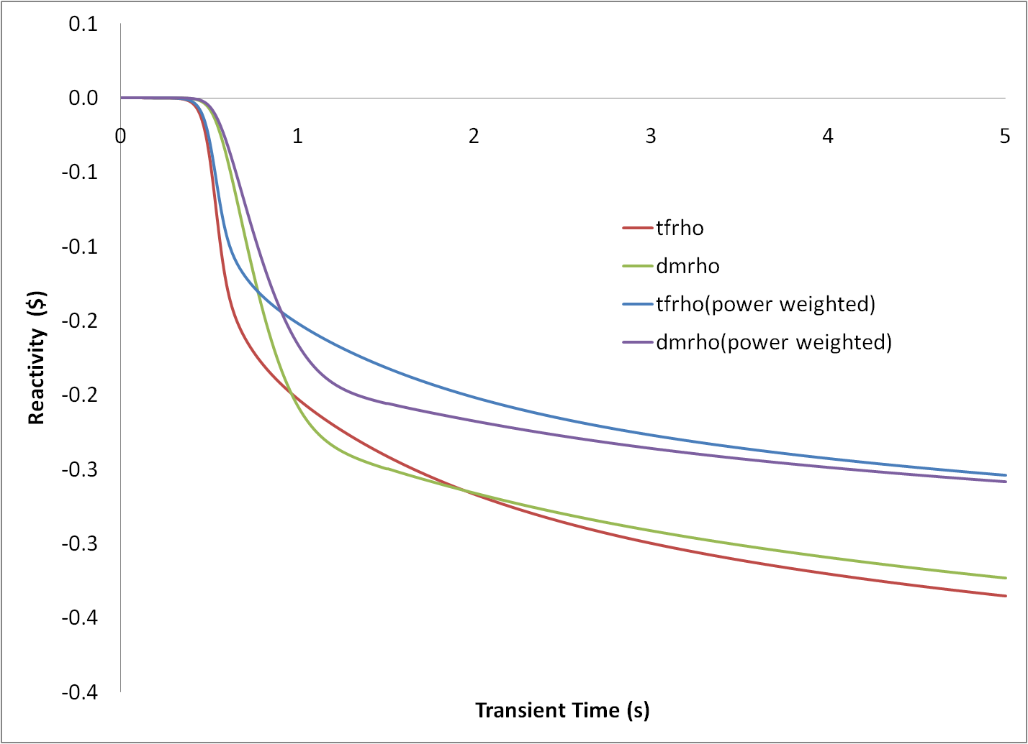
Feed back Reactivity from power weighted core average parameters

Slide 35
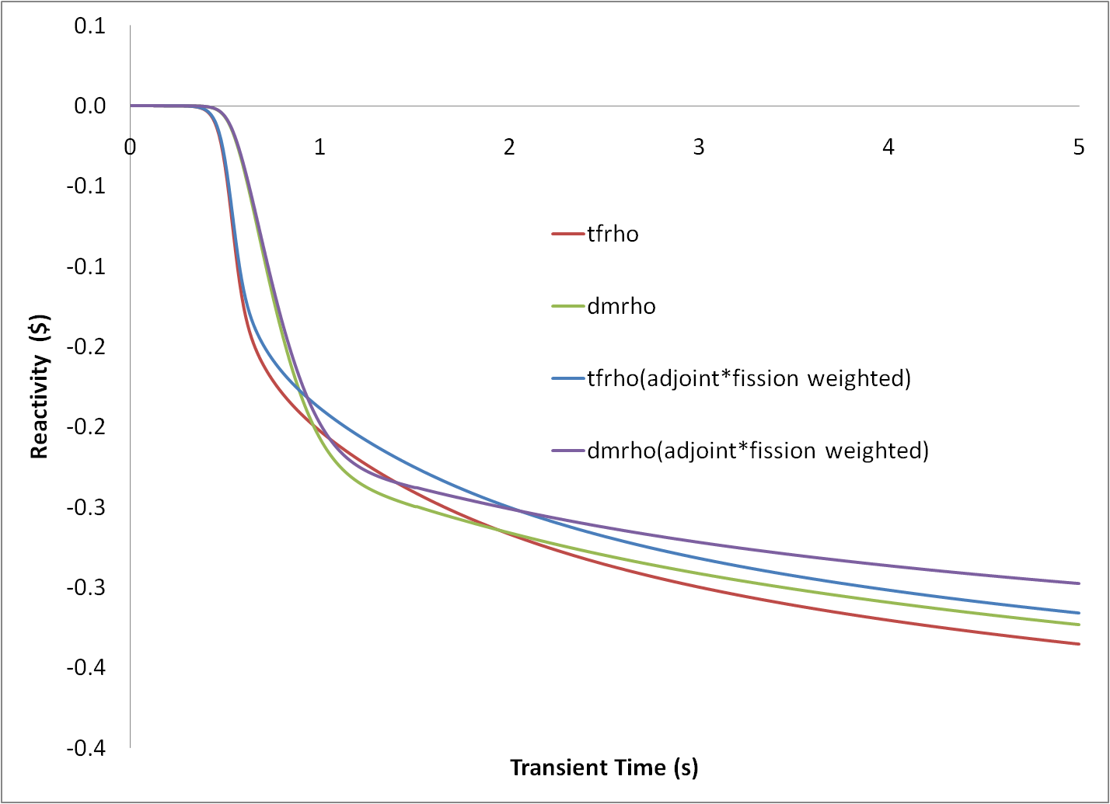
Feed back Reactivity from Adjoint*Fission weighted core average parameters

Slide 36
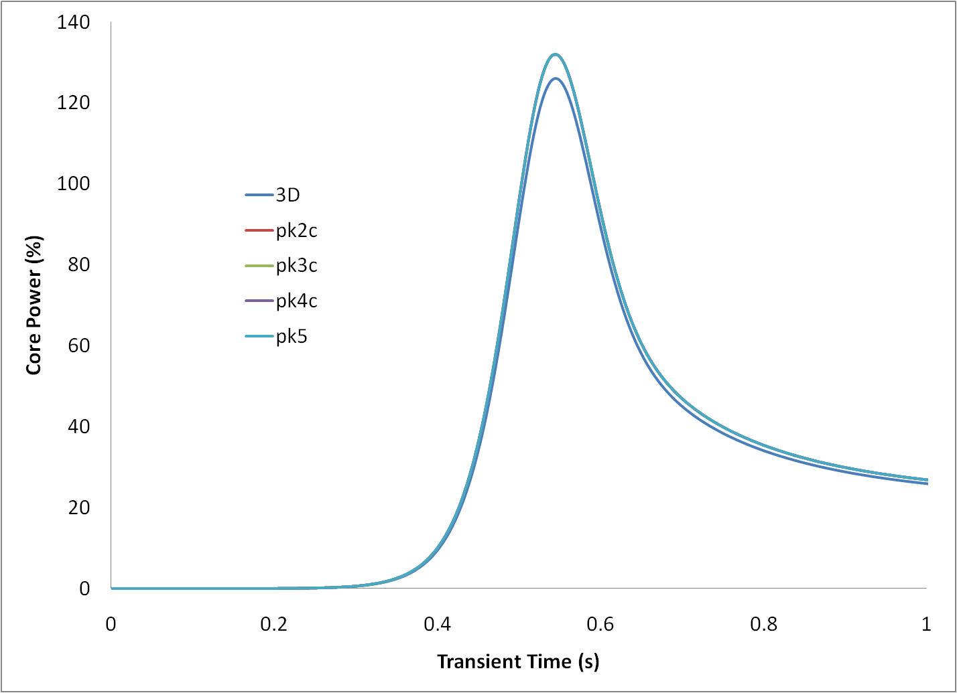
Point kinetic solutions with corrected imposed reactivity

Slide 37
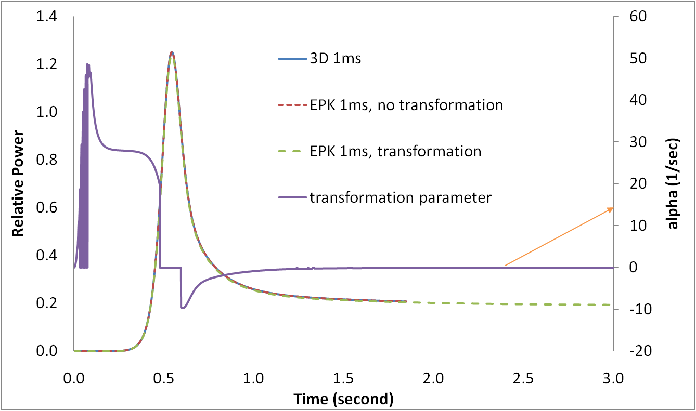
Analysis of Exponential Transportion:
EPK solution for NEACRP-A1 with 1ms steps

Slide 38
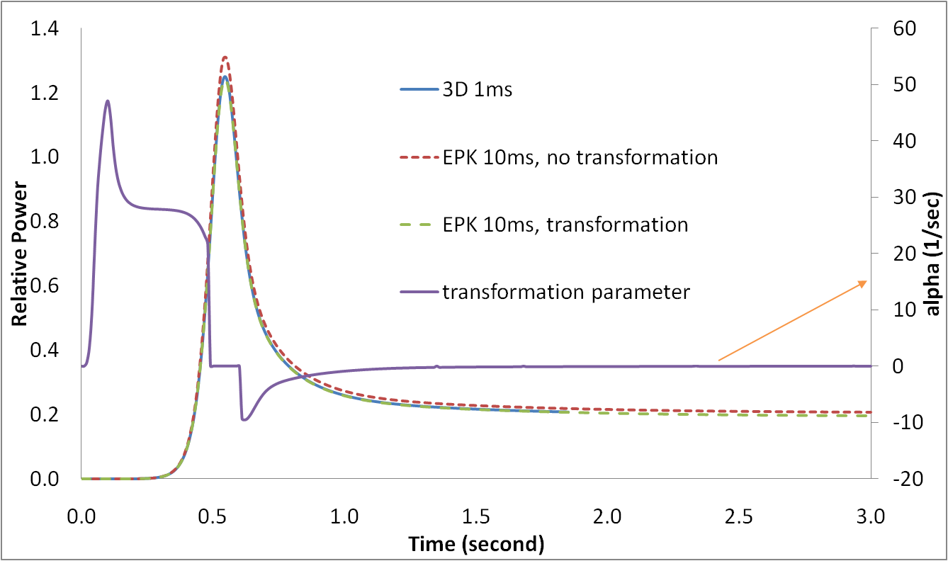
EPK solution for NEACRP-A1 with 10ms steps

Slide 39
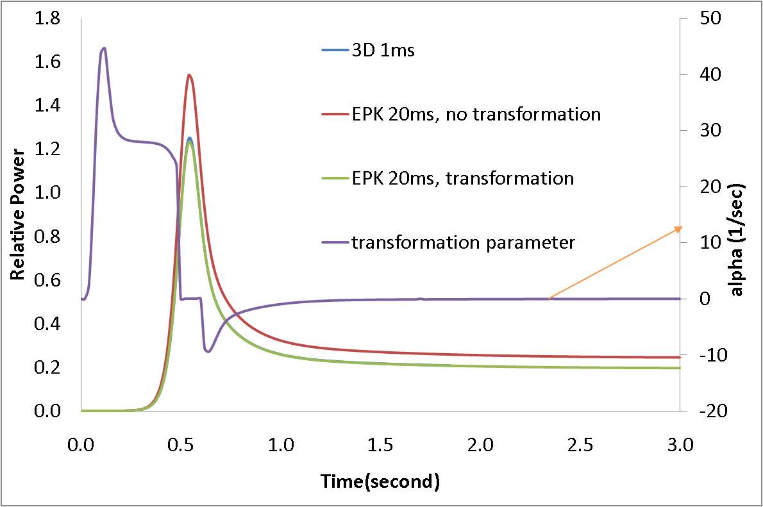
EPK solution for NEACRP-A1 with 20ms steps

Slide 40
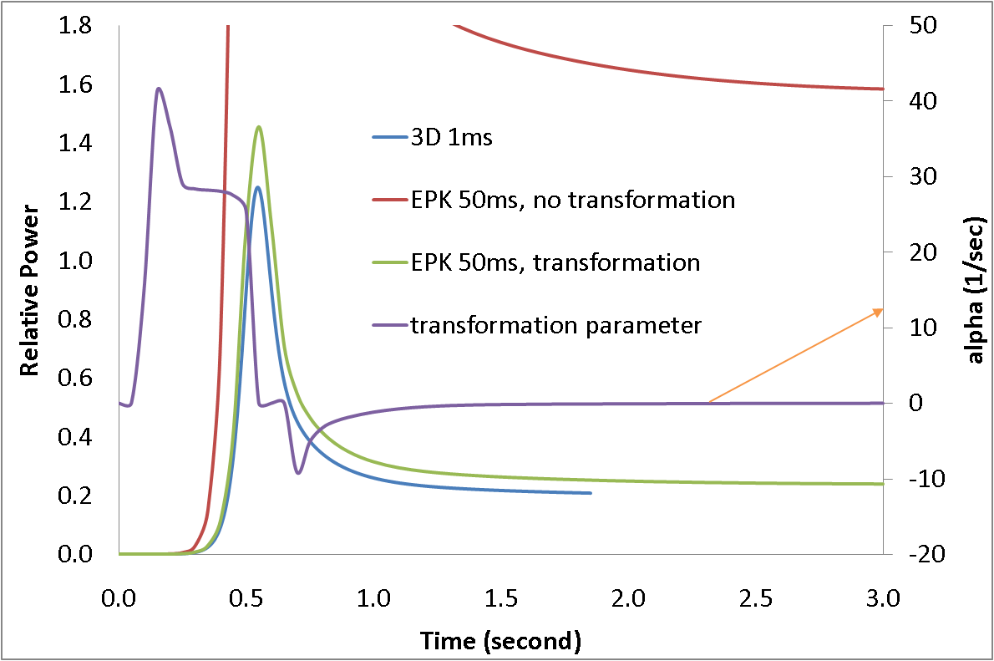
EPK solution for NEACRP-A1 with 50ms steps

Slide 41
Summary of Applications
Exact point kinetics can reproduce exactly the same power solution from the spatial kinetics solution with the pre-computed reactivity and time dependent kinetics parameters.
Point kinetics with pre-computed reactivity and only the initial kinetics parameters predicts power solution slightly different from spatial kinetics solution.
There is a large error in control rod reactivity using only the initial flux shape.
There are errors in the feed back reactivity evaluated with cross section or core average parameters. The reactivity evaluated with power weighted core average parameters has the largest error among the three methods.

Slide 42
Backup Slides

Slide 43
Spatial Kinetics Equations
Transient Neutron Diffusion Equation
Precursor equations
Notes:
Q: Why does the fission neutron source multiply with delay neutron spectrum?
A: The averaged fission spectrum is used in fission source term so that it is consistent with steady state equation, and it also leads to convenient form for reactivity definention.

Slide 44
Magnitude and Form Functions
Magnitude and Form Functions
Normalization of Form Function
: Integration
notation
Adjoint flux
Alternative Normalization?
Power Form Factor
Fission Power Level
Notes:
Q: Is there any approximation in this variable separation?
A: No.
Q: Why does the form function normalized this way instead of keep power form factor been 1?
A: Show you the reason in next slide.
Q:Why is adjoint flux used as weight function?
A:Keep this question in mind, it be answered later.

Slide 45
Integrate Flux Equation with Adjoint weighting
Time Derivative Term
Generation Time
Adjoint weighted quasi-stationary fission source
Time invariance
Notes:
Here is the reason for the way form function been normalized, to avoid additional term in time derivative.
Notice that the averaged fission spectrum is used in F(t)

Slide 46
Integrate Flux Equation (cont.)
Reactivity Term

Slide 47
Integrate Flux Equation (cont.)
Beta Terms
Delay neutron Terms
Notes:
The effective beta is weighted with delay neutron spectrum.
Q: Why F0 instead of F(t) be divided in precursor definition?
A:Keep this question in mind, it be answered later.

Slide 48
Integrate Flux Equation (cont.)
Put All Terms Together
Why adjoint weighting?
Impact on reactivity by form function error
Select weight function so that:
Notes:
The time invariance relation F(t)L(t)=F0L0 is used to eliminate F(t) from equation.

Slide 49
Integrate Precursor Eqns with Adjoint weighting
Time Derivative Term
Source term
Decay term
Put All Terms Together
Notes:
Q: Why the produce of delay neutron spectrum and adjoint flux is used as weight function?
A: to generate consistent term as in flux level equation.

Slide 50
Numerical error of evaluating Kappa0 and Kappa1
Differences of 0-8th order Taylor expansions and direct evaluation of Kappa0 and Kappa1 from 13th order Taylor expansions value. The Taylor expansions functions have significant truncation error for large input. On the other hand, for small input, there is large round off error in numerical evaluation of kappa2 due to subtract two close numbers.
50

