Slide 1
NERS 551 Nuclear Reactor Dynamics Lecture 2 Jan. 11, 2022 Prof. T. Downar

Slide 4
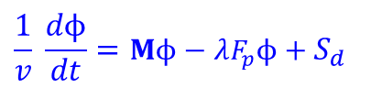



Time Dependent Phenomena in Nuclear Reactors
Three distinct time-dependent phenomena in nuclear reactors
Short time phenomena: typical time intervals of milliseconds to seconds. Explicitly Solve Time Dependent Neutron Diffusion Equation w/ Delayed Neturon Source:
Medium time phenomena: hours to days corresponding
to the mean buildup and decay times of certain fission products
Long time phenomena: several months or years
Fuel depletion analysis
$$\frac{1}{v} \frac{dϕ}{dt}=Mϕ−λF_{p}ϕ+S_{d}$$
Cm246
Cm245
$${}_{\text{52}}^{\text{135}}{\text{Te}}\overset{→}{ \text{19 }\text{s} }{}_{53}^{135}I\overset{→}{ \text{6.7 }\text{hr} }{}_{\text{54}}^{\text{135}}{\text{Xe}}\overset{→}{ \text{9.2 }\text{hr} }{}_{\text{55}}^{\text{135}}{\text{Cs}}\overset{→}{ \text{2.3}×\text{1}{\text{0}}^{6} \text{yr} }{}_{\text{56}}^{\text{135}}{\text{Ba} }(\text{stable})$$
Am244
Cm244
Pu243
Am243
Cm243
Pu242
Am242^{m}
Am242
Cm242
$$Mϕ=λFϕ$$
Pu241
Am241
Np240
P240
U239
Np239
Pu239
U238
Np238
Pu238
α
U237
Np237
U236
Np236
Pu236
$$\frac{dN_{A}(t)}{dt}=−(σ_{A}^{a}φ+λ_{A})N_{A}(t)+σ_{C}^{γ}φN_{c}(t)+λ_{B}N_{B}(t)$$
α
U235
α
Pa234
U234
$$Mϕ=λFϕ$$
Th233
Pa233
U233
(n,3n)
Th232
Pa232
U232
α
Th231
Pa231
U231
(n,3n)
Th230

Slide 5
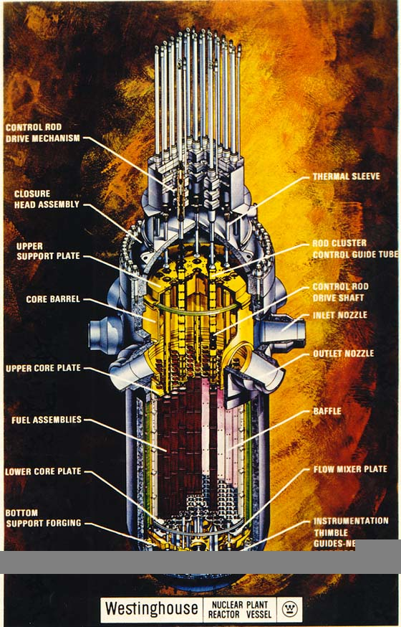
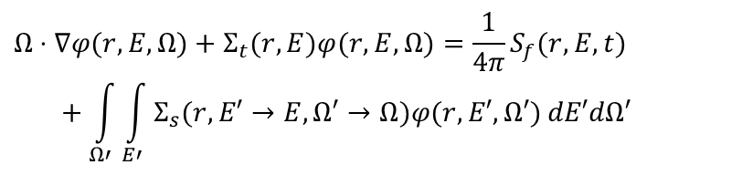
Long Term Phenomena: Coupled Field Equations for Nuclear Reactor Depletion Simulation
Neutron Transport Equation (Steady-state)
Nuclide Depletion Equation
Thermal Fluids:
Multi-Phase Mass, Energy, Momentum
$$Ω⋅∇φ(r,E,Ω)+Σ_{t}(r,E)φ(r,E,Ω)=\frac{1}{4π}S_{f}(r,E,t) \\ \begin{matrix} & \end{matrix}+\int_{Ω′}{\int_{E′}{Σ_{s}(r,E′→E,Ω′→Ω)φ(r,E′,Ω′)}}dE′dΩ′$$

Slide 6
Long Time Phenomena
Long time phenomena include particularly the burnup and buildup of fissionable isotopes, as well as the buildup, beta decay and burnup of fission products
Fuel burnup analysis is concerned with long-term reactor behavior which is determined by
In-reactor fuel irradiation
Various operations performed on fuel between burn cycles
Discharge of burned fuel
Shuffling of partially burned fuel
Loading of charged fuel
Fuel burnup analysis is part of fuel cycle analysis consists of three main components
Front-end cycle: preparation of charged fuel
Fuel burnup analysis
Back-end cycle: reprocessing of discharged fuel and spent fuel and/or waste treatment

Slide 7
U-Pu Burn Chains

Slide 8
Fuel Depletion
Uranium isotope concentrations
Plutonium isotope concentrations

Slide 9
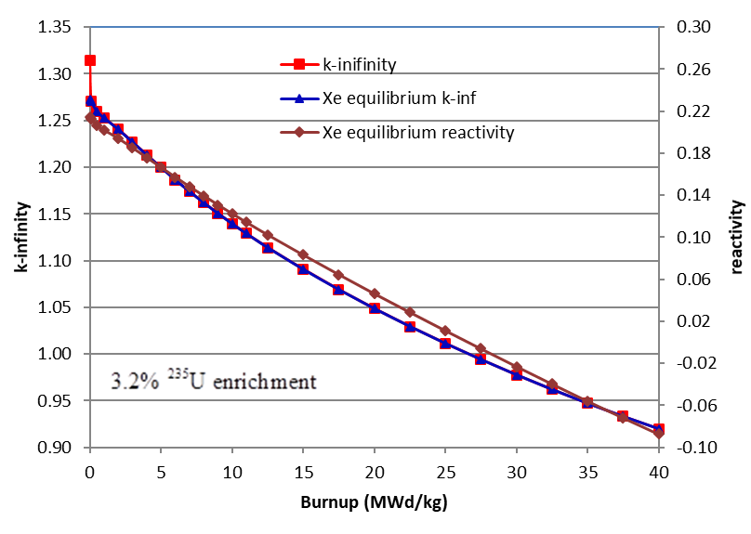
K-Infinity vs. Burnup (PWR)
Mwd/kg is the energy/mass generated in the FUEL
A sufficient fissile loading at BOC is needed to make the core critical throughout the cycle

Slide 10
Fuel Depletion
Long-term evolution of the slightly enriched fuel typical of that in water-cooled reactors
Buildup of higher isotopes of plutonium and uranium that result from successive neutron captures
Conversion ratio
Effect of depletion of ²³⁵U and buildup of plutonium on reactivity
Depletion of ²³⁵U and buildup of fission products will overwhelm the buildup of ²³⁹Pu

Slide 11
Fuel Depletion Equations
Fuel depletion equation

Slide 12
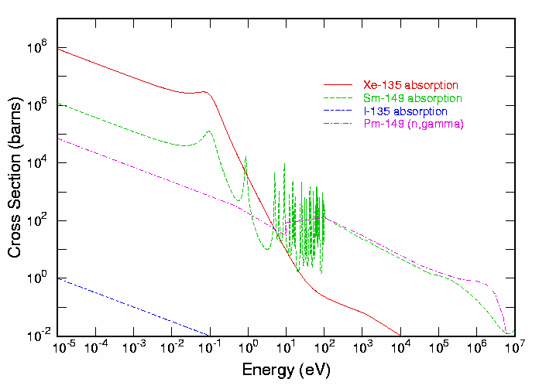
Medium Time Phenomena
Medium time phenomena are generally associated with the buildup, burnup, and beta decay of fission products ¹³⁵Xe and ¹⁴⁹Sm in thermal reactors
These two fission products have very large thermal neutron absorption cross sections and thus require special attention in thermal reactors

Slide 13
Xe-135 Buildup and Decay
Buildup and burnup of ¹³⁵Xe
ENDF/B-VII.1 & NuDat 2.7
Nuclide | Half-life | Decay constant (1/s) | Thermal XS (b) | U-235 Thermal Fission yield
Te-135 | 19.0 s | 3.648×10⁻²
I-135 | 6.57 hr | 2.926×10⁻⁵ | 80.03 | 0.0628 (cum)
Xe-135 | 9.14 hr | 2.107×10⁻⁵ | 2.665×10⁶ | 0.00256
Cs-135 | 2.3E+06 yr | 9.555×10⁻¹⁵ | 8.663 | 4.910×10⁻⁰⁶
Ba-135 | stable | 0.0 | 5.872

Slide 14
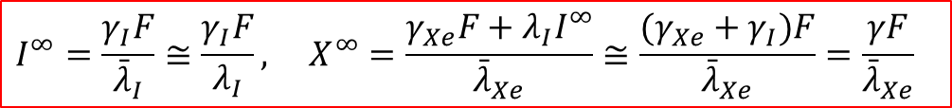
Equilibrium Xe-135 Concentration
System of differential equations
I-135 and Xe-135 concentrations for constant thermal flux
The concentrations of these isotopes quickly arise to their saturation or equilibrium values
$$I^{∞}=\frac{γ_{I}F}{{\bar{λ}}_{I}}≅\frac{γ_{I}F}{λ_{I}}, X^{∞}=\frac{γ_{Xe}F+λ_{I}I^{∞}}{{\bar{λ}}_{Xe}}≅\frac{(γ_{Xe}+γ_{I})F}{{\bar{λ}}_{Xe}}=\frac{γF}{{\bar{λ}}_{Xe}}$$

Slide 15
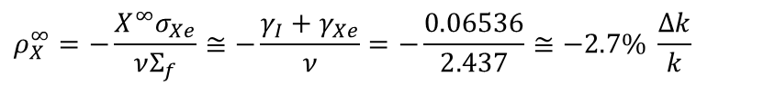
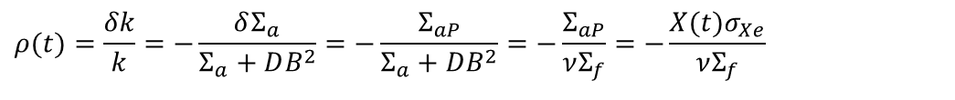
Xenon Poisoning
Reactivity effect of fission product poisoning
$$ρ(t)=\frac{δk}{k}=−\frac{δΣ_{a}}{Σ_{a}+DB^{2}}=−\frac{Σ_{aP}}{Σ_{a}+DB^{2}}=−\frac{Σ_{aP}}{νΣ_{f}}=−\frac{X(t)σ_{Xe}}{νΣ_{f}}$$
Reactivity worth estimate of equilibrium Xe-135 in high flux reactors:
$$ρ_{X}^{∞}=−\frac{X^{∞}σ_{Xe}}{νΣ_{f}}≅−\frac{γ_{I}+γ_{Xe}}{ν}=−\frac{0.06536}{2.437}≅−2.7\% \frac{Δk}{k}$$

Slide 16
Xe-135 Concentration after Shutdown
Using equilibrium concentrations, the time-dependent concentrations can be rewritten as
Reactor shutdown
If the reactor has been running for several days - long enough for iodine and xenon to reach equilibrium

Slide 17
Xenon Poisoning after Shutdown
For a sufficiently large operating flux the xenon concentration actually rises following shutdown
The peak concentration occurs at 11.3 hours after shutdown
The increase in Xe concentration causes a loss in reactivity that must be overcome if the reactor is to be restarted
Reactivity of Xe-135 Buildup after Shutdown

Slide 18
Xe-135 Buildup and Burnout Following Step Changes of Power

Slide 19
Sm-149 Buildup and Decay
Buildup and burnup of ¹⁴⁹Sm
ENDF/B-VII.1 & NuDat 2.7
Nuclide | Half-life | Decay constant (1/s) | Thermal XS (b) | U-235 Thermal Fission yield
Nd-149 | 1.728 hr | 1.114×10⁻⁵
Pm-149 | 53.08 hr | 3.627×10⁻⁶ | 1400 | 0.0108 (cum)
Sm-149 | stable | 0.0 | 4.052×10⁴ | 1.710×10⁻¹²
Equilibrium concentrations
Neodymium, Promethium
The equilibrium reactivity effect of Sm-149 is on the order of 0.6% Δk/k
Reactor shutdown

Slide 20
Samarium Poisoning after Shutdown
Reactor shutdown (cont’d)
If the saturation values have been reached by the time of shutdown
Reactivity effect
Samarium concentration rises following shutdown, and at long times is greater than the saturation value by an amount γ_{p}Σ_{f}φ/λ
To restart the reactor after an extended shutdown, sufficient additional reactivity must be available to overcome the added samarium that resulted from the promethium decay

Slide 21
Time Dependent Phenomena in Nuclear Reactors
Three distinct time-dependent phenomena in nuclear reactors
Short time phenomena: typical time intervals of milliseconds to seconds. Explicitly Solve Time Dependent Neutron Diffusion Equation w/ Delayed Neturon Source:
Medium time phenomena: hours to days corresponding
to the mean buildup and decay times of certain fission products
Long time phenomena: several months or years
Fuel depletion analysis
$$\frac{1}{v} \frac{dϕ}{dt}=Mϕ−λF_{p}ϕ+S_{d}$$
Cm246
Cm245
$${}_{\text{52}}^{\text{135}}{\text{Te}}\overset{→}{ \text{19 }\text{s} }{}_{53}^{135}I\overset{→}{ \text{6.7 }\text{hr} }{}_{\text{54}}^{\text{135}}{\text{Xe}}\overset{→}{ \text{9.2 }\text{hr} }{}_{\text{55}}^{\text{135}}{\text{Cs}}\overset{→}{ \text{2.3}×\text{1}{\text{0}}^{6} \text{yr} }{}_{\text{56}}^{\text{135}}{\text{Ba} }(\text{stable})$$
Am244
Cm244
Pu243
Am243
Cm243
Pu242
Am242^{m}
Am242
Cm242
$$Mϕ=λFϕ$$
Pu241
Am241
Np240
P240
U239
Np239
Pu239
U238
Np238
Pu238
α
U237
Np237
U236
Np236
Pu236
$$\frac{dN_{A}(t)}{dt}=−(σ_{A}^{a}φ+λ_{A})N_{A}(t)+σ_{C}^{γ}φN_{c}(t)+λ_{B}N_{B}(t)$$
α
U235
α
Pa234
U234
$$Mϕ=λFϕ$$
Th233
Pa233
U233
(n,3n)
Th232
Pa232
U232
α
Th231
Pa231
U231
(n,3n)
Th230

