Slide 1


A Hybrid Recognition System for Check-Worthy Claims
Using Heuristics and Supervised Learning
Team：Prise de Fer
Chaoyuan Zuo¹, Ayla Karakas², Ritwik Banerjee¹
¹ Department of Computer Science
² Department of Linguistics
Presented by
Chaoyuan Zuo
Notes:
Good afternoon, everyone. My name is Chaoyuan Zuo, and our team is from Stony Brook University, in the United States. Our team includes me, my advisor, Prof. Ritwik Banerjee , and Ayla Karakas, she is a student from Lingustic department

Slide 2
01
Introduction
A Hybrid Recognition System using Heuristics and Supervised Learning
Data
Preprocessing
Feature Extraction
Feature Selection
Model
Speaker Name Normalization
Sub-Datasets Creation
Feature
Design
Imbalanced Learning
Supervised Learning Methods
Heuristics
Notes:
At first, let me introduce the overview of our approach. For this task, our team handled it as a binary classification problem, and we used the probability that each sentence to be labelled as check-worthy as the score for further ranking. Here we presents a hybrid system using Heuristics and supervised learning, which includes three main steps: the first step, Data preprocessing, including the normalization of speaker name, and the creation of sub- datasets, mainly for the speech files in the test data, the next step is the extraction and selection of the feature, and the last part is model itself, including imbalanced learning methods to handle the high imbalance of the data, and then the supervised learing method and heuritsics.

Slide 3
02
Model and System
Notes:
Now we will move to the details of this system

Slide 4
Data Preprocessing
Speaker Name Normalization
Hillary Clinton (D-NY)
Sub-Datasets Creation
Training Data: Debate
Former Secretary of State, Presidential Candidate
Clinton
Test Data: Debate & Speech
Hillary Clinton
Two Classifiers
Notes:
During the Data preprocessing part, we are focusing on two issues, the first one is Speaker Name Normalization, that is, in the data, for each sentences, we have the speaker name as its attribute, however, we find there is a case that different speaker names actually refer to the same person, For example, we have speaker names as Hilary Clinton or Former Secretary or just Clinton, they all refer to Hilary Clinton, so we manually normalized all speaker names for further analysis.
Besides, in the training data, we have transcripts of three debates, but in the test data, except for debates, we also have transcript for speeches from Trump. And we believe the model build for debate may not work that good for speech files, so we decided to build different models for different files. And in the case, we create a new sub-dataset buy selecting all the sentences spoken by Trump in the original file. That is, we actually build two different classifiers in the task, one for debate files using original dataset and another for speech files using our new sub-dataset.

Slide 5
Feature Extraction
Lexical Features: Remove stopwords and stem the words
Semantic Features: Named entity
Word Embedding : Word vector
Stylometric Features : POS tags, tense, negations…
Affective Features: Sentiment analysis, subjectivity, bias…
Metadata Features: Binary non-linguistic features
Discourse Features: Segment features
Notes:
Then we extracted several features from the data, not only the traditional lexical and semantic features, but also the word embedding and affective features such as sentiment analysis, word subjectivity or bias. We also have some specific features for this task, like the metadata features, they are some binary non-linguistic features, for example, whether the speaker mentioned its opponent's name, We also use the definition of segmenr from some previous work , where ``segment‘’ e means the maximal set of consecutive sentences by the same speaker. As features, we include the relative position of a sentence within its segment, and the number of sentences in the previous, current and subsequent segments

Slide 6
Feature Selection
Imbalanced Dataset!
Training Data | # Sentences
Label 0 | 3895
Label 1 | 94 (2.36%)
Part 1
Univariate feature selection
Select 2000 best lexical features based on Chi-Square test
Part 2
Embedded feature selection
Under-Sampling
Create balanced subsets
Feature Selection
SVM with linear kernel with L1 norm
Features Combination
Over 3500 features → 2600
Notes:
After we obtained a large set of features, we find it might be better to do the feature selection to reduce the sparsity, we first do the univariate feature selection on lexical features based on Chi-square test.
And then we use the embedded feature selection , it will learn which feature best contribute to the accuracy of the classifier. However, recall the high-imbalance of the training data, where only a small part of the sentences is positive, we first use under-sampling method to create several balanced subsets, then train SVM model with linear kernel and L1 normalization, in this way, we get the useful feature for each subset and by combining them all, we obtain our final features sets, decreasing from over 3500 to 2600 now.

Slide 7
Model
Imbalanced Learning
Under-sampling
Over-sampling
System
Classifier
SVM
MLP
Heuristic
Rule
Strict Mode
Notes:
Now we will move to the actual model part, start to build the classifers

Slide 8
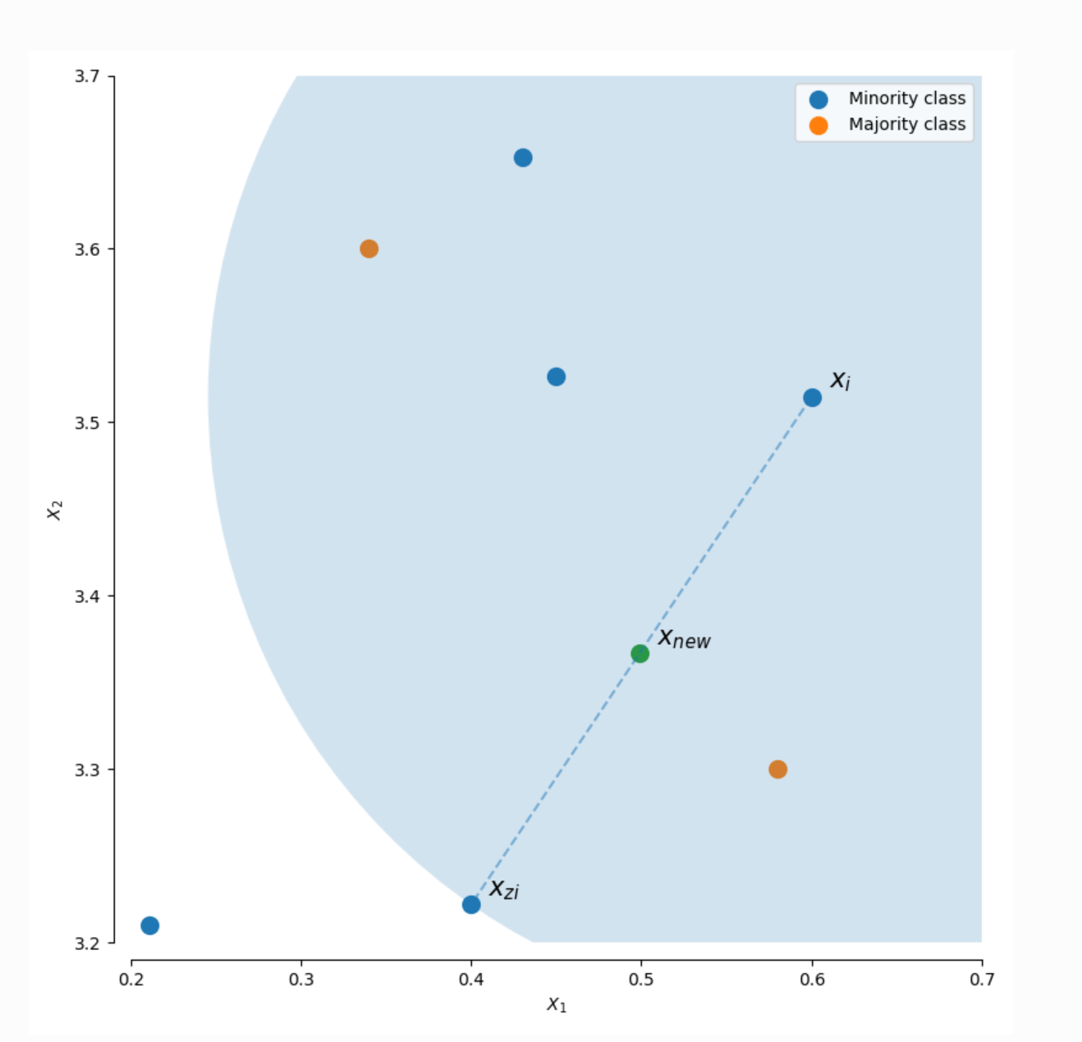

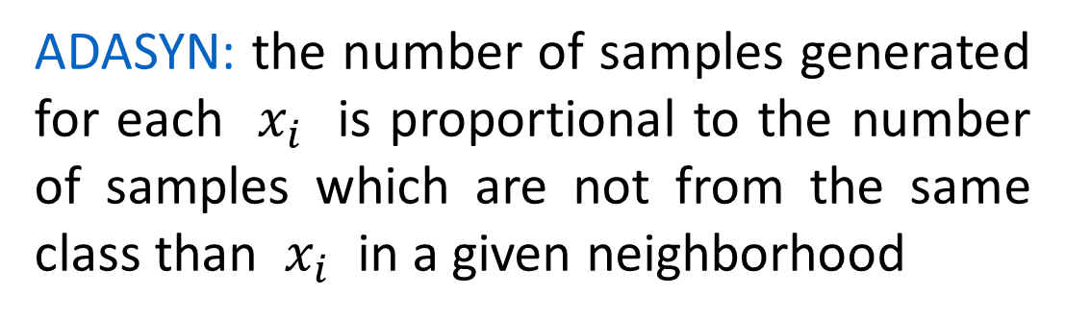

Imbalanced Learning
From random over-sampling to ADASYN
$$x_{new}=x_{i}+λ ∙{( x}_{zi} −x_{i})$$
$$λ∈\left[0,1\right], x_{zi}∈k \text{nearest}\text{−}\text{neighbors}$$
ADASYN: the number of samples generated for each $x_{i}$ is proportional to the number of samples which are not from the same class than $x_{i}$ in a given neighborhood
http://contrib.scikit-learn.org/imbalanced-learn/stable/over_sampling.html#from-random-over-sampling-to-smote-and-adasyn
Notes:
Again, since the dataset is highly imbalanced, which means we cannot directly train the model to get a reasonable results. And here instead of using random over-sampling or under-sampling, we tried a method called ADASYN which will create a new instance of the minority class from the original one.

Slide 9
Classifier
2 hidden layer: 100 and 8 units
L2 Regularization
Activation Function: Tanh
Optimization: Adam
SVM
MLP
Linear kernel with L2 loss
L2 Regularization
Notes:
During the training step, we have tried several different classifiers like random forest, decision tree and we found SVM and MLP outperform the others and here are the best configurations of these two classifiers

Slide 10
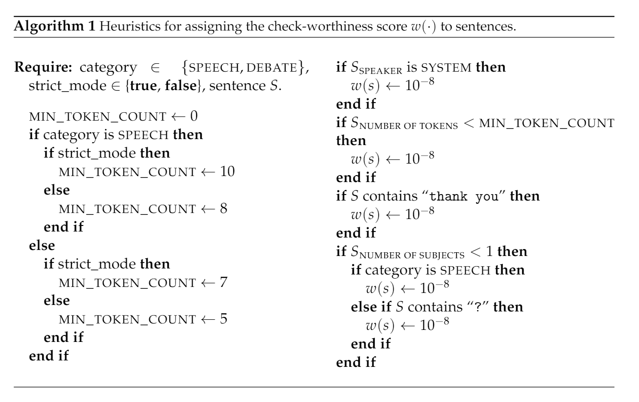
Heuristics
Motivation
False Positive Instances:
“ The USA, the USA, the USA…”
“Can you imagine the people that are, frankly, doing so well against us with ISIS?...”
Notes:
However, after finishing the training step and when we manually check the classification results, we find some common mistakes, and on the left we list some examples. And we find those kind of mistakes can be fixed by setting some simple rules, So we decide to introduce the heuristics to override the scores assigned by the classification models. These rules differed slightly based on either the category, that it, speech or debate, and or whether or not the ‘strict’ mode were used. The mean it would tend to discard more sentences.
So in this way, if a sentence is too short or it’s a incomplete then we won’t consider it to be check-worthy

Slide 11
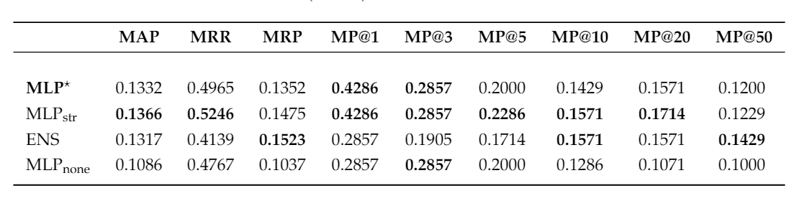
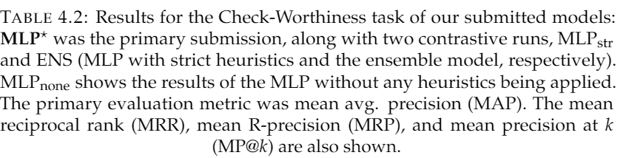
03
Results & Analysis
1:
Notes:
Here we list the results of our different model, the first one is the MLP with loose heuristics and it seems the strict heuristics will increase the performance, The third one is a ensemble model combined with the SVM and MLP, and the results of the fourth model, which is without the heuristics, shows the heuristics do offer better performance.

Slide 12
03
Results & Analysis
01
Tense:
e.g. “We’re cutting taxes.”
04
02
Duplicate sentences
05
Anecdotal stories
03
Sentence Fragments:
e.g. “Ambassador Stevens – Ambassador Stevens sent 600 requests for help”
Rhetorical figures of speech
Notes:
Then when detailly analysis the classification results, we found this problem is indeed difficult to handle. For example, as we know the tense of a sentence is a important flag for it to be checked or not, like we don’t need to check the sentence with future tense, but it’s hard to tell the exact tense of the sentence in dialogue, Besides, the problem of duplicate sentence or sentence fragments also affect the performance of the classifiers, and we believe that our features are better suited for written language than speech or debate transcript.

Slide 13
04
Conclusion
Conclusion
Future Work
Feature Design
Deep syntactic features
Imbalanced Learning
Automated name normalization
Heuristics
Complex neural networks
Notes:
So in all, our system achieve comparatively good performance in this task, and we believe the key factors will be the feature design, the imbalanced learning methods dealing with the imbalanced data and the introduction of heuristics. We still expect to explore more in this task.

Slide 14
Q & A
Notes:
That’s what I want to share today and thanks for listening, any questions?

Slide 15
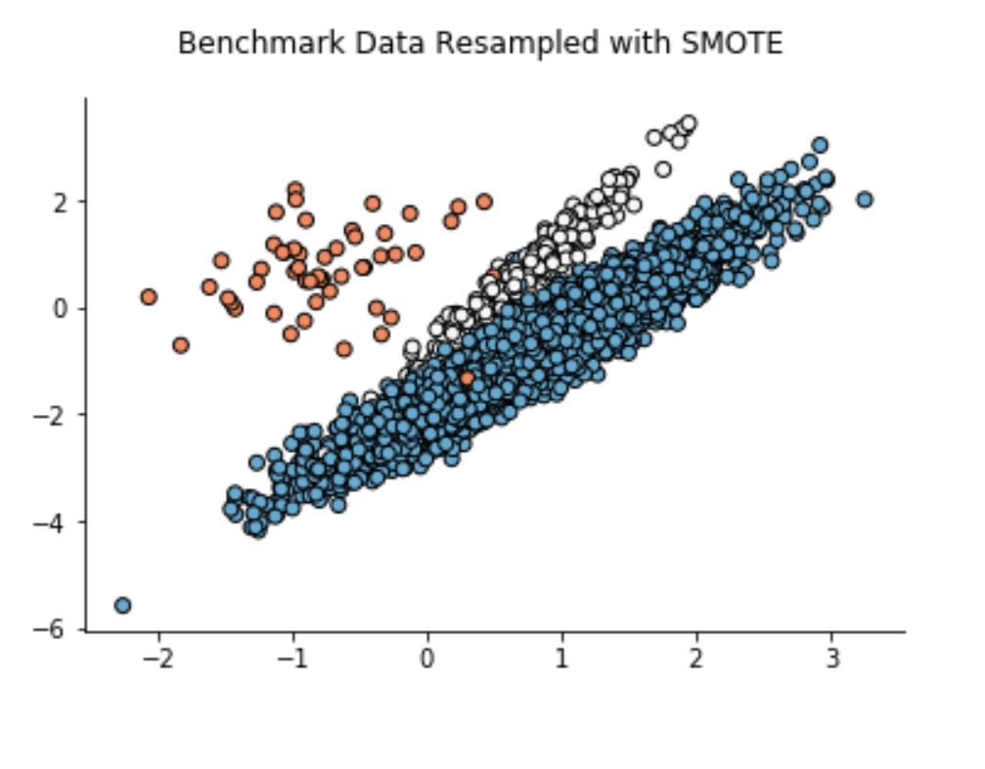
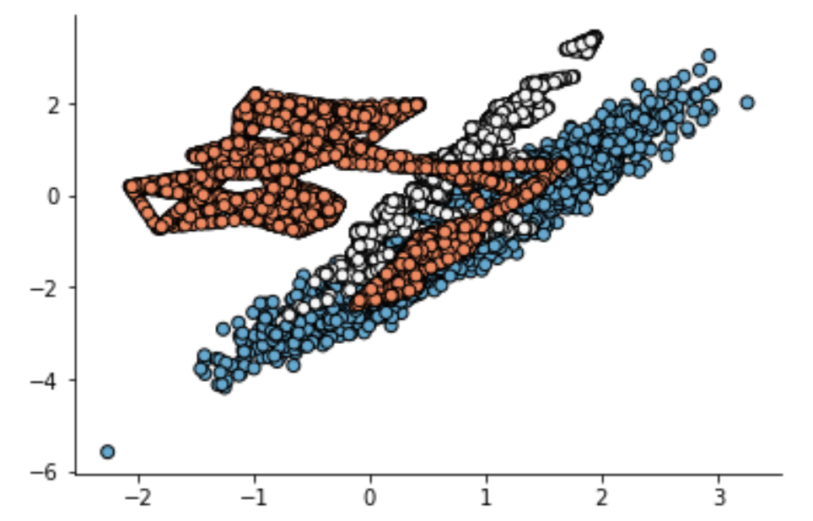

Oversampling with SMOTE
The SMOTE algorithm is parameterized with k_neighbors (the number of nearest neighbors it will consider) and the number of new points you wish to create. Each step of the algorithm will:
Randomly select a minority point.
Randomly select any of its k_neighbors nearest neighbors belonging to the same class.
Randomly specify a lambda value in the range [0, 1].
Generate and place a new point on the vector between the two points, located lambda percent of the way from the original point.
$$x_{new}=x_{i}+λ ∙{( x}_{zi} −x_{i})$$
Notes:
The weakness of SMOTE is readily apparent from this quick test. Because the algorithm doesn't have any jitter, for minority class sample clouds with few enough points it tends to result in long "data lines".
SMOTE has also done something here that I am less comfortable with: it's constructed a "bridge" between the main red point cloud and a handful of outlier points located in the blue cluster.

Slide 16
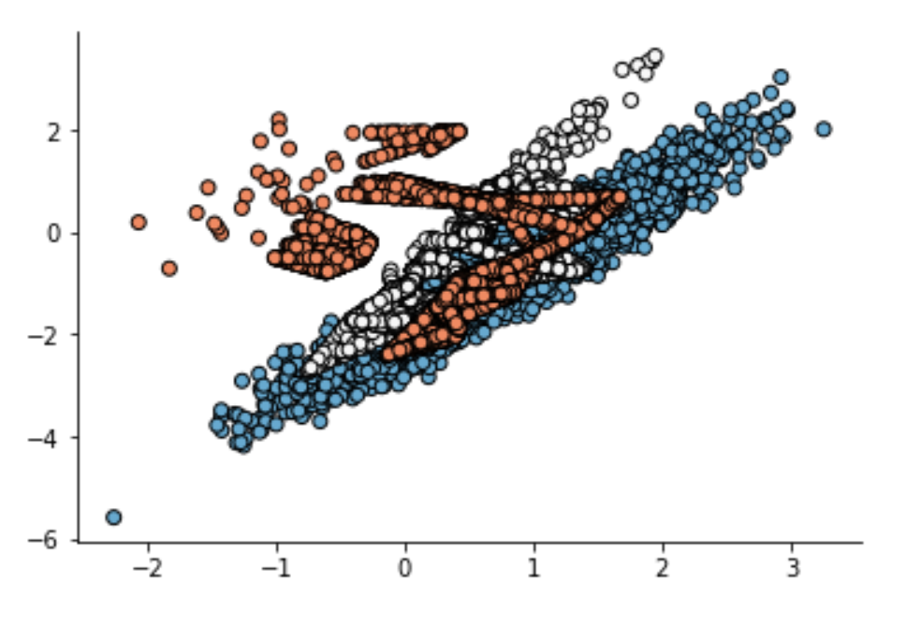

Oversampling with ADASYN
ADASYN is similar to SMOTE, and derived from it, featuring just one important difference. it will bias the sample space (that is, the likelihood that any particular point will be chosen for duping) towards points which are located not in homogenous neighborhoods
$$x_{new}=x_{i}+λ ∙{( x}_{zi} −x_{i})$$
Notes:
This technique inherits the primary weakness of SMOTE, e.g. its ability to create innerpoint-outerpoint bridges. Whether or not the heavy focus on the outlier points is a good thing or not is application dependent, but overall ADASYN feels like a very heavy transformation algorithm,

