Slide 1
IT Services Market View, 2022-2023

Slide 2
The IT Services Market View in 2022-2023
IT services providers can gain market share and grow revenue by examining and taking action on their competitive position, the market trends and relevant forecast assumptions.
This document summarizes Gartner’s research on the IT services marketplace. The content is presented in five sections:
Market Share and Forecast Segment and Schedule
Forecast Analysis
Market Share Analysis

Slide 3
Market Share and Forecast: Coverage, Taxonomy and Schedule

Slide 4
IT Services Market Coverage
Market Share (Publishes Annually)
Forecast (Publishes Quarterly)
258 IT Services Providers
2 Years of Data
44 IT Services Segments
7 Years of Data
2 Historical
5 Forecast
9 Segment Markets
48 Country Markets
48 Country Markets
12 Vertical Markets
Current U.S. Dollars, Constant U.S. Dollars and Local Currency
Current U.S. Dollars, Constant U.S. Dollars and Local Currency
Note: When looking at worldwide, regional or grouped countries’ market sizes, clients should always use current U.S. dollars. When looking at worldwide, regional or grouped countries’ growth rates, clients should use constant U.S. dollars. When looking at a single country, clients should use local currency.
In response to Russia’s invasion of Ukraine that began on 24 February 2022 and was ongoing at the time of this publication, Gartner is suspending forecast coverage of Russia and the Eurasia region. The definition of Rest of Eastern Europe has been expanded to include Russia and the countries previously covered in the Rest of Eurasia.

Slide 5
Changes to IT Services Vertical Segmentation 2022-2023
2021 Market Segmentation
2022 Market Segmentation
Banking and Securities
Communications, Media and Services
Education
Government
Healthcare Providers
Insurance
Manufacturing and Natural Resources
Retail
Transportation
Utilities
Wholesale trade
Name change
Banking and Investment Services
Communications, Media and Services
Education
Government
Healthcare and Life Sciences
Insurance
Manufacturing and Natural Resources
Retail
Transportation
Oil and Gas
Power and Utilities
Wholesale trade
(+) Life sciences , (+) Health insurance (payer)
(-) Health insurance (payer)
(-) Life sciences , (-) Energy resources and processing
(-) Pipelines
(+) Pipelines , (+) Energy resources and processing
Summary of segmentation changes:
“Banking and Securities” renamed to “Banking and Investment Services,” with no change in definition.
“Healthcare Providers” renamed to “Healthcare and Life Sciences,” with the addition of “Life Sciences” (previously reported under “Manufacturing and Natural Resources”), and “Health Insurance (Payer)” (previously reported under “Insurance”).
“Utilities” has been further divided into “Oil and Gas,” with the addition of “Pipelines” (previously reported under “Transportation”) and “Energy Resources and Processing” (previously reported under “Manufacturing and Natural Resources”), and “Power and Utilities.”

Slide 6
IT Services Market Segmentation
Business Consulting
Technology Consulting
IT Services
Consulting
Application Implementation
Application Implementation and Managed Services
Application Managed Services
Infrastructure Implementation
Infrastructure Implementation and Managed Services
Infrastructure Managed Services
Infrastructure as a Service (IaaS)
Client Device Support
Data Center Systems Support
Hardware Support
Network Systems Support
Business Process Services
Traditional BPS
Digital BPS
Source: “Market Definitions and Methodology: IT Services” (G00794035)

Slide 7
Consulting Market Taxonomy
Consulting
Business
Consulting
Business Operations
Corporate Strategy
Financial Management
Human Capital Management
Marketing and Customer Management
Technology
Consulting
Risk Management
Application Technology Consulting
Infrastructure Technology Consulting
Technology Strategy and Governance
Source: “Market Definitions and Methodology: IT Services” (G00794035)

Slide 8
Application Implementation and Managed Services Market Taxonomy
Application
Implementation
and Managed Services
Application
Implementation
Commercial Application Implementation
Custom Application Implementation
Commercial Application Managed Services
Application
Managed Services
Application Management and Modernization Services
Custom Legacy Application Managed Services
Custom Product-Centric Application Managed Services
Source: “Market Definitions and Methodology: IT Services” (G00794035)

Slide 9
Infrastructure Implementation and Managed Services Market Taxonomy
Infrastructure
Implementation
and Managed Services
Infrastructure
Implementation
Data Center and Workplace Implementation
Colocation
Hosted and Private Infrastructure
Network Implementation
Managed Services for Cloud and Edge Environments
Data Center Services
Managed Services for Traditional Data Center Environments
Enterprise Network Managed Services
Managed LAN/WLAN
Infrastructure
Managed Services
SD-WAN Managed Services
Service Desk Managed Services
Traditional WAN Managed Services
Managed Workplace Services
End-User Compute Services
Desktop as a Service
(DaaS)
Managed Mobility Services
Source: “Market Definitions and Methodology: IT Services” (G00794035)

Slide 10
Business Process Services Market Taxonomy
Business Process
Services
Traditional
BPS
Administration
Cloud Payment Processing
Customer Management
Customer Management
Finance and Accounting
Finance and Accounting
Human Resources
Operations
Human Resources
Digital
BPS
Supply Management
Operations
Digital BPS
Supply Management
Asset-Intensive
BPS = Business Process Services
Source: “Market Definitions and Methodology: IT Services” (G00794035)

Slide 11
Forecast Analysis

Slide 12
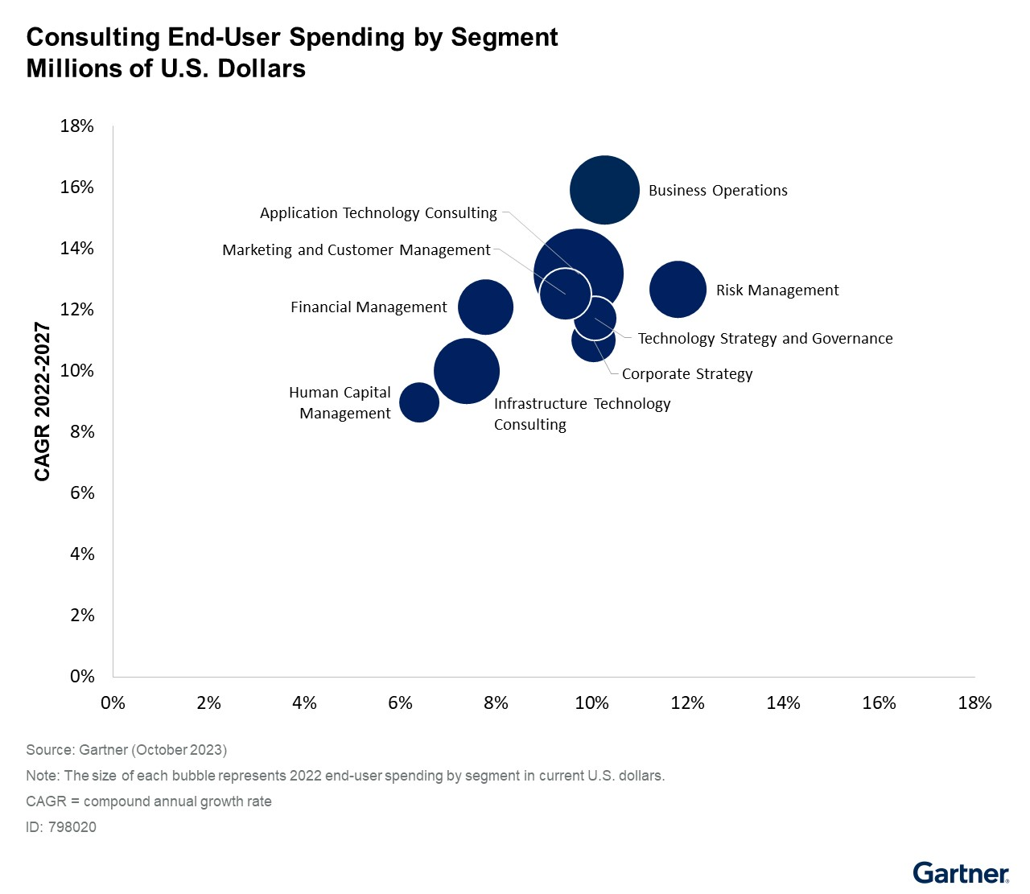
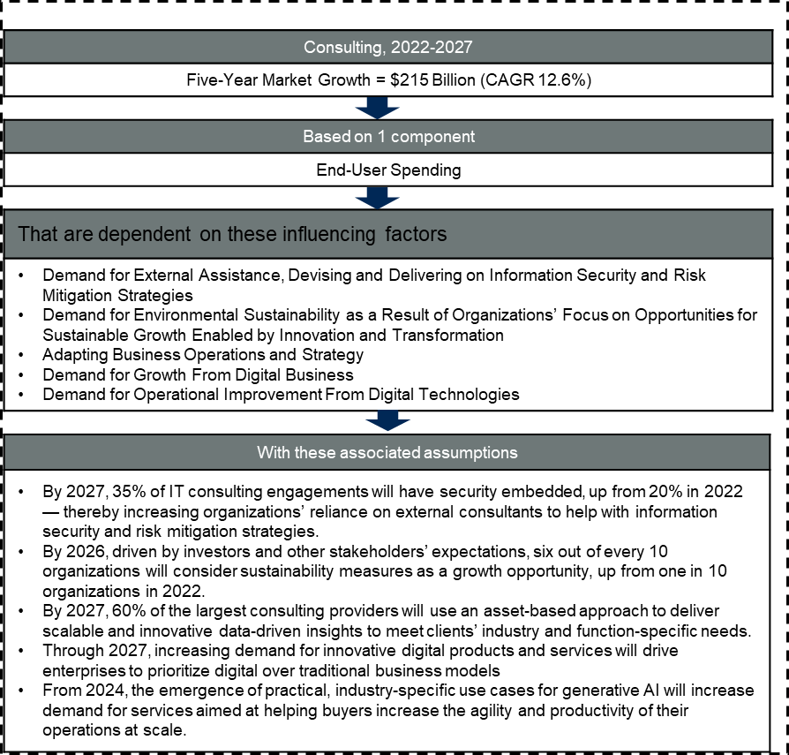
Forecast Analysis: Consulting Services, Worldwide

Slide 13
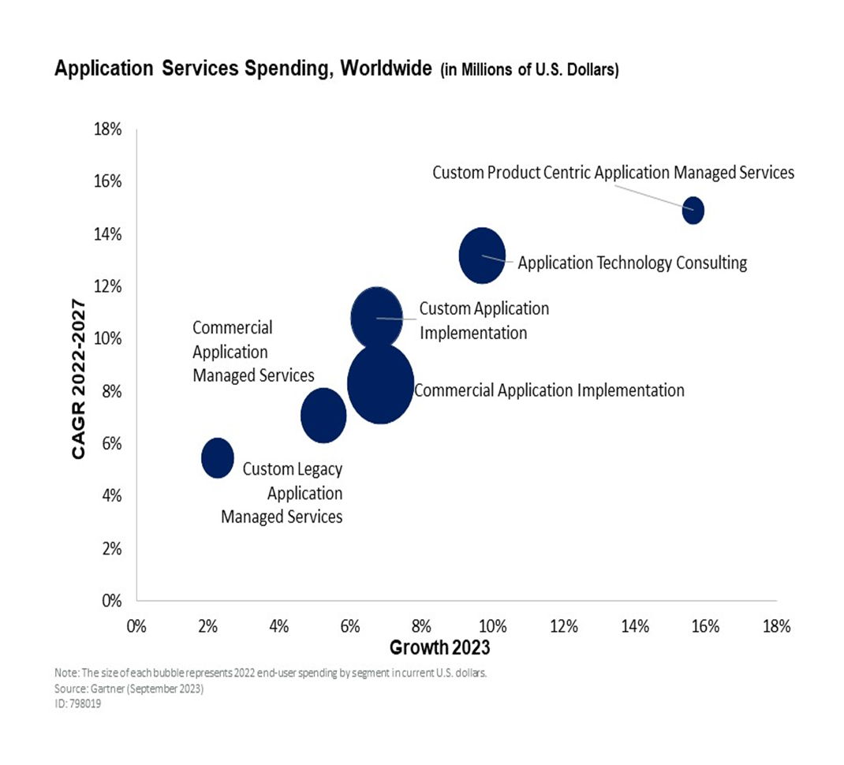
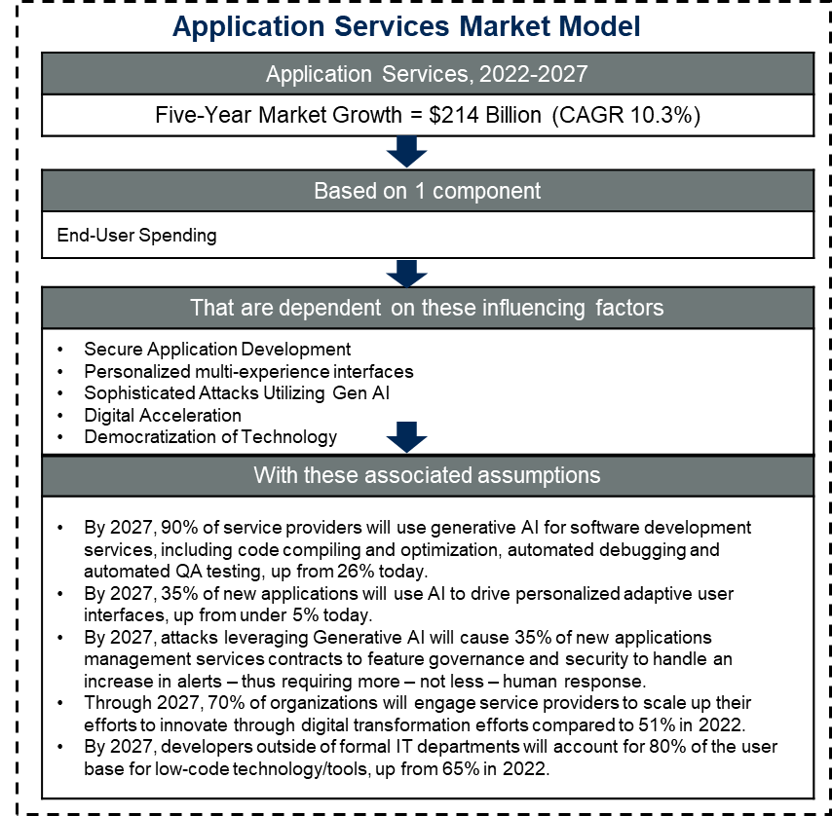
Forecast Analysis: Application Services, Worldwide

Slide 14
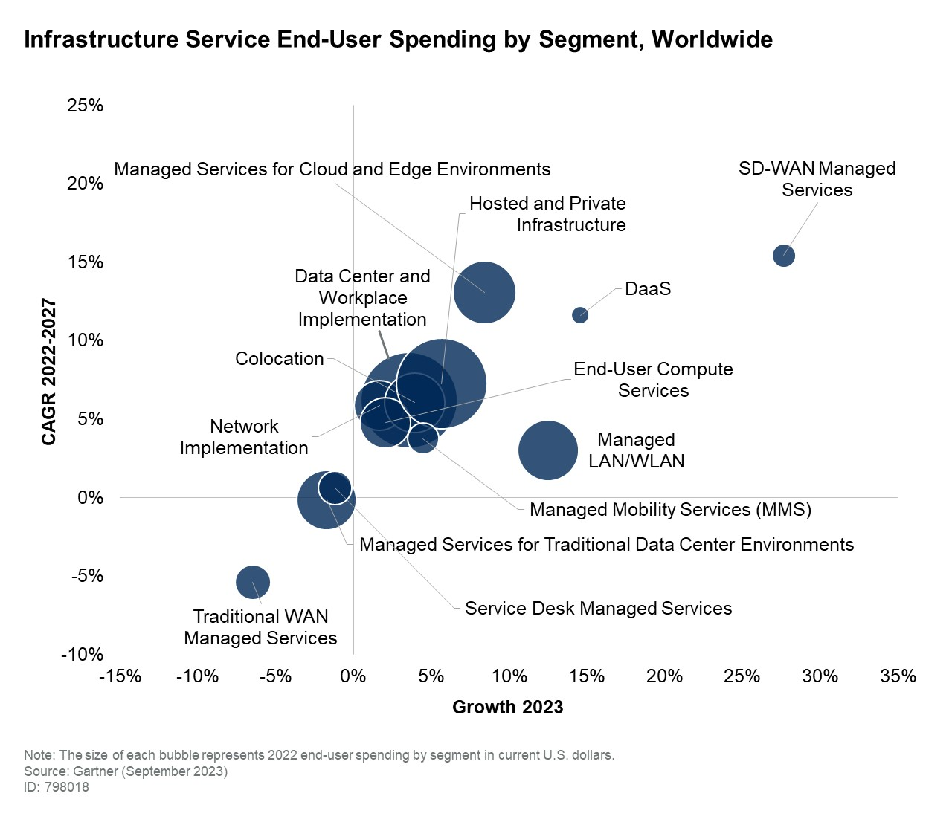
Forecast Analysis: Infrastructure Services, Worldwide
Infrastructure Services Market Model
Infrastructure Services, 2022-2027
Five-Year Market Growth = $94 Billion (CAGR 6.0%)
Based on 1 component
End-User Spending
That are dependent on these influencing factors
Digital Touchpoint Solutions Enterprise Application and Infrastructure Management
With these associated assumptions
By 2026, 75% of organizations will rely on a digital business model predicated on cloud as the fundamental underlying platform. By 2027, 50% of legacy and on-premises customized application workloads will be transformed for cloud delivery, up from 20% in 2022. In 2027, 5% of spending on managed services for cloud and edge environments will come from GenAI workloads, up from less than 1% in 2023.

Slide 15
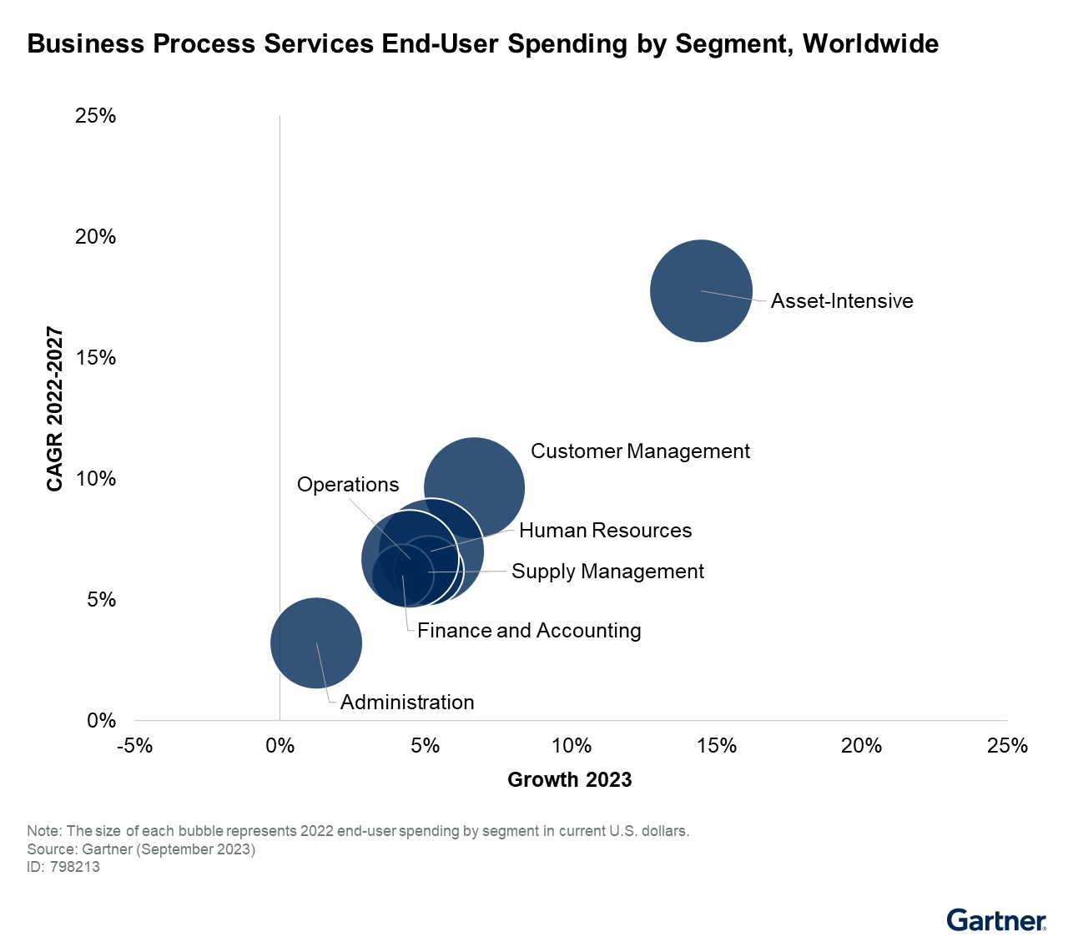
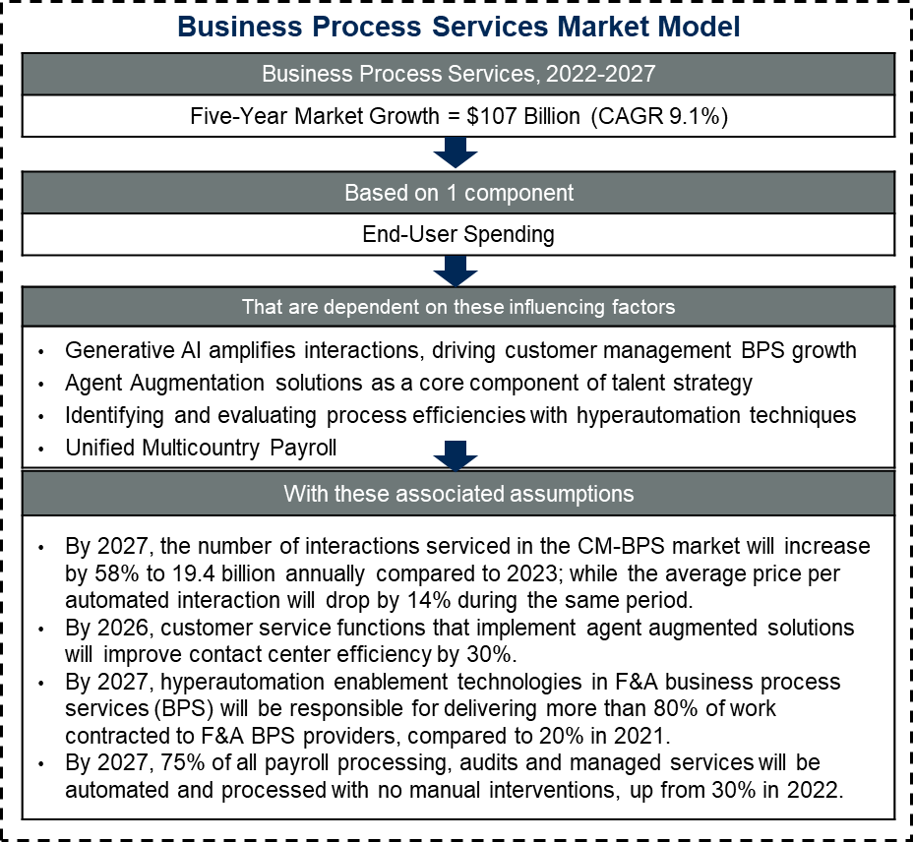
Forecast Analysis: Business Process Services, Worldwide

Slide 16
Market Share Analysis

Slide 17
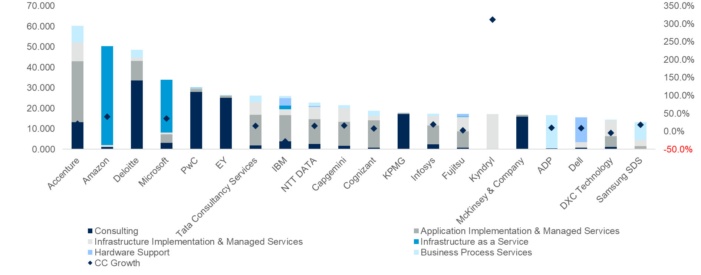


Top 20 IT Services Providers’ Revenue in 2022
CC = constant currency
Source: “Market Share: IT Services, Worldwide, 2022” (G00787876)
Note: IBM displays significant decline in growth rate due to Kyndryl Divestment.

Slide 18
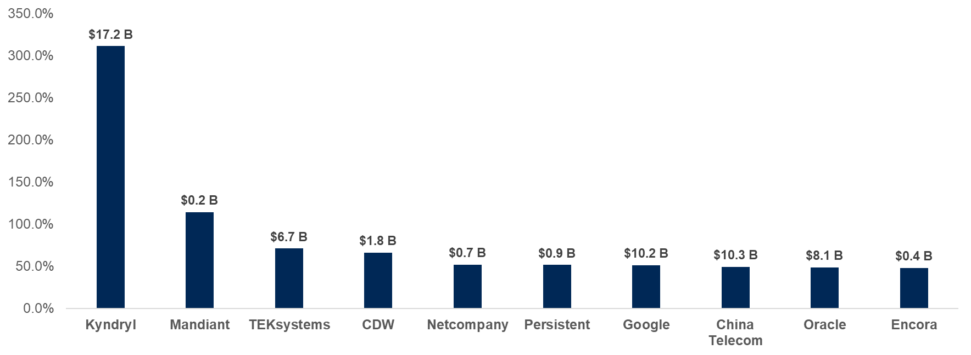
Top 10 Worldwide Fastest-Growing IT Services Providers by Annual Growth Rate in Constant Currency, 2022
Annual Growth Rate in Constant Currency
Source: “Market Share: IT Services, Worldwide, 2022” (G00787876)

Slide 19
IT Services Is a Market of $1.3 Trillion Annual Spend
Revenue by Segment
Revenue by Vertical
Service Segment | Share of Vendor Revenue | Growth in Vendor Revenue Constant Currency
Technology Consulting | 9.2% | 19.3%
Business Consulting | 11.2% | 20.7%
Application Managed Services | 8.9% | 14.4%
Application Implementation | 16.6% | 17.8%
Infrastructure Managed Services | 17.5% | 4.5%
Infrastructure Implementation | 6.9% | 6.4%
Infrastructure as a Service | 9.2% | 36.1%
Business Process Services | 15.0% | 10.2%
Hardware Support | 5.5% | 3.4%
Verticals | Share of Vendor Revenue | Growth in Vendor Revenue Constant Currency
Banking and Investment Services | 19.3% | 14.3%
Communications, Media and Services | 17.2% | 13.1%
Education | 2.4% | 15.7%
Government | 15.2% | 12.5%
Healthcare and Life Sciences | 7.7% | 18.5%
Insurance | 6.4% | 13.1%
Manufacturing and Natural Resources | 14.2% | 14.0%
Oil and Gas | 1.6% | 14.8%
Power and Utilities | 3.4% | 13.5%
Retail | 8.1% | 14.3%
Transportation | 3.5% | 11.7%
Wholesale Trade | 1.1% | 8.6%
Source: “Market Share: IT Services, Worldwide, 2022” (G00787876)

Slide 20
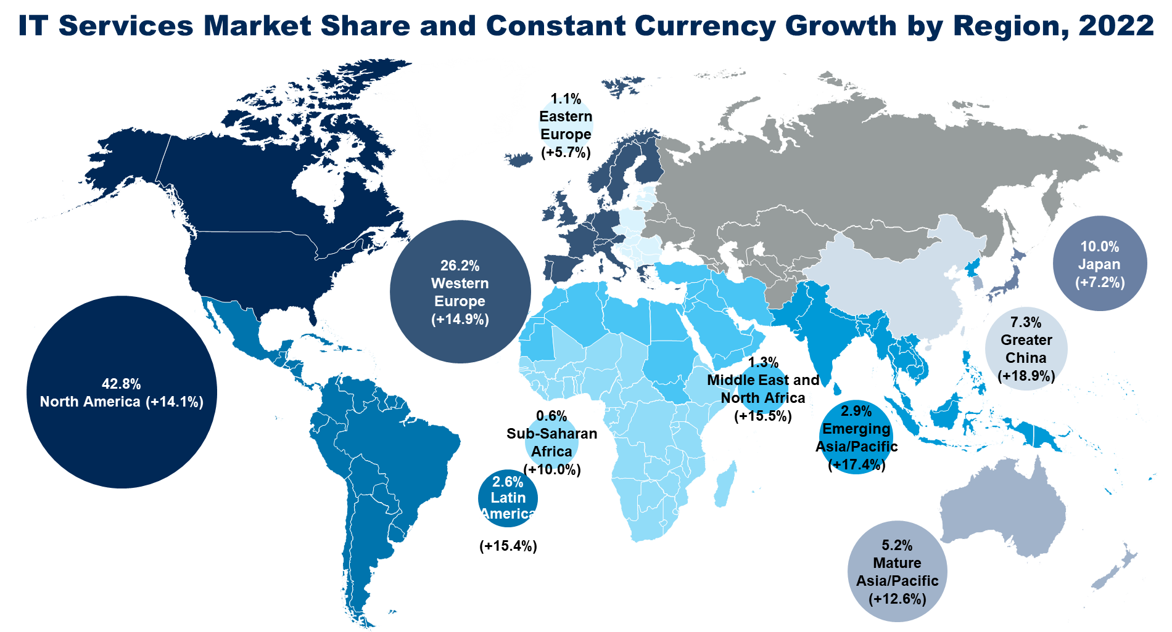
Source: “Market Share: IT Services, Worldwide, 2022” (G00787876)

