Slide 1
Continuous Threat Exposure Management
Jeremy D’Hoinne, Pete Shoard
Notes:
Ver 2022-1208
Presenter's Name
Presenter's Name

Slide 2
By 2026, organizations prioritizing their security investments, based on a continuous threat exposure management program, will realize a two-thirds reduction in breaches.
Gartner Strategic Planning Assumption

Slide 3
Continuous Threat Exposure Management
What It Is
An integrated, iterative approach, made of five-steps cycles prioritizing and validating responses and optimizations to continually refine security posture improvements.
Why It Matters to CIOs
The expanded attack surfaces that organizations now have, due to investments in cloud, SaaS and third-party supplier relationships, mean that traditional vulnerability management is simply not holistic enough.

Slide 4
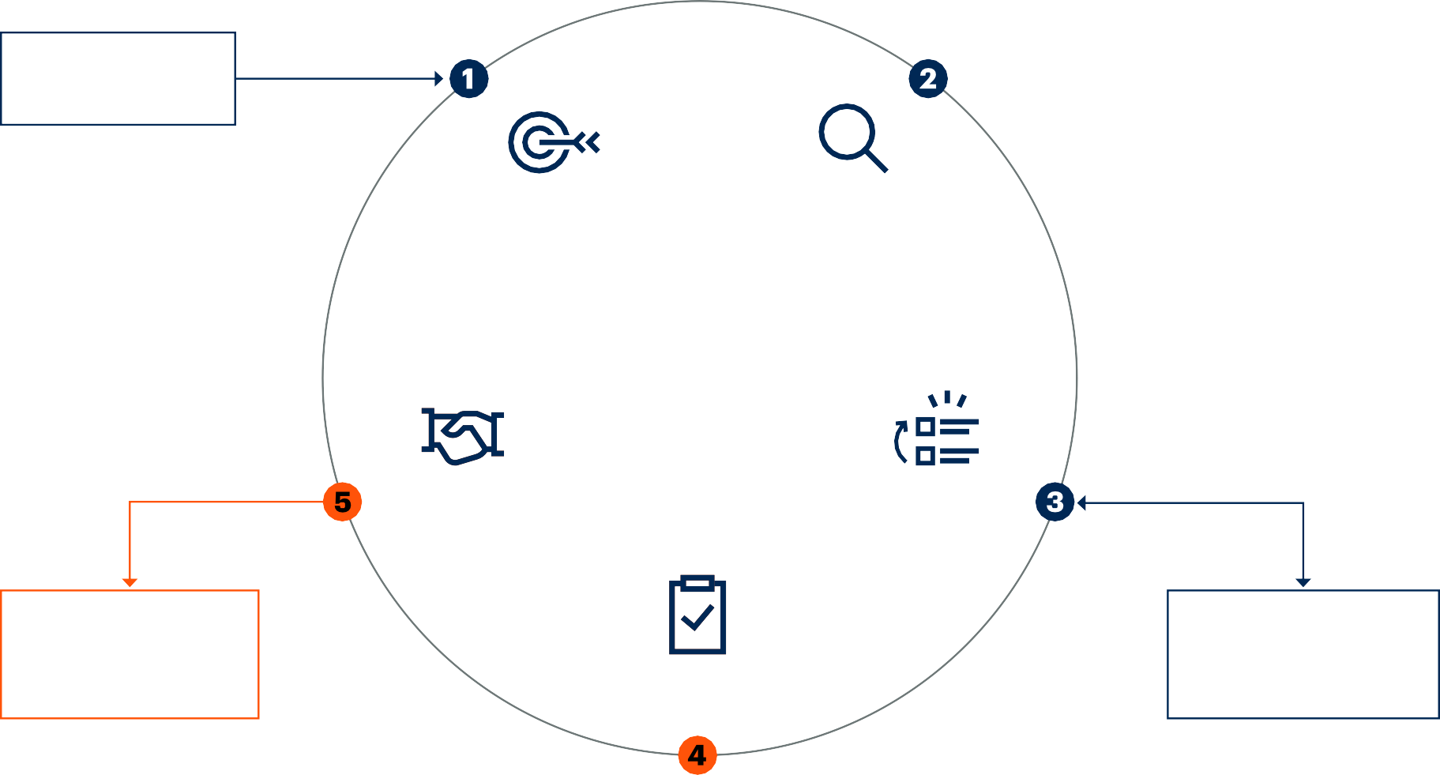
Continuous Threat Exposure Management
Cyber-Risk Management
Drive
Scoping
Discovery
D
i
a
g
n
o
s
e
CTEM
Initiate
A
Enrich
c
t
Mobilization
i
Prioritization
o
n
Treatments and Security Posture Optimization
Threat Detection Investigation and Response (TDIR)
Validation

Slide 5

University of Westminster
University of Westminster moved from a reactive to a proactive approach to cybersecurity by giving real-time visibility of IT assets to the IT team. They have extended the patch management program to facilitate the patching of more than 5,000 assets.
The effort was made to also include assets that weren’t managed by the IT team, and they had a critical need to identify and decommission end-of-life assets. Leveraging a new tool, they improved their ability to measure the exposure of their assets.
Source: Gartner Case Study: Case Study: Proactive Approach to Cybersecurity in Higher Education.

Slide 6

European Midsize Organizations*
The upcoming Tiber-EU framework includes requirements to reduce gaps found in security posture to days instead of months. This appears out of reach for midsize organizations without well-staffed security operation teams, and not a dedicated “red team.”
Expanding from successful pilot of breach and attack simulation, these organizations expanded on the tool to build regular (monthly or even weekly) and automated cybersecurity validation assessments, in addition to their mandatory quarterly penetration testing assessments.
*Aggregate example generated from analyst interactions with many relevant companies.

Slide 7
Recommendations for IT Leaders
Scoping before discovery enables better long-term scale management
Integrate continuous threat exposure management principles progressively
Adopt the “attacker’s view” to assess the effectiveness of key security controls
Improving mobilization starts with security champions and requires to offer a range of tactical and strategic remediations

Slide 8
Recommended Gartner Research
Implement a Continuous Threat Exposure Management (CTEM) Program; Jeremy D’Hoinne, Pete Shoard and Mitchell Schneider (G00763954)
Predicts 2023: Enterprises Must Expand From Threat to Exposure Management; Jeremy D’Hoinne, Pete Shoard and Others (G00779535)
Top Trends in Cybersecurity 2023; Richard Addiscott, Alex Michaels and Others (G00782545)
How to Implement a Risk-Based Vulnerability Management Methodology; Craig Lawson (G00777685)

Slide 9






Gartner Analysts Covering Industry Cloud Platforms
Jeremy D’Hoinne
VP Analyst
10 years at Gartner, 24 years industry experience
Jie Zhang
VP Analyst
12 years at Gartner, 23 years industry experience
Pete Shoard
VP Analyst
6 years at Gartner, 20 years industry experience
Paul Proctor
Distinguished VP Analyst
20 years at Gartner, 39 years industry experience
Mitchell Schneider
Senior Principal Analyst
9 years at Gartner, 9 years industry experience
Jonathan Nunez
Senior Principal Analyst
1 year at Gartner, 19 years industry experience

