Slide 1
Create Your Own Hype Cycle With Gartner’s Hype Cycle Builder
September 2023
Notes:
Presenter's Name
Presenter's Name

Slide 2
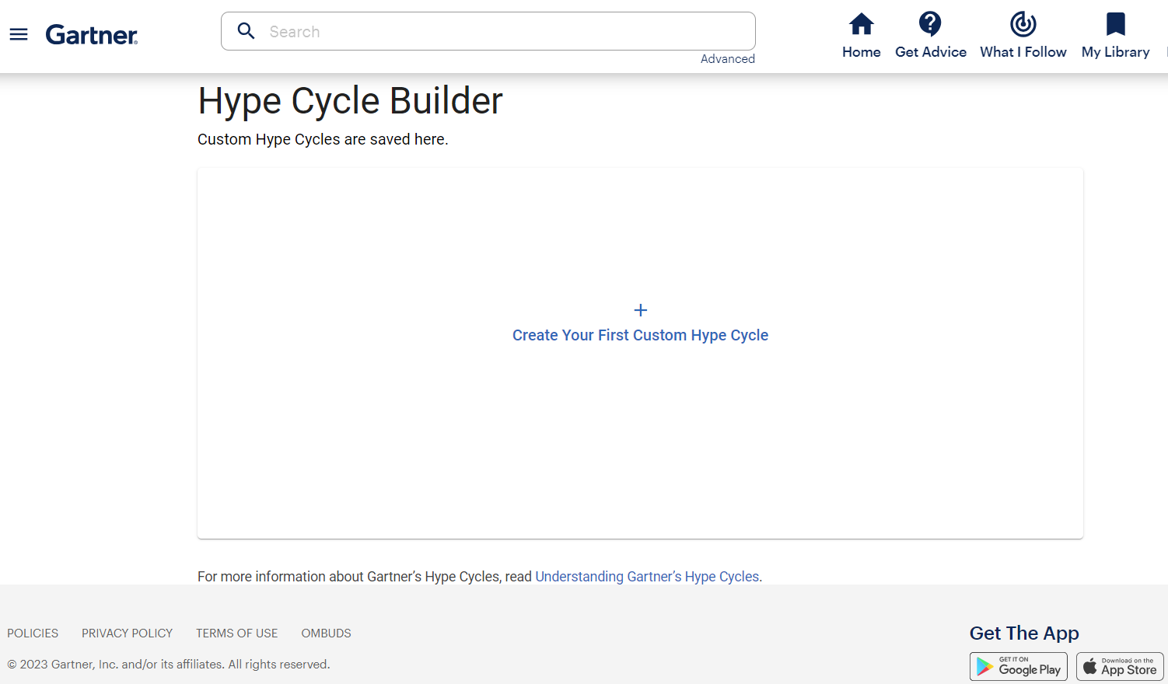
Hype Cycle Builder Opening Screen
Notes:
Once you have clicked on the launch button at the top of the narrative portion of the publication, you will arrive at this Hype Cycle Builder opening screen. This is the first step on your journey to creating your own custom Hype Cycles. From this screen, click the plus sign (+) in the middle of the screen to launch a new Hype Cycle. This will lead you to the next screen.

Slide 3
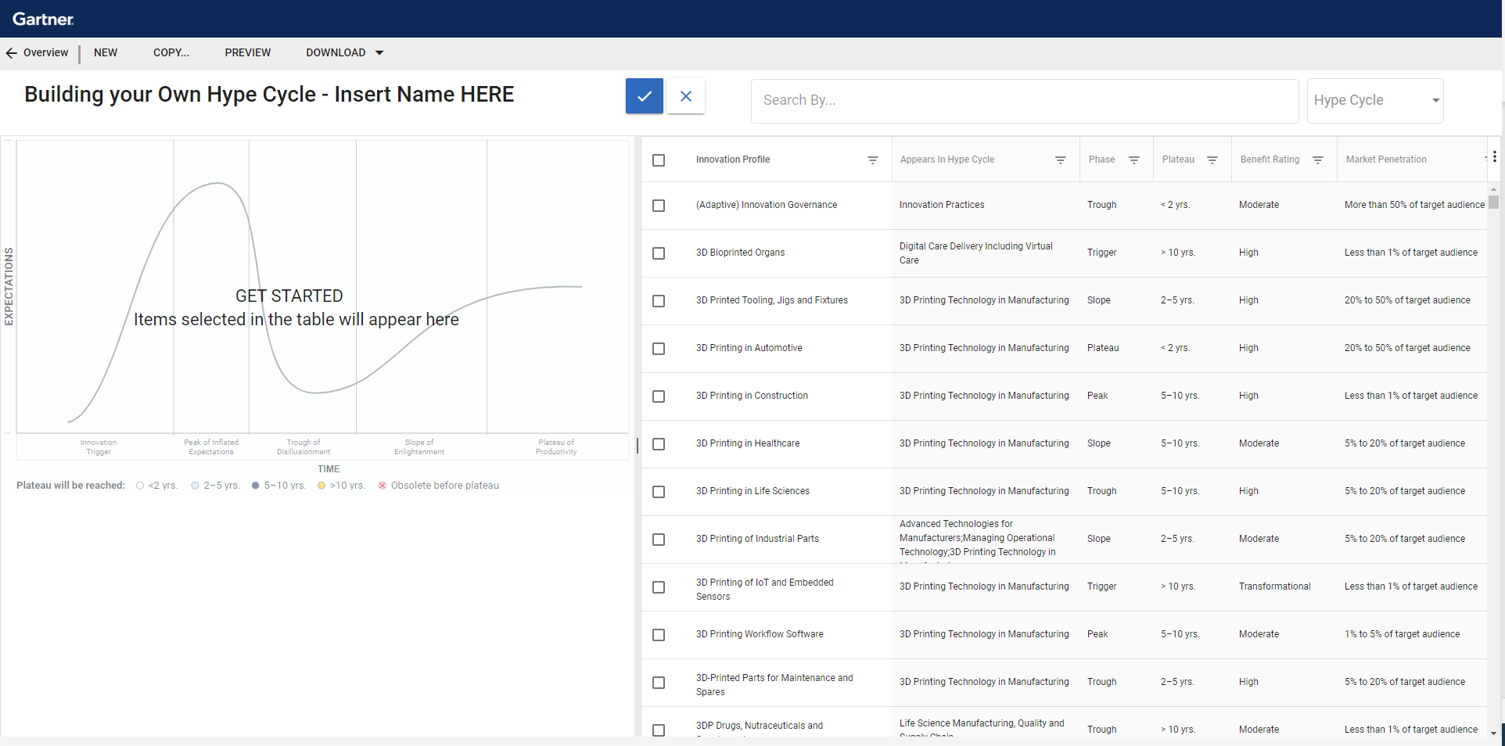
Hype Cycle Builder Foundational Area
Notes:
This is the main screen, where you will spend the majority of your time while creating your own customized Hype Cycles. This is a split screen with a blank Hype Cycle graphic on the left side. This Hype Cycle on the left side will dynamically update as you select various innovation profiles (also known as “dots”). The right side of the screen shows an interactive list. The list has a toggle function on the upper right that allows you to switch between searching a list of Hype Cycles or innovation profiles. Immediately above the list is a search bar, which allows you to type select content and quickly find a Hype Cycle or an innovation profile.

Slide 4
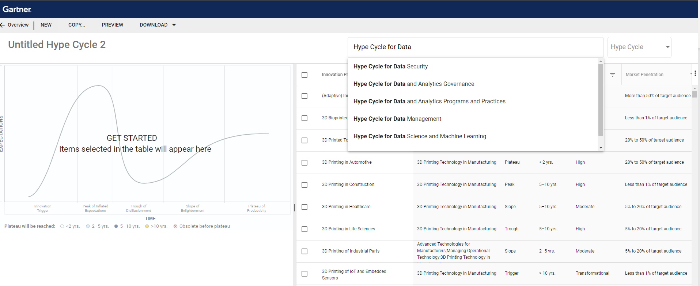
Search for Specific Hype Cycles With Type-Ahead Search Function
Search by Hype Cycle
Notes:
Use the drop-down menu to the right of the search bar to toggle between a list of Hype Cycles and innovation profiles. In this particular graphic, the “Hype Cycle” option is selected. As such, the drop-down displays various Hype Cycles that most closely match the words that were entered in the search bar. Searching by Hype Cycle will deliver a list of the innovations included on the Hype Cycle of your choice. The search bar also has a type-ahead function that allows you to quickly find Hype Cycles using keywords.

Slide 5
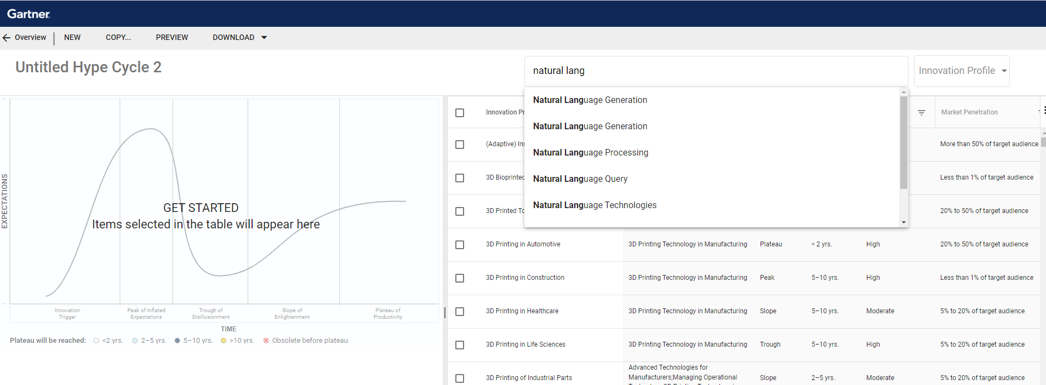
Search by Innovation Profile
Search by Innovation Profile
Notes:
In this scenario, a user has toggled to change the dynamic list to show innovation profiles. In this particular graphic, the “innovation profile” option is selected in the box to the right of the search bar. Searching by innovation profiles will deliver a list of all the innovations profiles regardless of the specific Hype Cycle where they may appear. The search bar also has a type-ahead function that allows you to quickly find innovation profiles using keywords. A custom Hype Cycle can include a maximum of 40 innovation profiles.

Slide 6
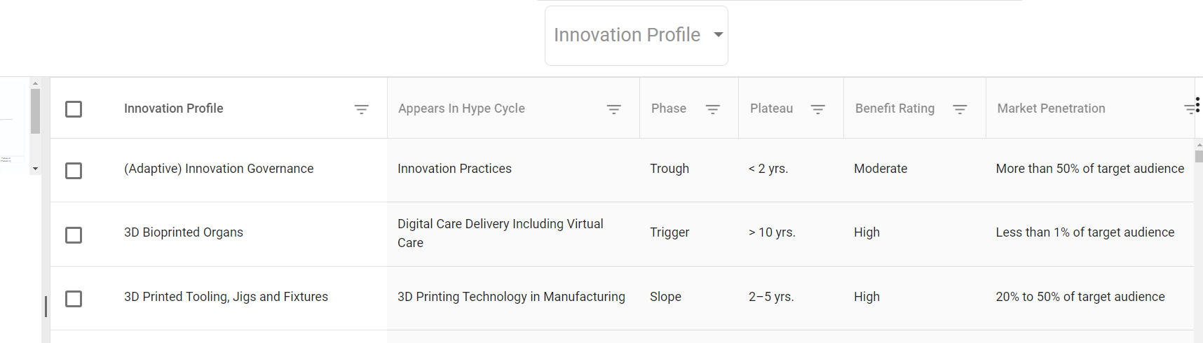
Filter or Search by Any Attribute Hype Cycle and innovation profile names Phase, maturity, benefit rating or market penetration level
Notes:
A user can also use the content headers (that appear across the top of the dynamic list) to select and filter by different aspects of the innovation profile ratings. For example, you can sort by phase or stage of innovation, which represents distinct investment and market patterns. Once you've narrowed your focus, use the check boxes to add innovation profiles to the Hype Cycle. There is functionality that also allows you to move the labels or expanding the columns for better visibility.

Slide 7
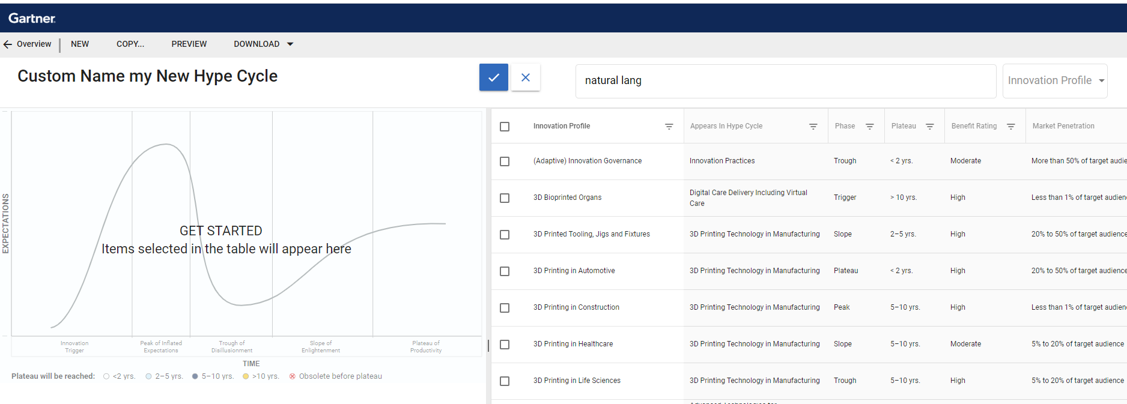
Custom Hype Cycle Naming
Notes:
At any point in time, you can place your cursor on the upper left corner of the screen and create a name for your new custom Hype Cycle. Once you exit and return to the initial screen, a list of all your custom Hype Cycles will appear with the custom name that you provided. At any point, you can change the name. You can also edit the Hype Cycle by removing innovation profiles or adding new ones. Simply click on the Hype Cycle graphic on the left side of the screen and select the innovation profile that you would like to delete.
After you review and save your work, your custom Hype Cycle is available as a PowerPoint slide, so you can use it in your documents, presentations, and other deliverables. It can also be saved as a PDF, complete with the written analysis for each innovation profile.

Slide 8
Appendix for Presentations: High-Level Understanding of Hype Cycle
For more information, please reference
Understanding Gartner’s Hype Cycles
Notes:
Many Gartner clients who create their own custom Hype Cycles also like to include reference slides that explain the Hype Cycle framework. In order to augment your custom Hype Cycle presentations with an explanation of the framework, we have include a select number of the background slides in this appendix.

Slide 9
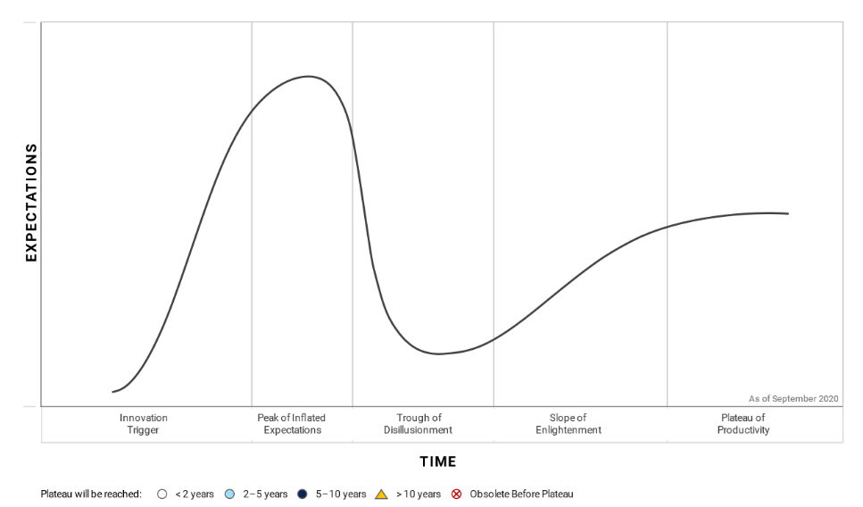
The Gartner Hype Cycle
Notes:
The two axes of the Hype Cycle are:
Time (horizontal axis). An innovation will progress through each stage as time passes. Most Hype Cycles are a snapshot that shows the relative positions of a set of innovations at a single point in time. However, single-topic Hype Cycles can be useful to predict the future path of a technology. One notable historic example was the e-business Hype Cycle published in 1999, which accurately predicted the dot-com bust of 2001 and the eventual emergence of e-business as “business as usual.”
Expectations (vertical axis). The expectations for an innovation will surge and diminish as it progresses. The level of expectations for an innovation fluctuates based on the marketplace’s assessment of its anticipated value. This axis highlights the changing sentiment of potential and actual adopters and the shifting pressures surrounding investment decisions.
We refer to the individual elements that are mapped on the Hype Cycle as “innovations.” Each innovation will be depicted as a “dot” on the Hype Cycle graphic. Some innovation profiles focus on specific technologies, while others focus on higher-level trends and concepts such as methodologies and strategies, operating and consumption models, management disciplines and standards, competencies, and capabilities.
An innovation typically transitions through five stages on its path to productivity:
Innovation Trigger. A breakthrough, public demonstration, product launch or other event sparks media and industry interest in a technology or other type of innovation.
Peak of Inflated Expectations. The excitement about, and expectations for, the innovation exceed the reality of its current capabilities. In some cases, a financial bubble may form around the innovation.
Trough of Disillusionment. The original overexcitement about the innovation dissipates, and disillusionment sets in due to performance issues, slower-than-expected adoption or a failure to deliver timely financial returns.
Slope of Enlightenment. Some early adopters overcome the initial hurdles and begin to see the benefits of the innovation. By learning from the experiences of early adopters, organizations gain a better understanding of where and how the innovation will deliver significant value (and where it will not).
Plateau of Productivity. The innovation has demonstrated real-world productivity and benefits, and more organizations feel comfortable with the greatly reduced level of risk. A sharp uptick in adoption begins until the innovation becomes mainstream.

Slide 10
Phases of the Hype Cycle
Experiential feedback surfaces and fast followers join adopters
Negative Press Begins and selected failures publicized
Additional vendors and more media hype
High growth and more extensive adoption achieved. Cases of proven value are publicized.
Early Adopters investigate
Vendor Consolidation Begins
Startups: Vendor Offerings
Approaches, frameworks, methodologies for delivering value emerge
R&D
Comprehensive adoption and demonstrated benefits are limited
Notes:
We categorize innovations into five phases based on distinct indicators related to investment, product and market patterns.
1. On the Rise
An innovation that is on the rise has passed the Innovation Trigger, but not yet reached the Peak of Inflated Expectations.
An Innovation Trigger is an event that sets off a period of rapid development and growing interest in the innovation.
2. At the Peak
At the Peak of Inflated Expectations, the excitement about an innovation dominates the media landscape. As the media hype builds, companies that are less risk-averse often rush to adopt the innovation before their competitors. Other organizations follow suit to avoid missing an opportunity.
3. Sliding Into the Trough
An innovation begins sliding into the trough when the early success stories are displaced by less-favorable stories about early adopters. The media coverage starts featuring the challenges associated with the innovation rather than the opportunities. Most early adopters struggle to derive meaningful value from the innovation, often due to their inappropriate application of it. Because the innovation has not lived up to the overinflated expectations of enterprises and the media, it is rapidly discredited.
4. Climbing the Slope
An innovation begins climbing the slope as suppliers improve products based on early feedback and overcome obstacles to performance, integration, user adoption and business case justification.
5. Entering the Plateau
The Plateau of Productivity represents the beginning of mainstream adoption. The real-world benefits of the innovation are predictable and broadly acknowledged, and it is increasingly delivered as an out-of-the-box solution. As an innovation achieves full maturity and mainstream adoption, its hype typically subsides and is replaced with a solid body of knowledge about best practices for applying and deploying it.
The Hype Cycle curve incorporates two key drivers of increased expectations — hype and maturity level. As market hype for an innovation builds, the innovation begins its ascent of the Peak of Inflated Expectations. Excitement occurs in a rush, creating unrealistic expectations that are not met because of the innovation’s low maturity level. With high expectations and low maturity, the innovation falls into the Trough of Disillusionment.
As the innovation matures, it climbs the Slope of Enlightenment. Early adopters realize real-world benefits from the innovation. Organizations increase their expectations until the innovation reaches mainstream adoption at the Plateau of Productivity.

Slide 11
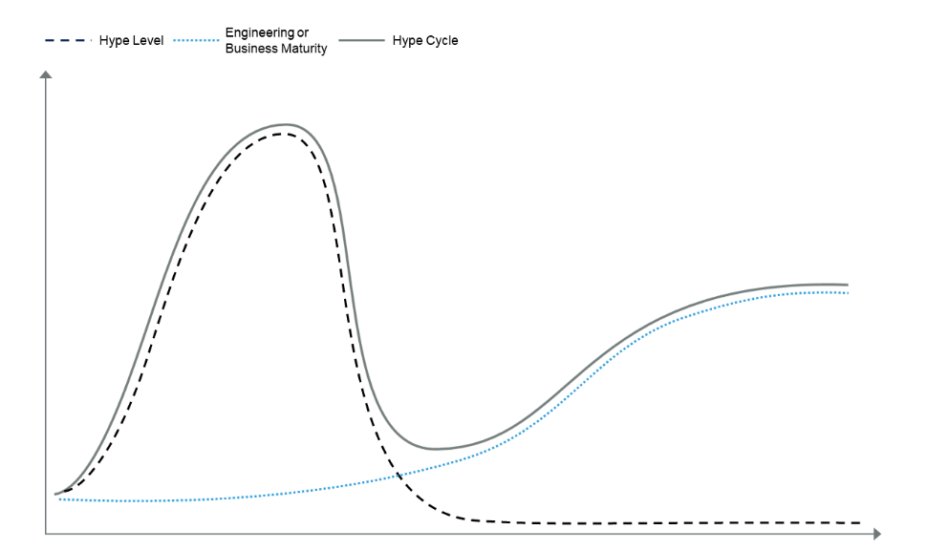
Components of a Hype Cycle
Notes:
The vertical scale of an innovation’s hype curve varies based on its perceived importance to organizations and society. In general, innovations that appeal to a wide range of organizations will attract greater exposure, hype and expectations than innovations that benefit a niche market. This principle applies to both the Peak of Inflated Expectations and the final height of the Plateau of Productivity.
For visualization purposes, we normalize the vertical scale of individual hype curves so that they fit on one Hype Cycle graphic.
Positioning an Innovation on the Hype Cycle
Gartner analysts position an innovation on the Hype Cycle based on a consensus assessment of its hype and maturity. They use a variety of market signals and proxy indicators to establish the level of expectations for an innovation. Some inputs may be quantitative, but the Hype Cycle is largely a structured, qualitative research tool.
During the early stages of the Hype Cycle — when uncertainty about an innovation is high — an innovation’s position is guided mainly by its hype levels and market expectations. At the later stages — as more information about the innovation’s performance and adoption becomes available — maturity plays a greater role in determining the innovation’s position.
An innovation may have radically different positions on different Hype Cycles. This can happen when innovations have numerous applications or are being adopted in different industries. Take as an example how the use and market penetration of various intelligent automation technologies varies across different industries. Regulated industries are much more conservative and cautious in changing business processes and leveraging intelligent automation, while financial services has an entire category of fintech companies developing new products and services.

Slide 12
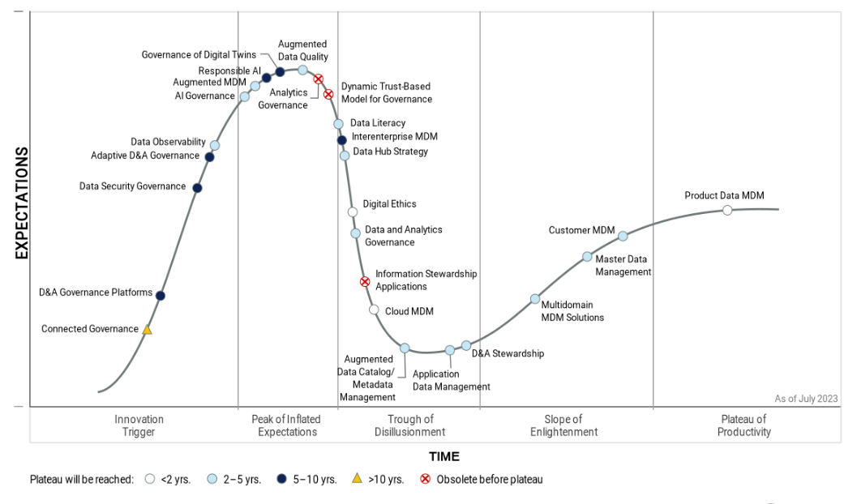
Example of a Hype Cycle
Hype Cycle for Data and Analytics Governance, 2023
Notes:
Innovations do not move through the Hype Cycle at a uniform speed. Each innovation profile is categorized based on how long it will take to reach the Plateau of Productivity. Icons on the Hype Cycle show the timelines for mainstream adoption:
White circle: Less than two years
Light-blue circle: Two to five years
Dark-blue circle: Five to 10 years
Yellow triangle: More than 10 years
Circle with red “X”: Obsolete before plateau (that is, the innovation will never reach the plateau — it will fail in the market or be overtaken by competing solutions)

Slide 13
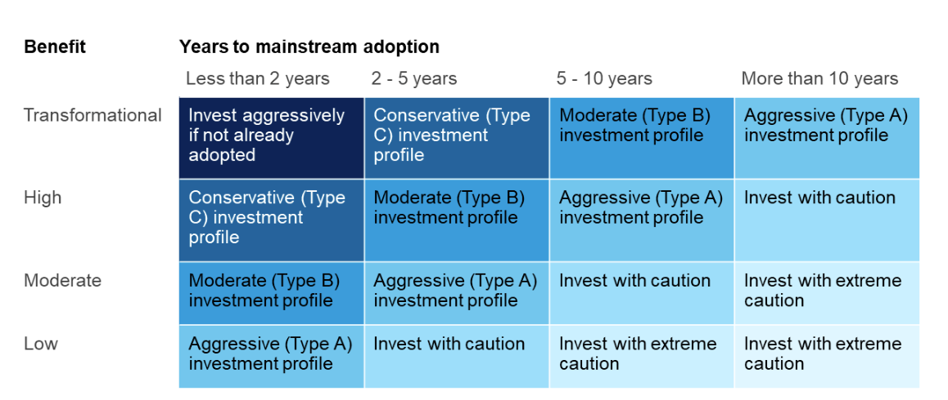
Priority Matrix
Notes:
What Is the Priority Matrix?
While the Hype Cycle helps navigate the common pattern of hype and disillusionment that inevitably accompanies new technologies, services or disciplines, Gartner’s Priority Matrix enables organizations to look beyond the hype.
To plan and prioritize adoption of emerging innovations, organizations must assess each one based on its potential benefit and its maturation timeline. The Priority Matrix complements the Hype Cycle by providing this critical information for each innovation.
The vertical axis of the Priority Matrix focuses on the potential benefit rating for the innovation:
Transformational. Establishes new ways of doing business within and across industries, resulting in major shifts in industry dynamics.
High. Enables new ways of performing horizontal or vertical processes that will significantly increase revenue or cost savings for an organization.
Moderate. Enables incremental improvements to established processes that will increase revenue or save money for an organization.
Low. Enables a slight improvement in processes, but may not translate into increased revenue or cost savings.
The horizontal axis of the Priority Matrix categorizes innovation profiles based on the time to plateau — that is, when the innovation is expected to reach mainstream adoption. The time-to-plateau rating is a simple measure of risk based on the projected rate of maturation for an innovation. There may be some variability on this axis between organizations and industries, but typically to a lesser degree than on the benefit axis. Innovation profiles rated as “obsolete before plateau” do not appear on the Priority Matrix.

