Slide 1
CICF Week 2: Scientific Python Programming

Slide 2
Welcome to week two of CICF!

Slide 3
The plan this week
We will work through four Jupyter notebooks in the tutorials this week.
Notes:
The notebooks will give you:
A quick tour of Jupyter notebooks.
A quick tour of Python programming language.
A quick overview of Python packages.
A quick example of working with some LIGO data in Jupyter.
By necessity, we will keep things short and simple, and gloss over some things.

Slide 4
Jupyter

Slide 5
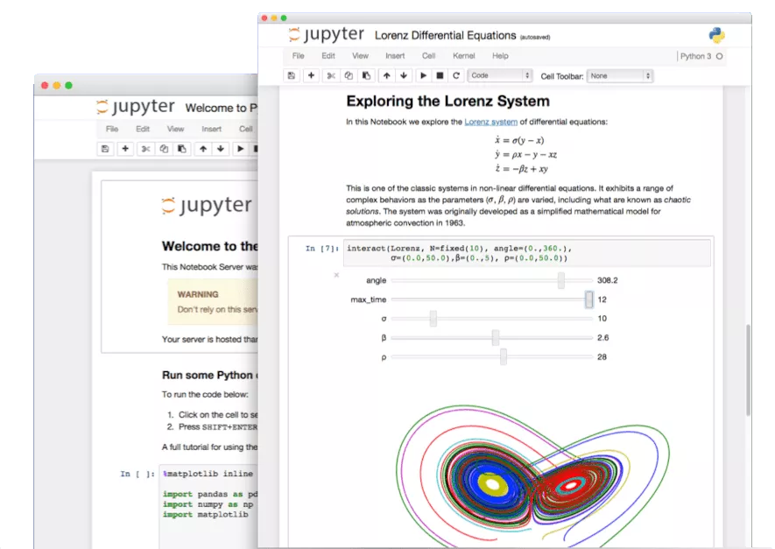
Jupyter notebooks
image from https://jupyter.org/
Notes:
What are Jupyter notebooks? Why are they useful?
Jupyter notebooks are a way to write text/documentation, code, equations, data, graphs, images, etc. together.
You can view and edit these notebooks in a web browser window.
You can execute code in these notebooks from the web browser window.
You can share these notebooks with other people.
They are kind of like paper lab notebooks, but in a browser window.

Slide 6
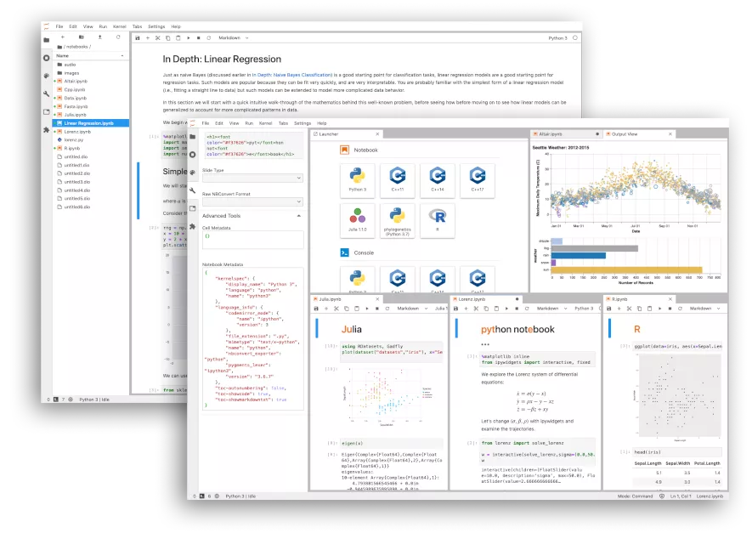
JupyterLab
image from https://jupyter.org/
Notes:
JupyterLab is a newer, fancier way of working with notebooks.
Kind of like a web-based IDE (integrated development environment).
You can work with multiple notebooks side by side, use a file browser, and use plugins that enhance functionality.

Slide 7
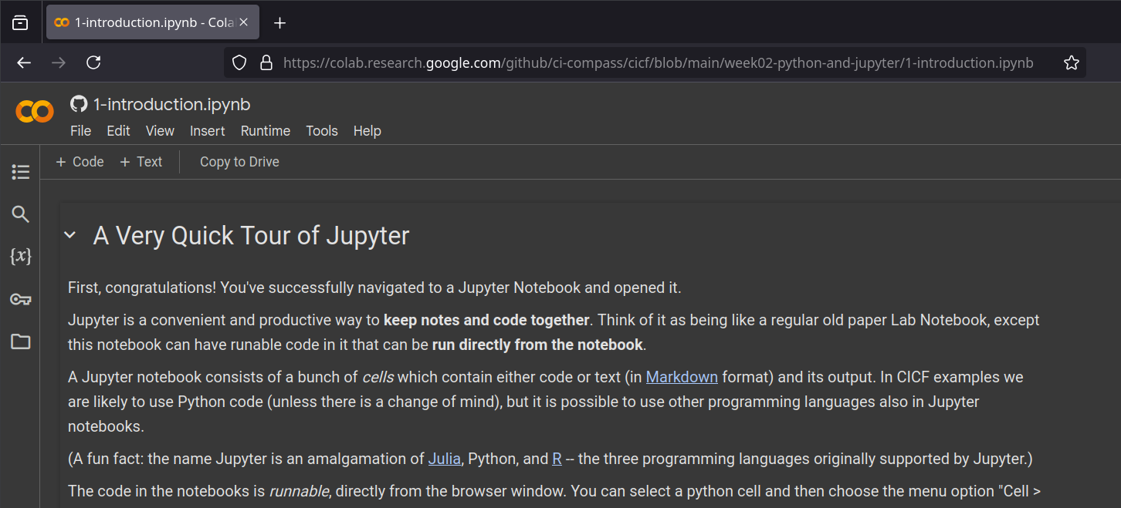
JupyterLab instances out there
Notes:
Many organizations and projects host their own JupyterLab instances.
Google Colab, Microsoft Planetary Computer, FABRIC project’s JupyterLab instance, Chameleon project’s JupyterLab instance, etc.
Google Colab is a fancier, dressed up rich cousin of JupyterLab. Your notebooks will work there.
You can also set up an IDE (such as VS Code or Codium) to work with notebooks.
You can preview notebooks from GitHub.com, sometimes.
GitHub Codespaces has support for notebooks.

Slide 8
Python

Slide 9
First, a little preliminary
We will not learn all of Python this week. Plenty of resources are out there if/when you need them.

Slide 10
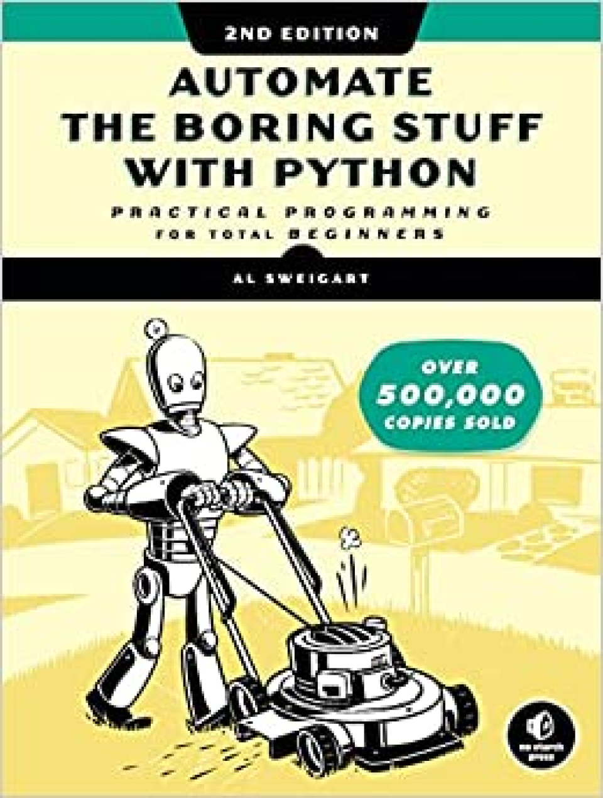
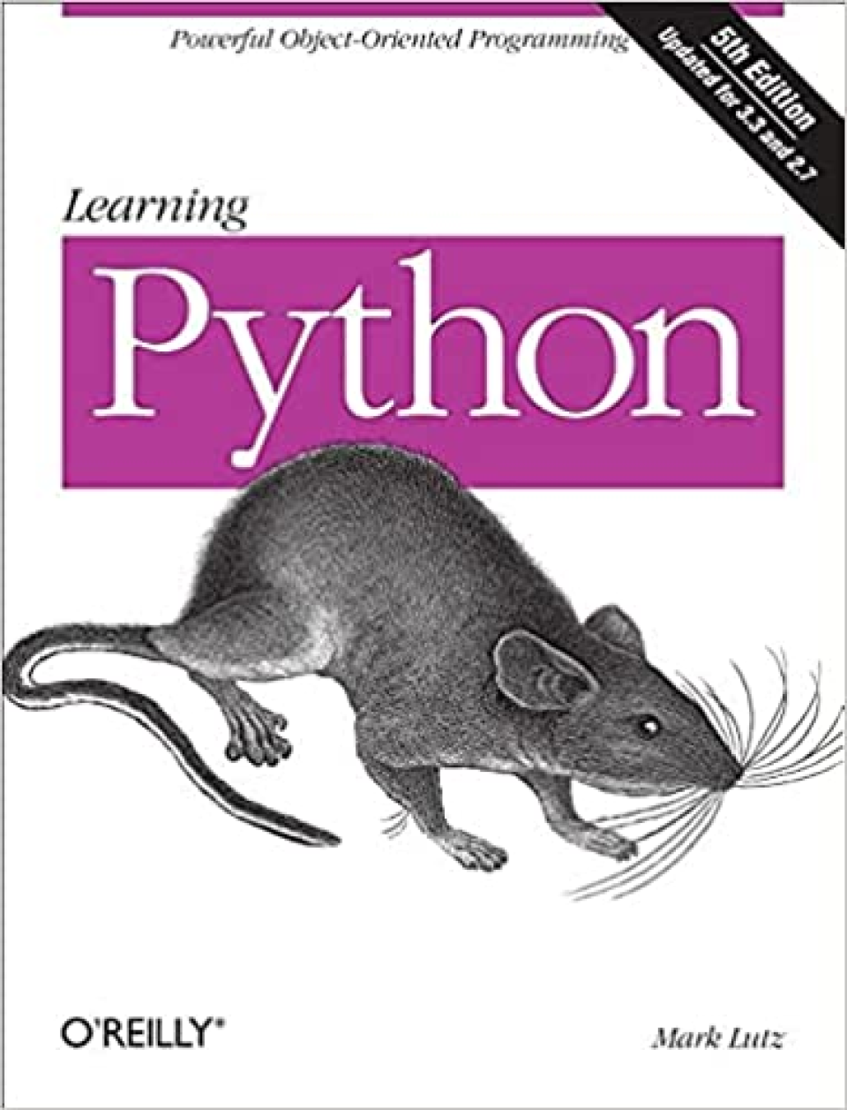
Notes:
If you know any other programming language, you can learn Python on your own very quickly. Find a resource that suits your learning style: books, tutorials, tutorial websites, videos, courses…

Slide 11
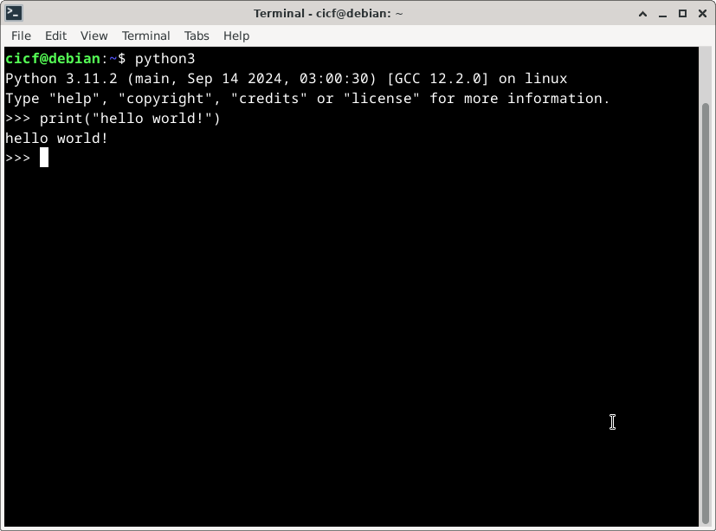
Trying out code
Two quick ways:
Jupyter notebooks
REPL
Notes:
You should try out the code examples on your own.
Use a Jupyter notebook, write code in new cells, and run them.
Use the Python REPL (“Read-Eval-Print Loop”)
Run python3 in a terminal in your VM.
You (very likely) already have python3 if you run macOS or Linux.
Windows? Install from Windows Store probably. I wouldn’t know!
You can also write little scripts using an editor or IDE and run them. REPL or notebook should be good enough to test things out.

Slide 12
Structure of a Python program
Python programs can be decomposed this way:
Programs consist of modules.
Modules contain statements.
Statements contain expressions.
Expressions create and process objects.
Notes:
We will discuss modules towards the end.
Statements perform some action.
Example: x = 42 (assignment), import math (an import statement)
Expressions are pieces of code that evaluate to a value. Example: 42, x + y, x > y, "hello", etc.

Slide 13
Variables
Variables give names to things.
Variables are not strongly typed.
>>> amount = 7 >>> amount 7 >>> amount = "a whole lot!" >>> amount a whole lot!
Notes:
Variables work the way you expect.
Unlike Java or C++, the are not “strongly” typed. A variable can be a number one moment and then can suddenly become a string.
You don’t have to declare types of variables.
Python is said to be dynamically typed.

Slide 14
Control flow statements
You have if, if/else, for, while, etc.
pass statement is a placeholder when you need to do nothing.
continue statement will cause a jump to the top of the loop.
break statement will cause an exit from the loop.

Slide 15
Example
Here’s a for loop inside of an if statement:
if temperature >= 100: print("It boiled!") for sample_tube in range(1, 6): print("concentration is: ", tube_concentration[sample_tube]) else: print("Warmed up, but not boiling yet. Try harder.")
Notice colons at the ends of the if, for, and else statements.

Slide 16
Code layout has meaning
Code blocks are indicated by indentation level.
In comparison C, C++ and Java begin blocks with { and end them with }.
Notes:
Indentation of a code block MUST be the same for the entire block.
Best Practice: indent with four spaces.
Do not use tab characters unless you’re certain that your editor will turn <tab> keys into spaces.

Slide 17
Basic data types
Booleans (True and False)
Numbers
Integers (example: -1, 0, 1, 2, …)
Floating point numbers (example: 3.14)
Strings (example: "hello world!")
Notes:
There are also:
Complex numbers (example: 3+4j)
Decimal(), Fraction() types in the standard library.

Slide 18
Built-in data structures
Lists
Dictionaries
Tuples
Sets

Slide 19
Lists
>>> temperatures = [44.2, 43.6, 107.9, "awfully hot!"] >>> temperatures[3] awfully hot!
Notes:
Python lists are like arrays in C++ and Java, except:
They can grow (and shrink) as needed.
The different elements of an array don’t all have to be the same type.
Lists are one-dimensional. If you would normally use a 2D array for something, you would want to use a list of lists.

Slide 20
Another list example
>>> grades = ["A", "B", "C", "D", "F"] >>> len(grades) 5 >>> grades[0] A >>> grades[4] F >>> grades[5] Traceback (most recent call last): File "<stdin>", line 1, in <module> IndexError: list index out of range
Notes:
Notice the first element in a list is numbered 0 (zero).
Any time you index into a list, Python always counts starting at 0, not 1. Forgetting this will likely be a big source of mistakes.

Slide 21
Strings
>>> 'hello' == "hello" True >>> 'hello" File "<stdin>", line 1 'hello" ^ SyntaxError: unterminated string literal (detected at line 1)
Notes:
Strings can be surrounded by single quotes (') or double quotes ("). Whichever one you start a string with, you have to end with that same kind.

Slide 22
Slicing strings and lists
>>> st = "ABCDEFG" >>> st[2:4] CD >>> st[4:] EFG >>> st[:2] AB >>> st[0:6:2] 'ACE'
Slicing uses the syntax object[start:end:step]; step is 1 by default.
Notes:
Python strings act just like lists of letters.
Here’s some useful syntax for selecting just parts of strings (and lists).
This operation is called “slicing”, and has the syntax object[start:end:step].

Slide 23
Dictionaries
>>> drugs = { ... "asprin": 325, ... "acetaminophen": 500 ... } >>> >>> drugs["asprin"] 325 >>> drugs["acetaminophen"] 500 >>> drugs["ibuprofen"] Traceback (most recent call last): File "<stdin>", line 1, in <module> KeyError: 'ibuprofen'
Notes:
Dictionaries (or dict objects in Python parlance) contain pairs of keys and values:

Slide 24
Tuples
() # An empty tuple. (1,) # A one-item tuple. (0, 'Ni', 3.14) # A four item tuple.
Notes:
Tuples construct groups of objects.
Example:

Slide 25
Sets
{1,2,3} {0, 'Ni', 3.14}
Notes:
Sets are structures whose elements are unique.
Example:

Slide 26
Operators
All the usual ones: +, -, *, /
Integer division: 7 // 2 yields 3
Remainder: 7 % 2 yields 1
Exponentiation: 2 ** 8 yields 256

Slide 27
Operator overloading
Operators can have different meanings depending on the data type.
The plus sign will concatenate strings: "Hi there, " + 'human' yields the single string "Hi there, human".

Slide 28
Functions
import math # use Python's math module. def area_of_circle(radius): """ Compute area of a circle. :param radius: radius of the circle. """ result = math.pi * radius ** 2 return result
>>> area_of_circle(10) 314.1592653589793 >>> area_of_circle(5) 78.53981633974483
Notes:
Lots of built-in functions: print(), range(), …
Easy to create your own.
We have also sneakily introduced usage of modules and comment syntax here!

Slide 29
User defined classes
class Customer: def __init__(self, name, address): self.name = name self.address = address def show(self): print(self.name + " lives at " + self.address)
>>> c = Customer("Bob", "1234 Wooded Way") >>> c.show() Bob lives at 1234 Wooded Way
Notes:
Python classes can’t be too strange to those familiar with C++ or Java.

Slide 30
Error handling with exceptions
try: individual_portion = total_grams / number_of_people except: print("Number of people was zero, no valid answer!")
Notes:
When an unrecoverable error occurs, the Python runtime “throws” an exception that is “caught” by an exception handler.
If you do not catch an exception, your program will fail with an error message.

Slide 31
Modules
Modules are Python’s organizational units.
mypackage/ __init__.py module1.py module2.py subpackage/ __init__.py submodule1.py
Notes:
Modules are organizational units of a Python program. When you create a Python project, you would split your code into logical units, called modules.
In concrete terms, modules correspond to files.

Slide 32
Using modules
from mypackage import module1 from mypackage.subpackage import submodule2 as sm2 module1.some_function() sm2.some_other_function()
import mypackage mypackage.module1.some_function() mypackage.subpackage.submodule1.some_other_function()
Notes:
You would use a module in another module like in the example.
These methods are roughly equivalent.

Slide 33
Python packages

Slide 34
What are packages?
Packages are the way to distribute Python software.
Notes:
Packages are the way to distribute Python software.
Packages can contain libraries (example: NumPy, SciPy…) or applications (example: Jupyter). Or sometimes both.
Packages are a collection of modules.
You can install packages, and use in your projects.

Slide 35
An example package: NumPy
Install NumPy like so:
pip install numpy
And then use it like so:
>>> import numpy as np >>> rng = np.random.default_rng() >>> samples = rng.normal(size=2500) >>> samples array([ 1.61380659, 1.21211191, -0.30766142, ..., 1.77788338,-3.08686752, -0.20901042])
Notes:
The example of generating normally distributed random numbers is from https://numpy.org/.

Slide 36
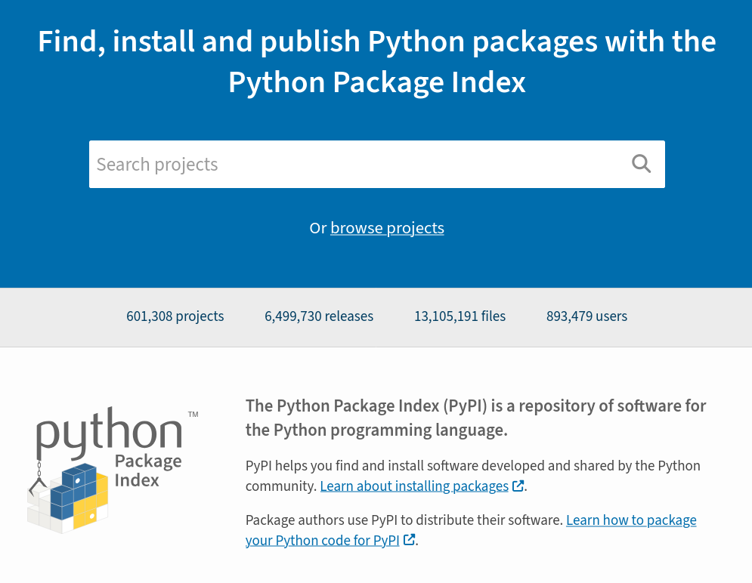
Python Package Index (PyPI)
Notes:
People publish Python packages at PyPI.
For most common needs with Python, there’s a really good chance someone already has created a solution and published it in Python Package Index, also known as PyPI (https://pypi.org/).
PyPI is a large repository of Python packages.
“601,286 projects; 6,499,014 releases; 13,103,667 files; 893,449 users” at the time of writing this. That is huge!

Slide 37
pip
pip is the Python package installer.
pip is on PyPI: https://pypi.org/project/pip/.
Notes:
pip is a command-line tool used to install Python packages from PyPI.
(Also from other Python repositories, sometimes.)
pip itself is on PyPI: https://pypi.org/project/pip/
so you can pip install --upgrade pip when there are new pip releases on PyPI.

Slide 38
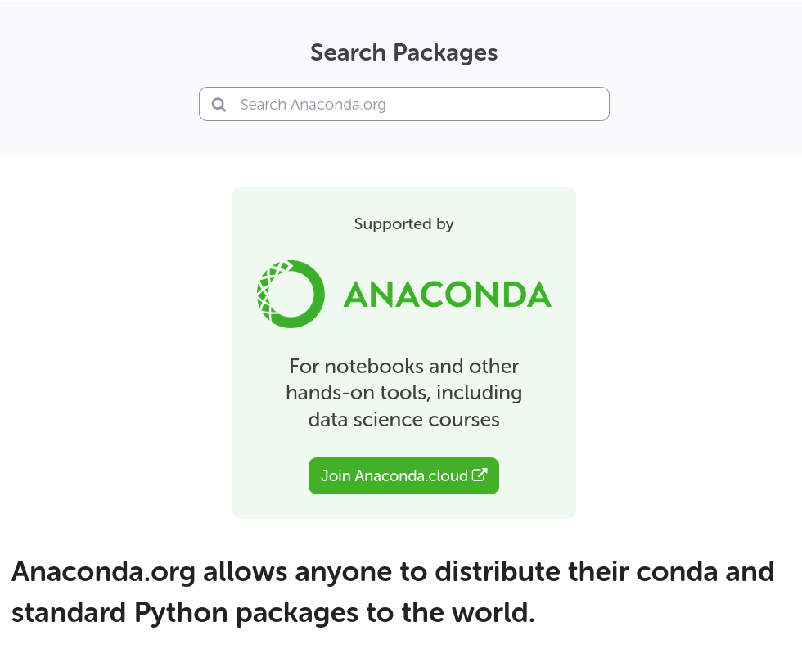
Anaconda and conda
Notes:
Anaconda (https://www.anaconda.com/) is a “Python distribution”.
It is a curated collection of Python software, popular in science, AI, and data science communities.
conda is Anaconda’s package manager.
conda is Anaconda’s alternative to pip.
Conda handles package management and dependency resolution better than pip.

Slide 39
Working with LIGO data

Slide 40
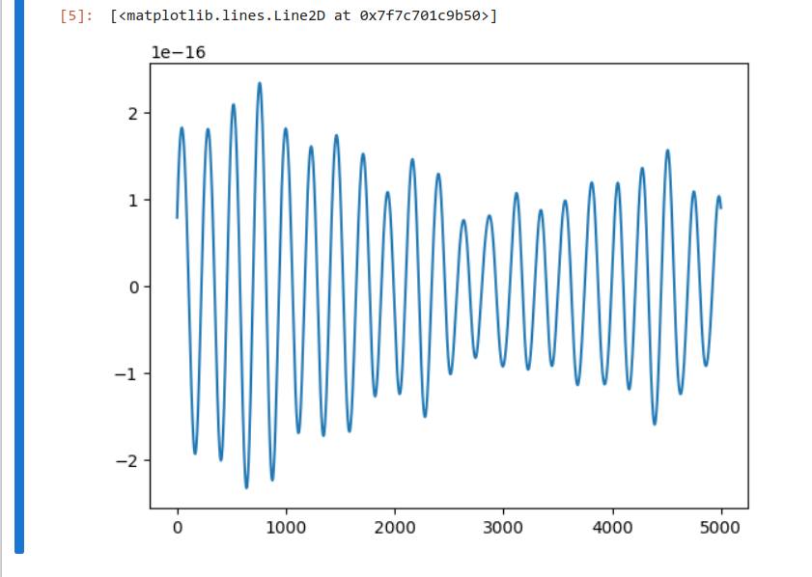
Plotting LIGO data
Notes:
LIGO (https://www.ligo.caltech.edu/) is an NSF major facility that studies gravitational waves.
LIGO makes experimental data available for the public.
One of your tasks this week is to download some of this data, and plot it in a Jupyter notebook.

Slide 41
FIN

