Slide 1
Making Projects
Claire Williamson 2464406w
Notes:
I created a tool that adapts tangible learning project tutorials by customising them into a syllabus. This is to make them accessible to people with disabilities, specifically intellectual, so that they can participate in tangible learning and gain its benefits.

Slide 2
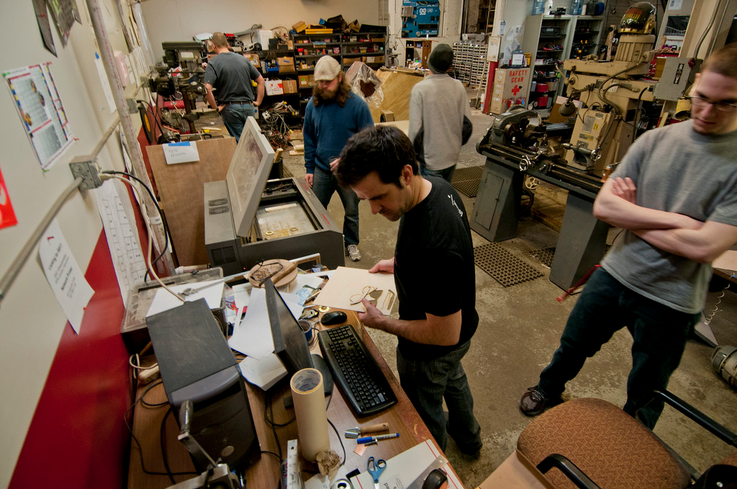
Tangible Learning & Intellectual Disabilities
What is making?
Makerspaces
Intellectual disabilities (IDs)
Milwaukee Makerspace Shop -
Pete Prodehl - Flickr under CC
Notes:
Tangible learning is the process of learning using physical objects. It can be an effective way to understand concepts, especially in people for whom traditional learning isn’t well suited for.
“Making” is one of its most popular forms. Its a global subculture that focuses on the process of building things yourself and the benefits this brings. This usually takes place in “makerspaces” - community workshops where makers can come together to share knowledge and tools to carry out their projects.
Intellectual disabilities are a group of neurodevelopmental disorders that affect a person’s mental abilities, typically causing limitations in abstract thinking, problem solving, and learning amongst other areas. Additionally, people may have issues with social and cognitive functioning, such as language, communication, memory and attention. People with intellectual disabilities also often struggle with motor functioning, or physical movement. Therefore tangible learning, and more specifically the culture of ‘making’ could offer an alternative way for people with these disabilities and other similar impairments to learn concepts in an effective way.

Slide 3
Barriers
Tangible learning can be inaccessible to people with IDs:
Requires high manual dexterity
Assumptions of prior knowledge and memory
Unclear, complex instructions
Notes:
However, Making can be inaccessible to people with IDs. There are many reasons for this; many projects require high manual dexterity such as twisting small screws or using fiddly switches; Assumptions of the persons prior knowledge and memory ability; or the tutorials having unclear and complex instructions. Tutorials can also not make it clear upfront what skills they require, leading to someone getting halfway through a project before realising they are not able to continue.
They should be able to fully participate and benefit from it. Some research has been done to tackle this, especially surrounding accessible toolkits but it has highlighted a need for adaptable resources, particularly ones that extend beyond beginner projects.

Slide 4
A Solution
A way of automatically adapting a course of tangible learning projects, to fit an individuals needs.
Focus on what a person can do, rather than what they can’t
Prioritising autonomy and choice
Notes:
Therefore I created a tool that can be used by those with intellectual disabilities and other disabilities to access projects that they both want to do, and have the ability to. It contains tutorials and allows a user to work out their requirements, then shows them if projects are currently suitable for them. It also allows them to have a customised syllabus of tutorials made for them which allows them to grow their skills over several suitable projects.

Slide 5
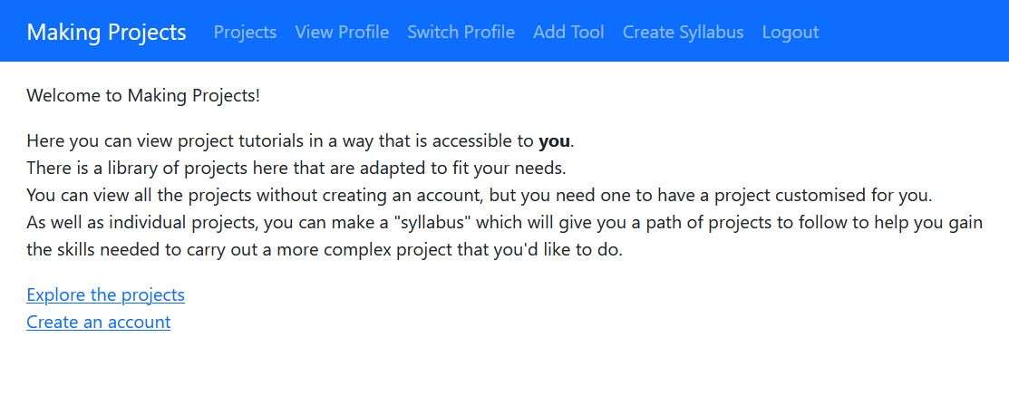
Implementation
A Django site: Python, SQLite, HTML, CSS, JavaScript.
Hosted on PythonAnywhere: https://ciw.eu.pythonanywhere.com/
Notes:
This was implemented as Django site, which is currently hosted on PythonAnywhere (link).
Its main components are the database models of the tutorials and the user, which use related functions to compare their requirements, as well as querying the database for project tutorials that match a users needs.
This is also designed to fail gracefully, in that if an exact match cannot be found, a project which is still do-able by the user is returned insead.

Slide 6
Demonstration
Notes:
I should show:
A project
Creating an account
Making a profile
Making a syllabus
Click on one of those projects
Now I will show you a brief demonstration of the tool. You can view projects without creating an account, and it shows you what materials you need. As well as what skill levels are needed, and what tools you need.
You can easily create an account, and then you’re redirected to work out your requirements. It was important to do this in such a way that clearly and accurately captured what someone could do, in a way that people with disabilities could easily understand.
You can also change your requirements.
You create a syllabus by selecting what project you’d like to be able to do, and the tool shows you what projects to carry out to build the skills needed. For example, if I want to make the Cube Creature, I should do these two other projects first. The braille cube will introduce me to 3D printing, which I dont have any experience in. But I can see is at a suitable skill level for me.

Slide 7
Evaluation
1-on-1 lab study with 3 participants.
Removing jargon
Legibility
Syllabus
"If you're on your own and you know you want to achieve something but you're not sure how to get there, it will show you the intermediate steps."
Notes:
The project was evaluated in a one to one lab study with three participants, who each had relevant experience with disabled people and tangible learning. This consisted of an interview, doing some tasks with the tool, and another interview post trial.
This revealed that participants found the tool easy to use as it removed complex technical language, is intuitive for people with different abilities, and would allow people with intellectual disabilities to successfully carry out projects, especially using the syllabus feature.

Slide 8
Conclusion
Highlighted the needs of people with IDs when interacting with technology and making
Developed a tool to address these needs
Evaluated the tool with relevant people
Notes:
To conclude, I developed a tool that aimed to fill this gap in the research by allowing people with disabilities to participate in tangible learning in a way that’s accessible to them, and continue their journey with more complex projects. The focus was less on the actual content of the projects, and more about creating an environment that could be used in these situations. The tool functions as required and I have identified areas which could be improved - such as appearance and optimising the search algorithm for projects. I’ve also highlighted some of the key requirements for targeting the needs of people with intellectual disabilities, as well as the need for more tools to make tangible learning accessible.
Thank you very much for watching.

