Slide 1
Outline
Supervised Learning
- BERT
Semi-supervised Learning
- Meta Pseudo Labels
Results

Slide 2
Movie Review
Total 10662 samples
5331 positive samples
- e.g. worth the effort to watch .
5331 negative samples
- e.g. simplistic , silly and tedious .

Slide 3
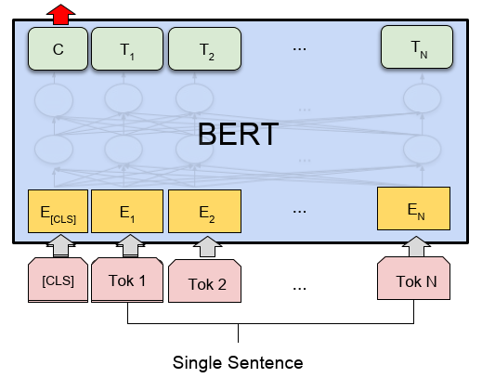
Supervised Learning
NN

Slide 4
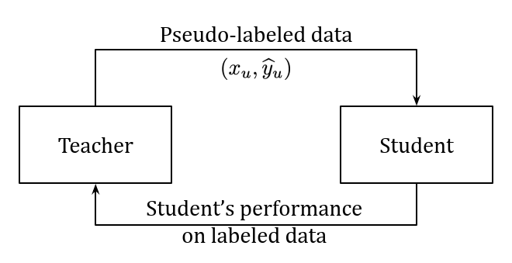
Meta Pseudo Labels
Labeled data

Slide 5




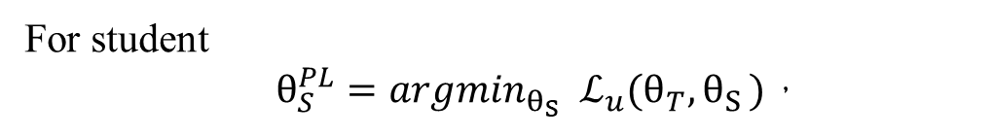
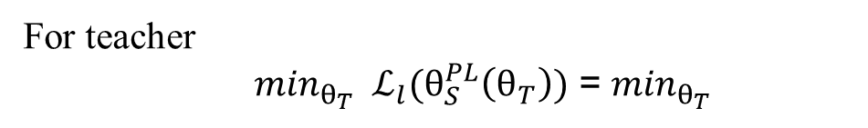
Semi-supervised Learning
Meta Pseudo Labels
$θ_{T}$: Teacher network parameters
$θ_{S}$: Student network parameters
For student
$θ_{S}^{PL}={{argmin}_{θ_{S}} ℒ}_{u}(θ_{T}{,θ}_{S})$，
${ ℒ}_{u}(θ_{T}{,θ}_{S})$ =
For teacher
${\min_{θ_{T}} ℒ}_{l}(θ_{S}^{PL}\left(θ_{T}\right))$ = $\min_{θ_{T}}$

Slide 6


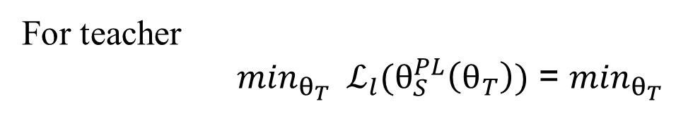
Meta Pseudo Labels
For teacher
${\min_{θ_{T}} ℒ}_{l}(θ_{S}^{PL}\left(θ_{T}\right))$ = $\min_{θ_{T}}$

Slide 7

Meta Pseudo Labels
Update student
Update teacher

Slide 8
Movie Review
Total 10662 samples
1024 labeled data for training
256 labeled data for test
Others used for unlabeled data

Slide 9
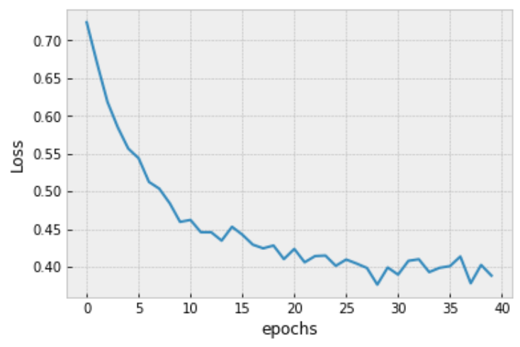
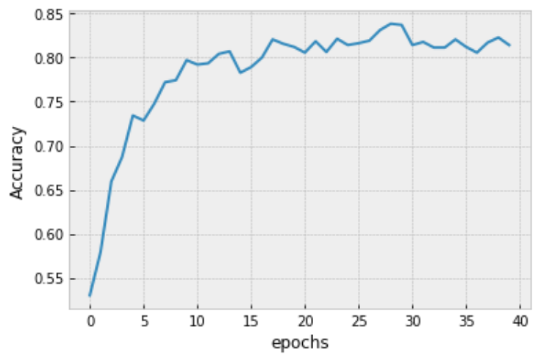
Results
Supervised

Slide 10
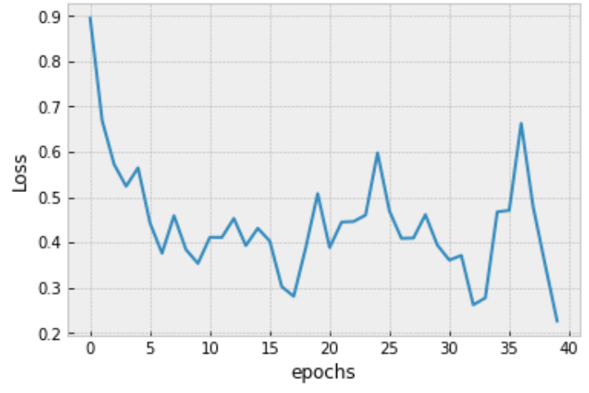
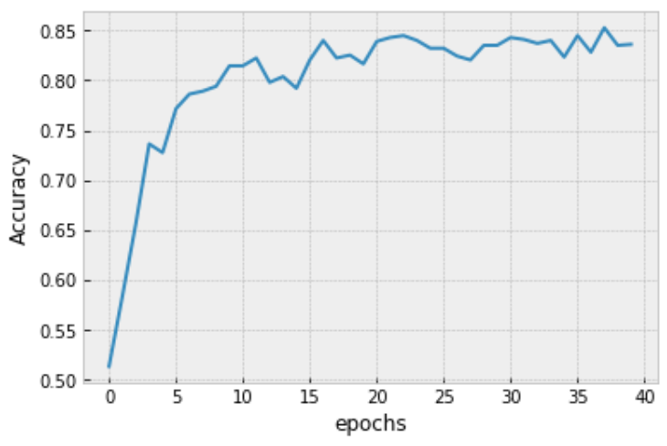
Results
MPL – student on labeled data

Slide 11
Results
On test set
Supervised
- accuracy 0.8600
range mean variance
Semi-supervised
- accuracy 0.8477

