Slide 1
Inline MATLAB Processing
Amol Pednekar
MR Clinical Scientist

Slide 2
Motivation for Inline MATLAB Tool
Majority of research collaborators use/prefer MATLAB
Currently data is exported from the scanner to a separate computer where custom built MATLAB tools are used
since the resultant images are not sent back to the patient database, the physicians do not have an easy access to the post-processed data e.g. T1,T2* maps
Feasibility of inline MATLAB tools will facilitate
Multi-central clinical validation of customer developed investigational tools
Harvesting of numerous post-processing tools written in MATLAB by various research collaborators
Mechanism to enrich console functionality
Essentially MR console and post-processing workstation should merge in near future
Currently cardiac and DTI analyses are the major (almost exclusive) exponent of the separate workstation

Slide 3
Inline Processing on Philips Platform
Generic inline processing is available
SmartScout, SmartPlan, Smart Geometry, SmartExamcard …
Leacher and XML
Wrapper tools implemented in IDL are available through the PRIDE framework to customize for specific applications
Specifically, Cardiac ejection fraction (EF) computation was implemented as inline MATLAB tool on the scanner console (>=R2.6) and EWS (>=R2.6.3.1)
Clinician can immediately assess EF (< 35% or not) on console
Assess the M-mode of high-temporal resolution cine on console
Multi-slice, multi-phase nature of the data tests the reliability of data import/export functions
Given the results so far we have stable MATLAB wrapper for image import/export which can be easily customized by collaborators in a manner similar to PRIDE tool

Slide 4
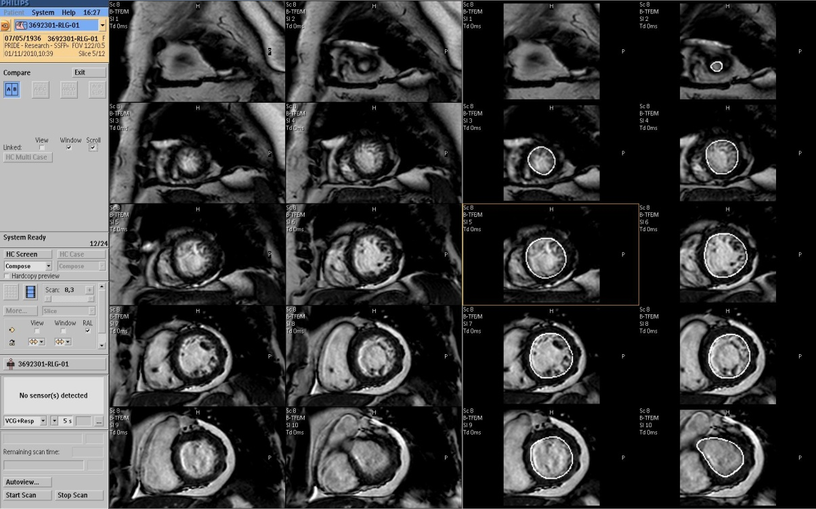
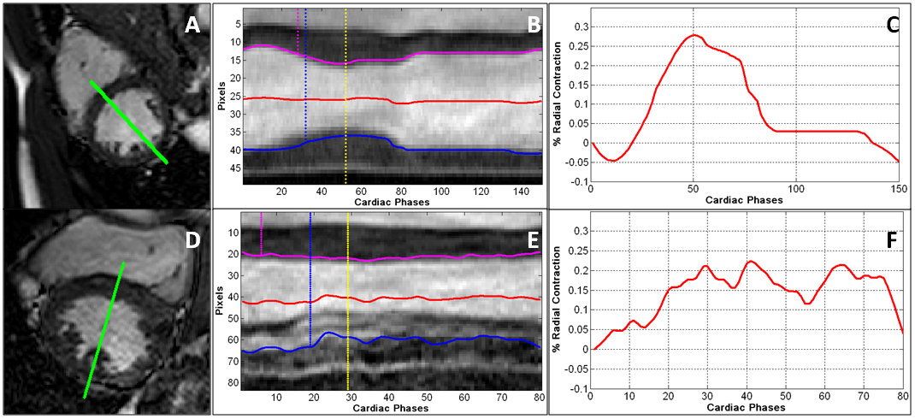
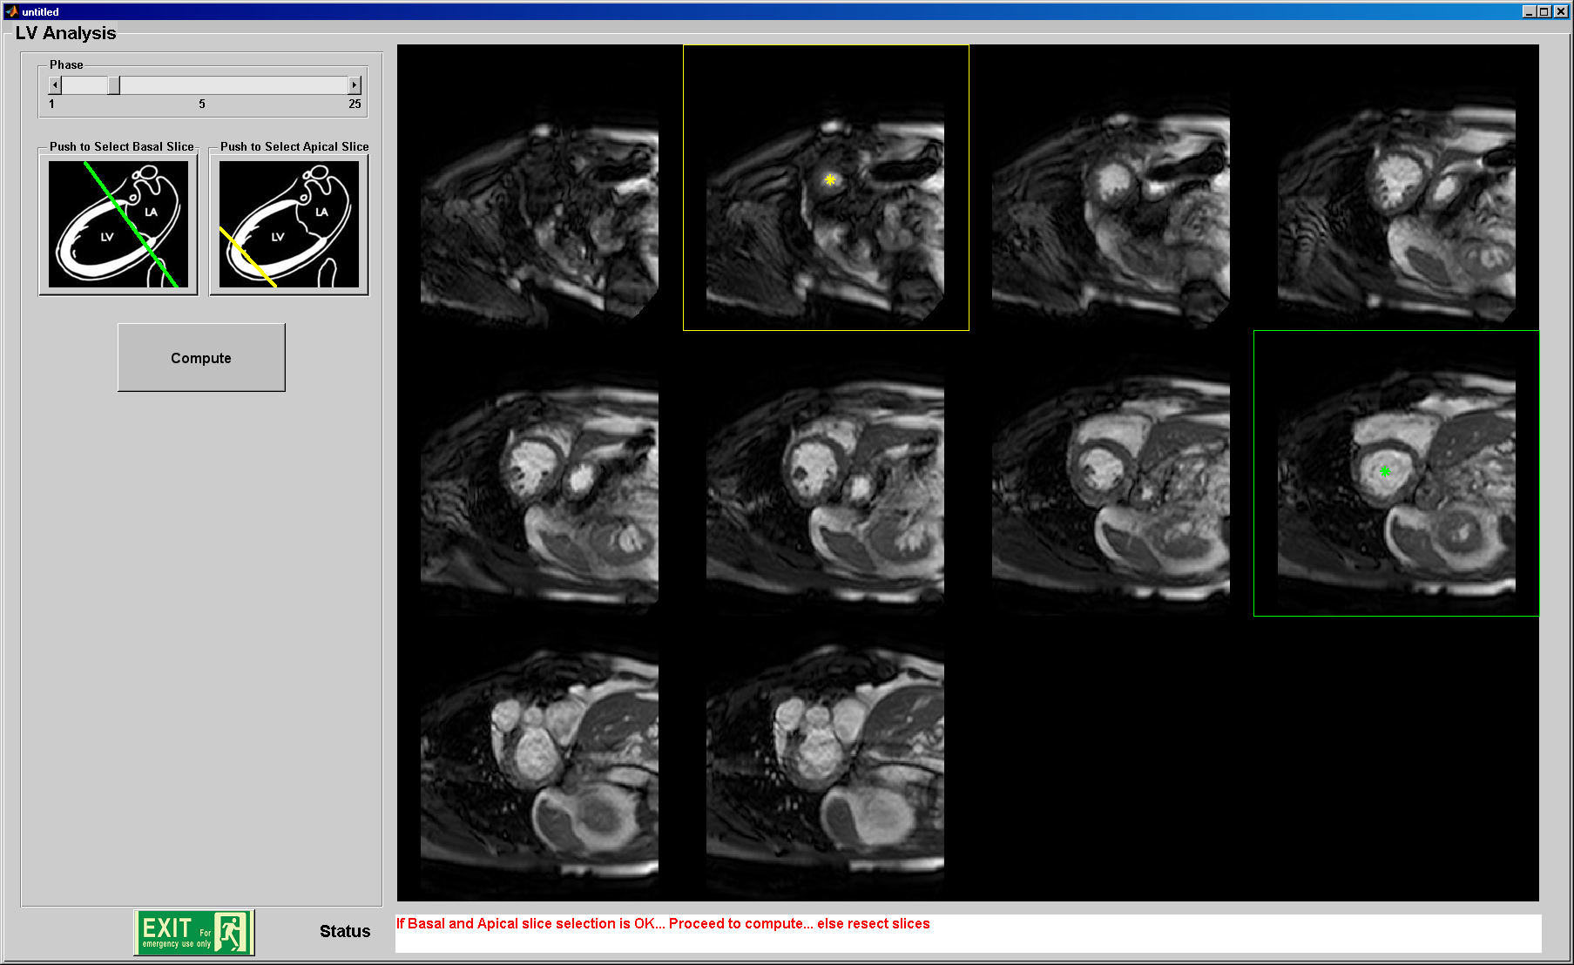
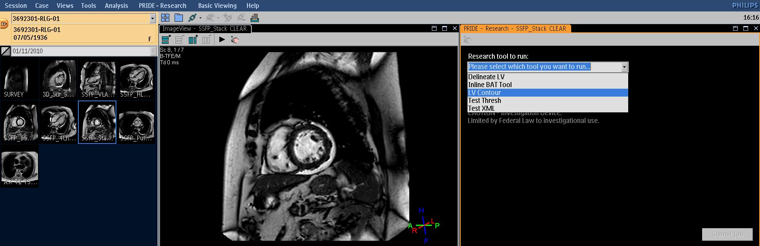
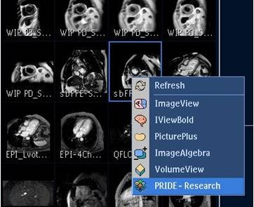
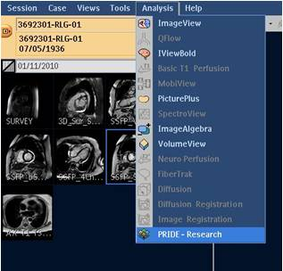
Example – Inline LV Analysis Tool
MATLAB tool integrated with scan protocol
1.5T Philips Achieva clinical scanner (Intel Xeon, 3.20GHz, 6GB RAM).
Import, process, and write back series data to patient database

Slide 5
Implementation: Need MATLAB Compiler
MATLAB Compiler allows to:
Deploy C or C++ code that interfaces with MATLAB
Package MATLAB® applications as executables and shared libraries
Distribute royalty-free, standalone executables and software components
Incorporate MATLAB-based algorithms into applications developed using other languages and technologies
Encrypt and protect MATLAB code

Slide 6
MATLAB Standalone Application
The MATLAB® Compiler™ product can compile M-files, MEX-files, MATLAB® objects, or other MATLAB code as
Standalone applications on UNIX®, Windows®, and Macintosh® platforms
C and C++ shared libraries (dynamically linked libraries, or DLLs, on Microsoft® Windows)
Output
a platform-specific binary file – Main function
an archive file containing MATLAB functions and data – multiple functions
Include
MATLAB Compiler Runtime (MCR) as well as a set of supporting files generated by the MATLAB Compiler product
set the system paths on the target machine so that the MCR and supporting files can be found

Slide 7
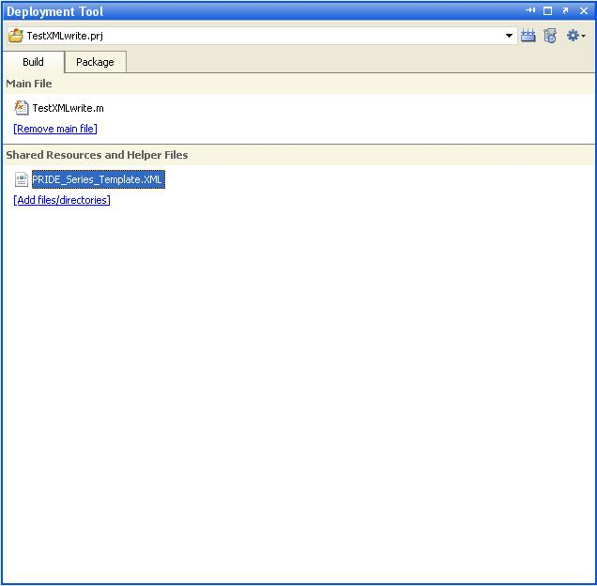
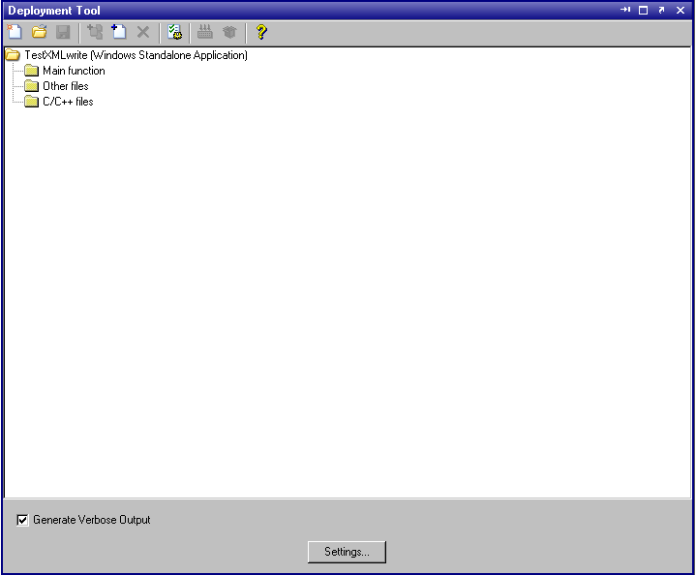
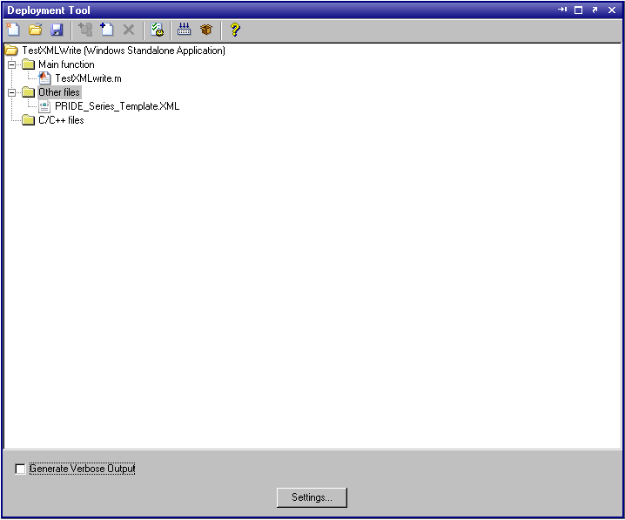
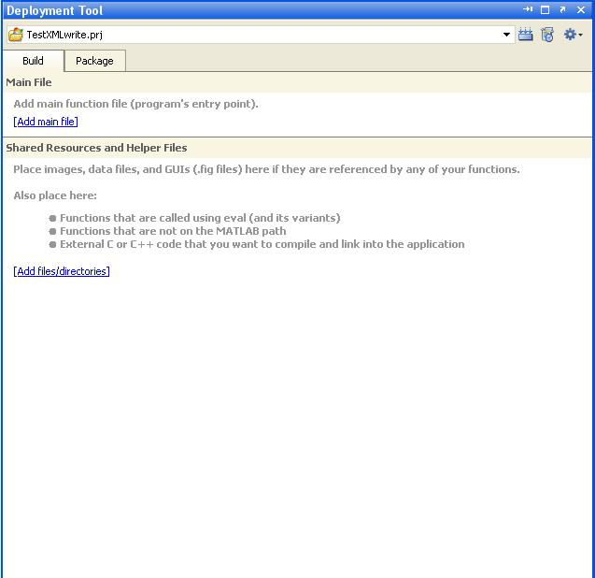
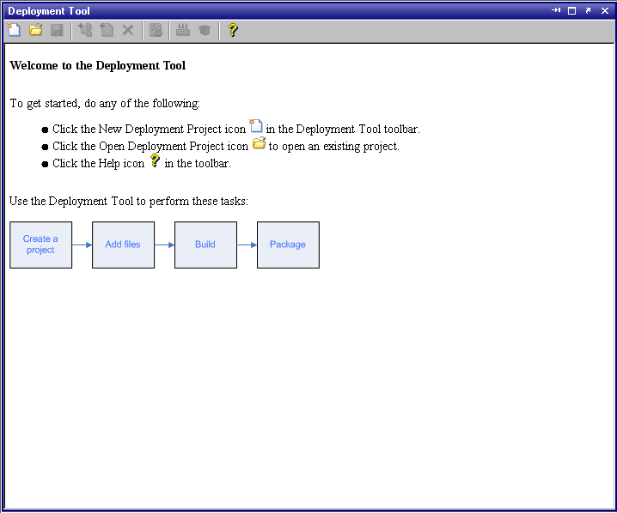
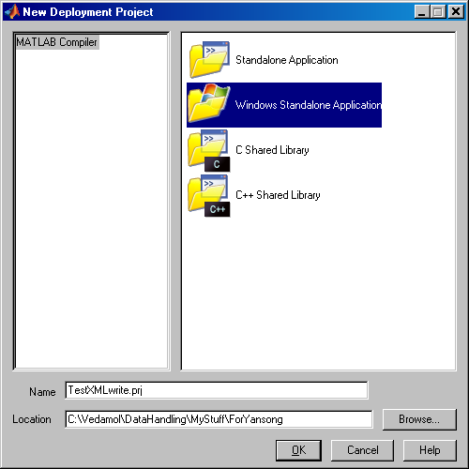
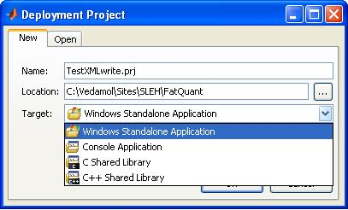
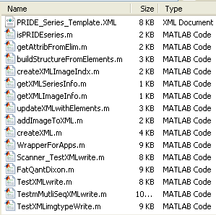
Deploying MATLAB Tool (L-Rel2009, R-Rel2010)

Slide 8
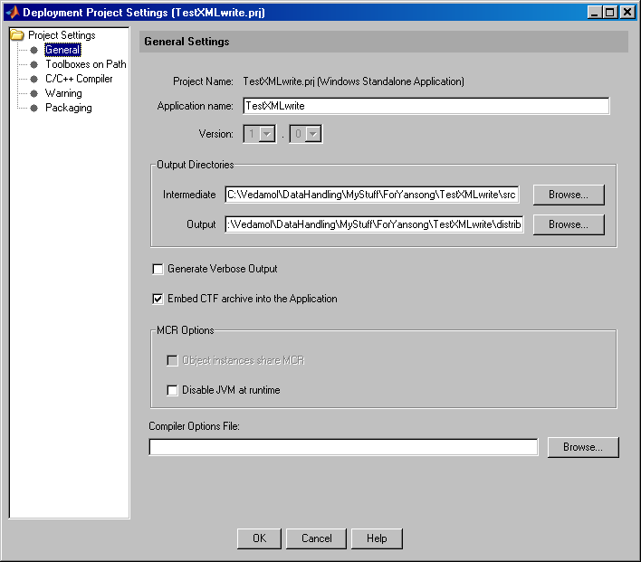
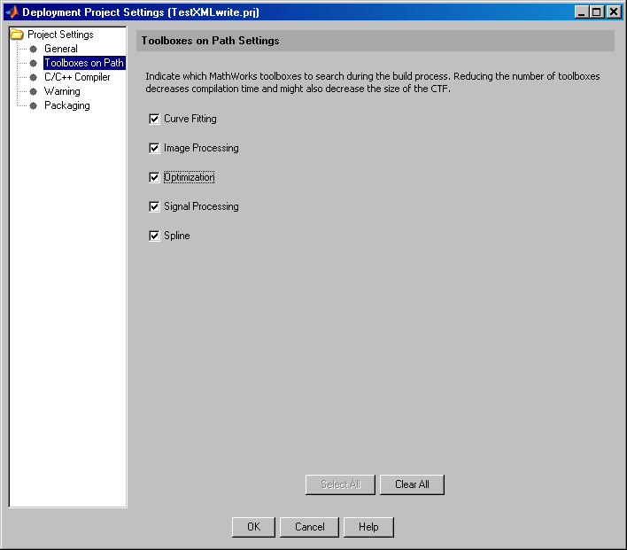
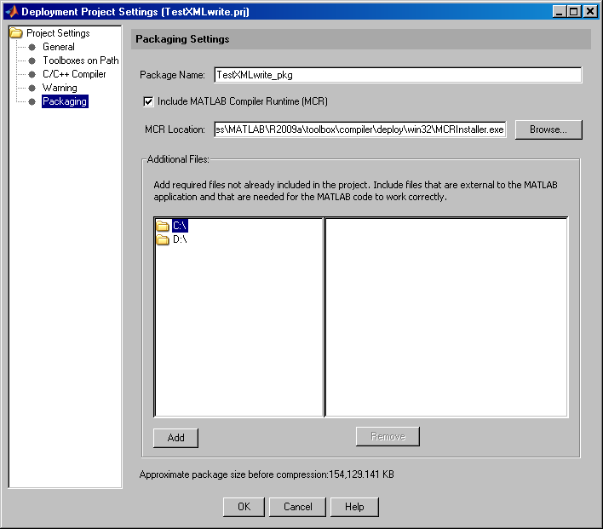
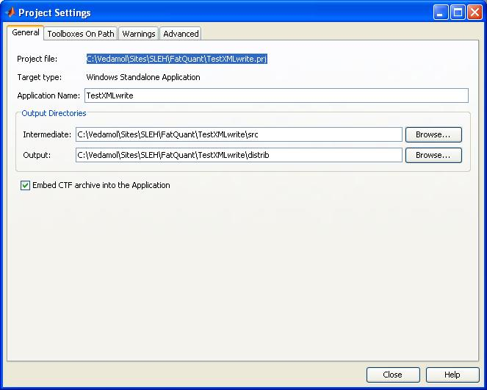
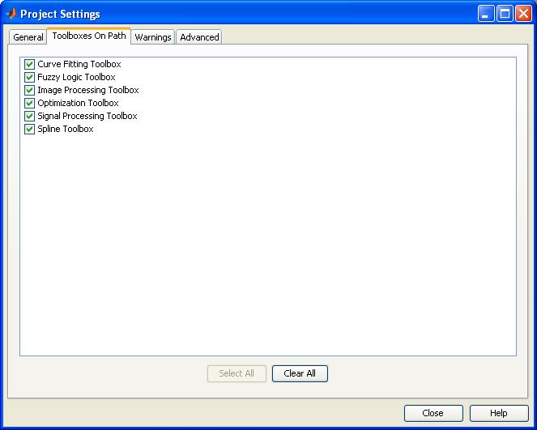
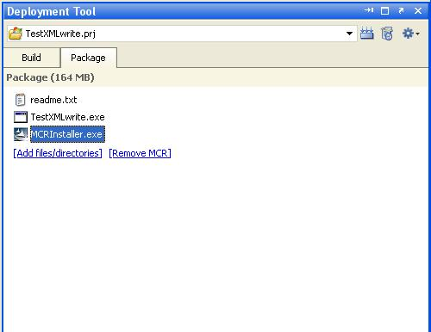
Deploying MATLAB Tool (L-Rel2009, R-Rel2010)
.ctf, contains the MATLAB functions and data that define the application
Include MCR for the very first run on the machine

Slide 9
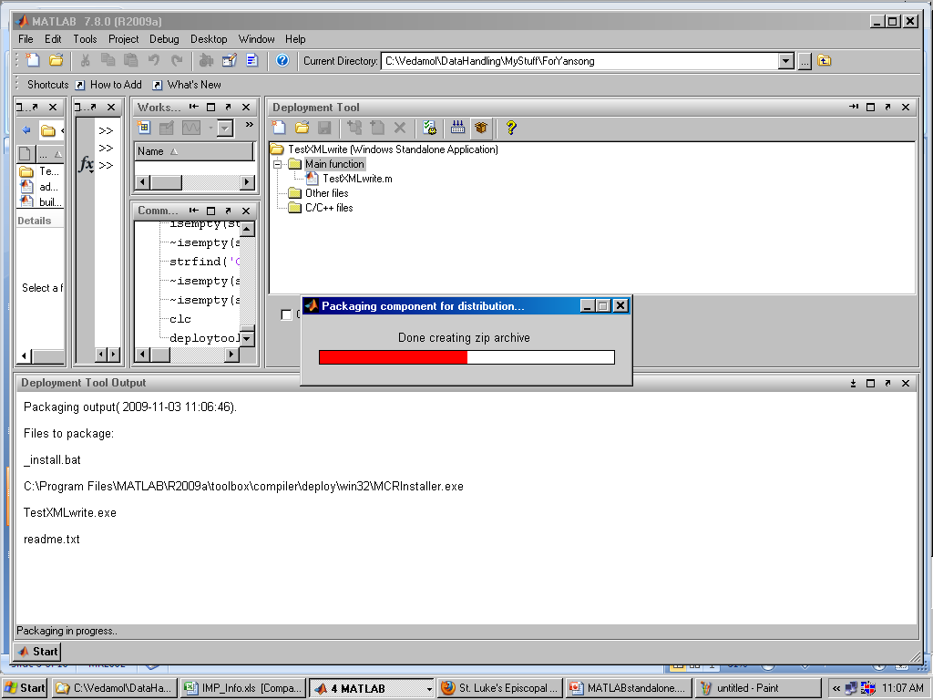
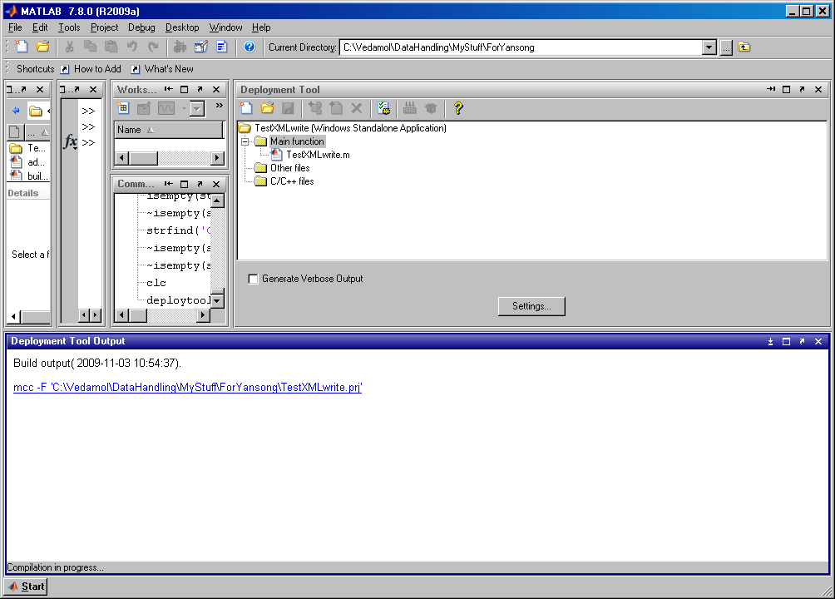
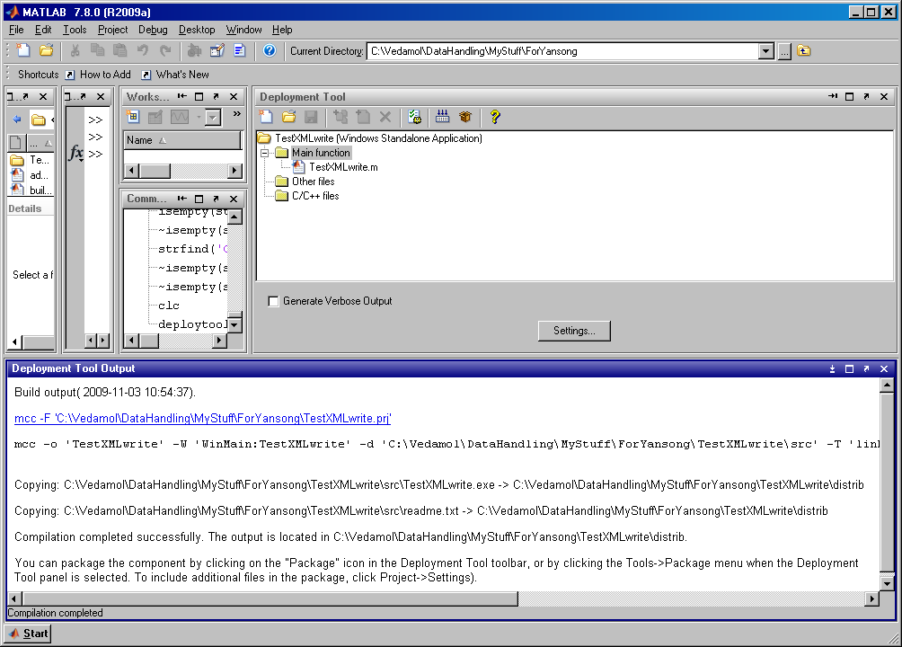
MATLAB Compilation and Packaging (Rel 2009)

Slide 10
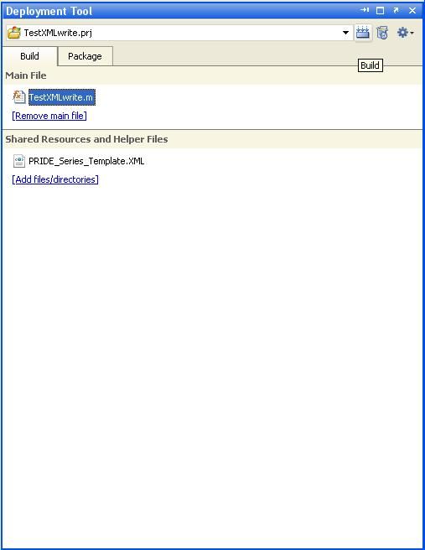
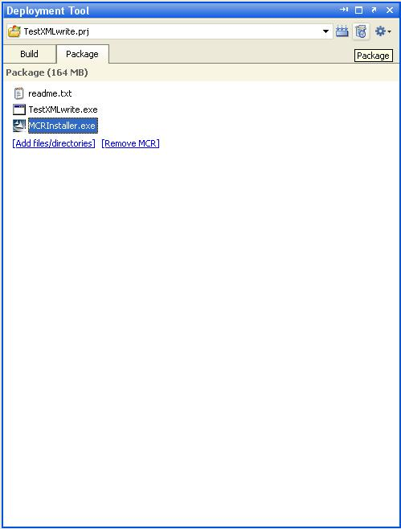
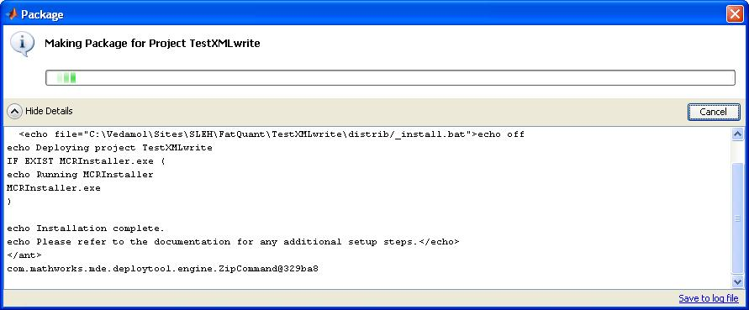
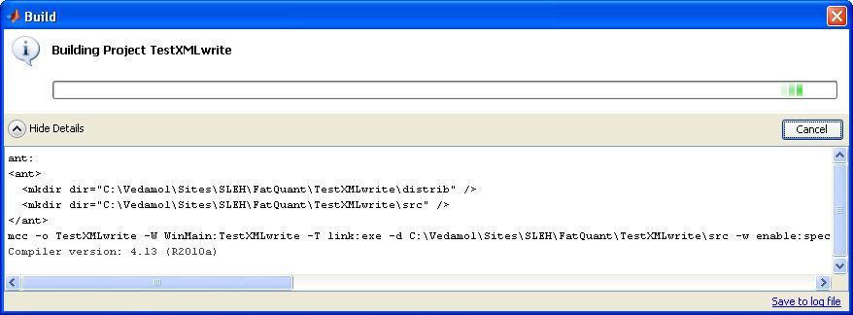
MATLAB Compilation and Packaging (Rel 2010)
10

Slide 11

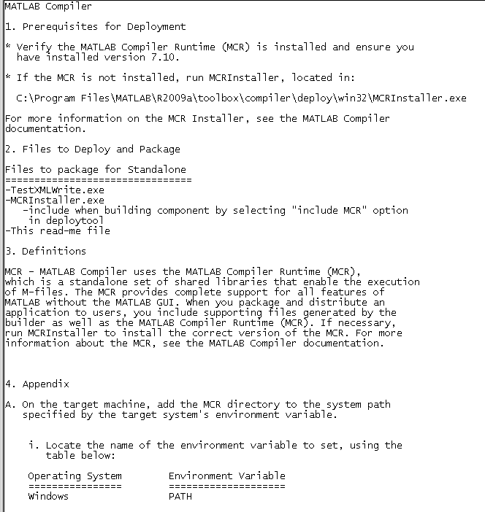

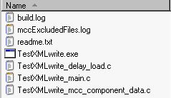
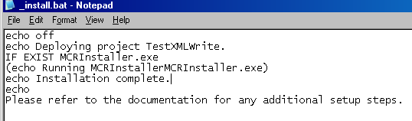
MATLAB Tool Deployment
Package and distribute MATLAB Compiler Generated Application
MATLAB Compiler Runtime (MCR) – first time only
a set of supporting files generated by the MATLAB Compiler (distrib)

Slide 12
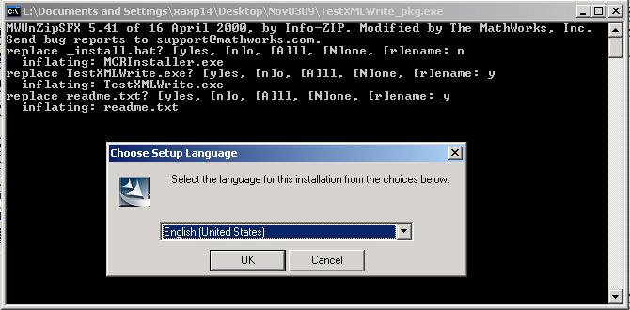
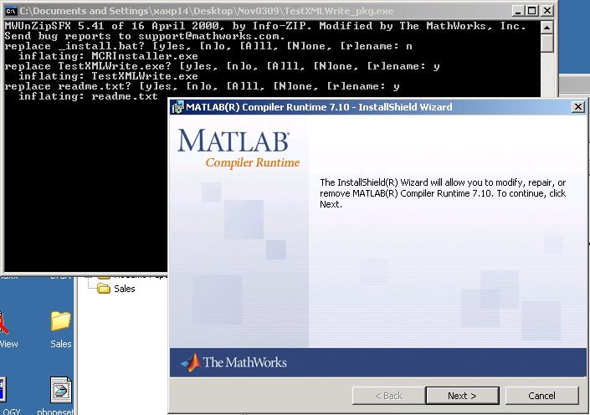
Installing MATLAB Runtime Environment
12

Slide 13
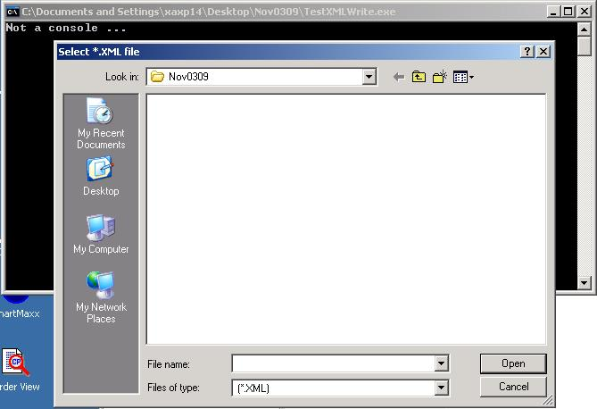
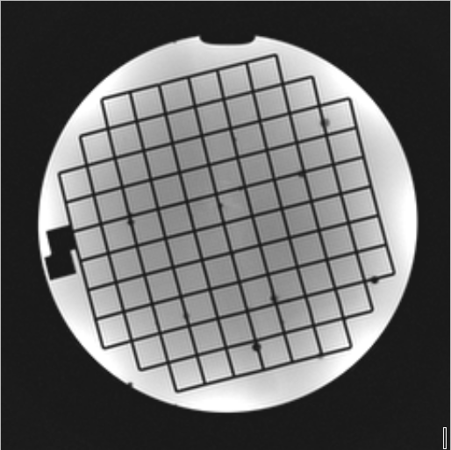
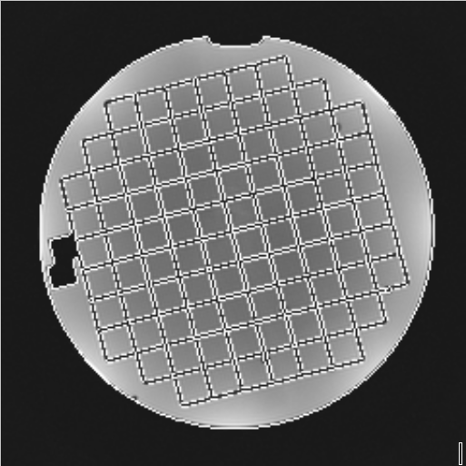
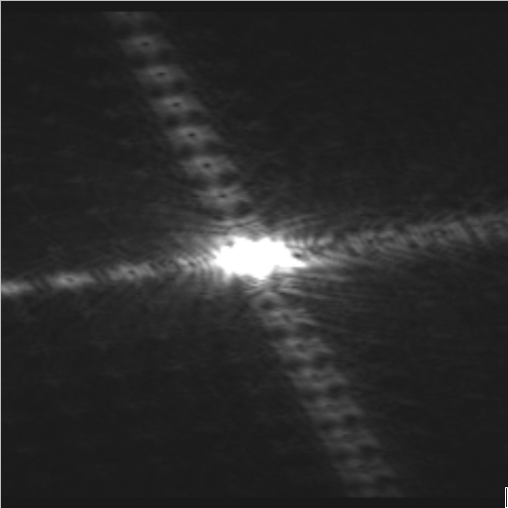
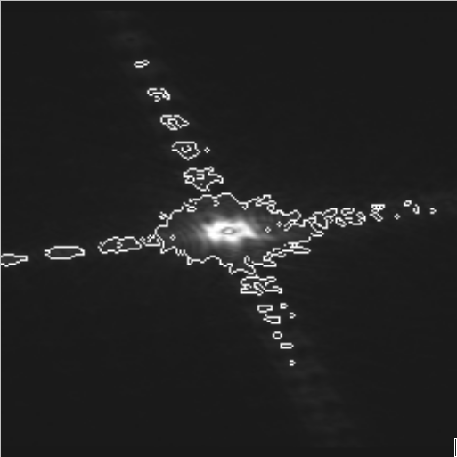
Running MATLAB Tool on Any Machine
13

Slide 14
Configuring the Tool on Console and EWS
Same requirements for release and CSK as inline PRIDE
On console g:\patch\pride\ (g->d for EWS)
First check on separate PC, check XML/REC output using PRIDE Image Reader application
Then reconfirm on EWS, and finally put it on the console
<PRIDE_V5>
<Series_Info>
<Attribute Name="Patient Name" Tag="0x00100010" Level="Patient" Type="String">test xl torso </Attribute>
…
</Series_Info>
<Image_Array>
<Image_Info>
<Key>
<Attribute Name="Slice" Tag="0x2001100A" Type="Int32">1</Attribute>
…
</Key>
<Attribute Name="Pixel Size" Tag="0x00280100" Type="UInt16">16</Attribute>
…
</Image_Info>
<Image_Info>
<Key>
</Key>
</Image_Info>
…
</Image_Array>
</PRIDE_V5>
PRIDE_V5
Series_Info
Image_Array
Attribute
# 43
Image_Info
# images
Key
Attribute
# 38
Attribute
# 10

Slide 15
Inline MATLAB Tools
Multiple tools can be configured at the same time. You can select the tool to run
Tools can be installed along with the patch
To export patch specific parameters and info, use empty/unused DICOM tags
Depending on the configuration of the 3rd-party tool, you can provide command-line arguments, and it is determined whether the tool runs in the background, or is an interactive tool
Note that no more than 1 output series will be generated per submitted job
Use multiple image types (M,R,I,P) to send back multiple images
To take multiple series as input
Break up tool into multiple tools
roids for each successive scan is in incremental order

Slide 16
Possible Side Effects of Inline MATLAB
There is no official support for installing 3rd party tools on the scanner console, so test your changes thoroughly!
Ronald Holthuizen checked the Matlab installation, and found the following:
Visual C++ Runtime is installed
The Matlab install itself is pretty clean but it does perform quite a number of COM-registrations
In particular the C++ Runtime installation is undesired. This can be a different version than already installed on the scanner console, and there is a small chance of unwanted side-effects.
So in summary, probably it is fine to have the MATLAB installation on the console, but there is a small chance of side-effects.

Slide 17



