Slide 1
Inline MATLAB Tool
Amol Pednekar, Ph.D.
MR Clinical Scientist
Philips Healthcare

Slide 2
Outline
Motivation for MATLAB inline processing
Example of Implementation and testing for cardiac analysis (presented in SCMR and ISMRM)
Specifics of inline MATLAB tool implementation
Example MATLAB tools and code

Slide 3
Motivation for Inline MATLAB Tool
Essentially MR console and post-processing workstation should merge in near future
Currently cardiac analysis is the major (almost exclusive) exponent of the separate workstation
Harvesting numerous post-processing tools written in MATLAB by various research collaborators will enrich console functionality
Majority of collaborators use/prefer MATLAB
Availability of inline MATLAB tools will facilitate multi-central clinical validation of customer developed investigational tools
Currently data is exported from the scanner to a separate computer where custom built MATLAB tools are used
since the resultant images are not sent back to the patient database, the physicians do not have an easy access to the post-processed data e.g. T1 map

Slide 4
Inline MATLAB Tools on Philips Platform
Generic ExamCards inline processing is available
Wrapper tools implemented in IDL are available through PRIDE framework to customize for specific applications
Majority of collaborators use/prefer MATLAB for development
Generic image import/export wrapper tool in MATLAB is needed
Specifically, Cardiac ejection fraction (EF) computation was implemented as inline MATLAB tool on scanner console (>=R2.6) and EWS (>=R2.6.3.1)
Clinician can immediately communicate EF (< 35% or not) to patient and referring physician
Multi-slice, multi-phase nature of the data tests the reliability of data import/export functions
Given the results so far we have stable MATLAB wrapper for image import/export which can be easily customized by collaborators in manner similar to PRIDE tool

Slide 5
Effects of MATLAB Inline Tool on Scanner Operations
Ronald Holthuizen checked the Matlab installation, and found the following:
Visual C++ Runtime is installed
The Matlab install itself is pretty clean. It does perform quite a number of COM-registrations though
In particular the C++ Runtime installation is undesired. This can be a different version than already installed on the scanner console, and there is a small chance of unwanted side-effects.
So in summary, probably it is fine to install the Matlab installation, but there is a small chance of side-effects.

Slide 6
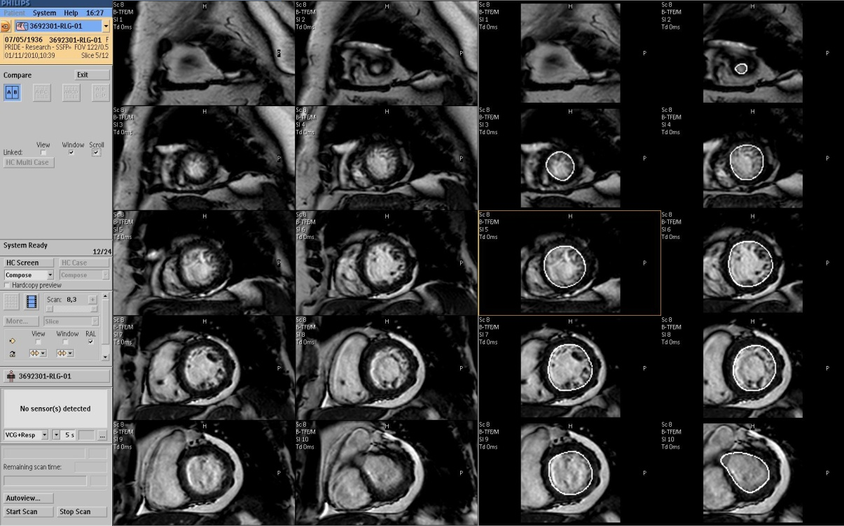
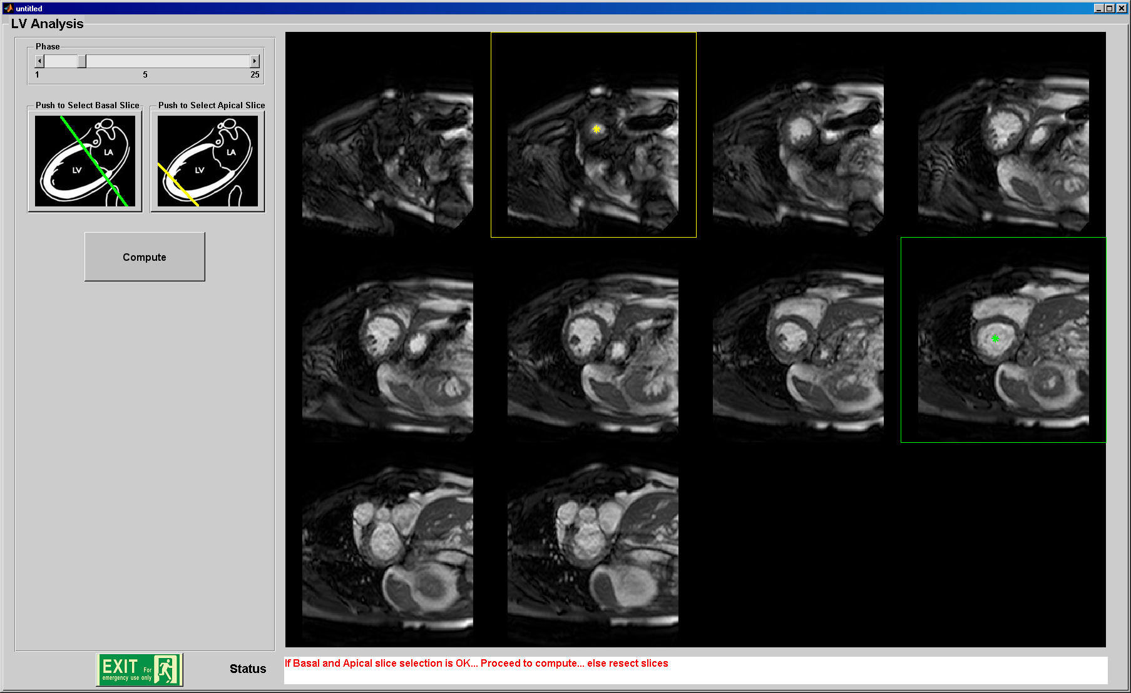
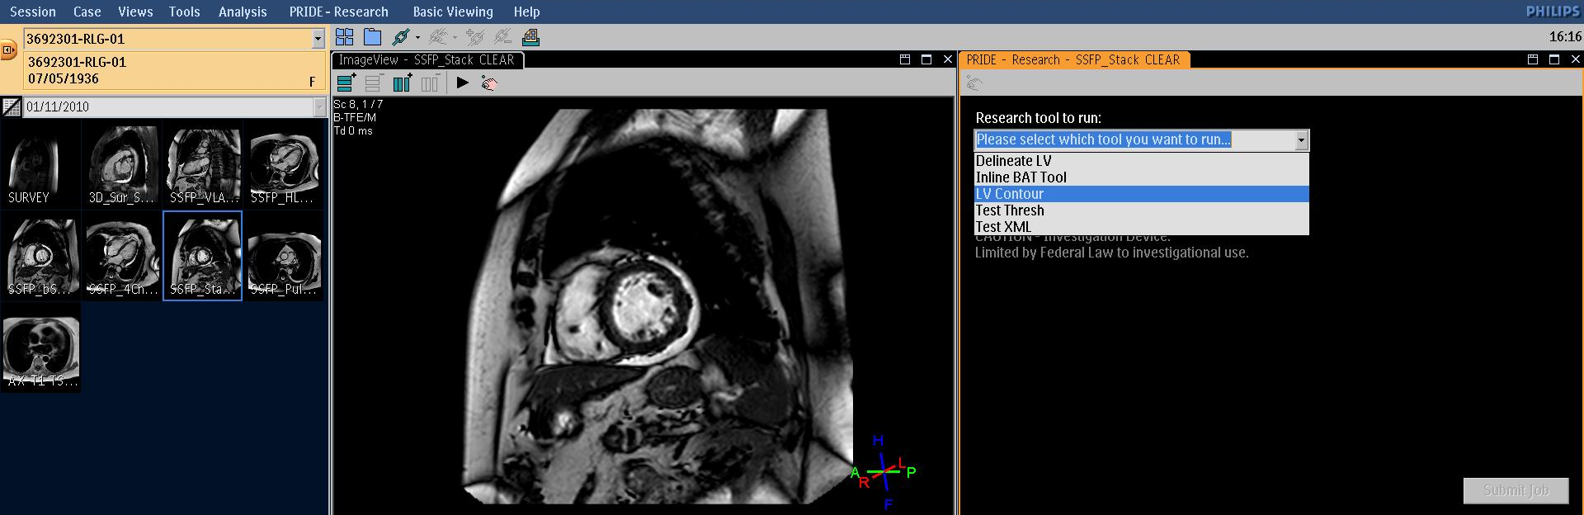
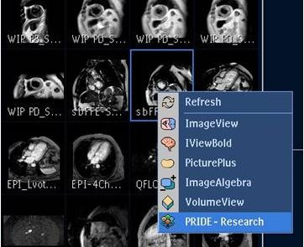
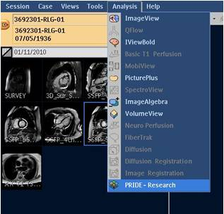
Example – Inline LV Analysis Tool
MATLAB tool integrated with scan protocol
1.5T Philips Achieva clinical scanner (Intel Xeon, 3.20GHz, 6GB RAM).
Import, process, and write back series data to patient database

Slide 7
Implementation: Need MATLAB Compiler
Deploy C or C++ code that interfaces with MATLAB
Package MATLAB® applications as executables and shared libraries
Distribute royalty-free, standalone executables and software components
Incorporate MATLAB-based algorithms into applications developed using other languages and technologies
Encrypt and protect MATLAB code

Slide 8
Implementation: MATLAB Standalone Application
The MATLAB® Compiler™ product can compile M-files, MEX-files, MATLAB® objects, or other MATLAB code as
Standalone applications on UNIX®, Windows®, and Macintosh® platforms
C and C++ shared libraries (dynamically linked libraries, or DLLs, on Microsoft® Windows)
Output
a platform-specific binary file – Main function
an archive file containing MATLAB functions and data – multiple functions
Include
MATLAB Compiler Runtime (MCR) as well as a set of supporting files generated by the MATLAB Compiler product
set the system paths on the target machine so that the MCR and supporting files can be found

Slide 9
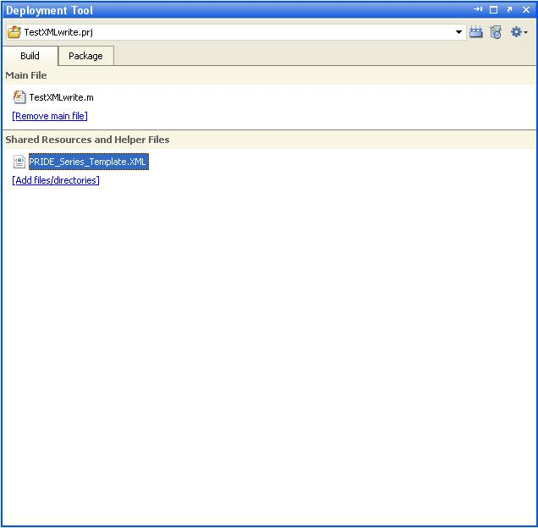
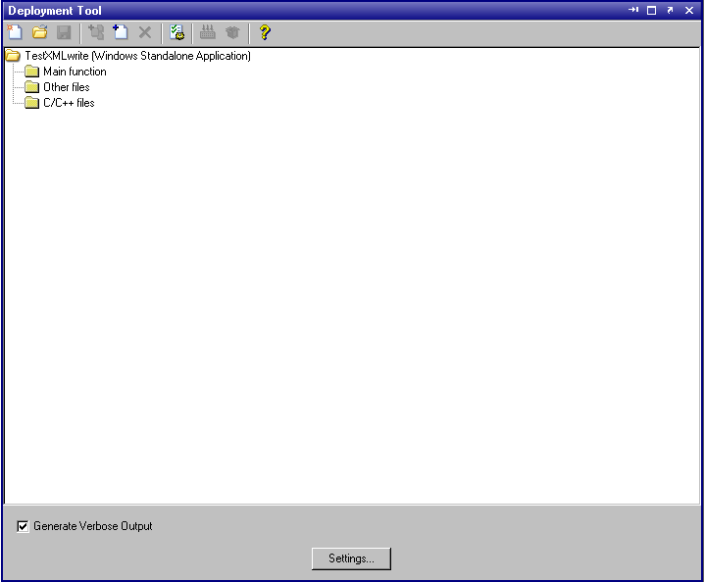
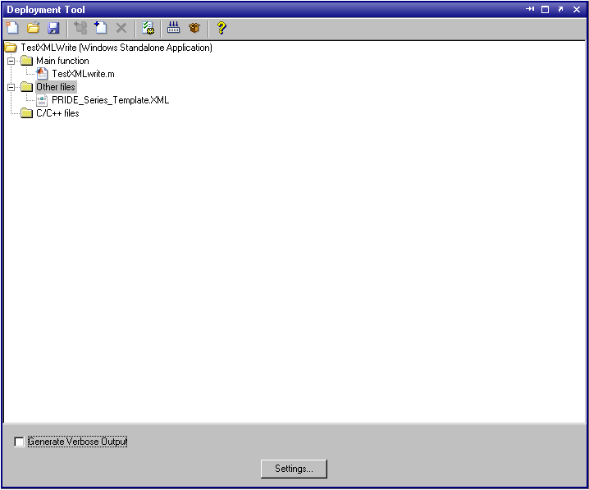
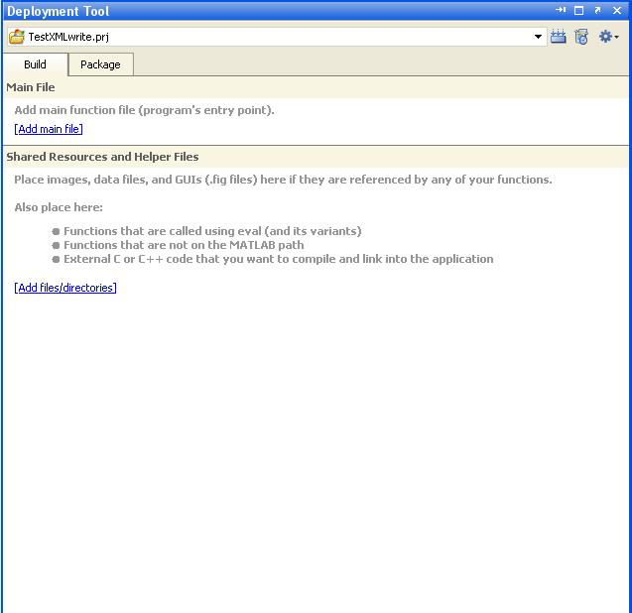
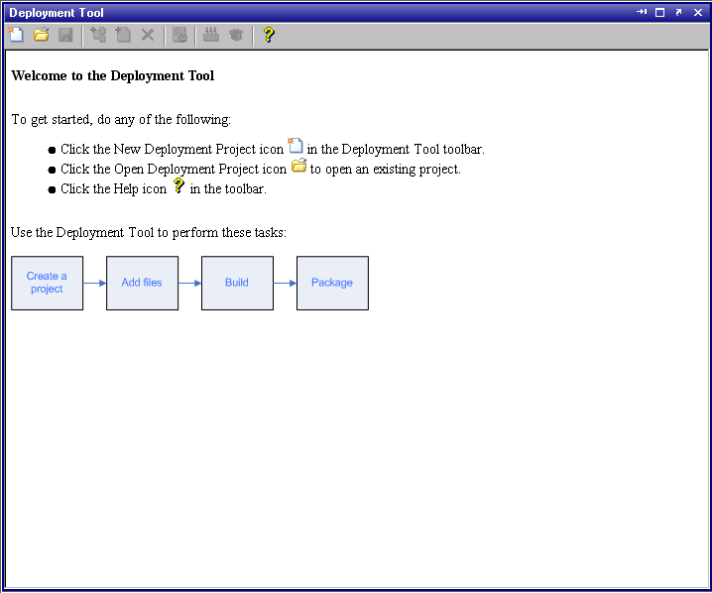
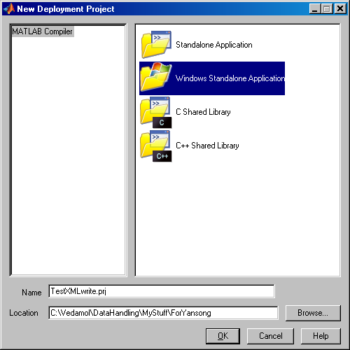
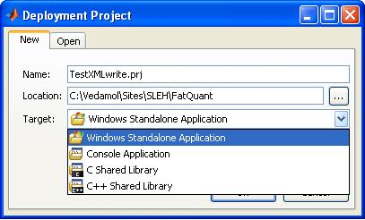
Deploying MATLAB Tool (L-Rel2009, R-Rel2010)

Slide 10
MATLAB Wrapper Files
Wrapper files generate platform specific binaries
Provides an interface to the compiled M-code
Performs initialization and termination as needed
Defines data arrays containing path information, encryption keys, and other information needed by the MCR.
Provides the necessary code to forward calls from the interface functions to the MATLAB functions in the MCR.
For an application, contains the main function
For a library, contains the entry points for each public M-file function.

Slide 11
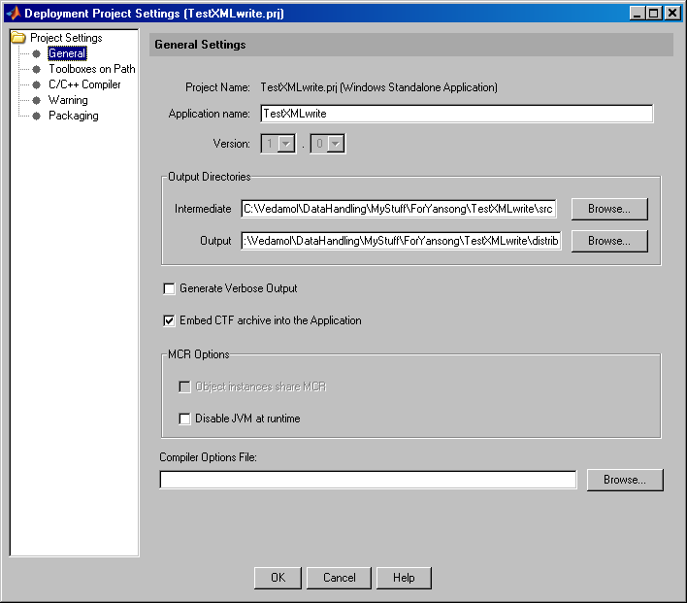
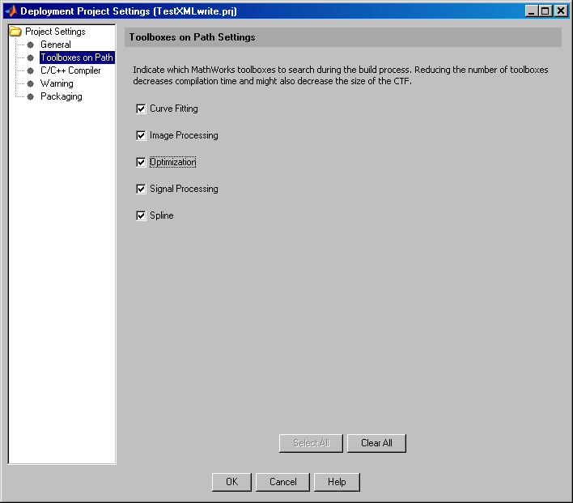
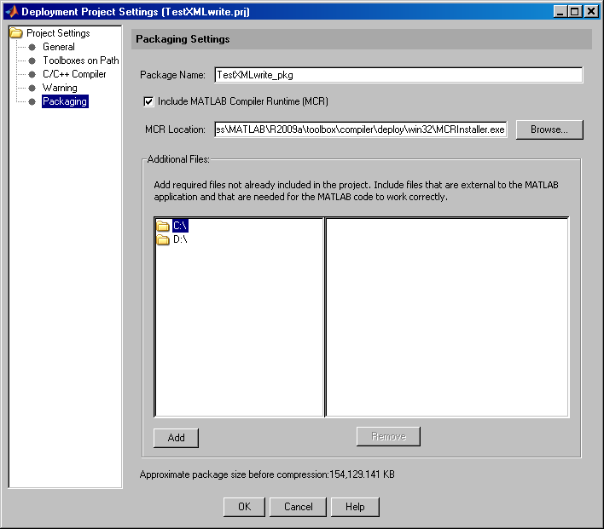
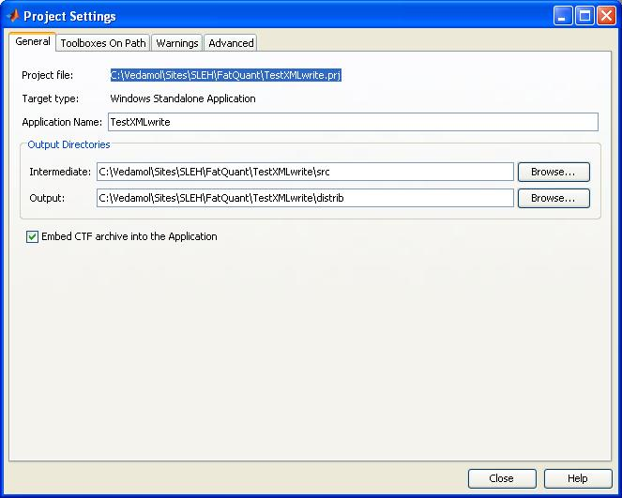
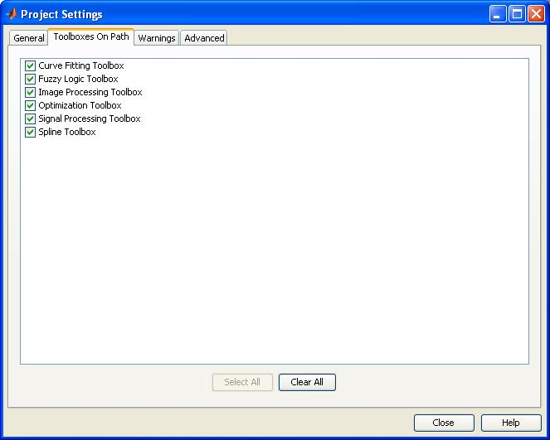
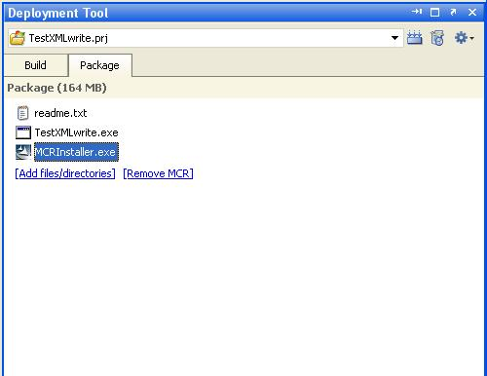
MATLAB Component Technology File (CTF)
.ctf, contains the MATLAB functions and data that define the application
Include MCR for the very first run on the machine

Slide 12
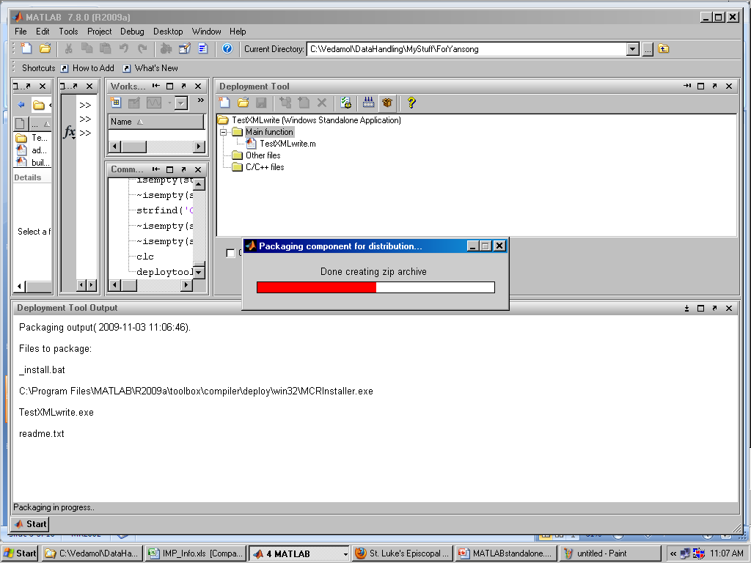
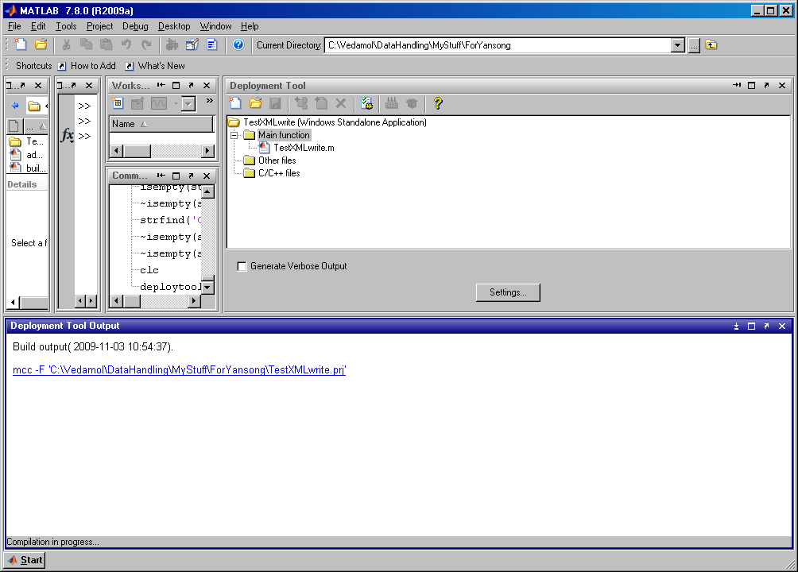
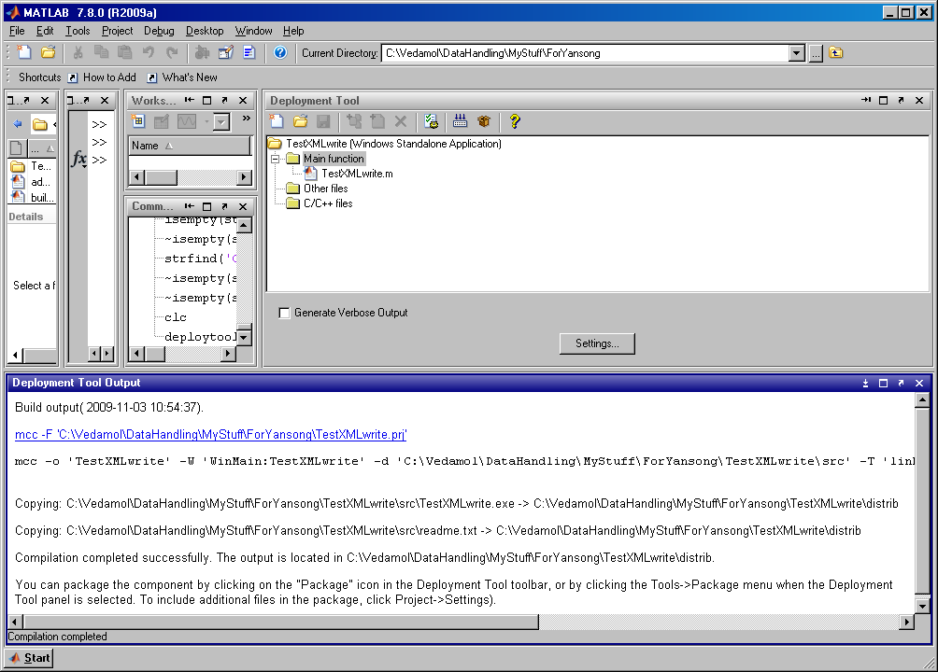
MATLAB Compilation and Packaging (Rel 2009)

Slide 13
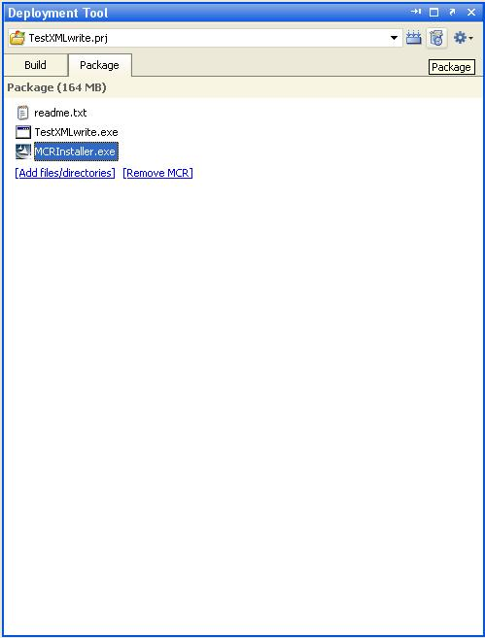
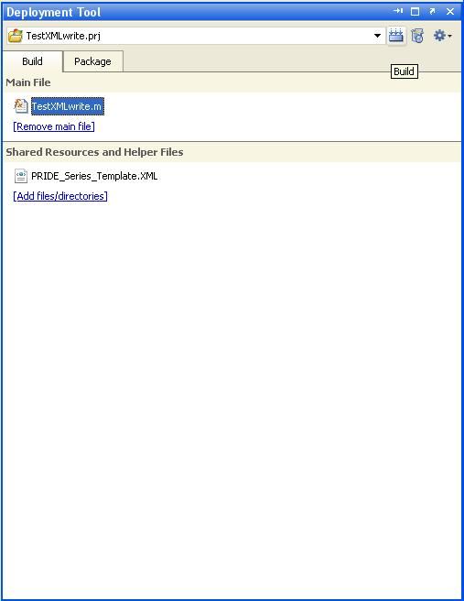
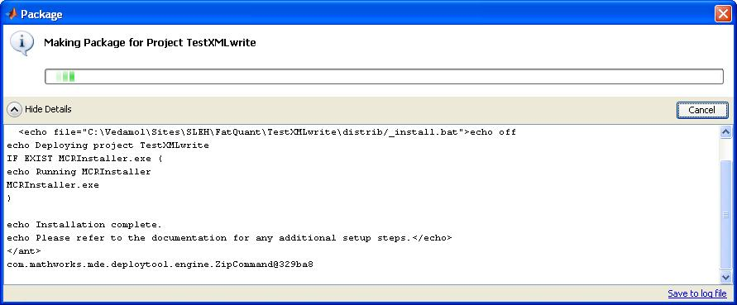
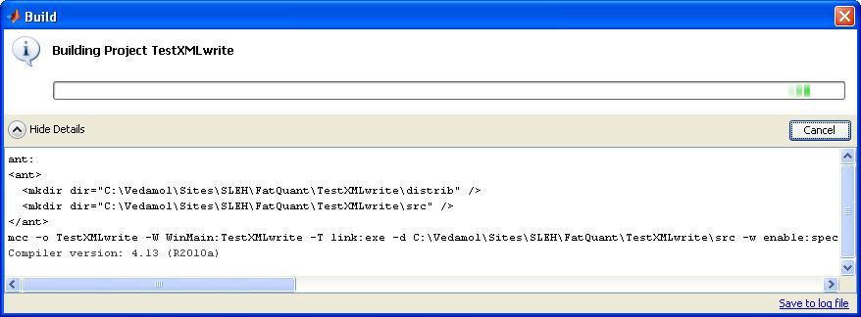
MATLAB Compilation and Packaging (Rel 2010)

Slide 14

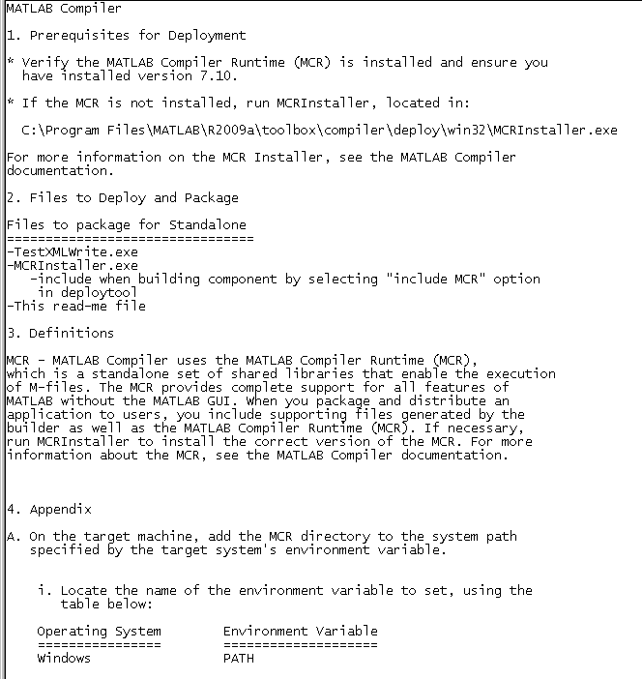

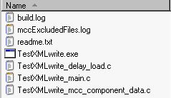
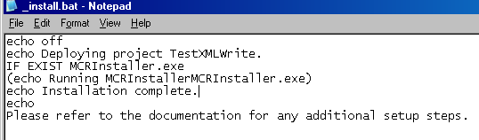
MATLAB Tool Deployment
Package and distribute MATLAB Compiler Generated Application
MATLAB Compiler Runtime (MCR) – first time only
a set of supporting files generated by the MATLAB Compiler (distrib)

Slide 15
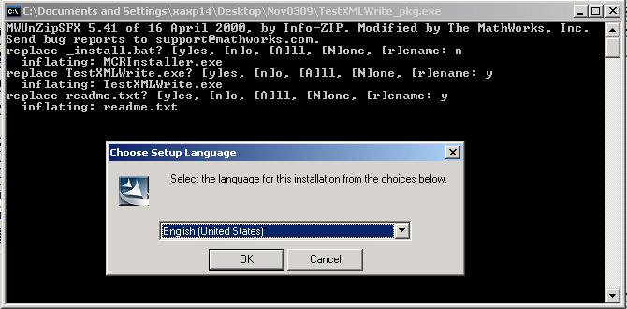
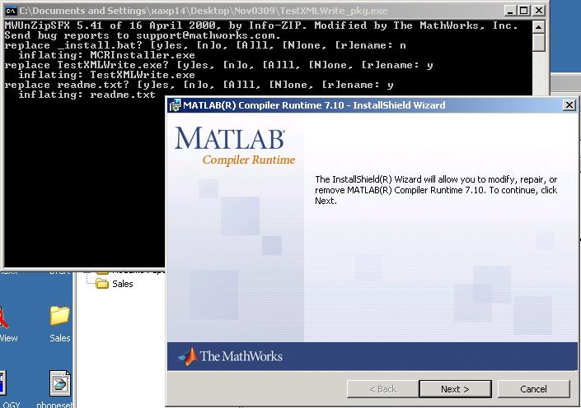
Installing MATLAB Runtime Environment

Slide 16
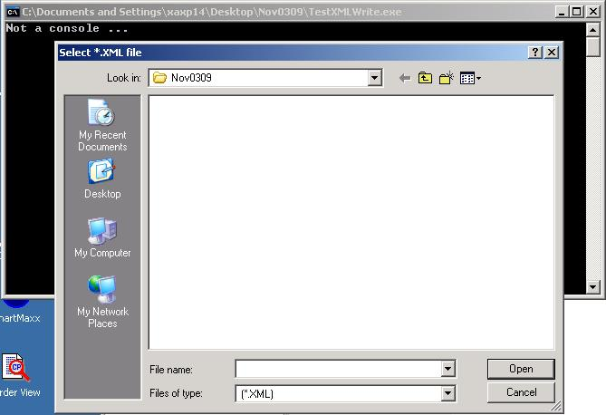
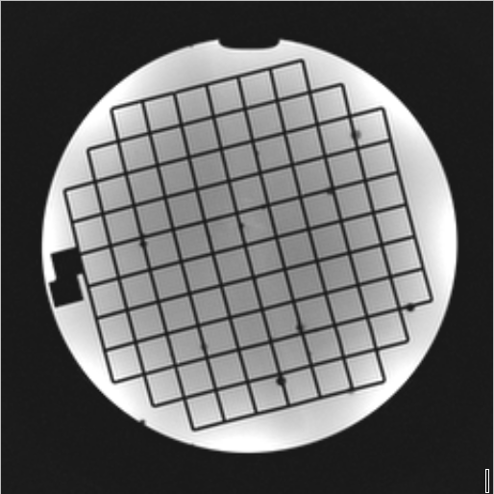
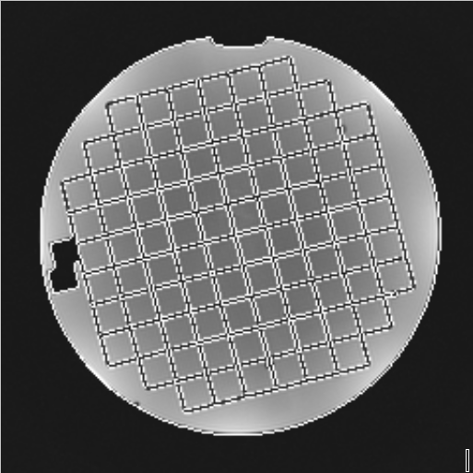
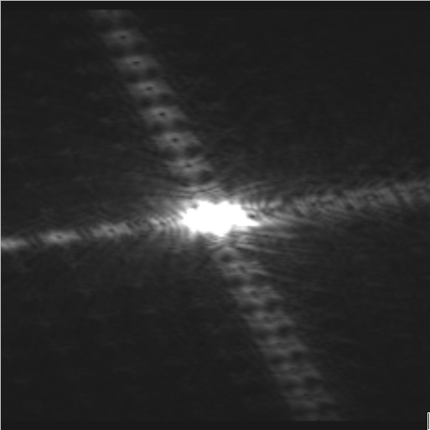
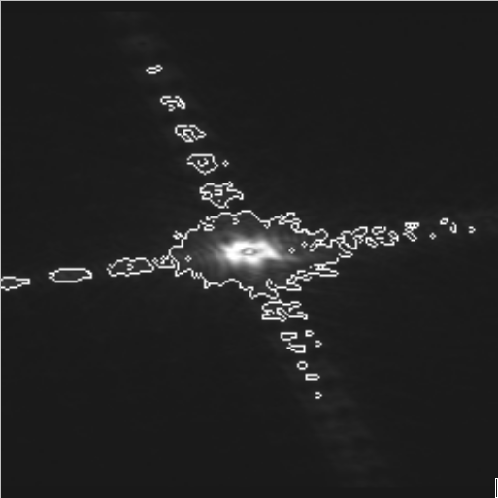
Running MATLAB Tool on Any Machine

Slide 17
Configuring the Tool on Console and EWS
Requires
Console (>=R2.6) and EWS (>=R2.6.3.1)
PRIDE Database access CSK39
XML/REC Export tool CSK43
Tool Launcher process runs from 'C:\Program Files (x86)\PMS\Mipnet42'
To configure your MATLAB tool on console, create an xml file PrideConfiguration.xml at g:\patch\pride\packageconfiguration (g->d for EWS)
Multiple tools can be configured at the same time. You can select the tool to run

Slide 18
PrideConfiguration.xml
<?xml version="1.0" encoding="utf-8"?>
<PrideConfiguration xmlns:xsd="http://www.w3.org/2001/XMLSchema" xmlns:xsi="http://www.w3.org/2001/XMLSchema-instance">
<PackageName>TestXMLwrite</PackageName>
<CommandLine>"g:\patch\pride\TestXMLwrite.exe"</CommandLine>
<CommandArguments>" "</CommandArguments>
<CommandArgumentsVisible>True</CommandArgumentsVisible>
<ShowUserInterface>True</ShowUserInterface>
</PrideConfiguration>
PackageName: The name of your tool
CommandLine: Which command-line tool to run.
CommandArguments: Which command arguments to pass to the tool
CommandArgumentsVisible: Whether the command arguments should be visible and customizable by the user in the tool launcher.
ShowUserInterface: Whether the tool is interactive, or runs fully automatically in the background.

Slide 19
Interfacing the Tool on Console
Keep executable of the MATLAB tool in G:\patch\PRIDE
The command-line of the configured tool will launch in the following way - G:\patch\pride\yourfilename <series_roid> <your command-arguments>
Prepare clean directories for data exchange with image database 'G:\patch\PRIDE\tempinputseries' and 'G:\patch\PRIDE\tempoutputseries'
Invoke c:\Program Files (x86)\PMS\Mipnet42\pridexmlleacher_win_cs.exe which will save the series_roid as XML/REC files in the directory g:\patch\pride\tempinputseries
Read XML/REC data from 'G:\patch\PRIDE\tempinputseries' and write back resultant images to 'G:\patch\PRIDE\tempoutputseries'
After your tool terminates, the scanner console will look for output saved in this path, and copy the contents into the database.
Color .png, .bmp, .jpg, .jpeg files -> These will be saved as a secondary capture series
Xml/Rec file-pair -> Will be saved as a full MR Series (monochrome)
Only one output series will be generated per submitted job

Slide 20
Guidelines for not affecting scanner operation
To not affect the scanner operation the tool must meet the following requirements:
No more that 1 GB of hard-disk space may be used on the G drive
No more than 500 MB memory may be used at all times
The application should be single-threaded, not taking up more than 1 CPU core at any time
The application must not block/hide top-most messages of the scanner, such as table movement
Not any installer may modify any system .dlls, edit the registry etc.
An installer should only install the desired files on the G:\patch\Pride location.
Recommendations
First install tool on a 3rd party PC with Windows XP 64-bit
Remember your tool has full, so be 100 % certain no system files are modified (e.g. local registry settings)

Slide 21


