Slide 1
Extending a Multi-Modal LLM for Protein Function Prediction
Thomas Haskell
Conor Jurewicz
Mohammed Alnajim

Slide 2
Agenda
Introduction
Methodology
Results
Future Work
Conclusion

Slide 3
Introduction
Problem Statement
Creating an accurately predicting protein function from sequence data remains a major challenge. Traditional
methods often reduce the task to rigid classification, which fails to capture biological complexity and nuance.
Motivation
Current models (like DeepGO, ProteinBERT) oversimplify by forcing proteins into discrete categories.
These label-based predictions often miss context, subtle functions, and biological interactions.
We need tools that go beyond classification — generating richer, more natural descriptions of what a protein does.
Why This Matters
Better function prediction supports research in drug discovery, disease mechanisms, and synthetic biology.
Making models more interpretable and descriptive benefits real-world biological investigation

Slide 4
Introduction (cont.)
Where We Come In
We build on ProteinChat, a large language model that accepts both protein sequences and text-based
prompts.
Unlike label-only models, ProteinChat aims to generate descriptive, human-readable explanations of protein
function.
Our Contributions to ProteinChat
Enhanced Prompting: Redesigned how we ask the model questions to guide more precise outputs.
Fine-Tuning with LoRA: Improved the model’s efficiency and accuracy with lightweight parameter tuning.
Interactive Refinement: Enabled users to refine and explore function predictions through dialogue-like interactions. (Think of ChatGPT)
Overall we transformed ProteinChat into a tool that is more biologically relevant, computationally efficient, and usable by researchers anyone interested in this field.

Slide 5
Methodology
Model Architecture
We extended ProteinChat, a pre-trained multi-modal language model designed to predict protein functions.
It processes amino acid sequences along with natural language prompts to generate descriptive outputs.
Our enhancements focus on prompt tuning and parameter refinement, rather than vast architectural changes.
Training Data
UniProt Swiss-Prot Dataset:
1.5 million (protein, prompt, answer) triplets.
462,019 unique proteins.
Pre-divided into train/val/test (80/10/10%).
Preprocessing Steps:
Tokenization: Sequences tokenized using xTrimoPGLM-1B tokenizer (max length: 1024 tokens).
Augmentation: Randomly masked 15% of sequence tokens and dropped 10% of words from prompts for model robustness.
Ensures model generalizes well and isn't overfit to narrow examples.

Slide 6
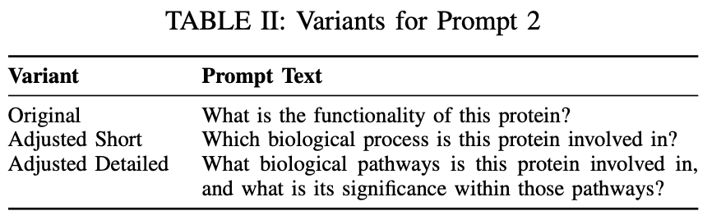
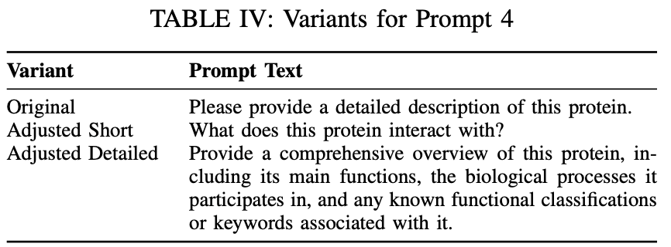
Methodology (cont.)
Prompt Engineering
Original ProteinChat used vague prompts (e.g., “Tell me about this protein”).
This would consistently lead to generic or occasionally incomplete outputs.
We introduced two new adjusted prompt sets the the model that enhance performance:
Short: Targeted but concise
Detailed: In-depth and specific

Slide 7
Methodology (cont.)
Low-Rank Adaptation (LoRA) is a popular and efficient technique used to fine-tune large pre-trained machine learning models, especially Large Language Models (LLMs), without having to retrain all of their billions of parameters.
Instead of updating all weights, LoRA injects trainable low-rank matrices into attention layers, reducing:
GPU memory consumption
Fine-tuning time
Risk of overfitting
Why We Used LoRA:
LoRA enabled us to fine-tune only task-relevant parameters, making the project
feasible using Google Colab and consumer-grade GPUs that were made to the public.

Slide 8
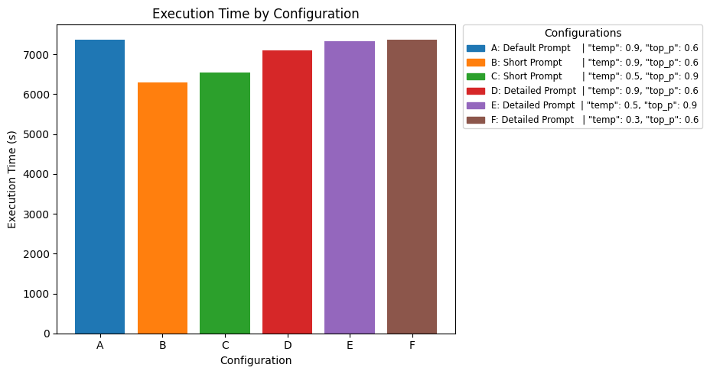
Results
temperature: Controls randomness. Lower values make the output more deterministic and focused, which is often better for factual tasks like function prediction. Higher values make it more random and creative.
top_p (nucleus sampling): Controls the pool of candidate tokens at each generation step. Lowering this value narrows the pool, leading to more conservative outputs.

Slide 9
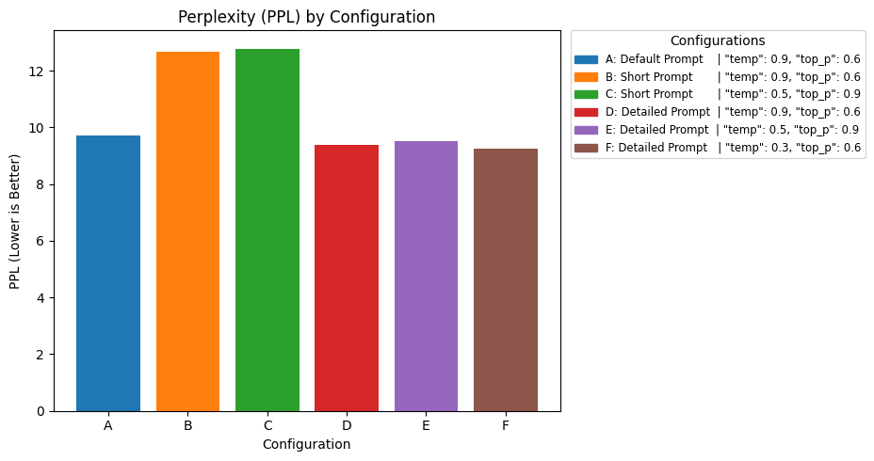
Results
Perplexity: evaluate how well a model predicts the next word in a sequence. It essentially measures the model's "surprise" or "uncertainty”.

Slide 10
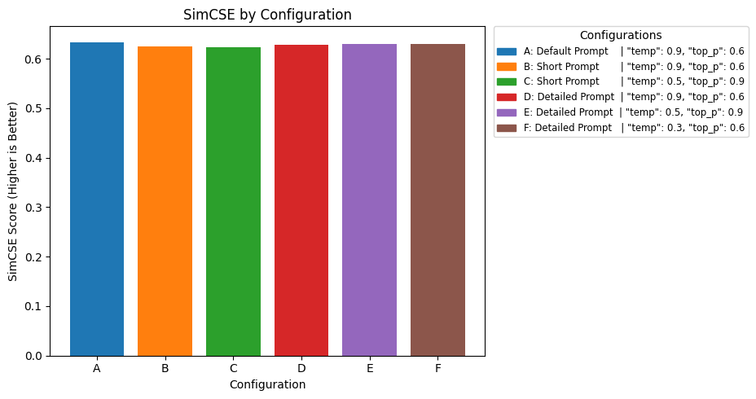
Results
SimCSE: [Simple Contrastive Learning of Sentence Embeddings] assess whether two sentences that are semantically similar.

Slide 11
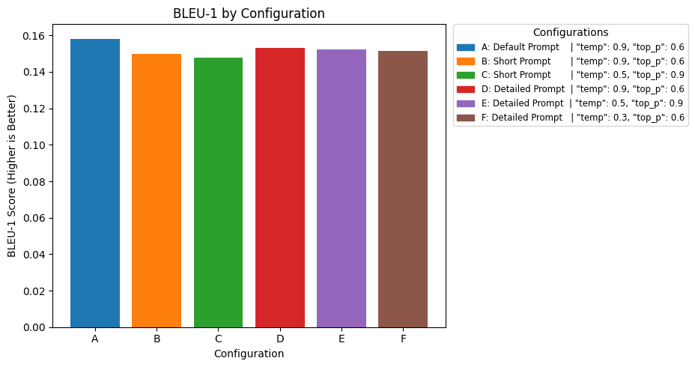
Results
BLEU-1: [Bilingual Evaluation Understudy] measures the precision of individual words between the generated text and a reference.

Slide 12
Challenges
Dependency Management: The repository uses a conda environment.yml file for managing dependencies instead of a requirements.txt file [Incrementally pip installed required models]
High GPU Memory for Training: The training process is resource-intensive, reportedly requiring approximately 55 GB of GPU memory. [Couldn’t train a new model]
Substantial GPU Memory for Inference: Even for testing or running inference with the model, a considerable 24 GB of GPU memory is needed. [Took 2 hours for A100 Google Colab GPU]

Slide 13
Future Work
Incorporate embeddings in the three-dimensional protein triplets to ground the language model
Human-in-the-Loop refinement to incorporate reinforcement learning through experts in the field
Evaluating the model on data beyond the Swiss-Prot dataset to test generalizability
Notes:
As of now the triplets from the dataset are just protein prompt and answer
Reinforcement learning would require some sort of interface for experts to approve or deny the outputs for a specific a protein and a prompt

Slide 14
Conclusion
Decreased performance from the more detailed prompt sets tells us the backbone Vicuna language model already captures sufficient biological context
Computational time was determined by the network architecture rather than the prompt size
Compute power is very extensive when training language models, limiting our options for adjustment
Notes:
We saw lower similarity scores for each of our tested configurations when compared to the original ProteinChat model, and can get insight into their choice of this model
Even when using Google Colab Pro with 40gb of GPU memory we were barely able to run inference for the model with the small changes we made. Adjusting the training portion could yield a larger difference in performance but that unfortunately takes more resources than we have available

Slide 15
Reference
[1] M. Huo, H. Guo, X. Cheng, D. Singh, H. Rahmani, S. Li, P. Gerlof, T. Ideker, D. A. Grotjahn, E. Villa, L. Song, and P. Xie, ”Multi-Modal Large Language Model Enables Protein Function Prediction,” bioRxiv, preprint, Aug. 2024. doi: 10.1101/2024.08.19.608729.
[2] UniProt Consortium, ”UniProt: the Universal Protein Knowledgebase in 2023,” Nucleic Acids Research, vol. 51, no. D1, pp. D523–D531, 2023, doi: 10.1093/nar/gkac1052.
[3] M. Brandes, K. Ofer, and M. Linial, ”ProteinBERT: A universal deep-learning model of protein sequence and function,” Bioinformatics, vol. 38, no. 8, pp. 2102–2110, 2022, doi: 10.1093/bioinformatics/btac020.
[4] M. Kulmanov, M. Khan, and R. Hoehndorf, ”DeepGO: predicting protein functions from sequence and interactions using a deep ontology-aware classifier,” Bioinformatics, vol. 34, no. 4, pp. 660–668, 2018, doi: 10.1093/bioinformatics/btx624.

Slide 16
Reference
[5] T. Gao, X. Yao, and D. Chen, ”SimCSE: Simple Contrastive Learning of Sentence Embeddings,” in Proceedings of the 2021 Conference on Empirical Methods in Natural Language Processing (EMNLP), pp.
6894–6910, 2021, doi: 10.18653/v1/2021.emnlp-main.552.
[6] K. Papineni, S. Roukos, T. Ward, and W. Zhu, ”BLEU: A method for automatic evaluation of machine translation,” in Proceedings of the 40th Annual Meeting of the Association for Computational Linguistics (ACL), pp. 311–318, 2002, doi: 10.3115/1073083.1073135.
[7] E. J. Hu, Y. Shen, P. Wallis, Z. Allen-Zhu, Y. Li, S. Wang, L. Wang, and W. Chen, ”LoRA: Low-Rank Adaptation of Large Language Models,” in Proceedings of the 11th International Conference on Learning
Representations (ICLR), 2022, arXiv:2106.09685.

Slide 17
Thank You! Questions?

