Slide 1
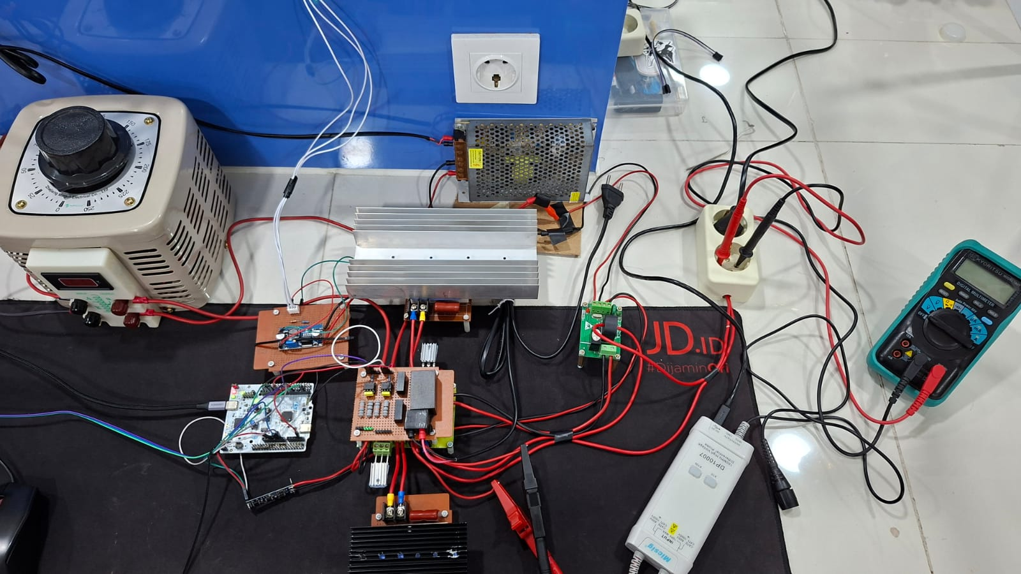

Slide 2
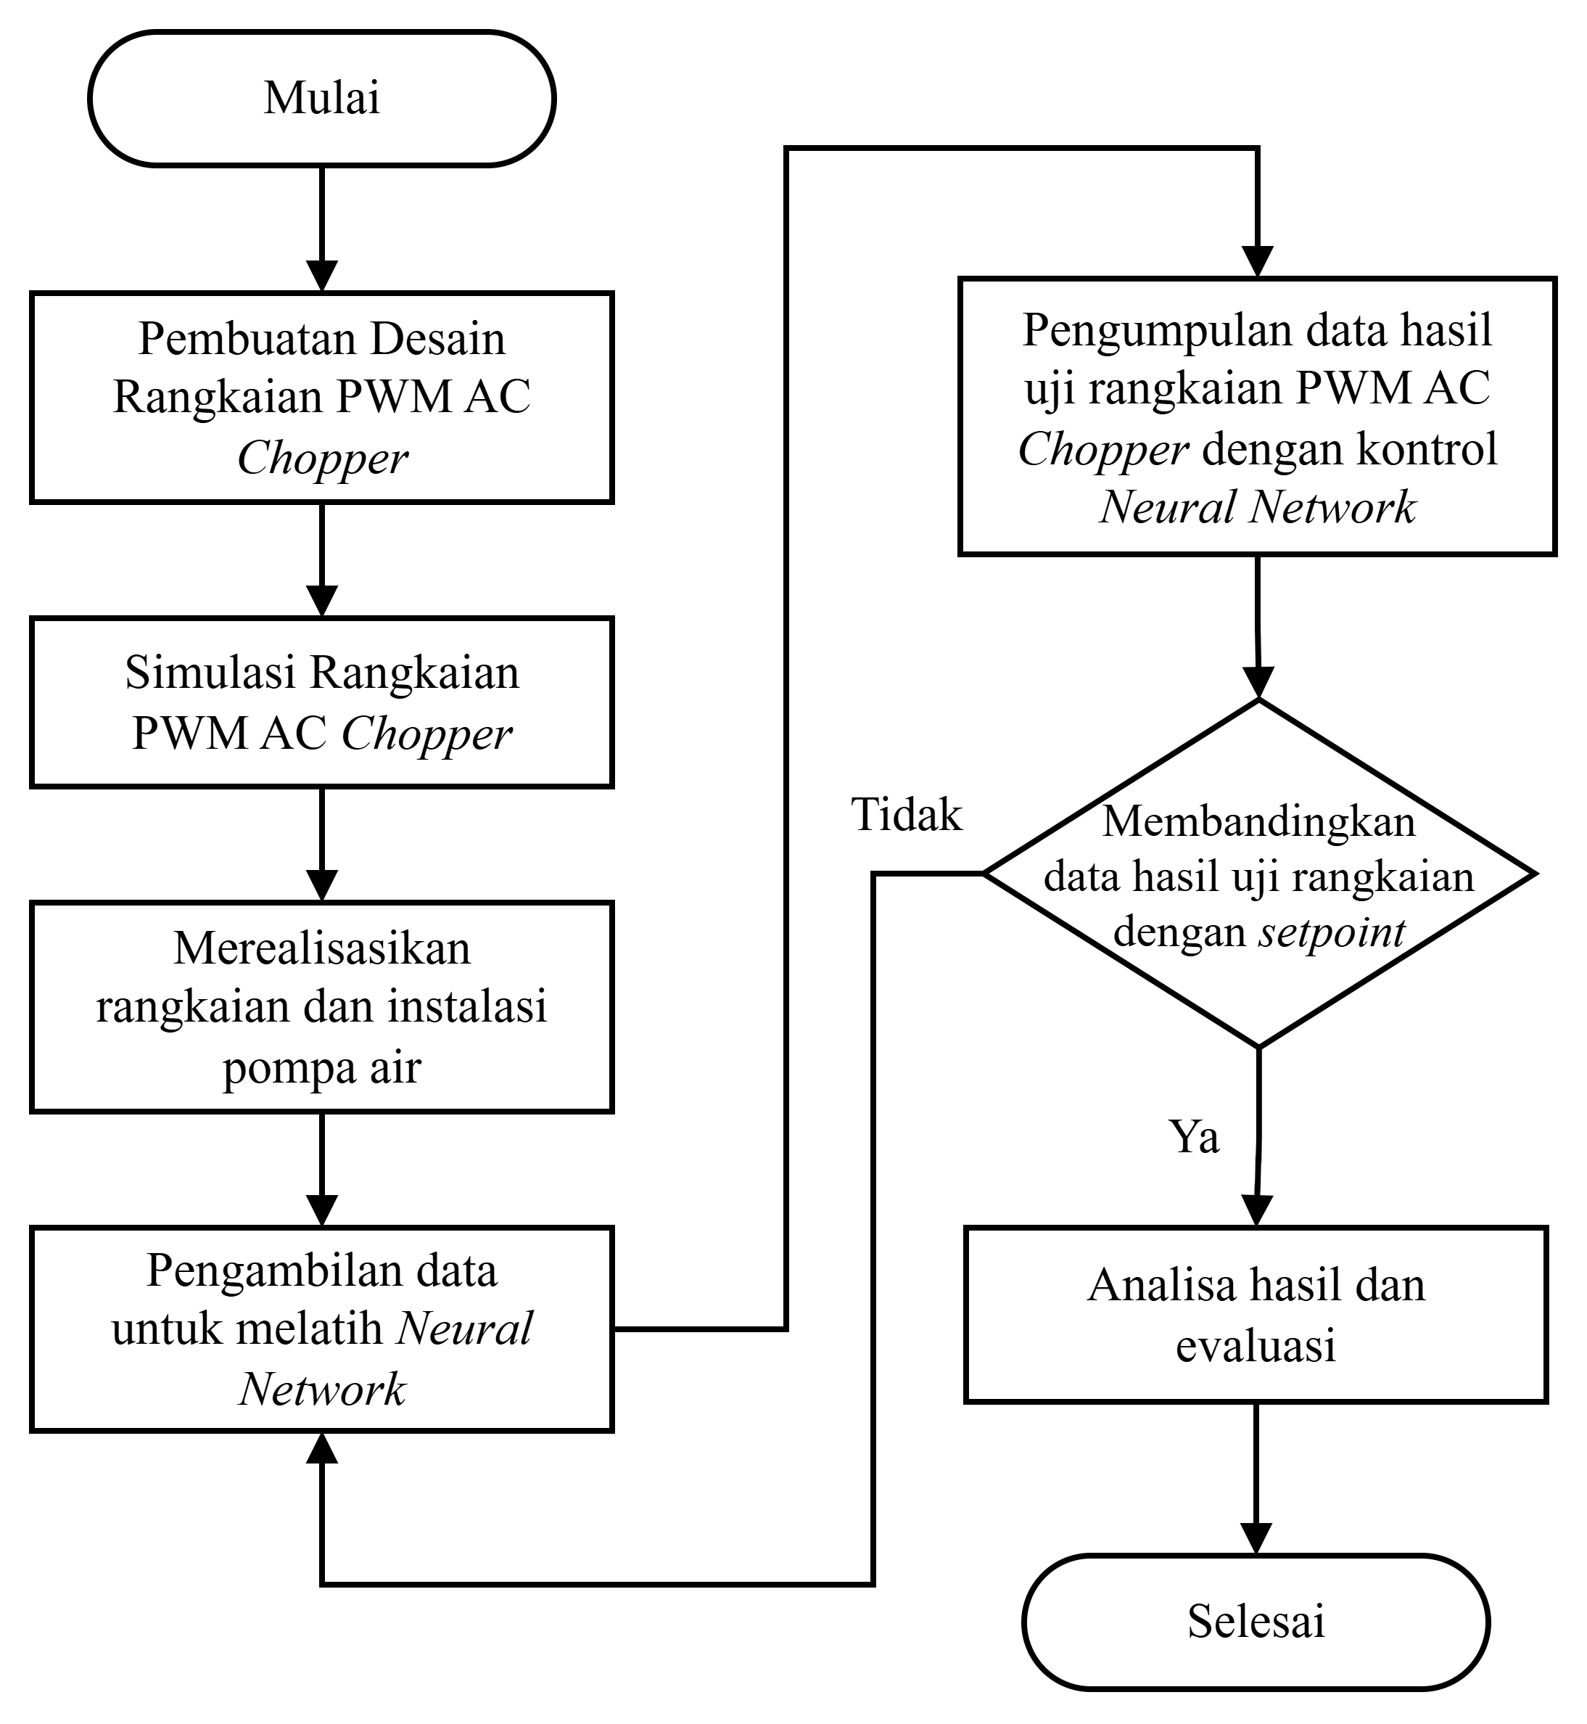

Slide 3
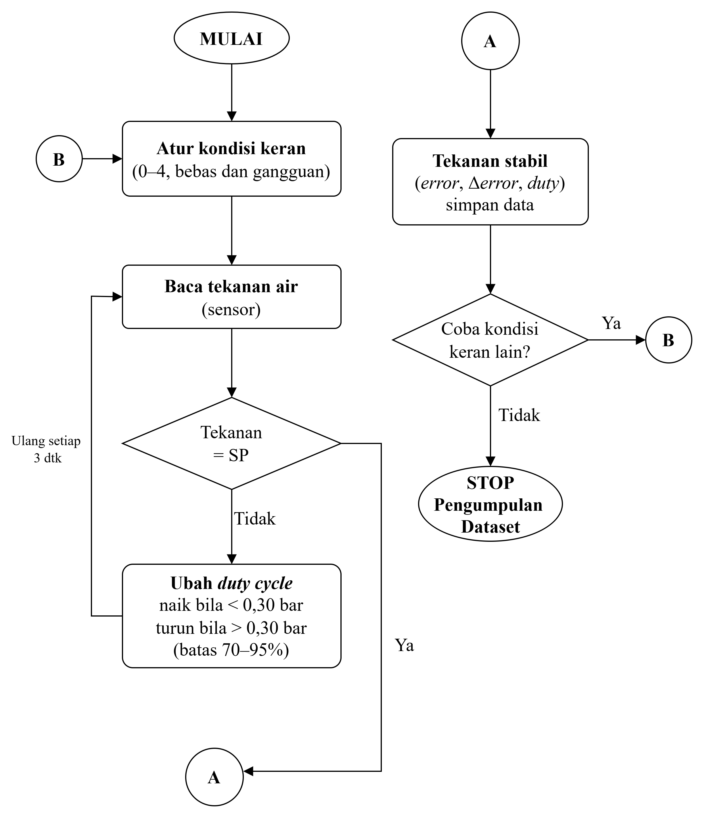

Slide 4
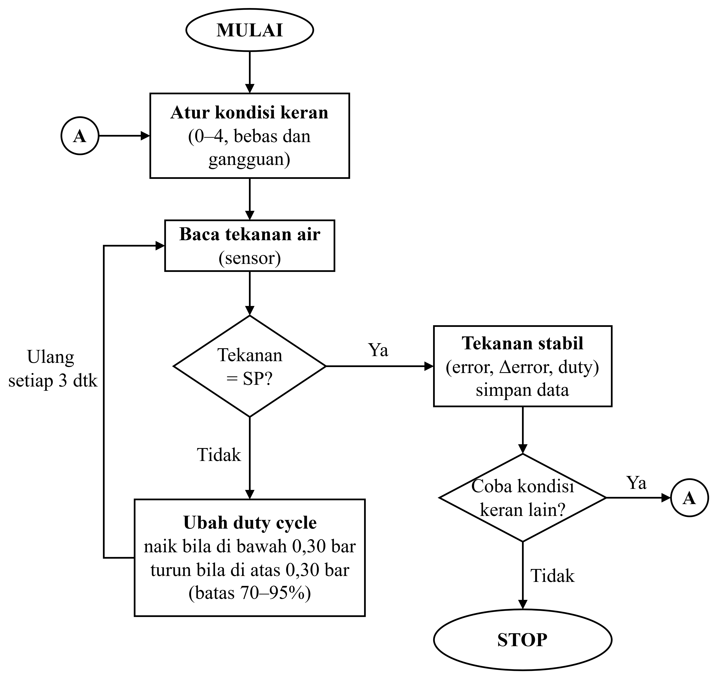

Slide 5
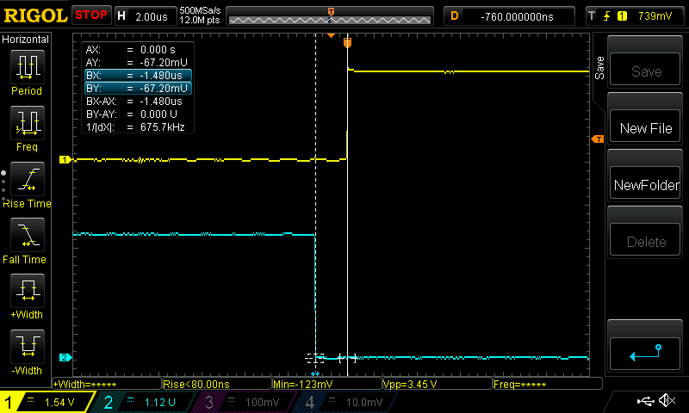

Slide 6
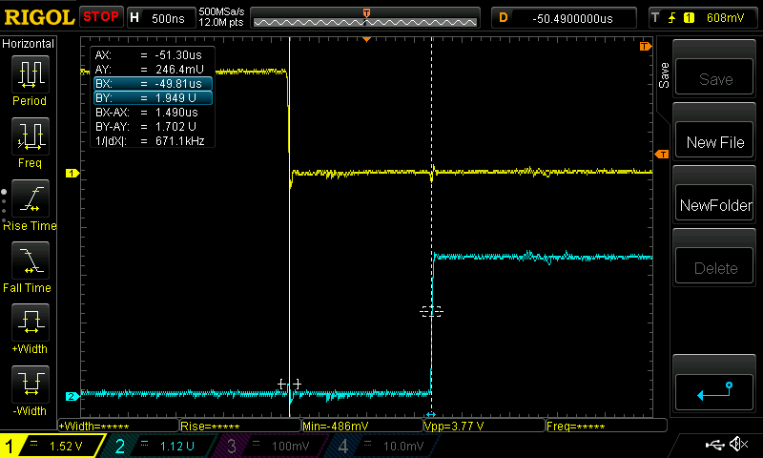

Slide 7
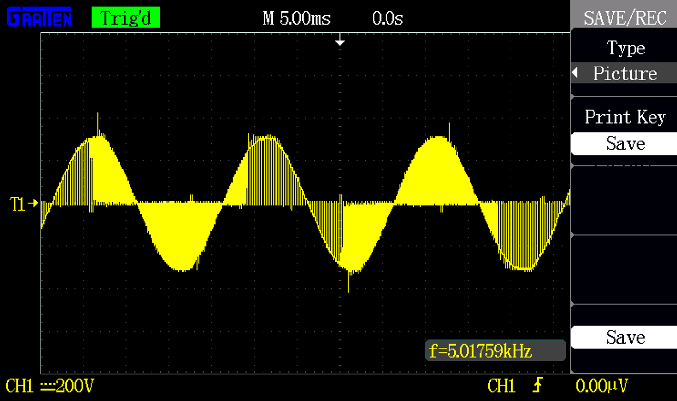

Slide 8
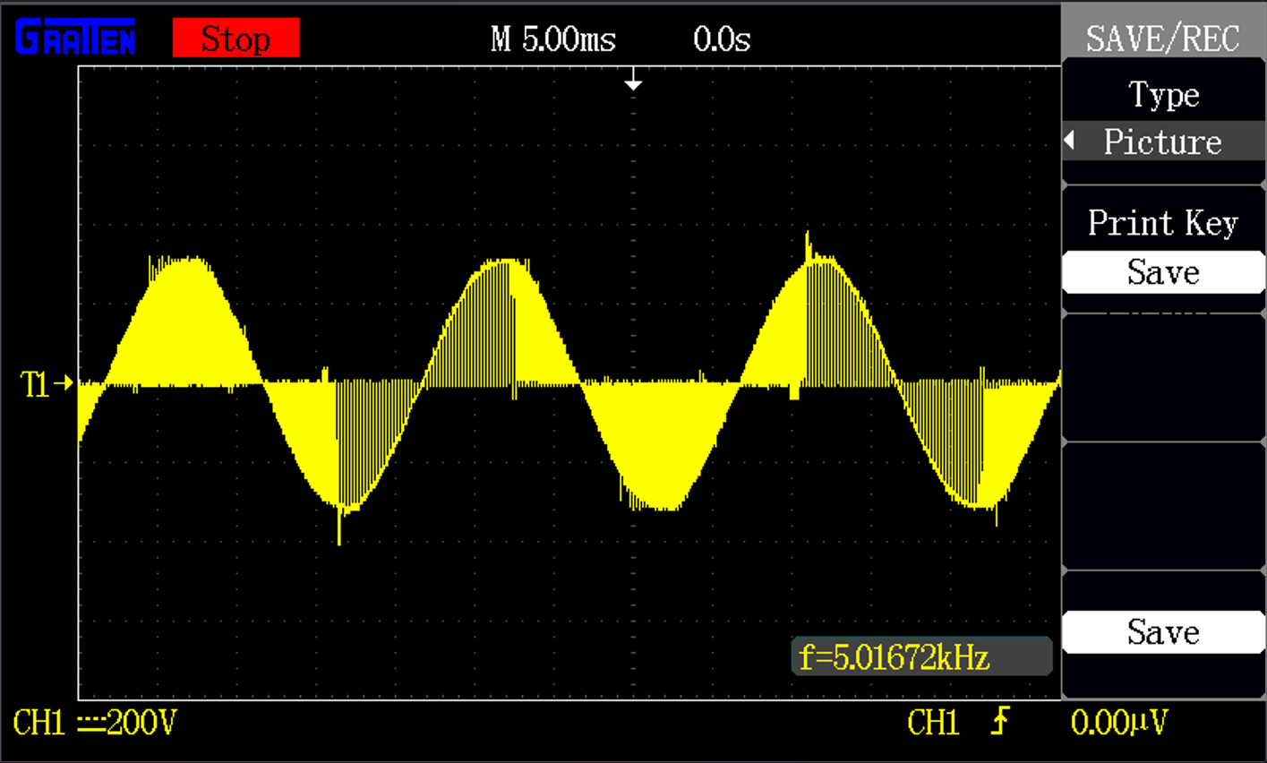
Duty Cycle: 70%

Slide 9
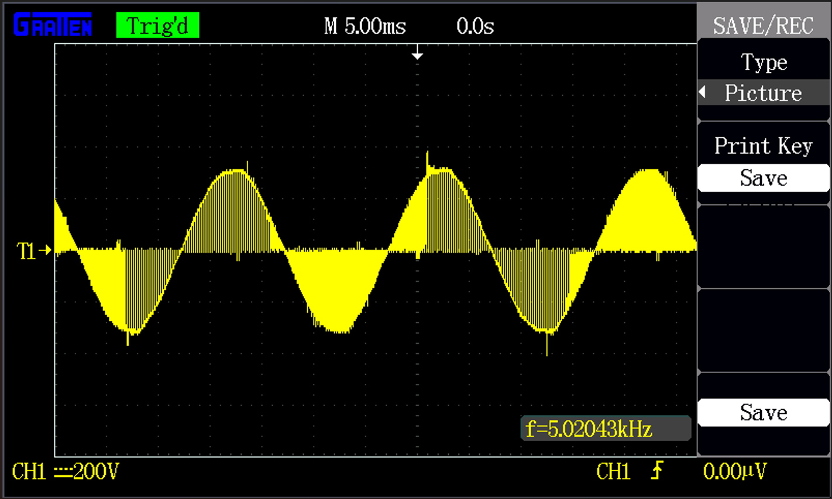
Duty Cycle: 75%

Slide 10
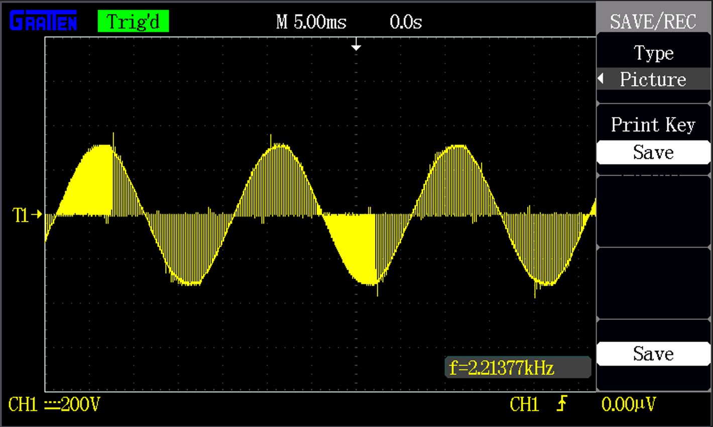
Duty Cycle: 80%

Slide 11
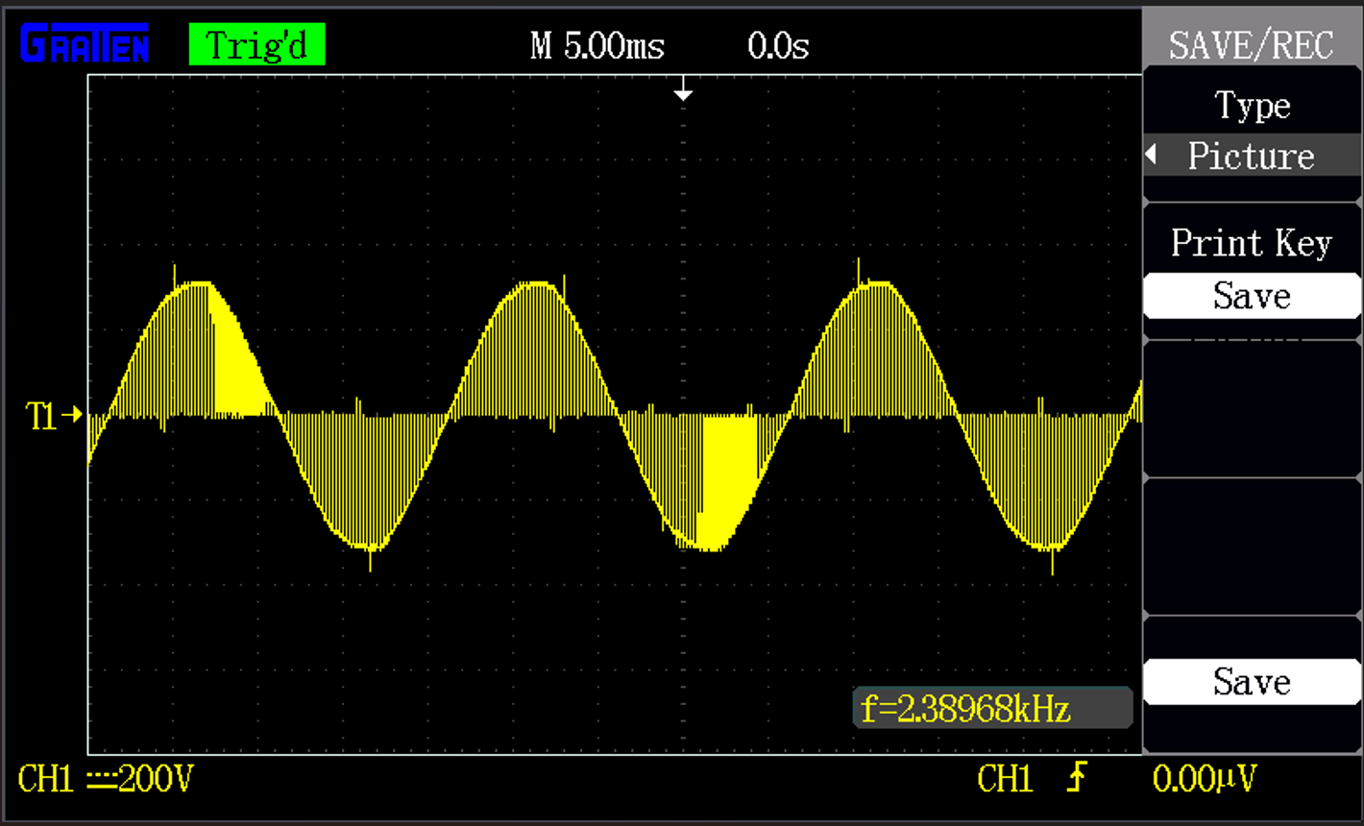
Duty Cycle: 85%

Slide 12
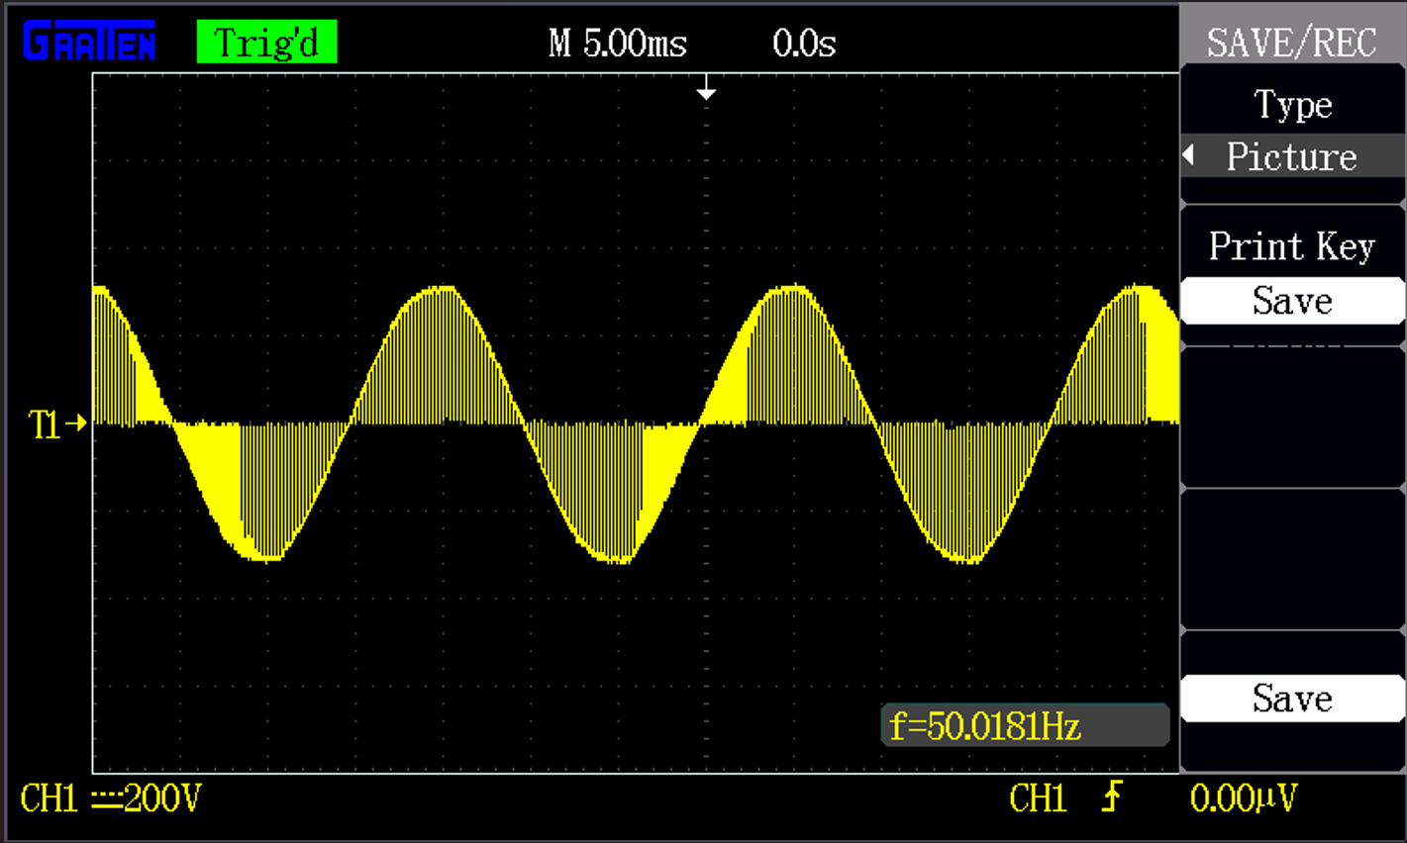
Duty Cycle: 90%

Slide 13
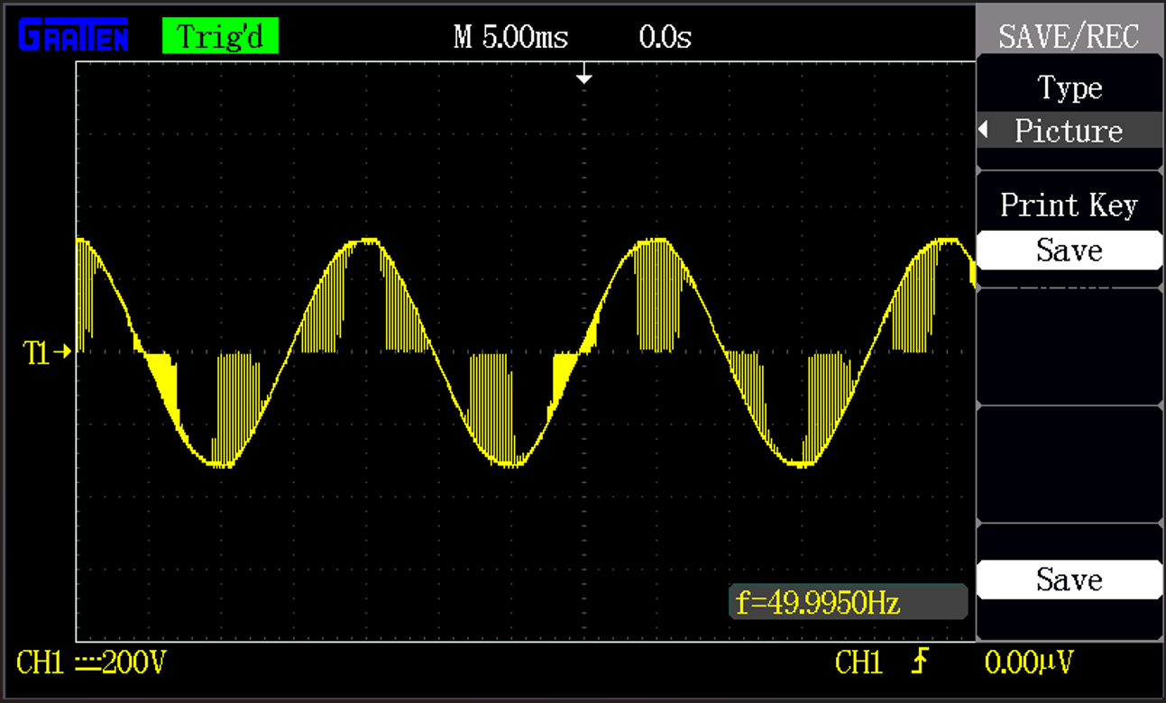
Duty Cycle: 95%

Slide 14
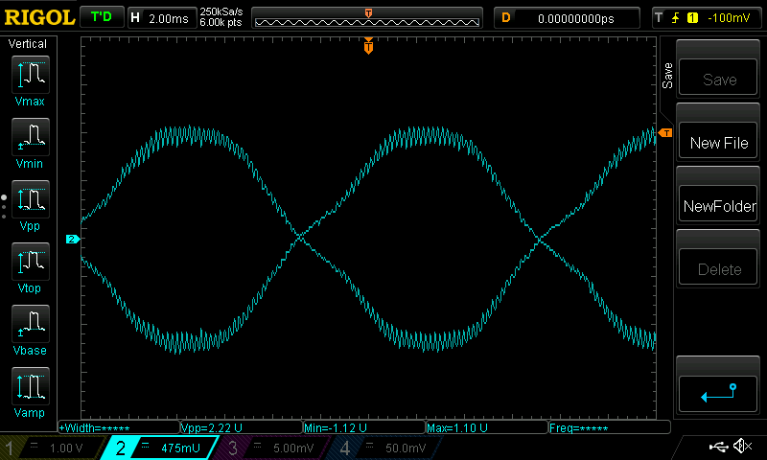
Duty Cycle: 70%

Slide 15

Duty Cycle: 75%

Slide 16
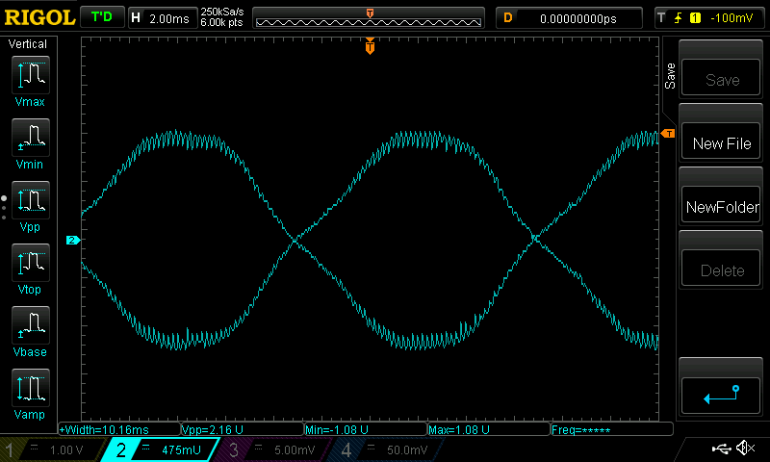
Duty Cycle: 80%

Slide 17
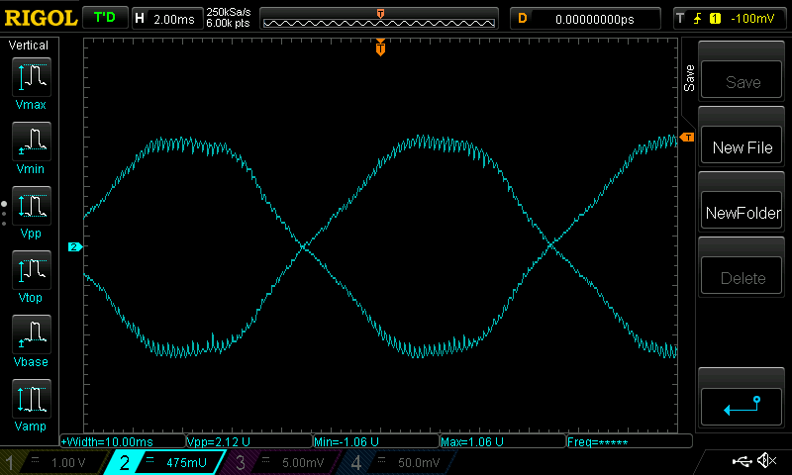
Duty Cycle: 85%

Slide 18

Duty Cycle: 90%

Slide 19

Duty Cycle: 95%

Slide 20
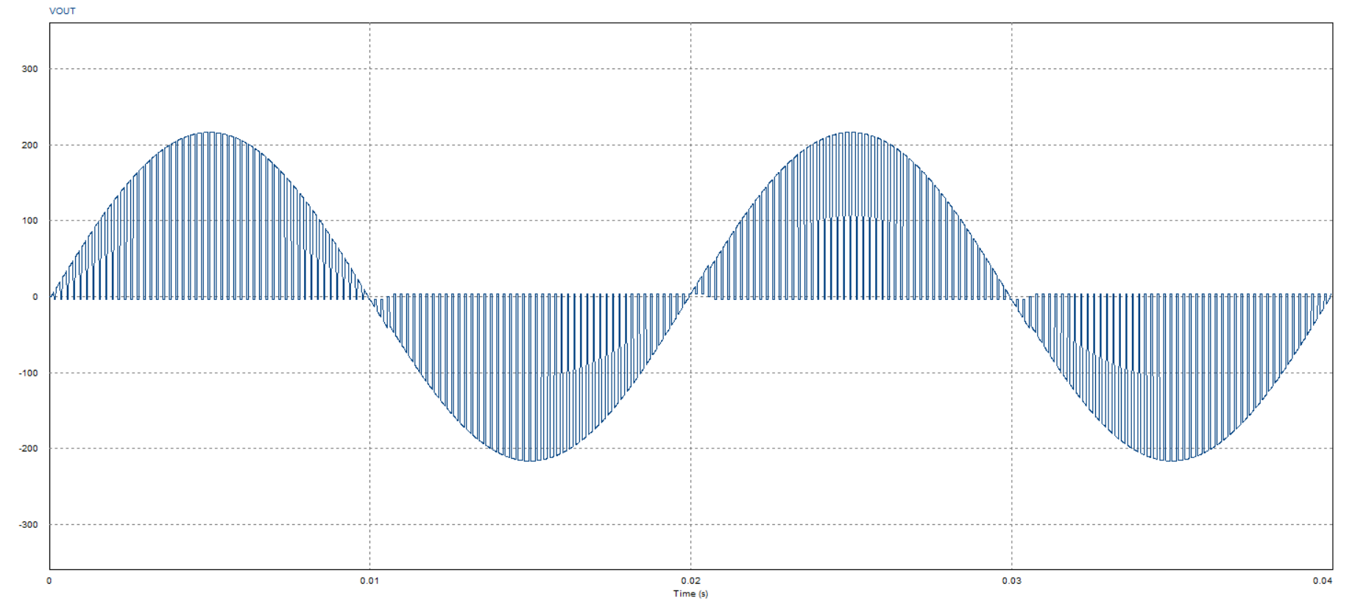
Duty Cycle: 70%

Slide 21
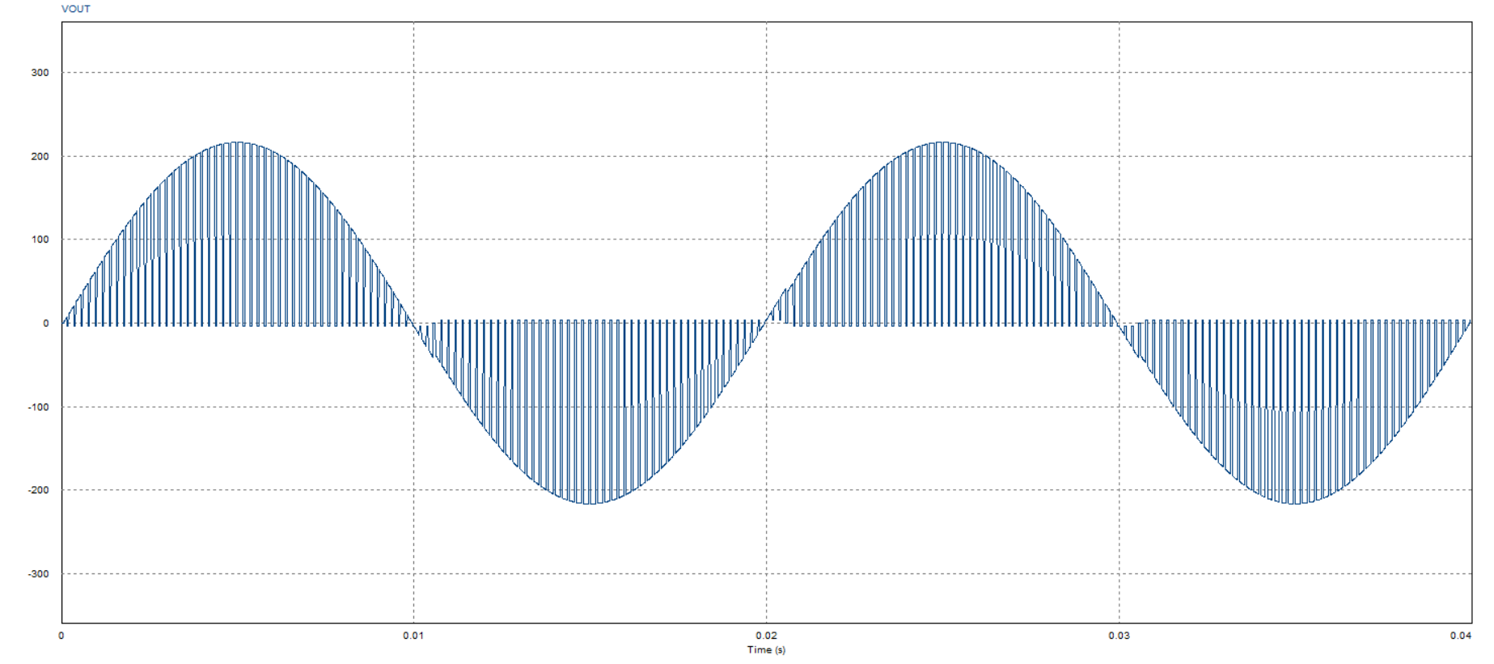
Duty Cycle: 75%

Slide 22

Duty Cycle: 80%

Slide 23
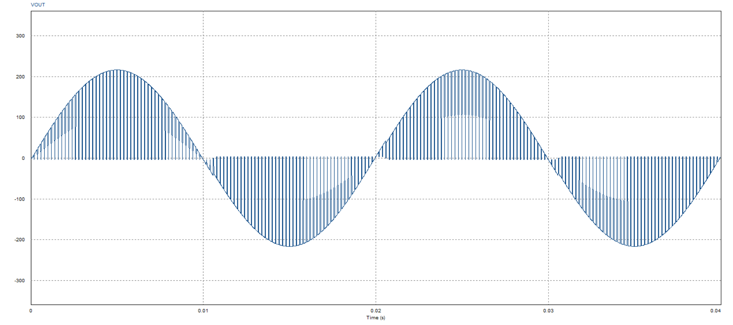
Duty Cycle: 85%

Slide 24
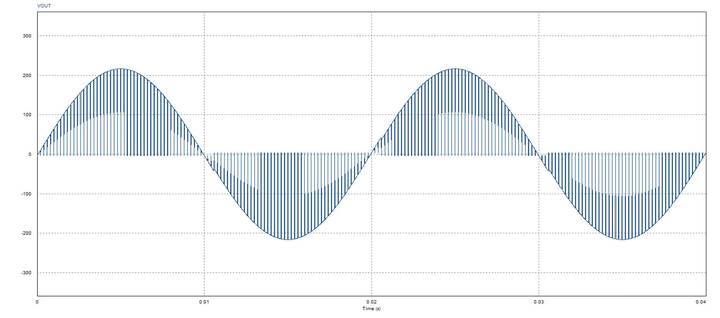
Duty Cycle: 90%

Slide 25
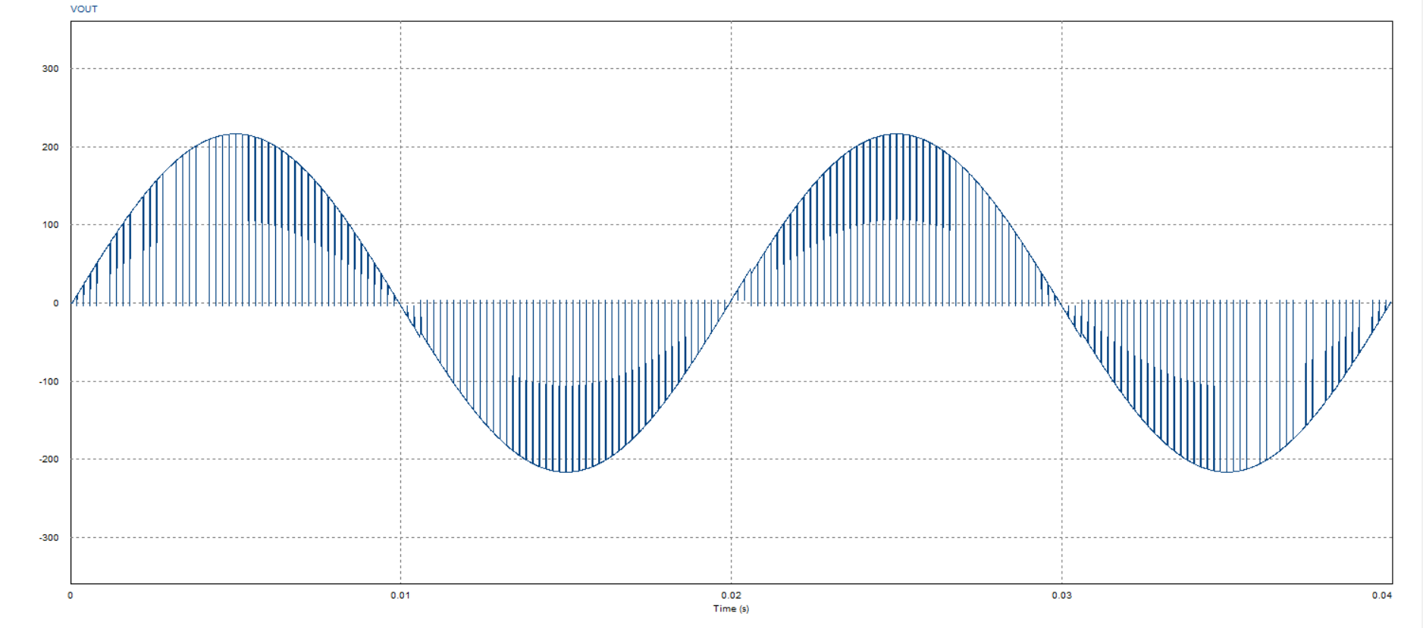
Duty Cycle: 95%

Slide 26
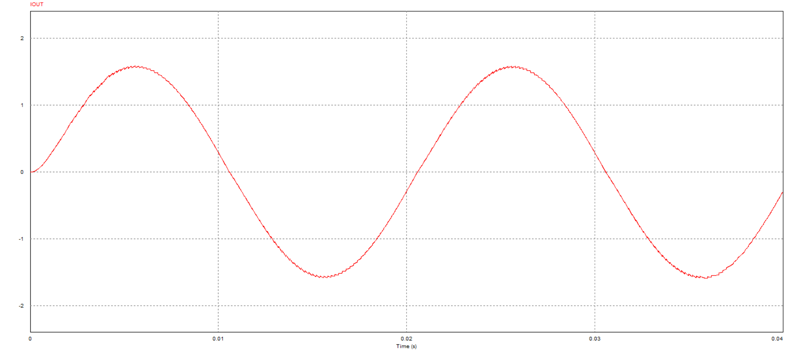
Duty Cycle: 95%

Slide 27
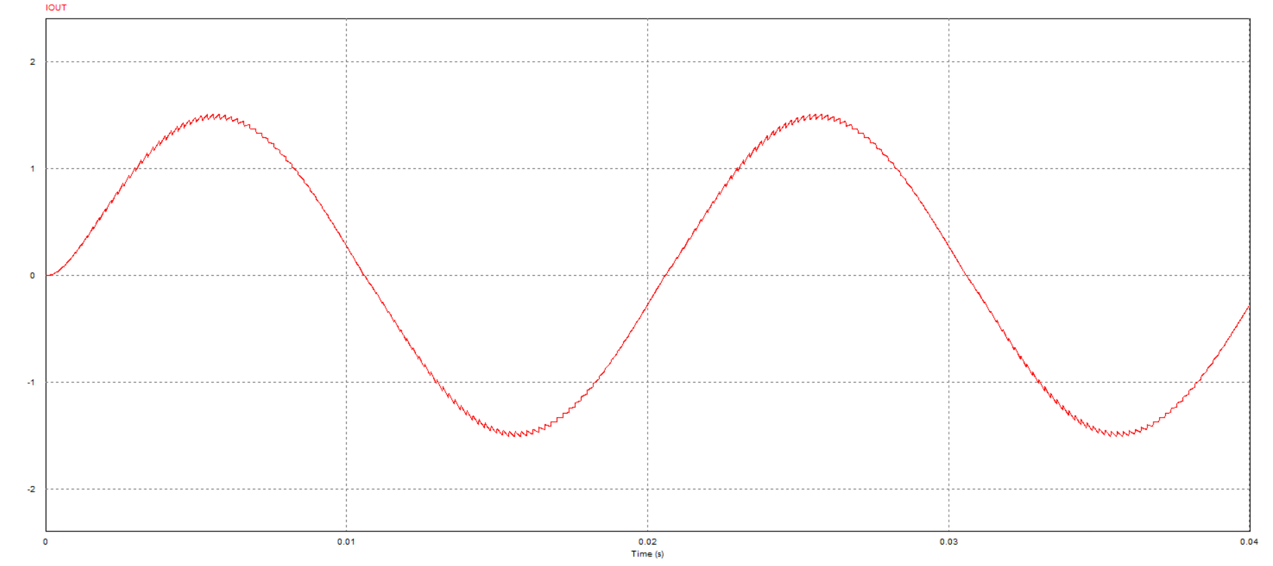
Duty Cycle: 90%

Slide 28
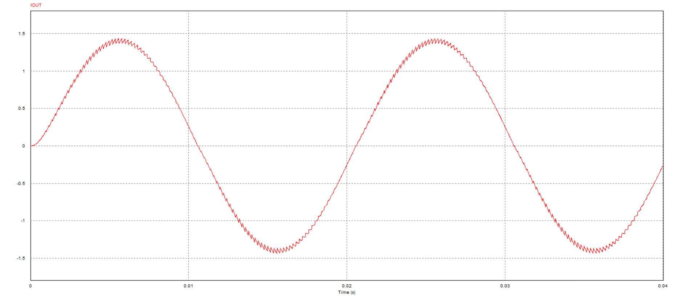
Duty Cycle: 85%

Slide 29
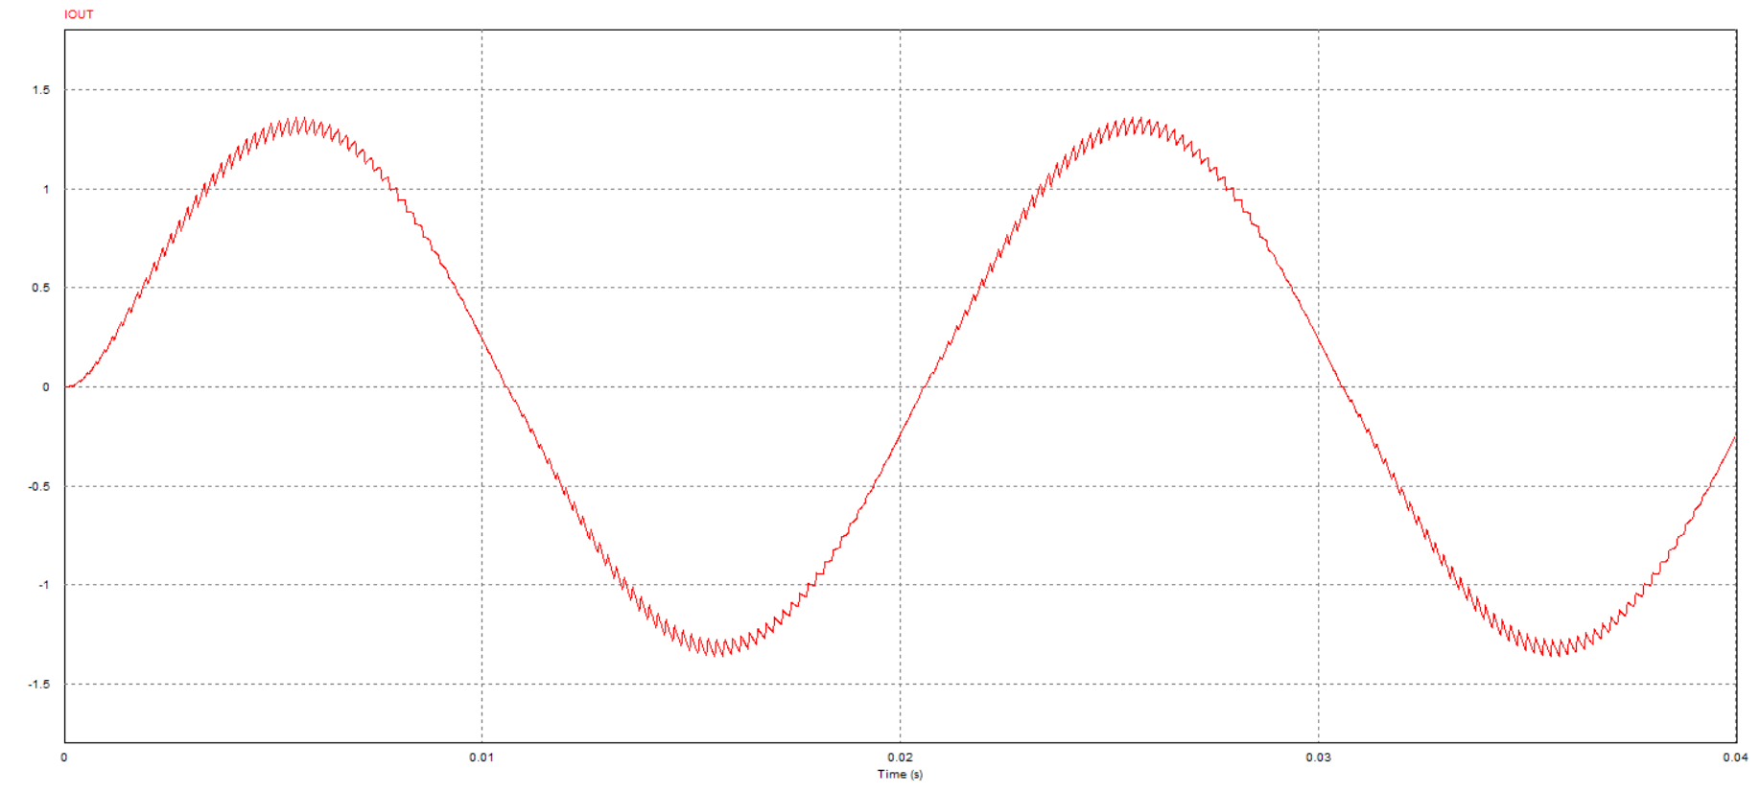
Duty Cycle: 80%

Slide 30
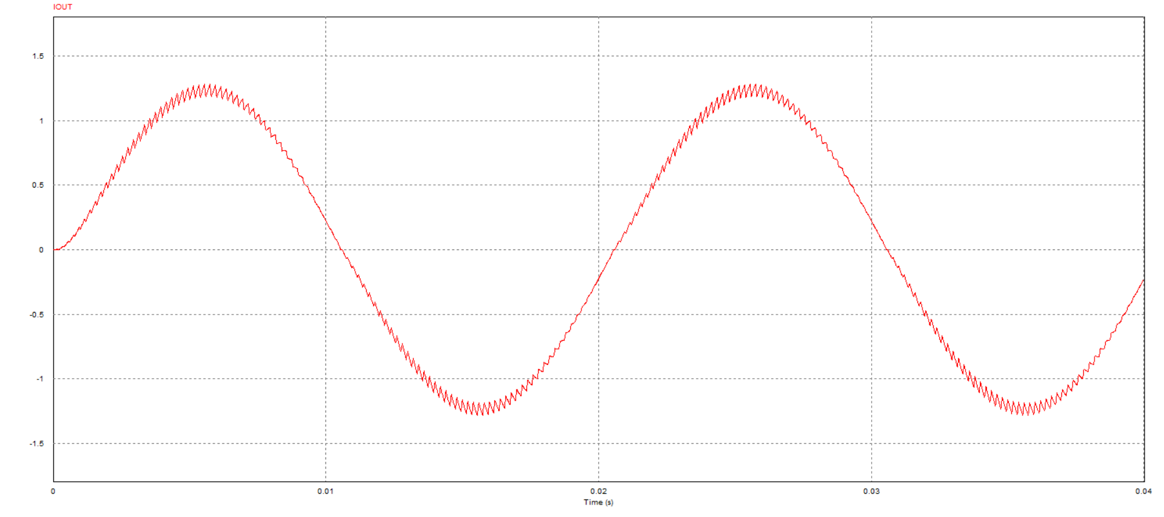
Duty Cycle: 75%

Slide 31
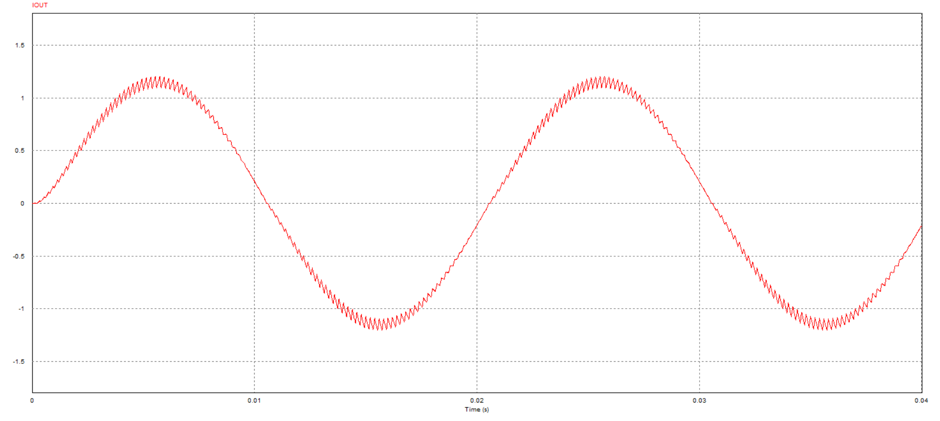
Duty Cycle: 70%

Slide 32
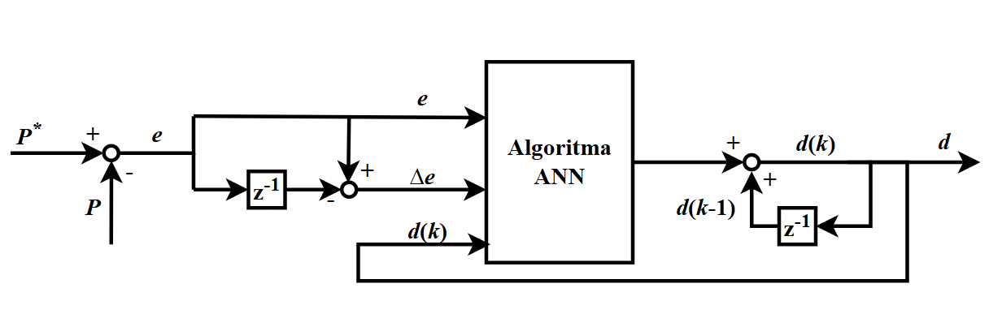

Slide 33
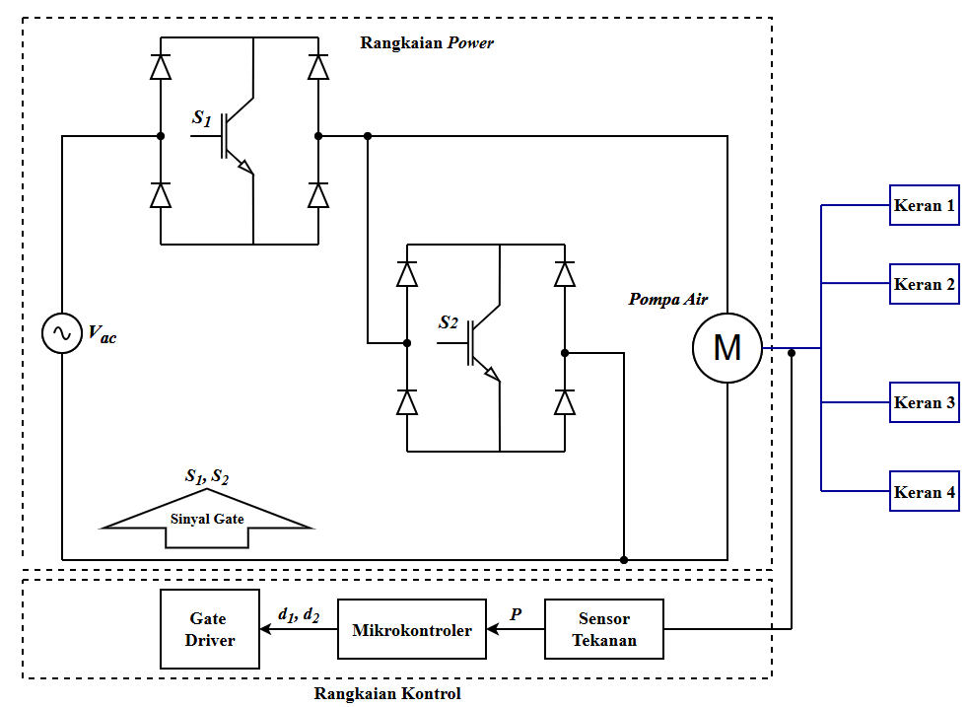

Slide 34
Mikrokontroler

Slide 35
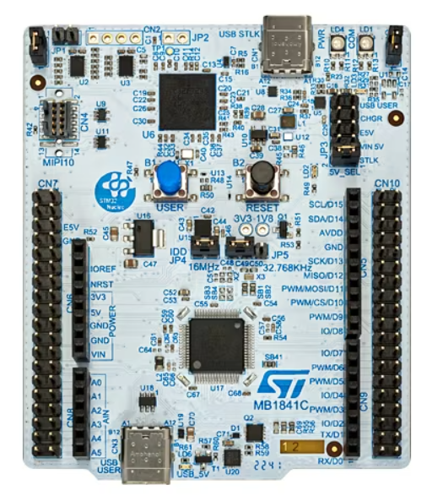

Slide 36
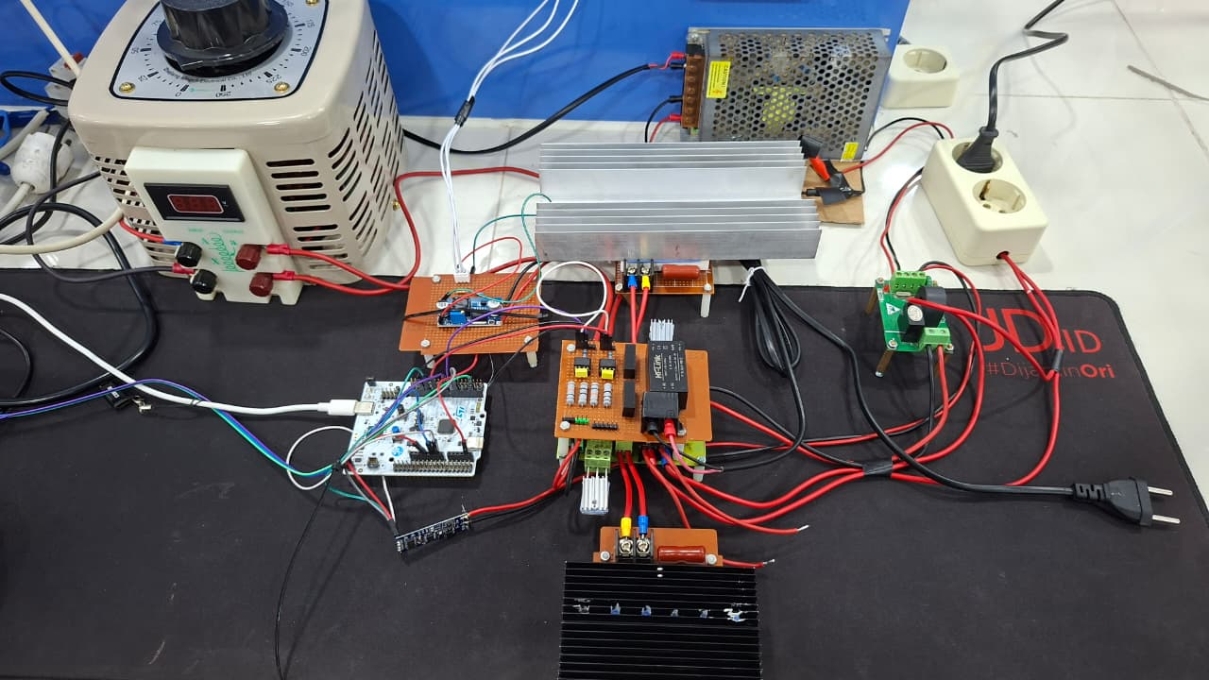
Sumber Tegangan 220 VAC
Pompa Air
Rangkaian Snubber Freewheeling
Pressure Sensor Voltage Divider
Sensor Arus
Rangkaian Power
Mikrokontroler
Sensor Tegangan
Rangkaian Snubber Active

Slide 37
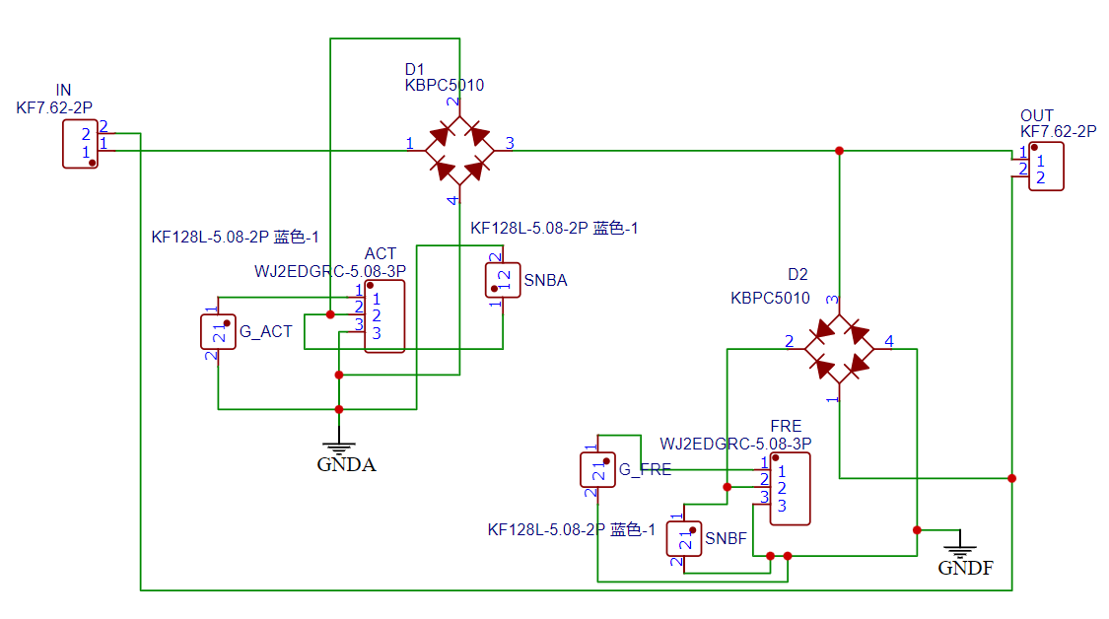
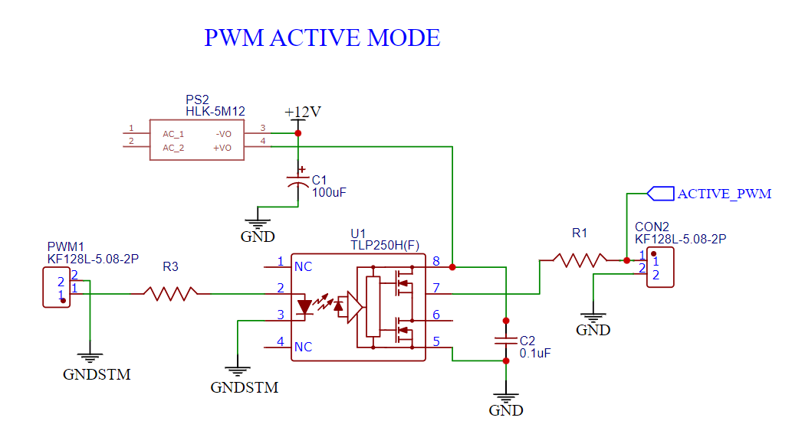
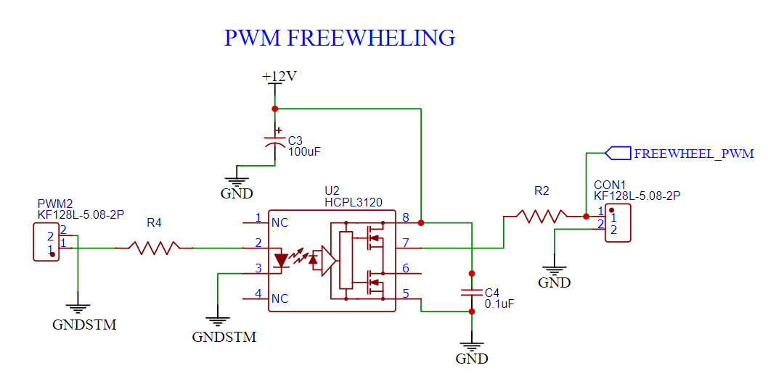

Slide 38
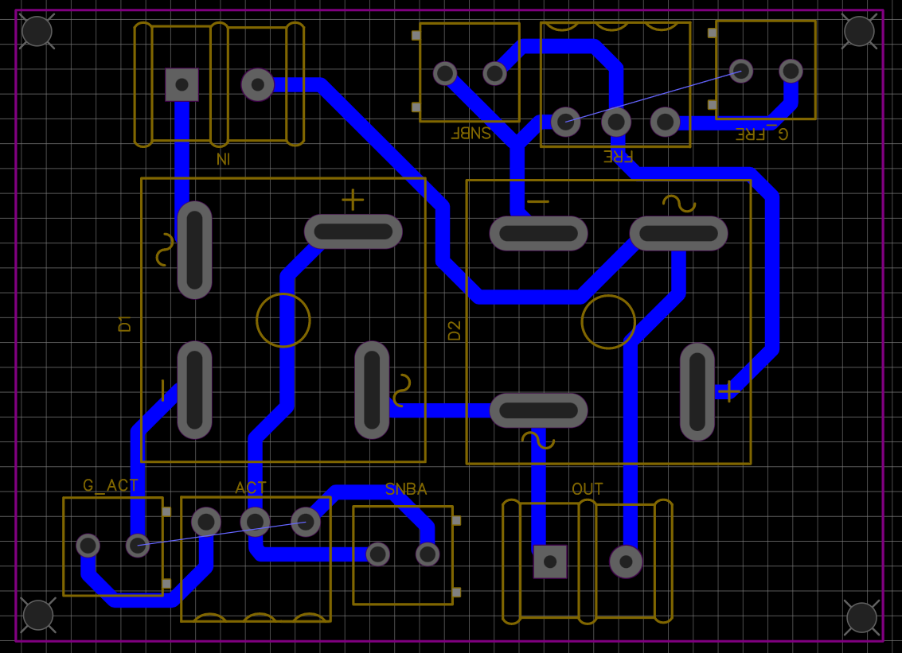
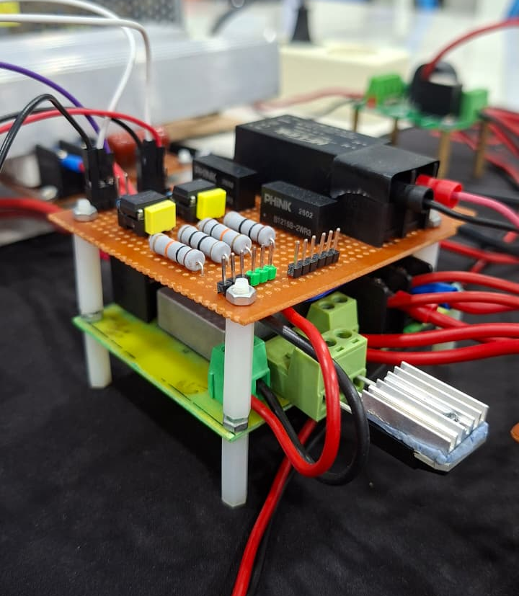
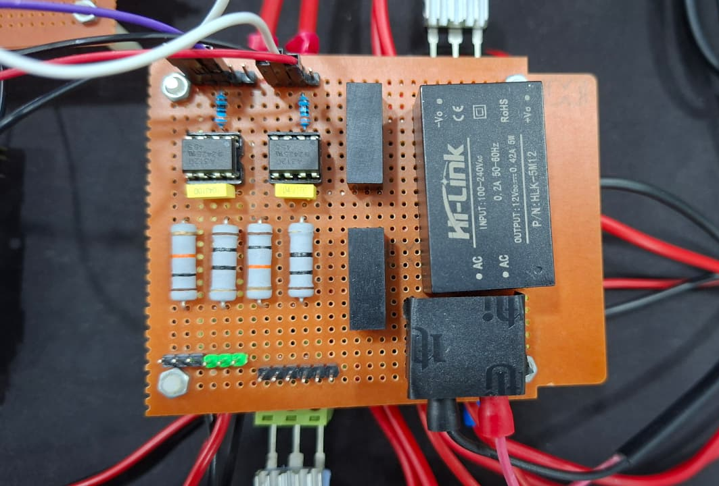
Rangkaian Driver IGBT
Rangkaian Power

Slide 39
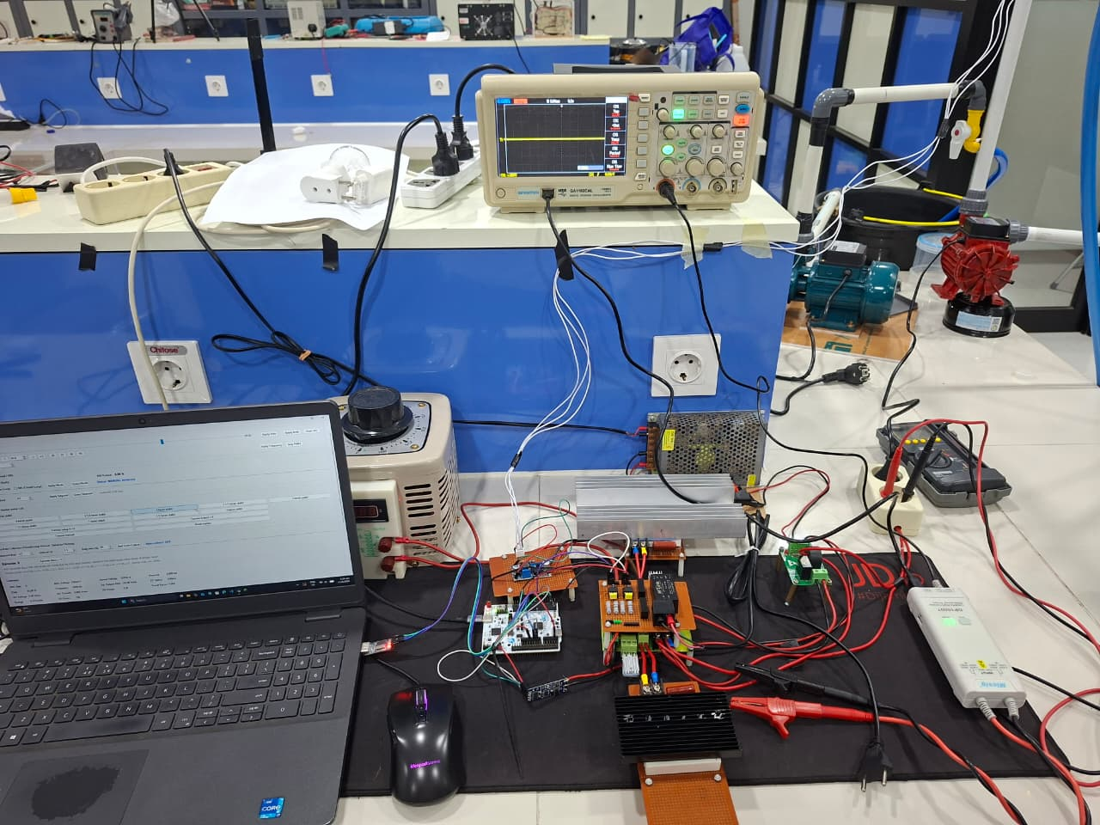

Slide 40
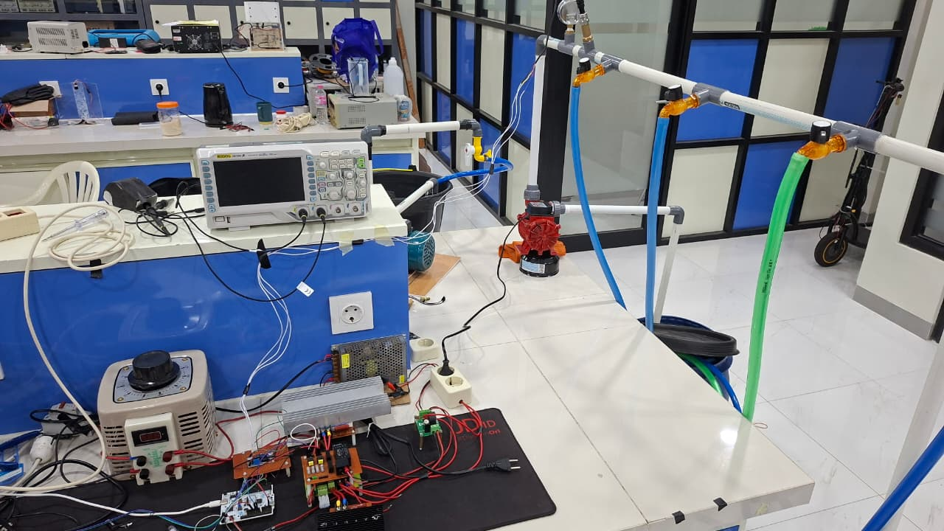

Slide 41
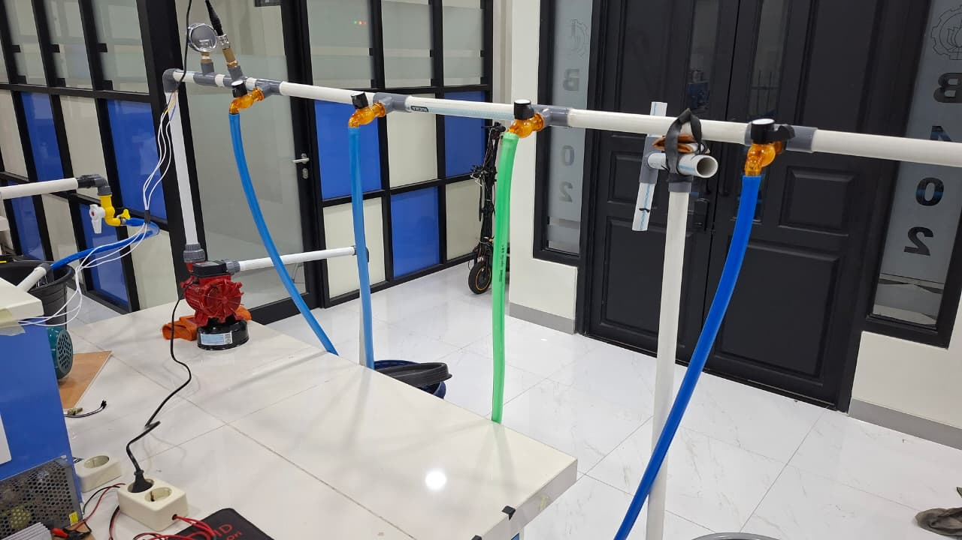
Sensor Tekanan
Pompa Air

Slide 42
Sumber Tegangan 220 VAC
Pompa Air
Rangkaian Snubber Freewheeling
Pressure Sensor Voltage Divider
Sensor Arus
Rangkaian Power
Mikrokontroler
Sensor Tegangan
Rangkaian Snubber Active

Slide 43
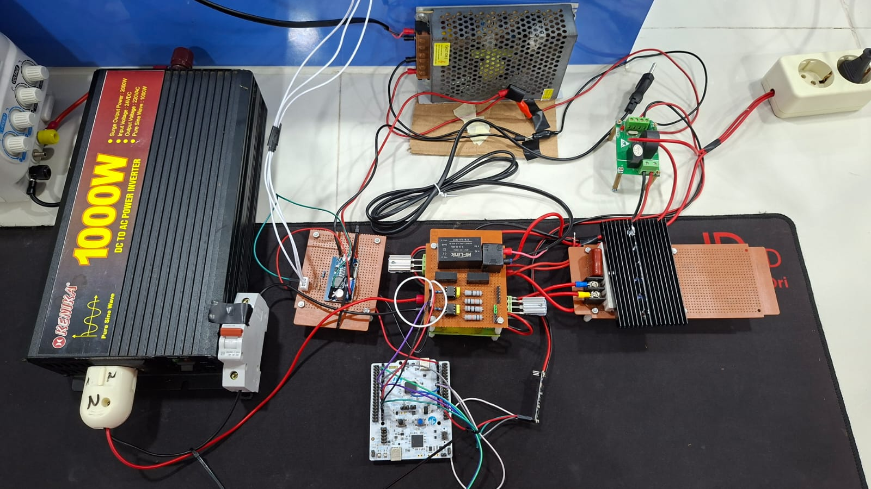

Slide 44
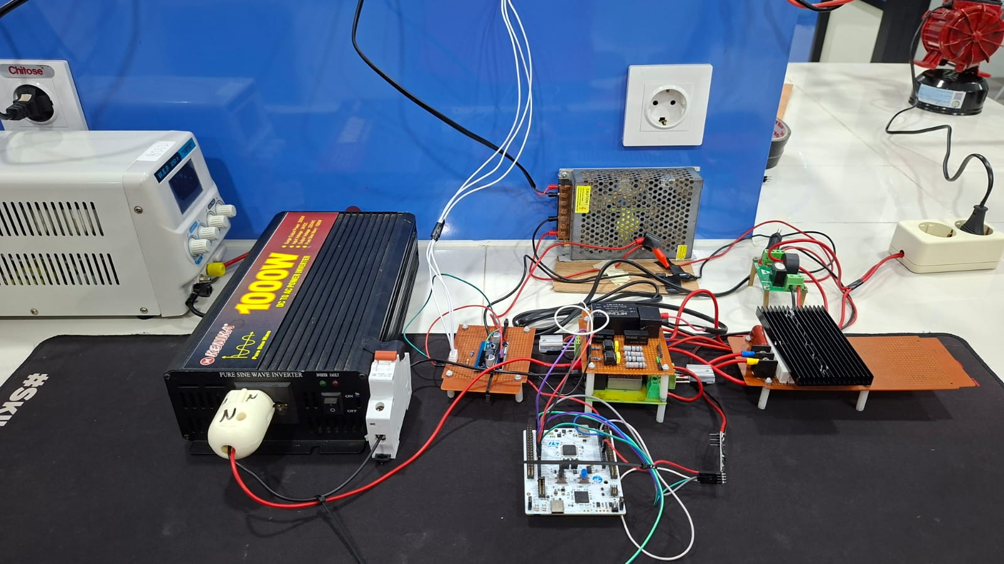
Pompa Air
Power Supply
Inverter
Sensor Arus dan Tegangan
Rangkaian Driver IGBT
Rangkaian Snubber
Sensor Tekanan
Rangkaian PWM AC Chopper
Mikrokontroler

Slide 45
Pompa Air
Power Supply
Inverter
Sensor Arus dan Tegangan
Rangkaian Driver IGBT
Rangkaian Snubber
Sensor Tekanan
Rangkaian PWM AC Chopper
Mikrokontroler

Slide 46
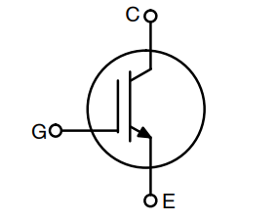
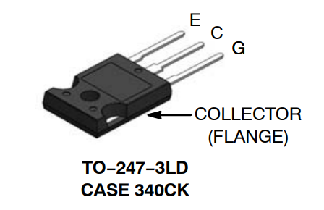
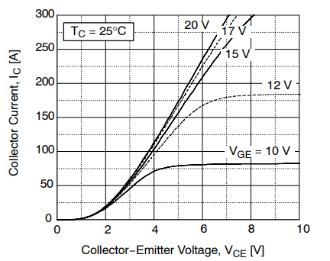

Slide 47
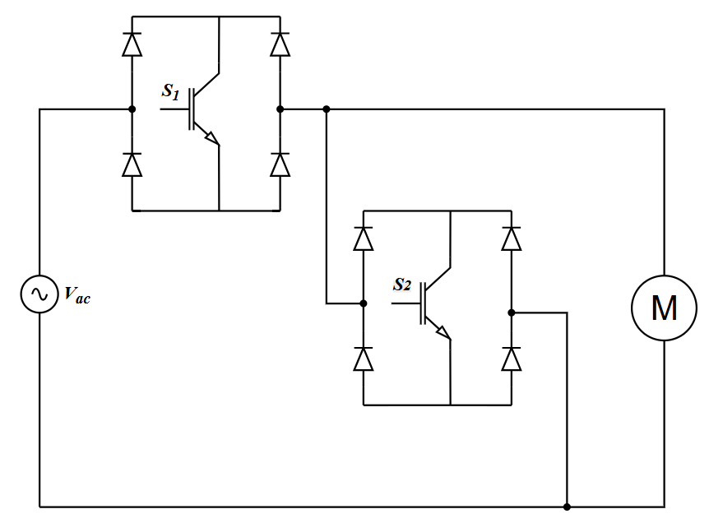
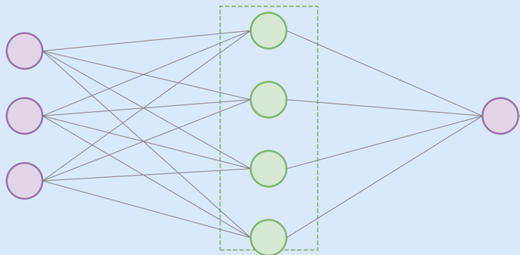




$${error=P}_{sp}−P_{act}$$
$$∆error$$
$$∆d$$
$$d$$

Slide 48
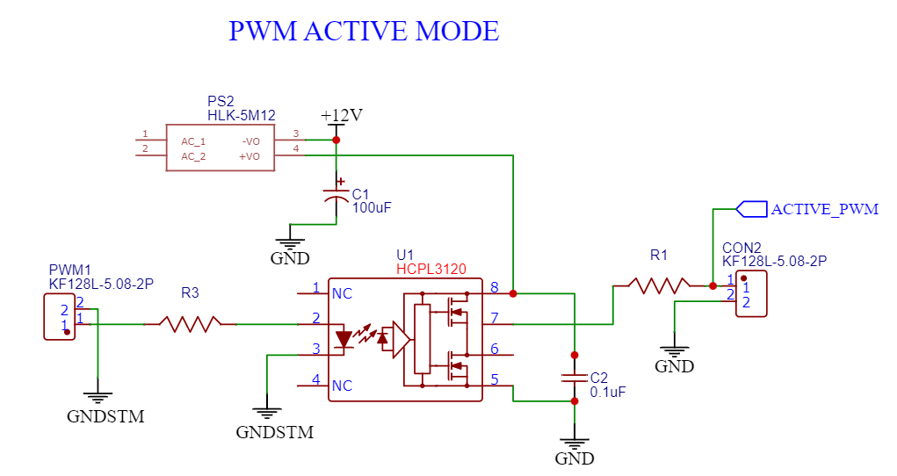

Slide 49
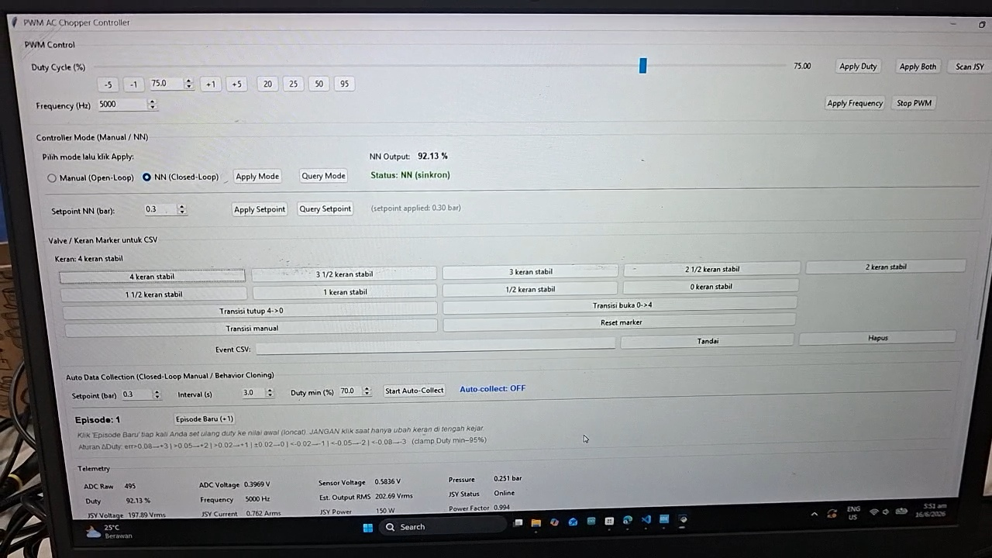

Slide 50
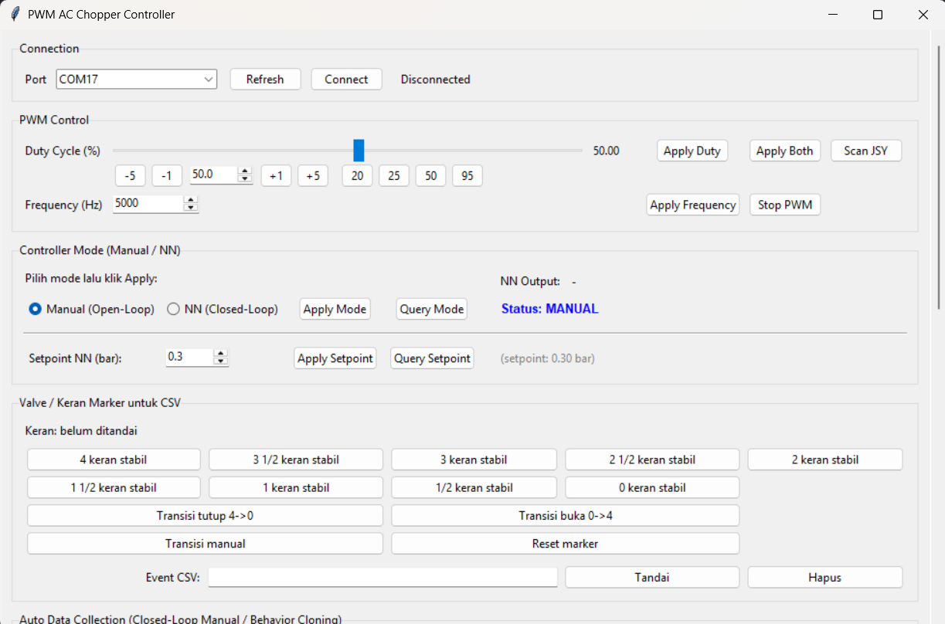

Slide 51


Slide 52





Slide 53
Power Supply
Power Supply 2
Inverter
Sensor Arus & Tegangan
PWM AC Chopper
Lampu
Circuit Breaker
Mikrokontroler

Slide 54
Gambar jurnal
Power Supply
Power Supply 2
Inverter
Sensor Arus & Tegangan
PWM AC Chopper
Circuit Breaker
Mikrokontroler
Lampu

Slide 55
Pengukuran Intensitas Cahaya
Lampu
Multimeter

Slide 56
Pengukuran Intensitas Cahaya
Lampu
Multimeter

Slide 57
Power Supply
Power Supply 2
Inverter
Pompa Air
Sensor Arus & Tegangan
Rangkaian Voltage Divider
Rangkaian Snubber
PWM AC Chopper
Mikrokontroler
Circuit Breaker

Slide 58
Power Supply
Power Supply 2
Inverter
Pompa Air
Sensor Arus & Tegangan
Rangkaian Voltage Divider
Rangkaian Snubber
PWM AC Chopper
Mikrokontroler
Circuit Breaker

Slide 59
Sensor Tekanan
Keran 1
Keran 2
Keran 3
Keran 4
Pompa Air

Slide 60
GUI
Isolated Voltage Probes

Slide 61



Slide 62


Slide 63


Slide 64


Slide 65


Slide 66


Slide 67



Slide 68


Slide 69


Slide 70


Slide 71


Slide 72


Slide 73


