Slide 1
Chapter 5
Systems of Linear Equations and Inequalities

Slide 2
§ 5.1
Solving Systems of Linear Equations by Graphing

Slide 3
Systems of Equations
We know that an equation of the form Ax + By = C
is a line when graphed.
Two such equations is called a system of linear equations.
A solution of a system of linear equations is an ordered pair
that satisfies both equations in the system.
For example, the ordered pair (2,1) satisfies the system
3x + 2y = 8
4x – 3y = 5
Blitzer, Introductory Algebra, 5e – Slide #<number> Section 5.1

Slide 4
Systems of Equations
Since two lines may intersect in exactly one point,
may not intersect at all, or may intersect in every
point; it follows that a system of linear equations
will have exactly one solution, will have no solution,
or will have infinitely many solutions.
Blitzer, Introductory Algebra, 5e – Slide #<number> Section 5.1

Slide 5
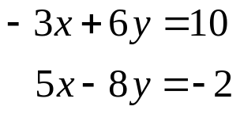




Systems of Equations
EXAMPLE
Determine whether (3,2) is a solution of the system
SOLUTION
Because 3 is the x-coordinate and 2 is the y-coordinate of the point(3,2), we replace x with 3 and y with 2.
?
Since the result is false, (3,2) is NOT a solution for the system. Also, I need not check the other equation since the first one failed.
?
?
false
Blitzer, Introductory Algebra, 5e – Slide #<number> Section 5.1

Slide 6
Systems of Equations
Solve Systems of Two Linear Equations in Two Variables, x and y, by Graphing
1) Graph the first equation.
2) Graph the second equation on the same set of axes.
3) If the lines representing the two graphs intersect at a point, determine the coordinates of this point of intersection. The ordered pair is the solution to the system.
4) Check the solution in both equations.
NOTE: In order for this method to be useful, you must graph the lines very accurately.
Blitzer, Introductory Algebra, 5e – Slide #<number> Section 5.1

Slide 7
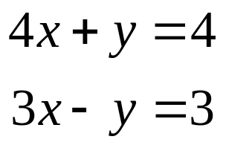



Systems of Equations
EXAMPLE
Solve by graphing:
SOLUTION
1) Graph the first equation. I first rewrite the equation in slope-intercept form.
m = -4 = -4/1, b = 4
Now I can graph the equation.
Blitzer, Introductory Algebra, 5e – Slide #<number> Section 5.1

Slide 8



Systems of Equations
CONTINUED
2) Graph the second equation on the same set of axes. I first rewrite the equation in slope-intercept form.
m = 3 = 3/1, b = -3
Now I can graph the equation.
Blitzer, Introductory Algebra, 5e – Slide #<number> Section 5.1

Slide 9
Systems of Equations
CONTINUED
3) Determine the coordinates of the intersection point. This ordered pair is the system’s solution. Using the graph below, it appears that the solution is the point (1,0). We won’t know for sure until after we check this potential solution in the next step.
Blitzer, Introductory Algebra, 5e – Slide #<number> Section 5.1

Slide 10








Systems of Equations
CONTINUED
4) Check the solution in both equations.
?
?
?
?
true
true
Because both equations are satisfied, (1,0) is the solution and {(1,0)} is the solution set.
Blitzer, Introductory Algebra, 5e – Slide #<number> Section 5.1

Slide 11
Solve the system by graphing.
Systems of Equations
EXAMPLE
3x + 2y = 12
2x – y = 1
Graph the first line. Find the x and y intercepts of 3x + 2y = 12.
x-intercept y-intercept
Let y = 0 Let x = 0
3x + 2(0) =12 3(0) + 2y = 12
3x = 12 2y = 12
x = 4 y = 6
The x-intercept is 4 and the y-intercept is 6.
Blitzer, Introductory Algebra, 5e – Slide #<number> Section 5.1

Slide 12
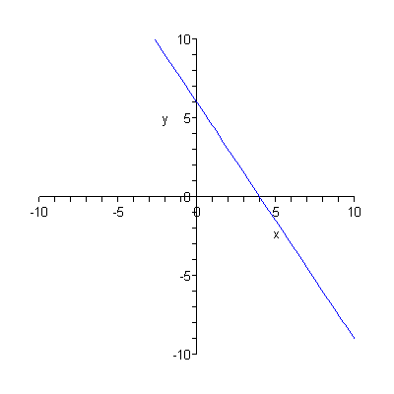
Graph the first line.
Systems of Equations
CONTINUED
Blitzer, Introductory Algebra, 5e – Slide #<number> Section 5.1

Slide 13
Now, graph the second line.
Systems of Equations
CONTINUED
Find the x and y intercepts of 2x - y = 1
x-intercept y-intercept
Let y = 0 Let x = 0
2x - (0) =1 2(0) - y = 1
2x = 1 -y = 1
x = 0.5 y = -1
The x-intercept is 0.5 and the y-intercept is -1.
Blitzer, Introductory Algebra, 5e – Slide #<number> Section 5.1

Slide 14
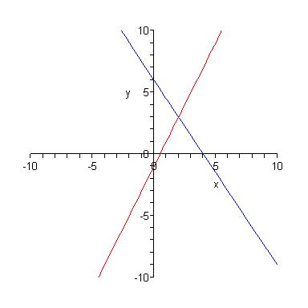
Graph the second line on same set of axes.
Systems of Equations
CONTINUED
Blitzer, Introductory Algebra, 5e – Slide #<number> Section 5.1

Slide 15
Find coordinates of intersection.
Systems of Equations
CONTINUED
Point of intersection: (2,3)
Blitzer, Introductory Algebra, 5e – Slide #<number> Section 5.1

Slide 16
Check the proposed solution in each equation. It appears graphically that the solution is (2,3), but you can’t be sure until you check the point in each of the original equations.
Systems of Equations
CONTINUED
Equation 1
3x + 2y =12
3(2)+2(3) ? 12
6 + 6 ? 12
12 = 12
True
Equation 2
2x - y =1
2(2) - (3) ? 1
4 - 3 ? 1
1 = 1
True
Since the point (2,3) checks in each of the original equations, it is indeed the solution of the given system of equations.
Blitzer, Introductory Algebra, 5e – Slide #<number> Section 5.1

Slide 17
Solve the system by graphing.
A System having No Solution
EXAMPLE
y = 2x – 3
y = 2x + 7
We note that the lines have the same slope, but are not the same line. We know that they are not the same because although the slopes are the same, the y-intercepts are different. Let’s look at the graph of each of the two lines on the same set of axes.
Blitzer, Introductory Algebra, 5e – Slide #<number> Section 5.1

Slide 18
System with no Solution
CONTINUED
Consider the first line. Since the line, y = 2x – 3, is in slope-intercept form, we know the slope and y-intercept.
The y-intercept is -3, so the line passes through (0, -3). The slope is 2/1. To graph, we start at the y-intercept and move 2 up (the rise) and 1 right (the run).
Now, consider the second line. Since the line, y = 2x + 7, is in slope-intercept form, we know the slope and y-intercept.
The y-intercept is 7, so the line passes through (0, 7). The slope is 2/1. To graph, we start at the y-intercept and move 2 up (the rise) and 1 right (the run).
Blitzer, Introductory Algebra, 5e – Slide #<number> Section 5.1

Slide 19
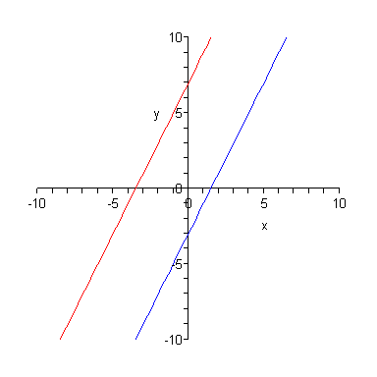
Graph the lines on the same set of axes.
No Solution
CONTINUED
This system is said to be inconsistent. Since the lines are parallel and fail to intersect, the system has no solution.
We would have to say that the solution is the empty set.
Blitzer, Introductory Algebra, 5e – Slide #<number> Section 5.1

Slide 20
Solving Systems of Equations
The Number of Solutions to a System of Two Linear Equations
Number of Solutions | What This Means Graphically | Graphical Examples
Exactly one ordered-pair solution | The two lines intersect at one point.
No solution | The two lines are parallel.
Infinitely Many Solutions | The two lines are identical.
Blitzer, Introductory Algebra, 5e – Slide #<number> Section 5.1

