Slide 1
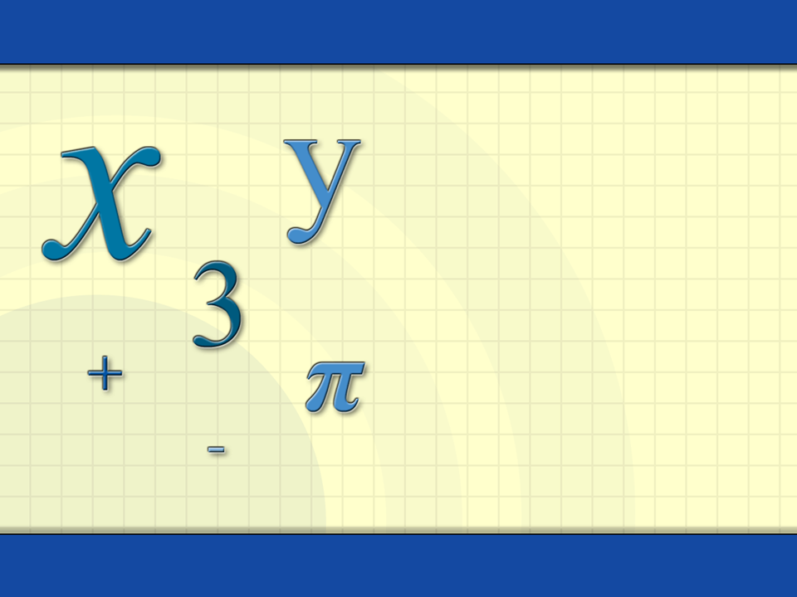
Arithmetic Sequences and Series
Digital Lesson

Slide 2

Definition of Sequence
An infinite sequence is a function whose domain is the set of positive integers.
a₁, a₂, a₃, a₄, . . . , a_{n}, . . .
terms
The first three terms of the sequence a_{n} = 4n – 7 are
a₁ = 4(1) – 7 = – 3
a₂ = 4(2) – 7 = 1
finite sequence
a₃ = 4(3) – 7 = 5.

Slide 3
Definition of Arithmetic Sequence
A sequence is arithmetic if the differences between consecutive terms are the same.
4, 9, 14, 19, 24, . . .
arithmetic sequence
9 – 4 = 5
14 – 9 = 5
19 – 14 = 5
24 – 19 = 5
The common difference, d, is 5.

Slide 4
Example: Arithmetic Sequence
Example: Find the first five terms of the sequence and determine if it is arithmetic.
a_{n} = 1 + (n – 1)4
a₁ = 1 + (1 – 1)4 = 1 + 0 = 1
a₂ = 1 + (2 – 1)4 = 1 + 4 = 5
a₃ = 1 + (3 – 1)4 = 1 + 8 = 9
a₄ = 1 + (4 – 1)4 = 1 + 12 = 13
a₅ = 1 + (5 – 1)4 = 1 + 16 = 17
d = 4
This is an arithmetic sequence.

Slide 5
The nth Term of an Arithmetic Sequence
The nth term of an arithmetic sequence has the form
a_{n} = dn + c
where d is the common difference and c = a₁ – d.
a₁ = 2
c = 2 – 6 = – 4
2, 8, 14, 20, 26, . . . .
d = 8 – 2 = 6
The nth term is 6n – 4.

Slide 6
Example: Formula for the nth Term
Example: Find the formula for the nth term of an arithmetic sequence whose common difference is 4 and whose first term is 15. Find the first five terms of the sequence.
a_{n} = dn + c
a₁ – d =
15 – 4 = 11
= 4n
+ 11
The first five terms are
a₁ = 15
15,
19, 23, 27, 31.
d = 4

Slide 7
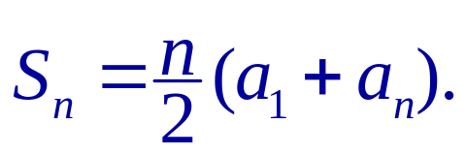
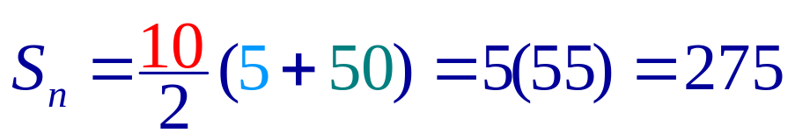
The Sum of a Finite Arithmetic Sequence
The sum of a finite arithmetic sequence with n terms is given by
5 + 10 + 15 + 20 + 25 + 30 + 35 + 40 + 45 + 50 = ?
n = 10
a₁ = 5
a₁₀ = 50

Slide 8
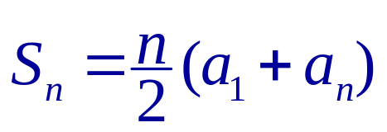
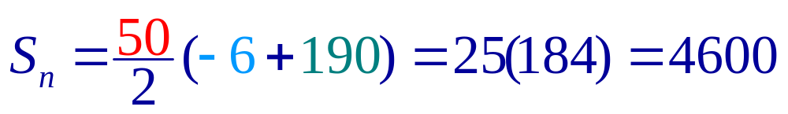
Example: The nth Partial Sum
The sum of the first n terms of an infinite sequence is called the nth partial sum.
Example: Find the 50th partial sum of the arithmetic sequence – 6, – 2, 2, 6, . . .
a₁ = – 6
d = 4
c = a₁ – d = – 10
a_{n} = dn + c = 4n – 10
a₅₀ = 4(50) – 10 = 190

Slide 9
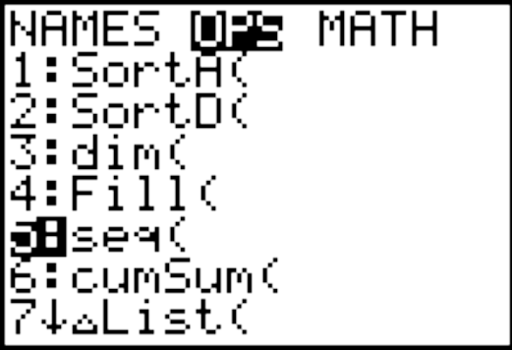
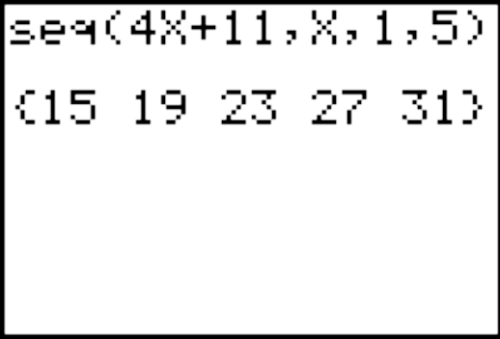
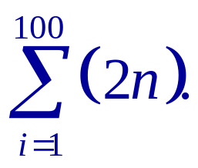
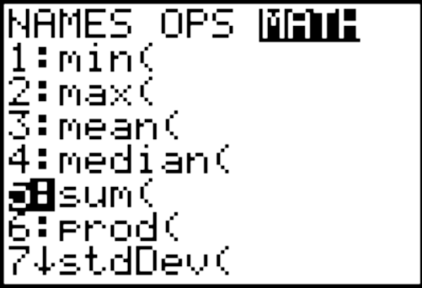
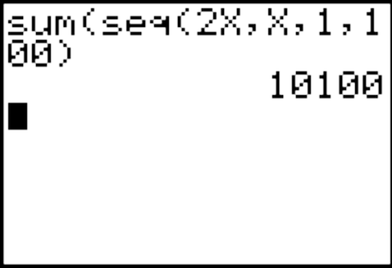
Graphing Utility: Terms and Sum of a Sequence
Graphing Utility: Find the first 5 terms of the arithmetic sequence a_{n} = 4n + 11.
variable
beginning value
List Menu:
end value
Graphing Utility: Find the sum
lower limit
upper limit
List Menu:

Slide 10
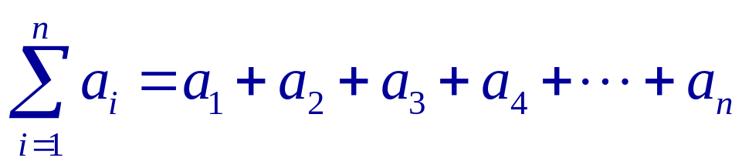
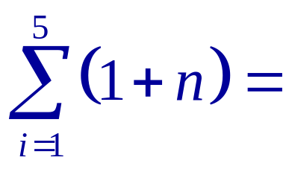


Definition of Summation Notation
The sum of the first n terms of a sequence is represented by summation notation.
upper limit of summation
index of summation
lower limit of summation

Slide 11
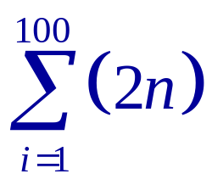
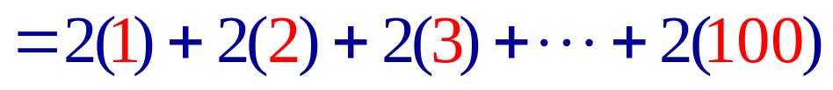

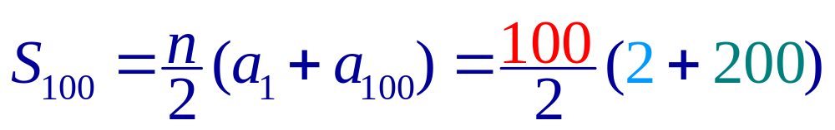
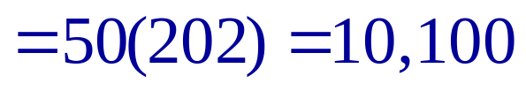
Example: Summation Notation
Example: Find the partial sum.
a₁
a₁₀₀

Slide 12
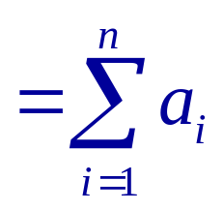

Definition of Series
Consider the infinite sequence a₁, a₂, a₃, . . ., a_{i}, . . ..
The sum of the first n terms of the sequence is called
a finite series or the partial sum of the sequence.
a₁ + a₂ + a₃ + . . . + a_{n}
The sum of all the terms of the infinite sequence is
called an infinite series.
a₁ + a₂ + a₃ + . . . + a_{i} + . . .

Slide 13
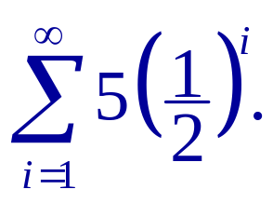
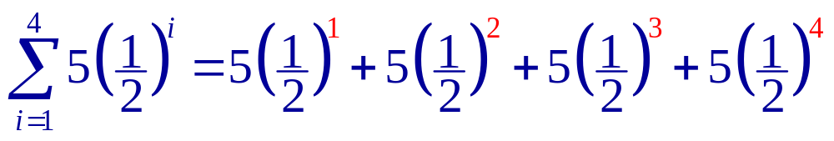
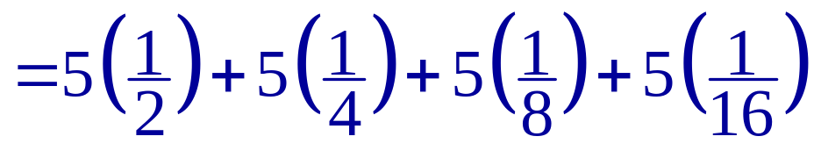
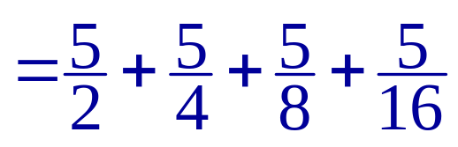
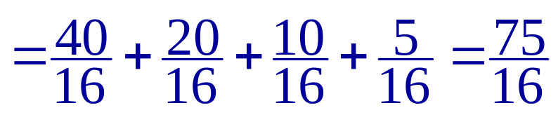
Example: Sum of Partial Series
Example: Find the fourth partial sum of

