Slide 1

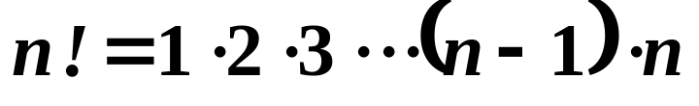

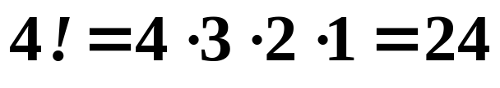

Sequences and Series
Factorial Notation
If n is a positive number, n factorial is defined as
with
For example,

Slide 2
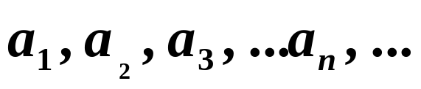
Sequences and Series
An infinite sequence is a list of numbers in a particular order.
The terms of a sequence are denoted as

Slide 3
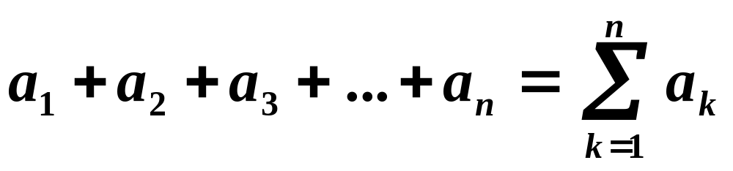
Sequences and Series
Summation Notation
The sum of the first n terms of a sequence is written as

Slide 4
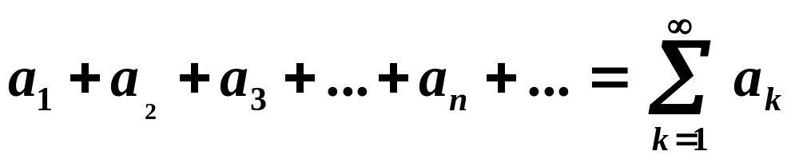
Sequences and Series
An infinite series is the sum of the numbers in an infinite sequence.

Slide 5
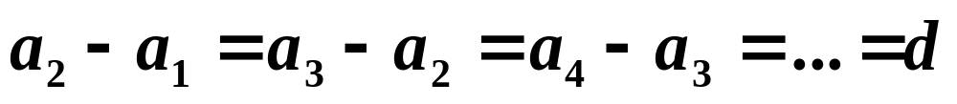
Sequences and Series
Arithmetic Sequences
A sequence is arithmetic if the difference between consecutive terms is constant.
d is the common difference of the series.

Slide 6
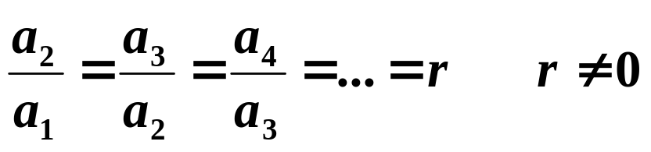
Sequences and Series
Geometric Sequences
A sequence is geometric if the ratio of consecutive terms is constant.
r is the common ratio of the series.

Slide 7
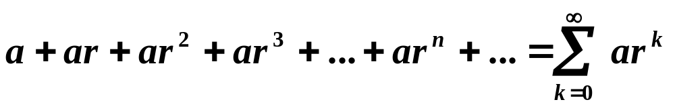

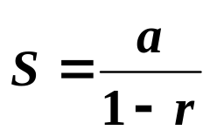
Sequences and Series
Geometric Series
The sum of the terms in an infinite geometric sequence is called a geometric series.
If , the series has the sum

Slide 8
