Slide 1
Quadratic Equations
An Introduction
SPI 3103.3.2 Solve quadratic equations and systems, and
determine roots of a higher order polynomial.

Slide 2
Quadratic Equations are written in the form ax² + bx + c = 0, where a ≠ 0.

Slide 3
Methods Used to
Solve Quadratic Equations
1. Graphing
2. Factoring
3. Square Root Property
4. Completing the Square
5. Quadratic Formula

Slide 4
Why so many methods?
- Some methods will not work for
all equations.
- Some equations are much
easier to solve using a
particular method.
- Variety is the spice of life.

Slide 5

Graphing
Graphing to solve quadratic equations does not always produce an accurate result.
If the solutions to the quadratic equation are irrational or complex, there is no way to tell what the exact solutions are by looking at a graph.
Graphing is very useful when solving contextual problems involving quadratic equations.

Slide 6
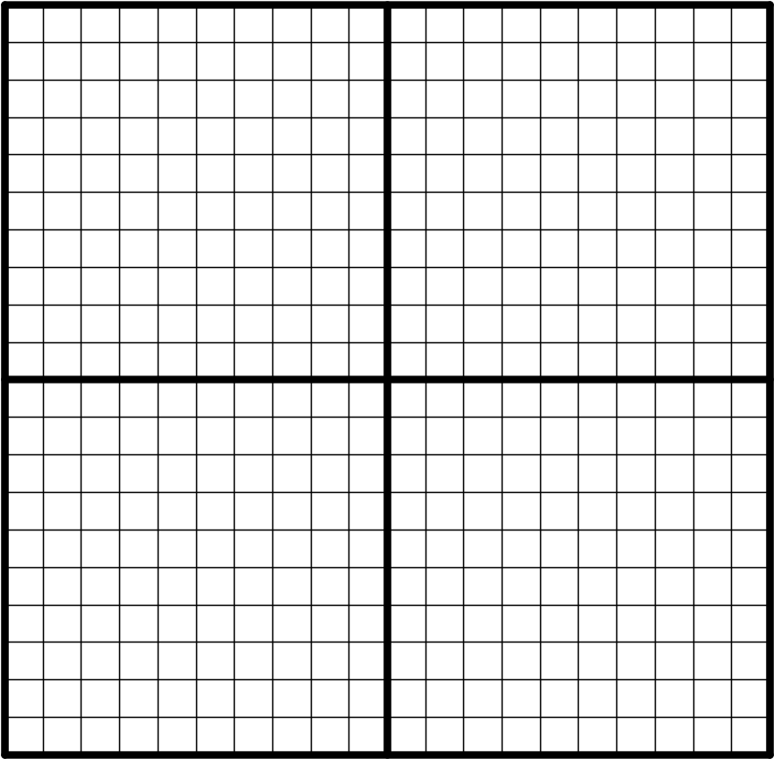
Graphing (Example 1)
y = x² – 4x – 5
Solutions are
-1 and 5

Slide 7
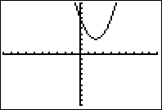
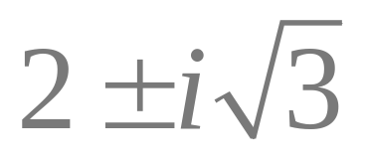
Graphing (Example 2)
y = x² – 4x + 7
Solutions are

Slide 8
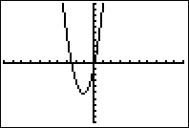
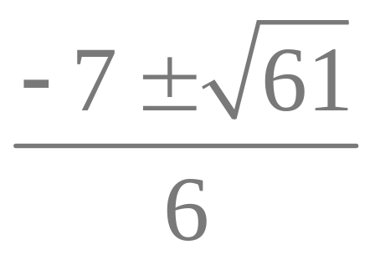
Graphing (Example 3)
y = 3x² + 7x – 1
Solutions are

Slide 9
Factoring
Factoring is typically one of the easiest and quickest ways to solve quadratic equations;
however,
not all quadratic polynomials can be factored.
This means that factoring will not work to solve many quadratic equations.

Slide 10
Factoring (Examples)
Example 1
x² – 2x – 24 = 0
(x + 4)(x – 6) = 0
x + 4 = 0 x – 6 = 0
x = –4 x = 6
Example 2
x² – 8x + 11 = 0
x² – 8x + 11 is prime; therefore, another method must be used to solve this equation.

Slide 11
Square Root Property
This method is also relatively quick and easy;
however,
it only works for equations in which the quadratic polynomial is written in the following form.
x² = n or (x + c)² = n

Slide 12
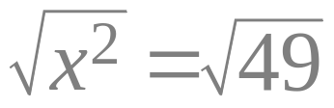
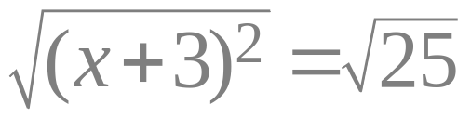
Square Root Property (Examples)
Example 1 Example 2
x² = 49 (x + 3)² = 25
x = ± 7 x + 3 = ± 5
x + 3 = 5 x + 3 = –5
x = 2 x = –8
Example 3
x² – 5x + 11 = 0
This equation is
not written in the
correct form to
use this method.

Slide 13
Completing the Square
This method will work to solve ALL quadratic equations;
however,
it is “messy” to solve quadratic equations by completing the square if a ≠ 1 and/or b is an odd number.
Completing the square is a great choice for solving quadratic equations if a = 1 and b is an even number.

Slide 14
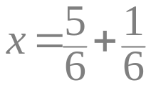
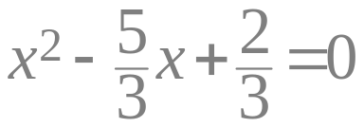
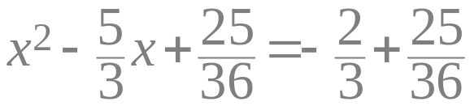
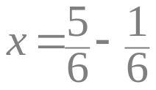
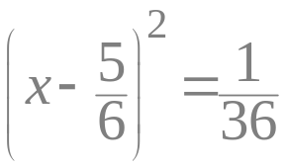
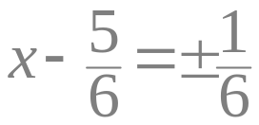
Completing the Square (Examples
Example 2
a ≠ 1, b is not even
3x² – 5x + 2 = 0
Example 1
a = 1, b is even
x² – 6x + 13 = 0
x² – 6x + 9 = –13 + 9
(x – 3)² = –4
x – 3 = ± 2i
x = 3 ± 2i
OR
x = 1 OR x = ⅔

Slide 15
Quadratic Formula
This method will work to solve ALL quadratic equations;
however,
for many equations it takes longer than some of the methods discussed earlier.
The quadratic formula is a good choice if the quadratic polynomial cannot be factored, the equation cannot be written as (x+c)² = n, or a is not 1 and/or b is an odd number.

Slide 16
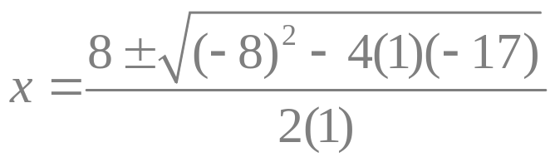
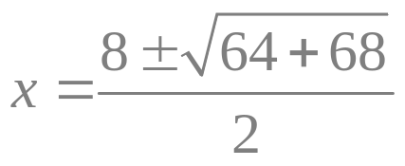
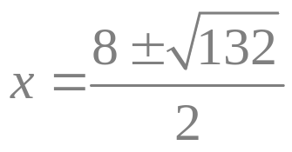
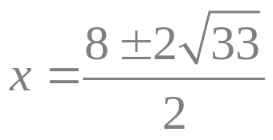
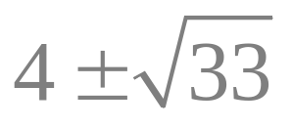
Quadratic Formula (Example)
x² – 8x – 17 = 0
a = 1
b = –8
c = –17

