Slide 1
Direct Variation
What is it and how do I know when I see it?

Slide 2
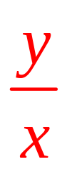
Definition:
Y varies directly as x means that y = kx where k is the constant of variation.
(see any similarities to y = mx + b?)
Another way of writing this is k =
In other words:
* the constant of variation (k) in a direct variation is the constant (unchanged) ratio of two variable quantities.

Slide 3
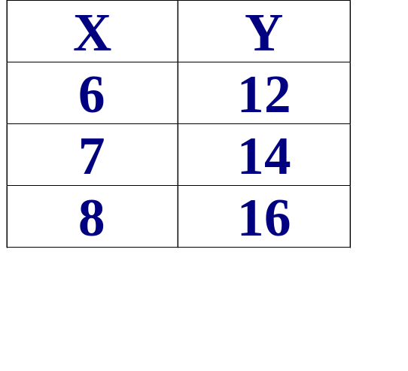
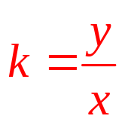
Examples of Direct Variation:
Note: X increases,
6 , 7 , 8
And Y increases.
12, 14, 16
What is the constant of variation of the table above?
Since y = kx we can say Therefore:
12/6=k or k = 2 14/7=k or k = 2
16/8=k or k =2 Note k stays constant.
y = 2x is the equation!

Slide 4
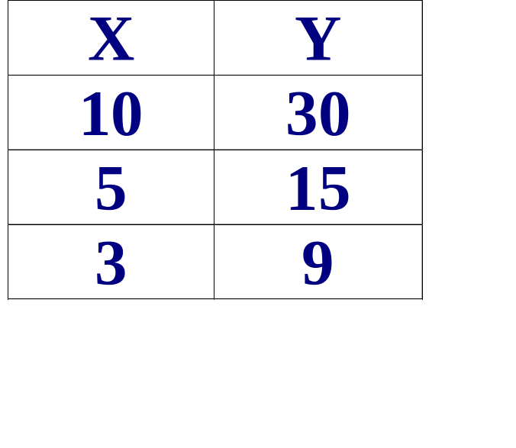
Examples of Direct Variation:
Note: X decreases,
10, 5, 3
And Y decreases.
30, 15, 9
What is the constant of variation of the table above?
Since y = kx we can say Therefore:
30/10=k or k = 3 15/5=k or k = 3
9/3=k or k =3 Note k stays constant.
y = 3x is the equation!

Slide 5
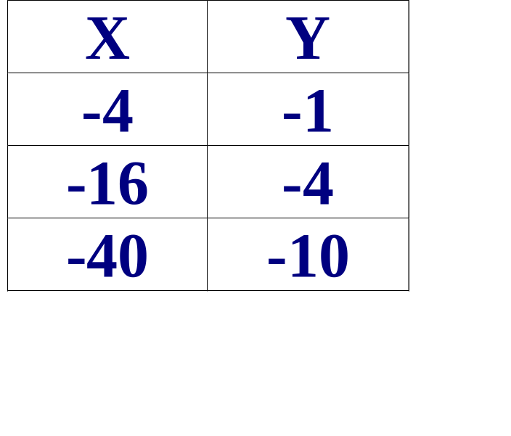
Examples of Direct Variation:
Note: X decreases,
-4, -16, -40
And Y decreases.
-1,-4,-10
What is the constant of variation of the table above?
Since y = kx we can say Therefore:
-1/-4=k or k = ¼ -4/-16=k or k = ¼
-10/-40=k or k = ¼ Note k stays constant.
y = ¼ x is the equation!

Slide 6
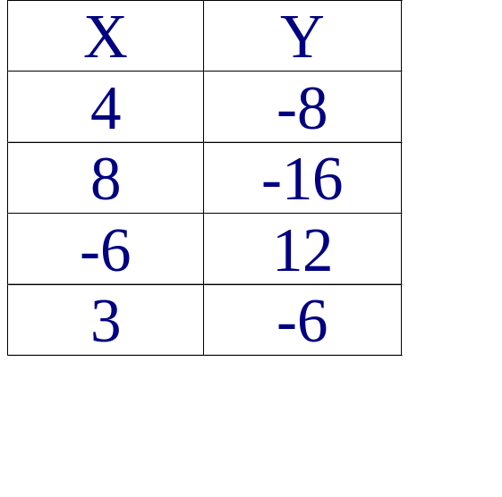
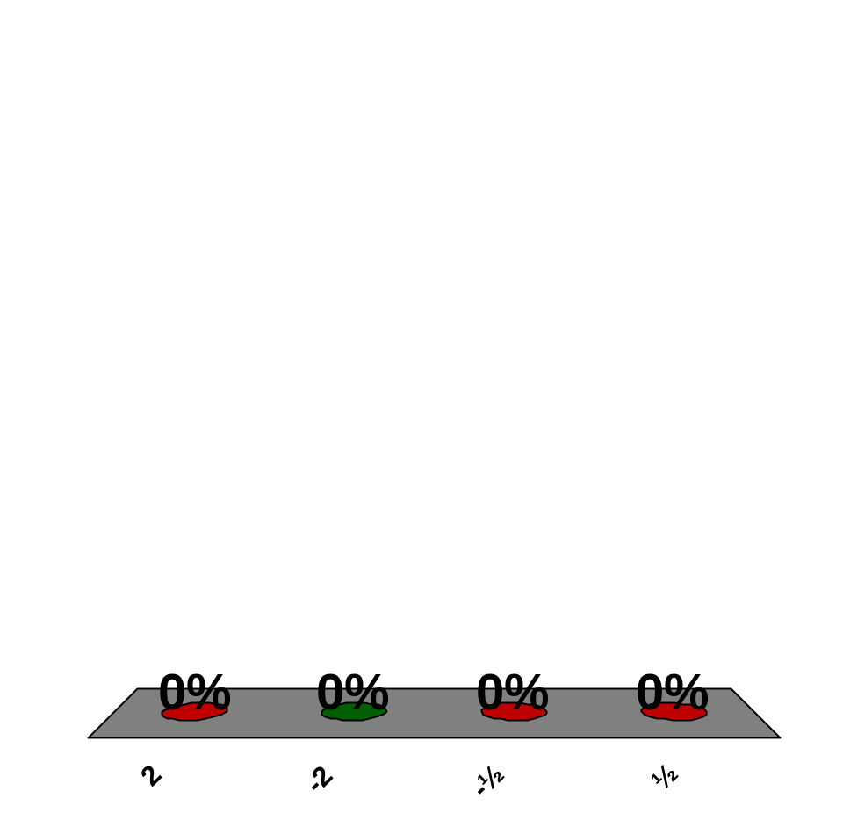
What is the constant of variation for the following direct variation?
2
-2
-½
½
Answer Now

Slide 7
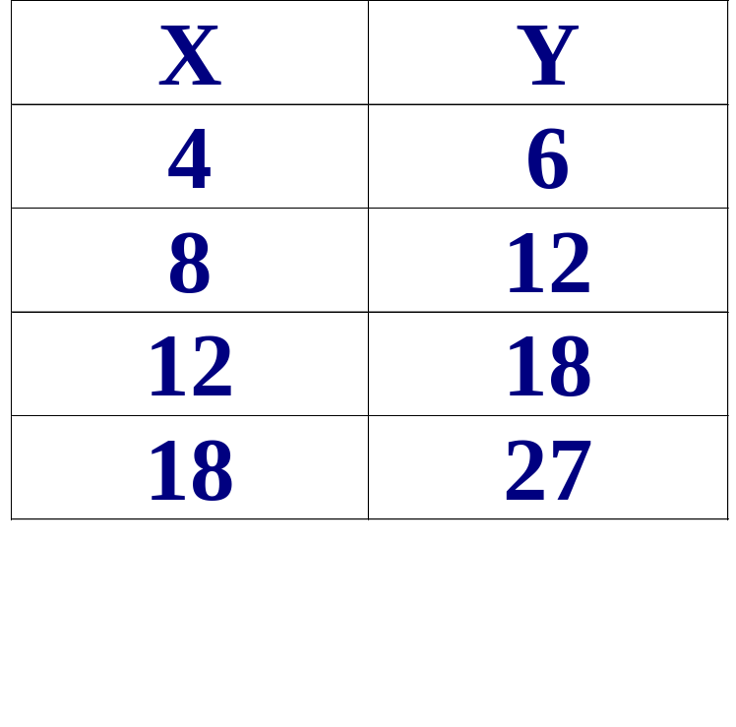
Is this a direct variation? If yes, give the constant of variation (k) and the equation.
Yes!
k = 6/4 or 3/2
Equation?
y = 3/2 x

Slide 8
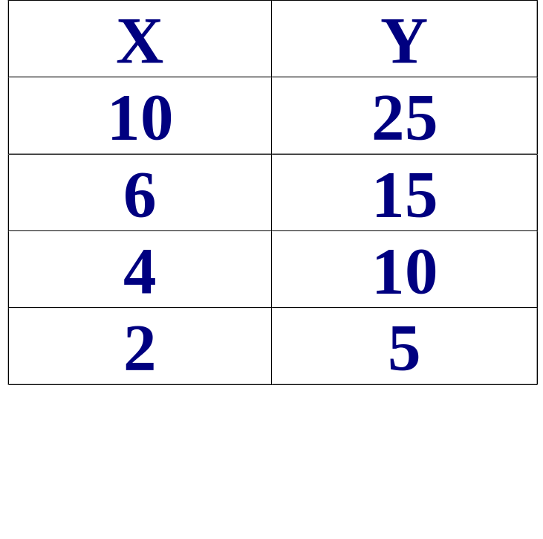
Is this a direct variation? If yes, give the constant of variation (k) and the equation.
Yes!
k = 25/10 or 5/2
k = 10/4 or 5/2
Equation?
y = 5/2 x

Slide 9
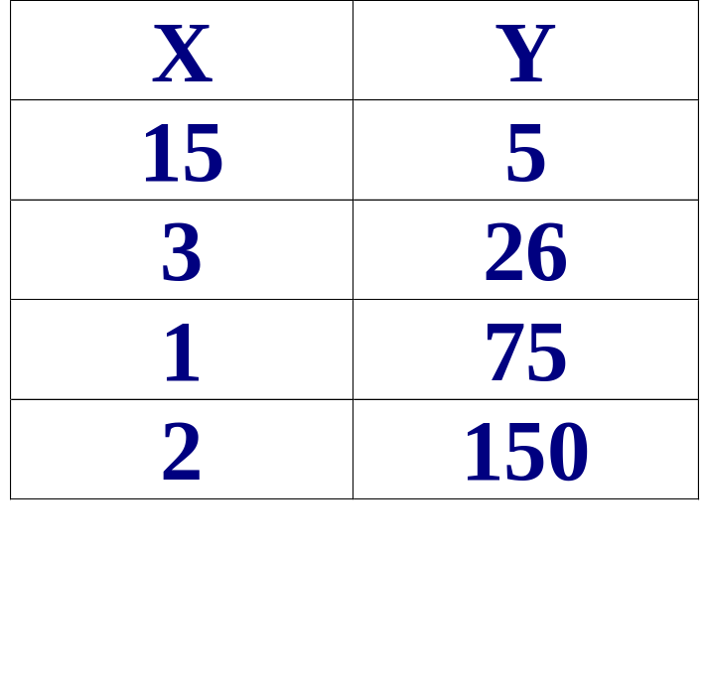
Is this a direct variation? If yes, give the constant of variation (k) and the equation.
No!
The k values are different!

Slide 10
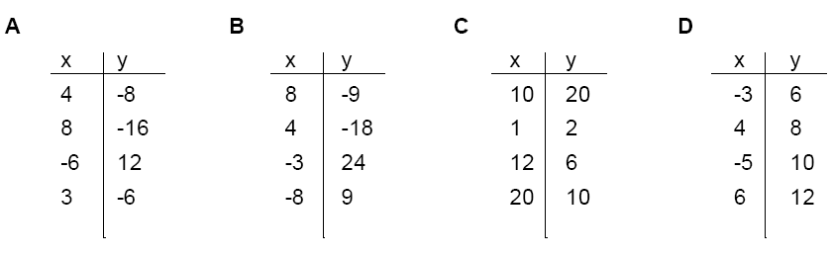
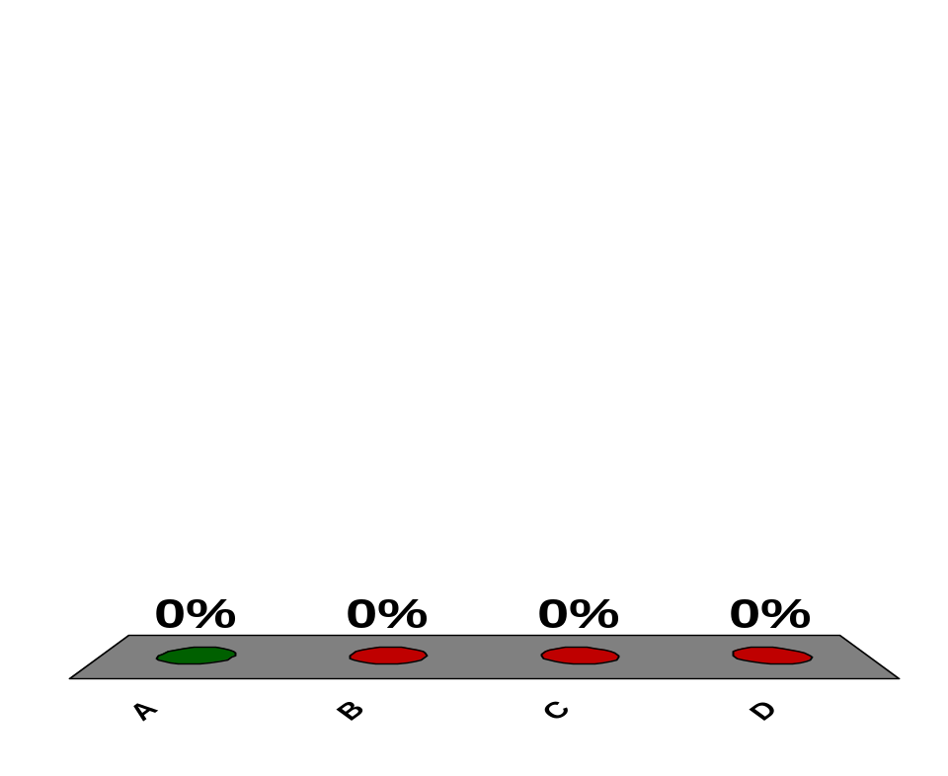
Which of the following is a direct variation?
A
B
C
D
Answer Now

Slide 11
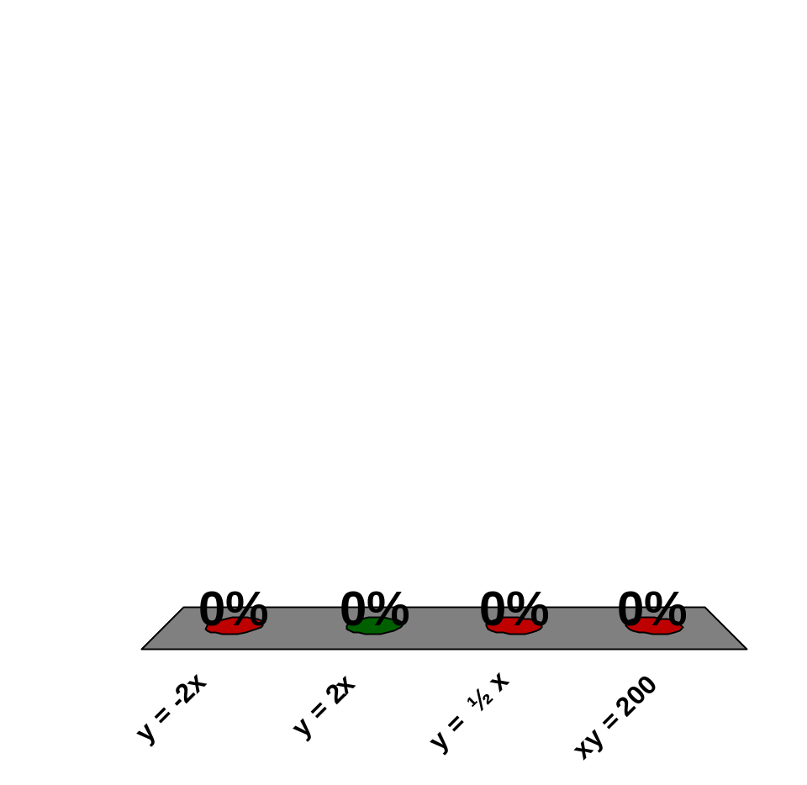
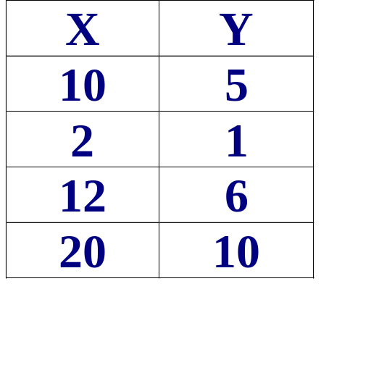
Which is the equation that describes the following table of values?
y = -2x
y = 2x
y = ½ x
xy = 200
Answer Now

Slide 12
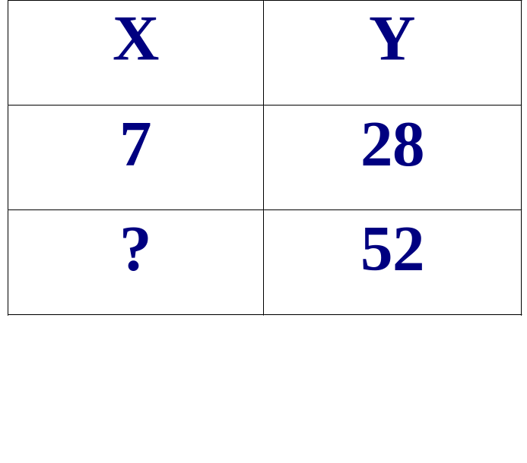
Using Direct Variation to find unknowns (y = kx)
Given that y varies directly with x, and y = 28 when x=7, Find x when y = 52. HOW???
2 step process
1. Find the constant variation
k = y/x or k = 28/7 = 4
k=4
2. Use y = kx. Find the unknown (x).
52= 4x or 52/4 = x
x= 13
Therefore:
X =13 when Y=52

Slide 13
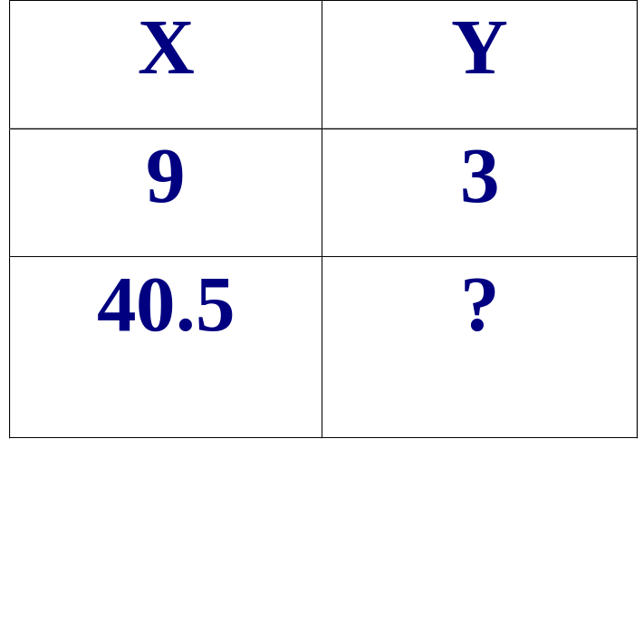
Using Direct Variation to find unknowns (y = kx)
Given that y varies directly with x, and y = 3 when x=9,
Find y when x = 40.5. HOW???
2 step process
1. Find the constant variation.
k = y/x or k = 3/9 = 1/3
K = 1/3
2. Use y = kx. Find the unknown (x).
y= (1/3)40.5
y= 13.5
Therefore:
X =40.5 when Y=13.5

Slide 14
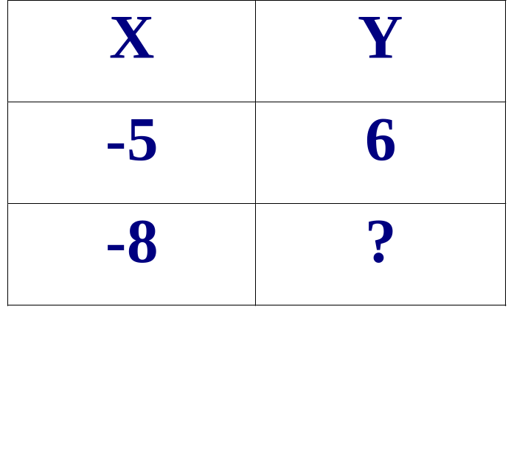
Using Direct Variation to find unknowns (y = kx)
Given that y varies directly with x, and y = 6 when x=-5,
Find y when x = -8. HOW???
2 step process
1. Find the constant variation.
k = y/x or k = 6/-5 = -1.2
k = -1.2
2. Use y = kx. Find the unknown (x).
y= -1.2(-8)
x= 9.6
Therefore:
X =-8 when Y=9.6

Slide 15
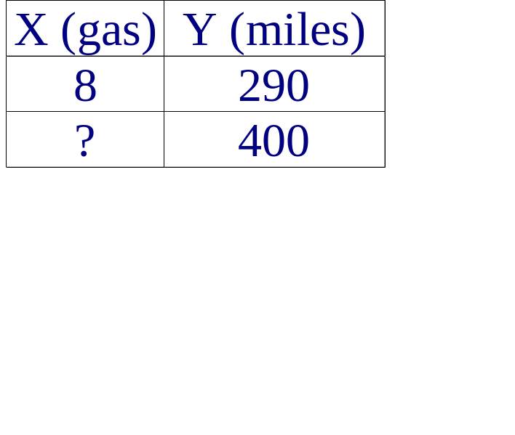
Using Direct Variation to solve word problems
Problem:
A car uses 8 gallons of gasoline to travel 290 miles. How much gasoline will the car use to travel 400 miles?
Step One: Find points in table
Step Two: Find the constant variation and equation:
k = y/x or k = 290/8 or 36.25
y = 36.25 x
Step Three: Use the equation
to find the unknown.
400 =36.25x
400 =36.25x
36.25 36.25
or x = 11.03

Slide 16
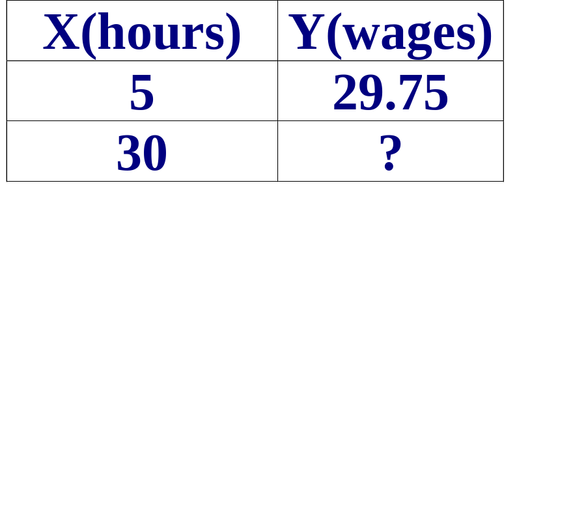
Using Direct Variation to solve word problems
Problem:
Julio wages vary directly as the number of hours that he works. If his wages for 5 hours are $29.75, how much will they be for 30 hours
Step One: Find points in table.
Step Three: Use the equation
to find the unknown. y=kx
y=5.95(30) or Y=178.50
Step Two: Find the constant variation.
k = y/x or k = 29.75/5 = 5.95

Slide 17
Direct Variation and its graph
y = mx +b,
m = slope and b = y-intercept
With direction variation the equation
is y = kx
Note: m = k or the constant and b = 0 therefore the graph will always go through…

Slide 18
the ORIGIN!!!!!

Slide 19
Tell if the following graph is a Direct Variation or not.
Yes
No
No
No

Slide 20
Tell if the following graph is a Direct Variation or not.
No
Yes
Yes
No

Slide 21


