Slide 1
R8 Radicals and Rational Exponents

Slide 2
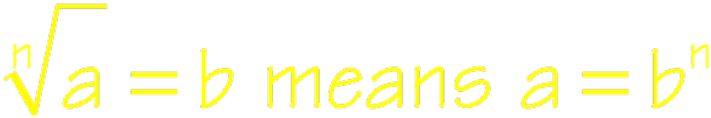
Radical Notation
n is called the index number
a is called the radicand

Slide 3
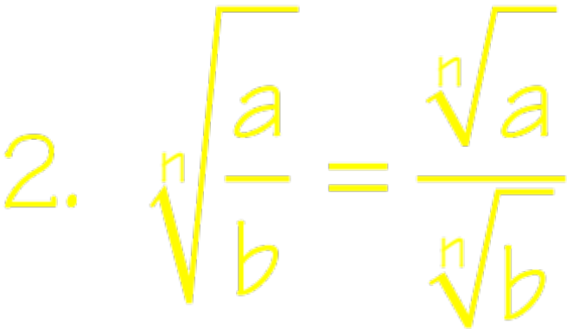
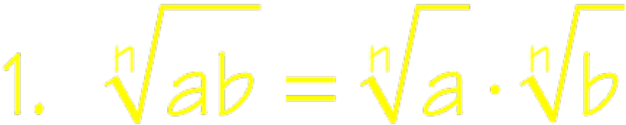
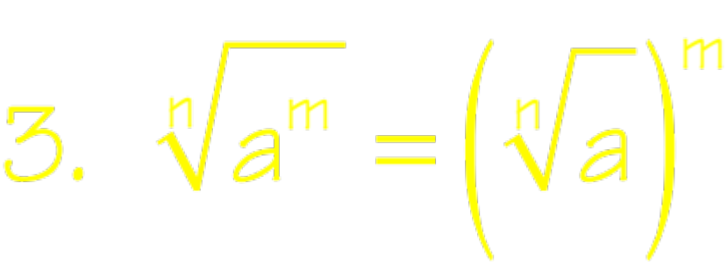
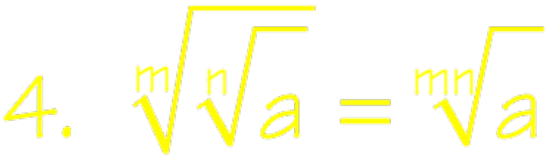
Properties of Radicals

Slide 4
Simplifying Radicals
The radicand has no factor raised to a power greater than or equal to the index number.
The radicand has no fractions.
No denominator contains a radical.
Exponents in the radicand and the index of the radical have no common factor.
All indicated operations have been performed

Slide 5
Simplifying Radicals
If there is no index #, it is understood to be 2
When simplifying radicals use perfect squares, cubes, etc.
Use factor trees to break a number into its prime factors
Apply the properties of radicals and exponents

Slide 6
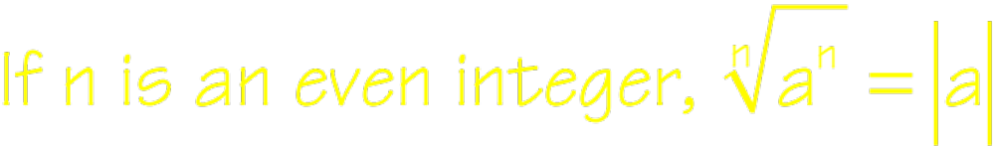

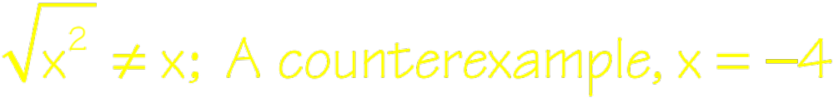
Simplifying Radicals

Slide 7



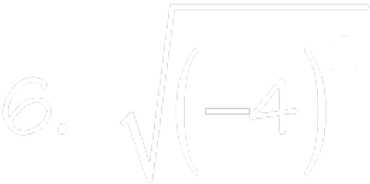





Simplify each radical expression

Slide 8






Assume that all variables represent nonnegative real numbers.

Slide 9




Assume that all variables represent nonnegative real numbers.

Slide 10
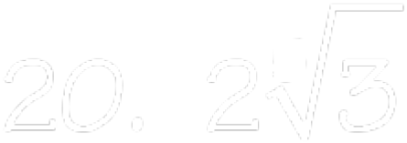



Rewrite each of the following as a single number under the radical sign.

Slide 11
Multiplying Radicals
Radicals must have the same index number
Multiply outsides and insides together
Add exponents when multiplying
Simplify your expression
Combine all like terms

Slide 12
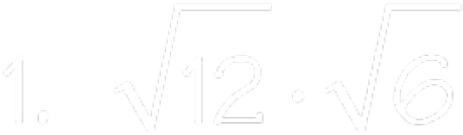
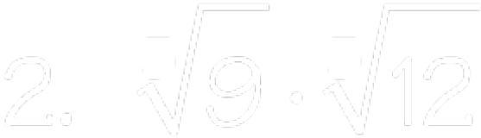

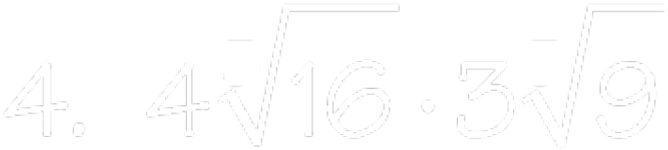
Assume that all variables represent nonnegative real numbers.

Slide 13


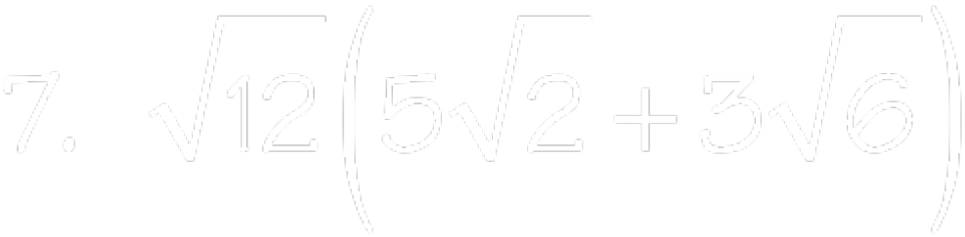
Assume that all variables represent nonnegative real numbers.

Slide 14
Add/Subtract Radicals
Simplify each radical expression
Radicals must have the same index number and same radicand
Add the outside numbers together and the radicand remains the same

Slide 15




Simplify each of the following radicals.

Slide 16
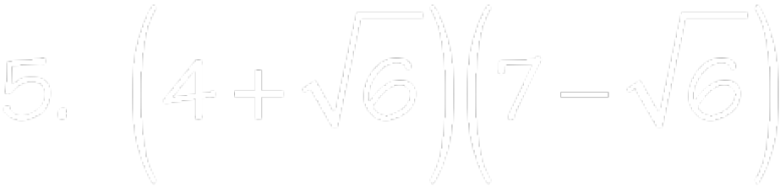
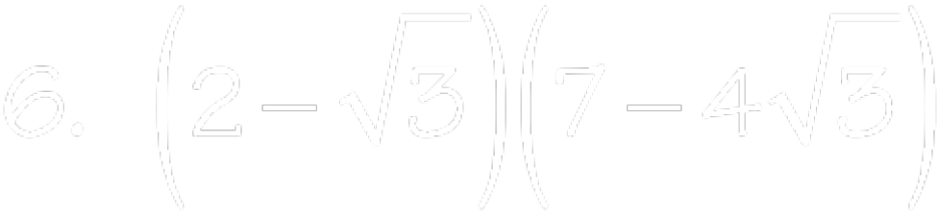
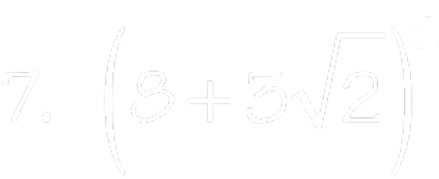
Simplify each of the following radicals.

Slide 17
Dividing Radicals
No radicals in the denominator
No fractions under the radicand
Apply the properties of radicals and exponents

Slide 18
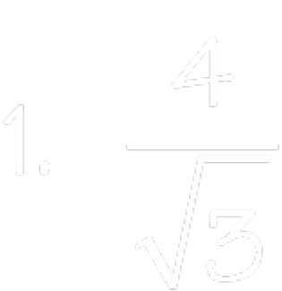
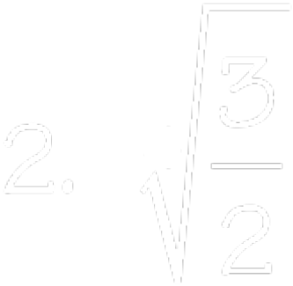
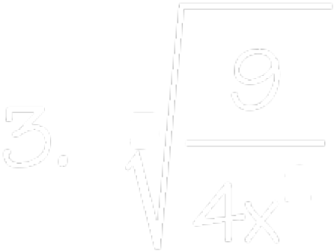
Assume that all variables represent nonnegative real numbers and that no denominators are zero.

Slide 19

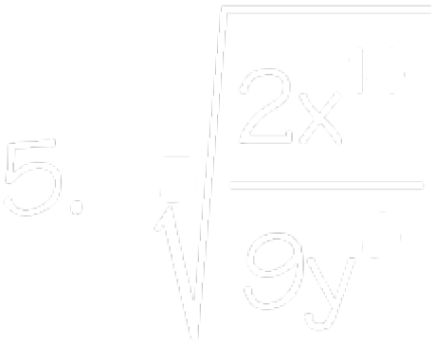
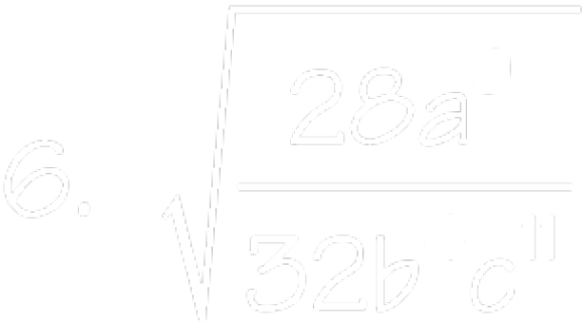
Assume that all variables represent nonnegative real numbers and that no denominators are zero.

Slide 20

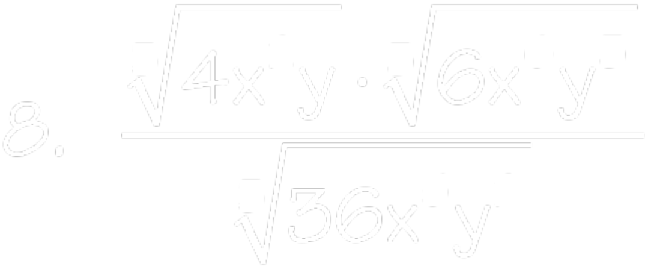
Assume that all variables represent nonnegative real numbers and that no denominators are zero.

Slide 21
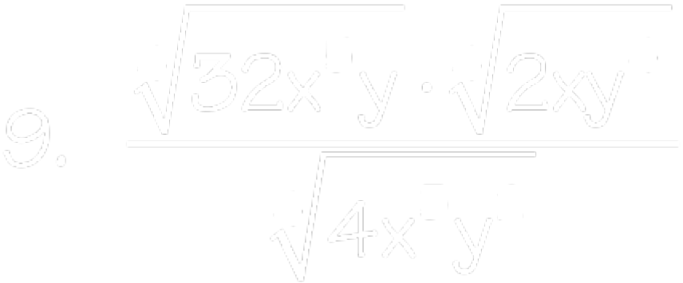
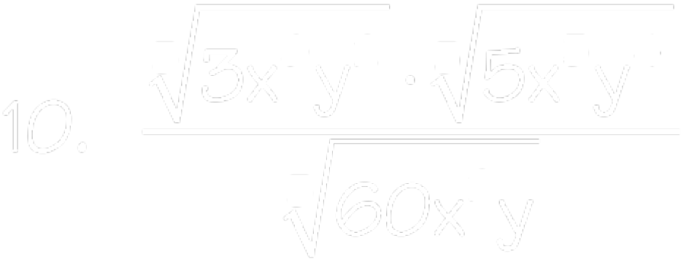
Assume that all variables represent nonnegative real numbers and that no denominators are zero.

Slide 22
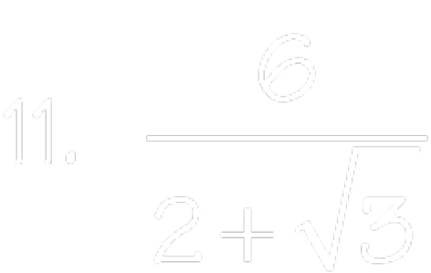
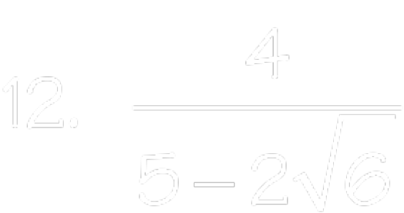
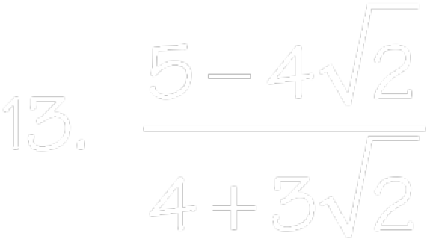
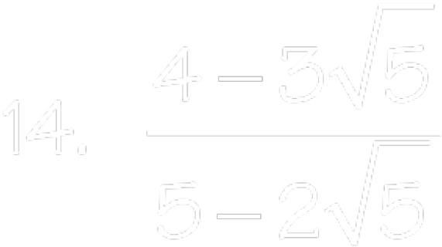
Simplify each of the following radicals.

Slide 23
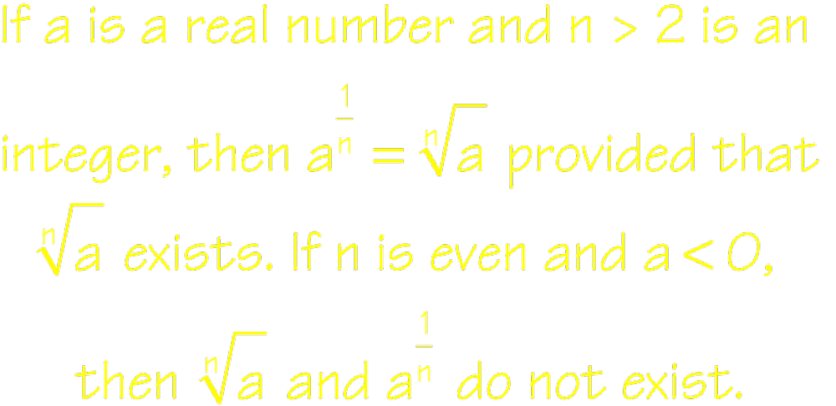
Rational Exponents

Slide 24
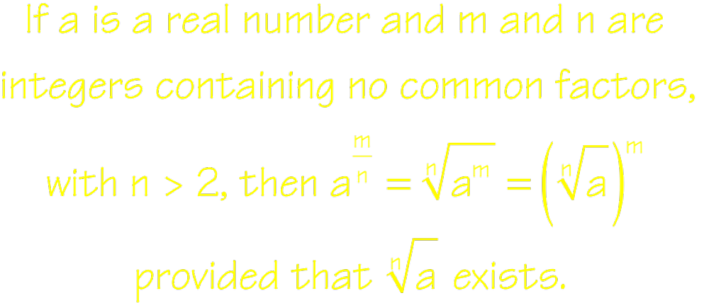
Rational Exponents

Slide 25


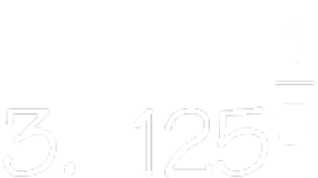
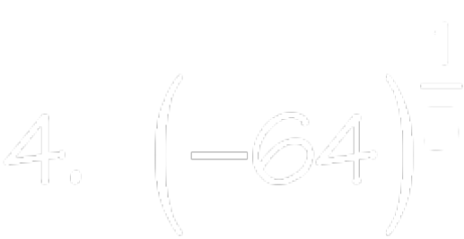


Simplify each expression containing fractional exponents as radicals.

Slide 26

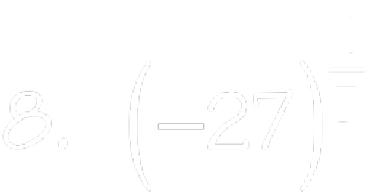




Simplify each expression using radicals and exponents.

Slide 27
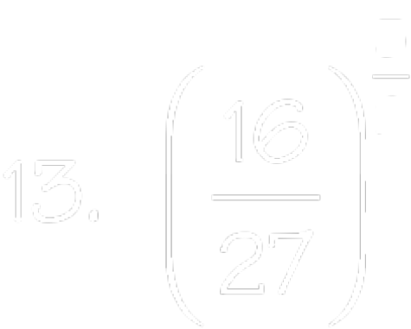
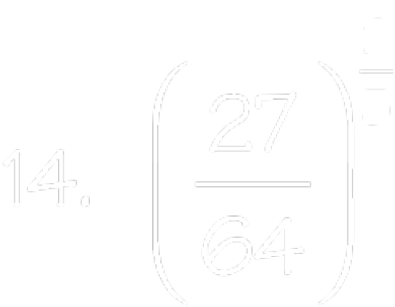

Simplify each expression using radicals or exponents.

Slide 28




Simplifying each expression. Express your answer so that only positive exponents occur. Assume that the variables are positive.

Slide 29




Simplifying each expression. Express your answer so that only positive exponents occur. Assume that the variables are positive.

Slide 30




Simplifying each expression. Express your answer so that only positive exponents occur. Assume that the variables are positive.

