Slide 1
Intermediate Algebra
Exam 2 Material
Rational Expressions

Slide 2
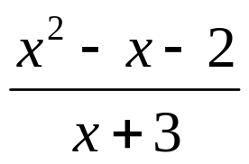
Rational Expression
A ratio of two polynomials where the denominator is not zero (an “ugly fraction” with a variable in a denominator)
Example:
Will the value of the denominator ever be zero?
If x = - 3, then the denominator becomes 0, so we say that – 3 is a restricted value of x
What is the “domain” of the rational expression (all acceptable values of the variable)?
Domain is the set of all real numbers except - 3.
Domain: {x | x ≠ -3}

Slide 3
Finding Restricted Values and Domains of Rational Expressions
Completely factor the denominator
Make equations by setting each factor of the denominator equal to zero
Solve the equations to find restricted values
The domain will be all real numbers that are not restricted

Slide 4
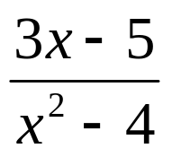
Example
Find the domain:
Factor the denominator:
(x – 2)(x + 2)
Set each factor equal to zero and solve the equations:
x – 2 = 0 and x + 2 = 0
x = 2 and x = -2 (Restricted Values)
Domain:
{x | x ≠ -2, x ≠ 2}

Slide 5
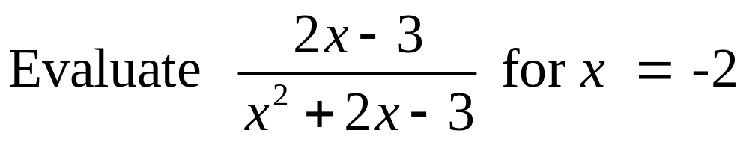
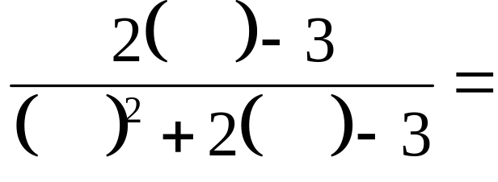

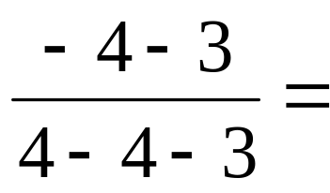
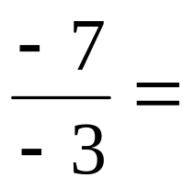

Evaluating Rational Expressions
To “evaluate” a rational expression means to find its “value” when variables are replaced by specific “unrestricted” numbers inside parentheses
Example:

Slide 6

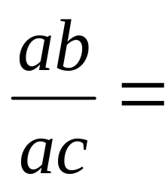

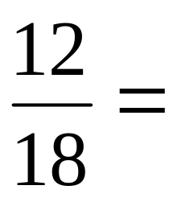
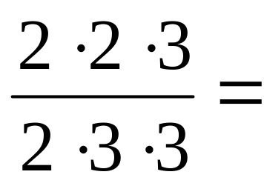

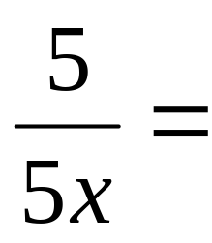

Fundamental Principle of Fractions
If the numerator and denominator of a fraction contain a common factor, that factor may be divided out to reduce the fraction to lowest terms:

Slide 7
Reducing Rational Expressions to Lowest Terms
Completely factor both numerator and denominator
Apply the fundamental principle of fractions: divide out common factors that are found in both the numerator and the denominator

Slide 8
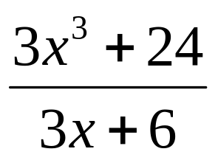
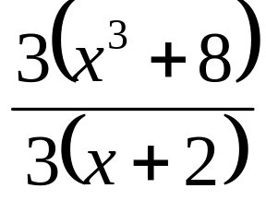
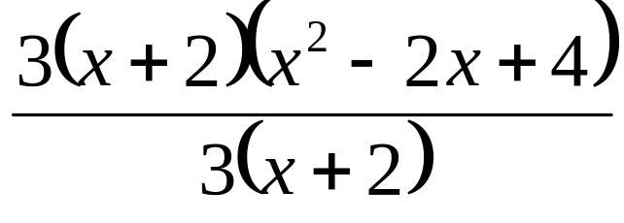
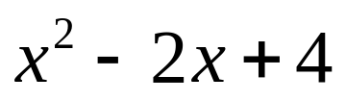
Example of Reducing Rational Expressions to Lowest Terms
Reduce to lowest terms:
Factor top and bottom:
Divide out common factors to get:

Slide 9
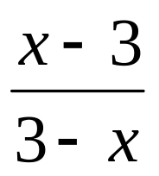
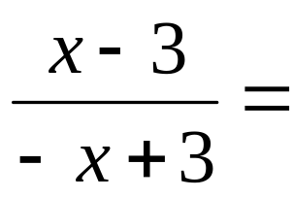
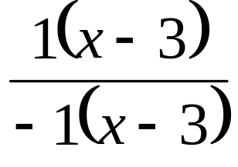
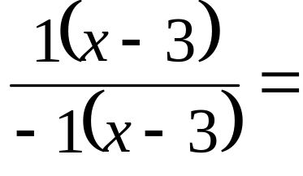

Example of Reducing Rational Expressions to Lowest Terms
Reduce to lowest terms:
Factor top and bottom:
Divide out common factors to get:

Slide 10
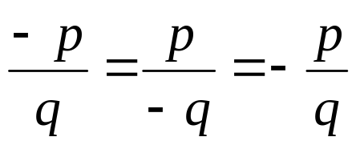
Equivalent Forms of Rational Expressions
All of the following are equivalent:
In words this would say that a negative factor in the numerator or denominator can be moved, respectively, to a negative factor in the denominator or numerator, or can be moved to the front of the fraction, or vice versa

Slide 11
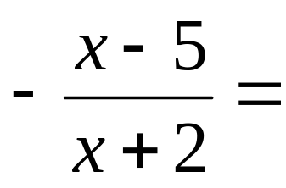
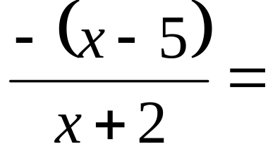
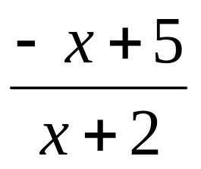
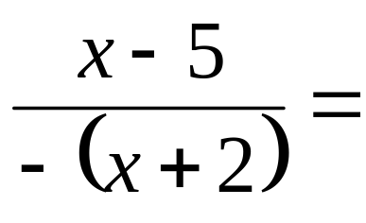
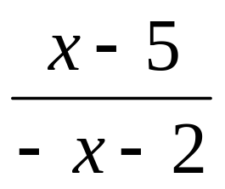
Example of Using Equivalent Forms of Rational Expressions
Write equivalent forms of:

Slide 12
Homework Problems
Section: 6.1
Page: 401
Problems: Odd: 3 – 9, 13 – 23, 27 – 63, 67 – 73
MyMathLab Homework Assignment 6.1 for practice
MyMathLab Quiz 6.1 for grade

Slide 13
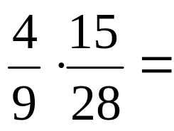
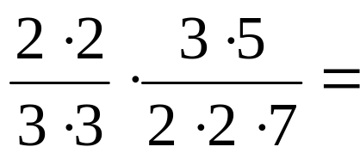
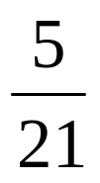
Multiplying Rational Expressions (Same as Multiplying Fractions)
Factor each numerator and denominator
Divide out common factors
Write answer (leave polynomials in factored form)
Example:

Slide 14
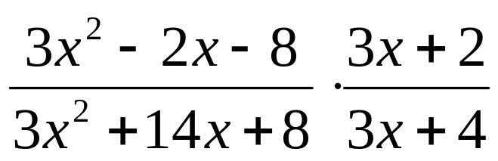
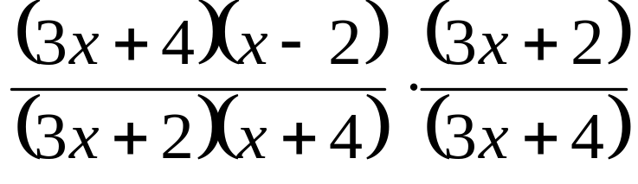
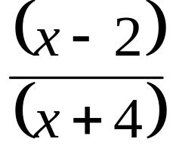
Example of Multiplying
Rational Expressions
Completely factor each top and bottom:
Divide out common factors:

Slide 15
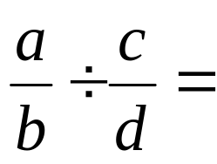
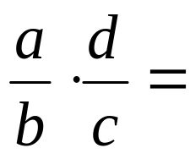
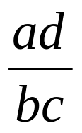
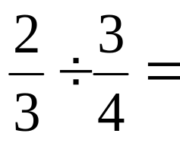
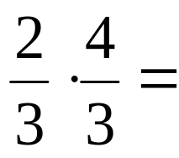

Dividing Rational Expressions
(Same as Dividing Fractions)
Invert the divisor and change problem to multiplication
Example:

Slide 16

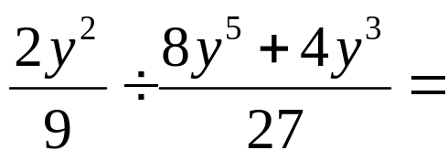
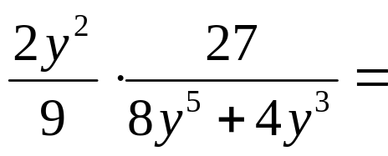
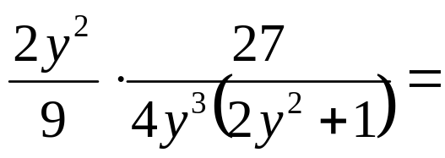


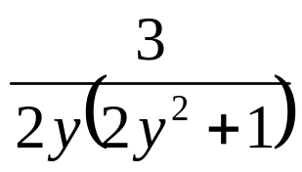
Example of Dividing
Rational Expressions

Slide 17
Homework Problems
Section: 6.2
Page: 408
Problems: Odd: 3 – 25, 29 – 61
MyMathLab Homework Assignment 6.2 for practice
MyMathLab Quiz 6.2 for grade

Slide 18
Finding the Least Common Denominator, LCD, of Rational Expressions
Completely factor each denominator
Construct the LCD by writing down each factor the maximum number of times it is found in any denominator

Slide 19




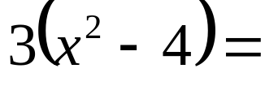
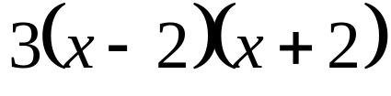

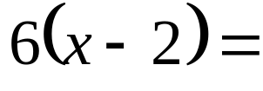
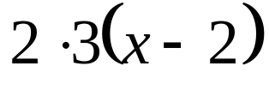

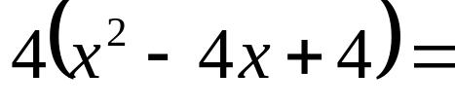
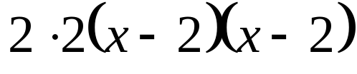

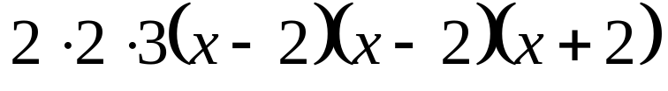
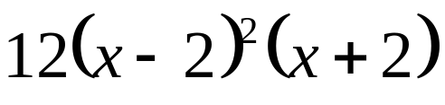
Example of Finding the LCD
Given three denominators, find the LCD:
, ,
Factor each denominator:
Construct LCD by writing each factor the maximum number of times it’s found in any denominator:

Slide 20
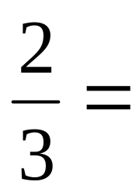
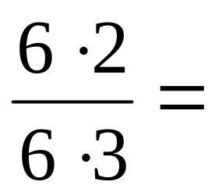
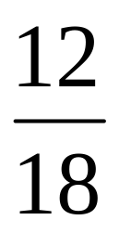
Equivalent Fractions
The fundamental principle of fractions, mentioned earlier, says:
In words, this says that when numerator and denominator of a fraction are multiplied by the same factor, the result is equivalent to the original fraction
.

Slide 21
Writing Equivalent Fractions With Specified Denominator
Given a fraction and a desired denominator for an equivalent fraction that is a multiple of the original denominator, write an equivalent fraction by multiplying both the numerator and denominator of the original fraction by all factors of the desired denominator not found in the original denominator
To accomplish this goal, it is usually best to completely factor both the original denominator and the desired denominator

Slide 22







Example
Write an equivalent fraction to the given fraction that has a denominator of 24:

Slide 23








Example
Write an equivalent rational expression to the given one that has a denominator of :

Slide 24
Homework Problems
Section: 6.3
Page: 414
Problems: Odd: 5 – 43, 51 – 69
MyMathLab Homework Assignment 6.3 for practice
MyMathLab Quiz 6.3 for grade

Slide 25
Adding and Subtracting Rational Expressions (Same as Fractions)
Find a least common denominator, LCD, for the rational expressions
Write each fraction as an equivalent fraction having the LCD
Write the answer by adding or subtracting numerators as indicated, and keeping the LCD
If possible, reduce the answer to lowest terms

Slide 26










Example
Find a least common denominator, LCD, for the rational expressions:
Write each fraction as an equivalent fraction having the LCD:
Write the answer by adding or subtracting numerators as indicated, and keeping the LCD:
If possible, reduce the answer to lowest terms

Slide 27
Homework Problems
Section: 6.4
Page: 422
Problems: Odd: 9 – 21, 25 – 47, 51 – 71
MyMathLab Homework Assignment 6.4 for practice
MyMathLab Quiz 6.4 for grade

Slide 28

Complex Fraction
A “fraction” that contains a rational expression in its numerator, or in its denominator, or both
Example:
Think of it as “fractions inside of a fraction”
Every complex fraction can be simplified to a rational expression (ratio of two polynomials)

Slide 29
Two Methods for Simplifying Complex Fractions
Method One
  Do math on top to get a single fraction
  Do math on bottom to get a single fraction
  Divide top fraction by bottom fraction
Method Two (Usually preferred)
  Find the LCD of all of the “little fractions”
  Multiply the complex fraction by “1” where “1” is the LCD of the little fractions over itself

Slide 30









Method One Example of
Simplifying a Complex Fraction
Do math on top to get single fraction:
Do math on bottom to get single fraction:
Top fraction divided by bottom:

Slide 31




Method Two Example of
Simplifying a Complex Fraction
Find the LCD of all of the “little fractions”:
Multiply the complex fraction by “1” where “1” is the LCD of the little fractions over itself

Slide 32
Homework Problems
Section: 6.5
Page: 431
Problems: Odd: 7 – 35
MyMathLab Homework Assignment 6.5 for practice
MyMathLab Quiz 6.5 for grade

Slide 33
Other Types of Equations
Thus far techniques have been discussed for solving all linear and some quadratic equations
Now address techniques for identifying and solving “rational equations”

Slide 34

Rational Equations
Technical Definition: An equation that contains a rational expression
Practical Definition: An equation that has a variable in a denominator
Example:

Slide 35
Solving Rational Equations
Find “restricted values” for the equation by setting every denominator that contains a variable equal to zero and solving
Find the LCD of all the fractions and multiply both sides of equation by the LCD to eliminate fractions
Solve the resulting equation to find apparent solutions
Solutions are all apparent solutions that are not restricted

Slide 36



















Example

Slide 37


















Example

Slide 38
Formula
Any equation containing more than one variable
To solve a formula for a specific variable we must use appropriate techniques to isolate that variable on one side of the equal sign
The technique we use in solving depends on the type of equation for the variable for which we are solving

Slide 39

Example of Different Types of Equations for the Same Formula
Consider the formula:
What type of equation for A?
Linear (variable to first power)
What type of equation for B?
Quadratic (variable to second power)
What type of equation for C?
Rational (variable in denominator)

Slide 40
Solving Formulas Involving Rational Equations
Use the steps previously discussed for solving rational equations:
  Find “restricted values” for the equation by setting every denominator that contains the variable being solved for equal to zero and solving
  Find the LCD of all the fractions and multiply both sides of equation by the LCD to eliminate fractions
  Solve the resulting equation to find apparent solutions
  Solutions are all apparent solutions that are not restricted

Slide 41






Solve the Formula for C:
Since the formula is rational for C, find RV:
Multiply both sides by LCD:

Slide 42






Example Continued
Solve resulting equation and check apparent answer with RV:

Slide 43
Homework Problems
Section: 6.6
Page: 439
Problems: Odd: 17 – 69, 73 – 87
MyMathLab Homework Assignment 6.6 for practice
( No MyMathLab Quiz until we finish Section 6.7 )

Slide 44
Applications of Rational Expressions
Word problems that translate to rational expressions are handled the same as all other word problems
On the next slide we give an example of such a problem

Slide 45














Example
When three more than a number is divided by twice the number, the result is the same as the original number. Find all numbers that satisfy these conditions.
.

Slide 46
Homework Problems
Section: 6.7
Page: 449
Problems: Odd: 3 –9
MyMathLab Homework Assignment 6.7 for practice
MyMathLab Quiz 6.6 - 6.7 for grade

