Slide 1
Legendre transformation
Part 1

Slide 2
Introduction
The Legendre transformation is a mathematical transformation from one set of independent variables to another.

Slide 3
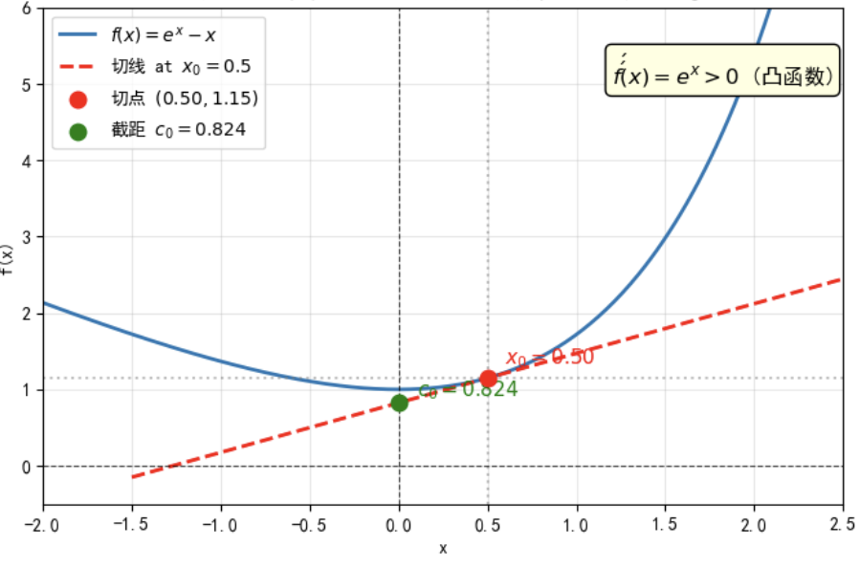
Legendre transformation is a mathematical technique used to transform the independent variable of a function while retaining all the information of the function
For a curve, the Legendre transformation redescribes the curve using its tangents at various points. The original curve is composed of points (x, y), while the new description is composed of the slope and intercept of the tangent (u, c), which are equivalent.
二阶导大于0的凸函数

Slide 4
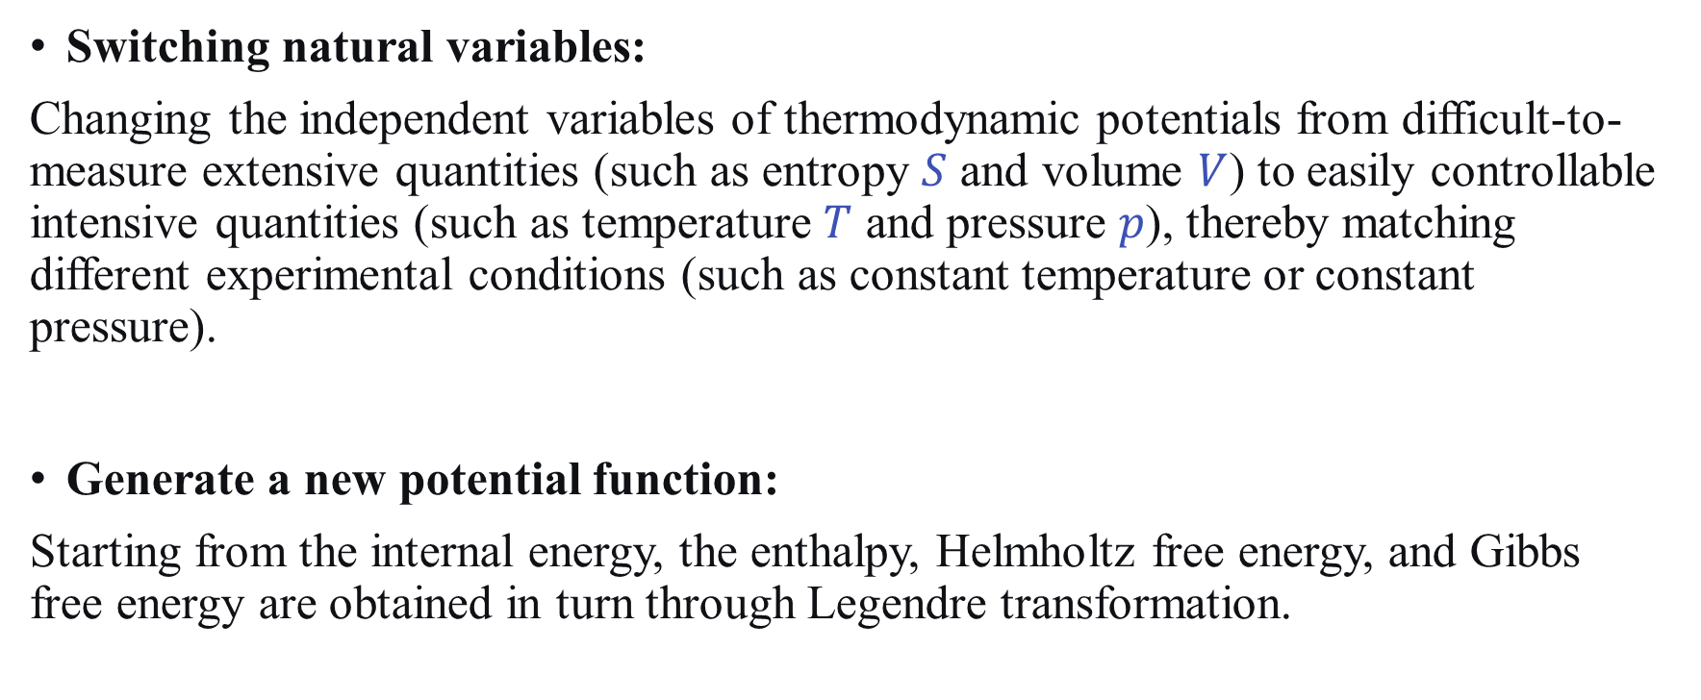
The role of Legendre transformation in thermodynamics
Switching natural variables:
Changing the independent variables of thermodynamic potentials from difficult-to-measure extensive quantities (such as entropy $S$ and volume $V$) to easily controllable intensive quantities (such as temperature $T$ and pressure $p$), thereby matching different experimental conditions (such as constant temperature or constant pressure).
Generate a new potential function:
Starting from the internal energy, the enthalpy, Helmholtz free energy, and Gibbs free energy are obtained in turn through Legendre transformation.

Slide 5
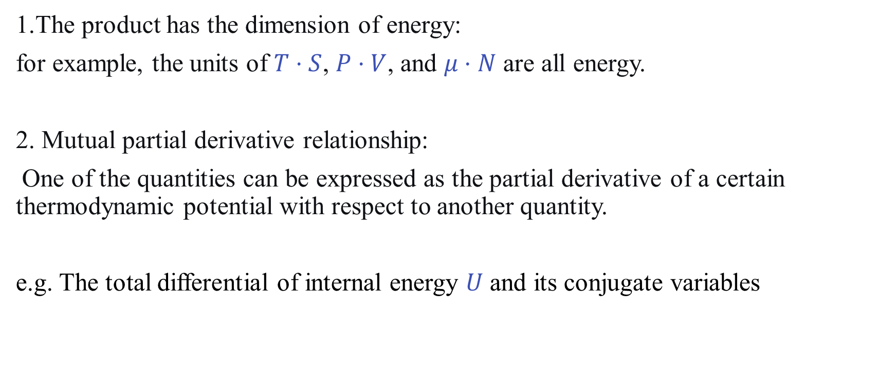
conjugate variables
The product has the dimension of energy:
for example, the units of $T⋅S$, $P⋅V$, and $μ⋅N$ are all energy.
2. Mutual partial derivative relationship:
One of the quantities can be expressed as the partial derivative of a certain thermodynamic potential with respect to another quantity.
e.g. The total differential of internal energy $U$ and its conjugate variables

Slide 6
Why is it called conjugate
The frame on the backs of two oxen is called a yoke(轭), which enables the two oxen to walk synchronously. Conjugation refers to a pair that matches according to a certain pattern
Appear in pairs, mutually defining each other

Slide 7
Legendre Transform
Part 2

Slide 8
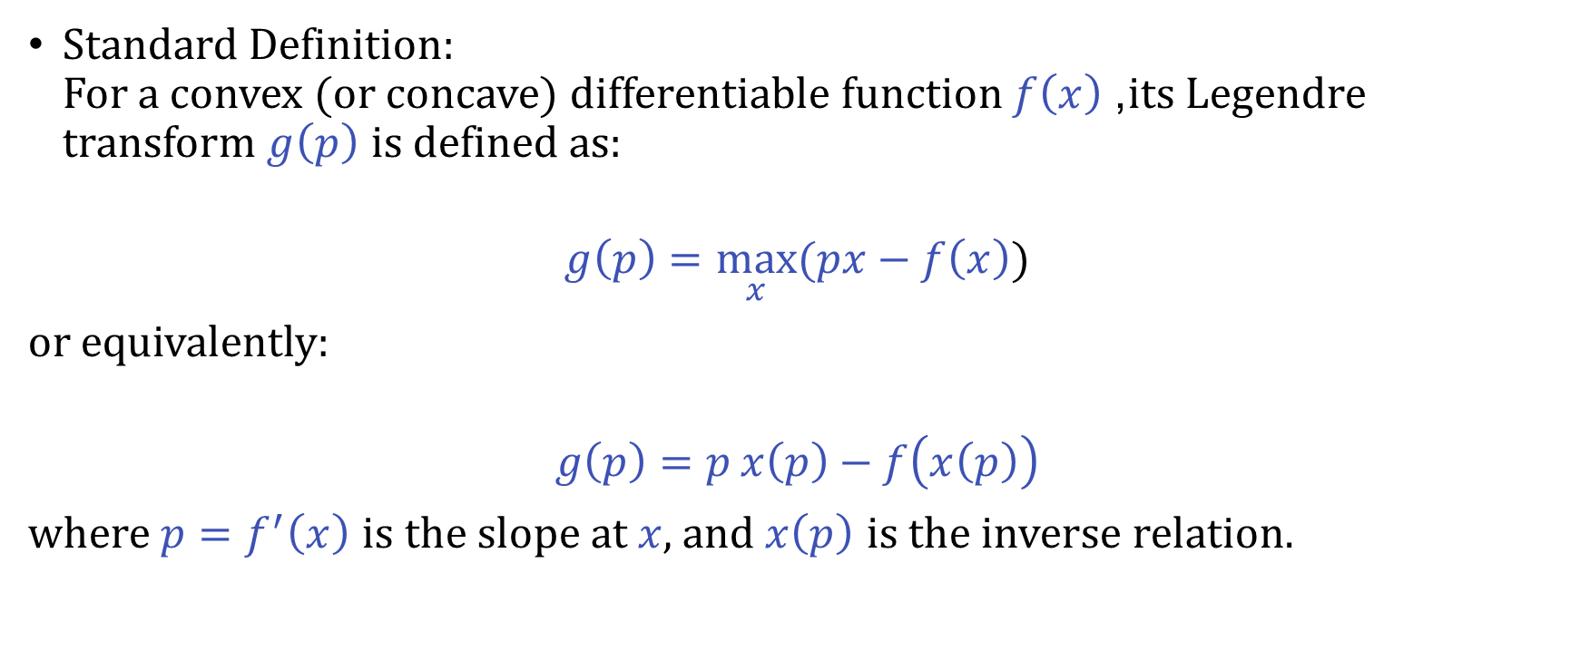
Mathematical Definition
Standard Definition: For a convex (or concave) differentiable function $f\left(x\right)$, its Legendre transform $g\left(p\right)$ is defined as:
$$g\left(p\right)=\max_{x}(px−f\left(x\right))$$
or equivalently:
$$g\left(p\right)=p x\left(p\right)−f\left(x\left(p\right)\right)$$
where $p=f^{′}\left(x\right)$ is the slope at $x$, and $x\left(p\right)$ is the inverse relation.

Slide 9
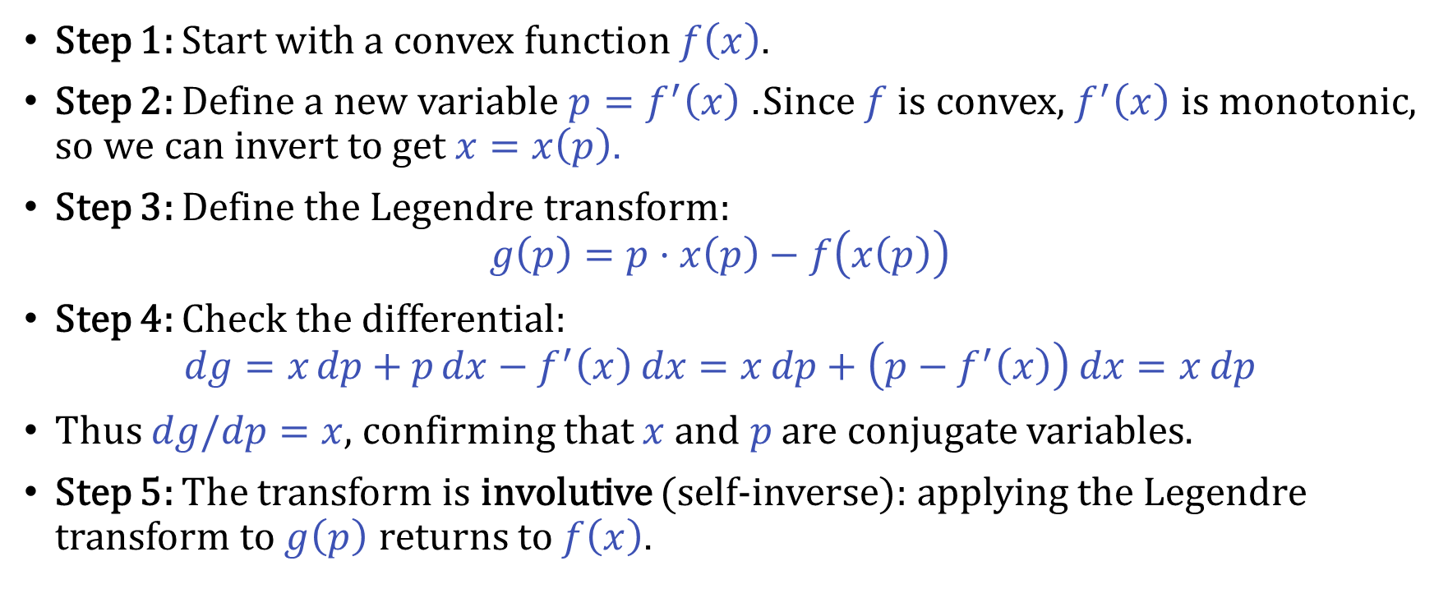
Mathematical Derivation
Step 1: Start with a convex function $f\left(x\right)$.
Step 2: Define a new variable $p=f^{′}\left(x\right)$. Since $f$ is convex, $f^{′}\left(x\right)$ is monotonic, so we can invert to get $x=x\left(p\right)$.
Step 3: Define the Legendre transform:
$$g\left(p\right)=p⋅x\left(p\right)−f\left(x\left(p\right)\right)$$
Step 4: Check the differential:
$$dg=x dp+p dx−f^{′}\left(x\right) dx=x dp+\left(p−f^{′}\left(x\right)\right) dx=x dp$$
Thus $dg/dp=x$, confirming that $x$ and $p$ are conjugate variables.
Step 5: The transform is involutive (self-inverse): applying the Legendre transform to $g\left(p\right)$ returns to $f\left(x\right)$.

Slide 10
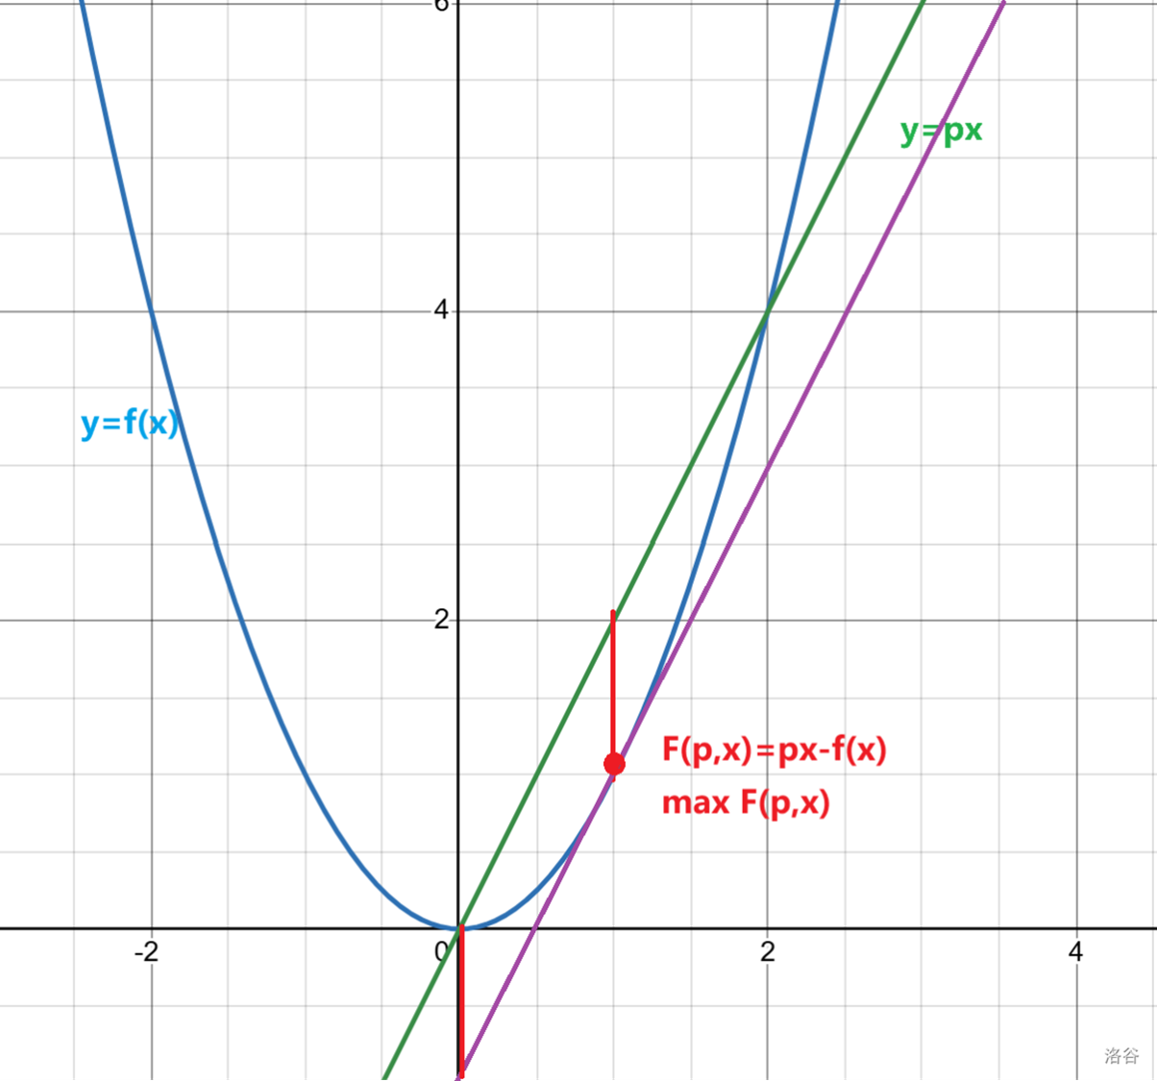
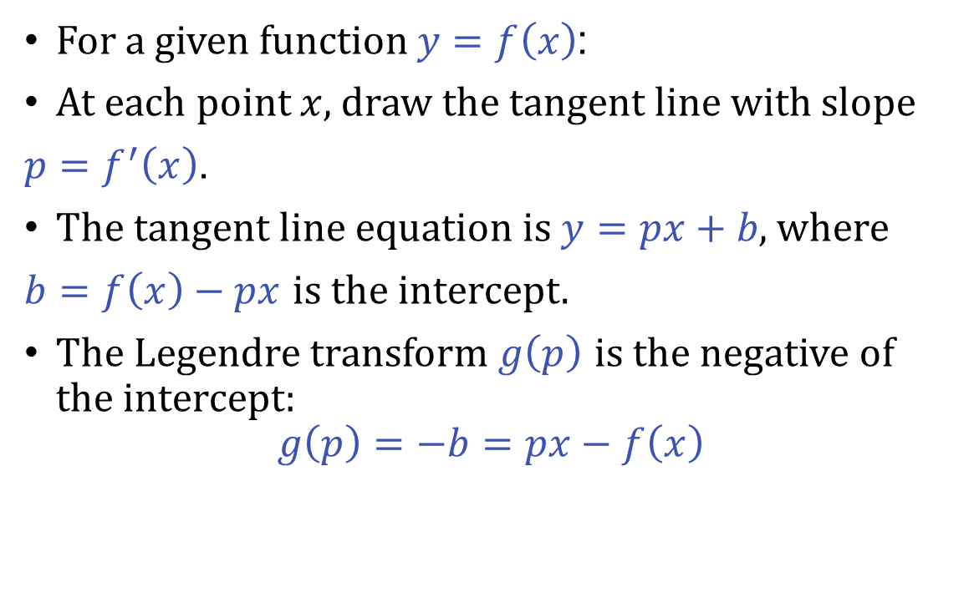
Geometric Interpretation
For a given function $y=f\left(x\right)$:
At each point $x$, draw the tangent line with slope
$p=f^{′}\left(x\right)$.
The tangent line equation is $y=px+b$, where
$b=f\left(x\right)−px$ is the intercept.
The Legendre transform $g\left(p\right)$ is the negative of the intercept:
$$g\left(p\right)=−b=px−f\left(x\right)$$

Slide 11
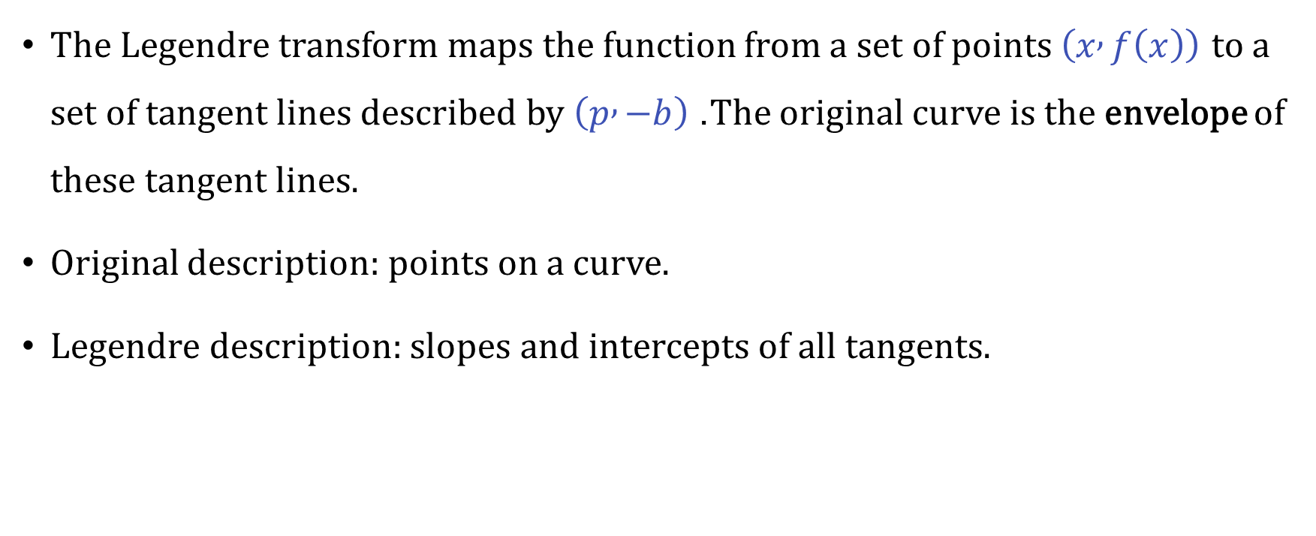
Geometric Meaning
The Legendre transform maps the function from a set of points $\left(x , f\left(x\right)\right)$ to a set of tangent lines described by $\left(p , −b\right)$. The original curve is the envelope of these tangent lines.
Original description: points on a curve.
Legendre description: slopes and intercepts of all tangents.

Slide 12
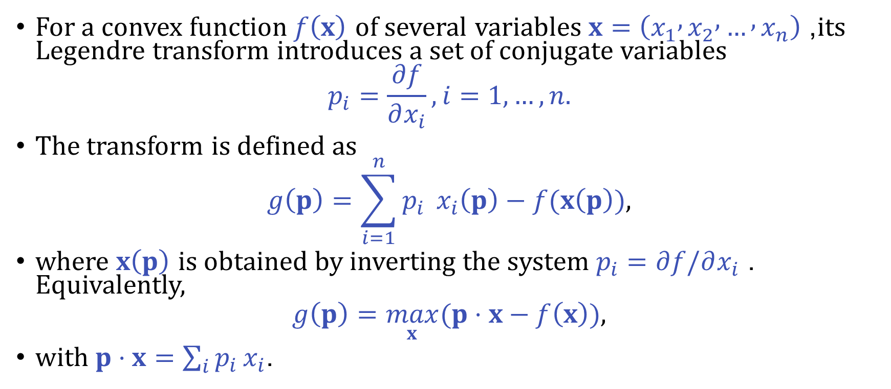
Extension to Multiple Variables
For a convex function $f\left(x\right)$ of several variables $x=\left(x_{1} , x_{2} , … , x_{n}\right)$, its Legendre transform introduces a set of conjugate variables
$$p_{i}=\frac{∂f}{∂x_{i}}, i=1,…,n.$$
The transform is defined as
$$g\left(p\right)=\sum_{i=1}^{n}{p_{i}} x_{i}\left(p\right)−f(x\left(p\right)),$$
where $x\left(p\right)$ is obtained by inverting the system $p_{i}=∂f/∂x_{i}$. Equivalently,
$$g\left(p\right)=\max_{x}(p⋅x−f\left(x\right)),$$
with $p⋅x=\sum_{i}{p_{i}}x_{i}$.

Slide 13

Conjugate Variables and Differentials
Taking the differential of $g$:
$$dg=\sum_{i}{x_{i}} dp_{i}+\sum_{i}{p_{i}} dx_{i}−\sum_{i}{\frac{∂f}{∂x_{i}}}dx_{i}=\sum_{i}{x_{i}} dp_{i},$$
so that
$$\frac{∂g}{∂p_{i}}=x_{i}.$$
Thus each pair $\left(x_{i} , p_{i}\right)$ forms a conjugate pair.

Slide 14
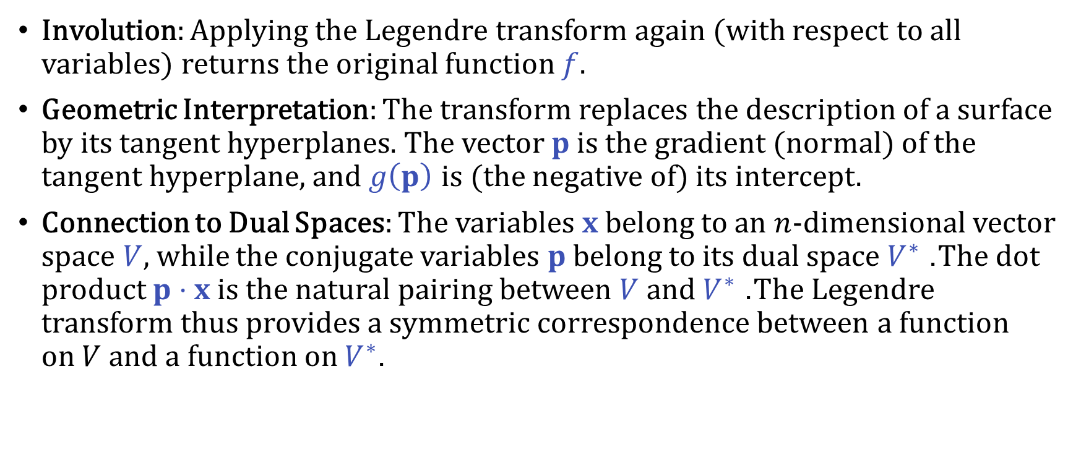
Properties in the Multivariate Setting
Involution: Applying the Legendre transform again (with respect to all variables) returns the original function $f$.
Geometric Interpretation: The transform replaces the description of a surface by its tangent hyperplanes. The vector $p$ is the gradient (normal) of the tangent hyperplane, and $g\left(p\right)$ is (the negative of) its intercept.
Connection to Dual Spaces: The variables $x$ belong to an $n$-dimensional vector space $V$, while the conjugate variables $p$ belong to its dual space $V^{∗}$. The dot product $p⋅x$ is the natural pairing between $V$ and $V^{∗}$. The Legendre transform thus provides a symmetric correspondence between a function on $V$ and a function on $V^{∗}$.

Slide 15
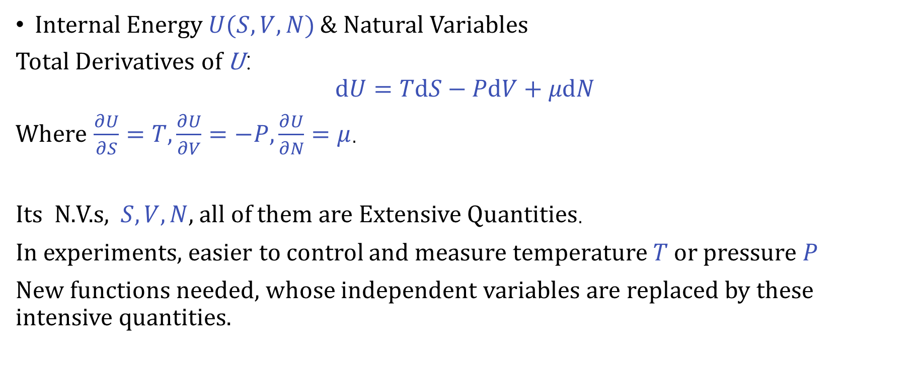
Legendre Transform in Thermodynamics
Internal Energy $U(S,V,N)$ & Natural Variables
Total Derivatives of U：
$$dU=TdS−PdV+μdN$$
Where $\frac{∂U}{∂S}=T,\frac{∂U}{∂V}=−P,\frac{∂U}{∂N}=μ$.
Its N.V.s, $S,V,N$, all of them are Extensive Quantities.
In experiments, easier to control and measure temperature 𝑇 or pressure 𝑃
New functions needed, whose independent variables are replaced by these intensive quantities.
Notes:
Let's start with the most fundamental potential: Internal Energy, denoted by U. Its natural variables are entropy S, volume V, and particle number N. The total differential of U is given by:
'dee U equals T dee S minus P dee V plus mu dee N'.
In this equation, T is the temperature, P the pressure, and μ the chemical potential. They are the partial derivatives of U:
'partial derivative of U with respect to S equals T', 'partial derivative of U with respect to V equals minus P', and 'partial derivative of U with respect to N equals mu'.
Notice that the natural variables S,V,N are all extensive quantities – they depend on the size of the system. However, in a laboratory, it is usually much easier to control intensive quantities like temperature T (by using a heat bath) or pressure P (by working in an open container). So we face a mismatch: our fundamental energy function U(S,V,N) uses variables that are not the ones we naturally control. We need new functions whose independent variables are these intensive quantities. This is exactly where the Legendre transform comes to the rescue."

Slide 16
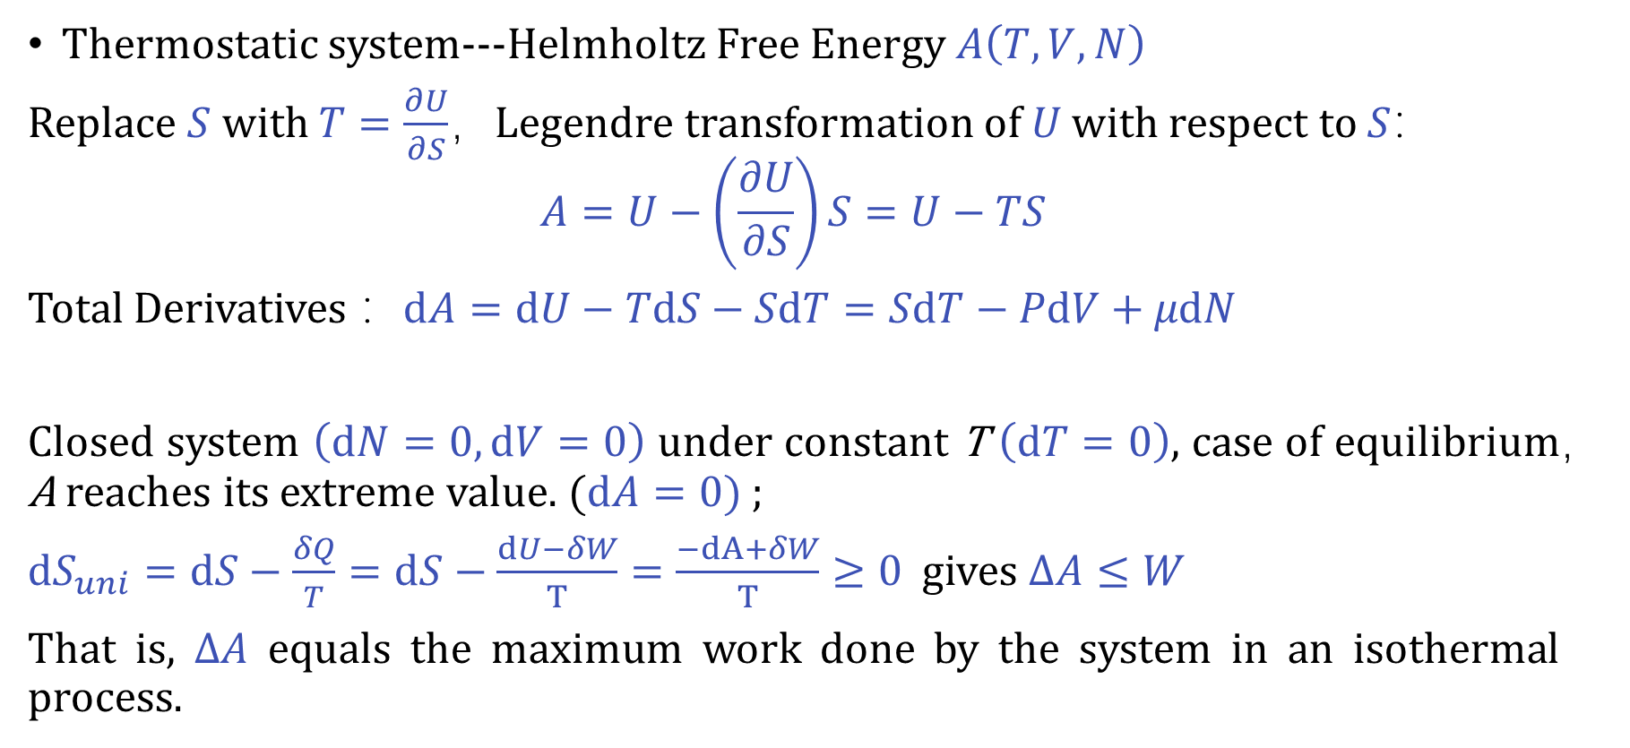
Legendre Transform in Thermodynamics
Thermostatic system---Helmholtz Free Energy $A\left(T,V,N\right)$
Replace $S$ with $T=\frac{∂U}{∂S}$，Legendre transformation of 𝑈 with respect to 𝑆：
$$A=U−\left(\frac{∂U}{∂S}\right)S=U−TS$$
Total Derivatives ：$dA=dU−TdS−SdT=SdT−PdV+μdN$
Closed system $\left(dN=0, dV=0\right)$ under constant T $\left(dT=0\right)$, case of equilibrium，A reaches its extreme value. $(dA=0)$ ;
$dS_{uni}=dS−\frac{δQ}{T}=dS−\frac{dU−δW}{T}=\frac{−dA+δW}{T}≥0$ gives $ΔA≤W$
That is, Δ𝐴 equals the maximum work done by the system in an isothermal process.
Notes:
"Let's begin with the case of a system kept at constant temperature – a thermostatic system. Here we want to replace the entropy S with its conjugate intensive variable, temperature T,
The Legendre transform of U with respect to S is defined as:
'A equals U minus T S'. This new function is called the Helmholtz free energy, and its natural variables become T,V,N.
For a closed system (dN=0) at constant temperature (dT=0), this simplifies to dA=−P dV. At equilibrium with fixed volume (dV=0), we have dA=0, meaning A reaches an extreme value – a minimum, as we know from the second law.
In fact, from the second law we can derive the inequality:
'Delta A is less than or equal to W', where W is the work done by the system. In an isothermal process, the change in Helmholtz free energy is exactly equal to the maximum work the system can perform. This is a key physical interpretation of A."

Slide 17
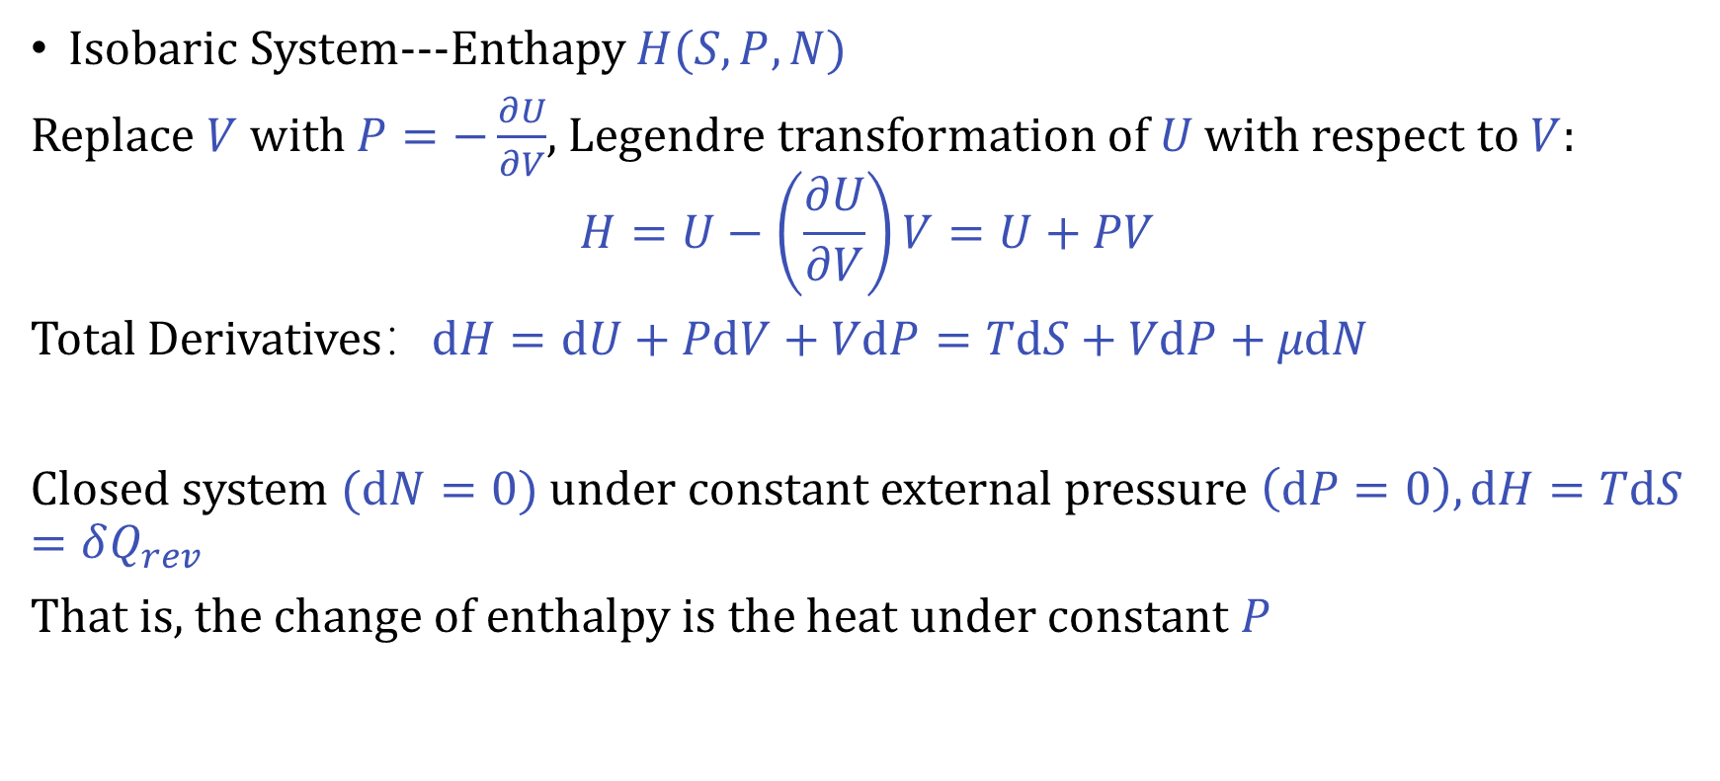
Legendre Transform in Thermodynamics
Isobaric System---Enthapy $H(S,P,N)$
Replace $V$ with $P=−\frac{∂U}{∂V}$, Legendre transformation of 𝑈 with respect to $V$:
$$H=U−\left(\frac{∂U}{∂V}\right)V=U+PV$$
Total Derivatives：$dH=dU+PdV+VdP=TdS+VdP+μdN$
Closed system $(dN=0)$ under constant external pressure $\left(dP=0\right), dH=TdS=δQ_{rev}$
That is, the change of enthalpy is the heat under constant $P$
Notes:
"Next, consider a system under constant external pressure – an isobaric system. This is common when a reaction is open to the atmosphere.
Here we want to replace the volume V with its conjugate variable, pressure P
'H equals U plus P V'. This new function is the enthalpy, with natural variables S,P,N.
Its total differential is:
'dee H equals T dee S plus V dee P plus mu dee N'.
For a closed system (dN=0) at constant pressure (dP=0), we get dH =TdS. In a reversible process, TdS is the heat exchanged. Therefore, the change in enthalpy equals the heat absorbed or released at constant pressure. This is why enthalpy is so useful in chemistry – most reactions are run under constant atmospheric pressure."

Slide 18
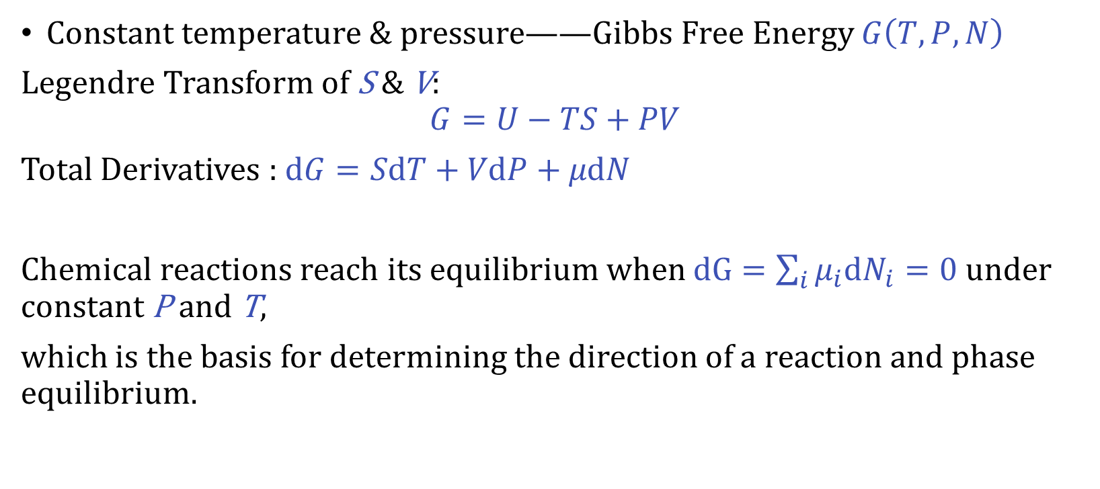
Legendre Transform in Thermodynamics
Constant temperature & pressure——Gibbs Free Energy $G\left(T,P,N\right)$
Legendre Transform of S & V:
$$G=U−TS+PV$$
Total Derivatives : $dG=SdT+VdP+μdN$
Chemical reactions reach its equilibrium when $dG=\sum_{i}{μ_{i}dN_{i}}=0$ under constant P and T,
which is the basis for determining the direction of a reaction and phase equilibrium.
Notes:
"Now we combine both conditions: constant temperature and constant pressure – the most common situation for chemical reactions.
We perform a Legendre transform with respect to both S and V:
'G equals U minus T S plus P V'. This is the Gibbs free energy, and its natural variables are T,P,N.
Its differential is: 'dee G equals minus S dee T plus V dee P plus mu dee N'.
At constant T and P, dG =μdN, and for a system with multiple components, dG=∑iμidNidG=∑i​μi​dNi​. At equilibrium, dG=0. This gives us the fundamental condition for chemical equilibrium and phase equilibria. Moreover, in spontaneous processes at constant T and P, G always decreases, reaching a minimum at equilibrium. This makes G the key potential for predicting reaction spontaneity."

Slide 19
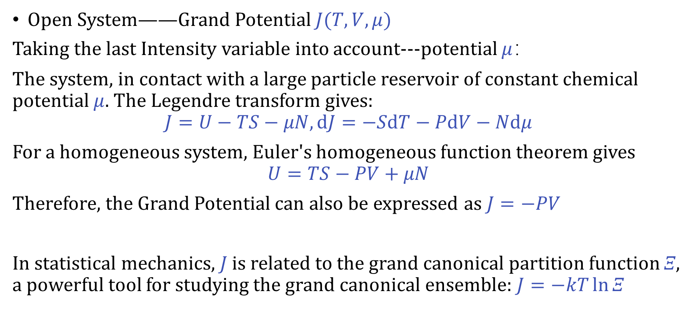
Legendre Transform in Thermodynamics
Open System——Grand Potential $J(T,V,μ)$
Taking the last Intensity variable into account---potential $μ$：
The system, in contact with a large particle reservoir of constant chemical potential $μ$. The Legendre transform gives:
$$J=U−TS−μN,dJ=−SdT−PdV−Ndμ$$
For a homogeneous system, Euler's homogeneous function theorem gives
$$U=TS−PV+μN$$
Therefore, the Grand Potential can also be expressed as $J=−PV$
In statistical mechanics, 𝐽 is related to the grand canonical partition function 𝛯, a powerful tool for studying the grand canonical ensemble: $J=−kT\ln{Ξ}$
Notes:
"Finally, we consider an open system that can exchange particles with a reservoir. Here the chemical potential μ is held constant, just as temperature was held constant by a heat bath.
We now perform a Legendre transform that replaces both S and N with their conjugates T and μ:
'J equals U minus T S minus mu N'. This is the grand potential. Its natural variables are T,V,μ.
If we take the total differential and substitute dU, we find:
'dee J equals minus S dee T minus P dee V minus N dee mu'.
Now, there is an important simplification for a homogeneous system. Because U is a homogeneous function of first order in its extensive variables, Euler's theorem gives:
'U equals T S minus P V plus mu N'.
Substituting this into the definition of J, we obtain:
J=−PV. So for a uniform system, the grand potential is simply J=−PV. This is a very neat result.
Moreover, in statistical mechanics, the grand potential is directly linked to the grand canonical partition function E:
'J equals minus k T ln Xi'. This connection makes the grand potential an indispensable tool for studying systems in contact with a particle reservoir."

Slide 20
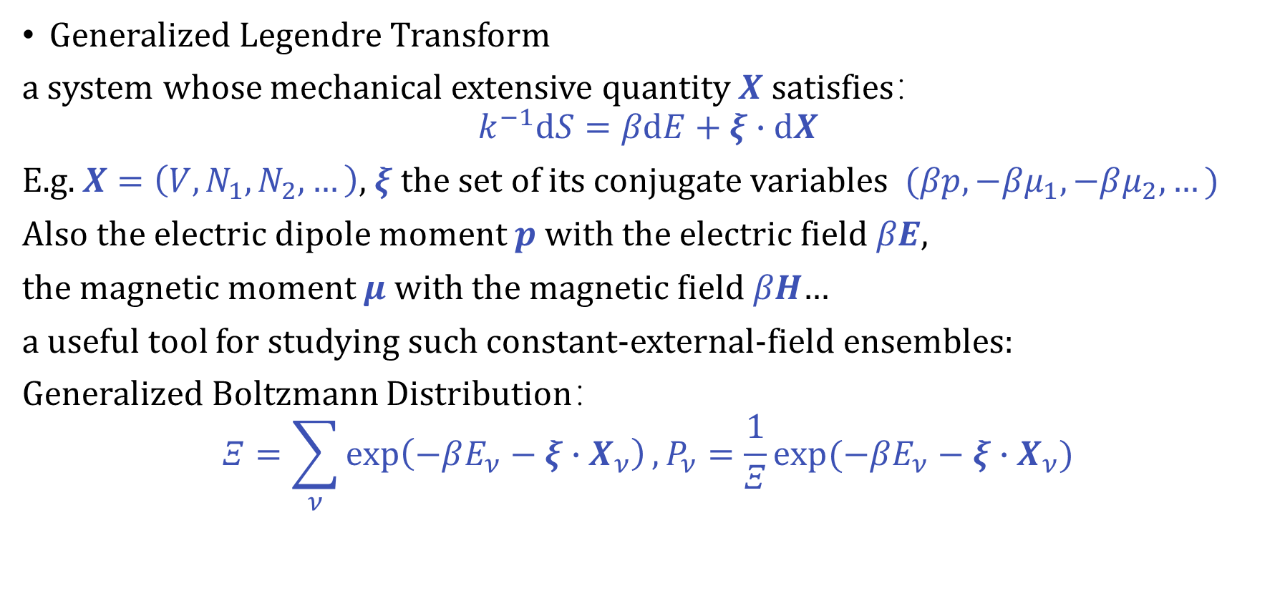
Legendre Transform in Thermodynamics
Generalized Legendre Transform
a system whose mechanical extensive quantity 𝑿 satisfies：
$$k^{−1}dS=βdE+ξ∙dX$$
E.g. $X=\left(V,N_{1},N_{2},…\right)$, $ξ$ the set of its conjugate variables $(βp,−βμ_{1},−βμ_{2},…)$
Also the electric dipole moment 𝒑 with the electric field 𝛽𝑬,
the magnetic moment 𝝁 with the magnetic field 𝛽𝑯…
a useful tool for studying such constant-external-field ensembles:
Generalized Boltzmann Distribution：
$$Ξ=\sum_{ν}{\exp\left(−βE_{ν}−ξ∙X_{ν}\right)},P_{ν}=\frac{1}{Ξ}\exp{(−βE_{ν}−ξ∙X_{ν})}$$
Notes:
"The idea of the Legendre transform extends far beyond the standard thermodynamic potentials. We can apply it to any system where an extensive quantity X has a conjugate intensive variable ξ.
In a generalized formulation, we often write:
'k inverse dee S equals beta dee E plus xi dot dee X'.
Here X could be volume, particle numbers, or even electric dipole moment p with its conjugate βE, or magnetic moment μ with conjugate βH. The symbol β is 1/(kB​T).
The Legendre transform of the thermodynamic energy with respect to these quantities gives us new potentials suitable for studying ensembles under constant external fields. The resulting generalized Boltzmann distribution takes the form:
'Xi equals sum over nu of exp of minus beta E nu minus xi dot X nu’.
And the second: 'P nu equals one over Xi times exp of minus beta E nu minus xi dot X nu'.
This powerful formulation shows that the Legendre transform is a universal tool for switching between different ensembles, always adapting the energy function to the constraints we wish to impose.
To summarize, the Legendre transform allows us to move seamlessly between the internal energy, enthalpy, Helmholtz free energy, Gibbs free energy, grand potential, and many other potentials – each perfectly suited for a particular experimental condition, yet all containing exactly the same thermodynamic information.
Thank you."

Slide 21
Supplementary Information

Slide 22
Properties of the Legendre Transform
1. Involution (Self-inverse)
Applying the Legendre transform twice returns the original function (for convex functions):
$$f\left(x\right)=\max_{p}(xp−g\left(p\right))$$
This means no information is lost – it's just a different representation.
2. Conjugate Variables
If $p=f^{′}\left(x\right)$, then $x=g^{′}\left(p\right)$. The pair $\left(x , p\right)$ are conjugate variables.

Slide 23
Properties of the Legendre Transform
3. Inequality (Young's Inequality)
For any $x$ and $p$:
$$px≤f\left(x\right)+g\left(p\right)$$
Equality holds when $p=f^{′}\left(x\right)$ or $x=g^{′}\left(p\right)$
4. Convexity Preserved
If $f$ is convex, then $g$ is also convex.
5. Duality
The Legendre transform establishes a duality between a vector space and its dual space:
$x$ belongs to the original space $V$
$p$ belongs to the dual space $V^{∗}$
The pairing $\left\langle p , x\right\rangle =px$ connects them.

Slide 24
Proof for Properties
1. Involution (Self-inverse)
Property: Applying the Legendre transform twice returns the original function (for convex functions).
$$f\left(x\right)=\max_{p}(xp−g\left(p\right))$$
Proof sketch:
Start with $g\left(p\right)=\max_{x}\left\{px−f\left(x\right)\right\}$, and let $x\left(p\right)$ be the maximizer, so $g\left(p\right)=px\left(p\right)−f\left(x\left(p\right)\right)$.
By definition, $p=f^{′}\left(x\left(p\right)\right)$ and $x\left(p\right)=g^{′}\left(p\right)$.
Now consider the Legendre transform of $g$: $h\left(x\right)=\max_{p}\left\{xp−g\left(p\right)\right\}$.
The maximizer $p\left(x\right)$ satisfies $x=g^{′}\left(p\left(x\right)\right)$, which implies $p\left(x\right)=f^{′}\left(x\right)$.
Substituting: $h\left(x\right)=xp\left(x\right)−g\left(p\left(x\right)\right)=xf^{′}\left(x\right)−\left[f^{′}\left(x\right)x−f\left(x\right)\right]=f\left(x\right)$.
Hence $h=f$. (Requires convexity to ensure uniqueness and differentiability.)

Slide 25
Proof for Properties
2. Conjugate Variables
Property: If $p=f^{′}\left(x\right)$, then $x=g^{′}\left(p\right)$.
Proof sketch:
From the definition, $g\left(p\right)=px\left(p\right)−f\left(x\left(p\right)\right)$, where $x\left(p\right)$ satisfies $p=f^{′}\left(x\left(p\right)\right)$.
Differentiate $g$ with respect to $p$:
$g^{′}\left(p\right)=x\left(p\right)+px^{′}\left(p\right)−f^{′}\left(x\left(p\right)\right)x^{′}\left(p\right)=x\left(p\right)+\left[p−f^{′}\left(x\left(p\right)\right)\right]x^{′}\left(p\right).$
Since $p=f^{′}\left(x\left(p\right)\right)$, the bracket vanishes, leaving $g^{′}\left(p\right)=x\left(p\right)$.
Thus $x=g^{′}\left(p\right)$. The variables are conjugate.

Slide 26
Proof for Properties
3. Young's Inequality
Property: For any $x$ and $p$,
$$px≤f\left(x\right)+g\left(p\right),$$
with equality iff $p=f^{′}\left(x\right)$ or $x=g^{′}\left(p\right)$
Proof sketch:
By definition, $g\left(p\right)=\max_{x^{′}}\left\{px^{′}−f\left(x^{′}\right)\right\}≥px−f\left(x\right)$ for any $x$.
Rearranging gives $px≤f\left(x\right)+g\left(p\right)$.
Equality holds when $x$ is the maximizer, i.e., $p=f^{′}\left(x\right)$.

Slide 27
Proof for Properties
4. Convexity Preserved
Property: If $f$ is convex, then $g$ is also convex.
Proof sketch:
Use the definition $g\left(p\right)=\max_{x}\left\{px−f\left(x\right)\right\}$.
For fixed $x$, the function $p↦px−f\left(x\right)$ is linear in $p$ (hence convex).
The pointwise maximum of a family of convex (actually linear) functions is convex.
Therefore $g\left(p\right)$ is convex.

Slide 28
Proof for Properties
5. Duality (Vector Space Interpretation)
Property: The Legendre transform establishes a duality between a vector space $V$ and its dual space $V^{∗}$: $x∈V$, $p∈V^{∗}$, with pairing $\left\langle p , x\right\rangle =px$.
Proof sketch:
In finite dimensions, choose a basis. Then $f$ is a function on coordinates $x^{i}$.
Its gradient $∂f/∂x^{i}$ lives in the dual space.
The Legendre transform $g\left(p\right)$ is a function on the dual coordinates $p_{i}$.
The involution property shows the symmetry: the double transform returns to the original space.

