Slide 1
The construction of Hamiltonian
Hermiticity and orthogonality of operator
Commutation and eigenfunctions

Slide 2
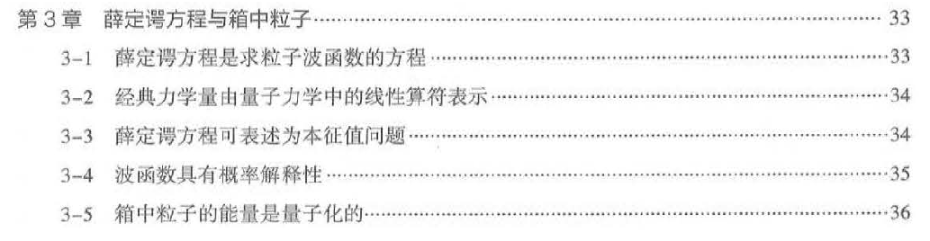

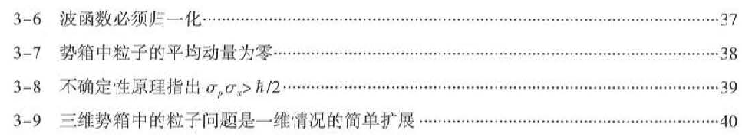
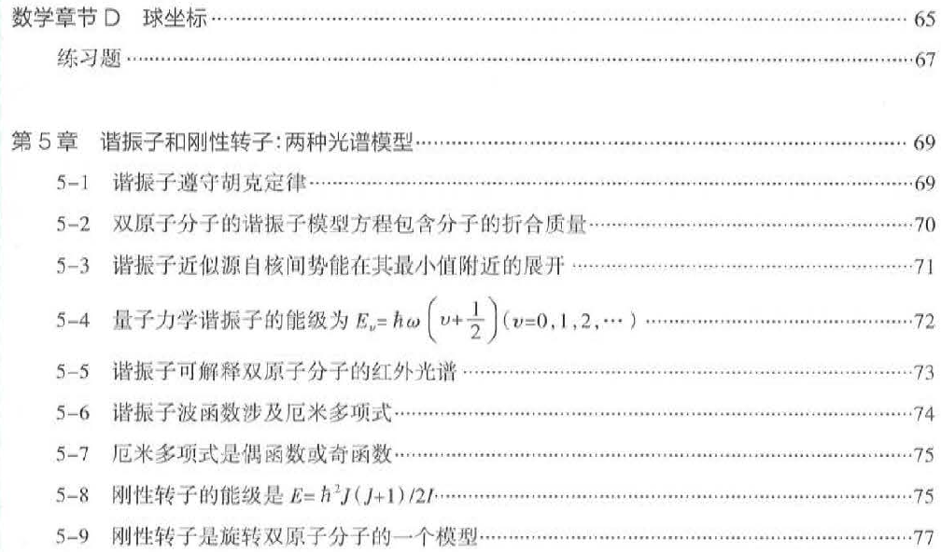

Slide 3
Chapter 3. Quantizations of translation, vibration and rotation
量子力学中的微观粒子：电子、原子核、原子、分子
3.1 Quantization of translation: particle in a box
3.2 Quantization of vibration: harmonic oscillator
3.3 Quantization of rotation: angular momentum

Slide 4
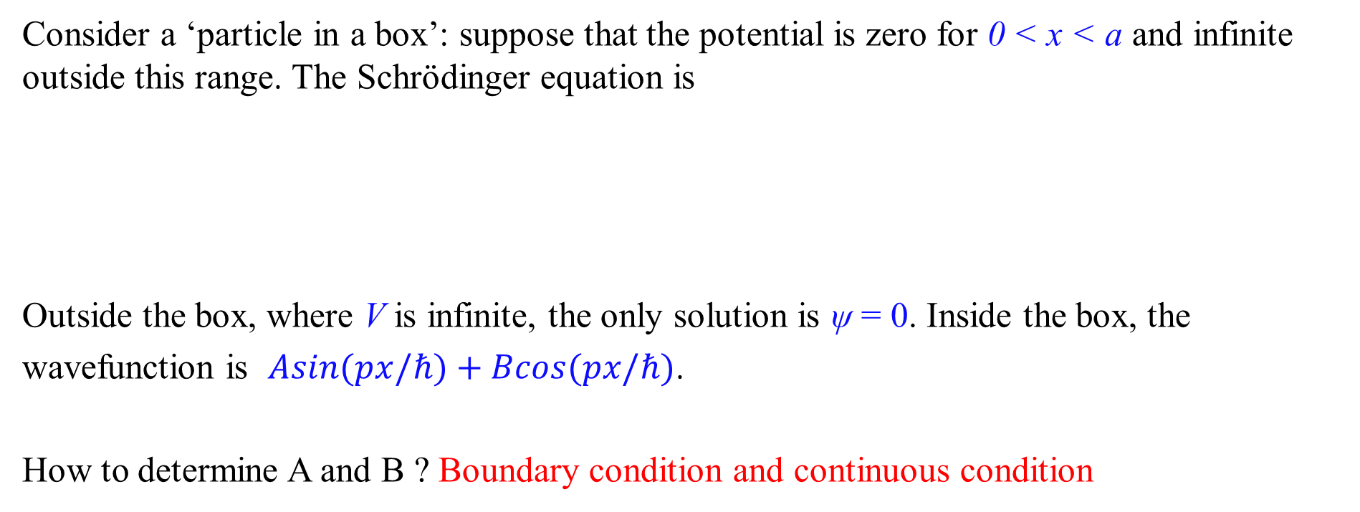
3.1.1 Quantization of translation: Particle in a box
Consider a ‘particle in a box’: suppose that the potential is zero for 0 < x < a and infinite outside this range. The Schrödinger equation is
Outside the box, where V is infinite, the only solution is ψ = 0. Inside the box, the wavefunction is $Asin(px/ℏ)+Bcos(px/ℏ)$.
How to determine A and B ? Boundary condition and continuous condition
Ĥψ

Slide 5
I, III:

Slide 6
II: V=0

Slide 7
Boundary condition and continuous condition: ψ(0)=0, ψ(a)=0
ψ(0) =Acos0 + Bsin0
ψ (a) =Bsin βa, x =Bsin βa=0; βa=nπ, β = nπ/a
A=0, B≠0; ψ=Bsinβx
Normalization

Slide 8
2. The properties of the solutions
n=1
n=2
n=3
The particle can exist in many states
Energy is quantized
The minimum energy (h²/8ma²)

Slide 9
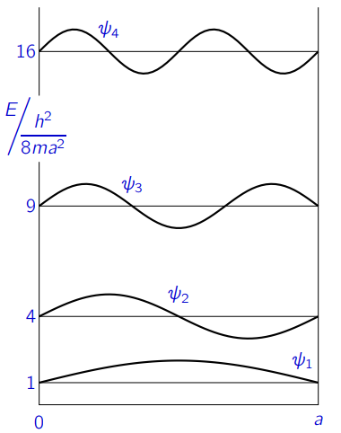
Boundary conditions and quantization
The allowed wavefunctions for the particle in a box are
for integer n > 0, and the corresponding energies are
We see that the imposition of boundary conditions leads to quantization: only certain values of the energy are possible.
Wavefunction for a particle in a box

Slide 10
Wavefunction for a particle in a box
1.波函数在一维势阱两端，根据边界条件有零点。除此之外：最低能量波函数没有节点；下一个波函数有一个节点，下一个有两个，依此类推。
2.偶函数（基态）奇函数（第一激发态），奇偶交替

Slide 11
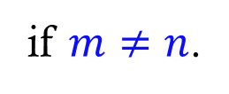
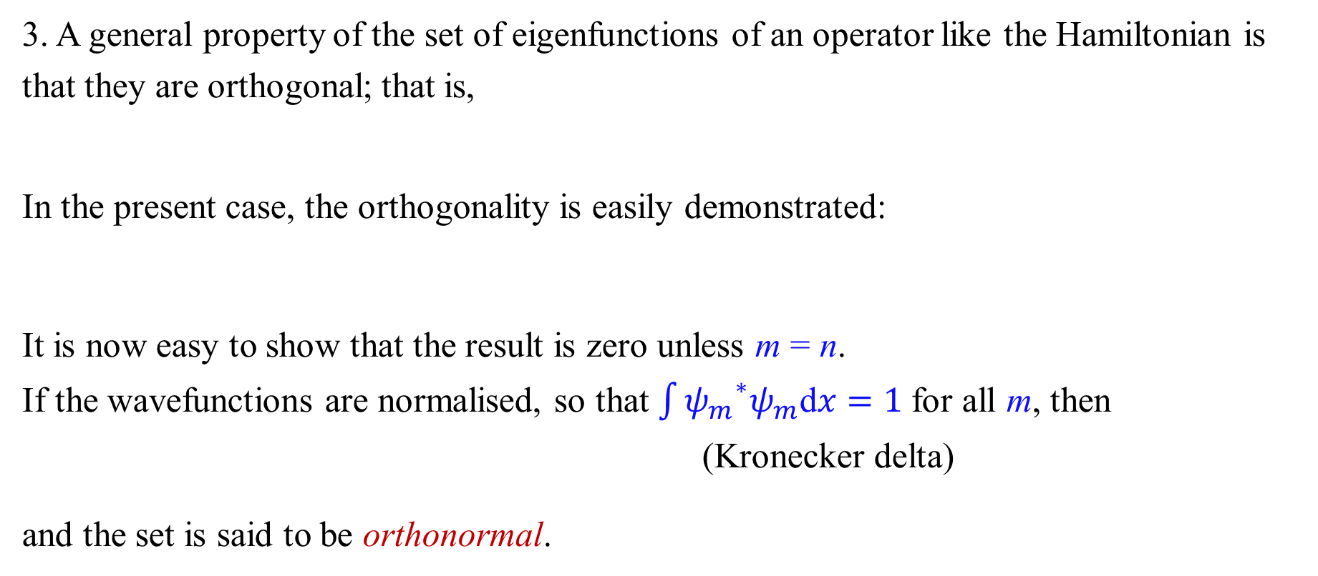
Sets of eigenfunctions
3. A general property of the set of eigenfunctions of an operator like the Hamiltonian is that they are orthogonal; that is,
In the present case, the orthogonality is easily demonstrated:
It is now easy to show that the result is zero unless m = n.
If the wavefunctions are normalised, so that $\int{{ψ_{m}}^{∗}ψ_{m}\text{d}x}=1$for all m, then
(Kronecker delta)
and the set is said to be orthonormal.
if $m≠n$.

Slide 12
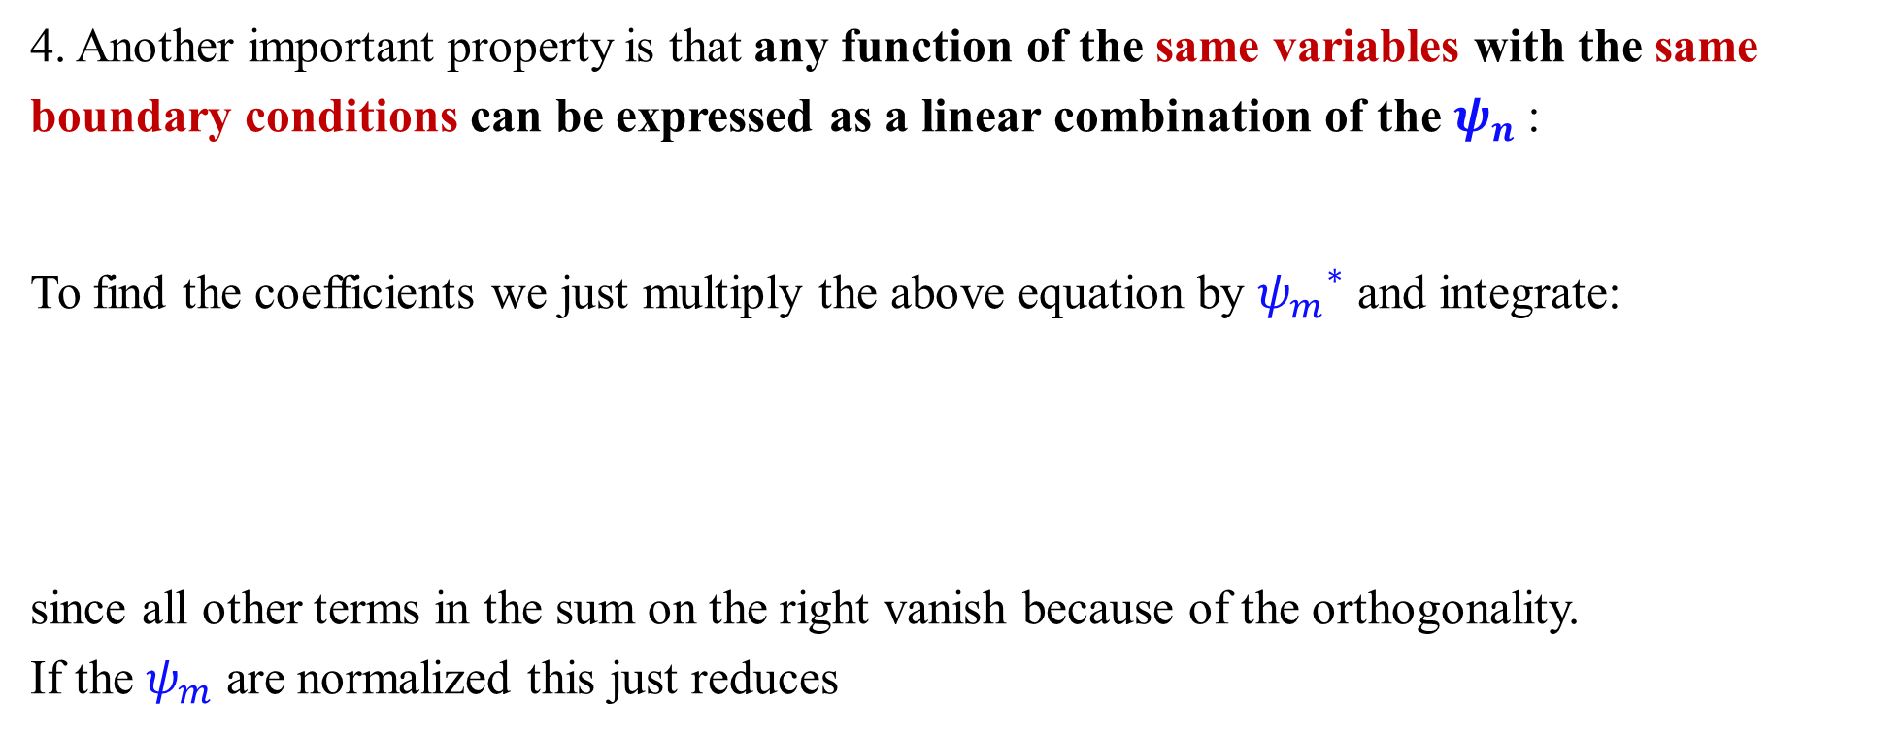
Expansion in eigenfunctions
4. Another important property is that any function of the same variables with the same boundary conditions can be expressed as a linear combination of the $ψ_{n}$:
To find the coefficients we just multiply the above equation by ${ψ_{m}}^{∗}$ and integrate:
since all other terms in the sum on the right vanish because of the orthogonality.
If the $ψ_{m}$ are normalized this just reduces

Slide 13
Quantum-classical correspondence principle
微观粒子体系能量依赖于某些量子数，当量子数足够高时，在从量子到经典力学的某个阶段，这两种描述必须融合。

Slide 14
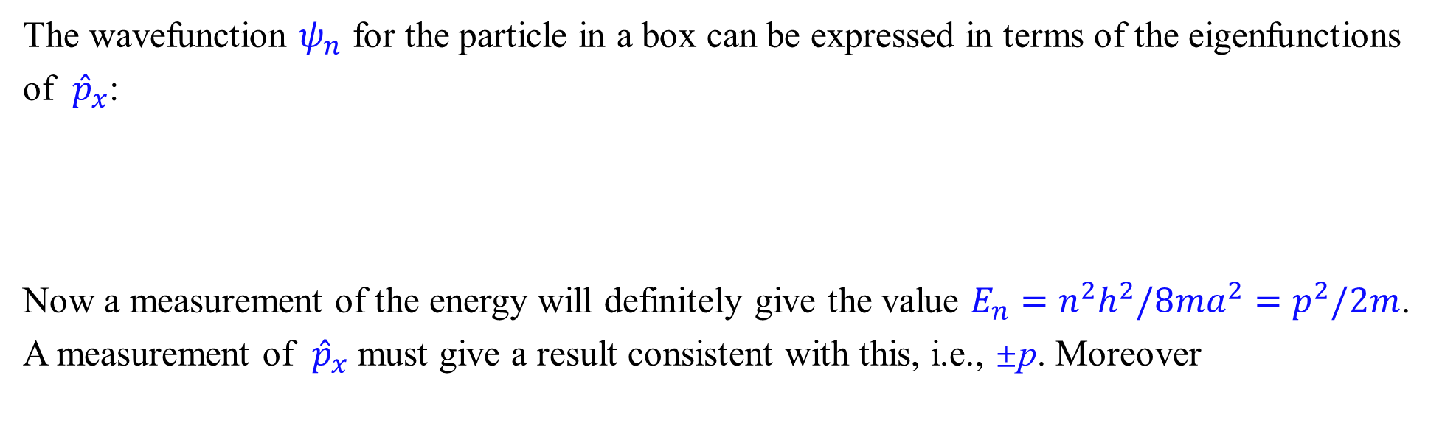
More on measurement
The wavefunction $ψ_{n}$ for the particle in a box can be expressed in terms of the eigenfunctions $\text{of}$ ${ \hat{p}}_{x}$:
Now a measurement of the energy will definitely give the value $E_{n}=n^{2}h^{2}/8ma^{2}=p^{2}/2m$. A measurement of ${ \hat{p}}_{x}$ must give a result consistent with this, i.e., ±p. Moreover
能量本征函数$ψ_{n}$是两个非简并动量波函数的线性组合，因此$ψ_{n}$不是动量算符的本征函数

Slide 15
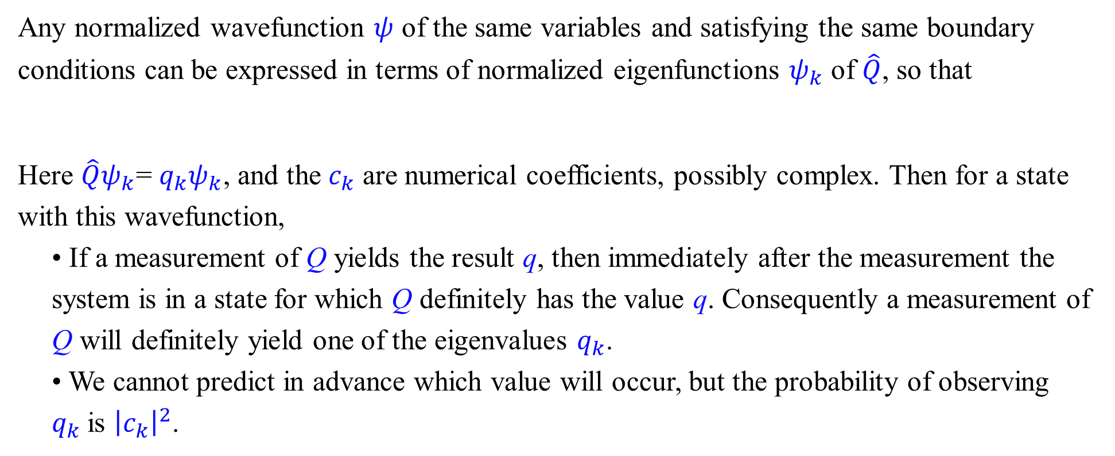
Prediction of measurements
Any normalized wavefunction $ψ$ of the same variables and satisfying the same boundary conditions can be expressed in terms of normalized eigenfunctions $ψ_{k}$ of $\hat{Q}$, so that
Here $\hat{Q}ψ_{k}$= $q_{k}ψ_{k}$, and the $c_{k}$ are numerical coefficients, possibly complex. Then for a state with this wavefunction,
• If a measurement of Q yields the result q, then immediately after the measurement the system is in a state for which Q definitely has the value q. Consequently a measurement of Q will definitely yield one of the eigenvalues $q_{k}$.
• We cannot predict in advance which value will occur, but the probability of observing $q_{k}$is ${\left|c_{k}\right|}^{2}$.

Slide 16
The general steps in the quantum mechanical treatment:
获得势能函数，然后推导哈密顿算符
解薛定谔方程 (ψ_{n} and E_{n})
推导出每个对应状态的各种物理量的数值，以及波函数ψ_{n}的特征.

Slide 17
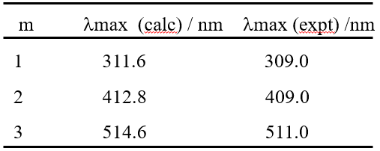
Example 1: The adsorption spectrum of cyanines
..
₊
The general formula of the cyanine dye:
R₂N-(CH=CH-)_{m}CH=NR₂
E
Total π electrons: 2m+4
In the ground state, these electrons occupy m+2 molecular orbitals
n=m+3
n=m+2
The adsorption spectrum correspond to excitation of electrons from the highest occupied (m+2) orbital to the lowest unoccupied (m+3) orbital.
n=2
n=1
Table 1. The absorption spectrum of the cyanine dye

Slide 18
Example 2: The delocalization effect of 1,3-butadiene
Four π electron form two π localized bonds
Four π electron form a π₄⁴ delocalized bonds
E=2×2 ×h²/8ml²=4E₁
＞
E=2×h²/8m(3l )² + 2×2² × h²/8m(3l )² =(10/9)E₁
E₁
E_{4/9}
E_{1/9}
l l l

Slide 19
3.1.2 Quantum leaks --- tunneling
Quantum tunneling is an effect where a particle can pass through a barrier it would not normally have the energy to overcome.
(0 ≤ x ≤ l)
V
I
II
III
The probability of penetration is given by
0
l
x
When E<V
该解描述了粒子能够穿透屏障的现象。这种微观粒子的穿透被称为隧穿效应或量子力学隧穿。对于电子、质子等低质量粒子而言，这一现象尤为重要。

Slide 20
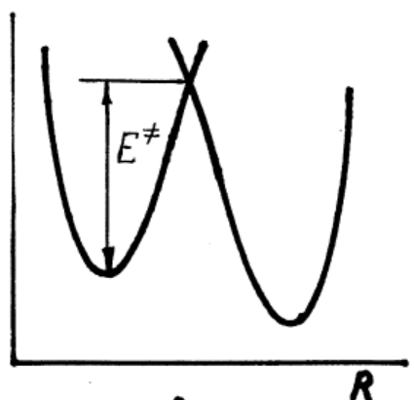
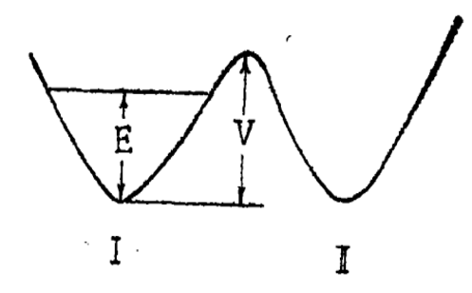
Tunneling in chemistry
Tunneling is used:
for the operation of many microelectronic devices (tunneling diodes, flash memory, …)
for advanced analytical techniques (scanning tunneling microscope, STM)
Responsible for radioactivity (e.g. alpha particles)
a double-well potential
proton transfer

Slide 21
3.1.3 Particle in a 3-D box of dimensions a, b, c
Out of the box, V(x, y, z) = ∞; In the box, V(x, y, z) =0
0 ≤ x ≤ a
0 ≤ y ≤ b
0 ≤ z ≤ c
Let ψ = ψ(x, y, z)= X(x)Y(y)Z(z) (separation of variables) Substituting into 3-D Schroedinger equation

Slide 22
E=E_{x}+E_{y}+E_{z}
Let E_{z} = E – (E_{x}+E_{y})

Slide 23
Multiply degenerate energy level when the box is cubic (a = b = c)
The ground state: n_{x}=n_{y}=n_{z}=1
The first excited state: n_{i}=n_{j}=1, n_{k}=2
The wave-functions are called degenerate (triply degenerate)

Slide 24
3.2 The Harmonic Oscillator
For nuclear motion in diatomic molecules
The accurate solution of the nuclear Schrödinger equation is hard.
expand U(R) in a Taylor series about R_{e}
The second term is zero and the fourth term can be neglected. (Why?)
Defining the equilibrium force constant:

Slide 25
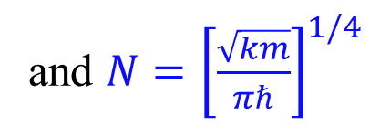
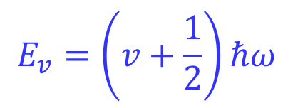
Wavefunction and Hamiltonian for Harmonic Oscillator
The Hamiltonian is
The ground state wavefunction
• should have no nodes, and
• should go to zero as x → ±∞.
The wavefunction in ground state is
and $N={\left[\frac{\sqrt{km}}{πℏ}\right]}^{1/4}$
$$E_{v}=\left(v+\frac{1}{2}\right)ℏω$$
Harmonic oscillator can model many different systems around their equilibrium point

Slide 26
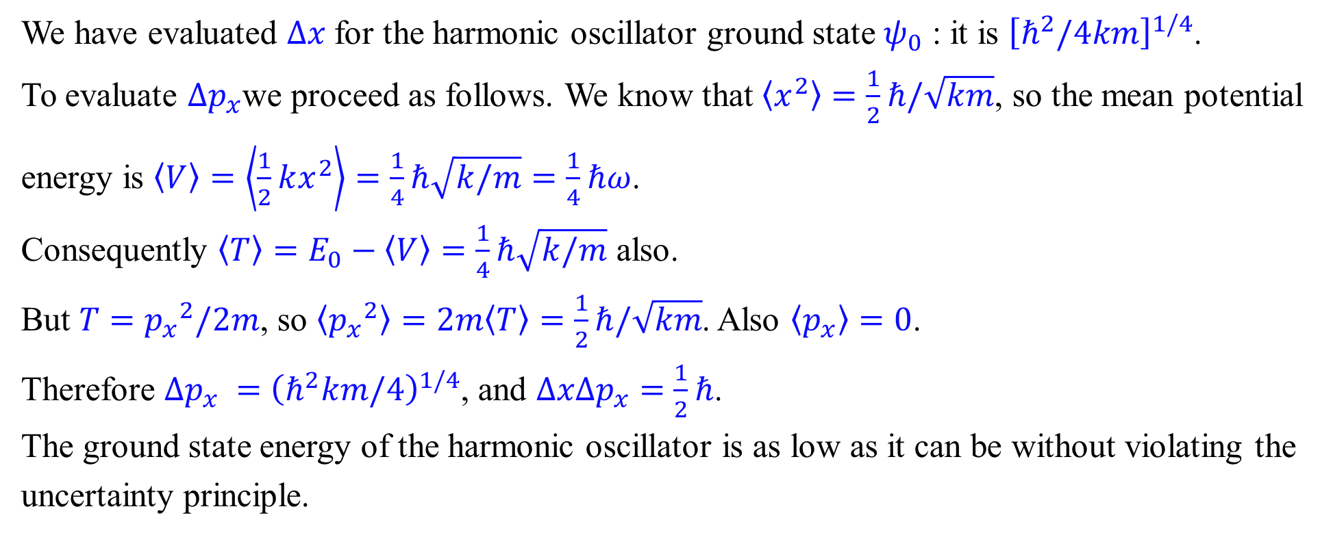

Zero-point energy and uncertainty
We have evaluated $∆x$for the harmonic oscillator ground state $ψ_{0}$ : it is ${\left[ℏ^{2}/4km\right]}^{1/4}$.
To evaluate $∆p_{x}$we proceed as follows. We know that $\left\langle x^{2}\right\rangle =\frac{1}{2}ℏ/\sqrt{km}$, so the mean potential energy is $\left\langle V\right\rangle =\left\langle \frac{1}{2}kx^{2}\right\rangle =\frac{1}{4}ℏ\sqrt{k/m}=\frac{1}{4}ℏω$.
Consequently $\left\langle T\right\rangle =E_{0}−\left\langle V\right\rangle =\frac{1}{4}ℏ\sqrt{k/m}$ also.
But $T={p_{x}}^{2}/2m$, so $\left\langle {p_{x}}^{2}\right\rangle =2m\left\langle T\right\rangle =\frac{1}{2}ℏ/\sqrt{km}$. Also $\left\langle p_{x}\right\rangle =0$.
Therefore $∆p_{x} =$ ${\left(ℏ^{2}km/4\right)}^{1/4}$, and $∆x∆p_{x}=$ $\frac{1}{2}ℏ$.
The ground state energy of the harmonic oscillator is as low as it can be without violating the uncertainty principle.
where ω is the angular frequency $\sqrt{k/m}$
Notes:
现代科学家认为真空并不意味着一无所有.即使在绝对零度，
关于零点能的设想来自量子力学的一个著名概念：海森堡不确定性原理。该原理指出：不可能同时以较高的精确度得知一个粒子的位置和动量。因此，当温度降到绝对零度时粒子必定仍然在振动；否则，如果粒子完全停下来，那它的动量和位置就可以同时精确的测知，而这是违反不确定性原理的。这种粒子在绝对零度时的振动（零点振动）所具有的能量就是零点能

Slide 27

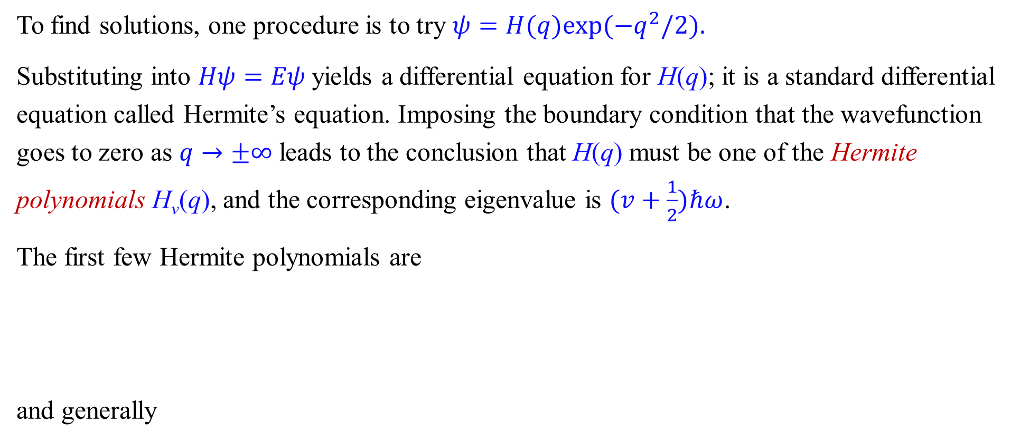
Other Harmonic Oscillator Wavefunctions
To find solutions, one procedure is to try $ψ=H(q)exp⁡(−q^{2}/2).$
Substituting into $Hψ=Eψ$yields a differential equation for H(q); it is a standard differential equation called Hermite’s equation. Imposing the boundary condition that the wavefunction goes to zero as $q→±∞$leads to the conclusion that H(q) must be one of the Hermite polynomials H_{v}(q), and the corresponding eigenvalue is $(v+\frac{1}{2})ℏω$.
The first few Hermite polynomials are
and generally
$$E_{v}=\left(v+\frac{1}{2}\right)ℏω$$

Slide 28
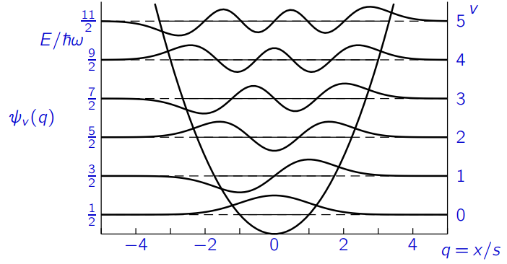
Compare the harmonic oscillator wavefunctions with those for the particle in a box. Note that
• The nodal structure is the same.
• The energies are now equally spaced.
• The wavefunction (and so the probability density) continues past the point where V = E_{v}, and thus enters the classically forbidden region, where T<0.
This is the mysterious phenomenon known as quantum tunnelling.

Slide 29
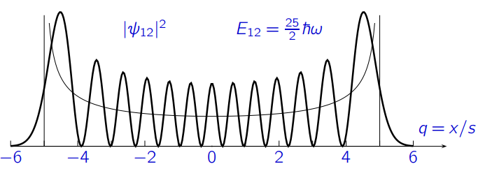
High vibrational levels
Features of high vibrational levels:
• The probability distribution $|ψ_{0}|2$approaches the classical distribution for large v, except for the quantum oscillations, and has a large peak near the classical turning-point.
• The probability of tunnelling outside the classical turning-point becomes smaller as v increases.

Slide 30
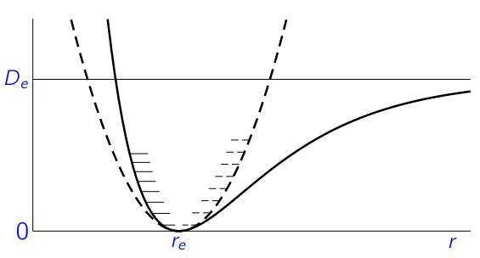
The Morse Oscillator
For a real diatomic molecule, the energy does not become infinite as the bond-length is increased indefinitely, but instead reaches an asymptotic value, the dissociation energy D_{e}. A better approximation to this behaviour is provided by the Morse potential:
where r is the bond-length of the diatomic and r_{e} its value at the equilibrium geometry.
A Morse potential (solid curve) compared with the harmonic oscillator potential (dashed curve)

Slide 31
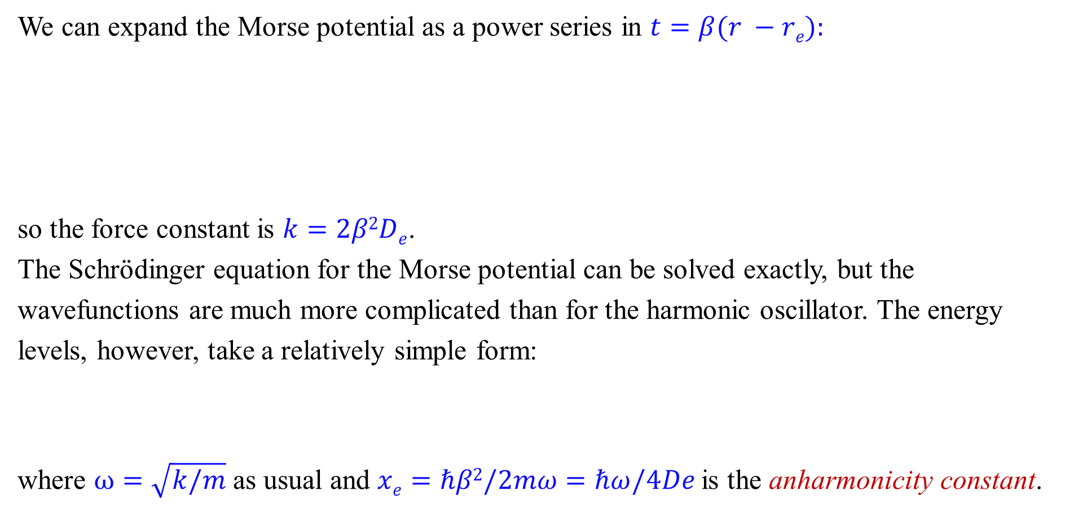
We can expand the Morse potential as a power series in $t=β(r −re):$
so the force constant is $k=2β2De$.
The Schrödinger equation for the Morse potential can be solved exactly, but the wavefunctions are much more complicated than for the harmonic oscillator. The energy levels, however, take a relatively simple form:
where $ω=\sqrt{k/m}$as usual and $xe=ℏβ2/2mω=ℏω/4De$is the anharmonicity constant.

Slide 32
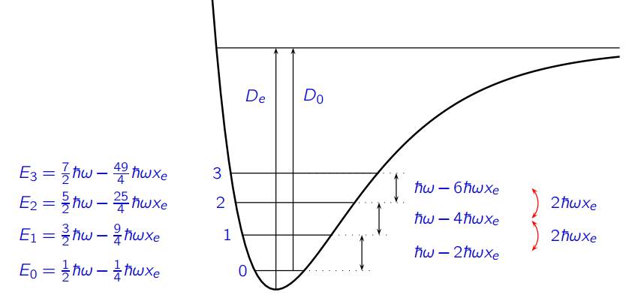

Slide 33
3.3 Quantization of rotation
旋转运动是原子和分子问题中非常重要的基本运动。当原子或分子的运动受到中心力场的影响时，就会产生这种运动。
Let’s start from a simple model “Particle on a cycle”
polar coordinate
R
ϕ
Let x= rsinϕ; y= rcos ϕ
x

Slide 34
Because r = R
Boundary condition:

Slide 35
A can be determined by applying normalization condition to function
We select:
1. The particle can exist in many states
2. Energy is quantized
3. The minimum energy 0, why?

Slide 36
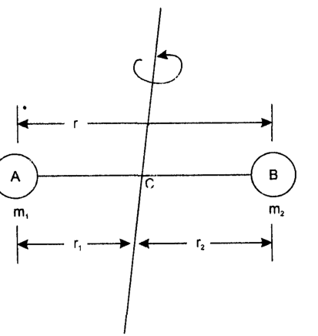
让我们考虑一个刚性转子来解释双原子分子的旋转运动，其中两个原子A和B的质量分别为m₁和m₂ ，它们之间的距离为r。
Classical treatment for rotational motion of particle
For two particles of rigid rotator
Where ω is the angular velocity of the particles
Where I is the moment of inertia for the diatomic molecular system

Slide 37
For balancing of the system, the equation is
Consider the fact that
μ is the reduced mass
Angular momentum of such system is
Classically, the kinetic energy of the rotator can have any value. This is not true in quantum mechanical framework！

Slide 38
3.3.1 The rigid rotor in quantum mechanics
For freely rotating rotator, potential energy is zero, hence total energy is equal to the kinetic energy. So
Replacing p (linear momenta for the particles of rigid rotator) with quantum mechanical operators

Slide 39
express rotation in forms of internal co-ordinates
Where μ is the reduced mass

Slide 40
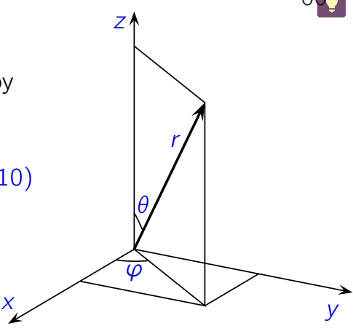
Spherical polar coordinates
Before proceeding, we recall the definition of spherical polar coordinates. They are defined by
and conversely
The volume element for integration over spherical polar coordinates is

Slide 41
The transformed expression is given by
r is constant
定义：

Slide 42
Solution of above equation provides
Where J is the rotation quantum number.
Therefore, energy for the rotator is given by

Slide 43
Substituting Y as function expressed as:
−
Both L.H.S. and R.H.S. of this equation may be taken as equal to m²
−

Slide 44
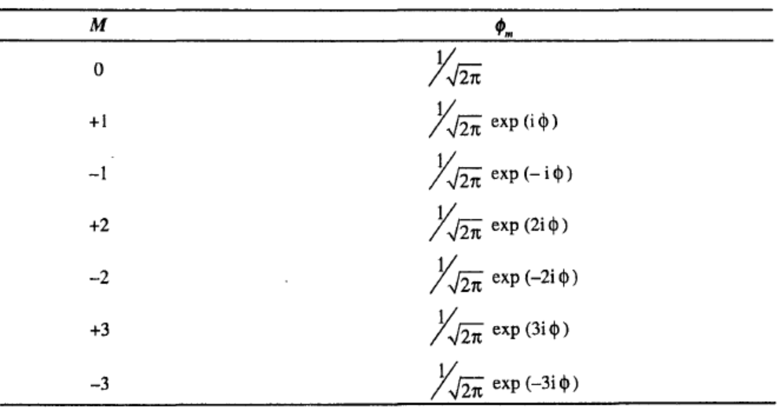
Solution of ϕ equation
The acceptable solution of this equation is

Slide 45
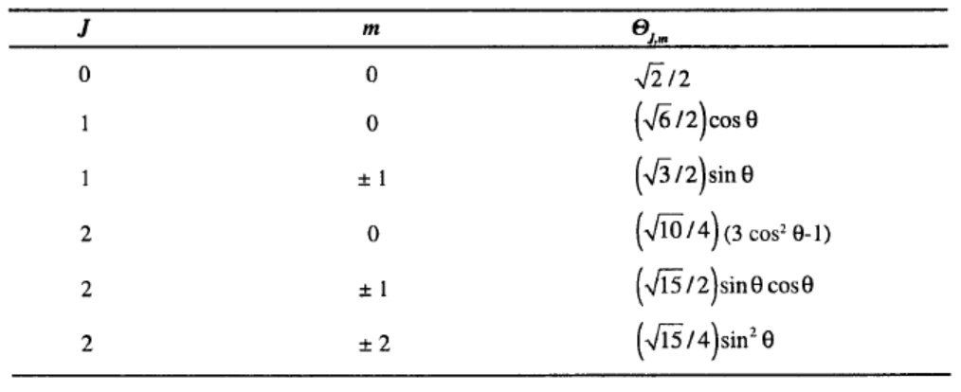
Solution of θ equation

Slide 46


刚性转子模型应用
能量量子化：转动能量不能取任意值，只能是特定的离散值，转动量子数 J= 0,1,2,...
角动量量子化：角动量大小是量子化的，角动量在空间特定方向（如外加磁场方向，称为Z轴）的分量也是量子化的
刚性转子模型应用：双原子分子、类氢原子 （板书:）

Slide 47
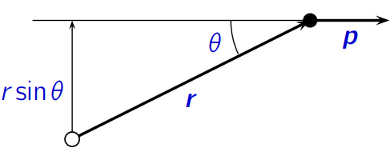
3.3.2 Angular Momentum
量子力学框架下，描述角动量的算符
In three dimensions, the angular momentum about a point is the magnitude p of the momentum multiplied by the perpendicular distance of the momentum
vector from the point (r sin θ in the diagram).
The angular momentum describes rotation about an axis perpendicular to the
plane containing r and p, so in vector notation it is J = r × p.

Slide 48
3.3.3 Angular momentum operators
CM
Classical Mechanics
Linear momentum
Angular momentum

Slide 49
One-particle Orbital-Angular-Momentum Operators
• Orbital angular momentum
• Spin angular momentum
QM

Slide 50
Angular momentum operators don’t commute
Writing $∂/∂x=\hat{∂}x$ for brevity, and $\hat{∂}x x=1+x\hat{∂}x$, $\hat{∂}x y=y\hat{∂}x$ and $\hat{∂}x\hat{∂}y=\hat{∂}y\hat{∂}x$,

Slide 51
The components of the angular momentum operator do not commute with each other.

Slide 52
Commutation relations for angular momentum
We have found that
Similarly,
(Note that x, y and z appear in cyclic order in these equations.)

Slide 53
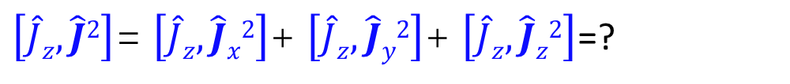
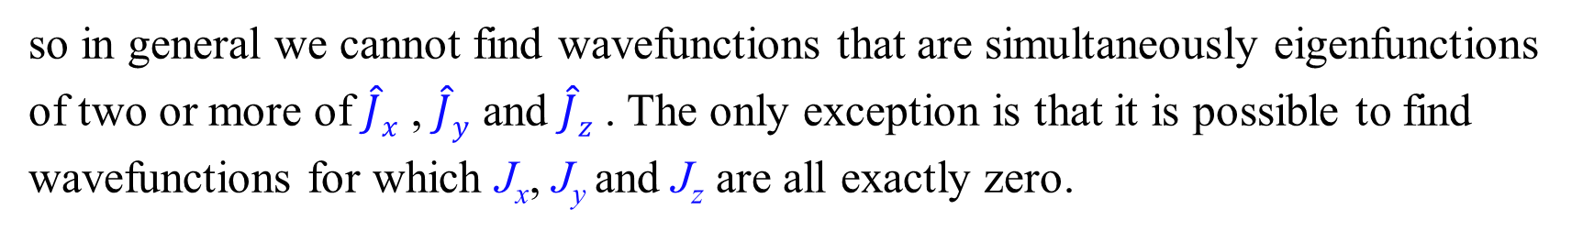
The uncertainty principle tells us that,
so in general we cannot find wavefunctions that are simultaneously eigenfunctions of two or more of $\hat{J}x$ , $\hat{J}y$ and $\hat{J}z$ . The only exception is that it is possible to find wavefunctions for which J_{x}, J_{y} and J_{z} are all exactly zero.
Do $\hat{J}x$ , $\hat{J}y$ and $\hat{J}z$ commute with $\hat{J}2=\hat{J}x2+$ $\hat{J}y2+\hat{J}z2$?
$\left[\hat{J}z,\hat{J}2\right]$= $\left[\hat{J}z,\hat{J}x2\right]$+ $\left[\hat{J}z,\hat{J}y2\right]$+ $\left[\hat{J}z,\hat{J}z2\right]$=?

Slide 54

$$\left[\hat{J}z,\hat{J}y2\right]=−iℏ\left(\hat{J}y\hat{J}x+\hat{J}x\hat{J}y\right)$$
while $\left[\hat{J}z,\hat{J}z2\right]=0$.
Adding these results together shows that $\left[\hat{J}z,\hat{J}2\right]=0$.
Therefore we can find wavefunctions that are eigenfunctions of both $\hat{J}2$ and one
only of $\hat{J}x$ , $\hat{J}y$ and $\hat{J}z$ . It is customary to choose $\hat{J}z$ .

Slide 55
Involved only θ and φ

Slide 56
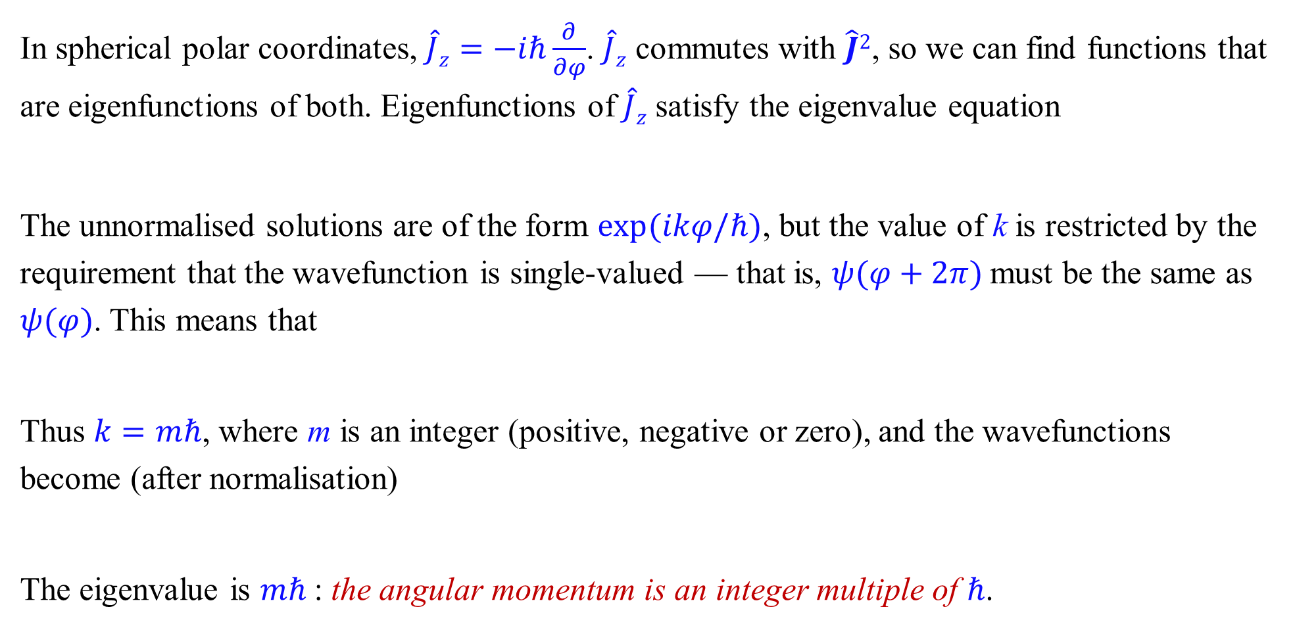
3.3.2. Spherical harmonics
In spherical polar coordinates, $\hat{J}z=−iℏ\frac{∂}{∂φ}$. $\hat{J}z$ commutes with $\hat{J}2$, so we can find functions that are eigenfunctions of both. Eigenfunctions of $\hat{J}z$ satisfy the eigenvalue equation
The unnormalised solutions are of the form $exp⁡(ikφ/ℏ)$, but the value of k is restricted by the requirement that the wavefunction is single-valued — that is, $ψ(φ+2π)$must be the same as $ψ(φ)$. This means that
Thus $k=mℏ$, where m is an integer (positive, negative or zero), and the wavefunctions become (after normalisation)
The eigenvalue is $mℏ$: the angular momentum is an integer multiple of $ℏ$.

Slide 57
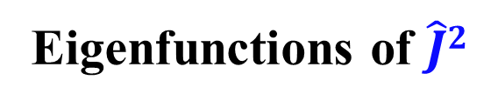
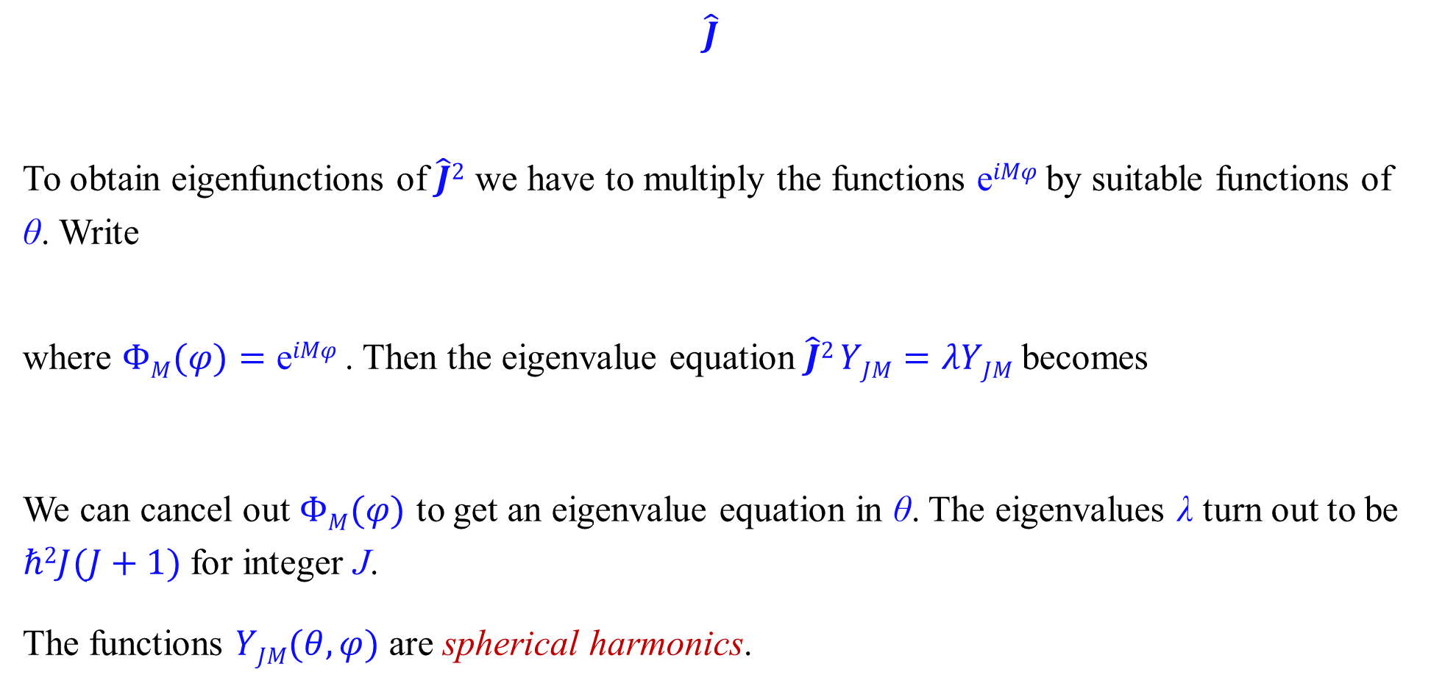
Eigenfunctions of $\hat{J}2$
$$\hat{J}$$
To obtain eigenfunctions of $\hat{J}2$ we have to multiply the functions $\text{e}iMφ$ by suitable functions of θ. Write
where $ΦM(φ)=\text{e}iMφ$ . Then the eigenvalue equation $\hat{J}2 YJM=λYJM$becomes
We can cancel out $ΦM(φ)$ to get an eigenvalue equation in θ. The eigenvalues λ turn out to be $ℏ2J(J+1)$for integer J.
The functions $YJM(θ,φ)$ are spherical harmonics.

Slide 58
球谐函数是轨道角动量算符两个重要本征方程的共同解.
中心力场问题求解的核心工具,球谐函数天然地成为了描述任何中心对称体系角度分布的基函数。氢原子、多电子原子等的电子轨道都建立在此基础上。
球谐函数作为J²和Jz 的共同本征函数，构成了角动量表象的一组标准正交完备基。任何中心对称体系波函数的角度部分都可以用球谐函数展开

Slide 59
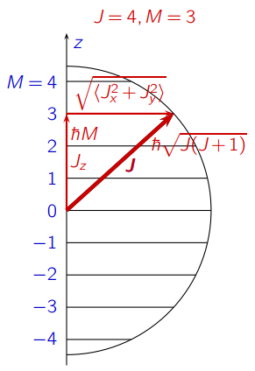
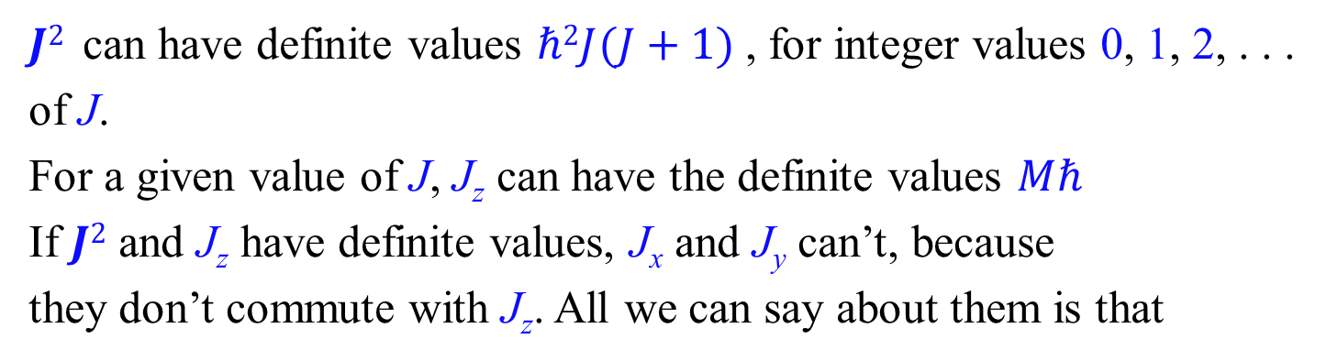
3.3.4 Angular momentum eigenvalues
$J2$ can have definite values $ℏ2J(J+1)$, for integer values 0, 1, 2, . . . of J.
For a given value of J, J_{z} can have the definite values $Mℏ$
If $J2$ and J_{z} have definite values, J_{x} and J_{y} can’t, because
they don’t commute with J_{z}. All we can say about them is that
J(J+1) ≥ M²
-[J(J+1)]^{1/2} ≤ M ≤ -[J(J+1)]^{1/2}
$M$ can take any of the integer values $J, J−1, . . . , −J+1, −J$.

Slide 60
m can have values 0, ± 1, ± 2, .......... ± J or m can have (2J+l) values
Example
What is zero level energy for a rigid rotator?
For zero level J = 0; Energy will be zero

Slide 61
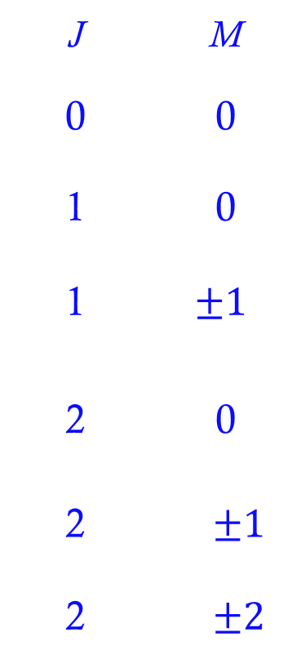
The first few normalized spherical harmonics are
J | M
0 | 0
1 | 0
1 | $$±1$$
2 | 0
2 | $$±1$$
2 | $$±2$$

Slide 62
How to determine the range of J?
Particle in a ball – shaped potential well

Slide 63
J(J+1)
In the potential well, V = 0
J(J+1)
If J =0
If J ≠0
U(r) is the linear combination of Bessel functions and Neumann functions

Slide 64
A central force

