Slide 1
Quantization of translation
wavefunctions for the particle in a box are
for integer n > 0, and the corresponding energies are

Slide 2
“Particle on a cycle”
R
ϕ
x

Slide 3
Boundary condition:
A can be determined by applying normalization condition to function
We select:

Slide 4
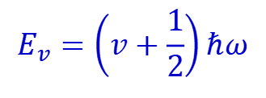
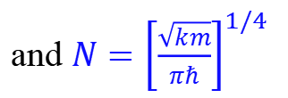
Quantization of vibration (one dimension)
The Hamiltonian is
The wavefunction in ground state is
and $N={\left[\frac{\sqrt{km}}{πℏ}\right]}^{1/4}$
$$E_{v}=\left(v+\frac{1}{2}\right)ℏω$$

Slide 5
Other Harmonic Oscillator Wavefunctions
$$ψ=H(q)exp⁡(−q^{2}/2).$$

Slide 6
Quantization of rotation
Rigid rotator

Slide 7
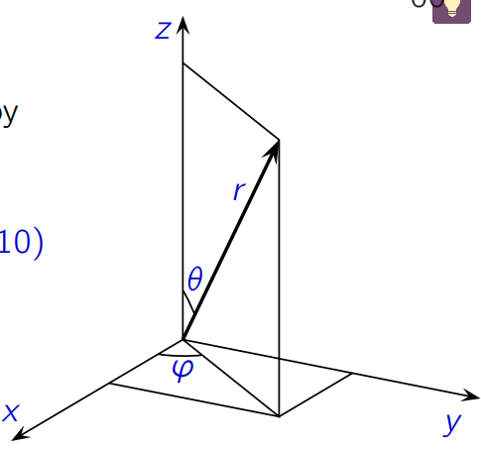
Particle in a ball – shaped potential well

Slide 8
J(J+1)
In the potential well, V=0
J(J+1)
If l =0
If l ≠0
U(r) is the linear combination of Bessel functions and Neumann functions

Slide 9
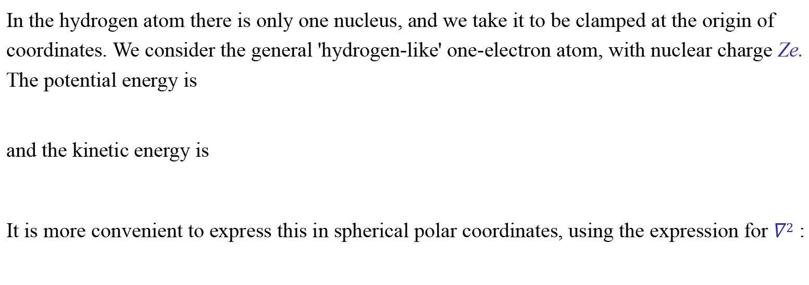
4.1 The hydrogen atom
In the hydrogen atom there is only one nucleus, and we take it to be clamped at the origin of coordinates. We consider the general 'hydrogen-like' one-electron atom, with nuclear charge Ze. The potential energy is
and the kinetic energy is
It is more convenient to express this in spherical polar coordinates, using the expression for $∇2$ :

Slide 10
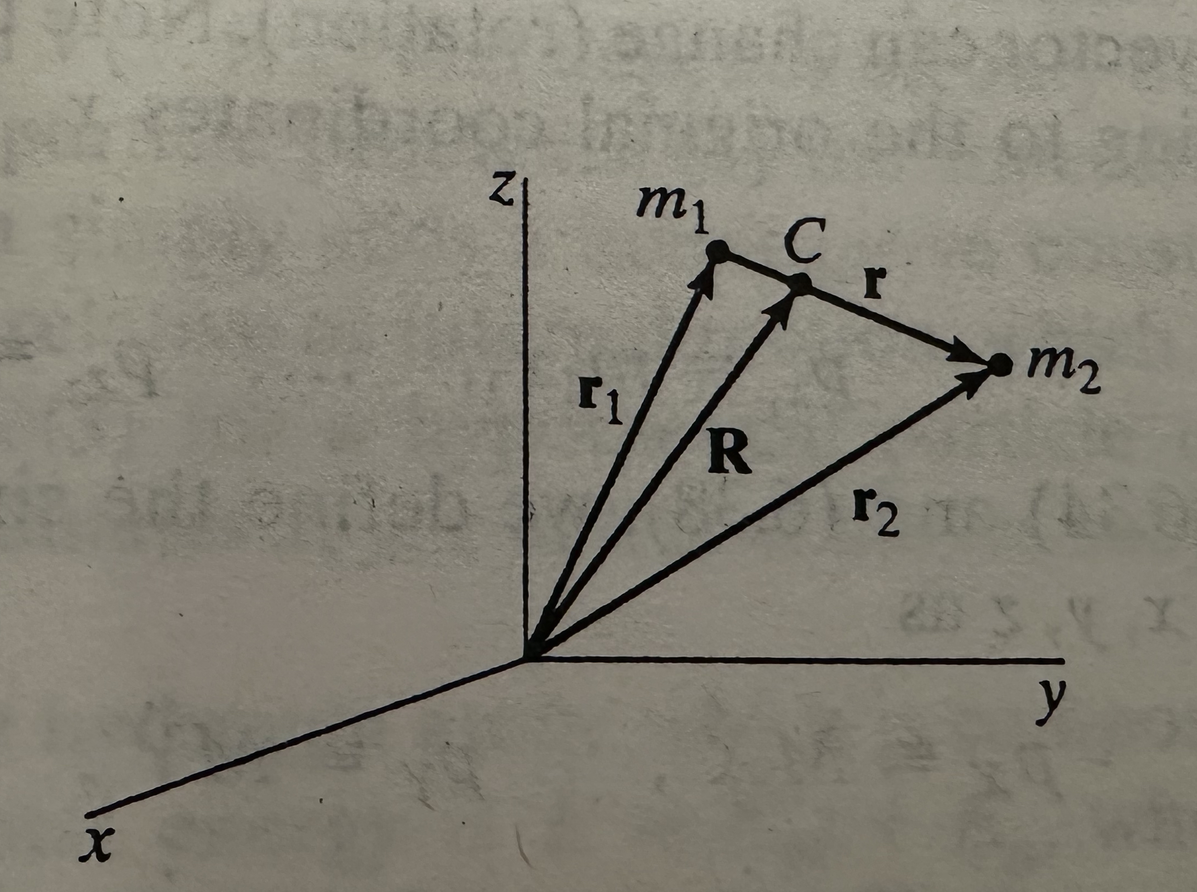
Tranformation of coordinates

Slide 11
The hydrogen atom contains two particles, the proton and the electron
Free particle
Translational; internal (vibration; rotation)

Slide 12
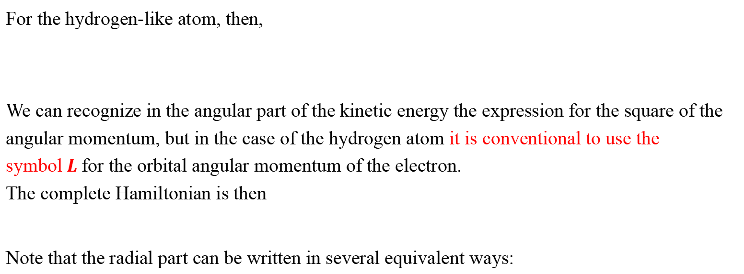
4.2 The hydrogen atom Hamiltonian
For the hydrogen-like atom, then,
We can recognize in the angular part of the kinetic energy the expression for the square of the angular momentum, but in the case of the hydrogen atom it is conventional to use the symbol$L$for the orbital angular momentum of the electron.
The complete Hamiltonian is then
Note that the radial part can be written in several equivalent ways:

Slide 13
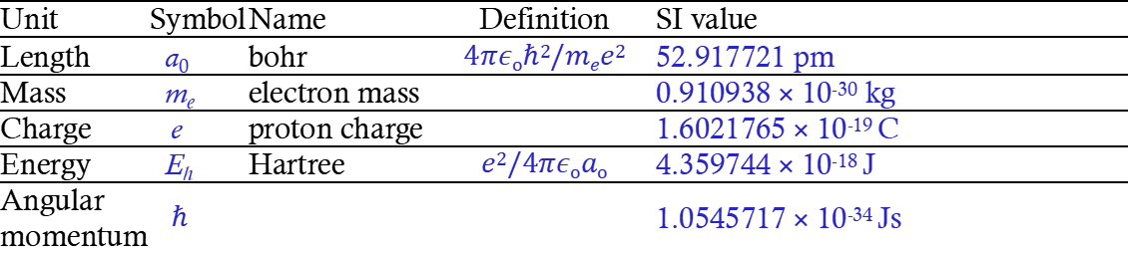
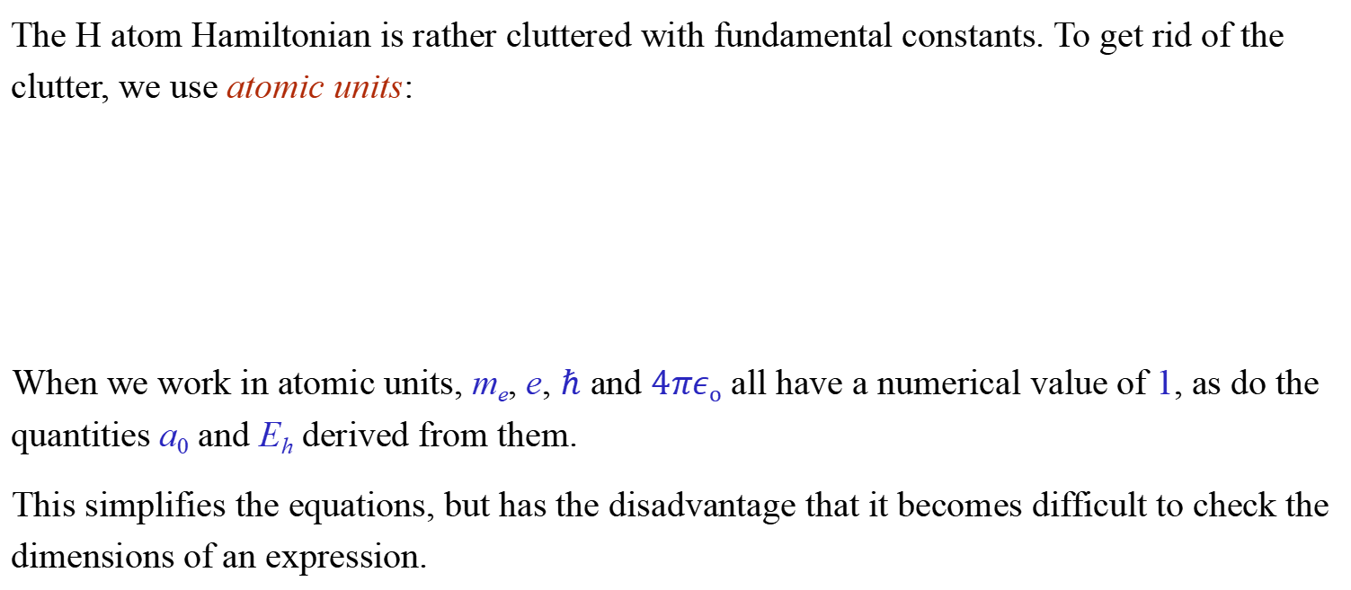
Atomic units
The H atom Hamiltonian is rather cluttered with fundamental constants. To get rid of the clutter, we use atomic units:
When we work in atomic units, m_{e}, e, $ℏ$ and $4πεo$ all have a numerical value of 1, as do the quantities a₀ and E_{h} derived from them.
This simplifies the equations, but has the disadvantage that it becomes difficult to check the dimensions of an expression.
Unit | Symbol | Name | Definition | SI value
Length | a₀ | bohr | $$4πεoℏ2/mee2$$ | 52.917721 pm
Mass | m_{e} | electron mass |  | 0.910938 × 10⁻³⁰ kg
Charge | e | proton charge |  | 1.6021765 × 10⁻¹⁹ C
Energy | E_{h} | Hartree | $$e2/4πεoao$$ | 4.359744 × 10⁻¹⁸ J
Angular momentum | $$ℏ$$ |  |  | 1.0545717 × 10⁻³⁴ Js

Slide 14
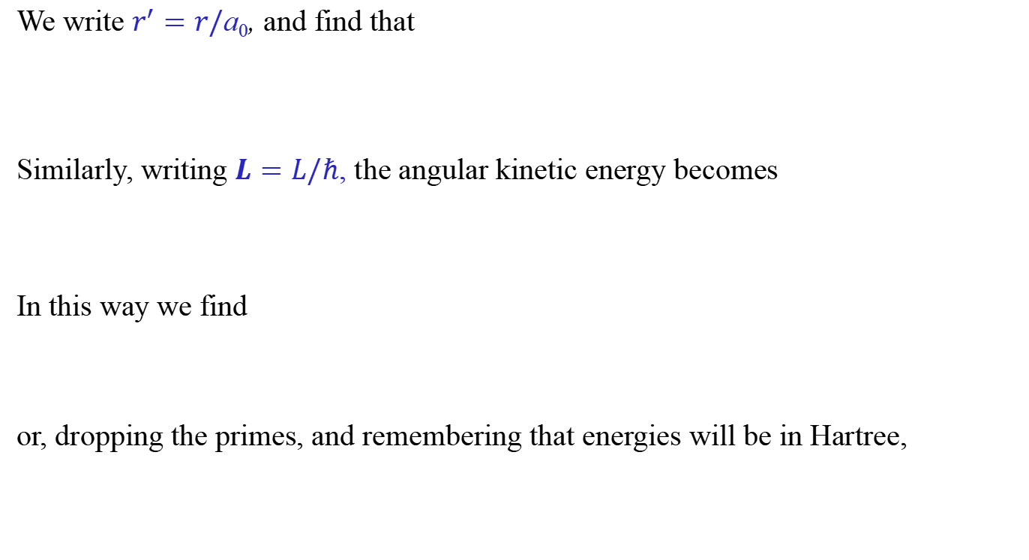
We write $r^{′}=r/\text{a}\text{0}$, and find that
Similarly, writing $L=L/ℏ$, the angular kinetic energy becomes
In this way we find
or, dropping the primes, and remembering that energies will be in Hartree,

Slide 15
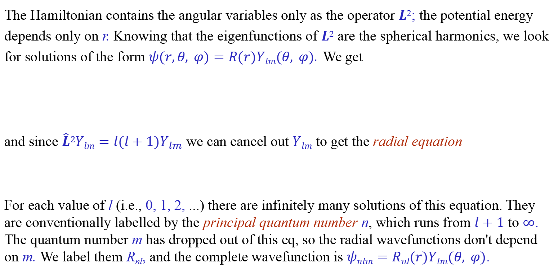
4.3 Wavefunctions for the hydrogen atom
The Hamiltonian contains the angular variables only as the operator $L$²; the potential energy depends only on r. Knowing that the eigenfunctions of $L$² are the spherical harmonics, we look for solutions of the form $ψ(r,θ, φ)=R(r)Ylm(θ, φ).$We get
and since $\hat{L}2Ylm=l(l+1)Y_{lm}$ we can cancel out $Ylm$ to get the radial equation
For each value of l (i.e., 0, 1, 2, ...) there are infinitely many solutions of this equation. They are conventionally labelled by the principal quantum number n, which runs from $l+1$ to $∞$.
The quantum number m has dropped out of this eq, so the radial wavefunctions don't depend on m. We label them R_{nl}, and the complete wavefunction is $ψnlm=Rnl(r)Ylm(θ, φ)$.

Slide 16

Solution of R equation
In this eq, write $ρ=Zr$. Then $\frac{∂}{∂r}=Z\frac{∂}{∂ρ}$ and we get
or
So the radial equation is the same for all Z, except that the energies scale with Z².

Slide 17
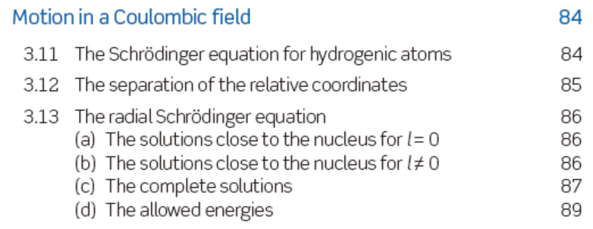
n: principle quantum number
k: radical quantum number
l: angular momentum quantum number
R is called Rydberg constant with the value of 13.6 eV
necessary condition: n ≥ l+1
n = 1, 2, 3,……
l = 0, 1, 2, ……
n: Principal quantum number

Slide 18
Degeneracy

Slide 19
The allowed values of quantum numbers
Quantum Numbers
n
1 2 3 4
l
0 0 1 0 1 2 0 1 2 3
m_{l}
0 0 -1 0 +1 0 -1 0 +1 0 -1 0 +1
-2 -1 0 +1 +2 -2 -1 0 +1 +2
-3 -2 -1 0 +1 +2 +3
The total number of orbitals for a given value of n is n².

Slide 20
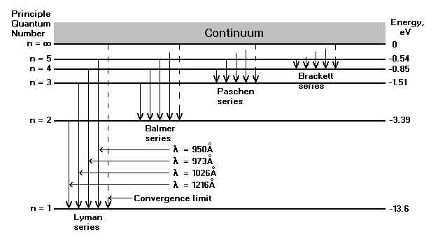
Energy states of a H atom.
n = principal
n = 1, 2, 3 …∞
n = 1 : ground state
n = 2 : first excited state
n = 3 : second excited state
R = 13.6 eV
E₁ = -13.6 eV
E₂ = -3.40 eV
E₃ = -1.51 eV
E₄ = -0.85 eV
E₅ = -0.54 eV
•
•
•
E∞ = 0 eV

Slide 21

The first few normalized radial wavefunctions are, writing $ρ=Zr$
As is customary, we write nl using the letters s, p, d, f, ... to represent l = 0, 1, 2, 3, ….Each of these has to be multiplied by one of the corresponding $Ylm$ (l = 0 for s, 1 for p, etc.). For each value of l, m can have any integer value from -l to l, so there are three 2p orbitals, five 3d orbitals, and so on.

Slide 22
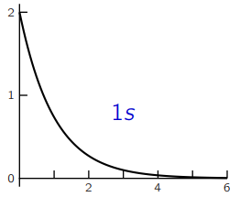
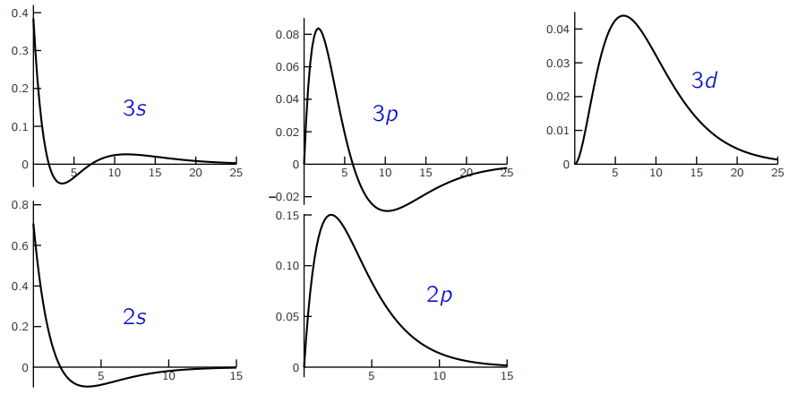
Radial wavefunctions for hydrogen
These are the functions of the previous slide, with Z = 1. Note the differences in horizontal and vertical scales; the functions with higher principal quantum number extend much further from the nucleus.

Slide 23

Radial probability density
The probability of finding the electron in an element of volume dv is
$|ψ|2\text{d}v=|ψ|2r2sinθ\text{d}r\text{d}θ\text{d}φ,$where $ψ$ is the normalized wavefunction for the electron.
If we integrate over the angles we get the probability of finding the electron in a spherical shell between $r$ and $r+\text{d}r$:
$P_{nl}(r)$is called the radial probability density. Note that it is independent of m

Slide 24
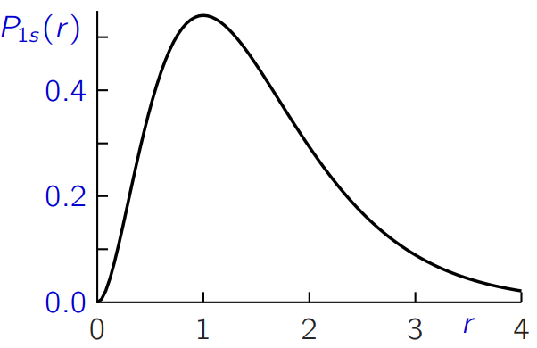

E.g., for hydrogen $1s$,
so
To find the maximum in $P1s(r)$:
so the maximum is at $r=1$.
Note that this is not the same as the expectation value of $r$:

Slide 25
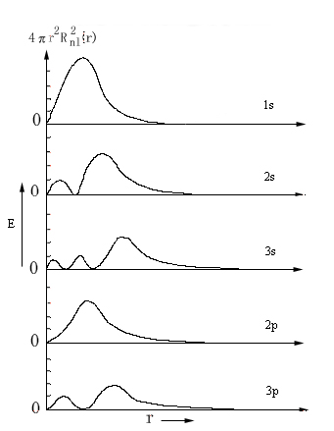

$$P_{nl}(r)$$
A spherical surface with the electron density of zero is called a node, or nodal surface.
The radial distribution function has (n-l) maxima and (n-l-1) nodal surfaces

Slide 26
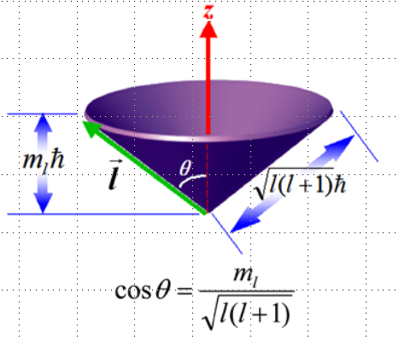
The angular functions $Ylm(θ, φ)$ for hydrogen
Indicates the angular distribution of an atomic orbital.

Slide 27
Denote the orbital angular momentum
Indicates the shape of the orbitals around the nucleus.
Denotes the different energy sublevels within the main level “n”
When there exist an angular momentum, there is also a magnetic moment.

Slide 28
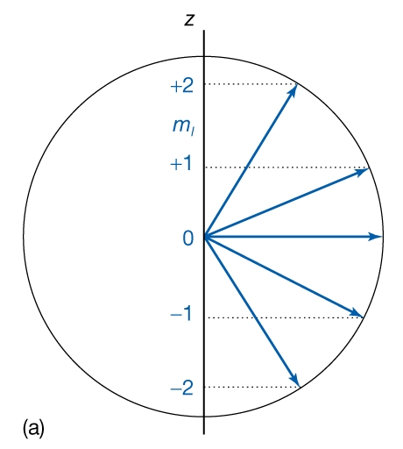
Determine the z-component of the orbital angular momentum of the atom.
Determine the component μ_{z} of the magnetic moment in the direction of the magnetic field.
Space quantization of orbital angular momentum. Here the orbital quantum number is l=2 and there are accordingly 2l+1=5 possible values of the magnetic quantum number m_{l}, with each value corresponding to a different orientation relative to the z axis.

Slide 29
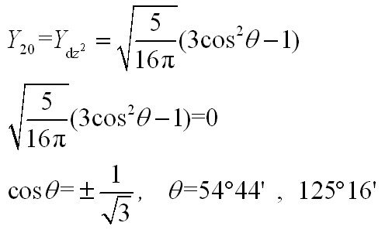
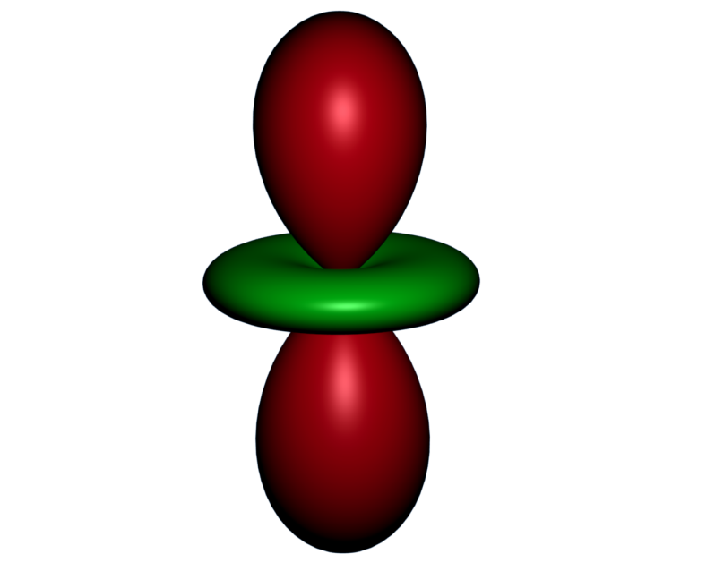
Nodes
A node is a surface on which an electron is not found. For a given orbital, the total number of nodes equals n-1. The number of angular nodes is l.
Y_{lm}(θ,φ)=0

Slide 30
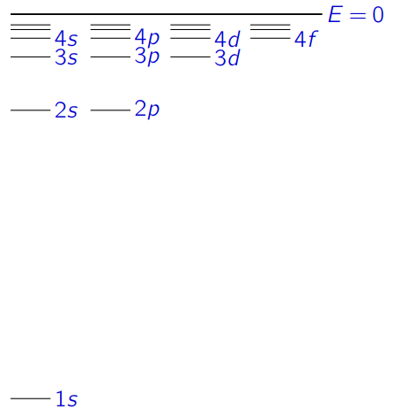
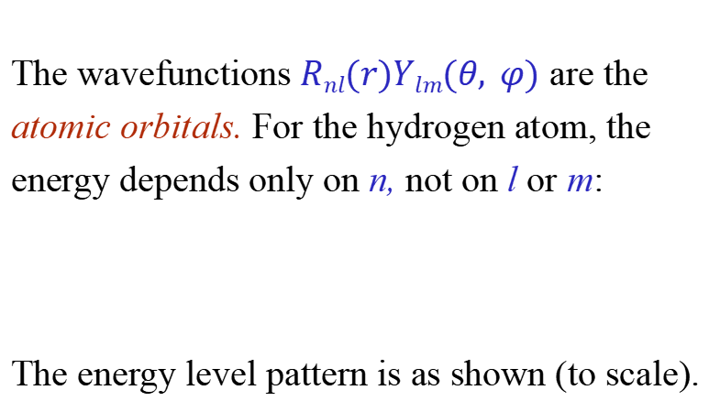
Atomic orbitals
The wavefunctions $Rnl(r)Ylm(θ, φ)$ are the atomic orbitals. For the hydrogen atom, the energy depends only on n, not on l or m:
The energy level pattern is as shown (to scale).

Slide 31

Real or complex orbitals?
If we assemble the complete 2p orbitals for the hydrogen atom ($Z=1$), we get:
$m=0$:
$m=1$:
$m=−1$:
Here $N2p={(32π)}^{−1/2}$.

Slide 32
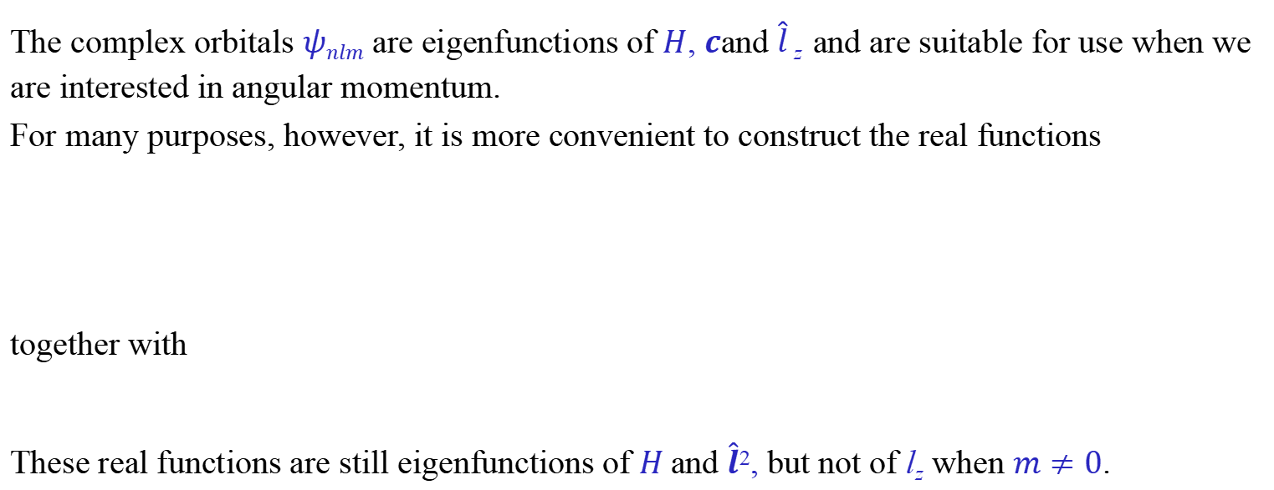
Real or complex p orbitals
The complex orbitals $ψnlm$ are eigenfunctions of $H$, $c$and $\hat{l}$ _{z} and are suitable for use when we are interested in angular momentum.
For many purposes, however, it is more convenient to construct the real functions
together with
These real functions are still eigenfunctions of $H$and $\hat{l}$², but not of l_{z} when $m≠0$.

Slide 33
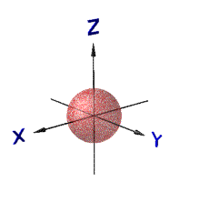
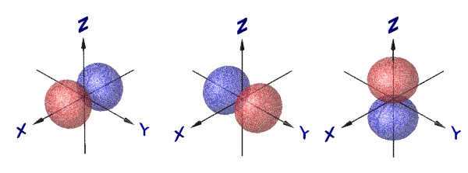
Angular function ( Y_{lm}(θ,ϕ) )
s-Orbital (l=0, 2l+1=1)
Y₀₀
p-Orbital (l=1, 2l+1=3)
Y₁₀
Y_{1±1}
p_{x} p_{y}

Slide 34

d orbitals
The 3d orbitals are constructed from the R_{3d} radial function and the $Y2m$ spherical harmonics:
where the normalising factor $N3d=\frac{4}{81}\sqrt{\frac{1}{30}}$ $∙\sqrt{\frac{5}{4π}}=\frac{2}{81}\sqrt{\frac{1}{6π}}$.
Just as for the p orbitals, we can write $r\text{sin}θ{\text{e}}^{±iφ}=x±iy$ and $rcosθ=z$, and take real and imaginary parts to obtain the 3d orbitals in the familar real form.
(Note that $r2sin2θ{\text{e}}^{±2iφ}=(r\text{sin}θ{\text{e}}^{±iφ})2 = (x±iy)2=x2−y2±2ixy$.)

Slide 35




d orbitals in real form
The 3d orbitals in real form are:
Note that the so-called $d_{z2}$ orbital is in fact proportional to $(3z2−r2)$.
$$m=0$$
$$m=±1$$
$$m=±2$$

Slide 36
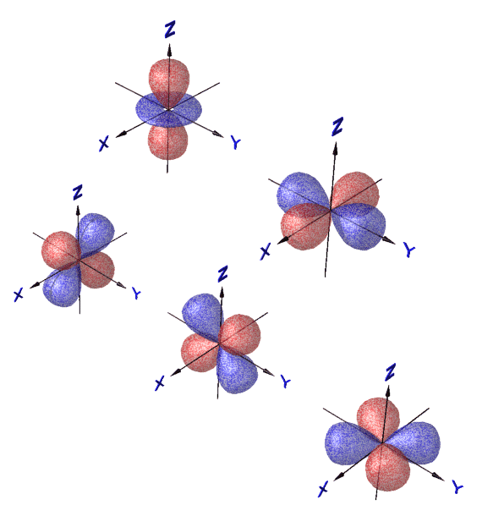
d-Orbital
Y₂₀
Y_{2±1}
Y_{2±2}

Slide 37
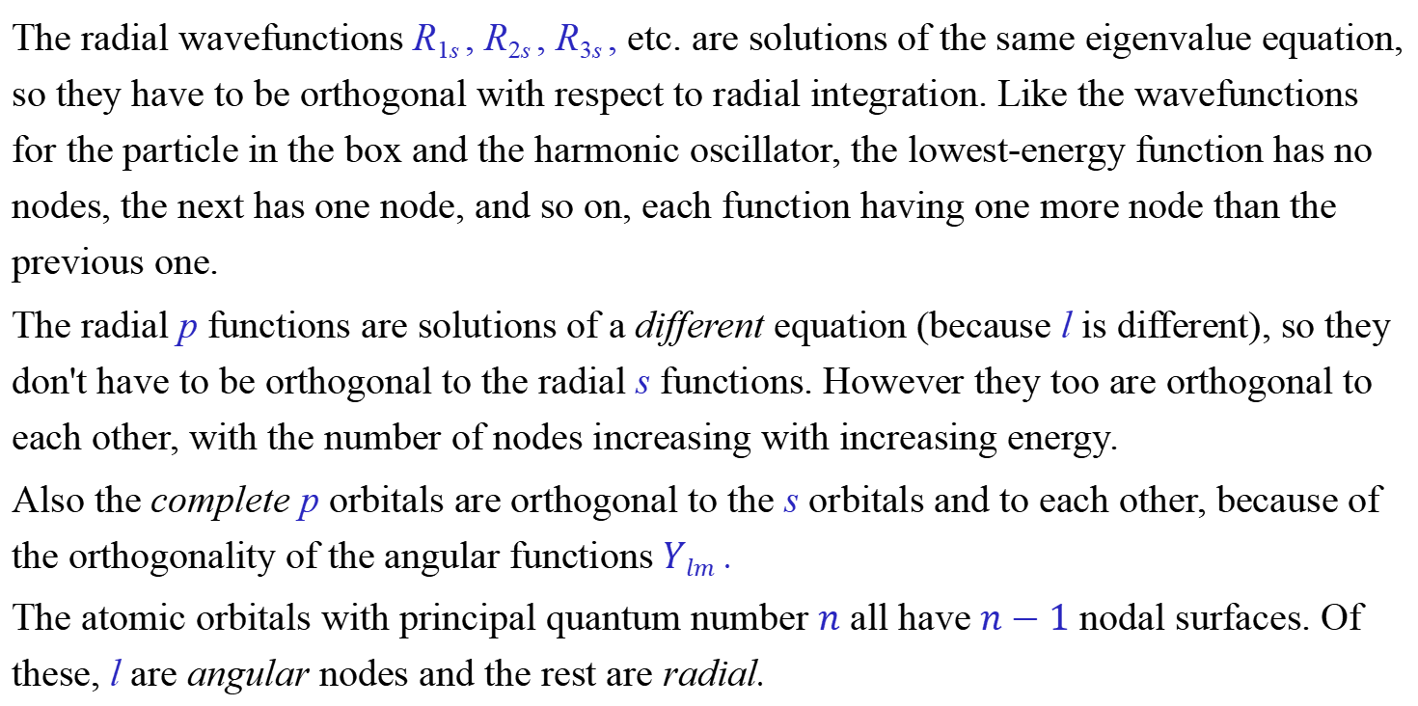
The radial wavefunctions R_{1s} , R_{2s} , R_{3s} , etc. are solutions of the same eigenvalue equation, so they have to be orthogonal with respect to radial integration. Like the wavefunctions for the particle in the box and the harmonic oscillator, the lowest-energy function has no nodes, the next has one node, and so on, each function having one more node than the previous one.
The radial p functions are solutions of a different equation (because l is different), so they don't have to be orthogonal to the radial s functions. However they too are orthogonal to each other, with the number of nodes increasing with increasing energy.
Also the complete p orbitals are orthogonal to the s orbitals and to each other, because of the orthogonality of the angular functions $Ylm$ .
The atomic orbitals with principal quantum number $n$ all have $n−1$ nodal surfaces. Of these, l are angular nodes and the rest are radial.

Slide 38
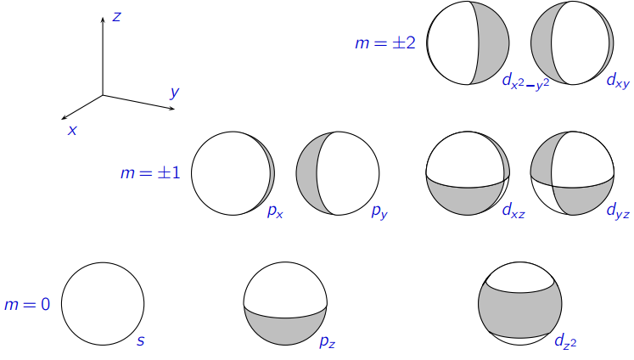
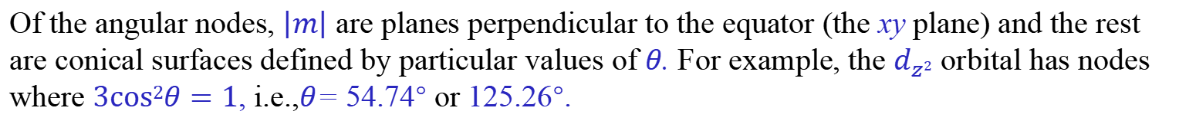
Angular nodes
Of the angular nodes, $\left|m\right|$ are planes perpendicular to the equator (the xy plane) and the rest are conical surfaces defined by particular values of $θ$. For example, the $d_{z2}$ orbital has nodes where $3cos2θ=1$, i.e.,$θ$= 54.74° or 125.26°.

Slide 39
system | Hamiltonian | Energy | Wave function
Free particles
Quantization of translation
Quantization of vibration
Quantization of rotation
Quantization of motion in a Coulombic field

