Slide 1
system | Hamiltonian | Energy | Wave function
Free particles
Quantization of translation
Quantization of vibration
Quantization of rotation
Quantization of motion in a Coulombic field

Slide 2
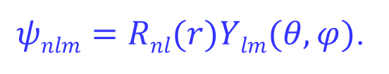

Hydrogen-like atom
The hydrogen-like atom contains two particles, the proton and the electron
$$Htot=H\left(r\right)+H\left(θ, φ\right)$$

Slide 3
类氢原子的三个量子数相互有联系
l ≤ n -1
n = 1, 2, 3,……
l = 0, 1, 2, ……
|m| ≤ l

Slide 4
自旋量子数的求解
n, l, m_{l}
Schrödinger equation:
n, j, m_{j}
Dirac equation:

Slide 5
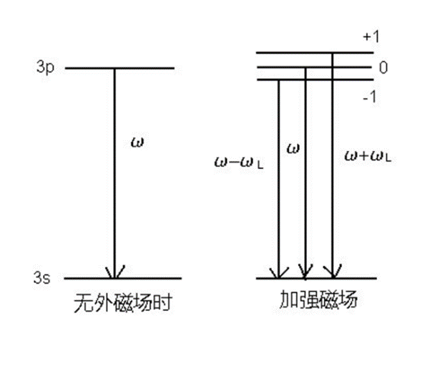
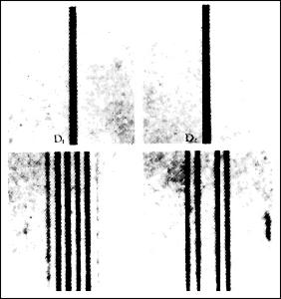
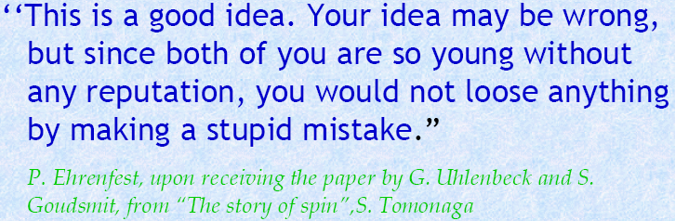
5.1 Spin and identity particles
Zeeman effect
The effect of splitting a spectral line into several components in the presence of a static magnetic field.
Normal
Anomalous
1925 Uhlenbeck (1900~1988) and Goudsmit (1902~1978)
Notes:
塞曼在1896年发现把产生光谱的光源置于足够强的磁场中，磁场作用于发光体使光谱发生变化，一条谱线即会分裂成几条偏振化的谱线，这种现象称为塞曼效应。
在外磁场中，总自旋为零的原子表现出正常塞曼效应，总自旋不为零的原子表现出反常塞曼效应。
塞曼效应是是对光的电磁理论的有力支持，证实了原子具有磁矩和空间取向量子化。
不考虑外加磁场时薛定谔方程的表达式是：HΨ=EΨ， 在这个表达式中能量只与n、l和m有关，而与磁量子数无关，也就是说与电子的自旋无关，所以具有同样的n、l和m的电子[也就是同一轨道中自旋反平行的两个电子]具有相同的能量；测试原子光谱时只有一条谱线。 考虑外加磁场时薛定谔方程的表达式：(H+Hb)Ψ=(E+Eb)Ψ, 此时Hb表示的是外加磁场对体系哈密顿量的影响, (H+Hb)是有外加磁场时的哈密顿量；Eb则有外场时Hb所对应的能量值，(E+Eb)是有外磁场时体系的能量；由于在外加磁场下自旋不同的电子有不同的能量，Eb值不同,所以在外磁场存在时原子光谱发生了分裂。
电子自旋假设，很好地解释了反常塞曼效应

Slide 6
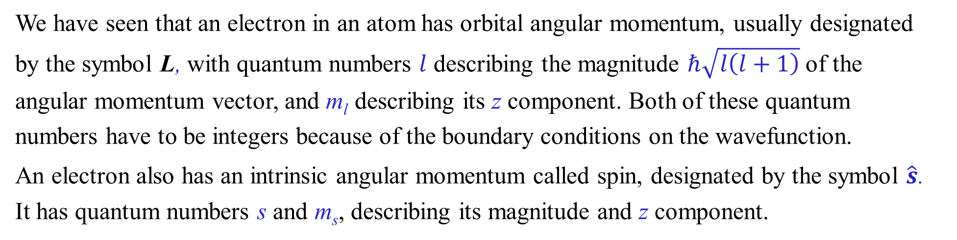
We have seen that an electron in an atom has orbital angular momentum, usually designated by the symbol L, with quantum numbers $l$ describing the magnitude $ℏ\sqrt{l\left(l+1\right)}$ of the angular momentum vector, and m_{l} describing its z component. Both of these quantum numbers have to be integers because of the boundary conditions on the wavefunction.
An electron also has an intrinsic angular momentum called spin, designated by the symbol $\hat{s}$. It has quantum numbers s and m_{s}, describing its magnitude and z component.
自旋是量子力学中一个难以解释的微观粒子特征，实验中自旋表现为一个角动量的性质，但它没有经典力学的类似参照。
在非相对论量子力学中，粒子自旋是公理。

Slide 7
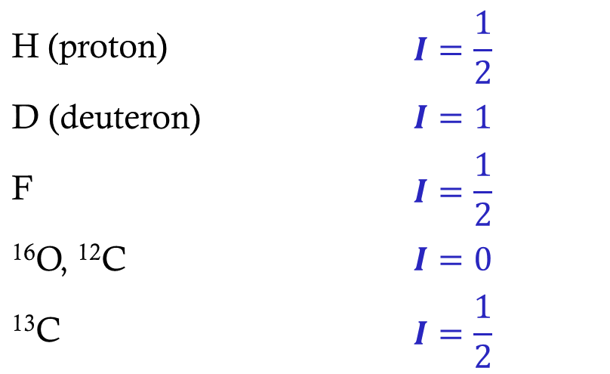
自旋无法用处理轨道角动量的角坐标方式来描述，其量子数也不受边界条件的限制。因此，自旋量子数除了可以取整数值外，还可以取半奇数值（如1/2, 3/2等）。
We note in passing that nuclei also have spin (important in n.m.r.). The nuclear spin operator is usually designated I, with quantum numbers I and m_{I}. Some values are:
H (proton) | $$I=\frac{1}{2}$$
D (deuteron) | $$I=1$$
F | $$I=\frac{1}{2}$$
¹⁶O, ¹²C | $$I=0$$
¹³C | $$I=\frac{1}{2}$$

Slide 8
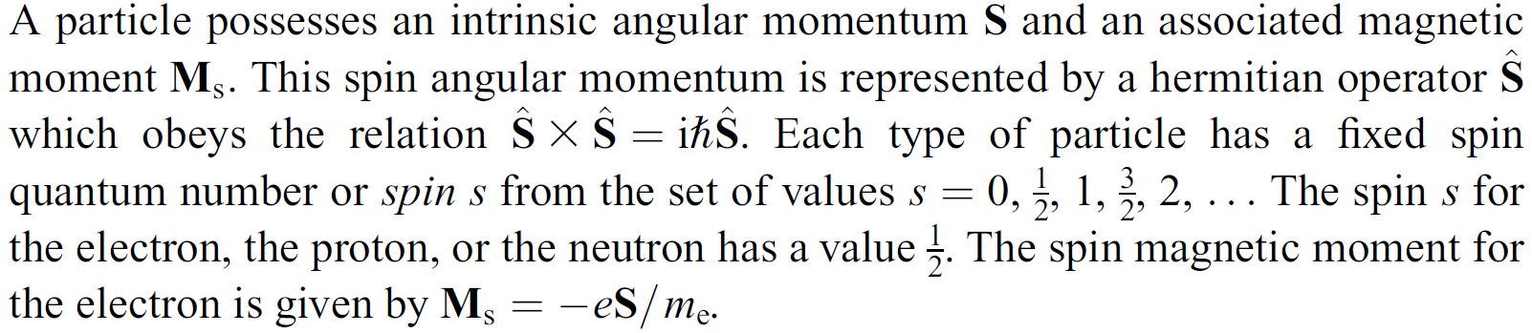


Slide 9
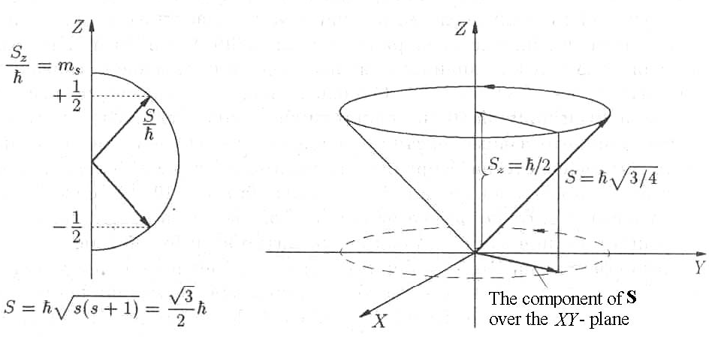
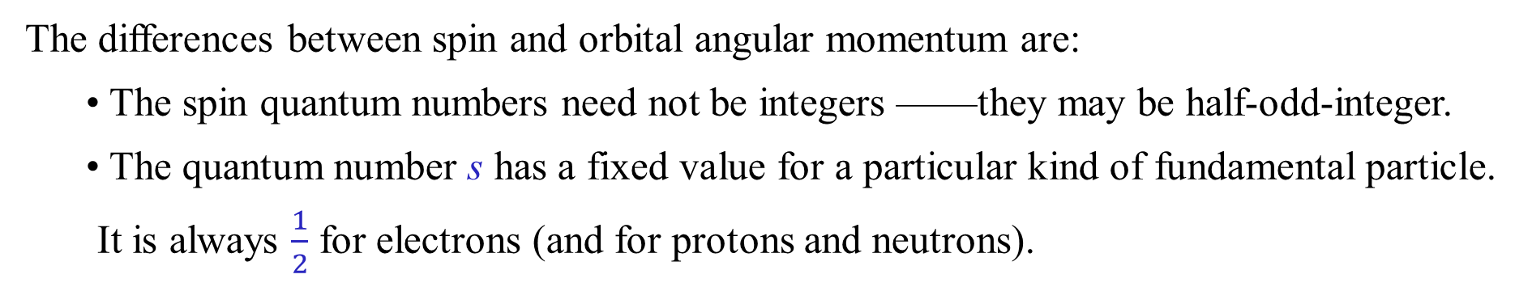
The differences between spin and orbital angular momentum are:
• The spin quantum numbers need not be integers ——they may be half-odd-integer.
• The quantum number s has a fixed value for a particular kind of fundamental particle. It is always $\frac{1}{2}$ for electrons (and for protons and neutrons).

Slide 10
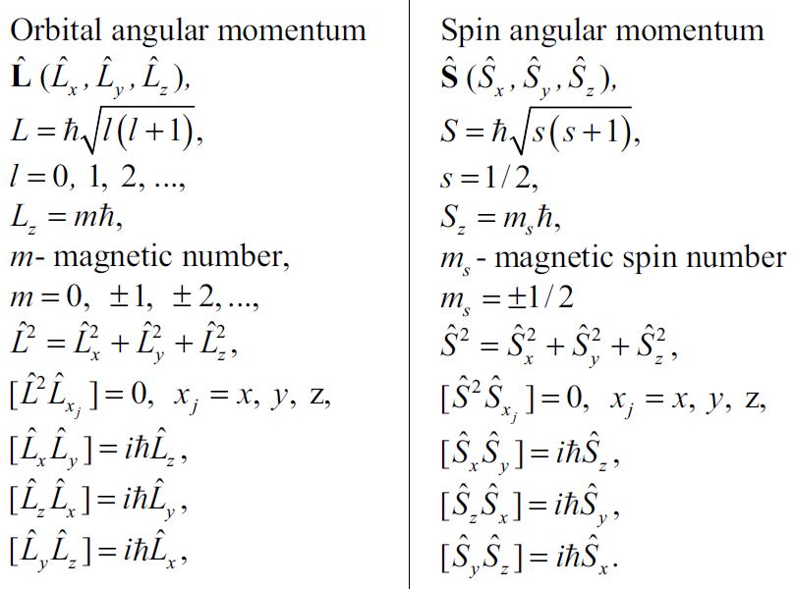

Slide 11
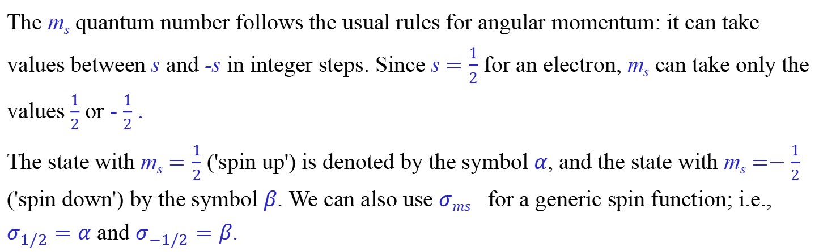
Notations for spin
The m_{s} quantum number follows the usual rules for angular momentum: it can take values between s and -s in integer steps. Since s $=\frac{1}{2}$ for an electron, m_{s} can take only the values $\frac{1}{2}$ or - $\frac{1}{2}$ .
The state with m_{s} $=\frac{1}{2}$ ('spin up') is denoted by the symbol $α$, and the state with m_{s} $=−\frac{1}{2}$ ('spin down') by the symbol $β$. We can also use $σms_{}$for a generic spin function; i.e., $σ_{1/2}=α$ and $σ_{−1/2}=β$.
These can be thought of as wavefunctions, but there is no coordinate in the conventional sense

Slide 12
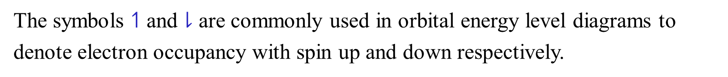
Spin wavefunction
S = 1/2
m_{s} = 1/2
|α>
S = 1/2
m_{s} = -1/2
|β>
The symbols $↿$ and $⇂$ are commonly used in orbital energy level diagrams to denote electron occupancy with spin up and down respectively.

Slide 13
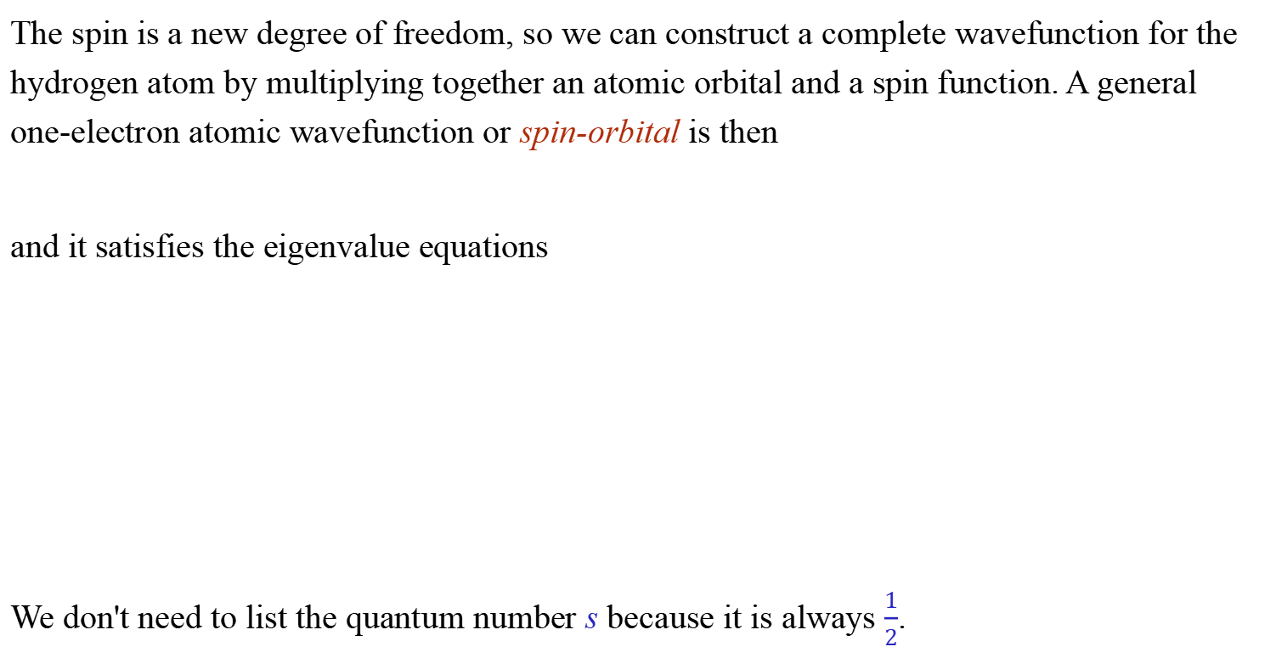
Wavefunctions including spin
The spin is a new degree of freedom, so we can construct a complete wavefunction for the hydrogen atom by multiplying together an atomic orbital and a spin function. A general one-electron atomic wavefunction or spin-orbital is then
and it satisfies the eigenvalue equations
We don't need to list the quantum number s because it is always $\frac{1}{2}$.

Slide 14
Quantum Numbers
n
1 2 3 4
l
0 0 1 0 1 2 0 1 2 3
m_{l}
0 0 -1 0 +1 0 -1 0 +1 0 -1 0 +1
-2 -1 0 +1 +2 -2 -1 0 +1 +2
-3 -2 -1 0 +1 +2 +3
The total number of orbitals for a given value of n is n². Considering the spin, the degeneracy is 2 n²

Slide 15
From hydrogen like atoms to multi-electron systems (atoms, molecules, radicals…), what happens?
电子自旋，对于多电子体系，讨论单个电子的自旋没有意义！
电子轨道角动量…
Notes:
在一个多电子体系中，当你测量其中一个电子的自旋时，你不仅瞬间决定了它的状态，也瞬间影响了其他纠缠电子的状态。因此，你无法再独立地、确定地描述任何一个单独电子的自旋。它们是一个不可分割的整体。

Slide 16
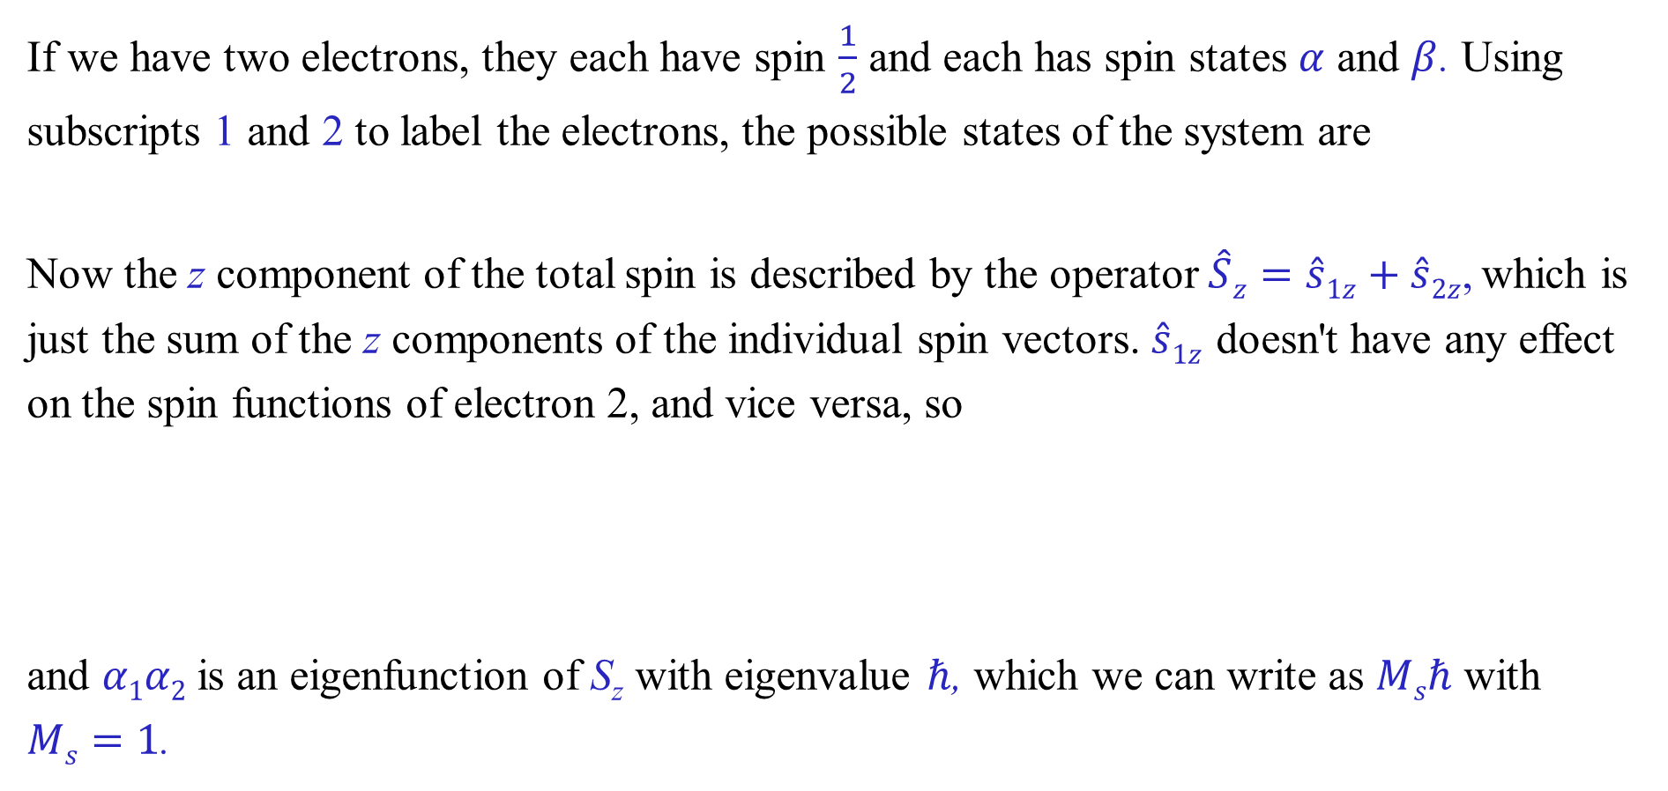
Two spins
If we have two electrons, they each have spin $\frac{1}{2}$ and each has spin states $α$ and $β$. Using subscripts 1 and 2 to label the electrons, the possible states of the system are
Now the z component of the total spin is described by the operator$\hat{S}z=\hat{s}1z+\hat{s}2z$, which is just the sum of the z components of the individual spin vectors. $\hat{s}1z$doesn't have any effect on the spin functions of electron 2, and vice versa, so
and $α1α2$is an eigenfunction of S_{z} with eigenvalue $ℏ$, which we can write as $Msℏ$ with $Ms=1$.

Slide 17
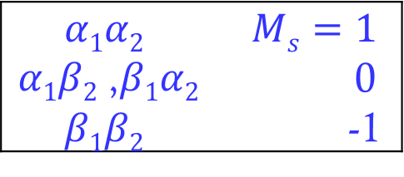
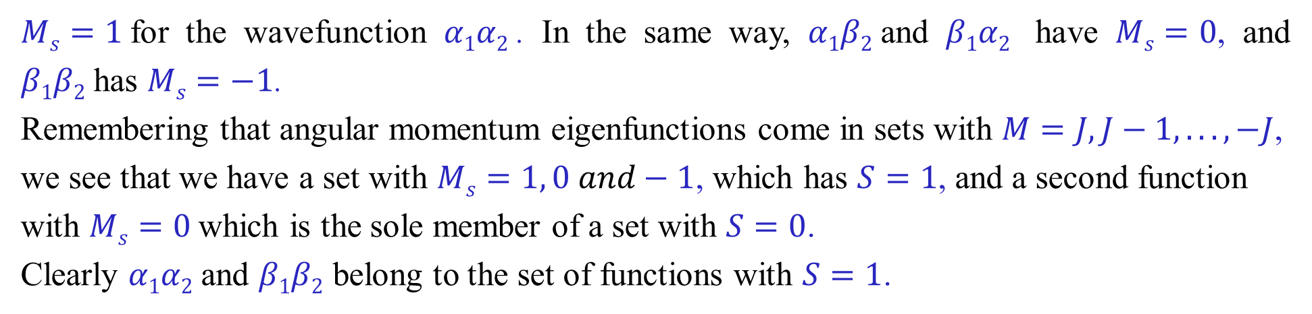
Two spins: singlet and triplet states
$Ms=1$for the wavefunction $α1α2$. In the same way, $α1β2$and $β1α2$ have $Ms=0$, and $β1β2$has $Ms=−1$.
Remembering that angular momentum eigenfunctions come in sets with $M=J, J−1,. .., −J$, we see that we have a set with $Ms=1, 0 and−1$, which has $S=1$, and a second function with $Ms=0$which is the sole member of a set with $S=0$.
Clearly $α1α2$and $β1β2$ belong to the set of functions with $S=1$.
$$α1α2$$ | $$Ms=1$$
$α1β2$,$β1α2$ | 0
$$β1β2$$ | -1
对于单个电子，S_{Z}足以确定状态，但如何确定多个电子体系的自旋？

Slide 18
Ladder operator
Orbital angular momentum and spin angular momentum have common mathematical properties that are not dependent on a coordinate representation
S = 1/2
m_{s} =±1/2

Slide 24
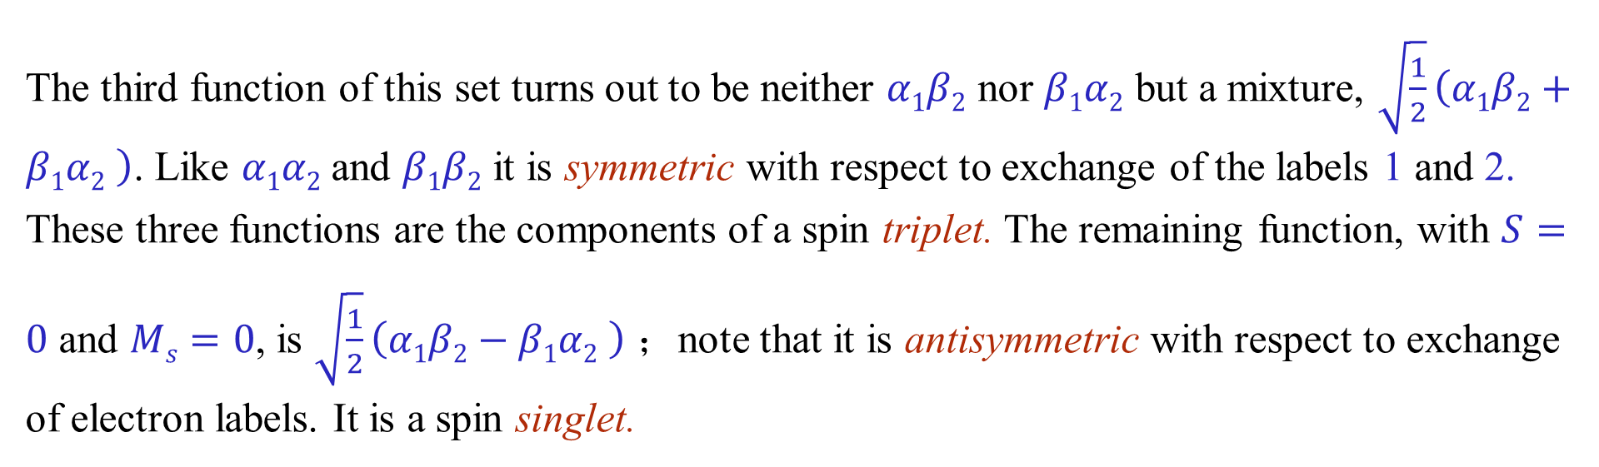
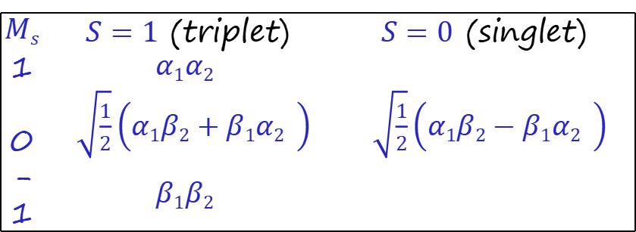
$$Ms$$ | $S=1$ (triplet) | $S=0$ (singlet)
1 | $$α1α2$$
0 | $\sqrt{\frac{1}{2}}\left(α1β2+β1α2 \right)$ | $\sqrt{\frac{1}{2}}\left(α1β2−β1α2 \right)$
-1 | $$β1β2$$
The third function of this set turns out to be neither $α1β2$ nor $β1α2$ but a mixture, $\sqrt{\frac{1}{2}}\left(α1β2+β1α2 \right)$. Like $α1α2$and $β1β2$ it is symmetric with respect to exchange of the labels 1 and 2. These three functions are the components of a spin triplet. The remaining function, with $S=0$ and $Ms=0$, is $\sqrt{\frac{1}{2}}\left(α1β2−β1α2 \right)$；note that it is antisymmetric with respect to exchange of electron labels. It is a spin singlet.

Slide 25
5.2 Identical particles
在经典力学中，尽管两个物体表观性质完全相同，我们仍然可以区分它们。因为它们在运动过程中都有自己确定的位置和速度。
在量子力学中，质量、电荷、自旋等固有性质完全相同的微观粒子称为“全同粒子”
在量子力学中，粒子的状态不再用位置和速度描述，而是用波函数描述。由于波粒二象性，两个粒子在运动中。其波函数在空间中发生重叠，我们无法分辨两个粒子。
全同粒子的不可区分特性是微观粒子固有特性。由全同粒子所组成的体系中，两个粒子相互交换并不引起体系状态的改变，这就是“全同性原理”。从而，全同粒子拥有经典体系所没有的量子特性。

Slide 26
量子纠缠（quantum entanglement）
根据量子力学，当几个粒子在彼此相互作用后，由于各个粒子所拥有的特性已综合成为整体性质，无法单独描述各个粒子的性质，只能描述整体系统的性质。
因此，对于一个子系统的测量结果无法独立于对其他子系统的测量。
Ψ(x₁,x₂) ≠ ψ(x₁)⋅ψ(x₂)

Slide 27
The permute operation should not change the physical property of the state wave function
the eigenfunctions of P_{ij}
symmetric or antisymmetric

Slide 28
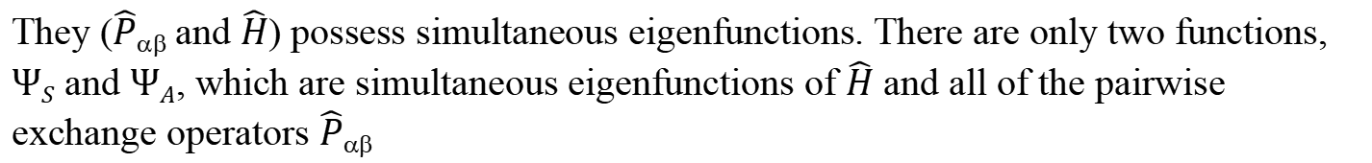
N-particle systems
They ($\hat{P}αβ$and $\hat{H}$) possess simultaneous eigenfunctions. There are only two functions, $ΨS$ and $ΨA$, which are simultaneous eigenfunctions of $\hat{H}$ and all of the pairwise exchange operators $\hat{P}αβ$
boson
fermion

Slide 29
A fermion is a type of particle that obeys the rules of Fermi-Dirac statistics, namely the Pauli Exclusion Principle. These fermions also have a quantum spin with contains a half-integer value, such as 1/2, -1/2, -3/2, and so on.
If a particle belongs to a fermion, the quantum state for this kind of particle should be singly occupied.
By comparison, there are other types of particles, called bosons, that have an integer spin, such as 0, 1, -1, -2, 2, etc.)

Slide 30
Symmetric and antisymmetric orbital functions
Electronic wave function can be regarded as the product of spatial part and spin part
This function doesn't change if we switch the electrons — it is symmetric with respect to electron exchange.
Ψ_{S}
This function changes sign if we switch the electrons ——it is antisymmetric with respect to electron exchange.
Ψ_{A}

Slide 31
For a system of two identical particles
If a system is composed of several kinds of particles, then its wave function must be separately symmetric or antisymmetric with respect to each type of particle.
two bosons
two fermions
Electronic wave function should be antisymmetric.
Ψ_{ele} = (spatial function) × (spin function)
antisymmetric
symmetric
antisymmetric
symmetric

Slide 32

The Pauli principle
We can combine these with singlet and triplet spin functions respectively to obtain acceptable overall wavefunctions.
Note that if $φ_{a}=φ_{b}$, the wavefunction of triplet state vanishes. Thus two electrons can go into the same orbital only if they have opposite spins (singlet state).

Slide 33
How to construct antisymmetric wave function?
For He atom:
For Li atom:
Spin-orbital

Slide 34
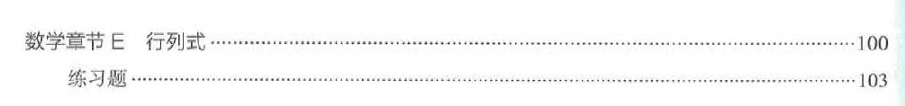
Ψ(1,2,…n)

Slide 35
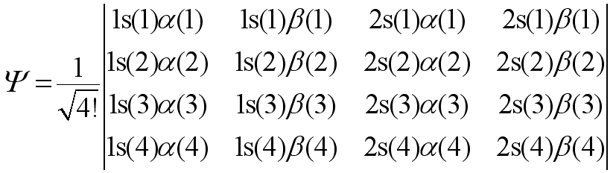
The electronic configuration (for ground state)
1s
H = 1s¹
He = 1s²
Li = 1s² 2s¹
Be = 1s² 2s²
B = 1s² 2s² 2p¹
C = 1s² 2s² 2p²
N = 1s² 2s² 2p³
O = 1s² 2s² 2p⁴
F = 1s² 2s² 2p⁵
Ne = 1s² 2s² 2p⁶
2s
2p

Slide 36
The helium atom
The 1s² configuration of the He atom has only one possible state, a singlet, so we consider the excited ls2s configuration to explore the energy differences between singlet and triplet.
For the ls2s configuration, the possible states are the spin singlet, for which the orbital function is symmetric:
and the spin triplet, for which the orbital function is antisymmetric:
Ψ_{singlet}
Ψ_{triplet}

Slide 37
Fermi holes
Consider a wavefunction for two electrons with the symmetric spin function (triplet), when the spatial parts of the electrons are the same, the wavefunction must vanish. That is, the probability of two electrons with the same spin being in the same place is zero.
There is no such limitation for electrons of opposite spin.

Slide 38
While the spin is not directly affected by electron repulsion, the interplay between orbital and spin angular momentum that results from the Pauli principle means that it is not useful to think about individual electron spins either, so we can only use the total spin, with quantum numbers S and M_{S}.
To reduce the electron repulsion energy as much as possible, we need as many Fermi holes as possible, which in turn means as many parallel electron spins as possible.

