Slide 1
Simple system
solvable
Particle in a Box
Harmonic Oscillator
Hydrogen-like Atom
Rigid Rotor
Hydrogen Molecule Ion
complex system
not separable
For example: many-electron atom or molecule

Slide 2

"整个化学领域所依赖的物理定律已完全明晰，困难仅在于这些定律的精确应用会导出过于复杂而无法求解的方程。因此，有必要发展量子力学的近似实用方法——这些方法无需过多计算便能解释复杂原子系统的主要特征。“
1929，狄拉克
量子力学的近似实用方法：变分法与微扰理论

Slide 3
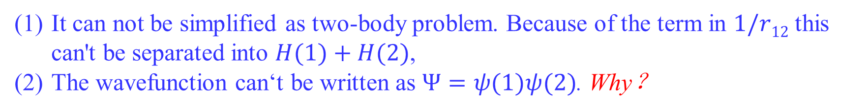
Many-electron systems
The Hamiltonian for He is
(1)
The Hamiltonian for HF is (板书)
It can not be simplified as two-body problem. Because of the term in $1/r12$ this can't be separated into $H(1)+H(2)$,
The wavefunction can‘t be written as $Ψ=ψ(1)ψ(2)$. Why？

Slide 4
6.1 The Born-Oppenheimer approximation
假定电子的运动可以与原子核的运动分开描述。其理论依据即为玻恩-奥本海默近似。除非需要极高的精确度，否则在我们关注电子行为时，可以完全忽略原子核的运动。因此，在计算电子波函数时，原子核视为固定不动
该近似下, 哈密顿算符表达为：
这一项如何表达？（板书）

Slide 5
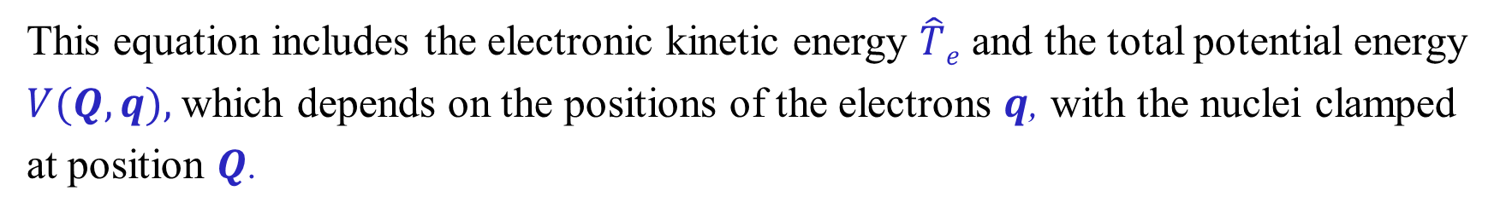
The electronic Schrodinger equation,
(2)
which is the first half of the Born-Oppenheimer approximation.
This equation includes the electronic kinetic energy $\hat{T}e$ and the total potential energy $V(Q,q),$which depends on the positions of the electrons $q$, with the nuclei clamped at position $Q$.
如果我们只关注某一特定核构型（例如平衡构型）下的电子能级和轨道，那么我们只需将𝑸设定为该构型下的原子核位置，并求解一次方程(1)即可。

Slide 6
如果我们希望进一步研究原子核的运动，就需要在一系列不同的核位置𝑸上求解该方程，以便得到电子能量$E\text{e}\text{l}\text{ec}(Q)$随𝑸变化的函数关系，即势能面。
where $\hat{T}N$ is the nuclear kinetic energy operator. The nuclear wave function $ψ\text{nuc}(Q)$ is calculated by solving the nuclear dynamics Schrodinger equation,
where E is the total energy.

Slide 7

在实际计算中，有时会采用Morse potential近似每一条势能曲线；或者，如果只关注平衡点附近的振动，则可采用谐振子势进行近似。
描述分子中所有电子与原子核整体运动的total wave function $ψ\text{tot}(q,Q)$是两者的乘积。
玻恩-奥本海默近似通常是准确的，但当不同的势能面相互靠近时，近似可能失效。
Using B.O approximation and atomic unit, the electronic Hamiltonian of He is:
即使有玻恩-奥本海默近似，该薛定谔方程也无法精确求解。

Slide 8
体系的能量期望值 E[ψ] = <ψ|Ĥ|ψ>/<ψ|ψ> 是一个典型的泛函。给定一个任意波函数 ψ，我们就会得到一个对应的能量数值 E
绕过无法精确求解的薛定谔方程，通过直接在函数空间中搜索和比较，来逼近那个使泛函取极值的函数

Slide 9
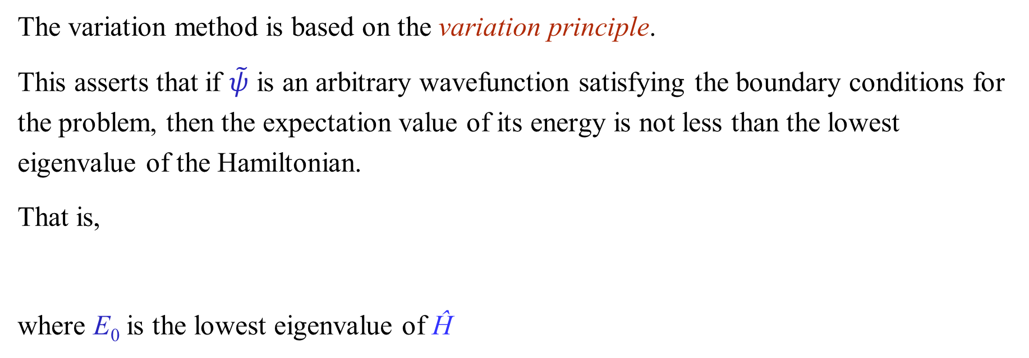
6.2 The variation method
The variation method is based on the variation principle.
This asserts that if $\tilde{ψ}$ is an arbitrary wavefunction satisfying the boundary conditions for the problem, then the expectation value of its energy is not less than the lowest eigenvalue of the Hamiltonian.
That is,
where E₀ is the lowest eigenvalue of Ĥ
Ĥ

Slide 10
Proof
Expand $\tilde{ψ}$ in terms of the normalized eigenfunctions of Ĥ
If Ĥ is any linear Hermitian operator that represents a physically observable property, then the eigenfunctions of Ĥ form a complete set.
Ĥ
Ĥ

Slide 11
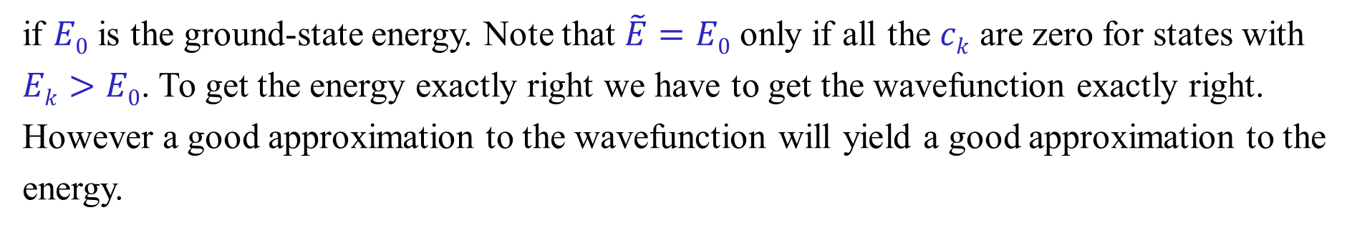
so that
Ĥ
if $E0$ is the ground-state energy. Note that $\tilde{E}=E0$ only if all the $ck$ are zero for states with $Ek>E0$. To get the energy exactly right we have to get the wavefunction exactly right.
However a good approximation to the wavefunction will yield a good approximation to the energy.
为获得基态能量的优良近似，需对诸多试探函数进行逐一测试，其目标在于寻得使变分积分达到极小的最优函数。

Slide 12
6.3 Application of variation method for simple cases
a particle in a box
the harmonic oscillator
multi-electron atoms

Slide 13
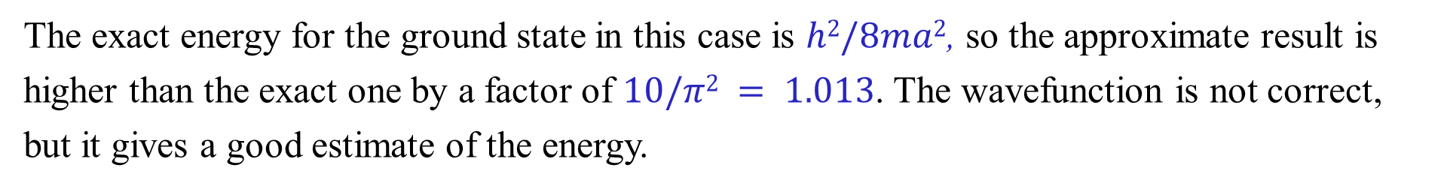
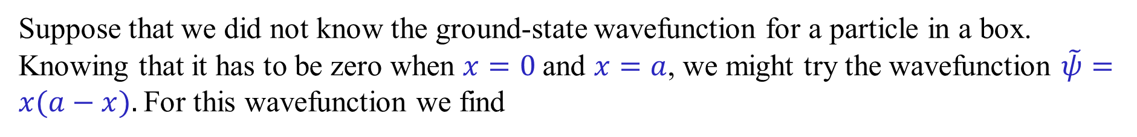
Variation principle for a particle in a box
Suppose that we did not know the ground-state wavefunction for a particle in a box. Knowing that it has to be zero when $x=0$and $x=a$, we might try the wavefunction $\tilde{ψ}=x(a−x).$For this wavefunction we find
Ĥ
Ĥ
Ĥ
0
l
The exact energy for the ground state in this case is $h2/8ma2$, so the approximate result is higher than the exact one by a factor of $10/π2 = 1.013$. The wavefunction is not correct, but it gives a good estimate of the energy.

Slide 14
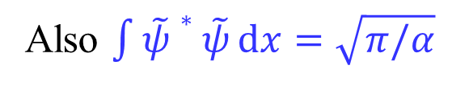
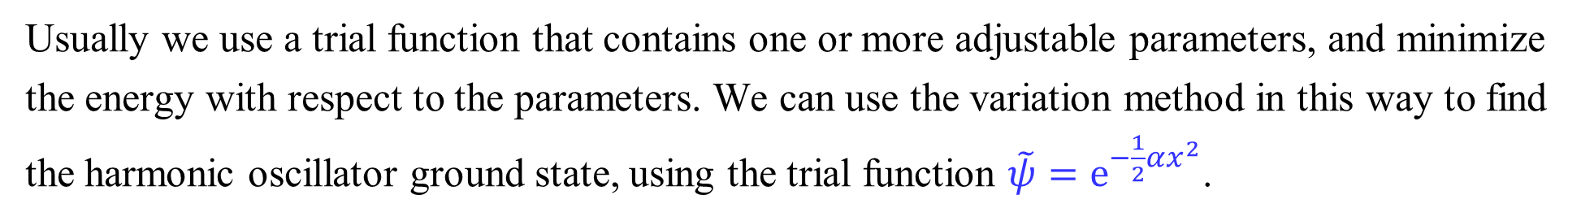
Variation method for the harmonic oscillator
Usually we use a trial function that contains one or more adjustable parameters, and minimize the energy with respect to the parameters. We can use the variation method in this way to find the harmonic oscillator ground state, using the trial function $\tilde{ψ}=e^{−\frac{1}{2}αx^{2}}$.
Ĥ
Ĥ
Also $\int{\tilde{ψ}∗\tilde{ψ}}dx=\sqrt{π/α}$
Ĥ

Slide 15
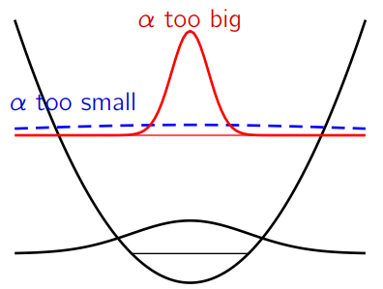
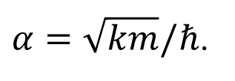
Ĥ
$α=\sqrt{km}/ℏ$.
𝐸̃中的第一项是动能期望值⟨𝑇⟩，第二项是势能期望值⟨𝑉⟩。若𝛼值较大，我们会得到尖锐峰化的波函数𝜓̃，此时体系势能较低但动能较高。若𝛼值较小，波函数会变得平缓且在空间分布较广，其随x变化缓慢，因而⟨𝑇⟩较小，但波函数会延伸至势能较高的区域。
波函数形貌与能量之间的关系

Slide 16
Variation method for the He atom
Ĥ

Slide 17
experimental value –79.01eV
error 5.3%
In practice, one usually puts several parameters into the trial function, and then varies these parameters so as to minimize the variational integral.

Slide 19
6.5 Linear Variation Functions
A linear variation function is a linear combination of n linearly independent functions f₁, f₂, …f_{n}.
Based on this principle, the parameters are regulated by the minimization routine so as to obtain the wavefunction that corresponds to the minimum energy. This is taken to be the wavefunction that closely approximates the ground state.
overlap integral S_{jk}

Slide 20
A necessary condition for a minimum

Slide 23
From the variation theorem, we know that the lowest value of root is the upper bound for the system’s ground-state energy.
If approximation to the energies of more states are wanted, we add more functions f_{k} to the trial function φ.
The addition of more functions f_{k} can be shown to increase the accuracy of the previously calculated energies.

Slide 24
Linear combination of atomic orbitals
Usually we choose a trial wavefunction that has one or more adjustable parameters in it, and choose values for the parameters that minimize the energy. An very important type of trial function is the linear combination of atomic orbitals (L.C.A.O.), which we can illustrate for the hydrogen molecule ion.
The wavefunction for an individual hydrogen atom is the 1s orbital; for a hydrogen molecule cation we try the wavefunction
where s_{a} is the normalized 1s orbital for atom a and s_{b} for atom b, and c_{a} and c_{b} are numerical coefficients that we shall adjust to minimize the energy. This function behaves like s_{a} near nucleus a, where s_{b} is small, and like s_{b} near nucleus b.

Slide 25
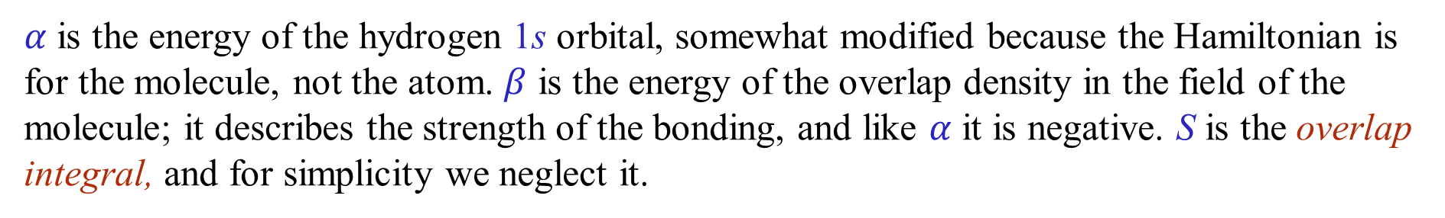

The energy $\tilde{E}$ for the L.C.A.O. trial function is
$α$ is the energy of the hydrogen 1s orbital, somewhat modified because the Hamiltonian is for the molecule, not the atom. $β$ is the energy of the overlap density in the field of the molecule; it describes the strength of the bonding, and like $α$ it is negative. S is the overlap integral, and for simplicity we neglect it.

Slide 26

$$S≠0$$
Note S_{aa} = S_{bb} = 1
and define
H_{aa} = H_{bb} = α
H_{ab} = H_{ba} = β
S_{ab} = S_{ba} = S

Slide 28
How to achieve c_{a} ?

Slide 30
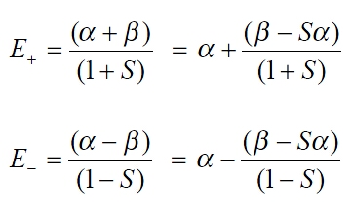
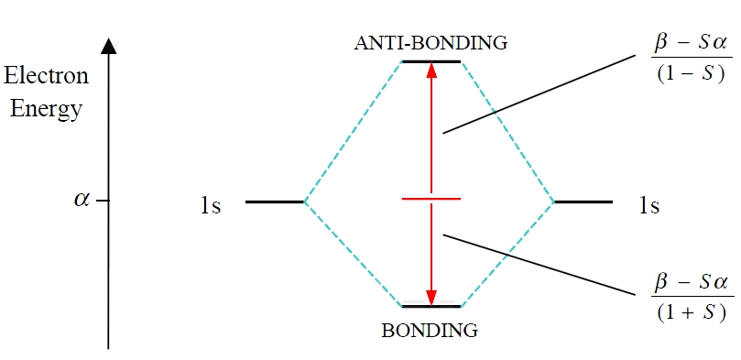

Slide 31
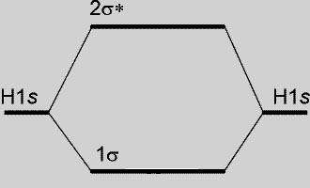
A molecular orbital energy level diagram for orbitals constructed from the overlap of H1s orbitals; the separation of the levels corresponds to that found at the equilibrium bond length.
+

Slide 32
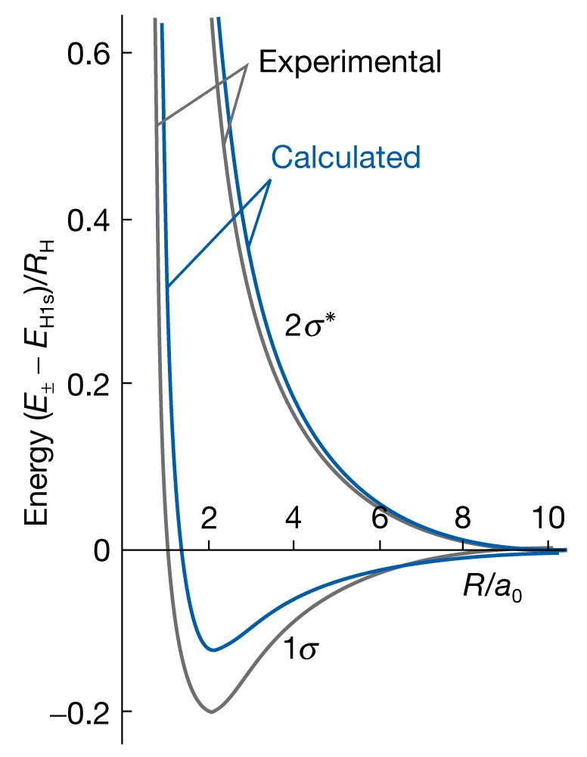
The calculated and experimental molecular potential energy curves for a hydrogen molecule-ion.

Slide 33
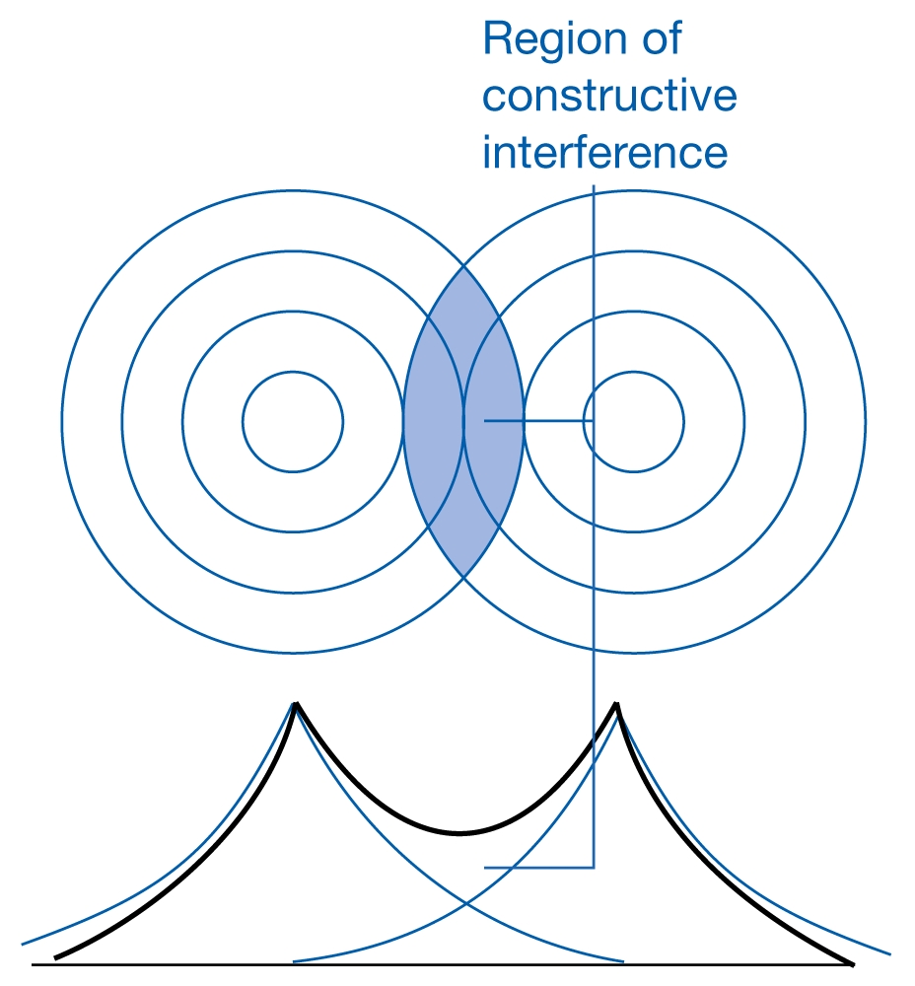
A representation of the constructive interference that occurs when two H 1s orbitals overlap and form a bonding σ orbital.
+
σ_{s}

Slide 34
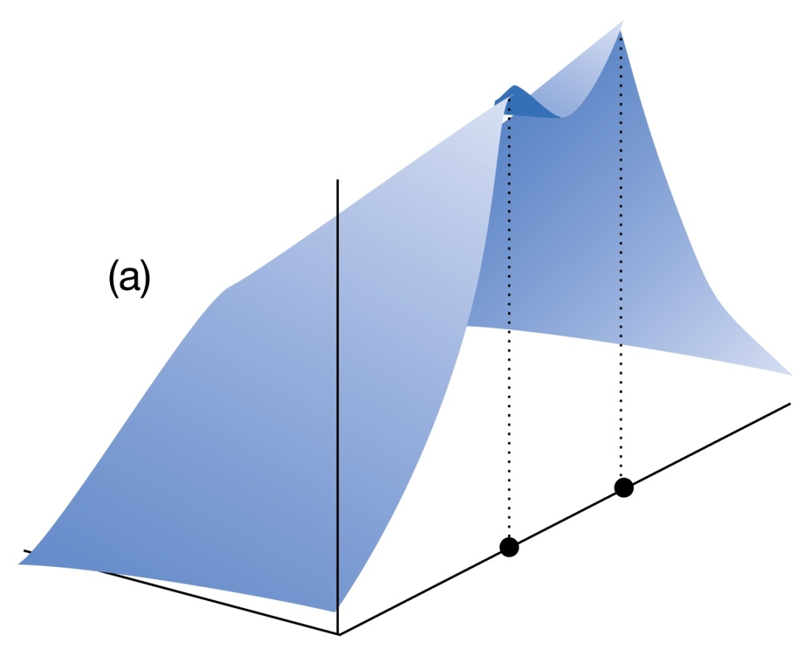
The electron density calculated by forming the square of the wavefunction.
Note the accumulation of electron density in the internuclear region.

Slide 35
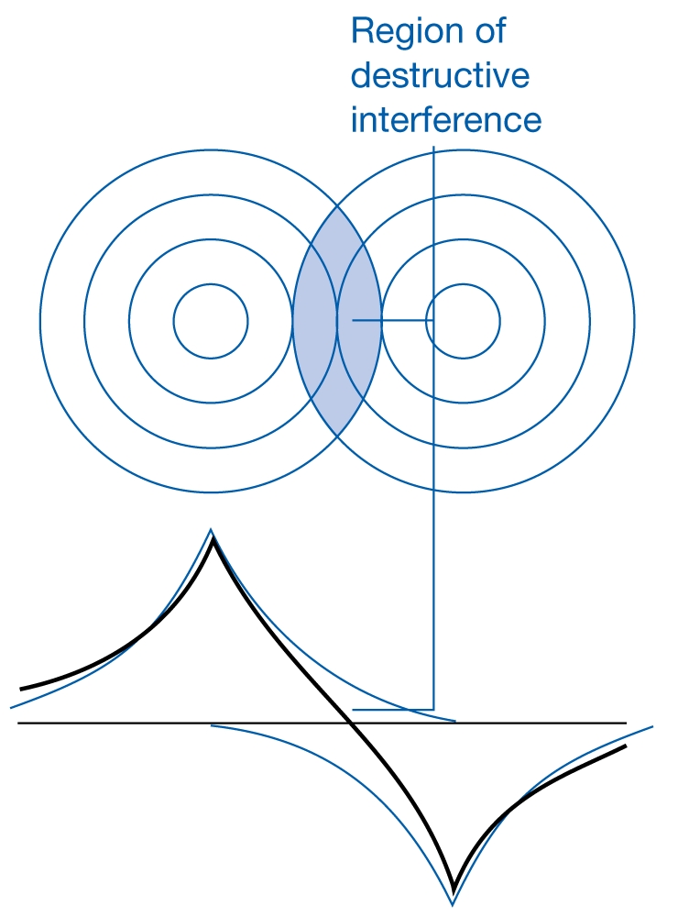
A representation of the destructive interference that occurs when two H1s orbitals overlap and form an antibonding σ* orbital.
+
-
σ_{s}*

Slide 36
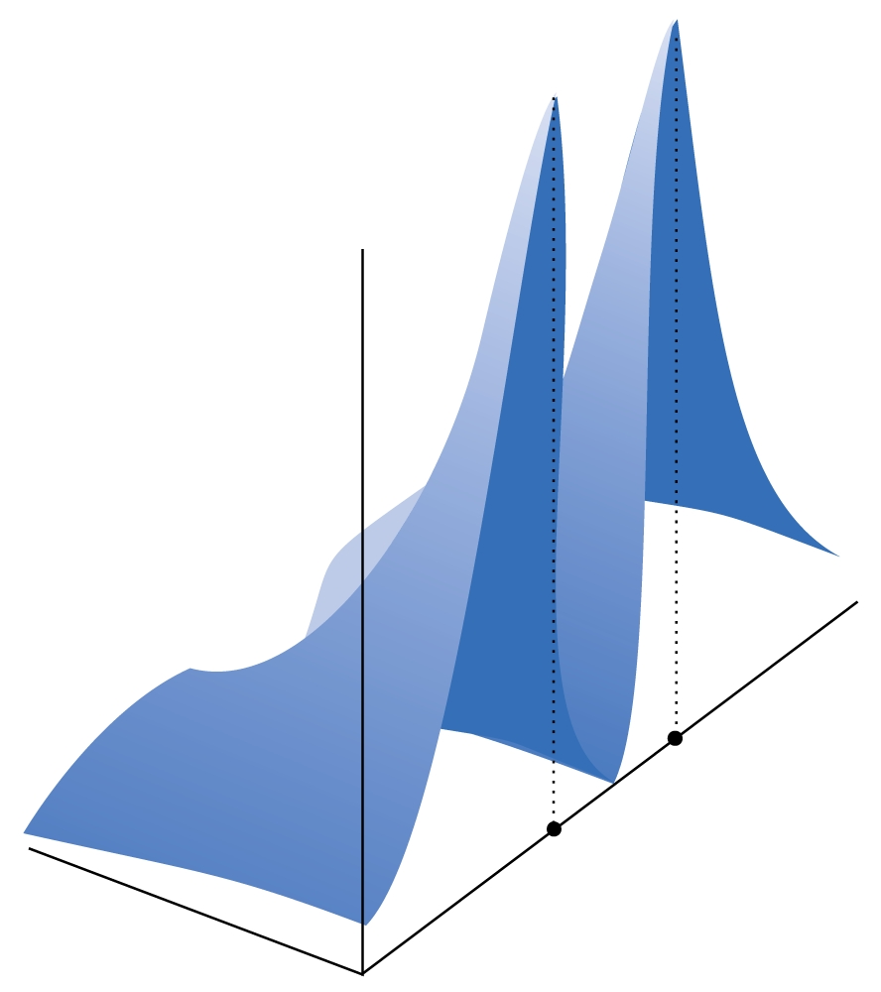
The electron density calculated by forming the square of the wavefunction. Note the elimination of electron density from the internuclear region.

Slide 37
Molecular orbitals of lithium hydride
Often we need to deal with heteronuclear molecules, of which LiH is the simplest example. Here the two valence orbitals, Li 2s and H 1s, have different energies
The secular equations become

Slide 38
In general, we find the orbital coefficients, c_{a} and c_{b} in this case, by substituting the energy back into the secular equations and solving for the coefficients.

Slide 39
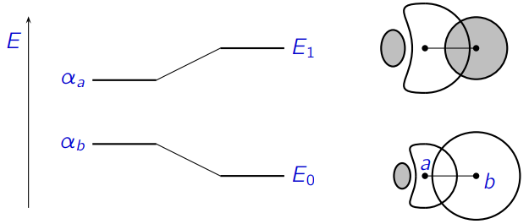
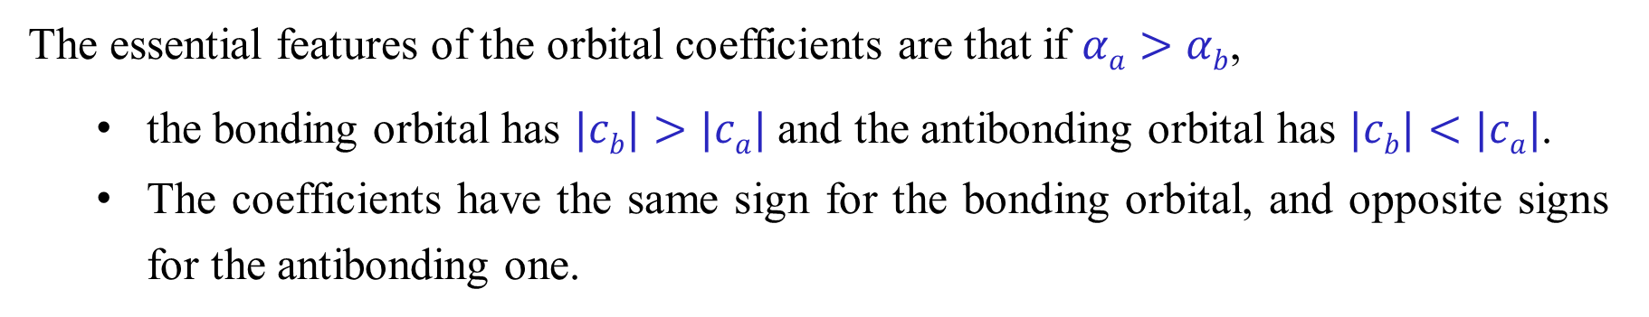
The essential features of the orbital coefficients are that if $αa>αb$,
the bonding orbital has $|cb|>|ca|$ and the antibonding orbital has $|cb|<|ca|$.
The coefficients have the same sign for the bonding orbital, and opposite signs for the antibonding one.

Slide 40
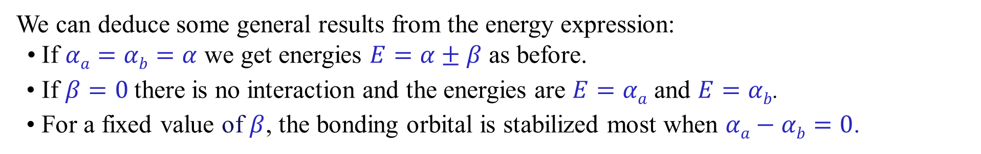
General features of the two-orbital problem
We can deduce some general results from the energy expression:
• If $αa=αb=α$ we get energies $E=α±β$ as before.
• If $β=0$there is no interaction and the energies are $E=αa$ and $E=αb$.
• For a fixed value of $β$, the bonding orbital is stabilized most when $αa−αb=0$.
If
E₁ ≈ α_{a}, E₂ ≈ α_{b}
If
E₁ = α_{a} − |β|, E₂ ≈ α_{b} +|β|
The AOs should have comparable energy.

Slide 41
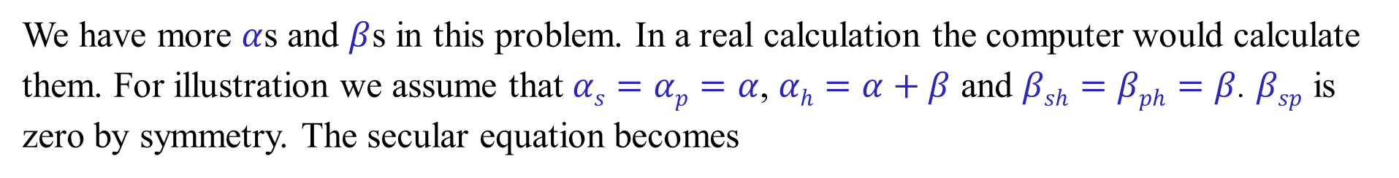
Lithium hydride: a better approach
How do we know that the Li orbital in this molecule is an sp hybrid? We allow the 2s and 2p_{z} orbitals to contribute independently to the wavefunction, and let the variation principle find the answer.
We have more $α$s and $β$s in this problem. In a real calculation the computer would calculate them. For illustration we assume that $αs=αp=α$, $αh=α+β$ and $βsh=βph=β$. $βsp$ is zero by symmetry. The secular equation becomes

Slide 42
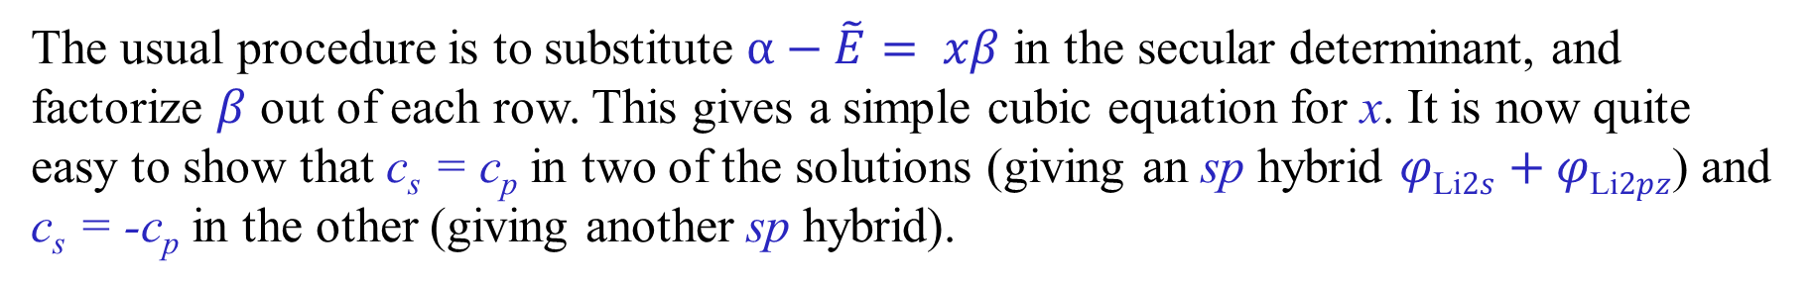
The usual procedure is to substitute $α−\tilde{E}= xβ$ in the secular determinant, and factorize $β$ out of each row. This gives a simple cubic equation for x. It is now quite easy to show that c_{s} = c_{p} in two of the solutions (giving an sp hybrid $φ\text{Li}2s+φ\text{Li}2pz$) and c_{s} = -c_{p} in the other (giving another sp hybrid).

Slide 43
基于线性变分法，哈密顿算符在尝试波函数表象下表达为哈密顿矩阵。通过引入库仑积分α和共振积分β来构建久期方程，从而定性讨论分子的成键、反键轨道和能级关系。我们称之为简单分子轨道理论。
基于此，引入库仑积分α和共振积分β近似，忽略重叠积分，应用于π电子体系，跳过对哈密顿矩阵元的具体计算，直接求解久期方程我们称之为休克尔分子轨道理论 （化学理论IB ）
库仑积分α和共振积分β如何确定？参数化！精度和可推广性无法满足定量计算要求
改造哈密顿算符→ 中心场近似

Slide 44
6.6 Central field approximation
Suppose that a system is composed of the noninteracting particles 1 and 2
we reduce the two-particle problem to two separate one-particle problems.

Slide 45
For n-particle systems
对于一个无相互作用的多粒子系统，能量是每个粒子的个体能量之和，波函数是每个粒子的波函数的乘积。

Slide 46
For a multi-electron atoms, the potential acting on the electron is spherical
Each electron in an atom moves independently in a central potential due to the Coulomb attraction of the nucleus and the average effect of the other electrons in the atom.
electron 1
2
2

Slide 47
Go to electron 2 and regard it as moving in a charge cloud of density due to the other electrons:
改造哈密顿算符→ 中心场近似→ 单粒子算符（算符里含有波函数）
This is called the Self-Consistent Field or SCF method.

Slide 48
6.7 The Hartree-Fock SCF method*
To vary the functional F(ϕ(x)) with respect to ϕ(x) subject to G(ϕ(x))=0,
Solve: δF + λδG = 0
We then obtain ϕ(x, λ) and fix λ by requiring G(ϕ(x, λ)) = 0
For Slater one-determinant function ψ

Slide 49
The Search for the conditional Extremum*
Condition: the orthonormality of the spinorbitals.
The necessary condition for the minimum is that the variation is zero according to differential.

Slide 50
Fock operator*
Canonical spinorbitals
Fock Op.
orbital energy
Both the Fock operator and the molecular spin orbital depend on the coordinates of one electron only.
Ĵ and K operators are connected with the potential energy of the interaction of electron 1 with all electrons in the system. They are defined via the action on any function of the position of electron 1.

Slide 51
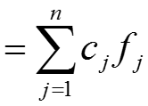
Molecular Orbital (MO) Theory
Every electron in a molecule is in an average potential field of the nuclei and the other electrons. The state of electron i is described by the ψ_{i} wavefunction, the one-electron wavefunction
LCAO-MO:
ψ

Slide 52
In mean field methods, instead of watching the motion of other objects in details, we average these motions, and the problem simplifies.
• one-determinant approximation,
• one-electron approximation,
• one-particle approximation,
• molecular orbital method,
• independent-particle approximation,
• mean field approximation,
• Hartree–Fock method,
• self-consistent field method (as regards practical solutions).

Slide 53
找一个尝试波函数ψ(λ₁, λ₂, λ₂… λ_{n})
E = <ψ(λ₁, λ₂, λ₂… λ_{n})|H|ψ(λ₁, λ₂, λ₂… λ_{n})>
∂E/∂λ_{n}
独立粒子近似
多电子波函数ψ(λ₁, λ₂, λ₂… λ_{n})要满足反对称化 => Slater行列式
单粒子轨道正交归一 => 拉格朗日乘子法（条件求极值）
Hartree-Fock
HK定理 + KS近似
ρ_{s}(r) defined → v_{s}(r_{i}) determined
KS-DFT

Slide 54
6.8. Perturbation theory

Slide 55
Perturbation theory
微扰理论为解决一类特殊体系的薛定谔方程提供了方法：当某个体系的特性与已知精确解的体系仅有微小差异时，该理论能通过近似计算获得其波动方程的解。
The Hamiltonian operator for the system is given by
We suppose that the Schrödinger equation for this Hamiltonian operator
Unknown：
However, we exactly know:
cannot be solved exactly.
Known：

Slide 56
In perturbation theory we assume that Ĥ may be expanded in terms of a small parameter λ
The operator is called the perturbation (small)
The operator Ĥ differs only slightly from Ĥ⁽⁰⁾, the eigenfunctions and eigenvalues of Ĥ do not differ greatly from those of the unperturbed Hamiltonian operator Ĥ⁽⁰⁾.

Slide 57
Nondegenerate Perturbation Theory
Known：
Unknown：
(*)
(**)
In the limit λ→0, the perturbed system reduces to the unperturbed system.

Slide 58
λ

Slide 59
The first-order equation is one equation with two unknowns.
Use the condition of δ_{mn}, the first order energy correction can be:
m = n
The first-order correction to the energy is an average of the perturbation operator over the unperturbed wave function

Slide 60
Example 1:
High level of harmonic oscillator

Slide 61
Example 2:
If the perturbated Hamiltonian is a constant amount, V₀. What is the first order correction?
Example 3:
A 1-dimensional box potential is perturbated so that it is raised by a constant amount, a, in the half of the box, and lowered by a in the right half. What is the first order change in energy for the lowest energy state ψ1?

