Slide 1
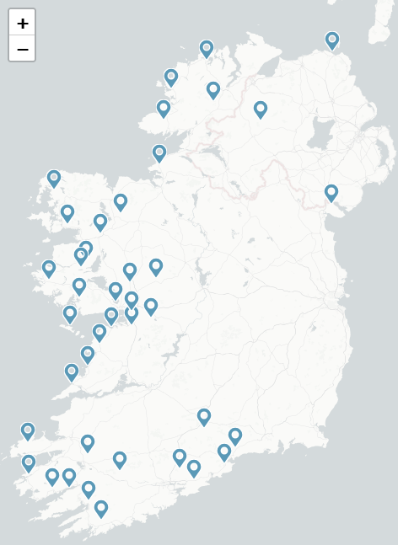
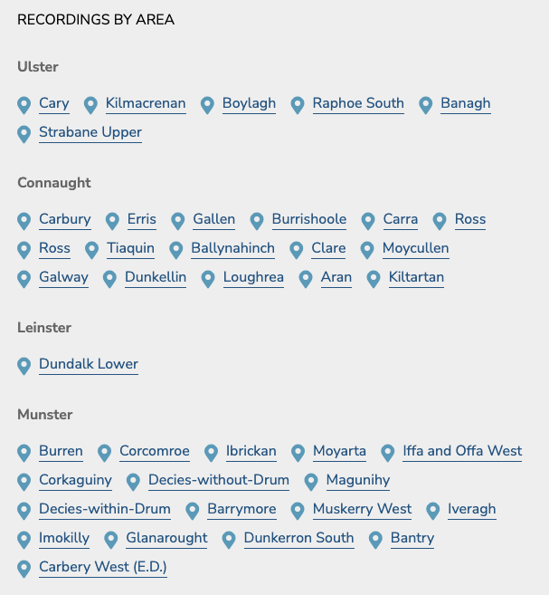
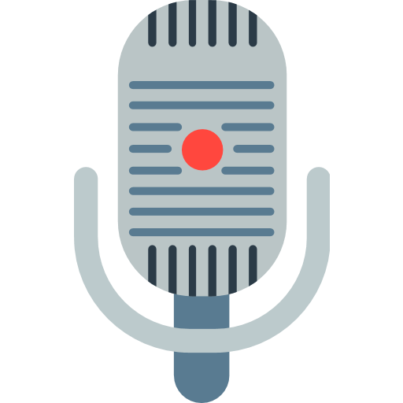
Mapping the Spoken Word
Click The Mic To Record!
PREVIOUS
Say this!
The movie theatre was showing that new film about the royal family's history, and the queue stretched all the way around the corner. People had been waiting for hours just to get tickets for the evening showing.

Slide 2


Mapping the Spoken Word
PREVIOUS
0:11
Keep going!
The movie theatre was showing that new film about the royal family's history, and the queue stretched all the way around the corner. People had been waiting for hours just to get tickets for the evening showing.

Slide 3


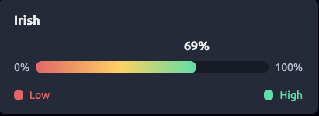

Mapping the Spoken Word
PREVIOUS
Confidence Rating
53.44442, -7.098127
Your result: Kinnegad

