Slide 1
MediWatch
Brought to you by:
Jordan Conway
Méabh Gibney
Jason Njoku
Cian Ashby

Slide 2

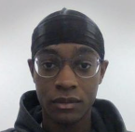
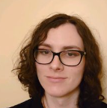

Get to know the team
Cian Ashby
Roles
Team Lead
Front End Developer
User Tester
Jason Njoku
Roles
Front End Developer
Front End Tester
Méabh Gibney
Roles
Back End Developer
Database Developer
Jordan Conway
Roles
Back End Developer
Hardware Engineer
System Tester

Slide 3
Get to know the idea
We wish to improve the current landscape of medication boxes, by adding an IoT system on top of existing implementations.​
This will allow users to effectively keep track of what medication they should or shouldn’t take.​
This information will be conveyed through hardware and notifications.
Users who are forgetful or stressed may benefit from our idea, as the resulting product should provide timely, easy-to-digest notifications. This will help lighten the burden of managing medication off the user’s mind.

