Slide 1
MediWatch
Brought to you by:
Jordan Conway
Méabh Gibney
Jason Njoku
Cian Ashby

Slide 2
Table of Contents
Introduction Card Table of Contents Get to know the team Get to know the idea Functionality M & S Functionality C & W User Personas How users connect How we can tell if the project has been successful or not. Initial UI Sketch User Interface User Interface List of Hardware | 14. Fritzing Diagram 15. Powering the Device 16. Network Connectivity 17. Physical Security 18. Data Storage 19. Data Storage – Example Entries 20. Data Gathering - Switches 21. Data Gathering - User 22. Data Processing 23. Data Processing – Example Queries 24. Data Security 25. Structure of User Test 26. Metrics of User Test 27. Life Cycle of User Tests

Slide 3
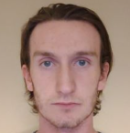
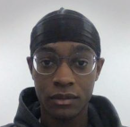
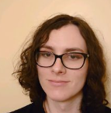
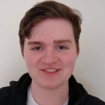
Get to know the team
Cian Ashby
Roles
Team Lead
Front End Developer
User Tester
Jason Njoku
Roles
Front End Developer
Front End Tester
Méabh Gibney
Roles
Back End Developer
Database Developer
Jordan Conway
Roles
Back End Developer
Hardware Engineer
System Tester

Slide 4
Get to know the idea
We wish to improve the current landscape of medication boxes, by adding an IoT system on top of existing implementations.​
This will allow users to effectively keep track of what medication they should or shouldn’t take.​
This information will be conveyed through hardware and notifications.
Users who are forgetful or stressed may benefit from our idea, as the resulting product should provide timely, easy-to-digest notifications. This will help lighten the burden of managing medication off the user’s mind.

Slide 5
Functionality M & S
Must Have
Should Have
Must be able to remind the user to take their medication.
Must be able to notify carers.
Must be able to track when medications is to be taken.
Must be able to handle inter-dependencies between medications.
Should be able to handle multiple medications.
Should be able to handle multiple boxes.
Should be able to handle loss of connection.
Should be able to warn the user if they have taken the wrong medication.

Slide 6
Functionality C & W
Could Have
Would be Nice to Have
Store a record of previous days.
Audio version of notifications.
Locking
It should be either portable or able to handle the user travelling without the box.
Location tracking.
Emergency contact button.

Slide 7
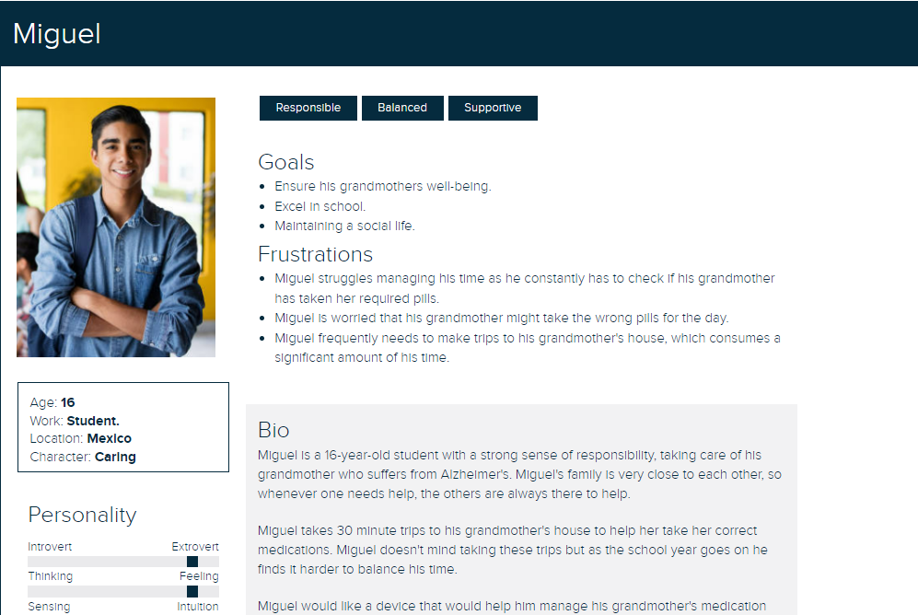
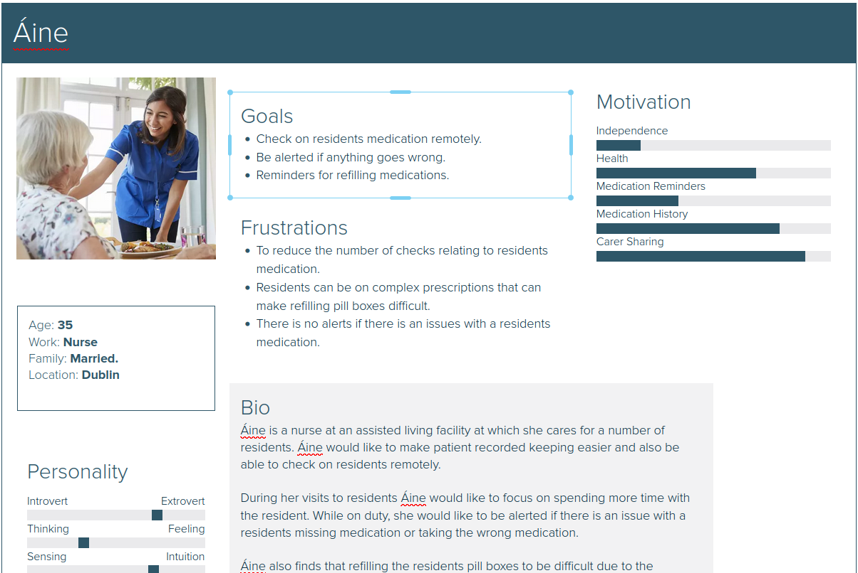
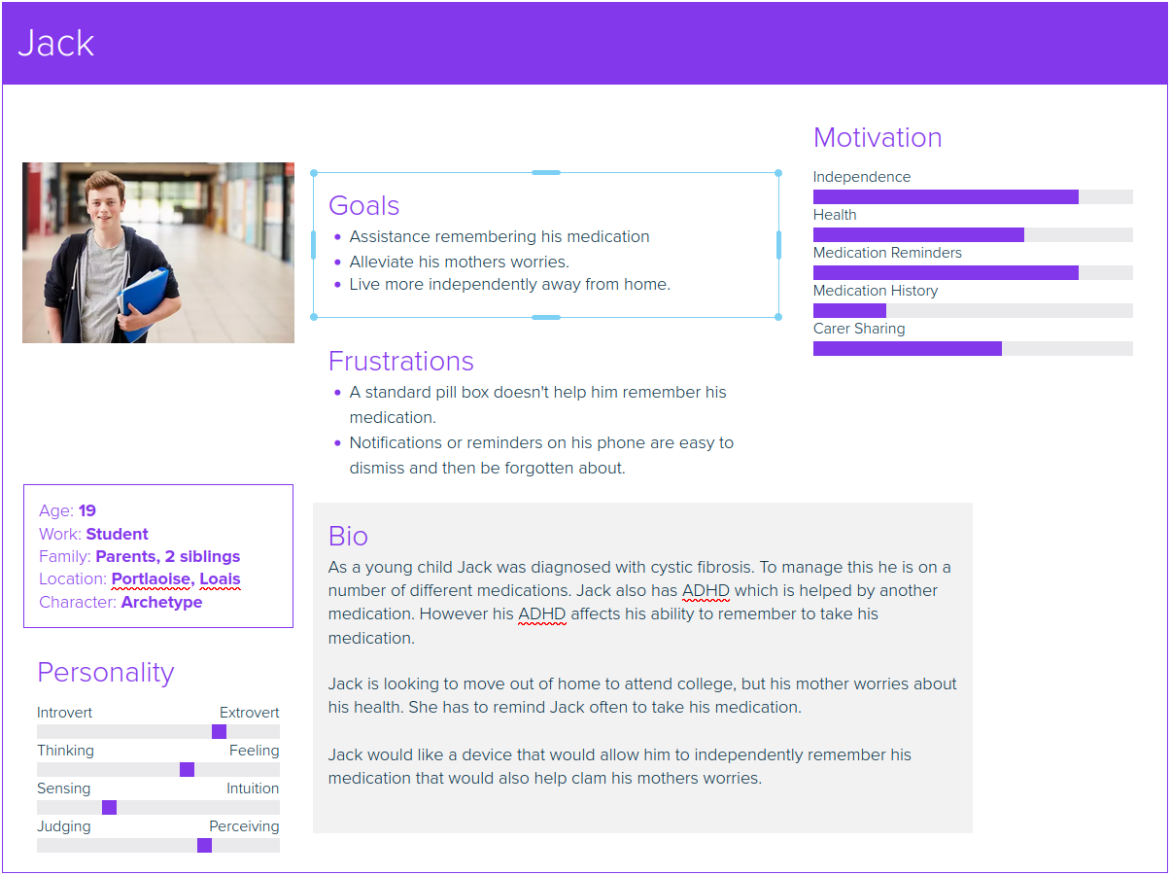
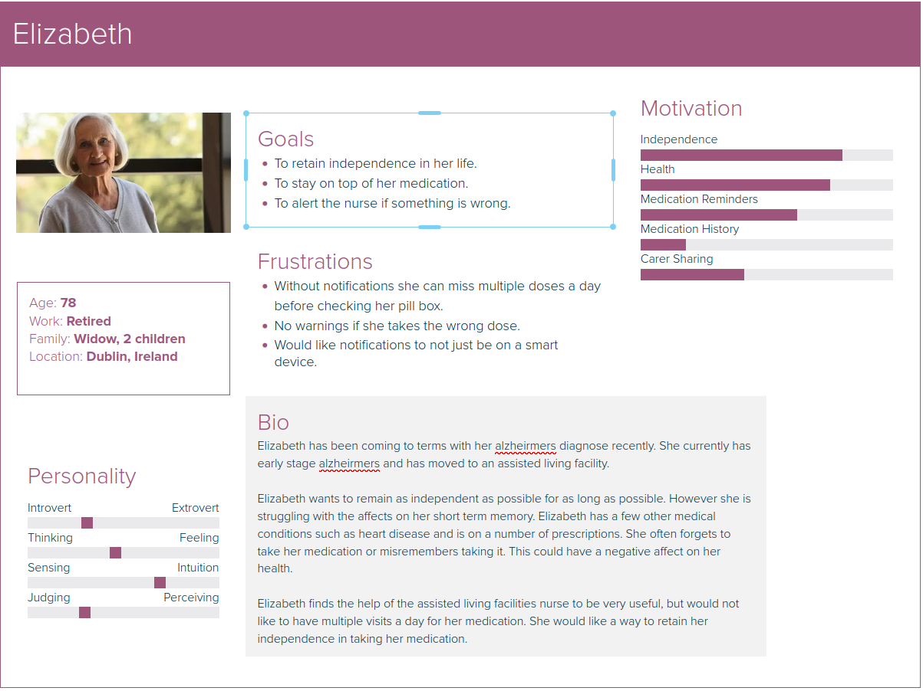
User Personas

Slide 8
How users connect
The application will absolutely start off available on desktop/laptops as most of our target audience is more comfortable with these devices.
However, many users may also be comfortable using mobile devices. Therefore, we are considering the potential of developing a progressive web app to cater for both desktop and mobile users.

Slide 9
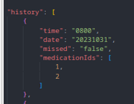
How we can tell if the project has been successful or not.
To assess the success of the project we can calculate the ratio of a user's {“missed” : “true”} to {“missed : “false”}.
If the ratio of {“missed” : “true”} to {“missed : “false”} is low, it indicates that the user has stuck to their medication regimen.
If the ratio of {“missed” : “true”} to {“missed : “false”} is high, it indicates that the user has frequently missed taking.

Slide 10
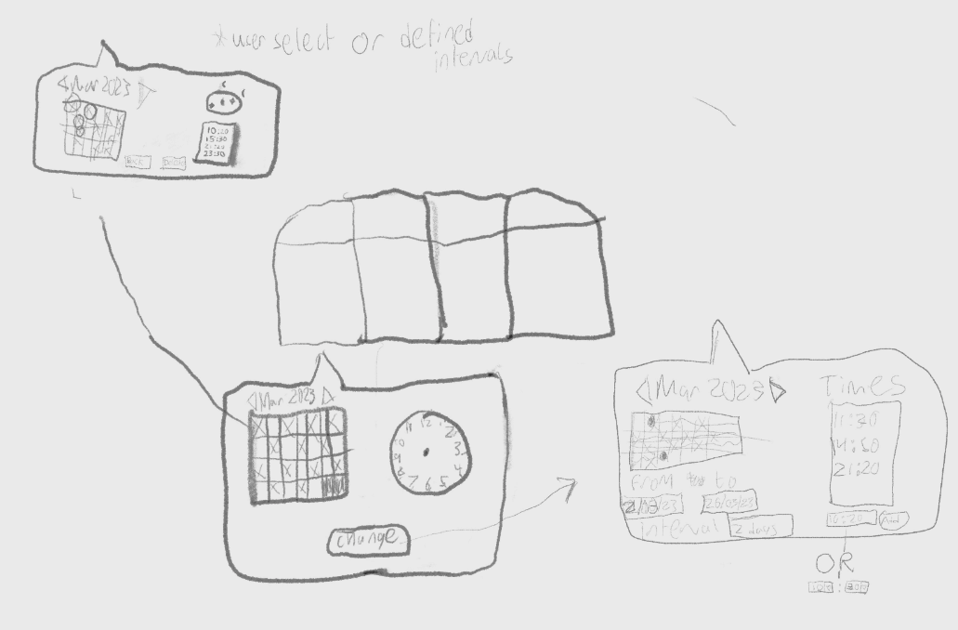
Initial UI Sketch

Slide 11
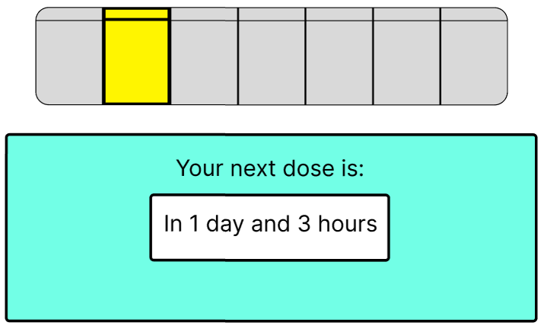
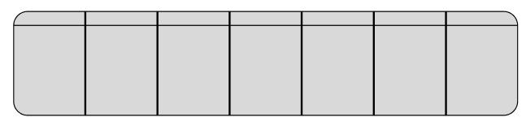
User Interface
Meets user’s mental model
Represents each physical section
Uncomplicated design
Each box holds the day/time of upcoming doses
Selecting a box shows countdown to next dose
Box highlighted in yellow for adequate contrast
Borders of selection emboldened

Slide 12
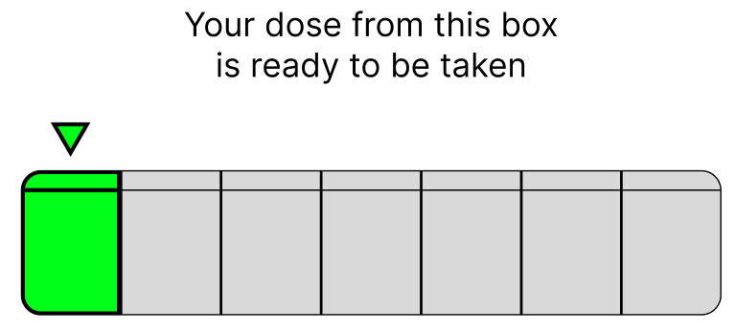
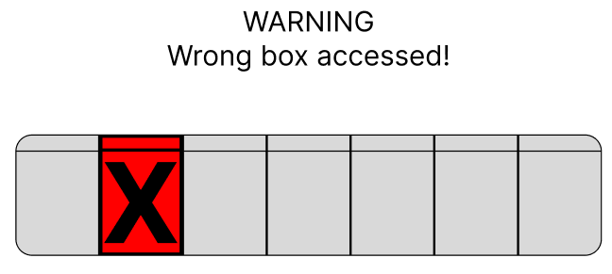
User Interface
Arrow pointing to the box to be accessed
Green box, matching the green LED
Red box to alert user to dangerous action
Large X is an extra indicator of user error
Capital letters and ! draw attention to message

Slide 13
List of Hardware
Roller Lever Micro Switches
Force-Sensitive Resistors
Green and Red LEDs
Resistors (220Ω and 330Ω)
Female to Female Cables

Slide 14
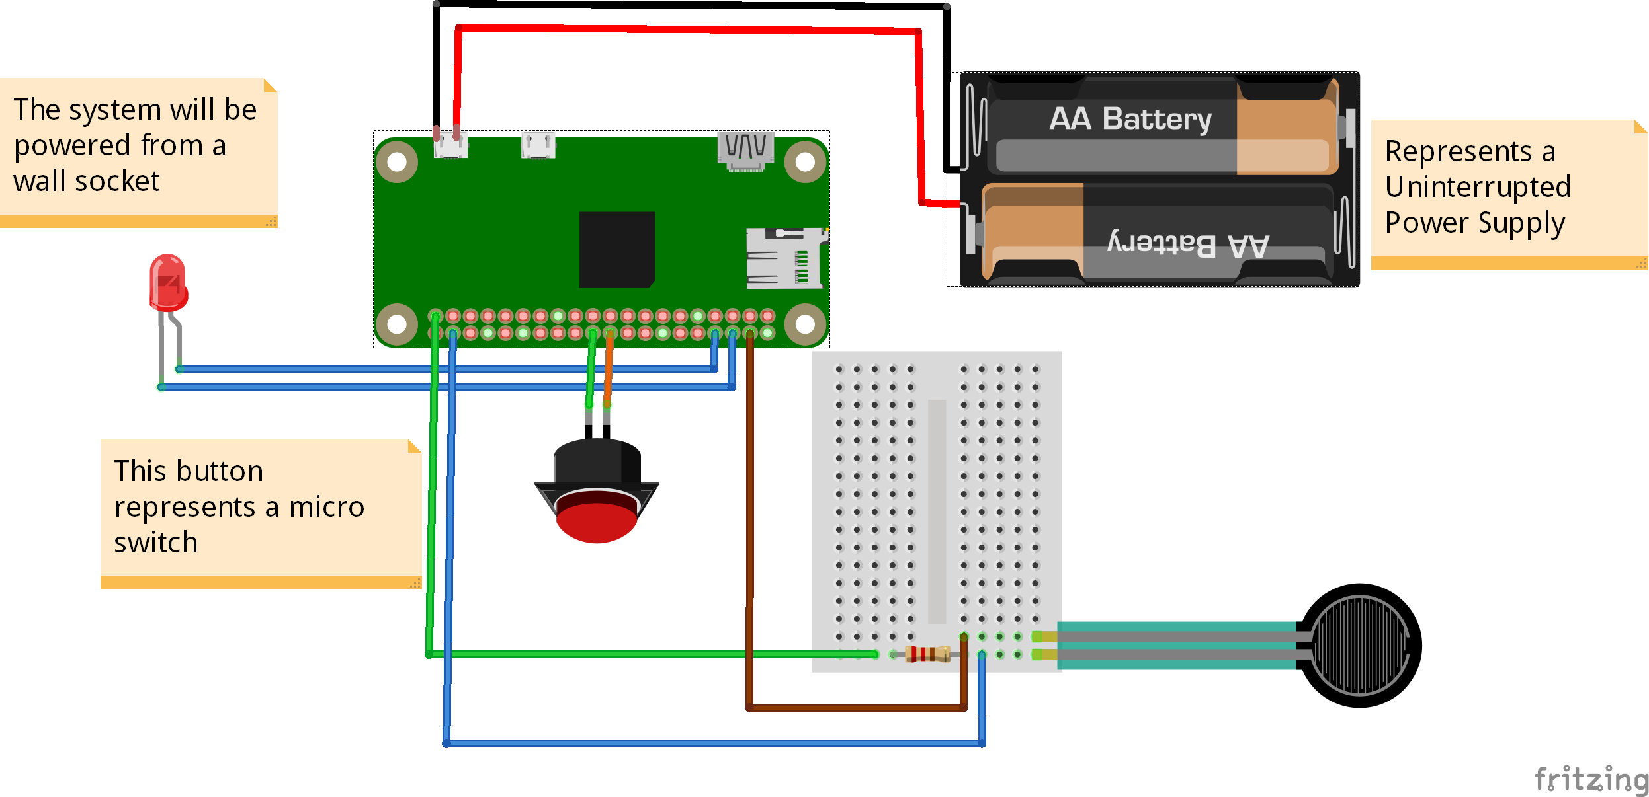
Fritzing Diagram

Slide 15
Powering the Device
The device will be plugged into the wall.
The device will use an Uninterruptible Power Supply (UPS) to handle loss of power. This will require 2 rechargeable batteries.

Slide 16
Network Connectivity
The device will connect to local Wi-Fi using the Raspberry Pi’s onboard wireless LAN.
When the device loses its connection to the internet, it will switch to using its onboard storage. When the connection is reestablished, it will bundle all local data and send it to the server.

Slide 17
Physical Security
The hardware will be built into the box to protect it from the environment.
The Pi will be mounted to the box using 4 M2.5 screws so it will not be damaged if the box is dropped or hit.
We plan on blocking off ports using Linux’s IPtables command.
This will stop unauthorized access to the box’s software.

Slide 18
Data Storage
The primary database will be a mongodb database hosted on the AWS server. A secondary database will exist on the Rasberry Pi. This will contain enough data to be able to operate the pill box for a period of time if the connection to the server fails.

Slide 19
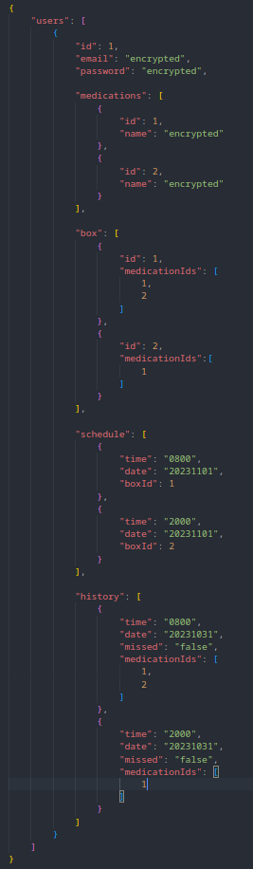
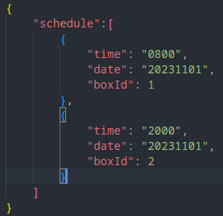
Data Storage – Example Entries
User Entry on server
Schedule stored on Rasberry Pi

Slide 20
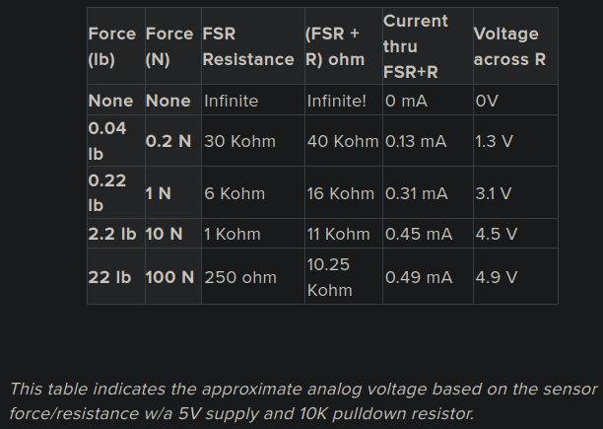
Data Gathering - Switches
Force Sensitive Resistor
- Analog data
- Values between 0mV – 5000mV
- 0mV represents no force
- 5000mV represents a high force
- This will tell us if a box is empty or has pills inside
Micro Switch
- 0v across a switch when the circuit is not completed
- 5v across a switch when the circuit is completed.
- This will tell us if a box is open or closed

Slide 21
Data Gathering - User
User Data
- User email
- Password
- This will be used to create a user account
Medication
- Medication details
- This will be used to assist in refilling the boxes and to create medication histories
Time
- To send notifications
- To see when a box was opened
- To record missed doeses

Slide 22
Data Processing
Sensor data will be processed locally.
Notifications and medication history will be process on the AWS server.
Notifications will be sent to the users’ devices by AWS server.
Medication data will be edited on the web client before being sent to AWS server.
The data will be processed to record if medication was taken on time, a dose was missed and if the medication box will require a refill.
A CRON job will be running to restart the program if it has stopped.

Slide 23



Data Processing – Example Queries
Find all entries where the user has missed a dose.
Get the 30 most recent history entries.
Get the next 5 entries in the users schedule.

Slide 24
Data Security
Data will be transferred between the device, server and web/mobile client by HTTPS.
HTTP GET will only be used to retrieved data.
HTTP POST or PUT will be used to enter or update data.
Sensitive data, such as medication information, will only be stored as encrypted data.
End to end encryption will be used to ensure only the user as access to sensitive data in a decrypted form.
The database will be stored on a AWS server.
Only times to take medication and which specific box it is stored in will be stored locally.
If sensor data is required to be stored locally due to an inability to communicate with the server, it will be wiped after the connection is reestablished and the updates are applied.

Slide 25
Structure of User Test
We will have structured tests with one person, in which metrics are used to reveal where the app excels or falls short
They will be monitored to assess their outwardly visible experience with the app, and their interactions will be analysed.
After the test, there will be a questionnaire that is intended to reveal the user’s internal thoughts and experiences

Slide 26
Metrics of User Test
Effectiveness A measure of how well the product supports the user in achieving their goal Useful in determining if the interface provides adequate information, not too little or too much Evaluates how well our project reflects the UD principle “Perceptible Information” | Efficiency A measure of how long it takes a user to complete their task We aim to take most of the thought and worry out of following a prescription, the less time spent setting up a prescription, the better
Errors Useful metric for evaluating how we abide to the UD principle “Tolerance of Error” Pinpoints areas of the app where people make mistakes most Knowing where mistakes happen help us fix errors Pareto principle style (20% of issues, 80% of results) | Satisfaction This metric tells us how a person feels when using our product Depending on the user’s circumstances, they could be under a lot of stress. At the very least, we should ensure we don’t exacerbate it We should ensure users don’t blame themselves for app issues they may encounter

Slide 27
Life Cycle of User Tests
Here are the planned steps to our future tests
Find a suitable person to act as a user
Conduct an evaluation of the product UI/hardware
Perform an interview with the user
Analyze results and guide project development with findings
Repeat 1-4 until development is complete!

