Slide 1
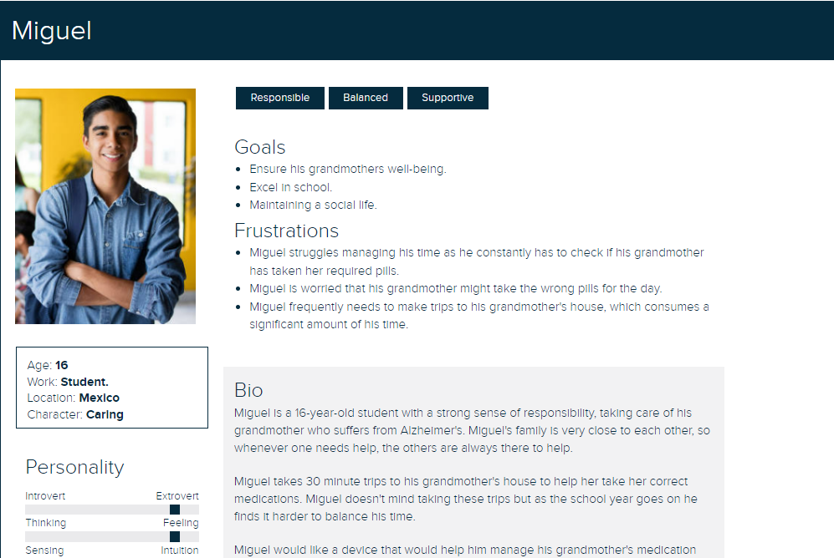
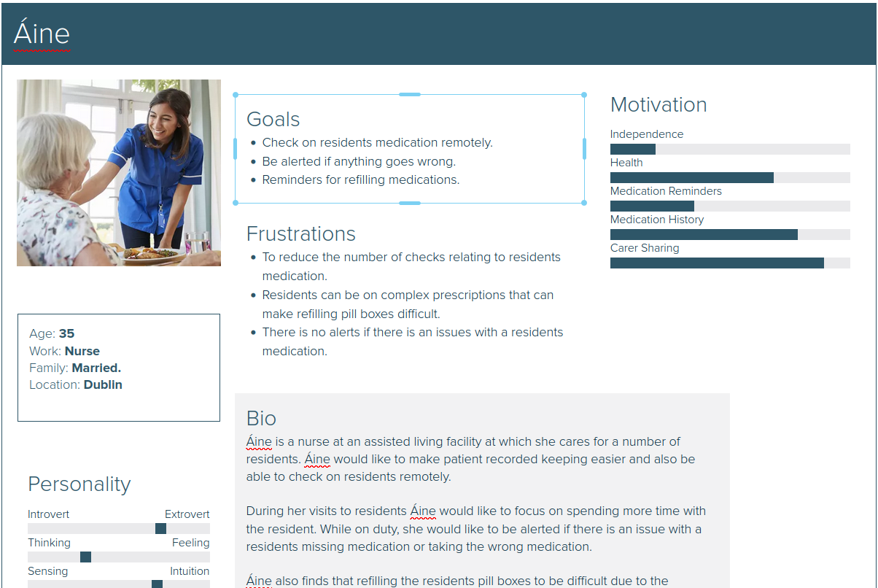
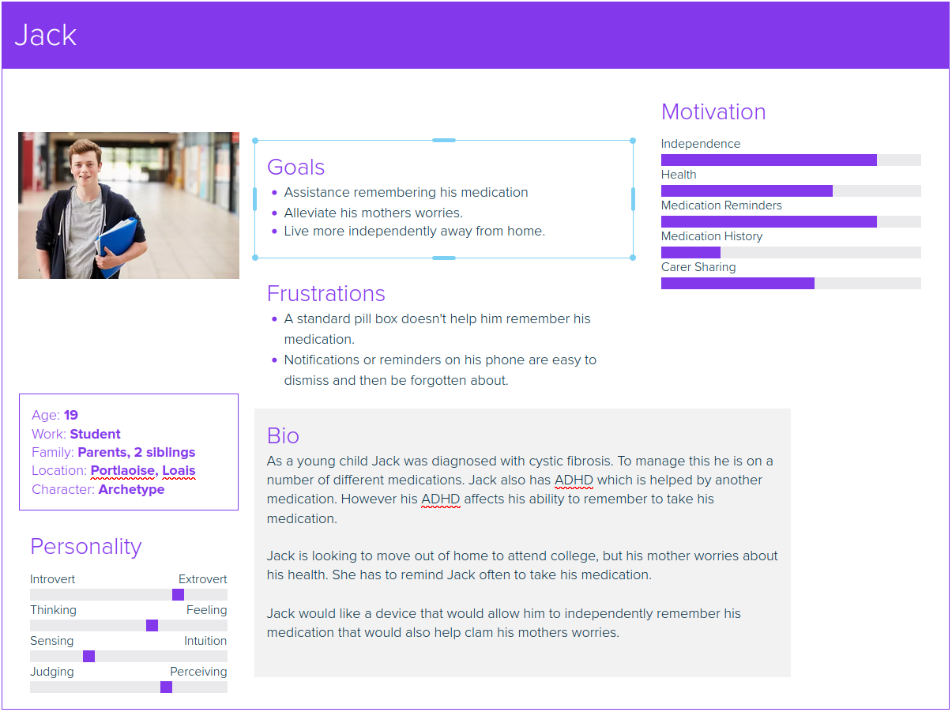
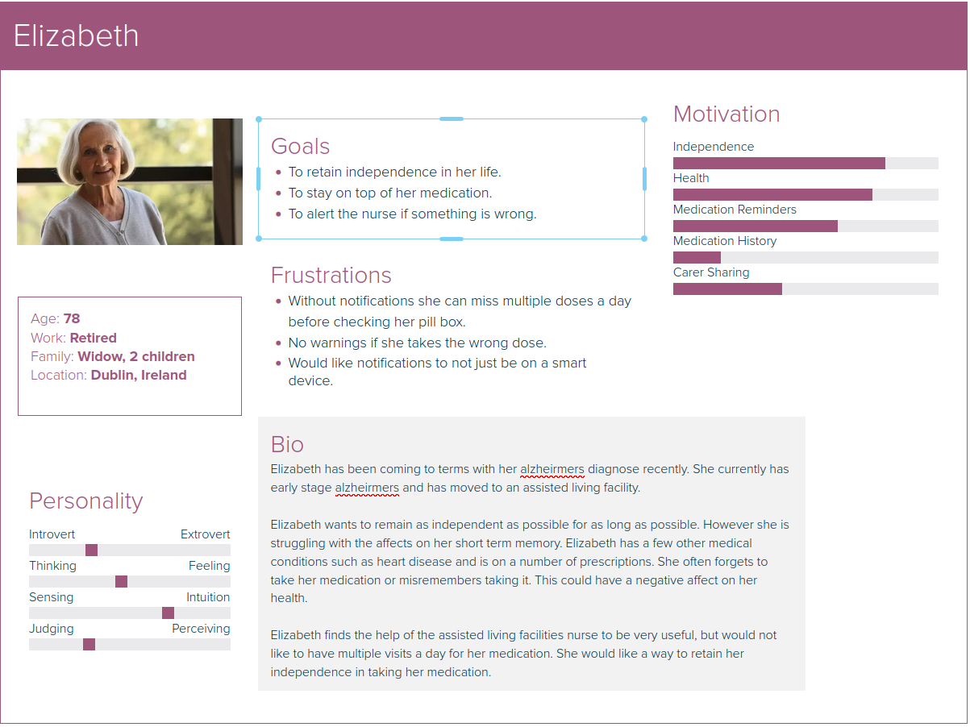
User Personas

Slide 2
How users connect
The application will absolutely start off available on desktop/laptops as most of our target audience is more comfortable with these devices.
However, many users may also be comfortable using mobile devices. Therefore, we are considering the potential of developing a progressive web app to cater for both desktop and mobile users.

Slide 3
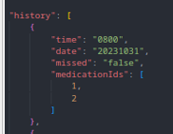
How we can tell if the project has been successful or not.
To assess the success of the project we can calculate the ratio of a user's {“missed” : “true”} to {“missed : “false”}.
If the ratio of {“missed” : “true”} to {“missed : “false”} is low, it indicates that the user has stuck to their medication regimen.
If the ratio of {“missed” : “true”} to {“missed : “false”} is high, it indicates that the user has frequently missed taking.

