Slide 1
ED116: History and Structure of Irish Education
‘Losing my religion’?
The Stanley Letter/’Act’ (1831) and the Forum on Patronage and Pluralism in the Primary Sector (2011- )
Cian Mac Liatháin – 11476078
Sean Doyle - 13533297

Slide 2
Patronage in Irish Education
Type of school | Percentage
Roman Catholic | 91.1%
Church of Ireland (Anglican) | 5.7%
Multi-denominational | 2.3%
Presbyterian | 0.4%
Inter-Denominational | 0.3%
Muslim | 0.1%
Methodist | <0.1%
Jewish | <0.1%

Slide 3
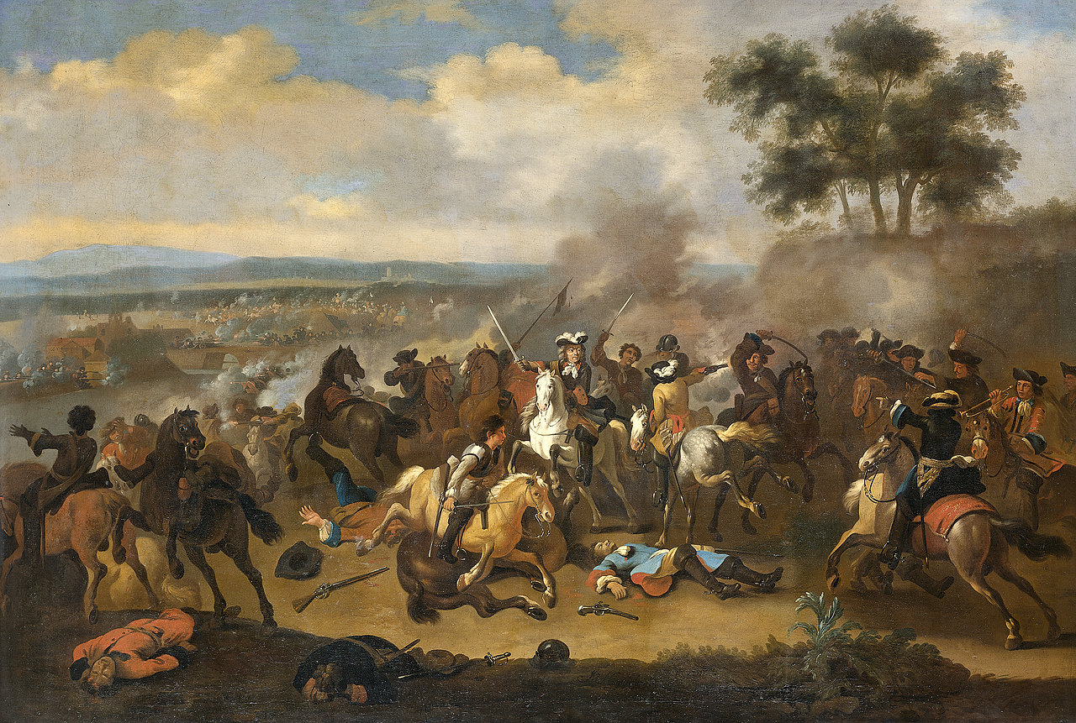
Battle of the Boyne (1690)

Slide 4
Penal Laws (1607)
“Laws passed against Roman Catholics in Britain and Ireland after the Reformation that penalized the practice of the Roman Catholic religion and imposed civil disabilities on Catholics”
(Britannica, 2013)

Slide 5
Education Act (1695 )
"no person of the popish religion shall publicly or in private houses teach school, or instruct youth in learning within this realm..."
Hedge Schools: Catholic hedge-priests and hedge-masters teaching in secret.
(Barker, 2013)

Slide 6
Penal Laws Repealed (1782)
“With the dismantling of the laws, one witnessed a growing assurance of the Catholic establishment in the late eighteenth century which in turn led to the growth of an exclusive Catholic system of education.”
By 1825: Presentation Sisters had 46 schools and the Christian Brothers had 24.
(Hanna, 2007)

Slide 7
The Stanley Letter (1831)
From Chief Secretary for Ireland Edward Stanley to the Duke of Leinster.
Formally established the national education system.
Board of Commission of National Education: dispersed funding for school grants and the hiring of teacher.

Slide 8
The Stanley Letter (1831)
“...unite in one system, children of all creeds” (The Stanley Letter, 1831)
Mixed religion schools.
Religious education separate from everyday education.

Slide 9
Christian Dominance
Churches unhappy with losing power: “put pressure on the government to allow aid to be given to schools under the management of individual churches.”
1850: only 4% of national schools were mixed religion.
Royal Commission of Inquiry into Irish Education (1868-1870): no request for separate system due to expectations being met.
(Akenson, 1970)

Slide 10
Forum on Patronage and Pluralism in the Primary Sector (2011)
“In 2011, the Minister for Education and Skills set up a group of consultants with people and make recommendations about how primary schools can become more inclusive of different traditions, religions and beliefs. “
(Department of Education, 2013)

Slide 11
Forum on Patronage and Pluralism in the Primary Sector (2011)
96% of schools under Denominational Patronage
Projected increase in enrolment 2017 +
Modernisation:
Intercultural Society
Increasing minority of non-believers
Pressure for more variance
(Department of Education, 2013)

Slide 12
The Advisory Group’s Conclusions
Enrolment policies – clear and fair. Appeals process should be in place e.g. Ombudsman for Children
Religion class - appropriate provisions must be made for other children
Children should be taught ethics and about different religions and beliefs

Slide 13
The Advisory Group’s Conclusions
Religious sacraments – concerned over time spent preparing.
Statues, symbols, assemblies and prayers – all children of the school should be represented in a balanced way

Slide 14
What has been implemented?
43 select areas were asked what type of school they would like for their children to attend.
The Minister for Education is seeking to have the school buildings of 28 of these areas transferred.
Work in progress – request for more parental suggestions by 22 November 2013
(Department of Education, 2013)

Slide 15
Bibliography
Akenson, D. H. (1970) ‘The Irish Educational Experiment’
Barker, H. (2013) ‘Hedge Britannia: A Curious History of a British Obesession’
Britannica (2013) ‘Penal Laws’ [online] available at: http://www.britannica.com/EBchecked/topic/449591/Penal-Laws [accessed on 23 Nov 2013]
Department of Education (2013) ‘Forum on Patronage and Pluralism’ [online] available at: http://www.education.ie/en/Press-Events/Conferences/Patronage-and-Pluralism-in-the-Primary-Sector/ [accessed 23 Nov 2013]
Hanna, T. (2007) ‘The Role of the Catholic Church in the Provision of Education in Ireland’

