Slide 1
Geographical Investigation
Friday 27th April 2012
Deadline

Slide 2
Fill in the appropriate Topic on Page 1 of your investigation report
For example:
Topic 1
Title:A Study of one landform evident on the Irish landscape formed by Geomorphic Processes
Landform: Sand Spit
Geomorphic Processes: Coastal Deposition due to Longshore Drift being interrupted.

Slide 3

Stages of Investigation
REMEMBER: SRP= Significant relevant point (of information)
Coherence = Flow/cohesion/logical arguments and information
The Introduction is where you pose the problems and come up with the strategy that you intend to undertake in your investigation.
You clearly select your topic for investigation for 2012.
You need to state clearly your investigation’s aims/hypotheses.
You need to outline your aims/ objectives -ie What we will do
Identify the types of information your investigation requires.
The investigation booklet asks you to include your aims/hypotheses here.

Slide 4
What Aims/Hypotheses do you Have?
Longshore Drift is a key process in this investigation Zone
and interruption of Longshore Drift has created this Depositional landform
Waves of Construction are active here
Human Interference has had negative impacts on the Landform
Human Interference has had positive impacts on the Landform
The Spit on Raven point has created the foundation for other landforms such as Sand Dunes
Materials found on the investigation zone are what one would expect to find in an area created by constructive waves
The beach attached to the Spit displays the distinctive zones as found on a beach

Slide 5
What aims did you come up with?
Group 1: Are the waves here Constructive or Destructive
Group 2: How have humans impacted on the landform?
Group 3:Investigate the effects of longshore drift on the landform
Group 4: Investigate the connection between the formation of other depositional landforms and materials found on the Spit
Group 5: Investigate the connection between longshore drift and the profile of the sand spit

Slide 6
How will you Gather the Info?
2 Methods – 4 Ways
1. Observation
2. Identification
3. Recording
4. Measuring

Slide 7
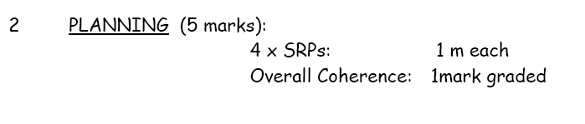
Planning = 5 marks
- We prepare for the fieldwork: This could be where you learned and practiced how to identify/use the geographical equipment e.g. Clinometer and/or transect poles.
-Planning and preparing for the fieldwork is important in order to be precise and collect worthwhile data. - Design of worksheet NB You must refer to 2 methods you will use to collect data (information) eg. 1.Observing& Identifying 2. Recording&Measuring
- You will select appropriate methods that will enable you to gather information for the investigation.
You need to decide on appropriate location(s) where you will collect information i.e. a location where geomorphic processes of coastal deposition/transportation are taking place. Distance from school? Accessible? Grid Reference?Why did we decide on Raven Point??/
The student needs to decide what will they observe? Measure? Record?
A need to revise coasts? How?
Equipment?

Slide 8
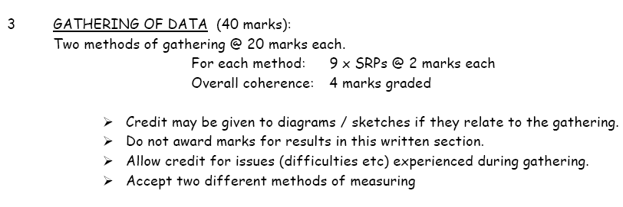
Gathering of Information = 40 marks
Here you need to say how you used instruments to take measurements.
You need to show how you recorded observations made in the field.
How did we measure/ record eg Wave surveys/evidence/Beach Profile/Analysis of Beach Material/sketching of landforms
What secondary sources did we use? e.g. Maps, documents, weather data to support your data collection. Keep to a minimum.
State any problems encountered.
Make sure that you only use two methods. 1.Observing& Identifying 2. Recording&Measuring
In this section you are describing how you collected your information in the field.

Slide 9
State 2 Methods
Method 1. - Identification and Observation?
Method 2. - Recording and Measuring?

Slide 10
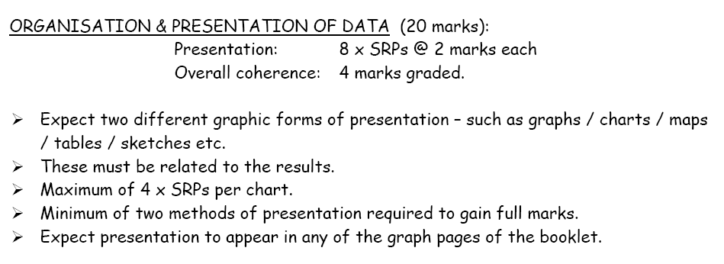
Presentation of Results = 20 marks
5.

Slide 11
Presentation of Results = 20 marks
DO...
Organise the data
Use illustrations, sketches, graphs, maps and tables wherever appropriate and possible. The words used to label your diagrams are not counted as part of the overall word count.
(**Make sure that anything you draw/sketch in the report is clearly labelled/annotated or referred to in your answer otherwise there is little point to its presence and lack of cohesion could be decided)
Use ICT where appropriate to plan, prepare and present results and conclusions.
If you have difficulty in drawing charts to represent data. Try using computer programmes to present them for you and you can recreate the format in your answer book.
DON’T
You cannot stick pictures into the booklet
Do not add printed material into your answer booklet.

Slide 12
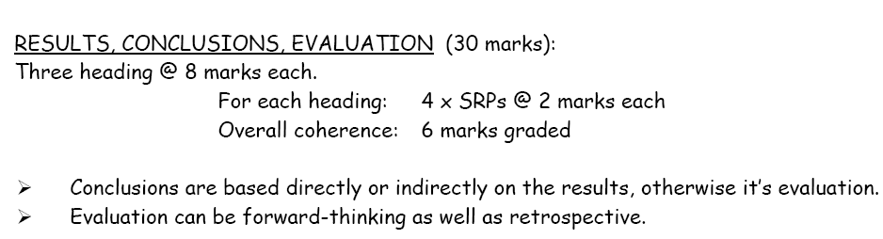
Results, Conclusions & Evaluation
30 marks
These must relate to aims/hypotheses
4.

Slide 13
Results/Conclusions/Evaluation
Analyse and interpret what the results mean.
Draw valid conclusions.
Compare findings with established theory.
Evaluate your hypotheses.
Examine the validity of the investigation.
Suggest improvements if the study was to be carried out again by you.

Slide 14
Evaluations – What are they?
Evaluations are assessments or judgement of the methods and the equipment you used during the Geographical Investigation.
It can also focus on the accuracy of your results

Slide 15
Evaluations -You need 4
Did you achieve your aims?
Did you show your hypotheses to be true?
Was your equipment suitable? If not – How could you modify for future investigations?
Were your results accurate? Why?/Why not?
Was the sample size large enough?
Should it have been longitudinal?
What suggestions do you have to improve future Geographical Investigations?

Slide 16
Possible Results/Conclusions
Should include brief explanation of how coastal processes operate in support of your conclusions

Slide 17
Rate of Longshore Drift
Result: The rate of Longshore Drift is x metres/mins in y direction
Conclusion: Sediment transfer by longshore drift is occurring/not occurring. The factors that could influence these should also be explained:
Shape of coastline
Wind Direction
Type of waves
The Tide
Man-made structures

Slide 18
Wave Frequency
Result: The wave frequency is over 10 per minute/under 10 per minute
Conclusion: The waves are destructive/ Constructive. Mention the factors affecting the occurrence of Destructive/Constructive waves eg:
Wind Speed
Wind Direction
Tide/Fetch
Slope of Beach

Slide 19
Beach Slope Angle
Result: The angle of the beach slope shows/does not show a large increase from foreshore to backshore
Conclusion: The beach was formed in summer by constructive wave action/ The beach was formed in winter by destructive wave action
Beach profiles change seasonally due to change in wave energy in summer and winter
Summer beach profile is formed by constructive waves – swash greater than backwash
Winter beach profile due to increased wave energy associated with storms and erodes and removes sediment from beach

Slide 20
Beach Fabric
Result: Beach fabric increases in size from foreshore to backshore
Conclusion: Wave action has sorted the beach fabric
This is common in many beaches.It is due to the gradual sorting of material by the action of constructive and destructive waves over millions of tidal cycles
Constructive waves carry larger stones up the shore in their swash. Water seeps into sand and backwash no longer strong enough to bring them back out

Slide 21
Beach Fabric
Only smaller sand and pebbles are carried back
Storms and tidal surges will aslo carry larger material onto backshore forming a storm beach
Finer sand and pebbles remain on foreshore

Slide 22
Tips
Make sure that you do not repeat information.
Use all available space.
Make sure all your diagrams/sketches/data is well labelled, given adequate titles and are annotated appropriately or referred to in your main sections.

