Slide 1
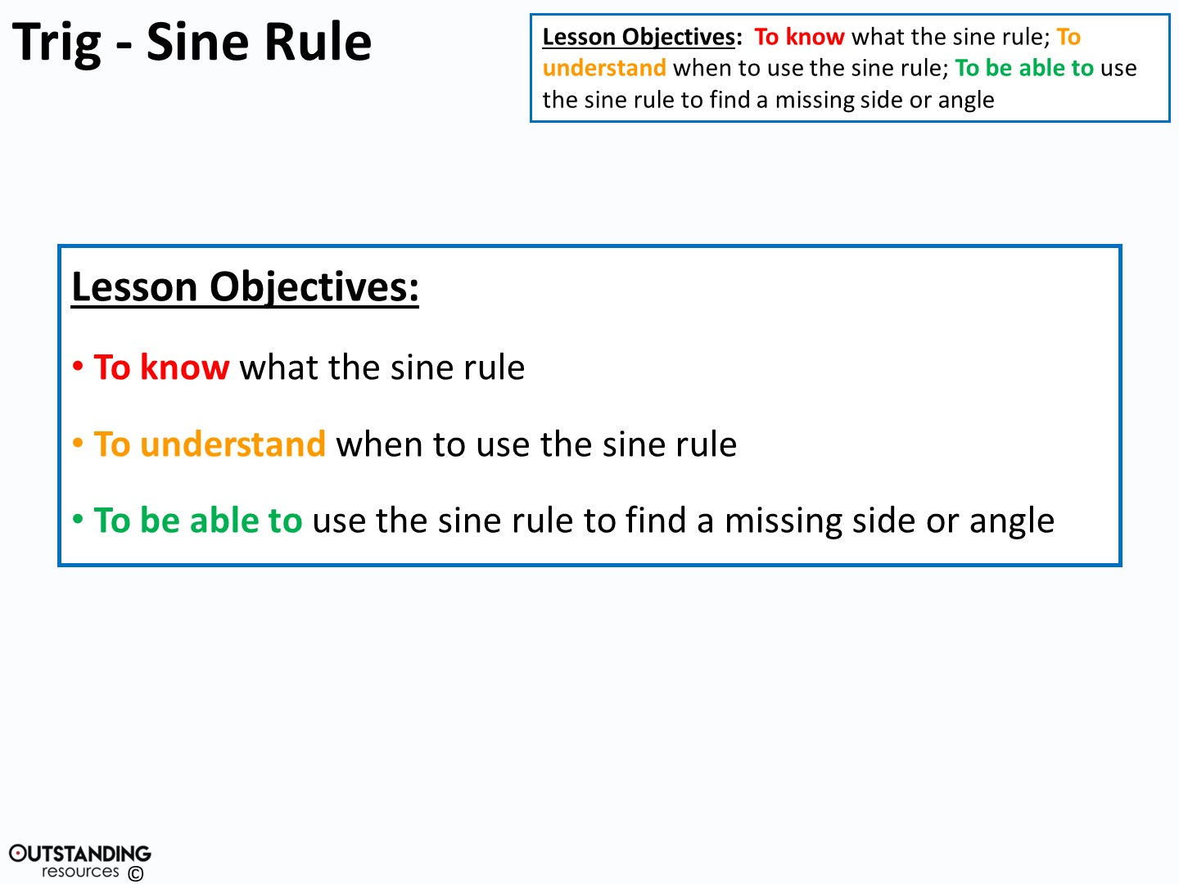

Slide 2
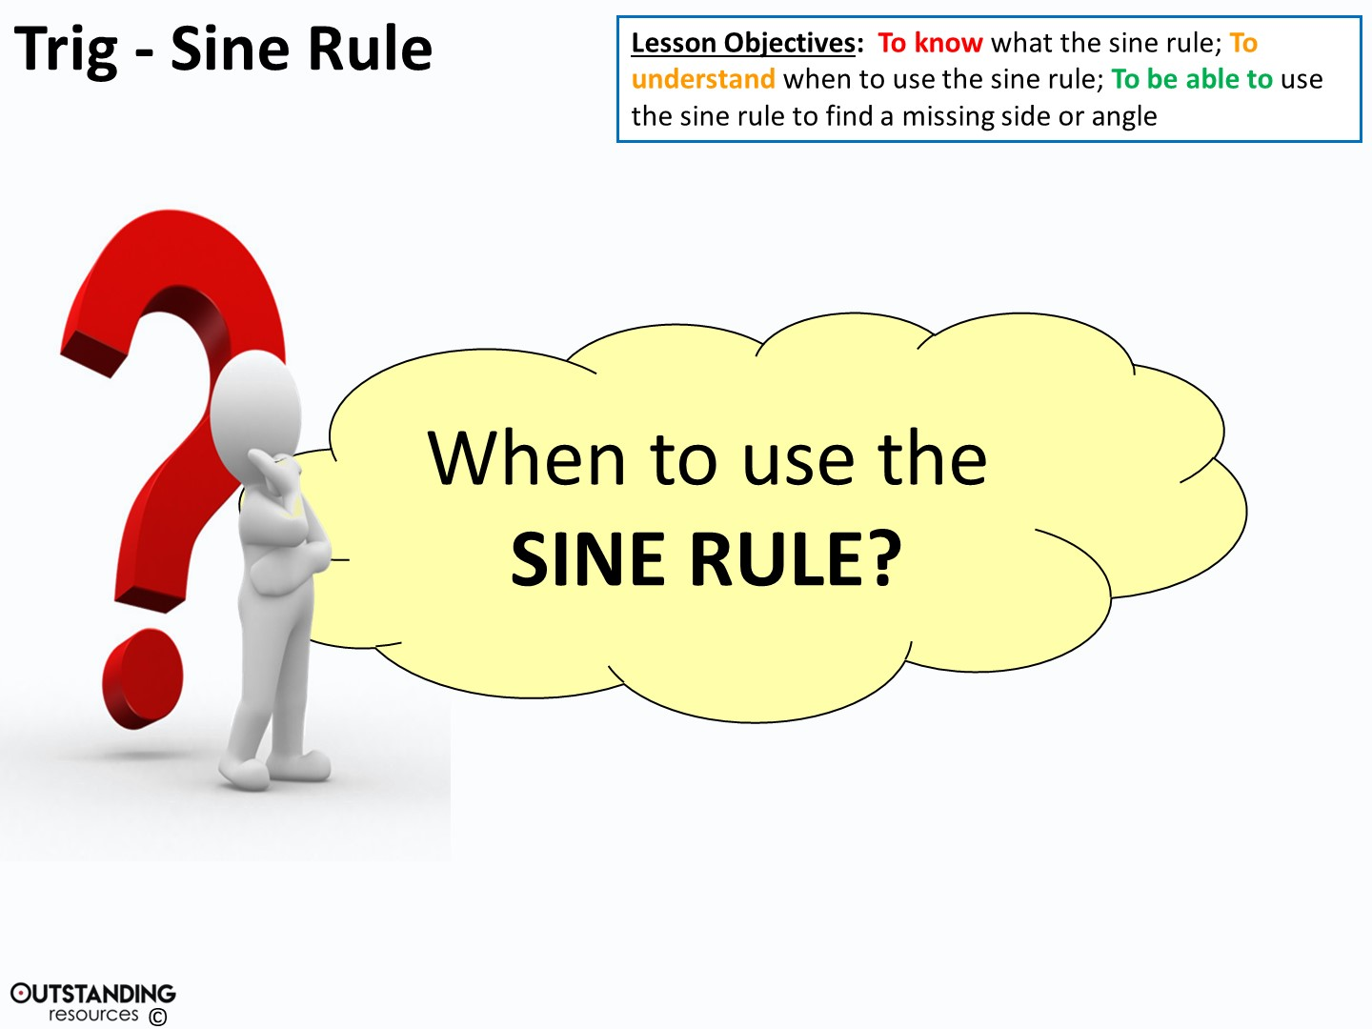
Notes:
Clipart – Questions Clipart #29226: taken from - http://clipartix.com/questions-clipart-image-29226/

Slide 3
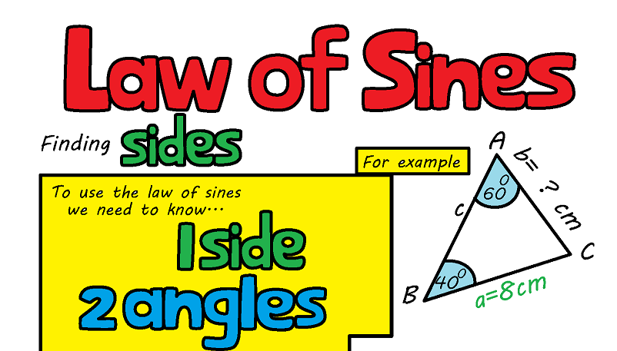

Slide 4
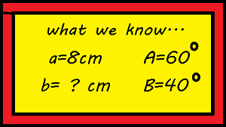
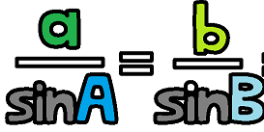

Slide 5
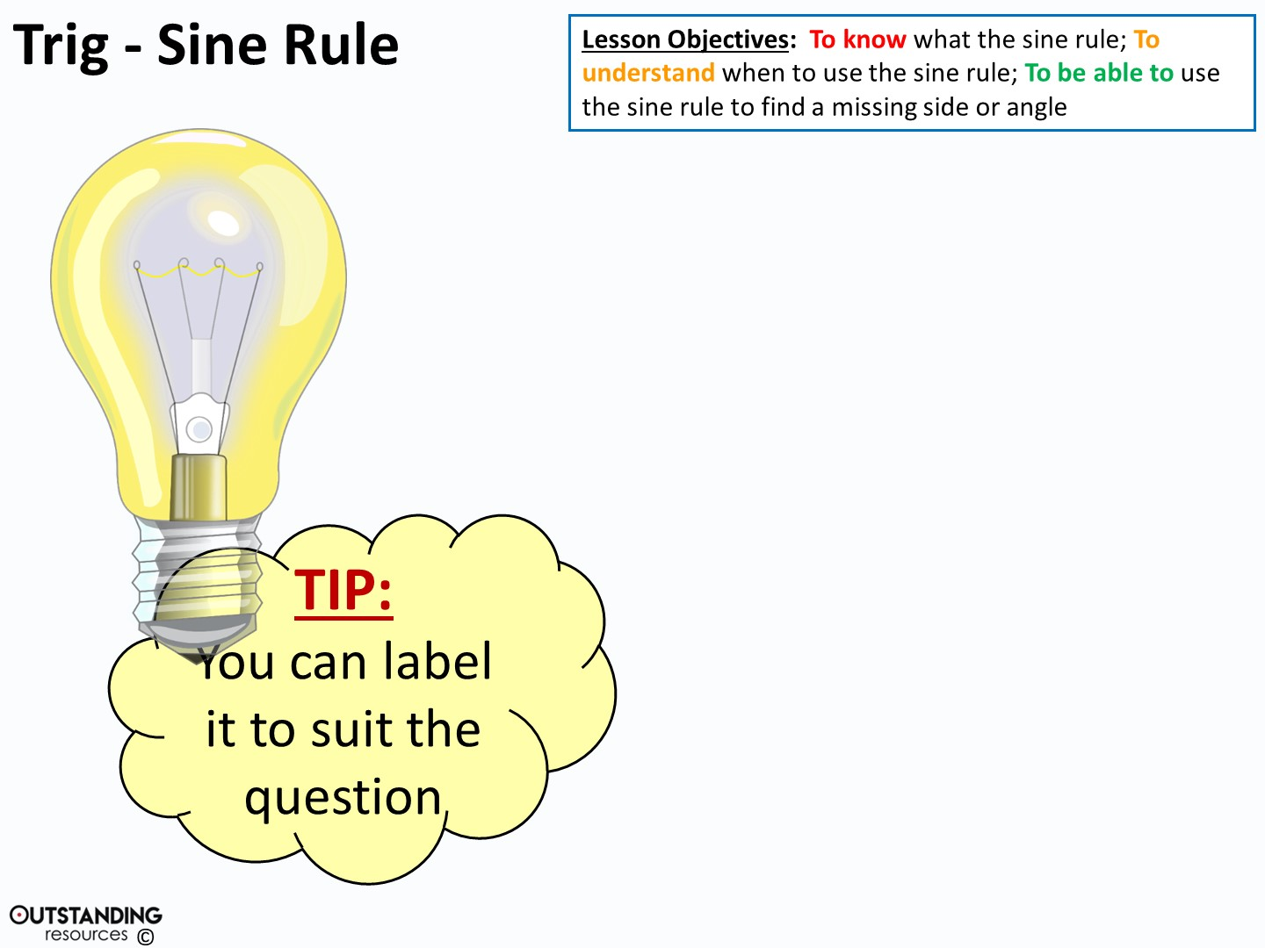
C
b
a
A
B
c
B
c
a
A
C
b
Notes:
Clipart - Light Bulb on : taken from - https://openclipart.org/detail/116581/light-bulb-onhttp://creativecommons.org/licenses/publicdomain/

Slide 6
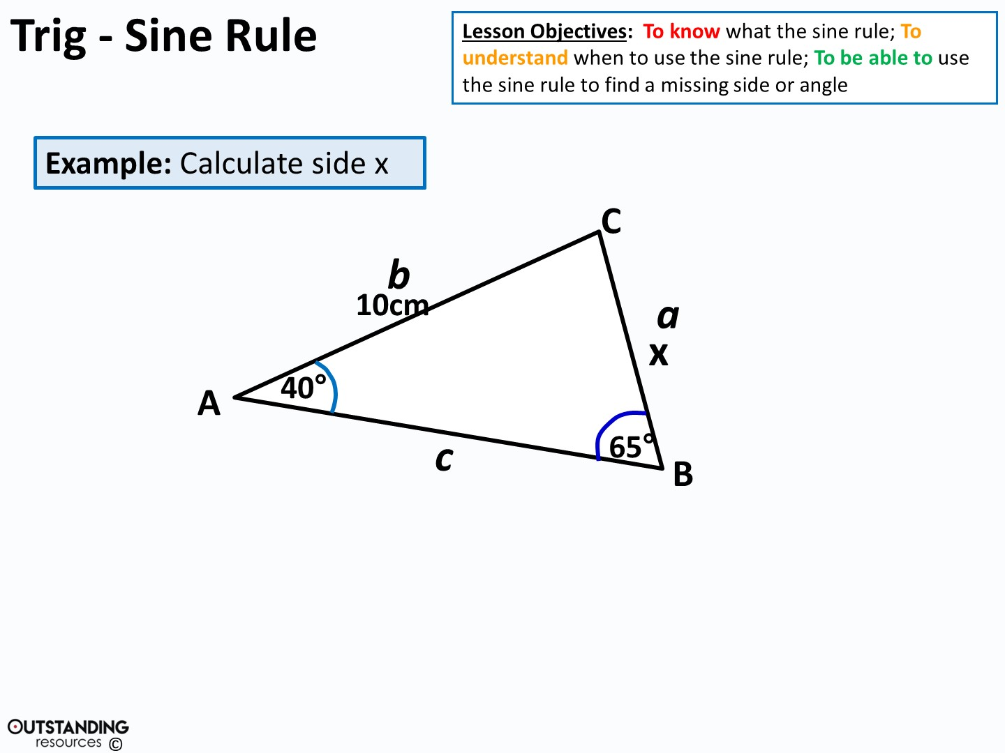
x 10
sin40° sin65°
=
=

Slide 7
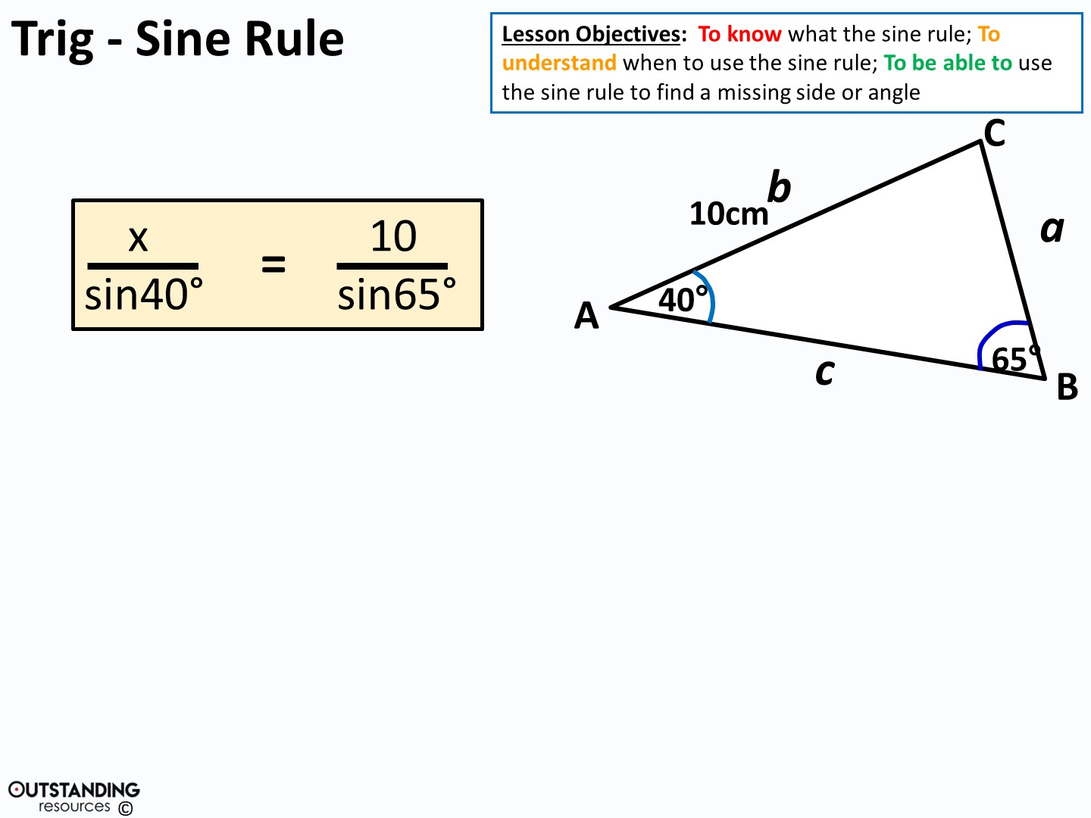
x
sin40°
=
11.033779…
x = 11.033779… x sin40°
x = 7.09 cm (to 3.s.f.)

Slide 8
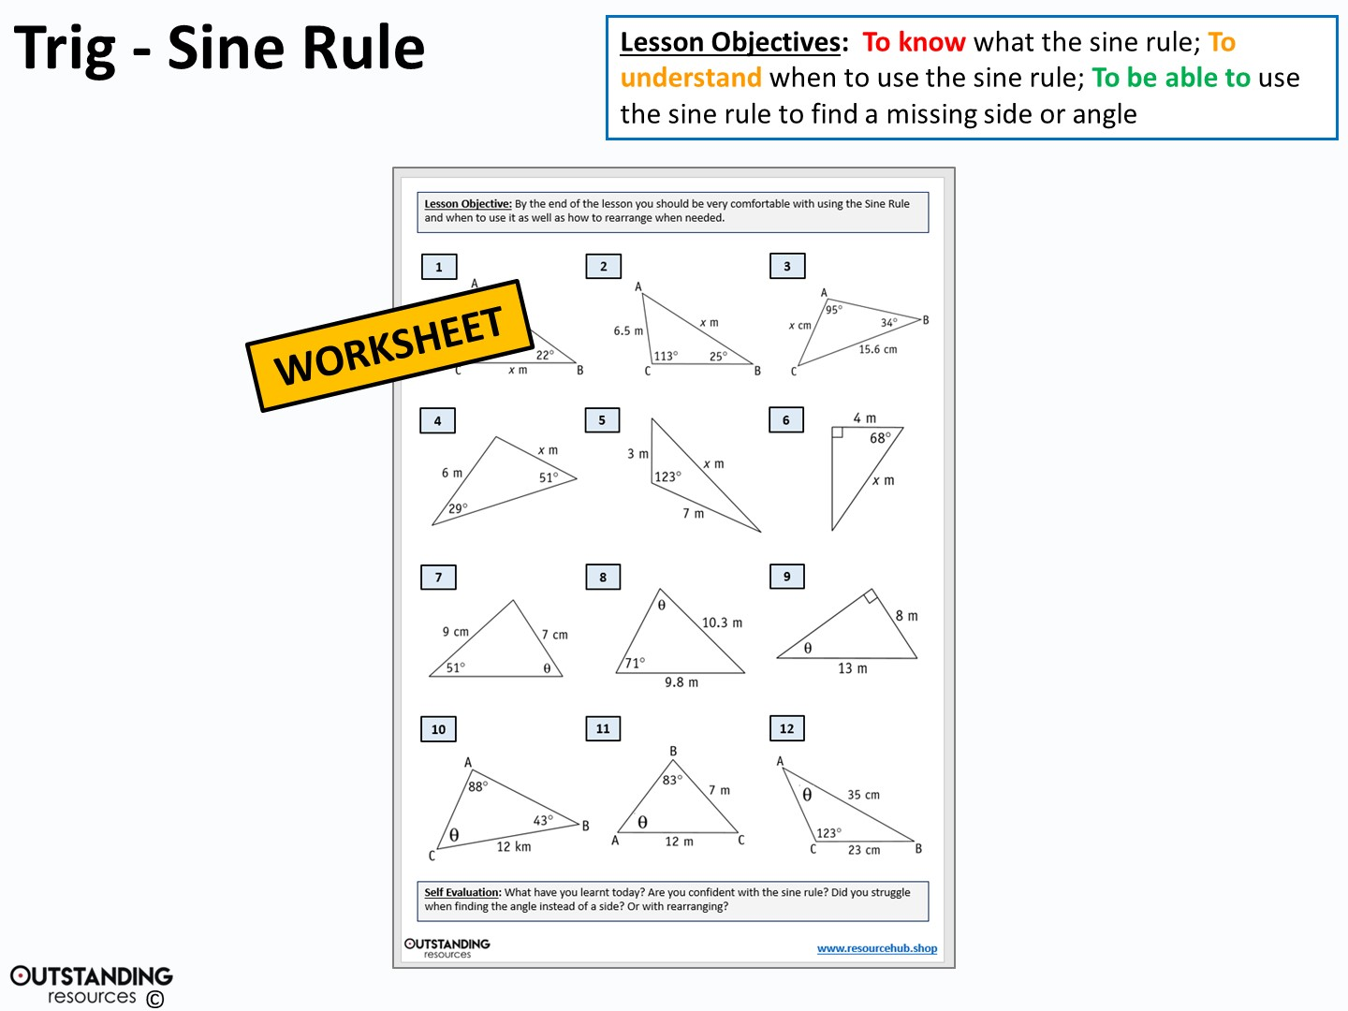

Slide 9
