Slide 1
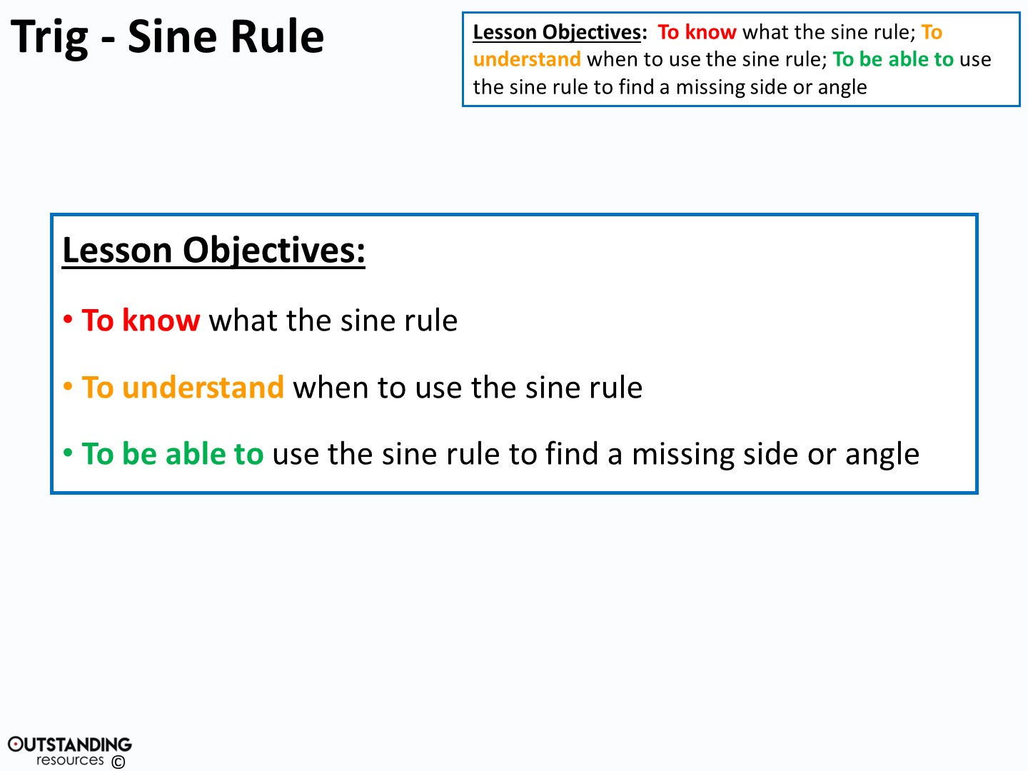

Slide 2
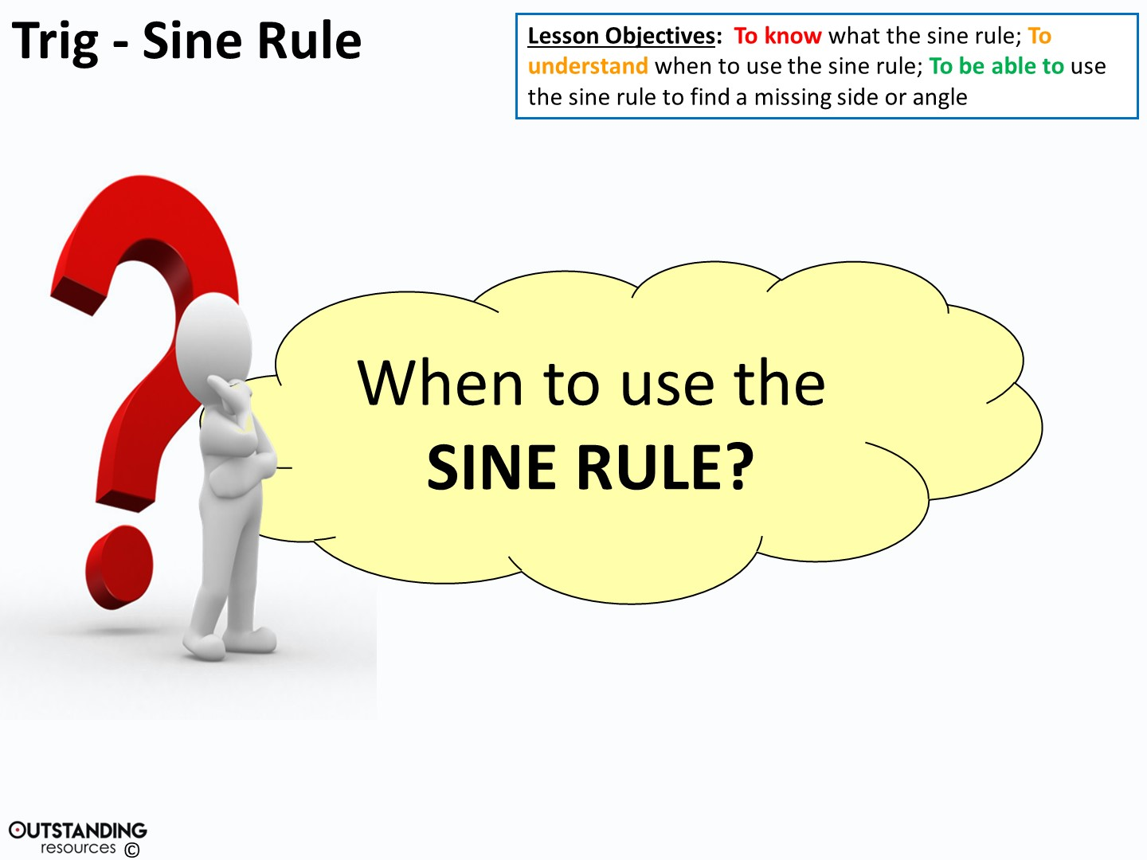
Notes:
Clipart – Questions Clipart #29226: taken from - http://clipartix.com/questions-clipart-image-29226/

Slide 3
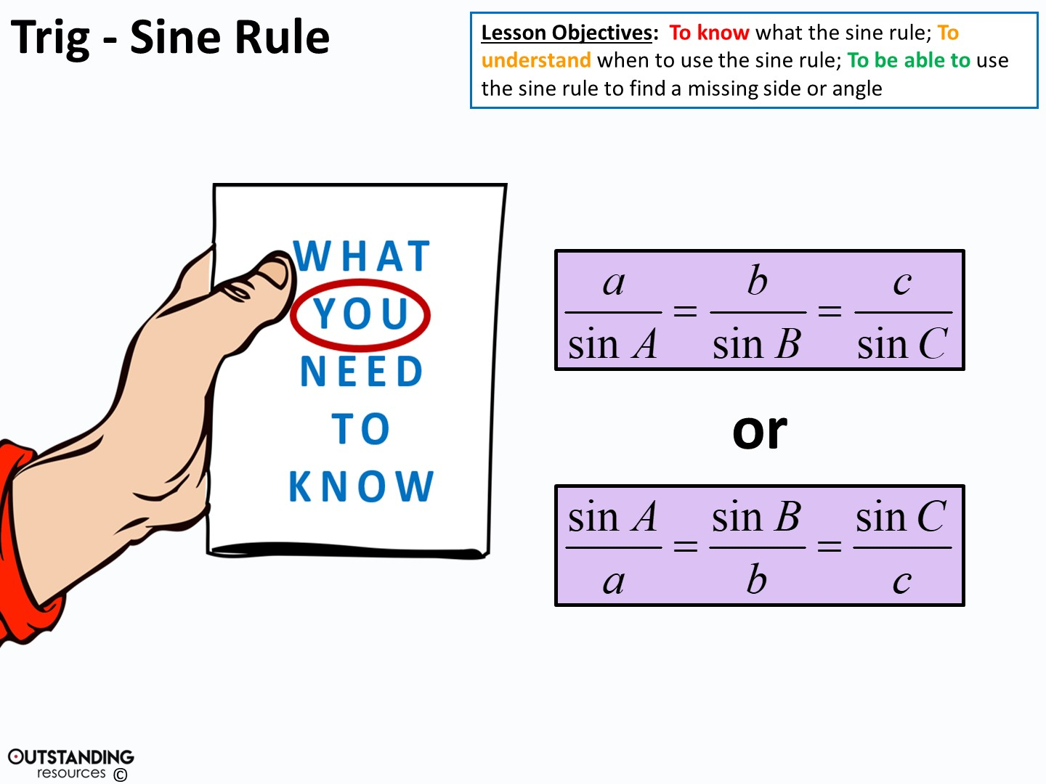
Notes:
Clipart – hand holding brochure : taken from - https://openclipart.org/detail/742/hand-holding-brochure http://creativecommons.org/licenses/publicdomain/

Slide 4
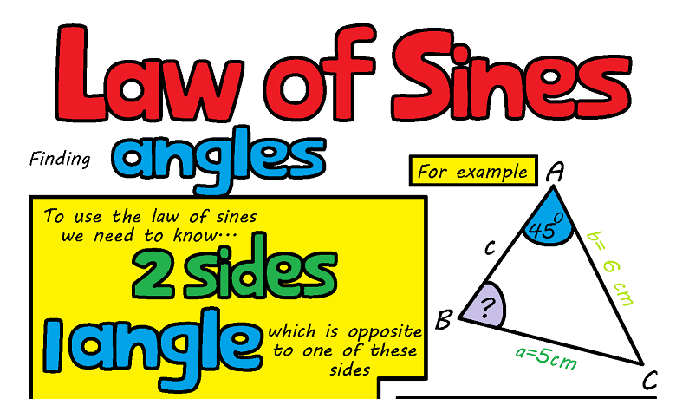

Slide 5
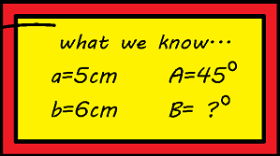


Slide 6
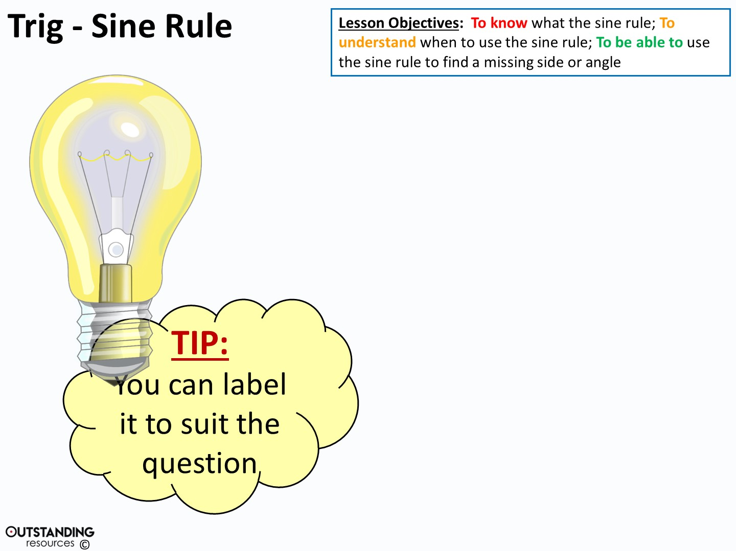
C
b
a
A
B
c
B
c
a
A
C
b
Notes:
Clipart - Light Bulb on : taken from - https://openclipart.org/detail/116581/light-bulb-onhttp://creativecommons.org/licenses/publicdomain/

Slide 7
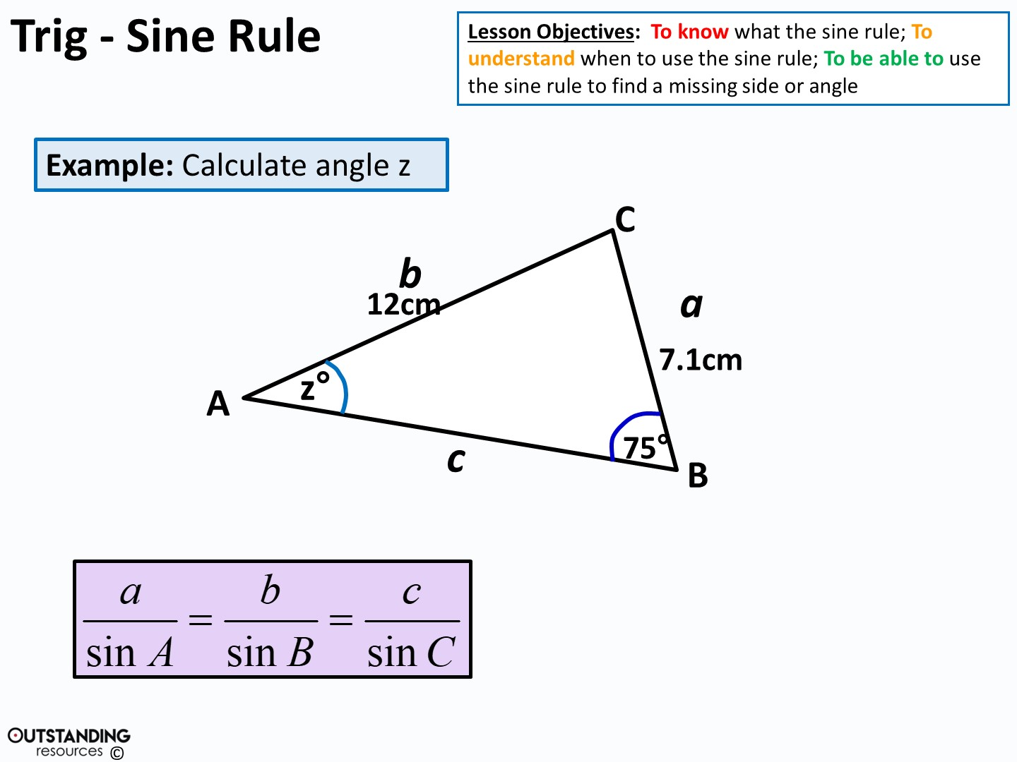
7.1 12
sin z° sin75°
=
=

Slide 8
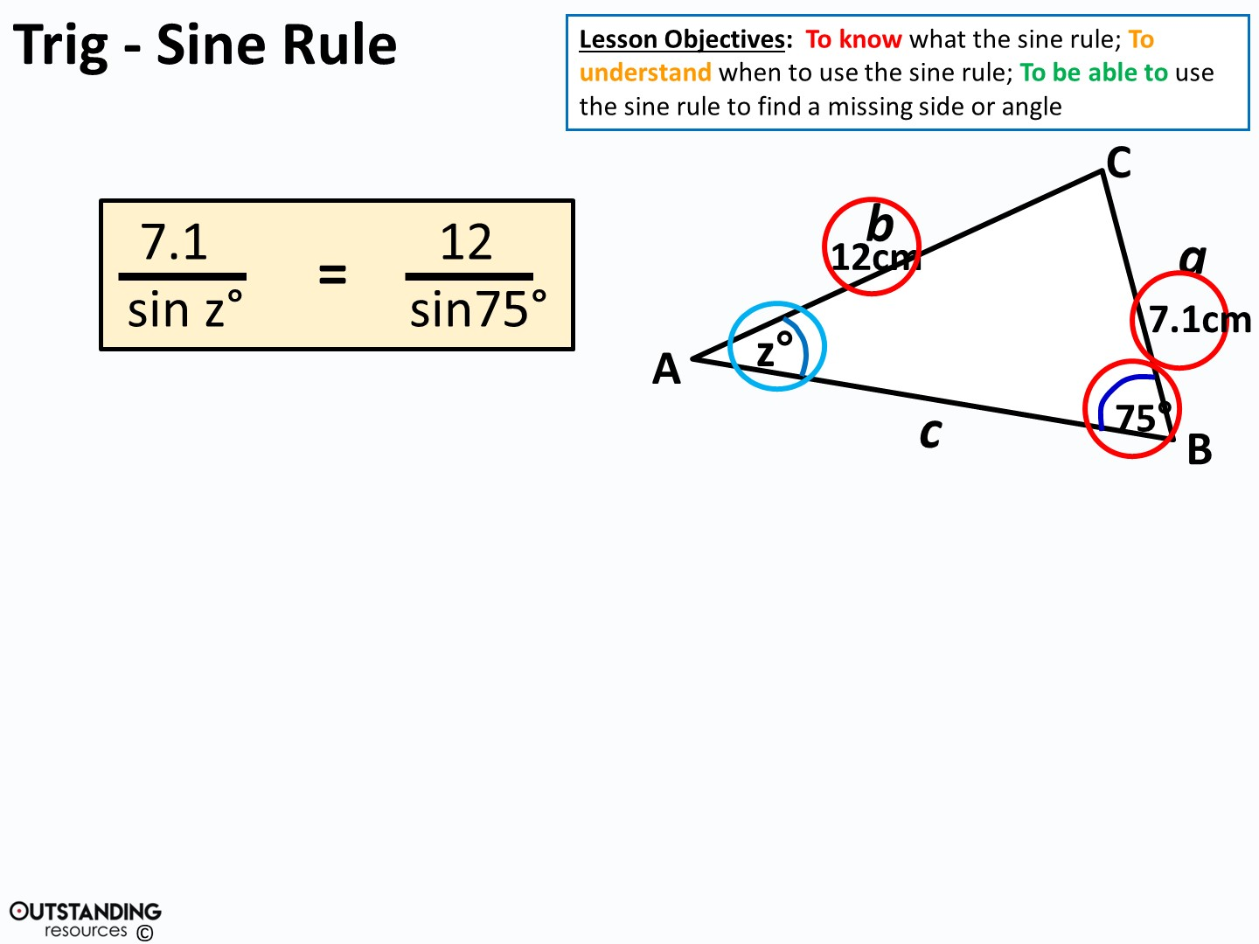

7.1
sin z°
=
12.4233 …
7.1
12.4233 …
7.1
12.4233 …
=
=
sin⁻¹
sin z°
z°
z = 34.9° (to 1.d.p)

Slide 9
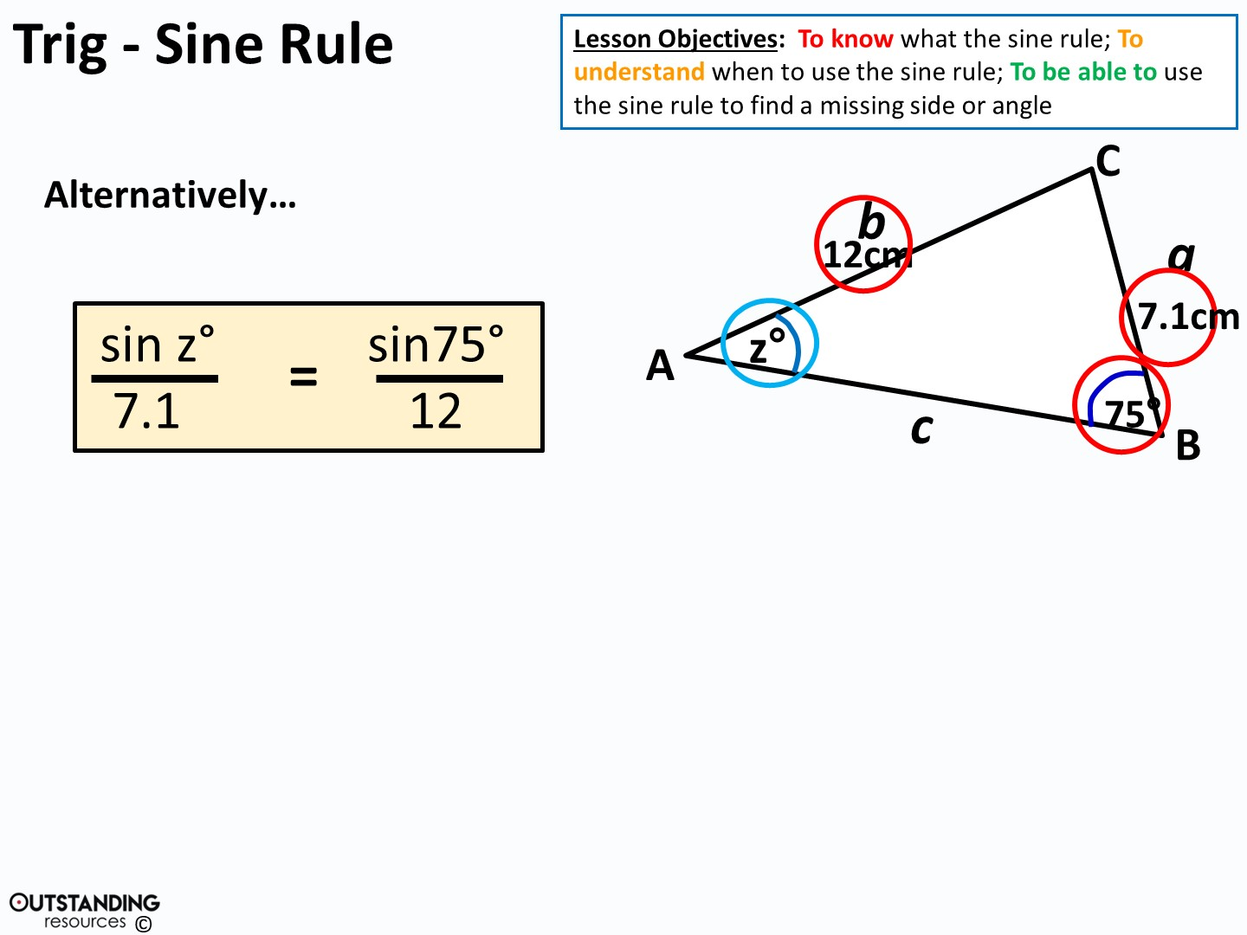
sin z°
7.1
=
0.08049 …
z = sin⁻¹ (0.570849…)
sin z°
=
0.08049 x 7.1
z = 34.9° (to 1.d.p)

Slide 10
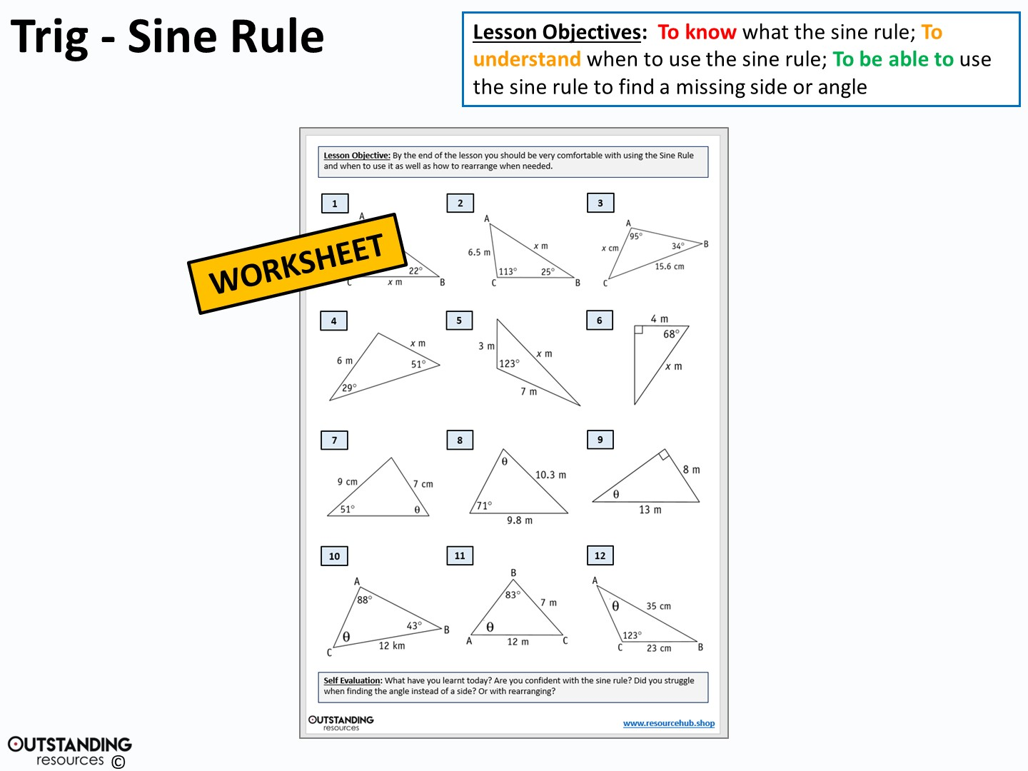

Slide 11
