Slide 1
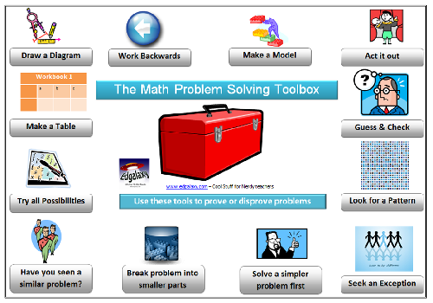

Slide 2






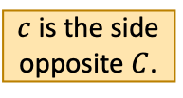





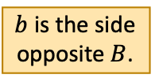







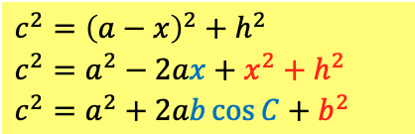

S1
Consider the triangle ABC.
$$A$$
$$C$$
Divide the triangle into two by drawing a line representing its height.
Apply Pythagoras’ theorem to both triangles.
$b$ is the side opposite $B$.
2
Substituting and gives:
$b^{2}=x^{2}+h^{2}$
1
2
$$b$$
$$c$$
$c$ is the side opposite $C$.
$$h$$
$c^{2}={\left(a−x\right)}^{2}+h^{2}$
$c^{2}=a^{2}−2ax+x^{2}+h^{2}$
$c^{2}=a^{2}+2ab\cos{C}+b^{2}$
$$C$$
$$B$$
$$A$$
$$x$$
$$a$$
$$a−x$$
$$B$$
$$D$$
Hence, for any triangle $ABC$, we have the cosine rule.
$$\cos{C}=\frac{x}{b} \\ ⇒x=b\cos{C}$$
$a$ is the side opposite $A$.
Let $CD=x$.
Then $DB=a−x$.
$$c^{2}=a^{2}+b^{2}−2ab\cos{C}$$
1

Slide 3
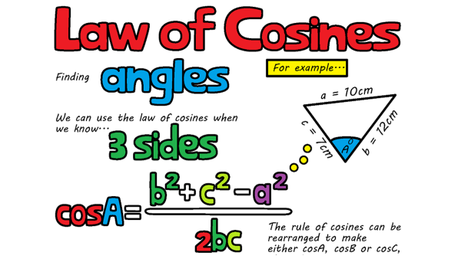

Slide 4





















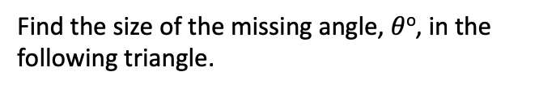




Ex3
Find the size of the missing angle, $θ$º, in the following triangle.
Ex4
Find the size of the missing angle, $θ$º, in the following triangle.
Solution
Solution
16cm
9cm
10cm
6cm
$θ$º
$θ$º
8cm
12cm
16² $=$ 9² $+$ 12² $−$ 2(9)(12)$cos$($θ$º)
6² $=$ 8² $+$ 10² $−$ 2(8)(10)$cos$($θ$º)
256 $=$ 225 $−$ 216$cos\text{(}θ\text{o}\text{)}$
36 $=$ 164 $−$ 160$cos\text{(}θ\text{o}\text{)}$
$−$ 225
$$− \text{225}$$
$−$ 164
$$−\text{ 164}$$
31 $=$ $−$216$cos\text{(}θ\text{o}\text{)}$
$−$128 $=$ $−$160$cos\text{(}θ\text{o}\text{)}$
$−$216
$$−\text{2}\text{16}$$
$−$160
$$−\text{16}\text{0}$$
31
216
31
216
$$−$$
$=$ $cos\text{(}θ\text{o}\text{)}$
$$−$$
0.8 $=$ $cos\text{(}θ\text{o}\text{)}$
$⇒$ $θ$º $=$ $\cos^{−1}$(0.8)
$=$ 36.9º
$⇒$ $θ$º $=$ $\cos^{−1}$
$=$ 98.3º

Slide 5








Q1
Work out the missing angle, $θ$º, in each of the following triangles to one decimal place.
[a]
40.8º
[b]
72.0º
[c]
24.1º
[d]
59.1º
10cm
8cm
10.4m
$θ$º
8.6m
11.4m
6cm
10m
$θ$º
8cm
$θ$º
16cm
$θ$º
9cm
12m
13.1m
[e]
81.1º
[f]
64.3º
[g]
20.0º
[h]
11.9º
12in
12.2ft
6.8km
25yd
$θ$º
14.2km
8.1in
5ft
6.2yd
$θ$º
$θ$º
18.1km
$θ$º
10.2in
11ft
21yd

Slide 6
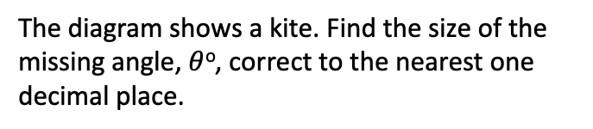

Q3
The diagram shows a kite. Find the size of the missing angle, $θ$º, correct to the nearest one decimal place.
Q4
Find the size of the smallest angle in the following triangle.
Solution
Solution
7cm
19.6m
67º
114º
15cm
72º
28.4m
46.1º
$θ$º
27.5cm
41º

