Slide 1
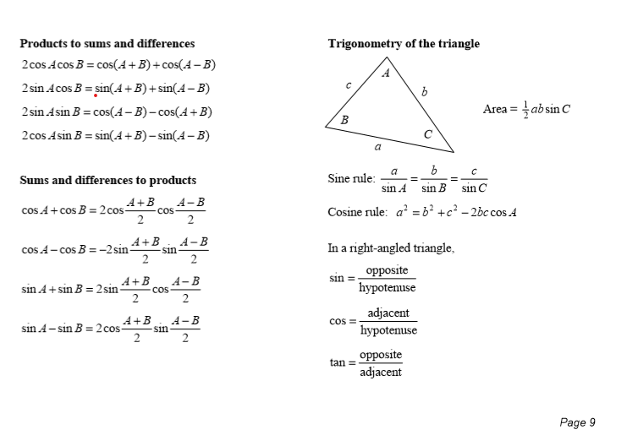
How Trigonometry looks in the Leaving Cert Formula Book:

Slide 2
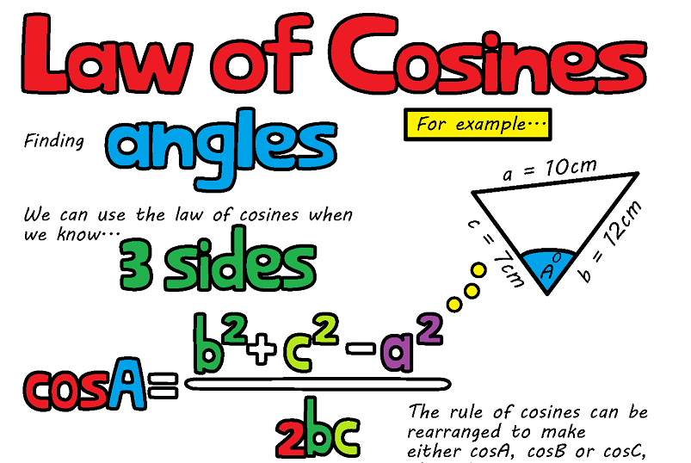

Slide 3
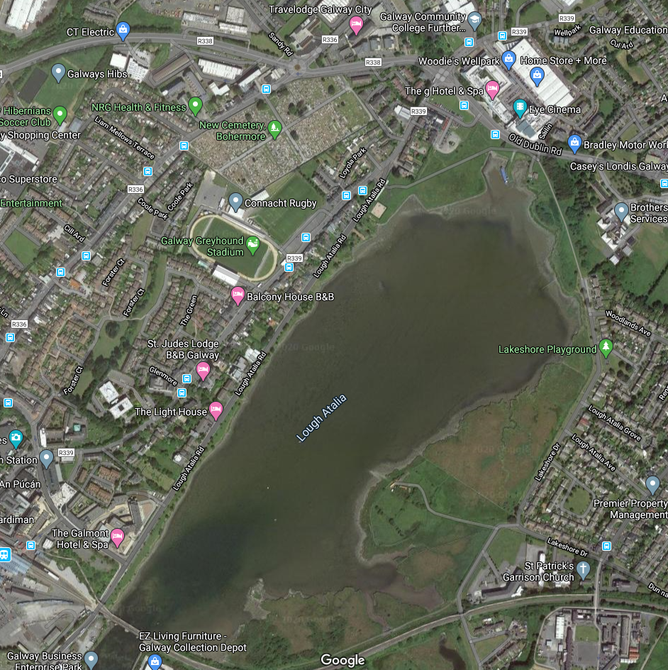
Finding the width of Loch an tSáile
We know that:
The distance from GCC to Renmore Playground
is 702 metres.
The distance from GCC to the Radisson Hotel is
1.3 kilometres.
How can we find the width of Loch an tSáile?
Do we have enough information?
Using a clinometer at Galway Community College a student found the angle to be 47⁰

Slide 4
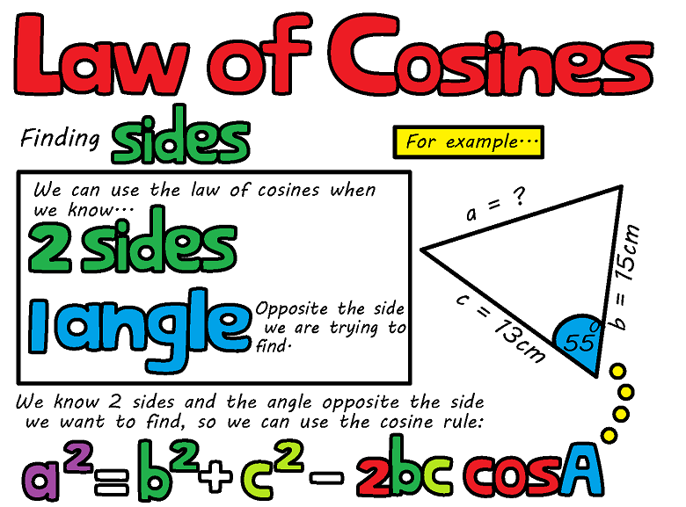

Slide 5




Q1
Work out the missing side, $x$, of each of the following triangles to one decimal place.
[a]
7.4cm
[b]
8.7yd
[c]
34.5in
[d]
5.4ft
$x$
11cm
5yd
80º
8yd
$$x$$
6.8ft
$$x$$
18in
37º
114º
44º
12cm
$$x$$
23in
7.6ft
[e]
21.7m
[f]
6.3km
[g]
5.9mm
[h]
10.6cm
9.2km
7.2mm
$$x$$
$$x$$
20º
15.2m
55º
16.5cm
104º
$$x$$
14.1km
$$x$$
4mm
20cm
32º
12.3m

Slide 6
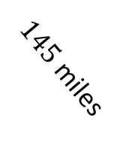
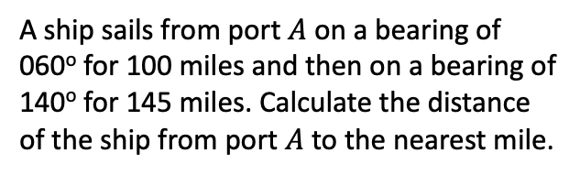
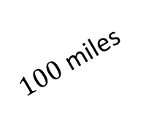






Q2
A ship sails from port $A$ on a bearing of 060º for 100 miles and then on a bearing of 140º for 145 miles. Calculate the distance of the ship from port $A$ to the nearest mile.
Q3
Find the perimeter of the following triangle.
Solution
Solution
18.5m
71º
24m
$$N$$
25.1m
$$N$$
$${140}^{o}$$
Perimeter $=$ 67.6m
$${60}^{o}$$
$100$ miles
$145$ miles
$190$ miles

Slide 7

Activity in pairs:
Match up the cards to find the right formula (red) and answer (yellow) for each triangle (blue).

Slide 8
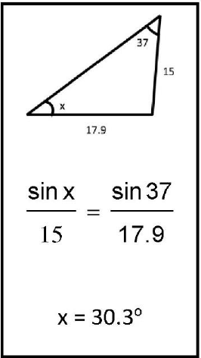
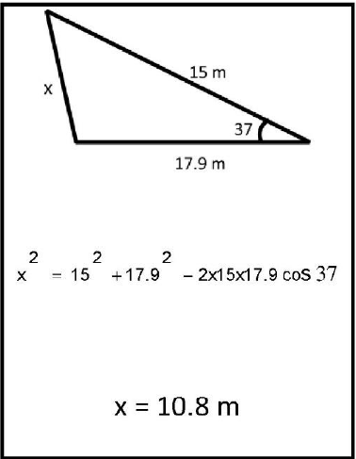
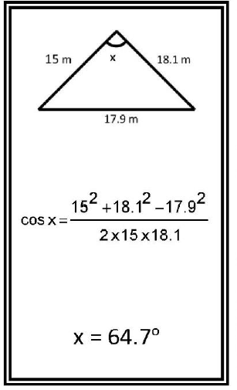

Slide 9
